Slide 1



2021: Year in Review
Section of Rheumatology
@BU_BMC_Rheum

Slide 2

Work in the time of the pandemic…
Another year without a gathering…

Slide 3
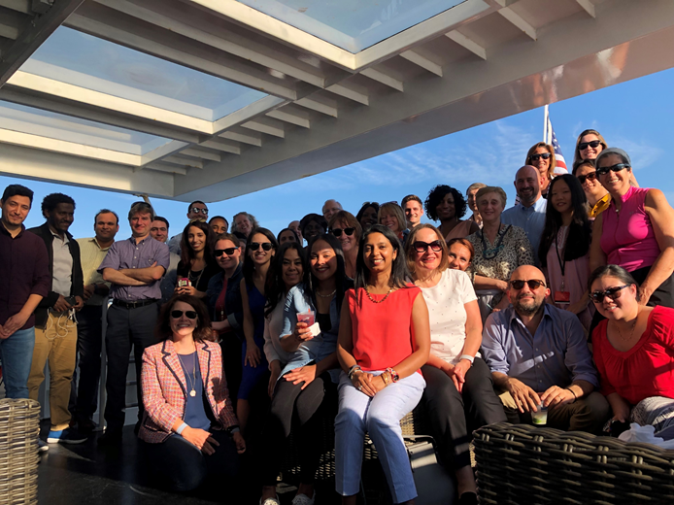
Section of Rheumatology

Slide 4
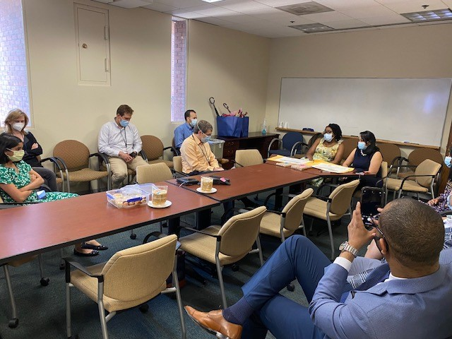
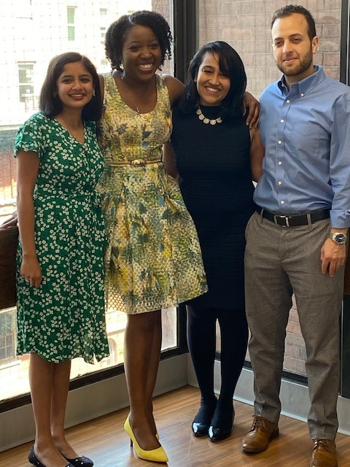
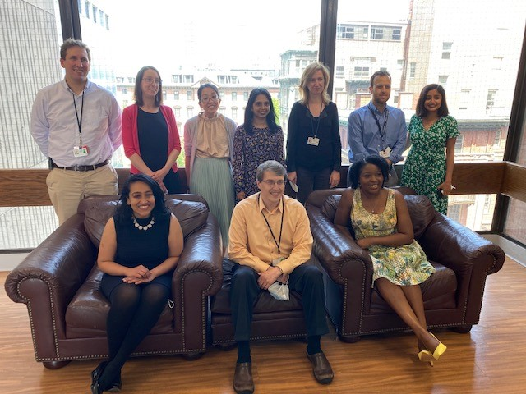
Fellow Graduation
June 2021

Slide 5


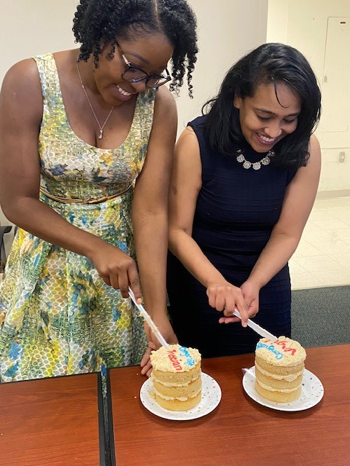
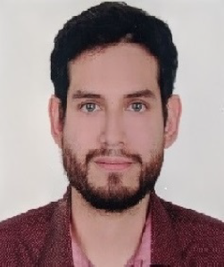
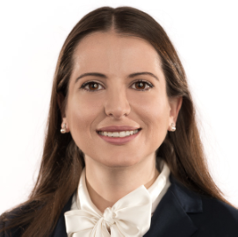
Fellows: Past and Present
Graduated Fellows
Drs. James-Goulbourne & Murugesan
2nd Year Fellows
Drs. Ballal & Zertuche
1st Year Fellows
Drs. Weilg & Merjanah

Slide 6
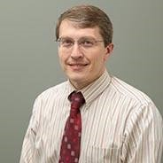
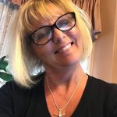
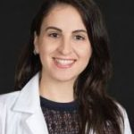
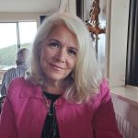
Fellowship interviews once again remotely…
>227 applicants
~40 invited
~175 interviews

Slide 7
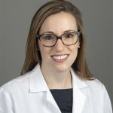
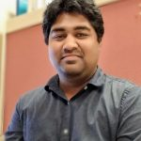
Rheumatology New Faculty…
Elizabeth Graef, DO
Adri Chakraborty, PhD

Slide 8
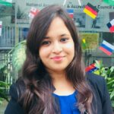
New Rheumatology Staff …
Alice Anderson
Academic & Clinical Affairs Manager/Fellowship Coordinator
Sayali Dhamne, MPH
Project Manager

Slide 9
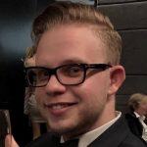
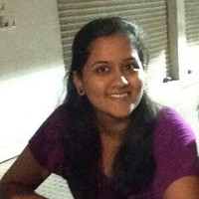
New Rheumatology Students …
Alexandra Dang
Alex Kim
Younjee Ko
Jessika Tatarian
Fernando Bomfim
Graduate Student
Vrinda Dambal

Slide 10
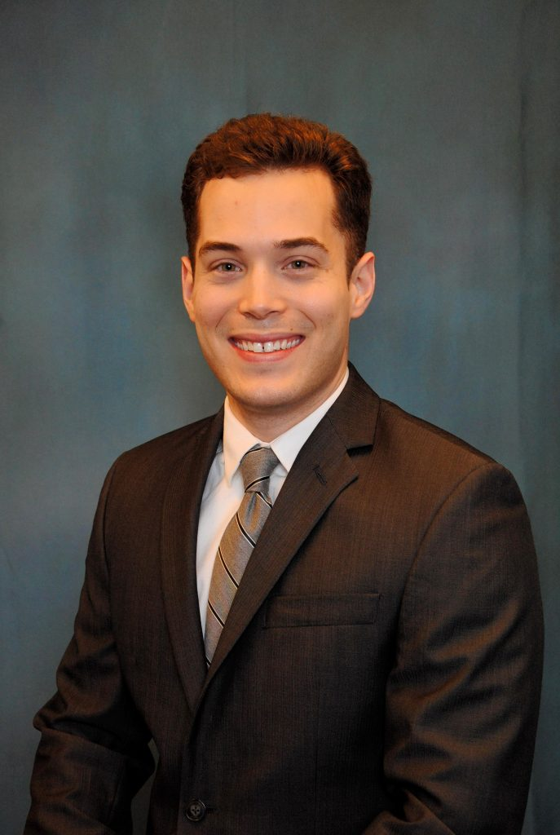
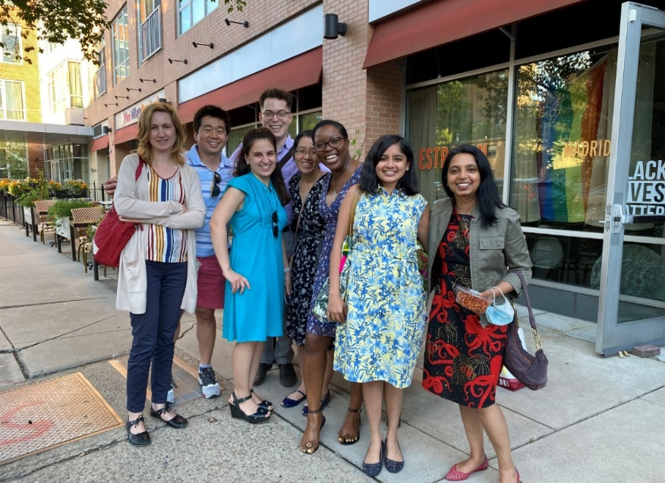
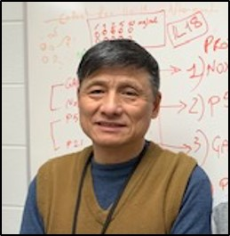
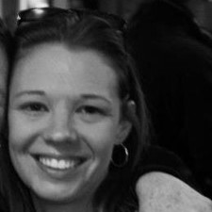
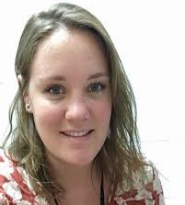
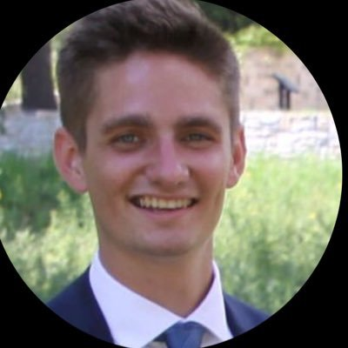
Farewells…Faculty and Staff
Faculty
Justin Bucci, MD
Staff
Connor Buchholz
Zoe Perkins
Xiaoyang Chen
Jiazhen Guan
Mortada Najem
Grace Marden
Tracy Keane
Jiazhen Guan
Tracy Keane
Connor Buchholz
Grace Marden

Slide 11
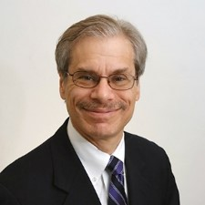
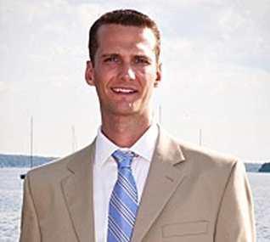
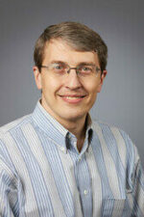
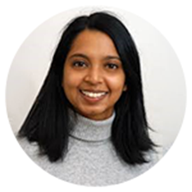
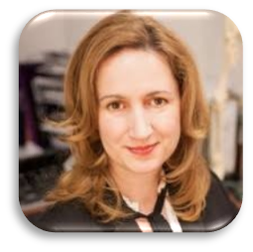
Awards and Distinctions
Joshua Stefanik, DPT, PhD:
Clinical Research Award from the American Physical Therapy Association, MA Chapter
David Felson, MD, MPH:
Robert Dawson Evans Distinguished Professor of Medicine
Top Doc Boston Magazine
Eugene Kissin, MD:
Recognition by the ACR as a Change-Maker
Top Doc Boston Magazine
Tuhina Neogi, MD, PhD:
Endowed chair and named the Alan S. Cohen Professor of Rheumatology
Receiving an honorary doctorate from Lund University, Sweden
Dr. Andreea Bujor, MD, PhD:
Outstanding mentor award with UROP (Undergraduate Research Symposium

Slide 12
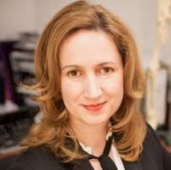
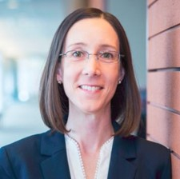
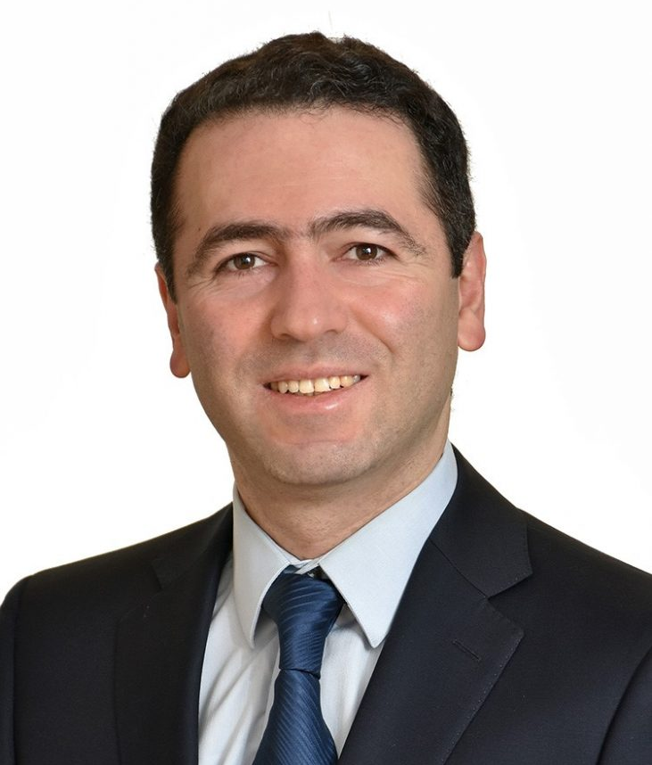
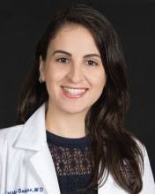
Grants Funded
Dr. Andreea Bujor:
R01 – The role of FLI1 in myeloid cells and contribution to cardiac fibrosis
Dr. David Felson:
Arthritis Foundation – Fast OA-MIL: Identification of Rapid Progression of PTOA in the Military Arthritis Foundation – Fast OA: Predictors of Rapid Symptom Progression after ACL Reconstruction
Dr. Maureen Dubreuil:
SPARTAN – Referral Recommendations Project
Dr. Reza Jafarzadeh:
Arthritis Foundation – Drug Repurposing to Prevent Posttraumatic Osteoarthritis
Dr. Monica Crespo-Bosque:
Rheumatology Research Foundation (RRF) – Lawren H. Daltroy Preceptorship in Health Communication

Slide 13
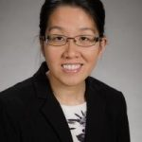
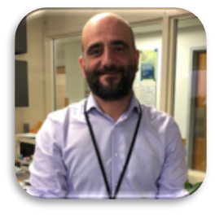
Grants funded / pending with fundable score
Dr. Jean Liew:
RRF Investigator Award – The impact of axial spondyloarthritis treatment on chronic opioid use
Dr. Giovanni Ligresti: R01 – Targeting vascular dysfunction to promote lung repair and fibrosis resolution – Pending (fundable score)

Slide 14
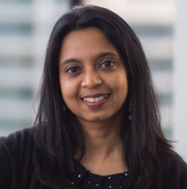
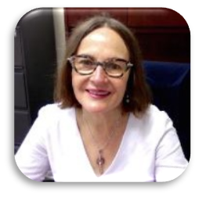
Grants funded / pending with fundable score
Dr. Tuhina Neogi:
R01 – Pathways of risk and resilience for overlapping pain & sensitization
Doris Duke Charitable Foundation MPI with Megan Bair-Merritt –Creating and Advancing Research Equity
R01 MPI-U Arizona – Healthy knee aging vs. osteoarthritis in three large diverse cohorts: What is the clinical relevance of structural changes seen on radiographs?
T32 – BU Rheumatology Research T32 Training (BURRT) Program – Pending Award (perfect score!)
Dr. Maria Trojanowska:
R01 – Lymphatic ERG signaling in scleroderma fibrosis – Pending (fundable score)

Slide 15
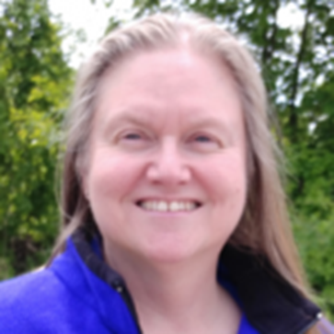
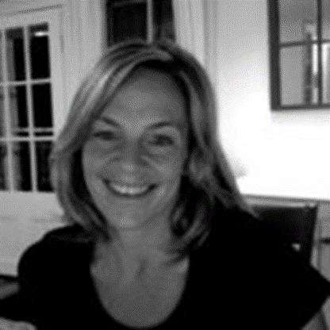
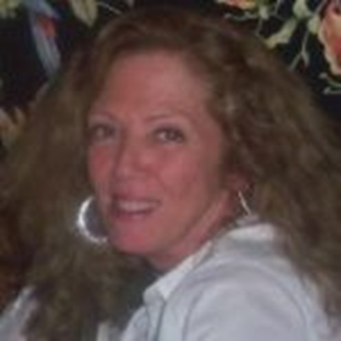
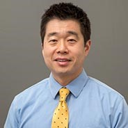
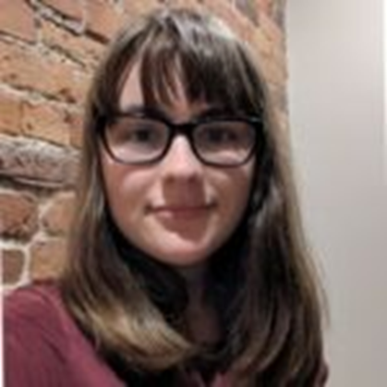
Promotions!
Christine Peloquin:
Quality Assurance & Data Manager
Kathy Bacon, PhD:
Assistant Professor of Medicine
Adri Chakraborty, PhD:
Research Assistant Professor of Medicine
Anne Plunkett: Communications Manager
Chan Kim, MD:
Assistant Professor of Medicine
Gabriela Rabasa:
Data Manager
Gene Kissin, MD:
Clinical Professor of Medicine

Slide 16
Publications
2021
126 publications as of December 17 , 2021

Slide 17
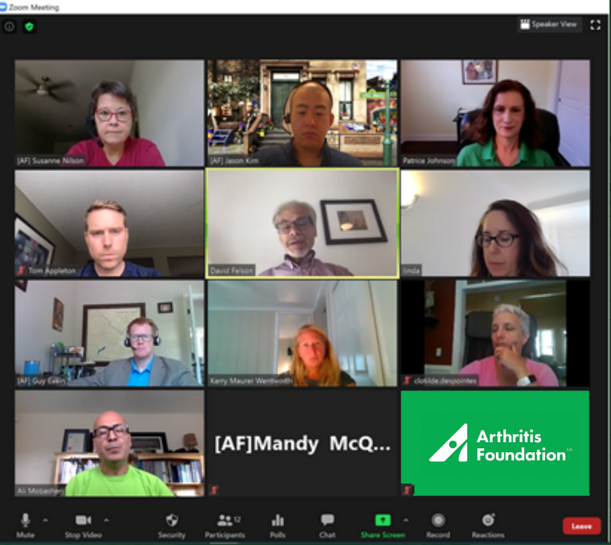
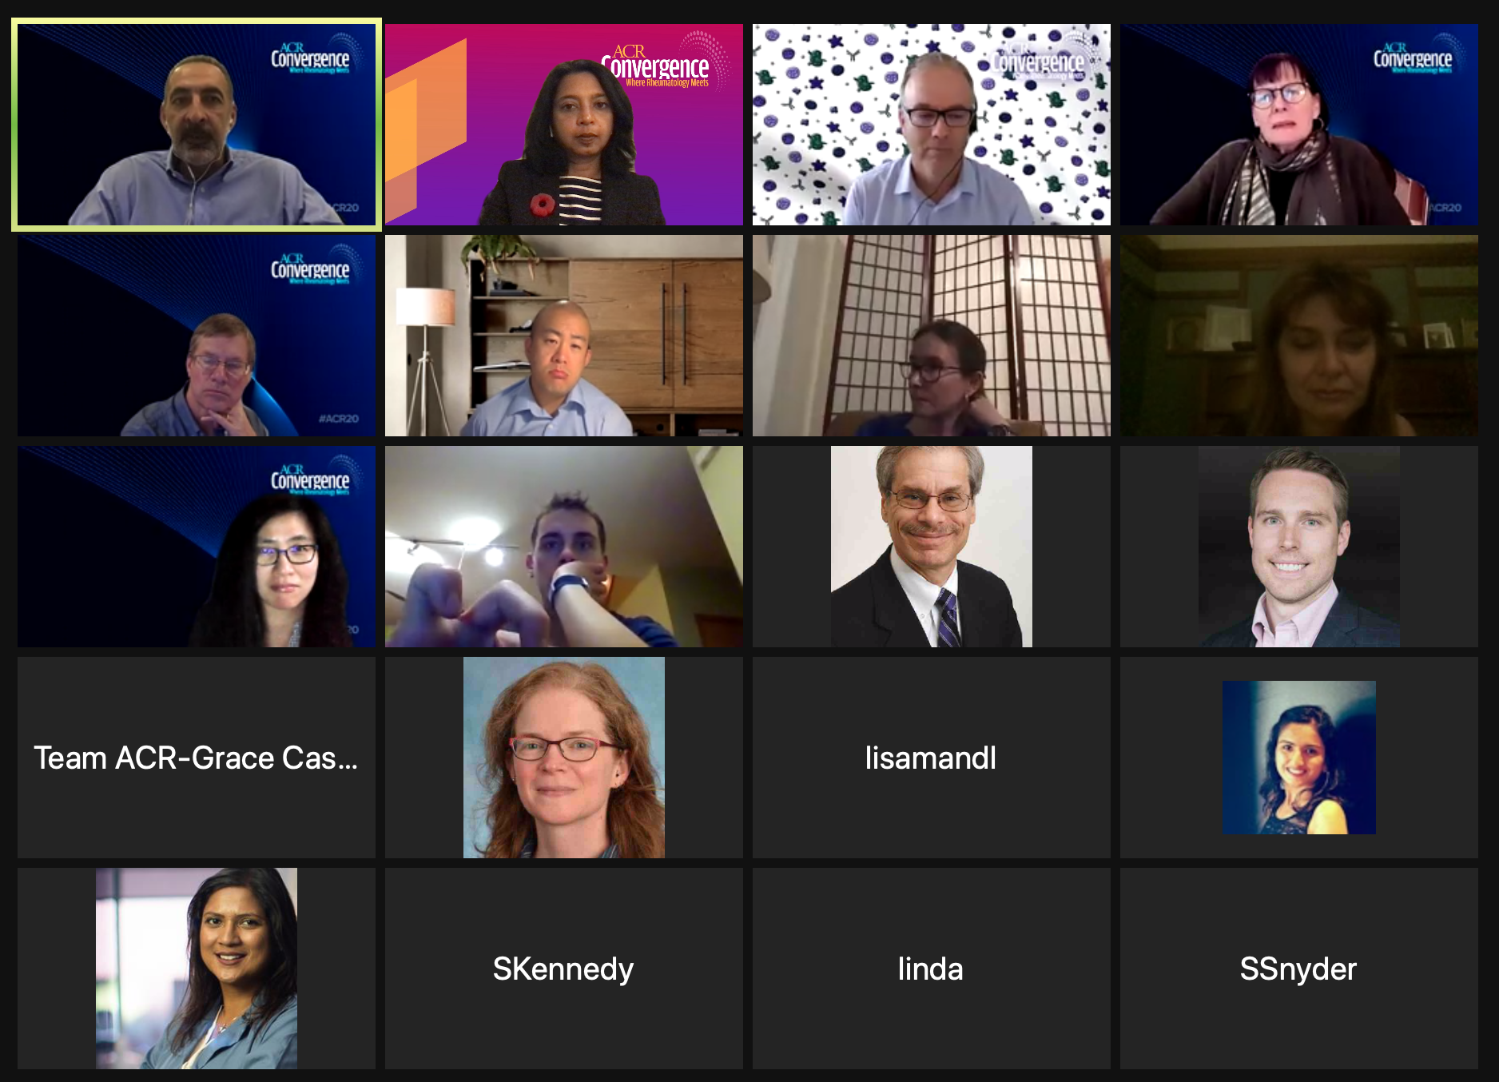
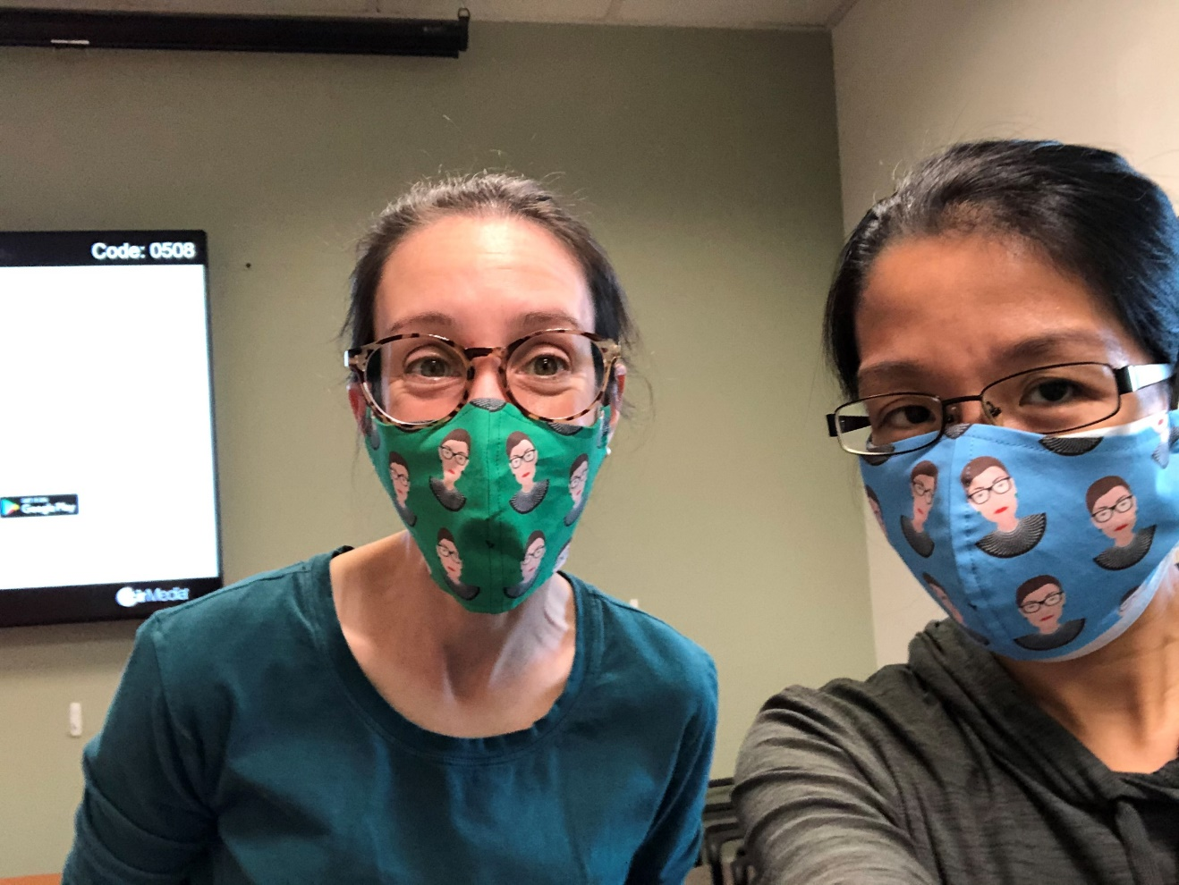
New Normal for Scientific Conferences!

Slide 18
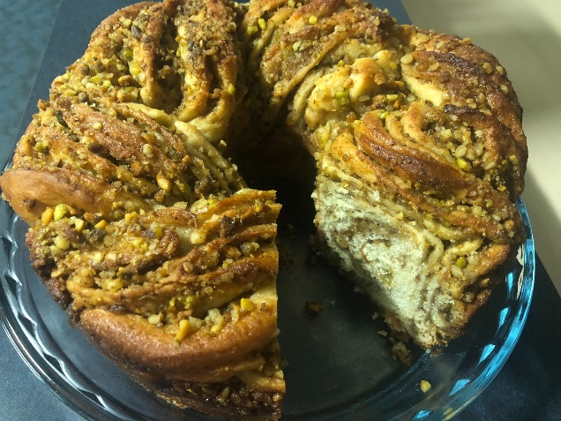
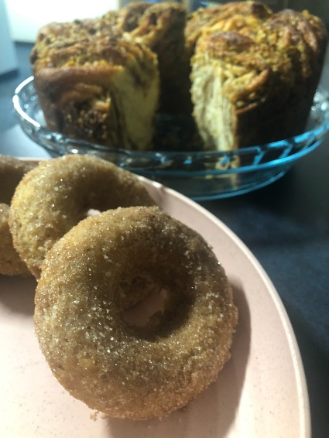
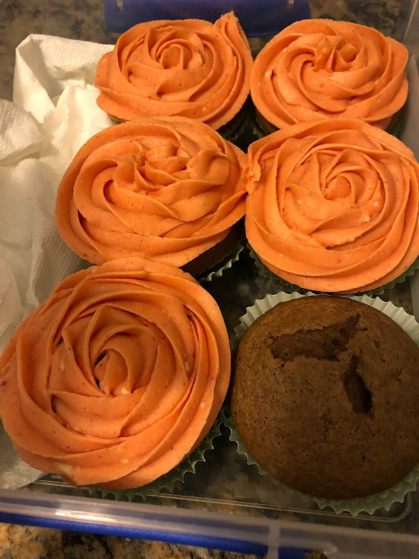
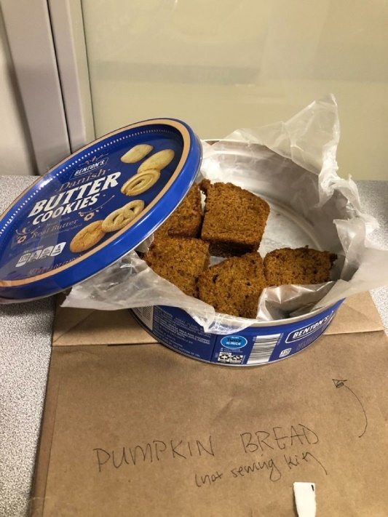
Don’t forget the baking…#ACRBakeAnythingChallenge: Big contributions by Drs. Liew and Graef

Slide 19
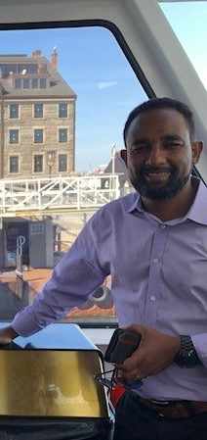
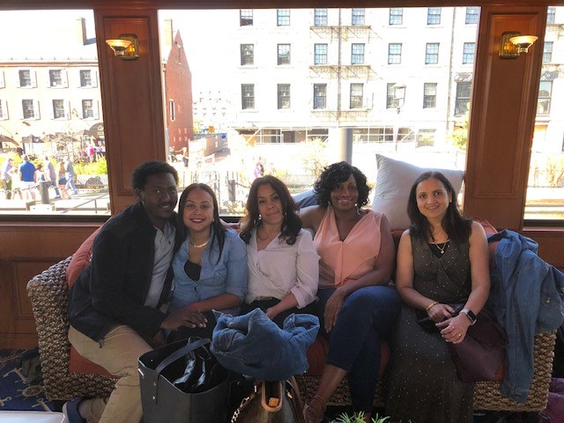
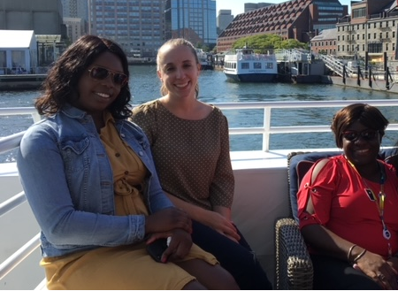

BIG THANKS TO…Our Clinic Staff
Lavern, Ashley, Silvia, Alicia, Marisol, Toya, Nancy, Julie, John, Amanuel, Sugna, Eileen, Anthony

Slide 20




…AND to our Section Admin Staff
Lisa, Sharon, Anne, Tracy, Alice

Slide 21







…AND our Research Staff
Christine, Molly, Gabriela, Margaret, Sayali, Trish, Kim

Slide 22




Milestones and more…
Trish Godio: Busy year, beautiful baby boy addition to her family, sold her home, moved to Portland!
Sayali Dhamne received her MPH degree from BU School of Public Health
Sharon Tomlinson
Moved to Gloucester, realizing her dream to live by the water

Slide 23


Happy Events…
Mike Lavalley, PhD and his wife picked up their daughter Tess at Logan Airport on Friday 12/10. Tess had been in the UK for a MS in History and this was her first time home since September 2020.
Priyanka Ballal, MD, 2nd Year Fellow and her husband are expecting their first baby in March.

Slide 24



Dr. Tuhina Neogi receiving an honorary doctorate from Lund University, Sweden.
Dr. Tuhina Neogi Lund Ceremony
The roar of the cannon and the distinguished hat!

Slide 25



Dr. Neogi Installation Cohen Professor of Rheumatology

Slide 26

David Felson designated a Robert Dawson Evans Distinguished Professor of Medicine
Congratulations to David Felson, who was named a Robert Dawson Evans Distinguished Professor of Medicine by the Department of Medicine in Boston University.
This honorific designation acknowledges faculty at the professorial rank whose academic achievements have had an exceptional impact on their field in research, education, or clinical care.
Please join us to honor Dr. Felson at a virtual ceremony on December 21, 2021 at noon EST:
https://bostonu.zoom.us/j/92430232663?pwd=eDNPT3Zkc21aRXJiN0FUUlZnVDFpZz09
Meeting ID: 924 3023 2663
Passcode: 680513

Slide 27
Looking forward to 2022!
Have a safe, healthy, and peaceful holiday season!!

Slide 28




Cheers to 2022!

