Slide 1
NIH Grant Proposal Preparation:
R01 and F Applications

Slide 2
Where To Begin:
General Instructions

Slide 3
Preparing an NIH grant application is a complex and lengthy process. Some of these steps will involve your interaction with a grants administration office at your institution. A person from this office can assist you in acquiring a Commons ID (which you will require for submission) as well as finding the program announcement for your NRSA application and the specific instructions that you will require to prepare all of the parts. The application is made electronically by submitting documents in Adobe format (you will require the proper Adobe version to complete these, presently versions 9-11) according to specific instructions located in the 424 instruction package.
There are two different sorts of information that you will be required to provide in your application. Information of the first sort is administrative and it is to be typed into electronic forms that are a part of the submission package. You will fill out forms in this package in collaboration with institutional grant administrators. A representative of that office is present this morning and is prepared to speak to you. He/she will describe services that this office will provide.
Information of the second type relates to the science of your proposal. This information will be prepared as Word documents which you will print as PDFs and then load electronically into the submission package. We have prepared a PowerPoint presentation that will give you some specific instructions as to how each of these documents can be prepared.

Slide 4
I have provided below some general instructions that include grants.gov web sites that you should navigate to obtain application information. Start at grants.gov. or just go to this link: http://www.grants.gov/search/basic.do. You’ll have a list of possible searches.
Alternatively, go to:
http://apply07.grants.gov/apply/opportunities/instructions/oppPA-11-111-cidADOBE-FORMS-B1-instructions.pdf. Once you click on this URL, you are taken to a site with a PDF or Word version of the instructions. Download, read, and follow these carefully. This document has all of the information you will need, but you will need also to consult with an official from your university grants administration office for clarification or help.

Slide 6
How to find the funding opportunity announcement
Go to grants.gov.
On right side of screen you will see Search: grant opportunity.
Do basic search inserting the program announcement (PA-16-309 for NRSA or PA-16-160 for RO1). You will get the “opportunity title”. Click on that.
The page that comes up has a field entitled “application package”
(right side of screen).
Click on “application” to get the forms you will need.
Download instructions and application.

Slide 7
Some Funding Opportunity Announcements
F30- MD/PhD Predocs: PA-16-306
F31- Predocs: There are a variety of options (diversity, Institute-specific) but the parent is PA-16-309
F32- Postdocs: There are a few options but the parent is PA16-307
F33 Senior Fellows: PA-16-310
Parent R01: PA-16-160
Parent R21: PA-16-161

Slide 8
There are a number of grant preparation workshops and workbooks found on the web. We have had particular success using a workbook entitled: The Grant Application Writer’s Workbook. Copies can be obtained from grantcentral.com for about $75-$80. Much of what we present in our training materials is keyed to specific chapters in this workbook.

Slide 9
Preparation of individual sections of an RO1 proposal
We will go through steps in the application preparation process in the order in which pages appear in the final proposal, even though you may choose not to prepare them in this order.
Make reference to appropriate chapters the workbook and consult your grants administrator for details regarding the completion of form pages and scientific content documents.

Slide 10
Template for the Research Plan
Abstract (1/2 page. 30 lines)
Specific Aims (1 page)
Research Strategy (6 or 12 pages)
Significance (from ½ to 1 page)
Innovation (about ½ to 1 page, but not required for NRSA
applications)
Approach (remainder of pages up to 6 or12)
Aim I
Statement of hypothesis
Rationale that supports hypothesis
Literature
Preliminary data
Feasibility
Experimental design
Expected outcomes and Statistical analysis
Pitfalls and alternative plans
Aim II…
Timetable

Slide 11
Proposal Title
Title should be compelling and informative.
The title should be relatively short, descriptive, and jargon-free.
It should be sufficiently flexible and general to encompass not only the experiments you propose but also other experiments that may accrue from the results that you will obtain.
Title should emphasize the payoff of your research.
See tips in Chapter 18 of the workbook.

Slide 12
Project Summary/Abstract
Must be less than 30 lines with margins of ½ inch on each side of the page.
This is the most important part of the proposal, as it is the only part that everyone will read.
Read carefully the instructions given in Chapter 19 of the workbook.
This section must be succinct, pithy, and must convey all that is in the specific aims, but in less space. Work on this carefully.
Use critical colleagues to re-review the content and form of this document multiple times. Choose individuals who are carefull and who are invested in your success.
This document must pass the “grandma” test. It should be clear, compelling, and understandable. Your goal here is not to impress the study section with your “in depth” knowledge of the subject.

Slide 13
Narrative
This is a PDF file of no more that three or four sentences.
It is meant to be a lay description of what your proposal is about.
It must pass the “grandma” test for clarity and impact.

Slide 14
Literature cited
This is the literature that you cite in the body of your proposal.
This section is best put together as a part of the writing process of your background/significance/rationale sections in the research plan.
We suggest that you acquire a program such as Endnote which allows the citation list to be compiled at the same time that the text of the research plan is written. Academic versions of this program are available at reduced cost.
The Endnote program has the capability of allowing the citation style to be modified easily. Choose the NIH grant format that is published with this package.
If possible, it is always best to include citations in the text (rather than numbered citations) if space permits.

Slide 15
Facilities and other resources
This section lists laboratory facilities, animal science resources (ASC), computer, office, and clinical facilities. These resources include the laboratory environment of your advisor/mentor/collaborator.
Follow the examples and illustrations provided in Chapter 15 of the workbook.

Slide 16
Equipment
This is the equipment that will be available to you to perform the work that you propose.
Follow suggestions for completion of this section in Chapter 15 of the workbook.

Slide 17
CV and Personal Statement
This is your personal information with you academic history. It should be as complete as possible, containing your academic history, educational background, honors and special achievements, your undergraduate and graduate academic record, and your publications.
You must provide a personal statement that states why you are the best person to do the proposed work.
Here is where you must justify the importance of your training/experience and what you hope to achieve when it is complete.
CVs and personal statements must also be prepared by your advisor(s)/collaborators and submitted here as well.
Note that these statements are on standard forms that are a part of the submission package. They are prepared as Word files and then uploaded as PDF files into the application package.

Slide 18
Biosketch Page
Forms and instructions are now available on the SF 424 (R&R) Forms and Applications page. The new format extends the page limit from four to five pages, and allows researchers to describe up to five of their most significant contributions to science, along with the historical background that framed their research. Investigators can outline the central findings of prior work and the influence of those findings on the investigator’s field. Investigators involved in Team Science are provided the opportunity to describe their specific role(s) in the work. Each description can be accompanied by a listing of up to four relevant peer-reviewed publications or other non-publication research products, including audio or video products; patents; data and research materials; databases; educational aids or curricula; instruments or equipment; models; protocols; and software or netware that are relevant to the described contribution. In addition to the descriptions of specific contributions and documentation, researchers will be allowed to include a link to a full list of their published work as found in a publicly available digital database such as MyBibliography

Slide 19
Research Support
This information is to be provided by a faculty advisor if you are applying for a K award. It is the listing of grant support that will sustain your research project during the period of your tenure as a trainee.
This support must be sufficient to sustain your work

Slide 20
Specific Aims
Refer to Estevez application and Chapter 7, Grant Application Writer’s Workbook.
Make a bullet outline to assist you in laying out its structure. Suggestion below:
Introductory paragraph
Opening sentence
Current knowledge
Gap in knowledge/unmet need
Focus on goals
Long term goal
Objective of application
Central hypothesis and rationale
Specific Aims Paragraph
Aim I
Hypothesis
Methods
Experiments to be performed
Result
Aim II….
Payoff statement (How is the world benefitted by your work.)

Slide 21
Significance
Refer to Chapter 9 in the workbook.
Positive effect that successful completion of your
Should be no more that ½ - 1 page.
Can be divided into three parts:
Critical review of the literature that describes an unmet need. Statement of significance.
Discussion of benefits of your work.

Slide 22
Innovation
Significance vs Innovation: “Significance is the positive effect that something is likely to have on other things”…. “Innovation is a new and substantially different way of considering and addressing something which results in positive change.”*
*Grant Application Writers Workbook, P77.
What is the norm (methodology, interpretation, mechanisms, etc.). Document with citations.
How does your approach depart from the status quo? Is it a pradigm shift?
How will this departure project to fundamental progress in the field?
Not required for NRSA, but if you have innovation, put it in the Significance section.

Slide 23
Approach
Aim I
Statement of hypothesis
Rationale that supports hypothesis
Literature
Impact
Preliminary data/feasibility
Experimental design
Expected outcomes and statistical analysis
Pitfalls and alternative plans
Aim II
Statement of hypothesis
Rationale that supports hypothesis
Literature
Impact
Preliminary data/feasibility
Experimental design
Expected outcomes and statistical analysis
Pitfalls and alternative plans
Timetable

Slide 24
Vertebrate Animals
Read and follow the instructions in the 424 instruction package.
Proposed use of animals. Here state the species, strains, ages, sex, and numbers of animals to be used by specific aim. If surgery is to be done, describe fully.
Justification for the use of vertebrate animals. Justify why live animals must be used. Provide arguments why such techniques as modeling and cell culture may not be sufficient for your purposes.
Procedures to limit discomfort, pain, and distress. What are the methods to be used. How do they avoid undue discomfort and pain.
Describe methods of euthanasia (required only if not consistent with AVMA guidelines). How are animals to be treated either to take tissue or to kill them at the end of the experiment.

Slide 25
How is your proposal reviewed?

Slide 26
Scores are based on a 9-point rating scale
Your proposal is submitted electronically to the Center for Scientific Review (CSR) which then assigns it to an appropriate study section.
The study section Scientific Review Officer (SRO) will assign your grant to up to three reviewers. Before the meeting reviewers will submit preliminary written critiques together with an overall score to CSR for ranking.
Score is based five general criteria: Significance, Investigator, Innovation, Approach, and Environment. 1 = exceptional; 9=poor. Only integers will be used for scoring
Before the review meeting each assigned reviewer will give a preliminary impact/priority score to each of their assigned applications. These score will help the review committee determine which applications will be discussed at the review meeting. Only the proposals ranked in the upper 50% will be discussed at the meeting.
At the time of the meeting, reviewers will be called upon to summarize the strengths and weaknesses of each proposal to which they were assigned. Based on this discussion each member of the study section (up to 25-30 reviewers) will vote an integer score in the range 1-9. Overall score for your grant is the average of these individual scores multiplied by 10.
Scores will be based on a 9-point rating scale. The new scoring system will use a 9-point rating scale ().. After discussing an application, each eligible committee member (without conflict of interest, etc.) will give a final impact/priority score which should reflect their evaluation of the overall impact the project is likely to have on the research field. The overall impact/priority score for each application is the average of all the final impact priority scores multiplied by 10 (the 81 possible impact/priority scores will range from 10-90, with 10 being the best possible final score. The preliminary and final impact/priority scores assigned by each reviewer will be determined primarily by consideration of the five core review criteria. An application does not need to be strong in all five core review criteria to be judged likely to have major scientific impact.

Slide 27
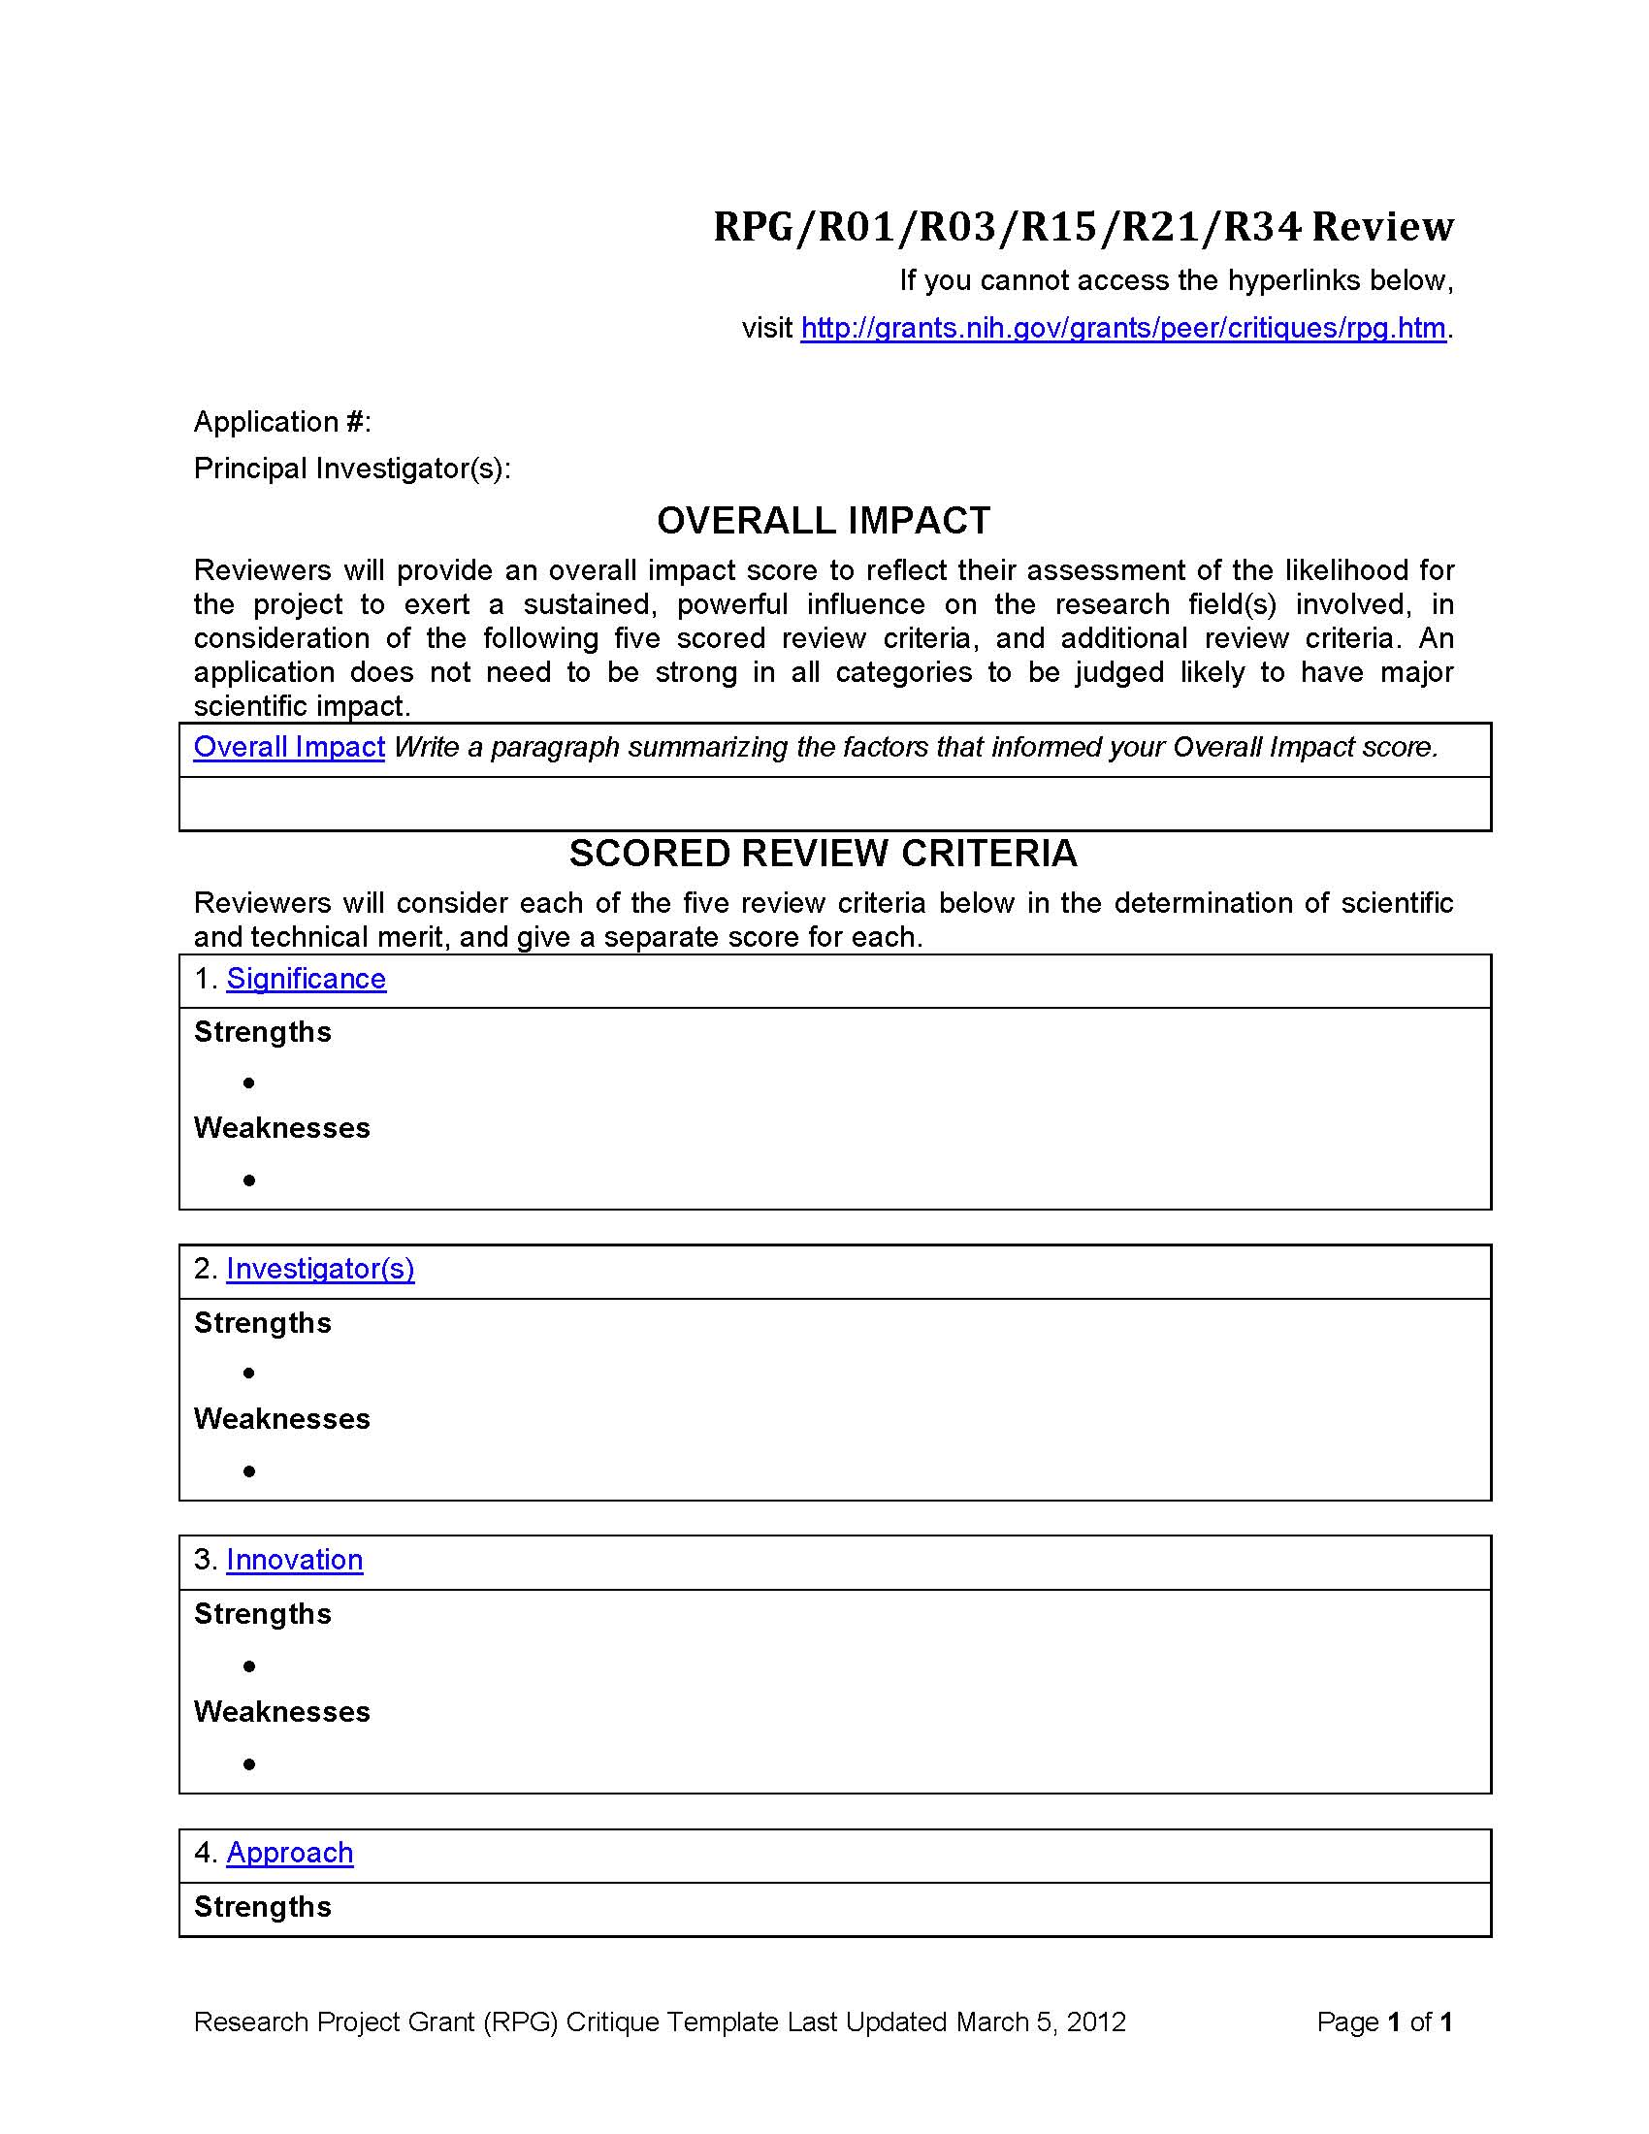

Slide 28
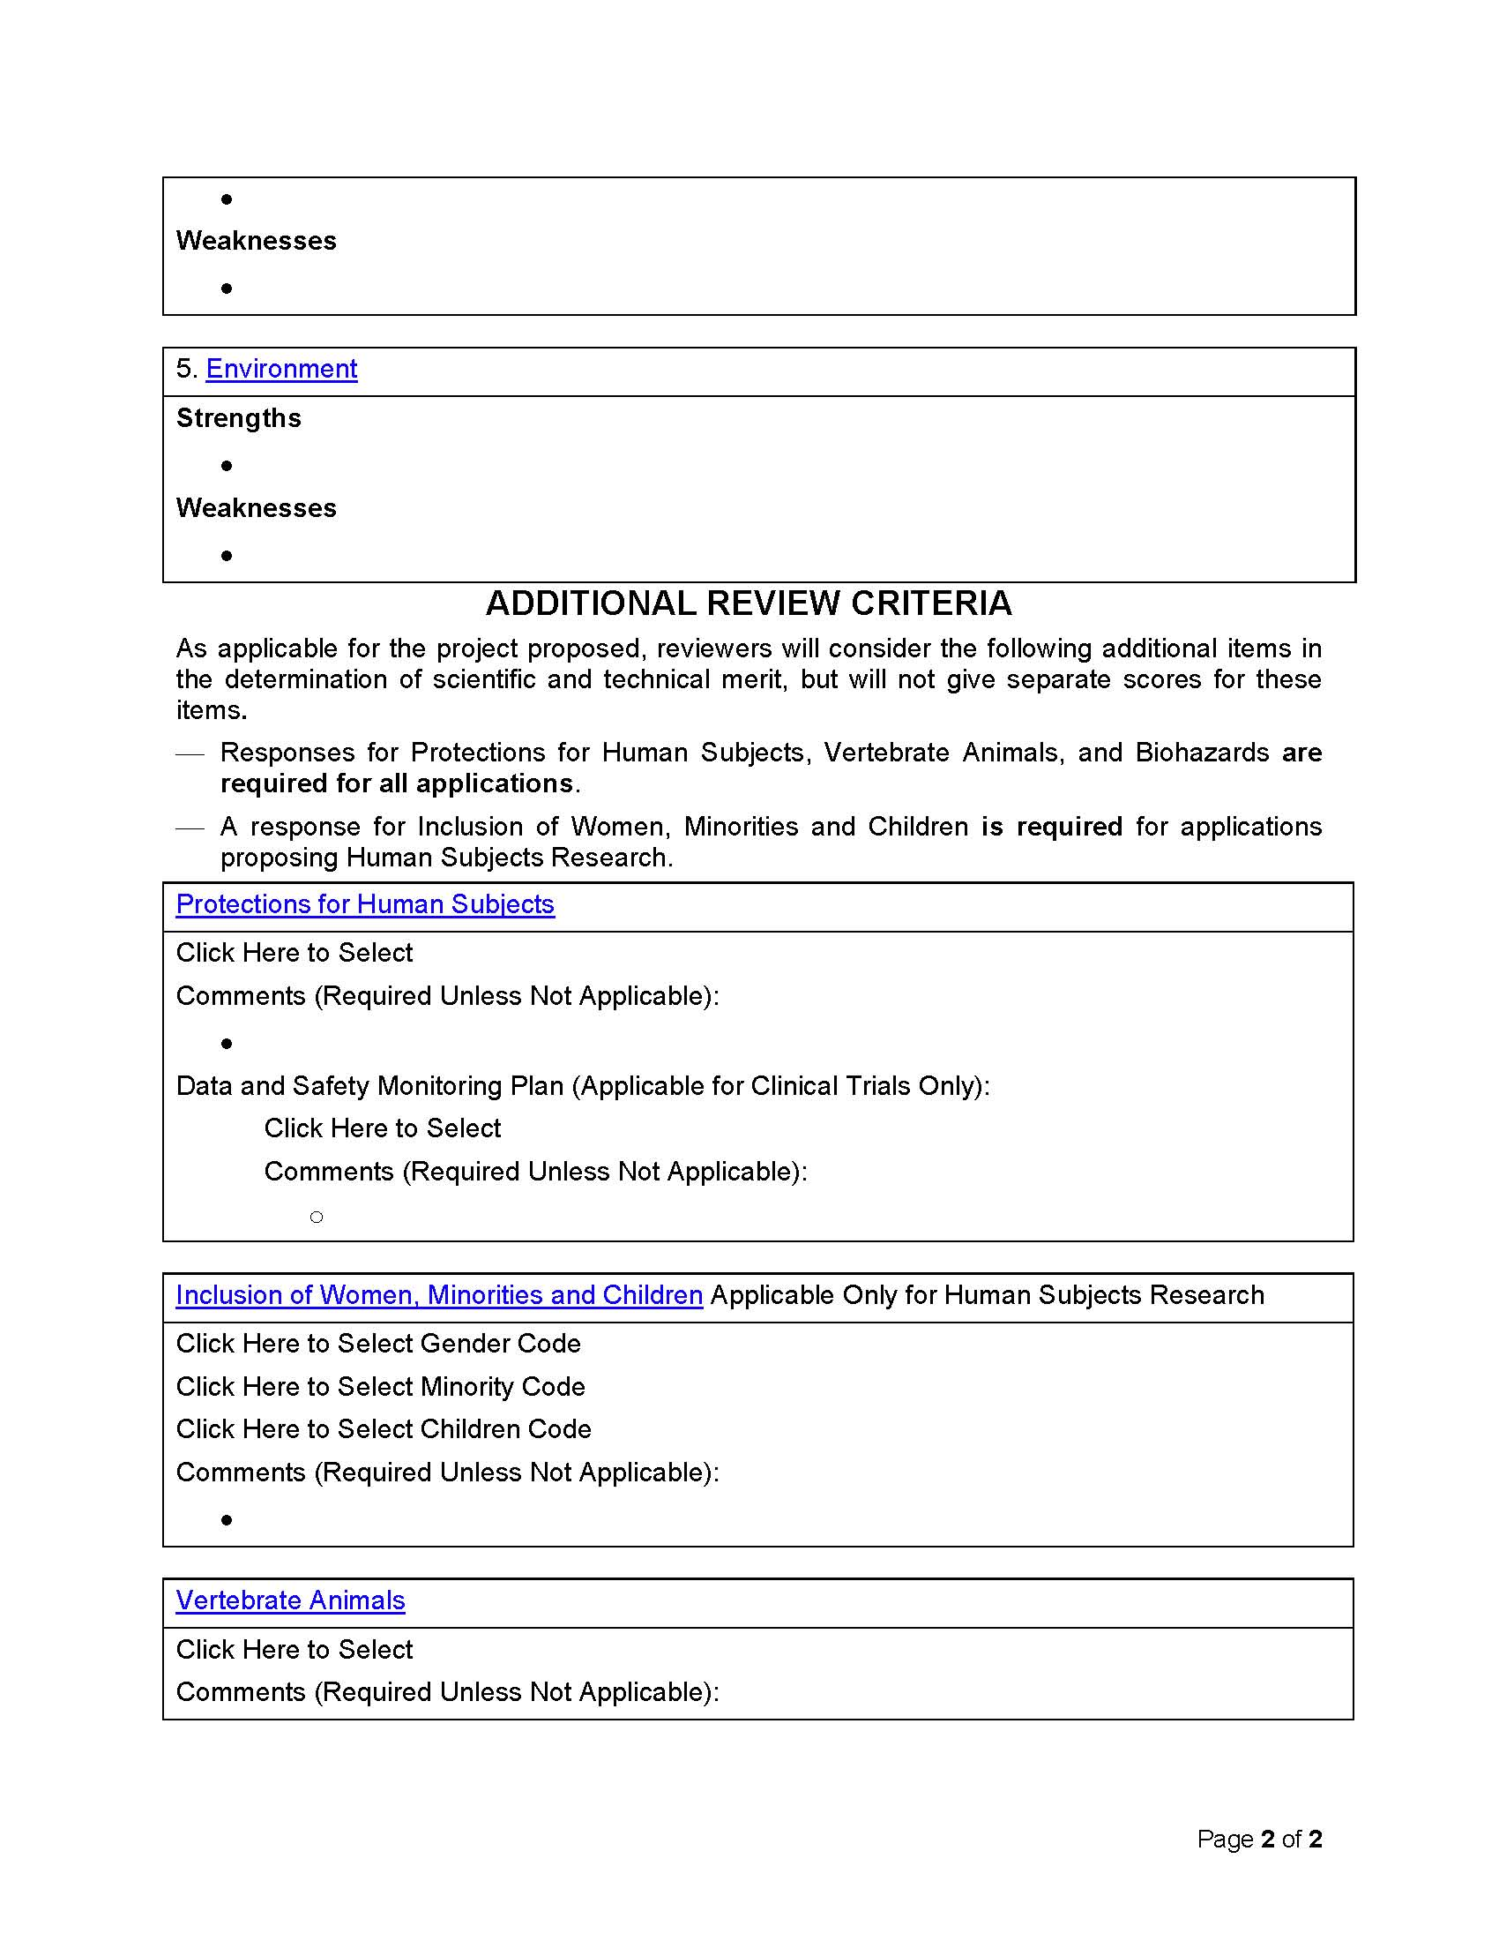

Slide 29
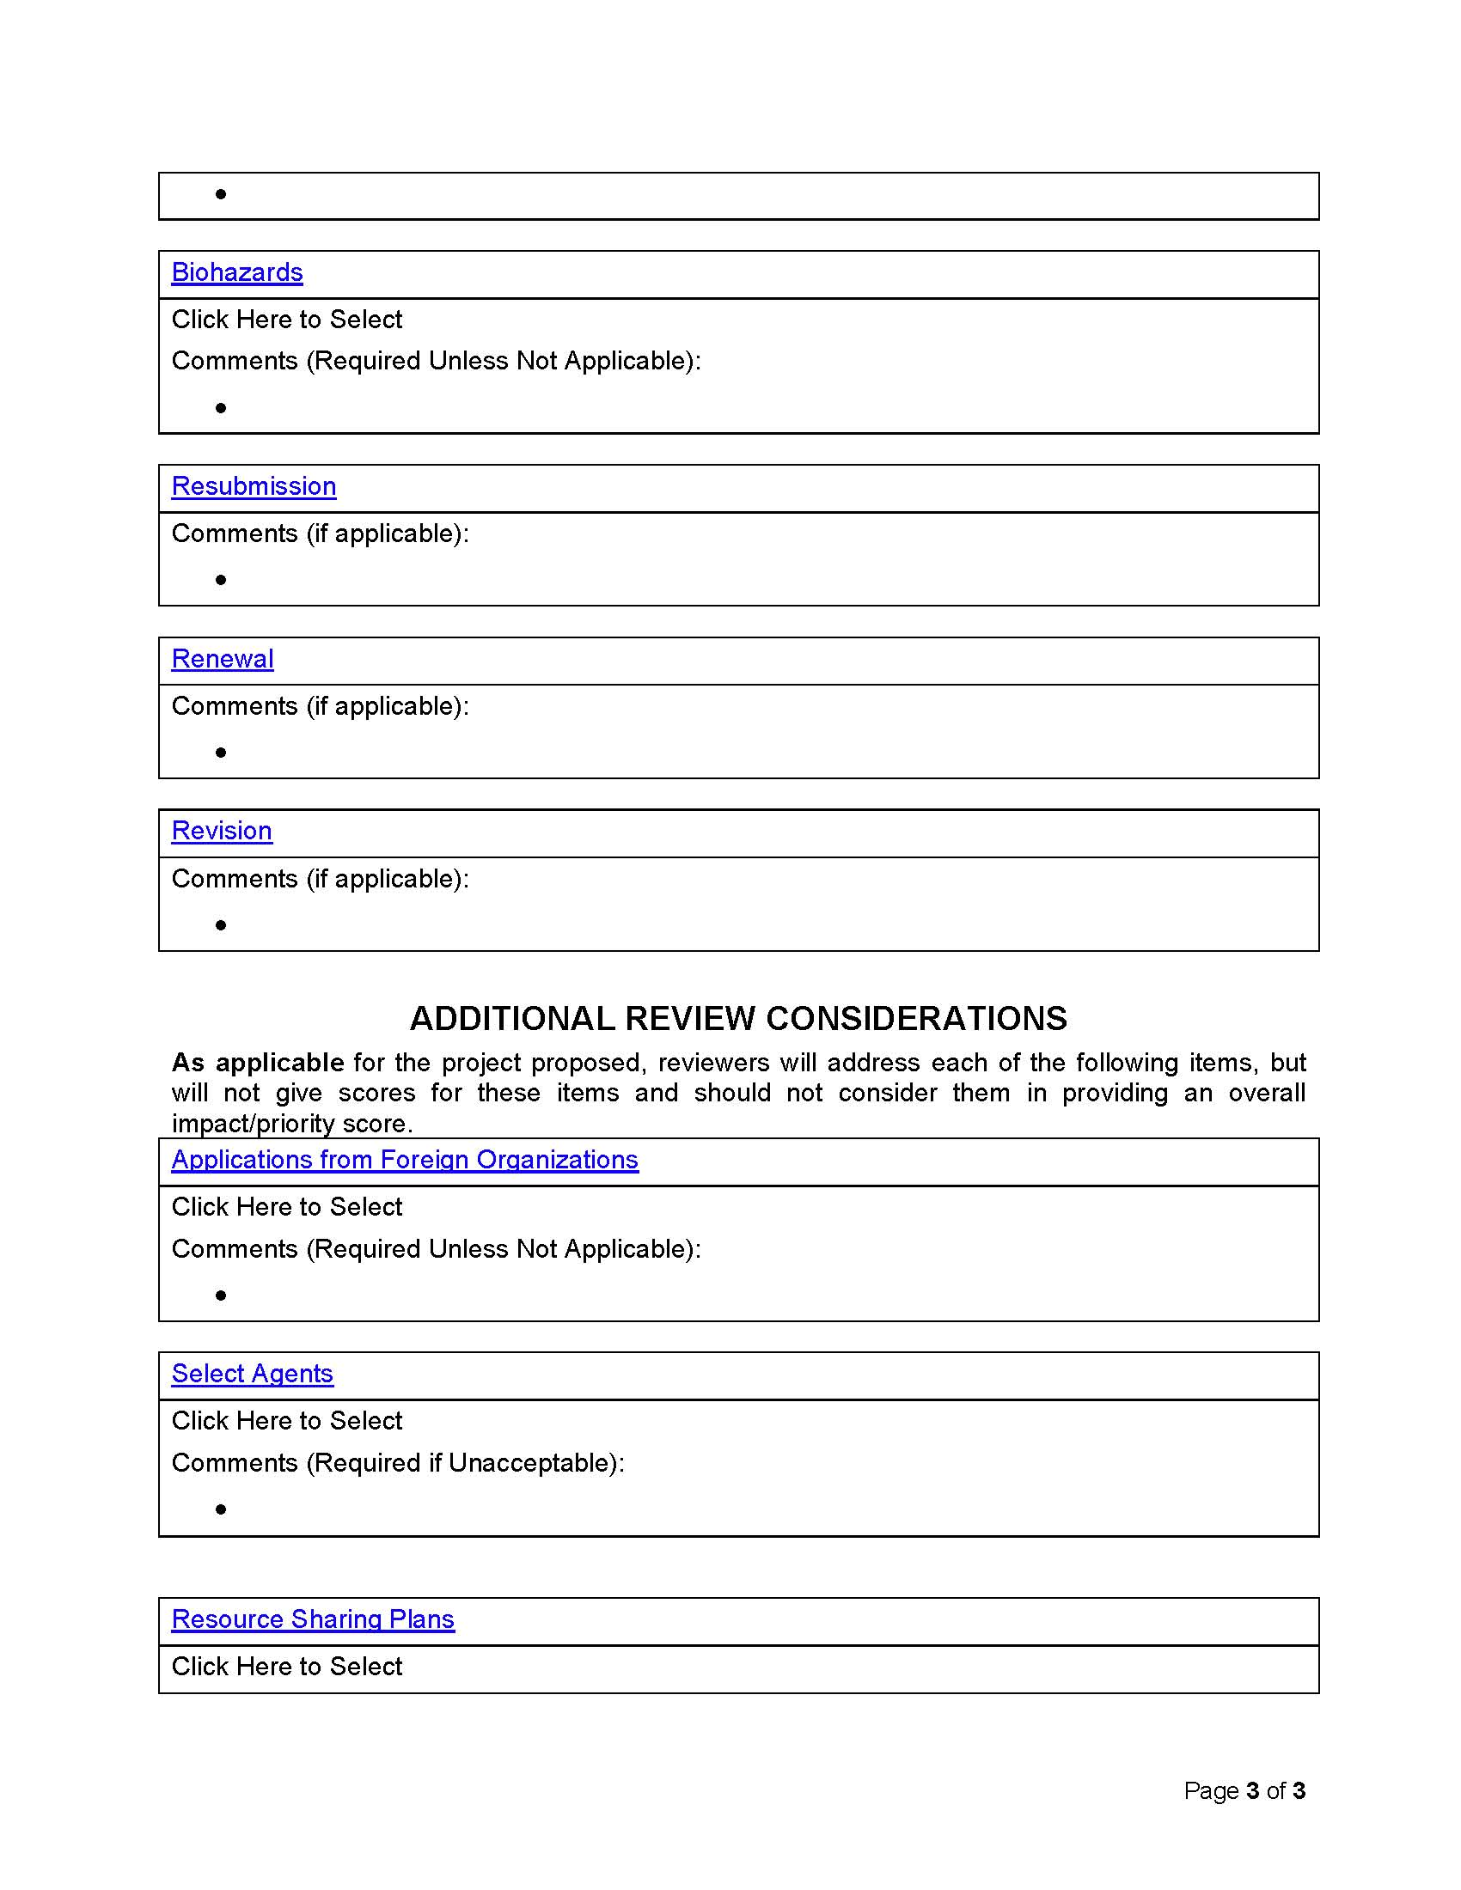

Slide 30
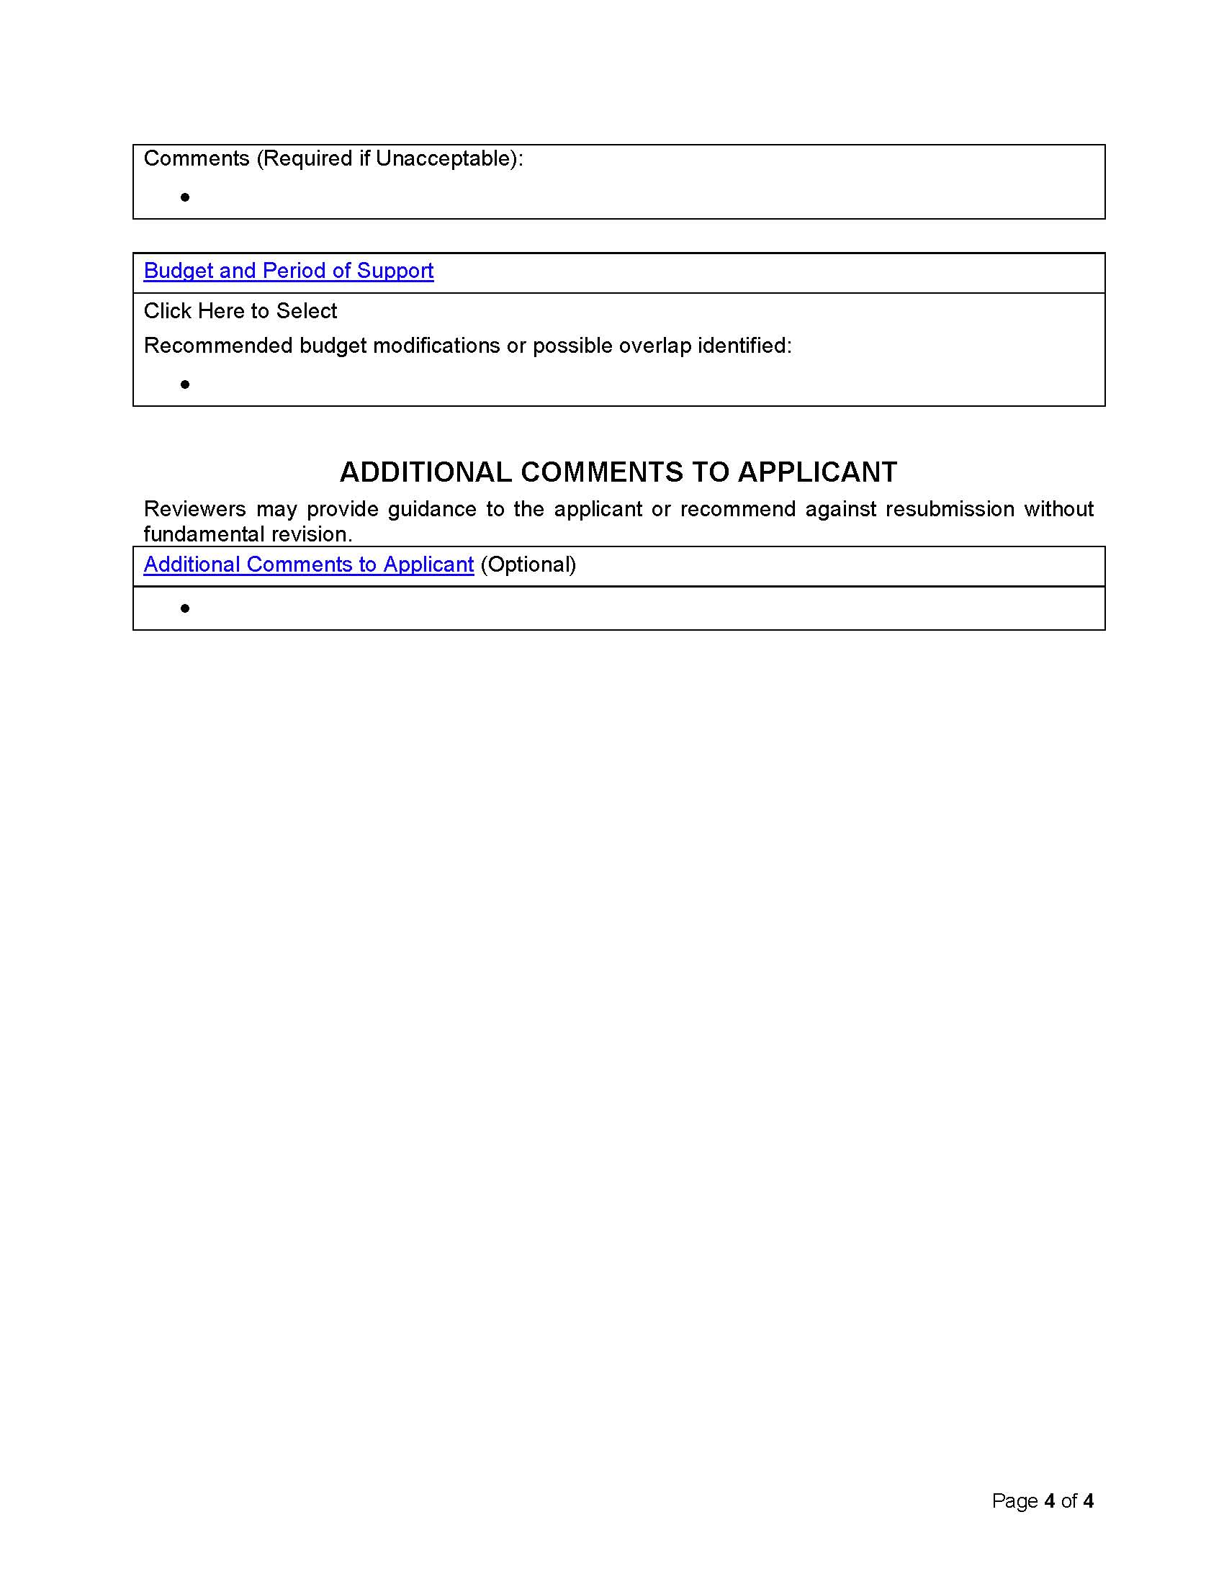

Slide 31
General Scoring Criteria
Impact | Score | Descriptor
High | 1 | Exceptional
 | 2 | Outstanding
 | 3 | Excellent
Moderate | 4 | Very Good
 | 5 | Good
 | 6 | Satisfactory
Low | 7 | Fair
 | 8 | Marginal
 | 9 | Poor

Slide 32
Score | Descriptor | Significance Descriptors
1 | Exceptional | Achieving the proposed aims is likely to advance the research field in profound and lasting ways
2 | Outstanding | Achieving the proposed aims is likely to advance the research field in critically important ways
3 | Excellent | Achieving the proposed aims is likely to advance the research field in important ways
4 | Very Good | Achieving the proposed aims is likely to contribute substantially to the current knowledge base of the research field
5 | Good | Achieving the proposed aims is likely to contribute meaningfully to the current knowledge base of the research field
6 | Satisfactory | Achieving the proposed aims is likely to contribute somewhat to the current knowledge base of the research field
7 | Fair | Achieving the proposed aims is likely to contribute only incrementally to the current knowledge base of the research field
8 | Marginal | Achieving the proposed aims is likely to contribute only minimally to the current knowledge base of the research field
9 | Poor | Achieving the proposed aims is unlikely to contribute in any way to the current knowledge base of the research field

Slide 33
Score | Descriptor | Investigator Descriptors
1 | Exceptional | The investigators are extremely well qualified to achieve the proposed aims.
2 | Outstanding
3 | Excellent
4 | Very Good | The investigators are qualified to achieve the proposed aims.
5 | Good
6 | Satisfactory
7 | Fair | The investigators do not appear to have adequate qualifications to achieve the proposed aims.
8 | Marginal
9 | Poor

Slide 34
Score | Descriptor | Innovation Descriptors
1 | Exceptional | Groundbreaking concepts, approaches, methodologies, or interventions that are novel for any research field
2 | Outstanding | New concepts, approaches, methodologies, or interventions that are novel across broadly related research fields
3 | Excellent | New concepts, approaches, methodologies, or interventions that are novel for this research field
4 | Very Good | Extensive improvements of the current concepts, approaches, methodologies, or interventions that are novel for this research field
5 | Good | Considerable improvements of the current concepts, approaches, methodologies, or interventions that are novel for this research field
6 | Satisfactory | Modest improvements of the current concepts, approaches, methodologies, or interventions that are novel for this research field
7 | Fair | Refinements of current the concepts, approaches, methodologies, or interventions of this research field
8 | Marginal | Only minor refinements of the current concepts, approaches, methodologies, or interventions of this research field
9 | Poor | No change of the current concepts, approaches, methodologies, or interventions of this research field

Slide 35
Score | Descriptor | Approach Descriptors
1 | Exceptional | The approach has an extremely high likelihood of achieving the proposed aims
2 | Outstanding | The approach has a very high likelihood of achieving the proposed aims
3 | Excellent | The approach has a high likelihood of achieving the proposed aims
4 | Very Good | The approach has a very good likelihood of achieving the proposed aims
5 | Good | The approach has a good likelihood of achieving the proposed aims
6 | Satisfactory | The approach appears likely to achieve the proposed aims
7 | Fair | The approach appears likely to achieve many but not all of the proposed aims
8 | Marginal | The approach is likely to achieve only some of the proposed aims
9 | Poor | The approach is unlikely to achieve most of the proposed aims

Slide 36
Score | Descriptor | Environment Descriptors
1 | Exceptional | The environment appears to provide outstanding resources to achieve the proposed aims, including uncommon or unique resources that facilitate achieving the proposed aims
2 | Outstanding
3 | Excellent
4 | Very Good | The environment appears to provide the resources needed to achieve the proposed aims
5 | Good
6 | Satisfactory
7 | Fair | The environment does not appear to provide resources needed to achieve the proposed aims
8 | Marginal
9 | Poor

Slide 37
9-Point Scoring (Overall Impact)

Slide 38
Grant Training II
April 24 & 25, 2017

Slide 39
Sign up sheet
Name | Email address | Department | School | Clinical Science or Basic Science Research? | Interested in attending workshop in April?
1.
2.
3.
4.
5.
6.
7.
8.
9.
10.
11.
12.
13.
14.
15.
16.
17.
18.
19.

Slide 40
Training Sessions
Trainees will be assigned to one of the two days.
Breakfast will be available at 8:30 a.m. A sack lunch will be served at noon. Participants should plan to participate for complete training session, which is likely to last until the early afternoon.
Trainees will bring fully prepared text of proposals stored either on a lap top or other storage device to the training session. Prepared text should include the following sections:
Abstract
Specific Aims
Significance
Innovation
Approach
Full text versions of these sections will be projected on to a screed from an LCD projector for discussion. Facilitators and other trainees will comment on organization, style, and clarity of exposition.
Trainees are encouraged to make modifications/corrections/additions/ deletions in real time. Each grant will received about an hour of discussion.

