Slide 1

Application Submission System &
Interface for Submission Tracking
August 2013

Slide 2

Dealing with paper-based, multi-project applications can be an overwhelming task for our applicants and NIH staff…
*

Slide 3


Multi-project apps are the last remaining paper submissions
These can be very complex!
Often large programs or centers
  Umbrella application describing overall effort
  Equivalent of full application for each component
Vary in size (from 2-200+ components)
Multi-tiered budgets (overall, component, consortia)
Can have large number of key personnel
May require form pages for different types of components in single application
  Research, Training, Career Development, etc.
Notes:
Add brief definition - multiple subprojects, up to 100 subprojects, up to TBD pages.

Slide 4


It’s time for electronic submission!

Slide 5

Unfortunately…
The structure of NIH’s multi-project applications cannot be accommodated by Grants.gov’s downloadable forms.

Slide 6

Our Approach
We partnered with the Grants.gov team so NIH could develop ASSIST, a web-based submission system to accept NIH’s multi-project applications that works in conjunction with Grants.gov.

Slide 7
The result
Essentially, ASSIST works as an alternate web front end to Grants.gov’s “Apply” for NIH’s multi-project applications, much like a system-to-system service provider might.
This approach allows system-to-system submitters to continue to send their submissions through Grants.gov once their solutions support multi-project applications.

Slide 8





Behind the scenes…

Slide 9

ASSIST Features
Leverages existing eRA Commons accounts
Pre-populates data from eRA Commons profiles
Validates Grants.gov and NIH business rules before you submit
Provides preview of NIH application image
Generates table of contents, headers & footers
Tracks Grants.gov and eRA Commons submission status

Slide 10

ASSIST Status
ASSIST has been ‘piloted’ with selected multi-project FOAs since November 2012
  Thanks go out to all pilot applicants that provided feedback and suggestions for system improvements!
Systems are ready to begin
activity-code based transitions to electronic submission Fall 2013
  Paper to electronic format
  PHS 398 to SF424 Research & Related (R&R)
  data set

Slide 11

Transition Timeline
Once an activity code transitions, all applications (new, resubmission, renewal, and revision) to an FOA for that code must be submitted electronically
  NO PAPER APPLICATIONS WILL BE ACCEPTED!
P01, P20, P50, U19, P2C (new), U2C (new), R24*, U24*
G12, P30, P40, P41, P42, P51, P60, R28, S06, U10, U41, U42, U45, U56, UC7
U54, UM1
Due Dates on/after
Sept. 25, 2013
Due Dates on/after
Jan. 25, 2014
Due Dates on/after
May. 25, 2014
*Transitioning to single-project Grants.gov downloadable forms model. R24 and U24 multi-project programs will move to alternate activity codes (e.g., P2C, U2C).

Slide 12

Registration – Two Separate but Linked Systems
Grants.gov
eRA Commons
Federal-wide portal to find and apply for Federal grant funding
Organization registration required
  System for Award Management (SAM) registration and annual renewal also required
Agency system for applicants, grantees and Federal staff to share application/grant info
Organizations, Principal Investigators and component leads must be registered
IMPORTANT: If not yet registered, start now!
http://era.nih.gov/files/Registrations_Needed_Submit_Applications_NIH.pdf

Slide 13
Registration - Preparing Application
All ASSIST users must have eRA Commons credentials with one of the following roles:
  Signing Official (SO)
  Administrative Official (AO)
  Principal Investigator (PI)
  Assistant (ASST)
  Account Administrator (AA)

Slide 14
Registration – Submitting Application
To submit your application using ASSIST you will need:
  an eRA Commons account with the Signing Official (SO) role
AND
  active Grants.gov Authorized Organization Representative (AOR) credentials

Slide 15

Account Notes
Work within eRA Commons and Grants.gov to establish your accounts and be sure you can log in to those systems before using your accounts with ASSIST
If you run into password or other account issues, return to eRA Commons or Grants.gov to work through those
issues

Slide 16
Electronic Submission of Multi-Project Applications Using ASSIST

Slide 17








Overview of Process
Find
Opportunity
Enter application data for all components
Initiate application and create the application shell
Submit your application through Grants.gov to NIH
Find
Plan
Initiate
Build Team
Enter Data
Finalize
Submit
Track
Get familiar
with the process and create an application plan
Finalize
components and prepare your application for submission
Define your team and provide application access
Track status and view final application image

Slide 18
Find Opportunity
Find
Plan
Initiate
Build Team
Enter Data
Finalize
Submit
Track

Slide 19


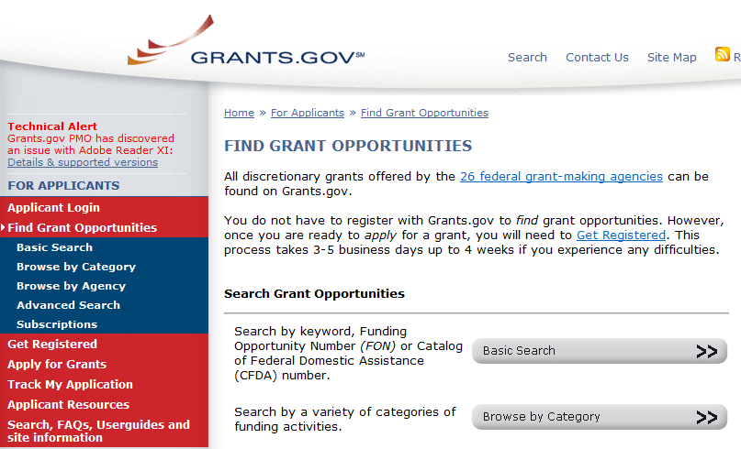
Find Multi-project FOAs in…
NIH Guide for Grants & Contracts
Grants.gov Find

Slide 20
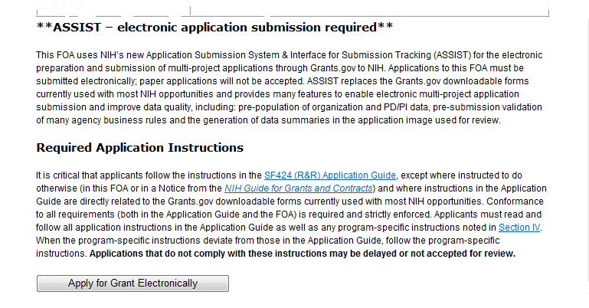
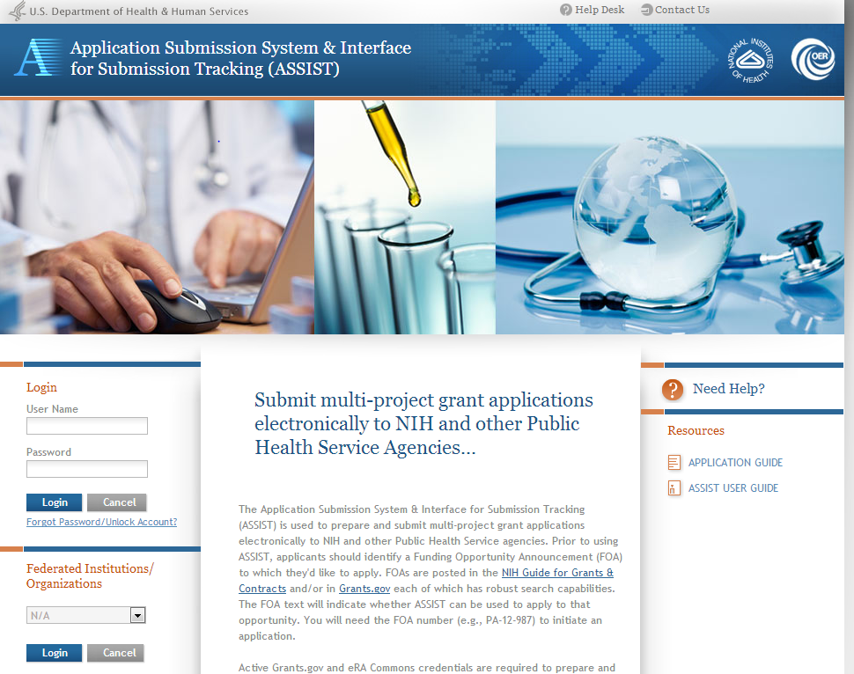
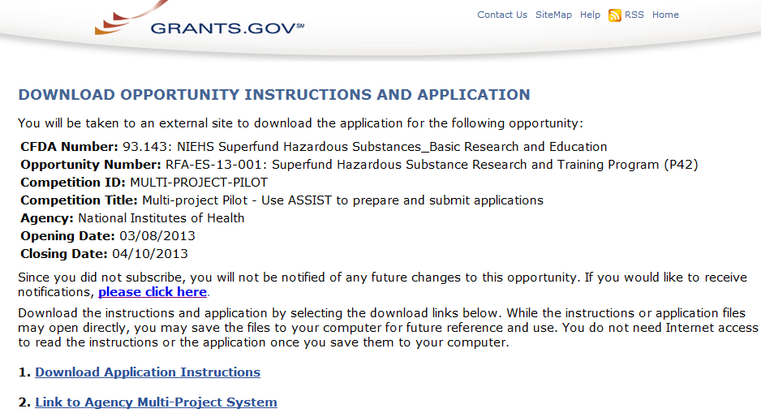
FOAs Link You to ASSIST
NIH Guide for Grants & Contracts
Grants.gov ‘Apply’

Slide 21

Before jumping into ASSIST, take some time to learn about the new process

Slide 22
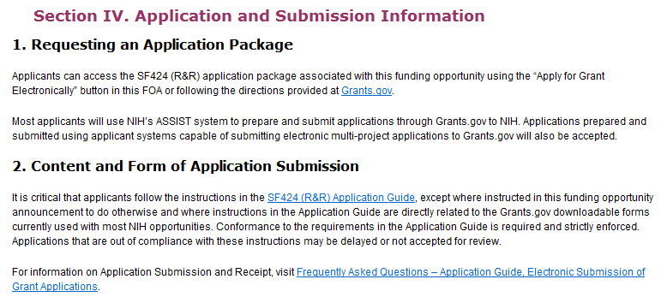
Multi-project FOAs
Section IV. Application and Submission Information of NIH FOAs includes important guidance for preparing your application in ASSIST.
The SF424 (R&R) Application Guide provides general instructions for completing application forms.

Slide 23

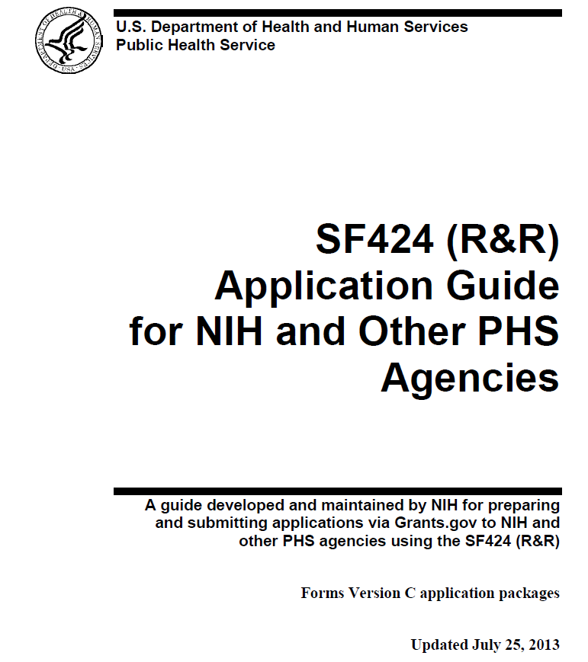

Application Guide
Check out new section for multi-project applications
Agency-specific instructions are marked with the HHS logo.
When instructions in the Application Guide conflict with instructions in the FOA, the FOA wins.

Slide 24
Terminology
Multi-project Application
  Single submission with multiple, interrelated components that share a common focus or objective
Component
  A distinct, reviewable part of a multi-project application for which there is a business need to gather detailed information
  Each component includes the data collection identified for it’s specific component type
  Typically involves people, sites, work and budget

Slide 25
More Terminology
Component Type
  A named, agency-defined collection of forms that may be repeated within an application
    Examples: Project, Admin Core, Core, Training, Career Dev, Construction
  ‘Overall’ is a special component type with a single occurrence in every complex application
    Provides overview information for the entire application
Form
  A named collection of data fields approved by the Office of Management and Budget (OMB)

Slide 26
New Application Format
All electronic multi-project applications will include:
A single Overall component
  Provides overview of entire application
Some number of additional components
  Component types allowed will vary by opportunity
  Announcements will clearly indicate the types of components expected in a responsive application
Automatically prepared data summaries
  Compiled from information included in components
  Helps reviewers and staff work with the applications

Slide 27
Multi-project Application Assembly
Understand how your application image will be assembled by NIH
  The Overall component is presented first
    Including system-generated data summaries
  Additional component types are presented in alphabetical order (e.g., Cores before Projects)
    Components of the same type are grouped together and presented in the order created in ASSIST
    Components are identified by type and sequential number (e.g., Core-001, Core-002)

Slide 28
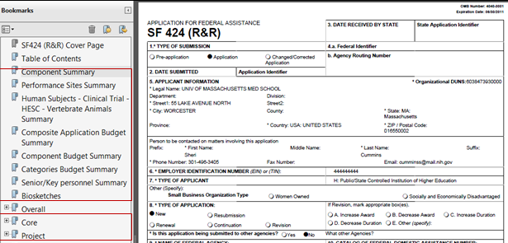

Multi-project Application Assembly
Overall Cover Page
Table of Contents
System generated summaries compiled from component data
Remaining Overall component data
Additional components grouped by type
Check out this resource: http://grants.nih.gov/grants/ElectronicReceipt/files/Electronic_Multi-project_Application_Image_Assembly.pdf

Slide 29

Create an Application Plan
Find
Plan
Initiate
Build Team
Enter Data
Finalize
Submit
Track

Slide 30
Create an Application Plan
Carefully read the FOA and note the allowable types of required/optional components and any special instructions
Decide how to distribute the work
Ensure all eRA Commons and Grants.gov registrations are in place
  Gather the Commons IDs for everyone who will be working on your application in ASSIST

Slide 31
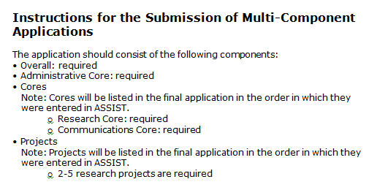
FOA Text Instructions
Sample excerpt from FOA (section IV)

Slide 32
Define the Layout of Your Application
Think about the components you plan to include
  PD/PI(s) for entire application
  Organization lead for each component
  Project lead for each component
  Project Title for application/components
  Start/End dates for application/components

Slide 33
Define the Layout of Your Application
Determine the order you want the components to appear in the final application image
Create the application shell by initiating the application and adding the components in the appropriate order
  Remember that components will display in the final application image in the order created

Slide 34







Sample Application Shell Layout
Overall Component
PD/PIs: Cher D. Money, Ben A. Round
Organization: Whatsamatta U
Project Title: Research Center to Cure All the Diseases of the World
Component Type: Admin Core
Component Type: Core
Component Type: Project
Admin Core-001
Core-001
Project-001
Project Title: Administrative Core
Project Lead: Jed I. Knight
Organization:
Whatsamatta U
Project Title: Research Core
Project Lead: Ben A. Round
Organization: Whatsamatta U
Project Title: Fabulous Research Focus 1
Project Lead: Cher D. Money
Organization: Whatsamatta U
Subaward Budget
Project-002
Organization:
Sub-stantial Research
Project Title: Fabulous Research Focus 2
Project Lead: Quin T. Sential
Organization:
Better Now
Core-002
Project Title: Communications Core
Project Lead: Abel Tu Lead
Organization:
Better Now
Project-003
Project Title: Fabulous Research Focus 3
Project Lead: Ima Doer
Organization:
Cures R Us

Slide 35

Initiate Your Application and Create an Application Shell
Find
Plan
Initiate
Build Team
Enter Data
Finalize
Submit
Track

Slide 36
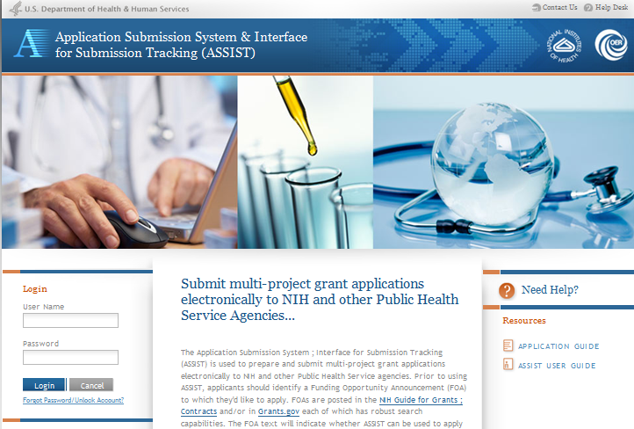
Log In to ASSIST
https://public.era.nih.gov/assist
Use your eRA Commons credentials to access ASSIST.

Slide 37
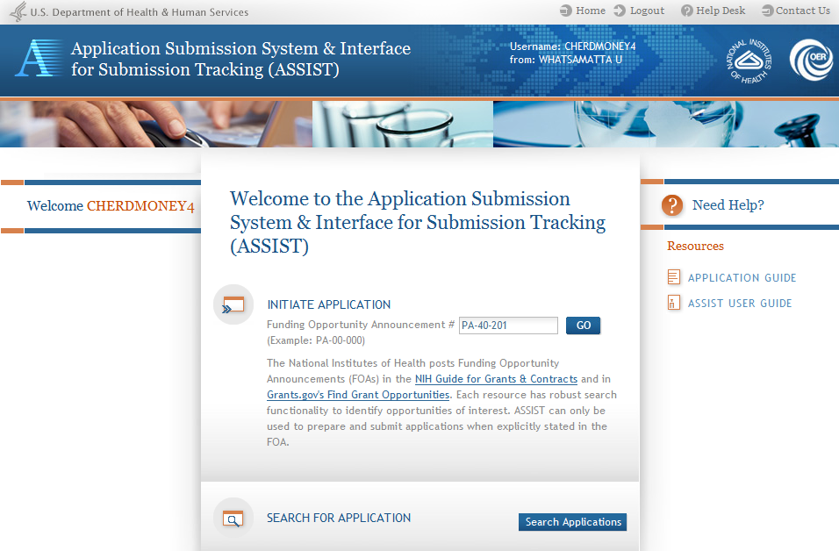
Initiate Application

Slide 38
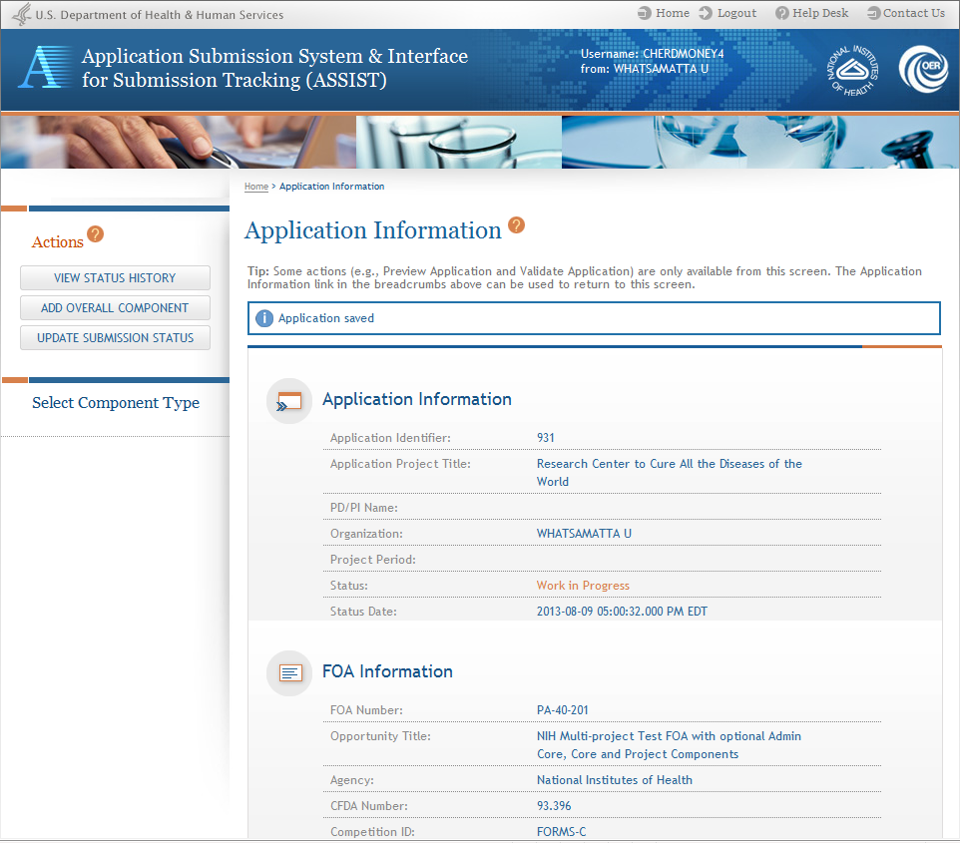
Using ASSIST
Click on question mark icon to access ASSIST help.
ASSIST messages appear at top of screen.
Available actions vary based on application context and access.

Slide 39
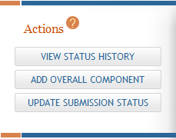
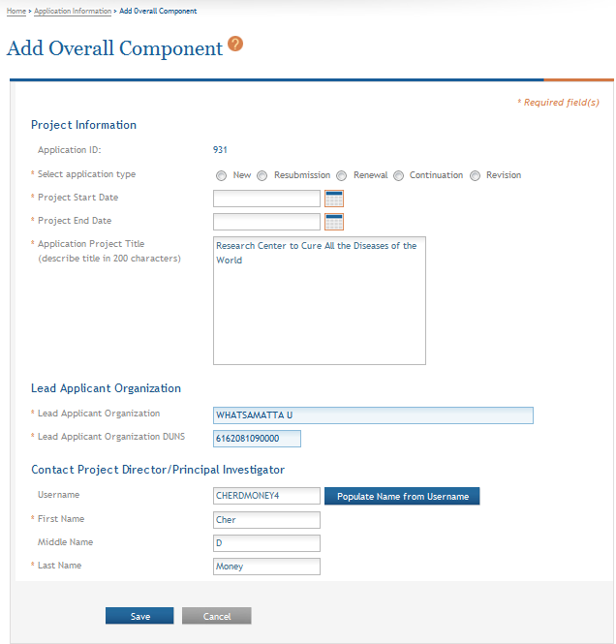
Add Overall Component
Click Add Overall Component to start building your application.
Enter the Commons Username for the contact PD/PI and use the Populate Name from Username button or type PD/PI name.

Slide 40
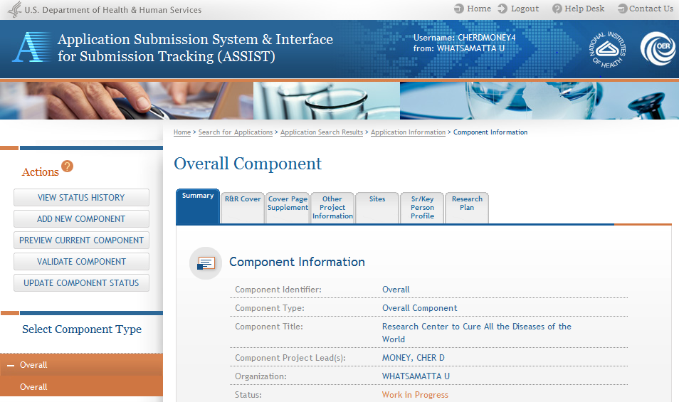
Overall Component
The required forms are presented for each component.
Where’s the budget?
Budget forms roll up to create the Overall budget.
The Overall component is added to the component navigation.

Slide 41
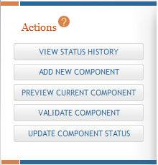
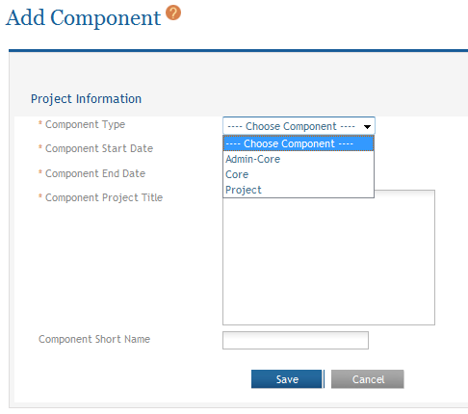
Adding Additional Components
Applicants are only presented with allowable component types as defined in the FOA.
Applicants can define a short (20-char) name to identify the component during application preparation.

Slide 42
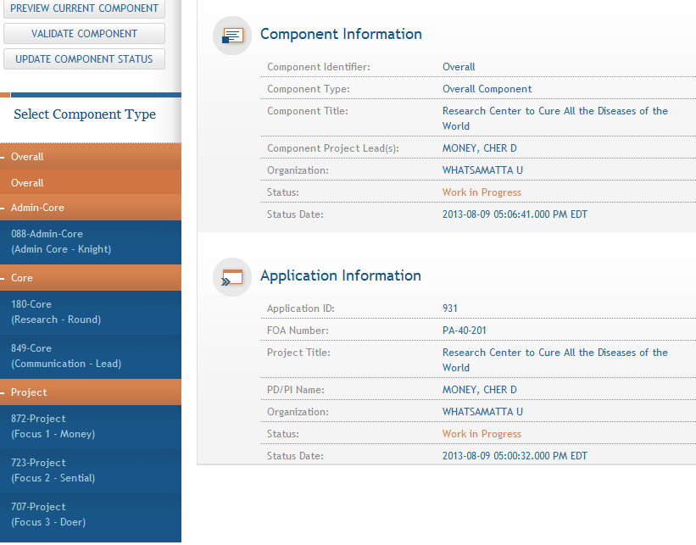
Adding Components
Continue adding components to build out the application shell.
Both the user-defined short name and the ASSIST-generated component identifier are displayed in the navigation.

Slide 43
Define Your Team and Provide Application Access
Find
Plan
Initiate
Build Team
Enter Data
Finalize
Submit
Track

Slide 44
Automatic Application Access
ASSIST automatically provides application access to some individuals based on their Commons roles or role on the application
  All SOs and AOs at the applicant institution have edit access for the entire application
  All PD/PIs listed on the Overall application have edit access for the entire application
    Can be reduced to View access using Manage Access action
  The person that initiates the application has edit access for the entire application

Slide 45
Automatic Application Access (cont.)
  For components led by collaborating institutions
    All SOs and AOs at the lead institution have edit access for their component once DUNS is provided on the R&R Cover form
  Component Project Leads have edit access for their components once Commons ID is provided on the Sr/Key Person Profile form

Slide 46

Managing Access
Application access can be granted to additional users and controlled across these variables:
  Entire application vs. specific components
  Read vs. Edit
  Budget vs. Non-budget data

Slide 47

Managing Access
SOs at the applicant institution can
  Manage application access for other users
  Manage application status all the way to Ready for Submission status
  Delegate Access Maintainer
  and Status Maintainer authority
  to other users within their
  institution
  Access the Submit action

Slide 48
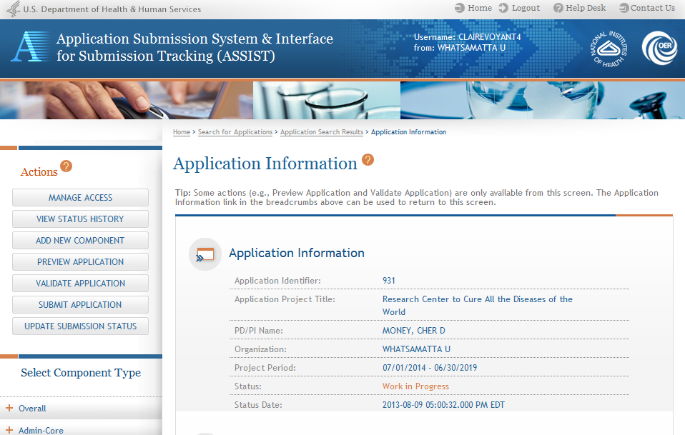
Manage Access
CLAIREVOYANT4 is an SO at Whatsamatta U
Click Manage Access
The Manage Access action can be used to provide access to additional users or modify access for existing users.

Slide 49
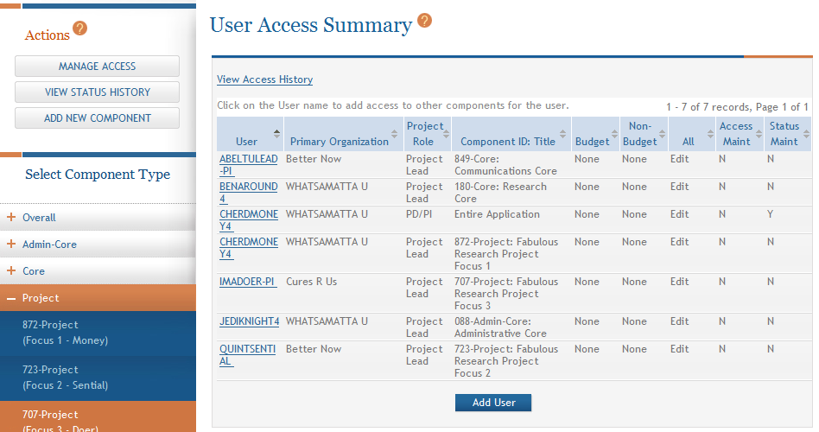
Manage Access
Users with automatic access based on application role are listed on the User Access Summary page and their access can be changed.
Click Add User to provide access to others

Slide 50
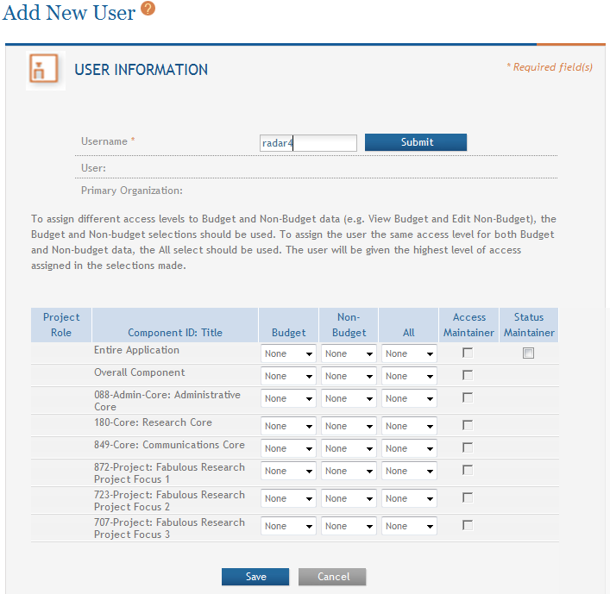
Manage Access
Provide the Commons Username of the person to be given access and click Submit

Slide 51
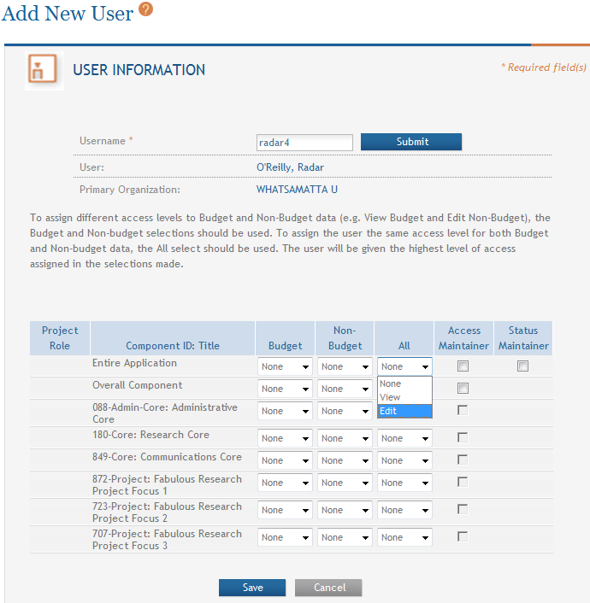
Manage Access
Name and Organization pulled from Commons profile.
Edit access for the Entire Application can be granted by selecting Edit under All.

Slide 52
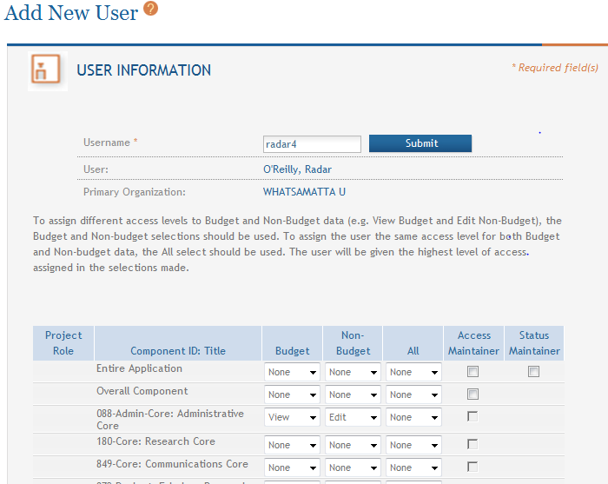
Manage Access
Access can be given for individual components instead of the entire application.
Different access levels can be selected for Budget and Non-budget data on a component.

Slide 53
Manage Access
SOs can give Access Maintainer and/or Status Maintainer authority to other users in their organization.

Slide 54
Enter Application Data
Find
Plan
Initiate
Build Team
Enter Data
Finalize
Submit
Track

Slide 55
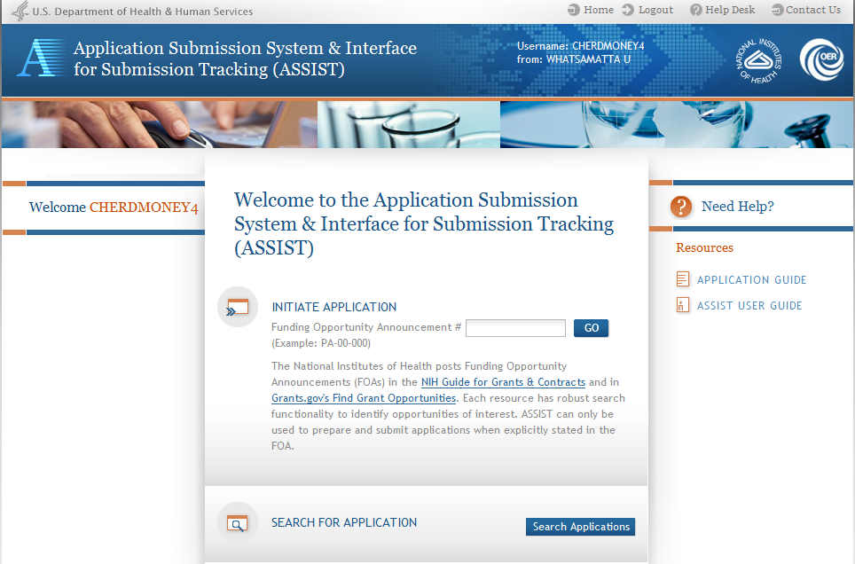
Searching for In-progress Applications
Use Search Applications to access your in progress application.

Slide 56
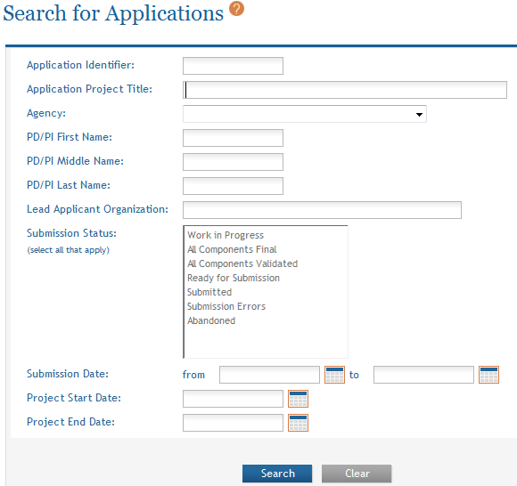
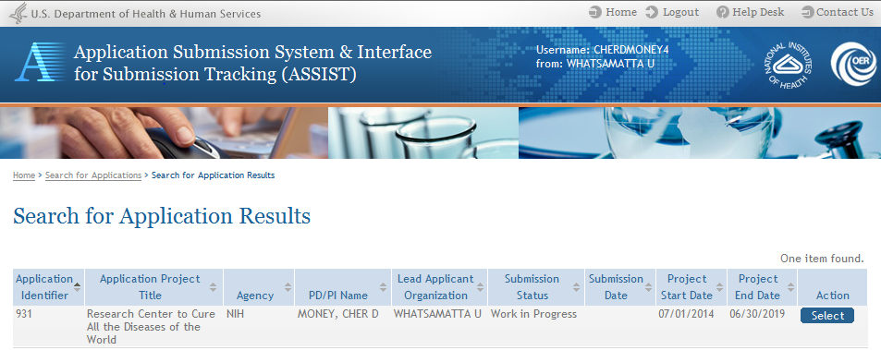
Searching for In-progress Applications
Enter search parameters and click Search.
Select application.

Slide 57
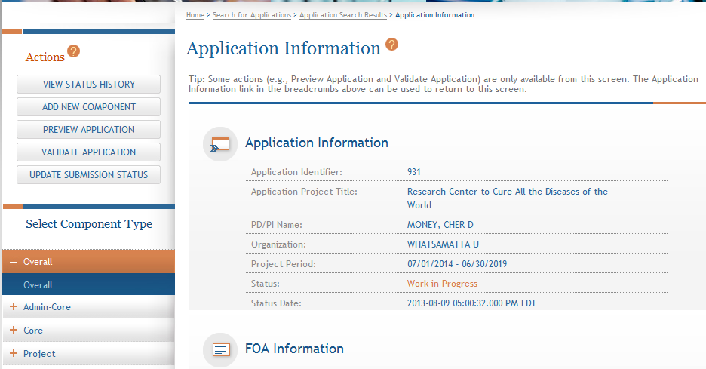
Navigating to a Specific Component
Use the component navigation to identify the component you want to work on.

Slide 58
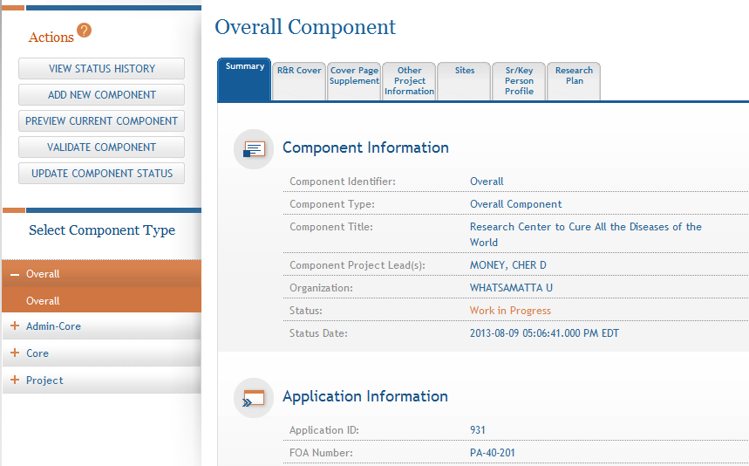
Summary Page
Every component has a Summary page.
Some actions are only available from the Summary page.
The Summary page shows status information.

Slide 59
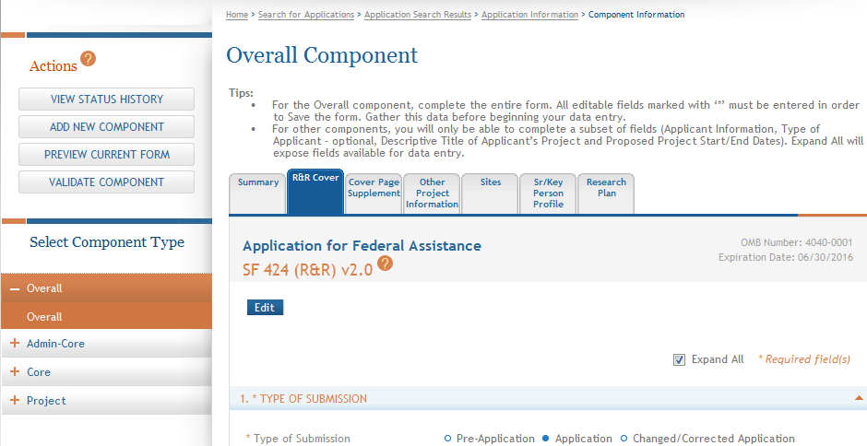
Entering Application Data
Many screens have useful tips – read them!
Click each tab to access form data entry screens.
Clicking Edit locks out other users from editing a specific form.

Slide 60
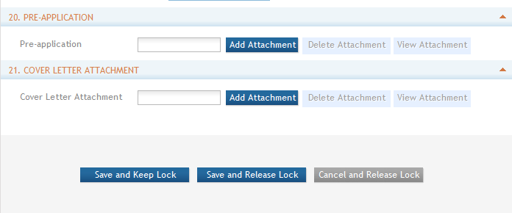
Form Save Options
Save and Keep Lock saves your data and allows you to continue working on the form.
Save and Release Lock saves your data and allows other users to edit the form.
Cancel and Release Lock leaves the form without saving and allows other users to edit the form.

Slide 61
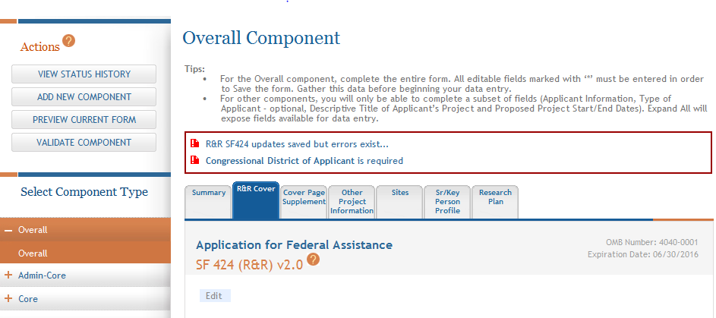
Data Entry Validation
ASSIST will validate entered data and provide errors at the top of the screen when you Save.

Slide 62
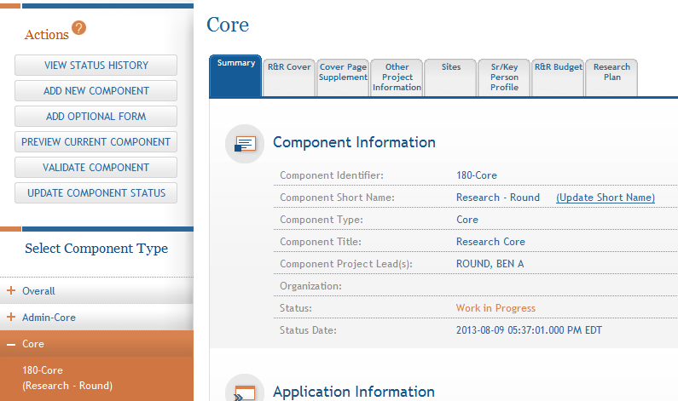
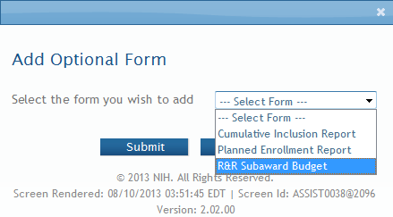
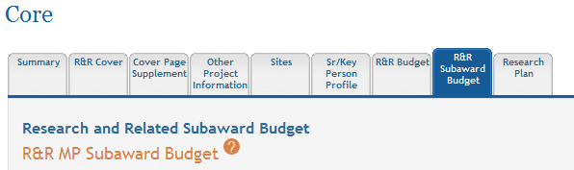
Adding R&R Subaward Budget & Optional Forms
Select form and click Submit.
The form tab is added to the component form navigation.

Slide 63
Data Entry: R&R Cover
Overall | All other components
All form fields used | Subset of fields used: Field 5: Organization Information Field 7 (Optional): Type of Applicant Field 11: Descriptive Title of Applicant’s Project Field 12: Proposed Project Start/End Dates

Slide 64
Data Entry: Other Project Information
Overall Component | All other components
Human Subjects: Standard Application Guide instructions apply | Human Subjects: Answer only the ‘Are Human Subjects Involved?’ and Is the Project Exempt from Federal regulations?’ questions.
Vertebrate Animals: Standard Application Guide instructions apply | Vertebrate Animals: Answer only the ‘Are Vertebrate Animals Used?’ question.

Slide 65
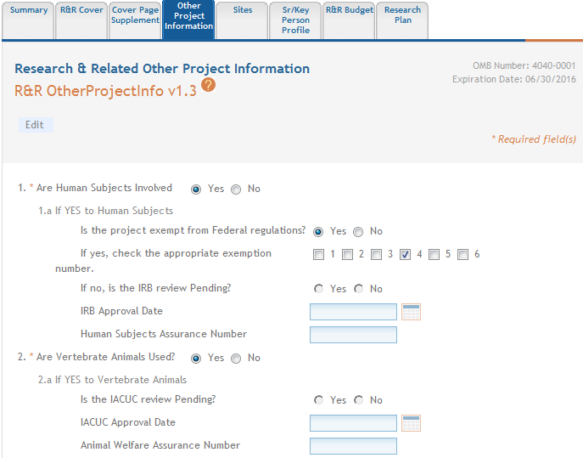
Data Entry: Other Project Information
ASSIST prevents data entry of additional Human Subject and Vertebrate Animal info on components other than Overall.

Slide 66
Data Entry: Research Plan
Overall Component | All other components
Attachments: Describe the entire application Introduction: Required for Resubmission/ Revision applications Specific Aims: Required Research Strategy: See FOA instructions for page limit | Attachments: Reflect the activity in the specific component Introduction: See FOA instructions Specific Aims: Required Research Strategy: See FOA instructions for page limit

Slide 67
Data Entry: Sr/Key Person Profile
Overall Component | All other components
Use the PD/PI section to designate the Contact PD/PI and any Multi-PD/PIs Use Project Role PD/PI Must Provide Organization for all Sr/Key entries | Use the PD/PI section to designate the Project Lead Must not use PD/PI role ASSIST defaults role to Other, Project Lead Must Provide Organization for all Sr/Key entries
Applications must include a single biosketch for each Sr/Key person regardless of the number of components they are listed on. Biosketch can be included with any entry – just pick one.

Slide 68
Avoid Common Errors
ASSIST screen tips
  Found at the top of many data entry screens
Annotated form sets
  http://grants.nih.gov/grants/ElectronicReceipt/communication.htm#forms
Ten Checks to Help Avoid Common Errors
  http://grants.nih.gov/grants/ElectronicReceipt/avoiding_errors.htm#10checks
PDF Guidelines:
  http://grants.nih.gov/grants/ElectronicReceipt/pdf_guidelines.htm

Slide 69
Component Actions
As component data is entered several actions are available:
  Validate Component
  Preview Current Component
  Update Component Status
    Work In Progress – only status that allows editing
    Complete – component data entry is complete
    Final – component has been reviewed by applicant organization and incorporated into the application

Slide 70
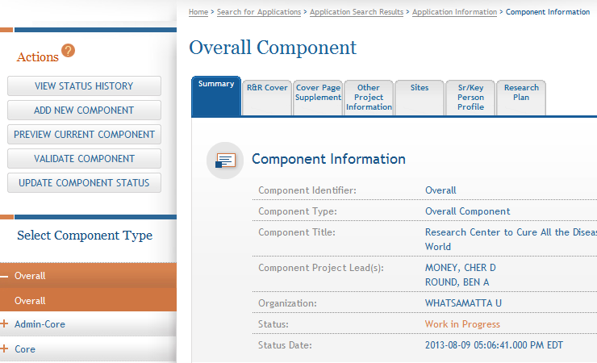
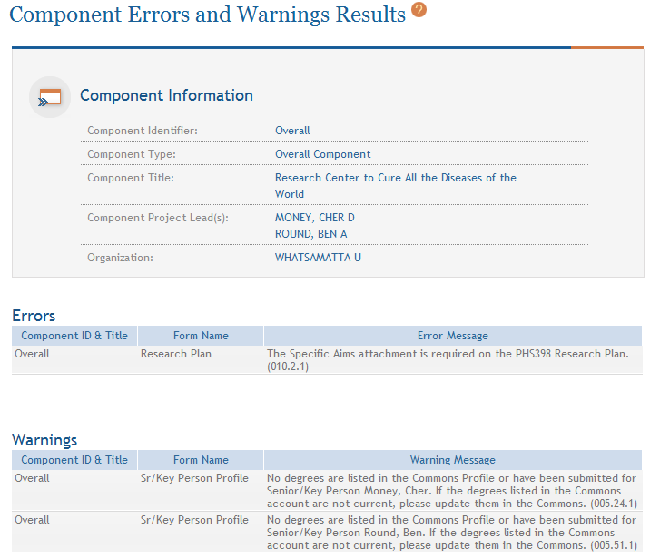
Validating a Component
Errors and Warnings are displayed.

Slide 71


Errors & Warnings
Errors stop application processing and must be corrected before the deadline
Warnings do not stop application submission and are corrected at the discretion of the applicant before the deadline
Check out this resource: http://grants.nih.gov/grants/ElectronicReceipt/avoiding_errors.htm

Slide 72
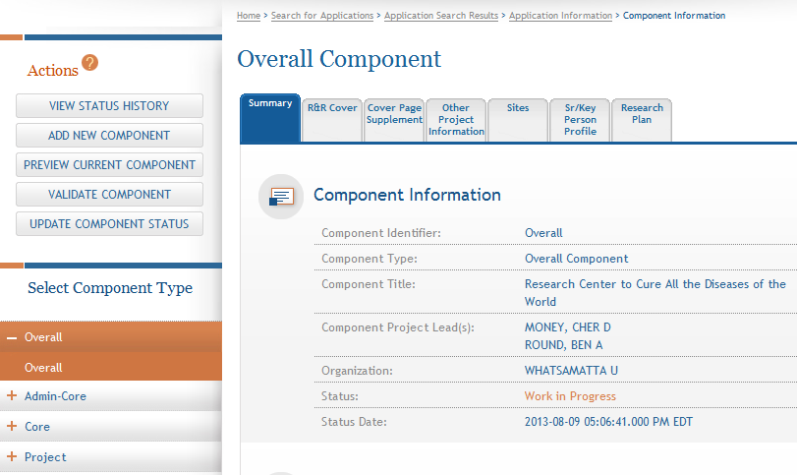
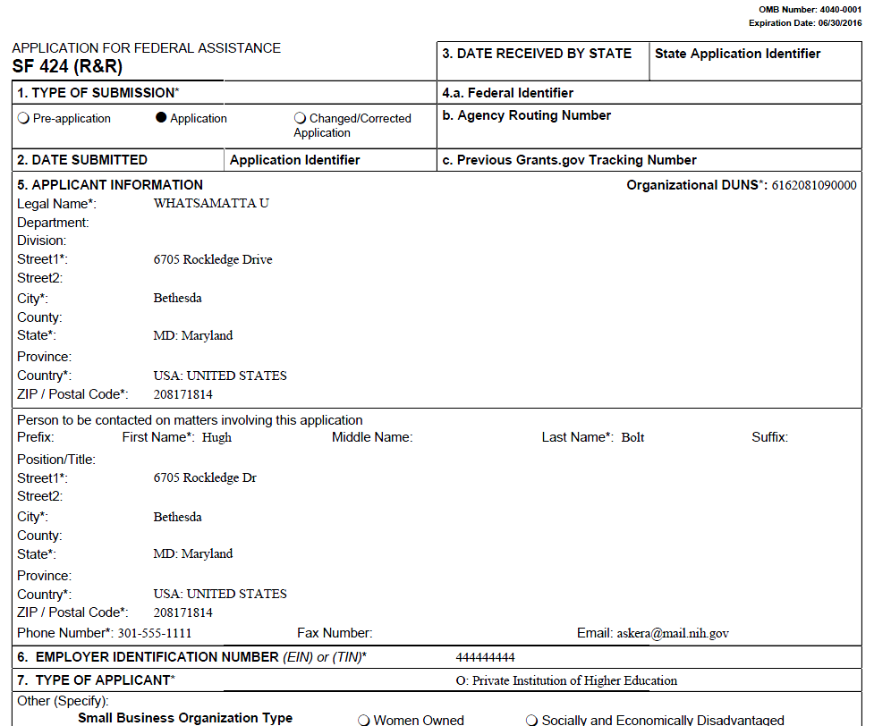
Previewing a Component
Component preview does not include bookmarks, Table of contents, data summaries or biosketches.

Slide 73
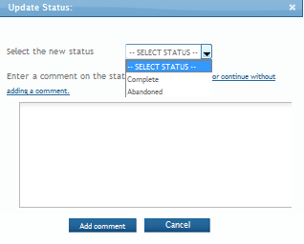
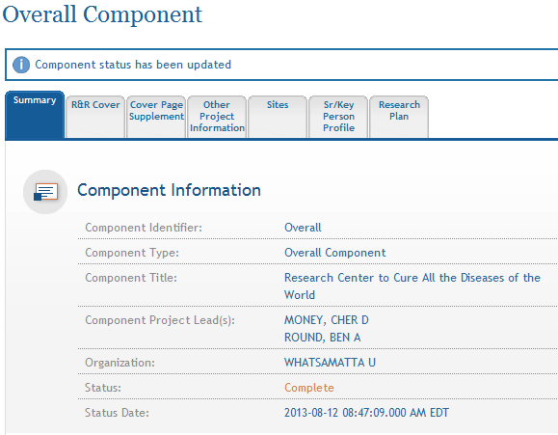
Updating Component Status to Complete
Select status and enter comment for Status History.
Once a component is marked ‘Complete’ no additional edits can be made unless someone with entire application edit authority returns the status to ‘Work in Progress’.
Status on Summary page is updated.

Slide 74

Finalize Content & Prepare Your Application for Submission
Find
Plan
Initiate
Build Team
Enter Data
Finalize
Submit
Track

Slide 75
Finalizing Components
As components are marked ‘Complete’, the applicant organization can preview them and incorporate those that are ready into the final application by updating the component status to ‘Final’.
All components must be marked ‘Final’ before an application can be prepared for submission.
Prior to finalizing components it is a good practice to validate the application.

Slide 76
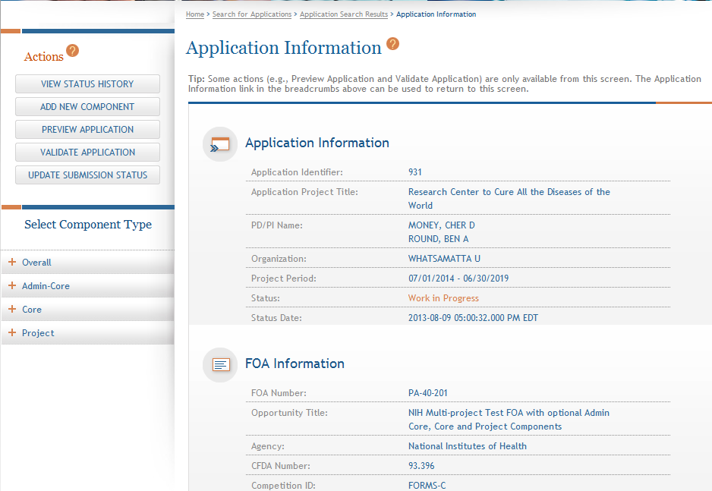
Validating the Application
The Validate Application action is only available from the Application Information screen.
Click Validate Application.

Slide 77
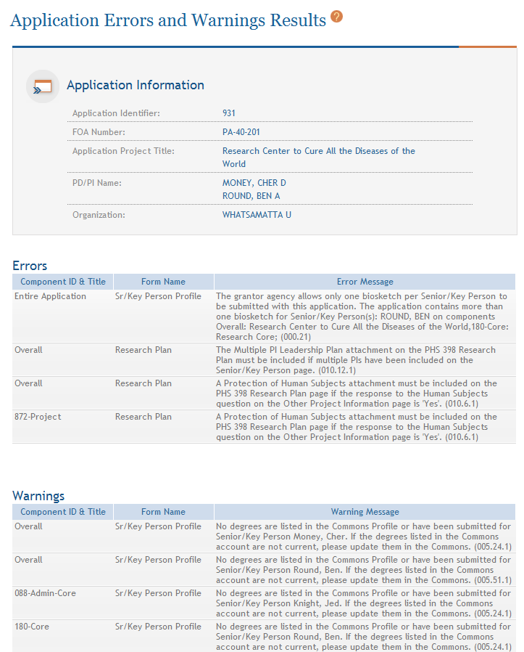
Application Validation Results
If Errors or Warnings are detected for a component in ‘Complete’ status it can be put back in ‘Work In Progress’ status for correction.
Multiple biosketch error can be addressed when finalizing the components.
Each Error or Warning includes the component and form where the problem was identified.

Slide 78
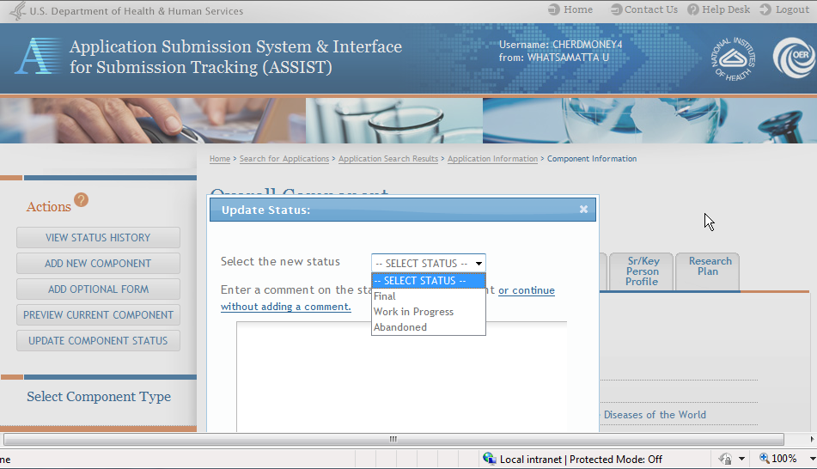
Finalizing Components
Update the component status to Final once you are satisfied that the component is ready to be included in the final application.

Slide 79
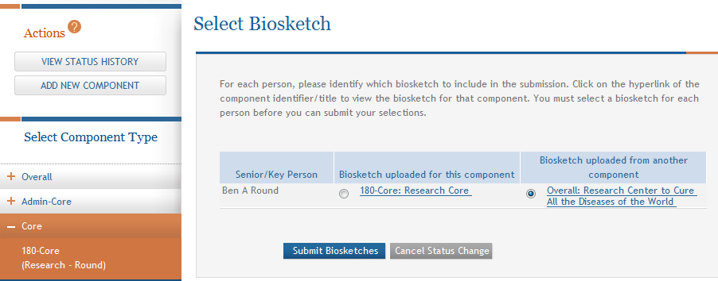
Finalizing Components
ASSIST will check to ensure that only one biosketch is included for every Senior/Key person in the application.
Click Submit Biosketch.
If a biosketch is already included for any Sr/Key, you will have the option to view each biosketch and select the one you wish to keep.

Slide 80
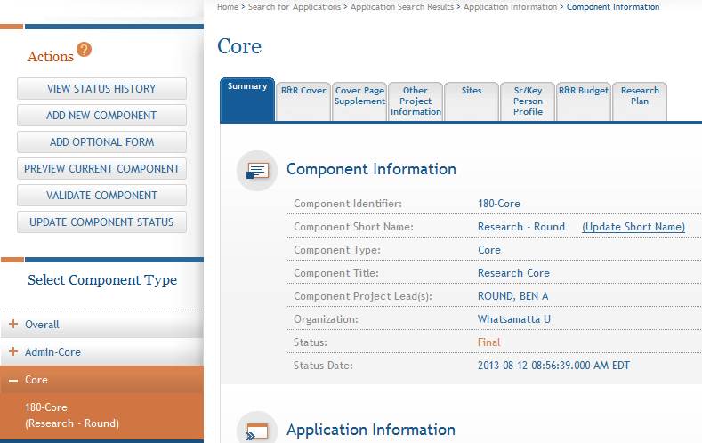
Finalizing Components
  After all biosketch issues are reconciled, the component status is set to Final.

Slide 81
Updating Application Status
Although the Status shown in the Component Information for each component is set to Final. The Application Information still shows a Status of Work in Progress.

Slide 82
Application Status Flow
Work In Progress – Allows editing
All Components Final – Can only be updated once each component status is Final; must Validate Application to move to next status
All Components Validated – Automatically set once Application Validation is error-free
Ready for Submission – Should be set after all internal reviews have taken place
Submitted – Automatically set after submitting to Grants.gov

Slide 83
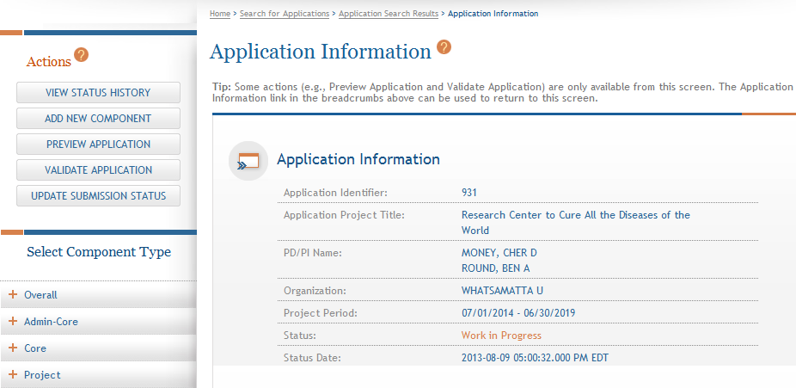
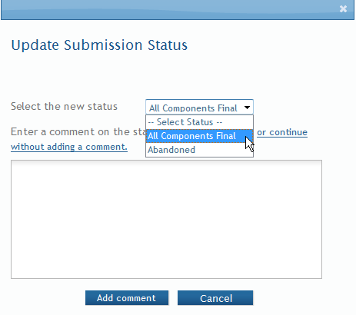
All Components Final
You can prepare your application for submission once the status for all individual components has been set to Final.
Set the application status to All Components Final.

Slide 84
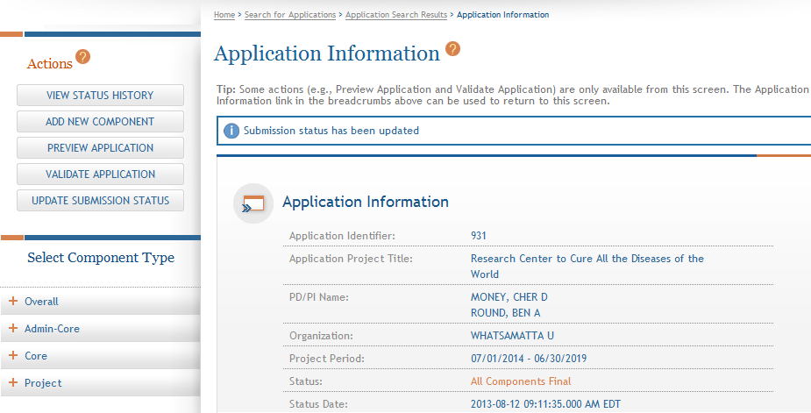
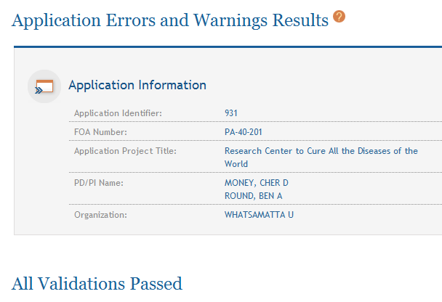
Final Validation Check
Before an application can be submitted, it must pass validations (Warnings are OK).
ASSIST runs the same checks that NIH eRA systems do post-submission.

Slide 85
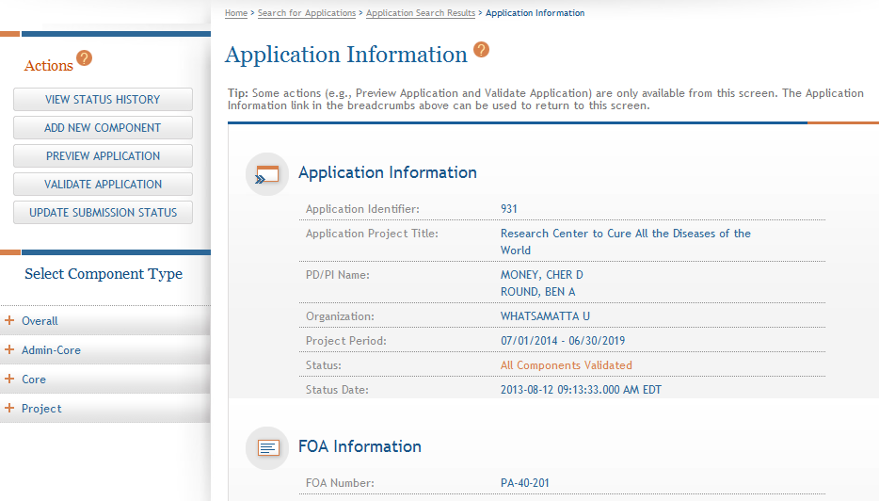
All Components Validated
When the application passes validations, the application status is automatically updated to All Components Validated.

Slide 86

Preview Application
Before you submit you can Preview Application and verify that everything is just the way you want it to go to review.

Slide 87

Preview Application Request Mock-up
Coming in late August…Preview Application action will bring users to page where they can look at previous generated preview or request a new preview.
Screen Mock-up

Slide 88

Ready for Submission
Once all internal reviews are complete, update the application status to Ready for Submission.

Slide 89
Submit Your Application
Find
Plan
Initiate
Build Team
Enter Data
Finalize
Submit
Track

Slide 90

On-time Submission
Error-free submission must be made by 5:00 p.m. local time (of submitting organization) on due date
  It takes time to prepare your application for submission
  Submit early (days, not minutes)
  to have time to address any
  unforeseen issues and to view
  your application image in Commons

Slide 91


Submit Your Application
Only a Signing Official (SO) for the Lead Organization who is an Authorized Organizational Representative (AOR) can submit an application.
Application Status must be set to Ready for Submission before you can submit.
Click Submit.

Slide 92


Submit Your Application
Applications are submitted from ASSIST to Grants.gov.
Enter your Grants.gov AOR credentials and click Enter.
Message will appear indicating the application was sent to Grants.gov.

Slide 93
Track Your Application
Find
Plan
Initiate
Build Team
Enter Data
Finalize
Submit
Track

Slide 94

Notifications
ASSIST sends out quite a few email notifications throughout the preparation and submission process to help you track your application
  Application access changes
  Component/application updates
  Component/application status changes
  Submission status updates
  More…
Check out this resource: http://grants.nih.gov/grants/electronicreceipt/files/ASSIST_eNotifications.pdf

Slide 95
Tracking Submission Status - ASSIST
ASSIST provides the ability to track both Grants.gov and NIH Agency status
ASSIST provides a link to the Commons Detailed Status Information to view your application

Slide 96

Tracking Submission Status - ASSIST
After submitting to Grants.gov, submission status can be tracked in ASSIST.
Click View Submission Status Details.

Slide 97

Tracking Submission Status - ASSIST
You must click Check for Status Updates to force ASSIST to poll Grants.gov and NIH for status.
ASSIST will indicate if a status change was detected.

Slide 98

Tracking Submission Status - ASSIST
ASSIST, Grants.gov and Agency submission status are available.
Grants.gov status of Agency Tracking Number Assigned and Agency status of Processed is good news!

Slide 99


Tracking Submission Status - ASSIST
If the application is processed without error, then the Agency Tracking # will be linked to the detailed Status Information page in Commons.
e-Application is the application image reviewers will use so check it carefully.
You will also want to check the Cover Letter and Component Appendices which are stored separate from the image.

Slide 100

Viewing Your Application in Commons
It is your responsibility to carefully review the entire
application to ensure it has been processed correctly!

Slide 101

Component Summary
Key for readers to match the component identifier assigned during application image assembly to the Component Project Title and PD/PI or Project Lead.
Money, Cher D
Knight, Jed I
Round, Ben A
Lead, Abel Tu
Money, Cher D
Sential, Quin T
Doer, Ima

Slide 102

Project/Performance Site Location Summary
Shows the Overall primary site followed by a table of all additional sites in alphabetical order by organization name.

Slide 103

Human Subject, Clinical Trial, Stem Cell, and
Vertebrate Animals Summary
Easy identification of the components that include Human Subjects, Clinical Trials, HESC, or Vertebrate Animals.

Slide 104

Composite Application Budget Summary
Compiled based on component budget data. Data collected on all budget forms with the same DUNS as the applicant organization are summarized as the applicant budget. Budget data collected on forms with different DUNS are included under Consortium Costs.

Slide 105

Component Budget Summary
All major budget categories defined on the budget forms are summarized for each component.

Slide 106

Categories Budget Summary
Each budget category is summarized across components.

Slide 107

Senior/Key Personnel Summary & Biosketches
PD/PIs for entire application listed first, followed by all other Senior Key personnel in alphabetical order.
Biosketches follow in same order.

Slide 108

Application Viewing Window
Applicants have two (2) business days to view the assembled application image in Commons before it automatically moves forward to NIH staff for further processing
If you can’t VIEW it, we can’t REVIEW it!

Slide 109

Rejecting the Application
SO can Reject application in Commons within viewing window and submit a Changed/Corrected application prior to the due date, if needed.

Slide 110

Submission Complete!
If no action is taken to reject the application during the two business day viewing window, the application automatically moves forward to NIH for further processing.

Slide 111

Some Final Notes…
Be patient when Validating or Previewing a Component or Application and resist the urge to click the action button again and again. It will only increase the time to complete the action.
  Submitting again without doing a Changed/Corrected application can cause a ‘duplicate’ error

Slide 112

Dealing with System Issues
There could be bumps with a new system. Applicants should follow NIH’s standard ‘system issue’ procedure if they run into problems beyond their control that threaten their on-time submission: http://grants.nih.gov/grants/ElectronicReceipt/support.htm#guidelines

Slide 113

ASSISTance

Slide 114


On-line ASSIST Help
Help opens in a separate window at the location requested.
Click on question mark icon to access ASSIST help.
Search feature.
Help on form data entry screens provides easy access to Application Guide for additional guidance on field content information.

Slide 115

Applicant Links & Resources
ASSIST: public.era.nih.gov/assist
Online help: era.nih.gov/erahelp/ASSIST/
Application Guide: http://grants.nih.gov/grants/funding/424/index.htm
Applying Electronically Website for Multi-project Applications: grants.nih.gov/grants/ElectronicReceipt/com_index.htm
Annotated form set: grants.nih.gov/grants/ElectronicReceipt/files/annotated_multi-project.pdf

Slide 116

Demo Site
You are welcome to use our non-production demo environment to ‘play’ with ASSIST
  Instructions: http://grants.nih.gov/grants/ElectronicReceipt/files/playing_ASSIST_applicants.pdf

Slide 117

Help Desk
eRA Commons Help Desk
Web: http://era.nih.gov/help/
Toll-free: 1-866-504-9552
Phone: 301-402-7469
TTY: 301-451-5939
Hours: Mon-Fri, 7a.m. to 8 p.m. Eastern Time
(Except for Federal holidays)
Although we’ve worked closely with Grants.gov, ASSIST is a system developed and managed by NIH.
The eRA Commons Help Desk should be an applicant’s first stop for support.

Slide 118

Feedback
We welcome continued feedback to help with a smooth transition to e-applications.
Unfortunately, we can’t add as many bells and whistles as we might like, but we really want to know what is needed.
Have suggestions? Let us know through the eRA Help Desk web ticketing system
    https://public.era.nih.gov/commonshelp
    Choose ‘Other’ for the ‘I need help with question’
    Start your Description with ‘ASSIST Feedback’

Slide 119

Questions

