Slide 1
Effectively communicating
your research
Shannon Fisher, M.D., Ph.D.
Tuesday, June 9th, 2026

Slide 2
Publications
  Gold standard for documenting your procedures and results
  Restrictions on format
  Limited interaction

Slide 3
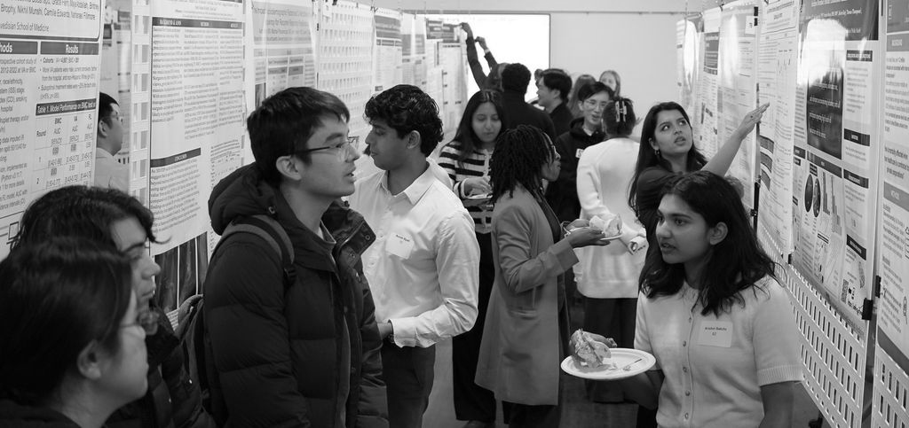
Poster sessions
  Less scripted, more time
  Lots of interactions possible
  Few restrictions on content and format
  Often the first presentation outside your group

Slide 4
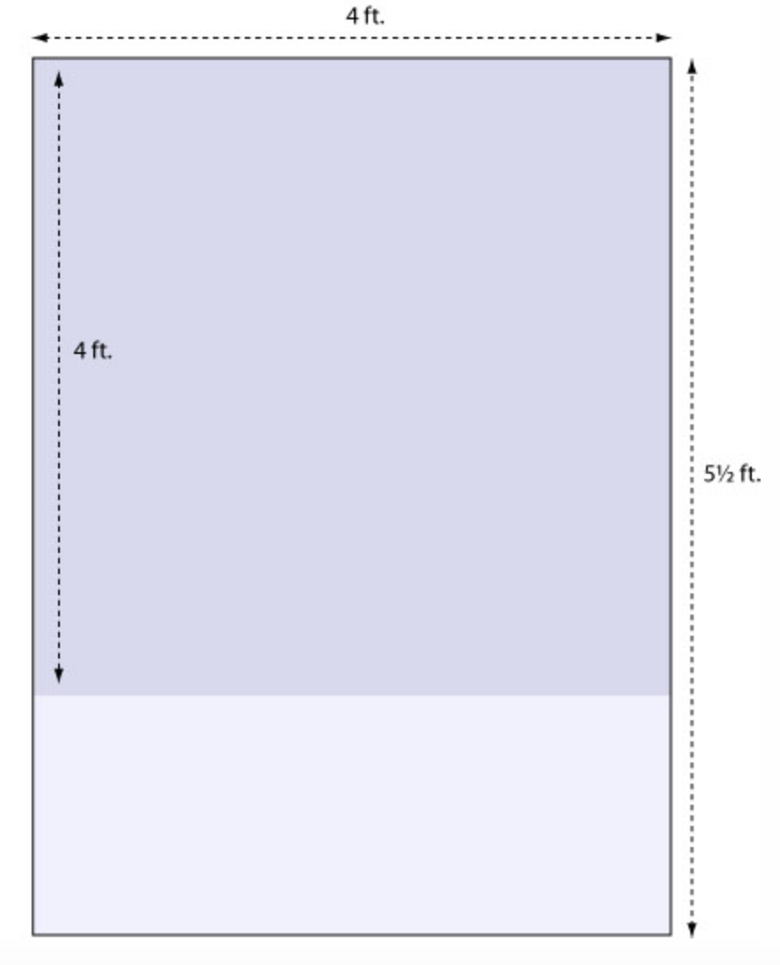
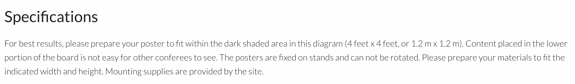
Read the directions!
Size limitations imposed by meeting
Requirements of printer

Slide 5
Read the directions!
Size limitations imposed by meeting
Requirements of printer

Slide 6
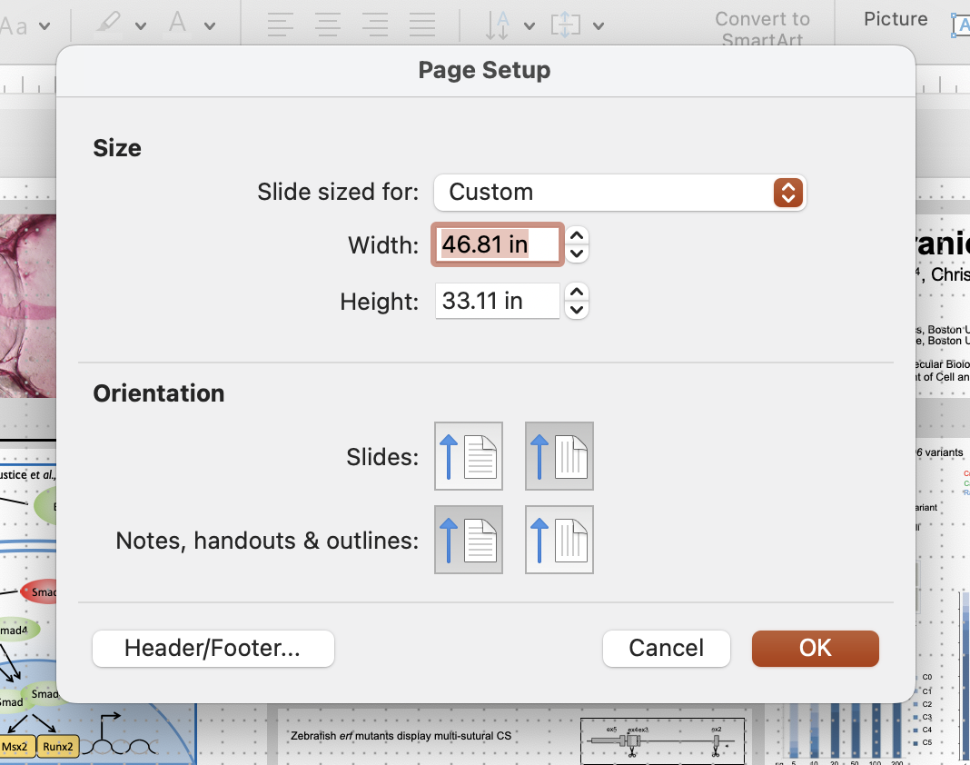
Nuts and bolts
  PowerPoint is convenient and accessible
  Set your page to the correct size before you start

Slide 7
Fonts and legibility
  Pick a font (preferably sans serif) and be consistent
b d
p q
Arial
b d
p q
Times

Slide 8
Fonts and legibility
  Pick a font (preferably sans serif) and be consistent
b d
p q
Arial
b d
p q
Times
  Less cluttered
  Easier for dyslexic readers

Slide 9
Fonts and legibility
  Large font size and fewer words
  For emphasis and titles, using bolding or larger size
Title
Subheading
Subheading
Title
Subheading
Subheading

Slide 10
Color palette
    Start with your data
    Limit the number of colors
    Consider color blindness

Slide 11


Slide 12

Coolors.co

Slide 13
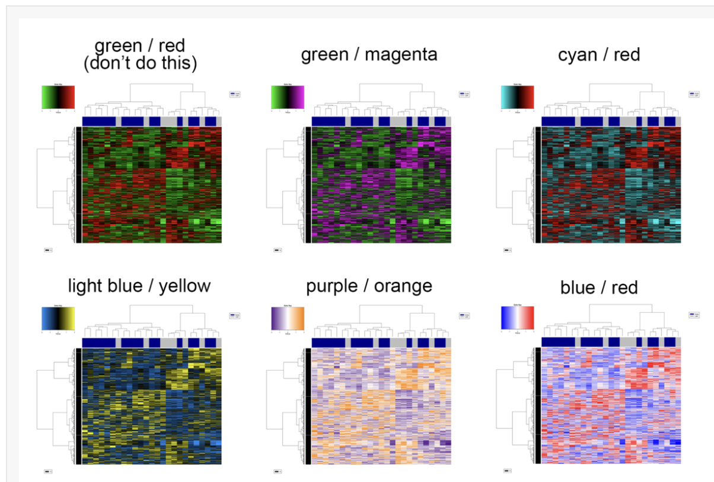
Color accessible palettes

Slide 14
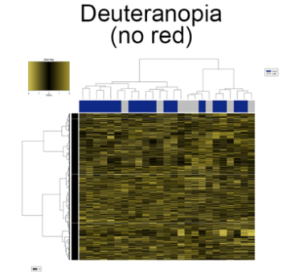
Color accessible palettes

Slide 15
Color accessible palettes

Slide 16
Components of a poster
  Introduction: why did you carry out the study?

Slide 17
Components of a poster
  Introduction: why did you carry out the study?
  Methods: what techniques and approaches did you use?

Slide 18
Components of a poster
  Introduction: why did you carry out the study?
  Methods: what techniques and approaches did you use?
  Results: what did you find?

Slide 19
Components of a poster
  Introduction: why did you carry out the study?
  Methods: what techniques and approaches did you use?
  Results: what did you find?
  Conclusions: what are your take-home messages?

Slide 20
Components of a poster
  Acknowledgements: help, materials, funding, etc.
    Future studies (could include in Conclusions)
    References (not many, could include in body of poster or group at end)

Slide 21
Components of a poster
  Acknowledgements: help, materials, funding, etc.
    Future studies (could include in Conclusions)
    References (not many, could include in body of poster or group at end)
X
Abstract

Slide 22
General design principles
  Organize in columns to be read from left to right
  Make the columns the same width and align everything

Slide 23
Not this…

Slide 24
But this!

Slide 25

Eye-catching image

Slide 26
The “No words” test
  What does your poster say if you take away all the words?
  If you work on something abstract, how can you convey the concepts visually?

Slide 27

The “No words” test
  What does your poster say if you take away all the words?
  If you work on something abstract, how can you convey the concepts visually?

Slide 28
Poster session
  Check the schedule!
  Be next to your poster at the assigned time
    You want to be there when an interested colleague shows up
    Poster judging!

Slide 29
Poster session
  Check the schedule!
  Be next to your poster at the assigned time
    You want to be there when an interested colleague shows up
    Poster judging!
  Have a 5 minute “walk through” prepared
  Tell a story (and make sure your poster matches)
  Be engaging and have fun!

Slide 30
Talks
  Can be long or short, formal or informal
  Scripted and time-limited
  Some interaction with audience

Slide 31
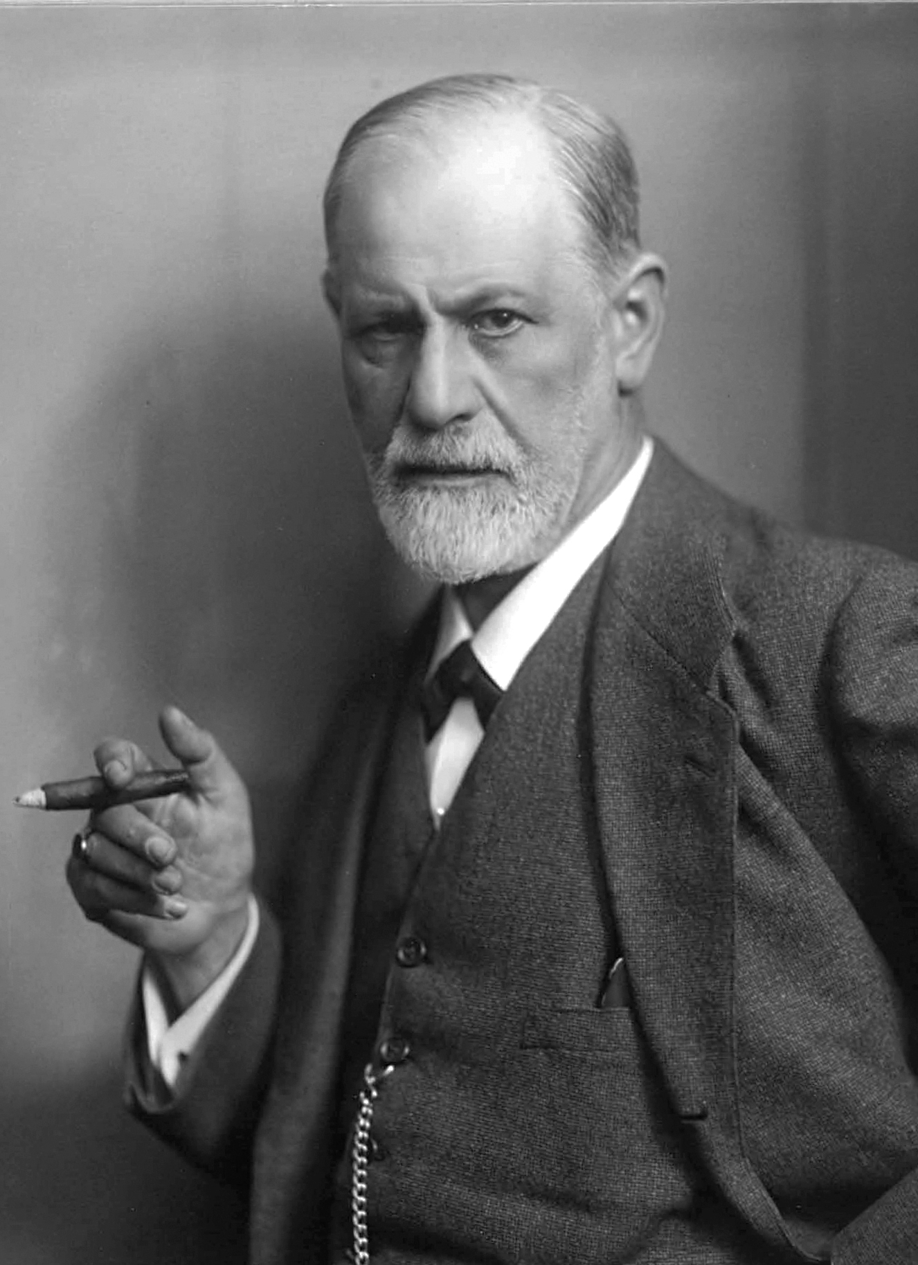

So I gave my lecture yesterday. Despite lack of preparation, I spoke quite well and without hesitation
~ Sigmund Freud,
in a letter to his fiancée Martha Bernays, 1884

Slide 32
So I gave my lecture yesterday. Despite lack of preparation, I spoke quite well and without hesitation, which I ascribe to the cocaine I had taken beforehand.
~ Sigmund Freud,
in a letter to his fiancée Martha Bernays, 1884

Slide 33
So I gave my lecture yesterday. Despite lack of preparation, I spoke quite well and without hesitation, which I ascribe to the cocaine I had taken beforehand. I told about my discoveries in brain anatomy, all very difficult things that the audience certainly didn’t understand
~ Sigmund Freud,
in a letter to his fiancée Martha Bernays, 1884

Slide 34
So I gave my lecture yesterday. Despite lack of preparation, I spoke quite well and without hesitation, which I ascribe to the cocaine I had taken beforehand. I told about my discoveries in brain anatomy, all very difficult things that the audience certainly didn’t understand, but all that matters is that they get the impression that I understand it.
~ Sigmund Freud,
in a letter to his fiancée Martha Bernays, 1884

Slide 35
Preparation
Know your material
Talk about your project and answer questions
  Lab meetings, etc.
  Discussions with your peers
What is your main point?
  You only have time for one in a short talk

Slide 36
Preparation
Short talks are hard to give!
~1 slide/minute
Write out what you want to say
Practice, practice, practice!

Slide 37
Preparation
Know your audience
Give sufficient background
Define terms and acronyms, avoid jargon

Slide 38
Organization
Background
Why am I working on this problem?
Hypothesis
Methods
What was the data and how did we analyze it?

Slide 39
Organization
Results
Bulk of talk
Limitations, challenges
Conclusions
Major take-home message(s)
Future implications, next steps
Acknowledgements
Names of mentor, other team members

Slide 40
Slide design
Minimal words (<20/slide)
Effective graphics
Titles are optional
Assertion-evidence slide

Slide 41
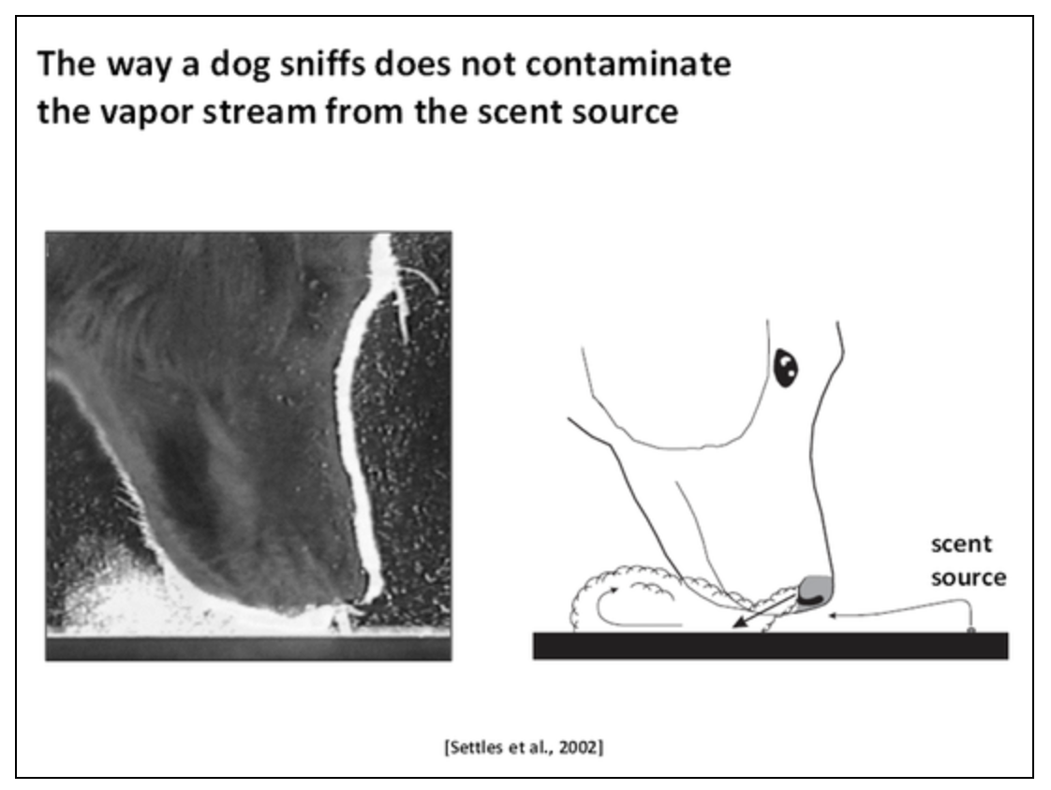
Assertion
Evidence

Slide 42
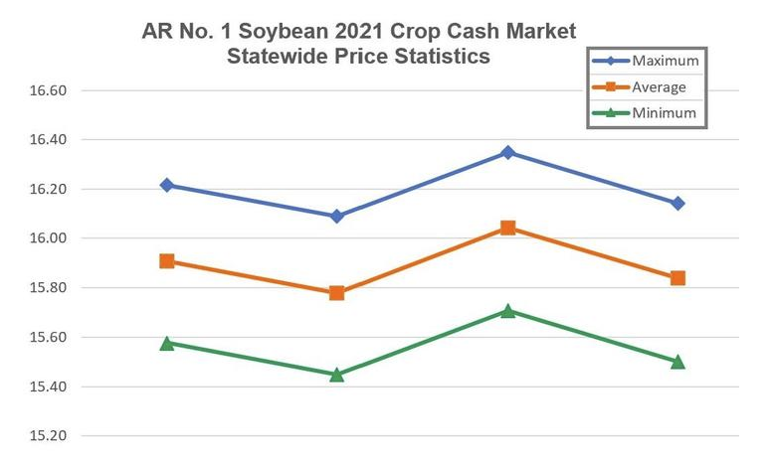
Shape differences
https://accessibility.huit.harvard.edu/data-viz-charts-graphs

Slide 43
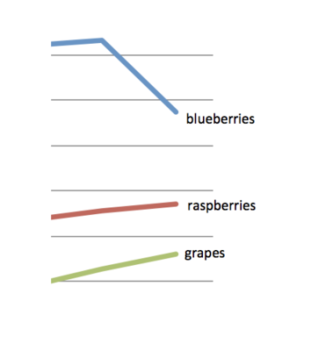
Direct labeling

Slide 44
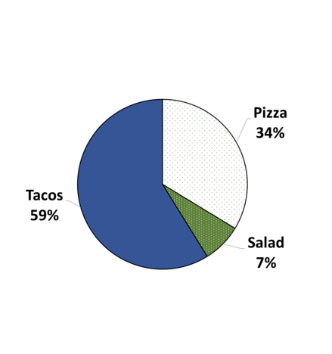
Data point callouts

Slide 45
Presentation
Speak to your audience
Use plain language
Define key terms

Slide 46
Resources
betterposters.blogspot.com: Website with lots of design tips, examples of good and bad posters
coolors.co: Tools to pick color palettes
www.ascb.org/science-news/how-to-make-scientific-figures-accessible-to-readers-with-color-blindness/
Ten Simple Rules for a Good Poster Presentation (https://journals.plos.org/ploscompbiol/article?id=10.1371/journal.pcbi.0030102)

Slide 47
Resources
https://catalyst.harvard.edu/writing-communication-center/visualize-science/: many tips about slide and poster design
https://www.howtogiveatalk.com/: blog by David Stern with some controversial but mostly good advice

