Slide 1



Intro to Using
Evidence-Based Practices in Graduate Education Research
John Vasquez, Ph.D., M.H.S.A.
Director of Assessment &
Professional Development
Van Andel Institute Graduate School
Committee Member
Master of Health Professions Education Program
University of Michigan Medical School
Evaluation & Assessment

Slide 2
Agenda
Evaluation vs. Assessment
Equity-Minded Assessment (Readings)
Using Qualitative Research in Assessment & Evaluation (Example)
Evaluation & Assessment Framework

Slide 3
Evaluation vs Assessment

Slide 4
Evaluation vs Assessment
How do we know programs are effective?
What skills do these programs address and what skills are missing or underutilized?
What are the biggest challenges facing trainee's engagement in and faculty support for these programs?
Notes:
Another example, in 2015, AMA identified 9 challenges medical educators want to solve right now:
New ways to make medical training more patient-centered
How to exclude redundant information from a redesigned curriculum
Strategies for increasing diversity in medical education
Creating specialized curriculums for a “medical school"
How massive open online courses fit into future medical schools walls”
Health care delivery science and the physician of the future
The challenges new medical schools encounter as a result of limited time and funding for programs
Whether Step 1 of the United States Medical Licensing Examination should be pass or fail
Effective ways to shorten student training

Slide 5
Evaluation vs Assessment
Assessment
”Any systematic method of obtaining information from tests and other sources, used to draw inferences about characteristics of people, objects, or programs.”
AERA
APA
NCME
How do we know programs are effective?
What skills do these programs address and what skills are missing or underutilized?
What are the biggest challenges facing trainee's engagement in and faculty support for these programs?
Notes:
Citation: American Educational Association, American Psychological Association, & National Council on Measurement in Education. (1999). Standards for educational and psychological testing. Washington, D.C.: American Educational Research Association.

Slide 6



Evaluation vs Assessment
Evaluation
” seeks to address critical questions concerning how well a program is working and is typically under-taken for decision-making purposes; findings are then used by a variety of stakeholders to determine the merit, worth, and/or value of a program.”
How do we know programs are effective?
What skills do these programs address and what skills are missing or underutilized?
What are the biggest challenges facing trainee's engagement in and faculty support for these programs?
Notes:
Citation: D. Russ-Eft & H. Preskill. (2009). Evaluation in Organizations: A Systematic Approach to Enhancing Learning, Performance and Change (2nd ed.). New York, NY: Basic Books.
(Russ-Eft & Preskill, 2009, p. 6).

Slide 7
Evaluation vs Assessment
Evaluation
Does
(Action)
Shows How
(Performance)
” seeks to address critical questions concerning how well a program is working and is typically under-taken for decision-making purposes; findings are then used by a variety of stakeholders to determine the merit, worth, and/or value of a program.”
Knows How
(Competence)
Knows
(Knowledge)
George Miller’s Pyramid (Miller, 1990)
How do we know programs are effective?
What skills do these programs address and what skills are missing or underutilized?
What are the biggest challenges facing trainee's engagement in and faculty support for these programs?
Notes:
Miller’s pyramid can be a useful construct for guiding thinking about teaching and assessment in the health professions.
Knowledge – base of pyramid, foundation on which all other important aspects or features of learning in health professions rest – prereq for al other types of learning; best measured by written exams and traditional multiple-choice questions (MCQs)
Knows how – cognitive knowledge, student’s ability to manipulate knowledge in some useful way, to apply this knowledge, to be able to demonstrate some understanding of relationships between concepts & principles and ability to describe solutions to some types of novel problems; assessed by essays, clinical problem-solving exercises and extended MCQs, oral exams.
Shows how – moves the method of assessment towards performance methods and away from traditional written tests of knowledge; simulated patients to assess the communication skills of medical students
Does – highest level, associated with more independent and free-range observations of the student’s performance in actual patient or clinical settings;

Slide 8
Evaluation vs Assessment
Strongly Disagree
Disagree
Neither Agree nor Disagree
Agree
Strongly Agree
The assessment process during residency motivated me to learn more during residency
The residency assessment program during my residency was fair.
I was evaluated with various assessment methods (i.e. verbal feedback, midpoint evaluations, portfolio)
The activities I was assessed on match stated educational goals.
The assessment program covered assessment of all competency areas required in my residency training.
A Likert Scale
Evaluation
” seeks to address critical questions concerning how well a program is working and is typically under-taken for decision-making purposes; findings are then used by a variety of stakeholders to determine the merit, worth, and/or value of a program.”
Dissatisfied
Somewhat Satisfied
Satisfied
Very Satisfied
A Likert –type Scale
How do we know programs are effective?
What skills do these programs address and what skills are missing or underutilized?
What are the biggest challenges facing trainee's engagement in and faculty support for these programs?
Notes:
Shah, S., McLaughlin, J. E., Eckel, S. F, Mangun, J., & Hawes, E.. (2016). Evaluating the Quality of Competency Assessment in Pharmacy: A Framework for Workplace Learning. Pharmacy, 4(1), 4.

Slide 9
Evaluation
Product-oriented
What did you learn?
What were some outcomes?
Judgmental
Arrive at an overall grade/score/decision
Assessment
Process-oriented
How is learning going?
How did we get here?
Diagnostic
Identify areas for improvement
Summative
Final summation used
to gauge quality
Formative
Ongoing inquiry used
to improve individual learning or processes
Evaluation
” seeks to address critical questions concerning how well a program is working and is typically under-taken for decision-making purposes; findings are then used by a variety of stakeholders to determine the merit, worth, and/or value of a program.”
How do we know programs are effective?
What skills do these programs address and what skills are missing or underutilized?
What are the biggest challenges facing trainee's engagement in and faculty support for these programs?
Notes:
Content adapted from:
Angelo, T and Cross, K.P. 1993. Classroom assessment techniques a handbook for college teachers. Jossey-Bass A Wiley Imprint, San Francisco, CA. Pp 427.
Assessment of Student Learning in STEM disciplines. A Duke University ‘Teaching IDEAS workshop’ presented by Ed Neal, Ph.D. Director of Faculty Development, Center for Teaching and Learning, University of North Carolina.
Content: timing, primary purpose
Orientation: focus of measurement
Findings: uses thereof

Slide 10
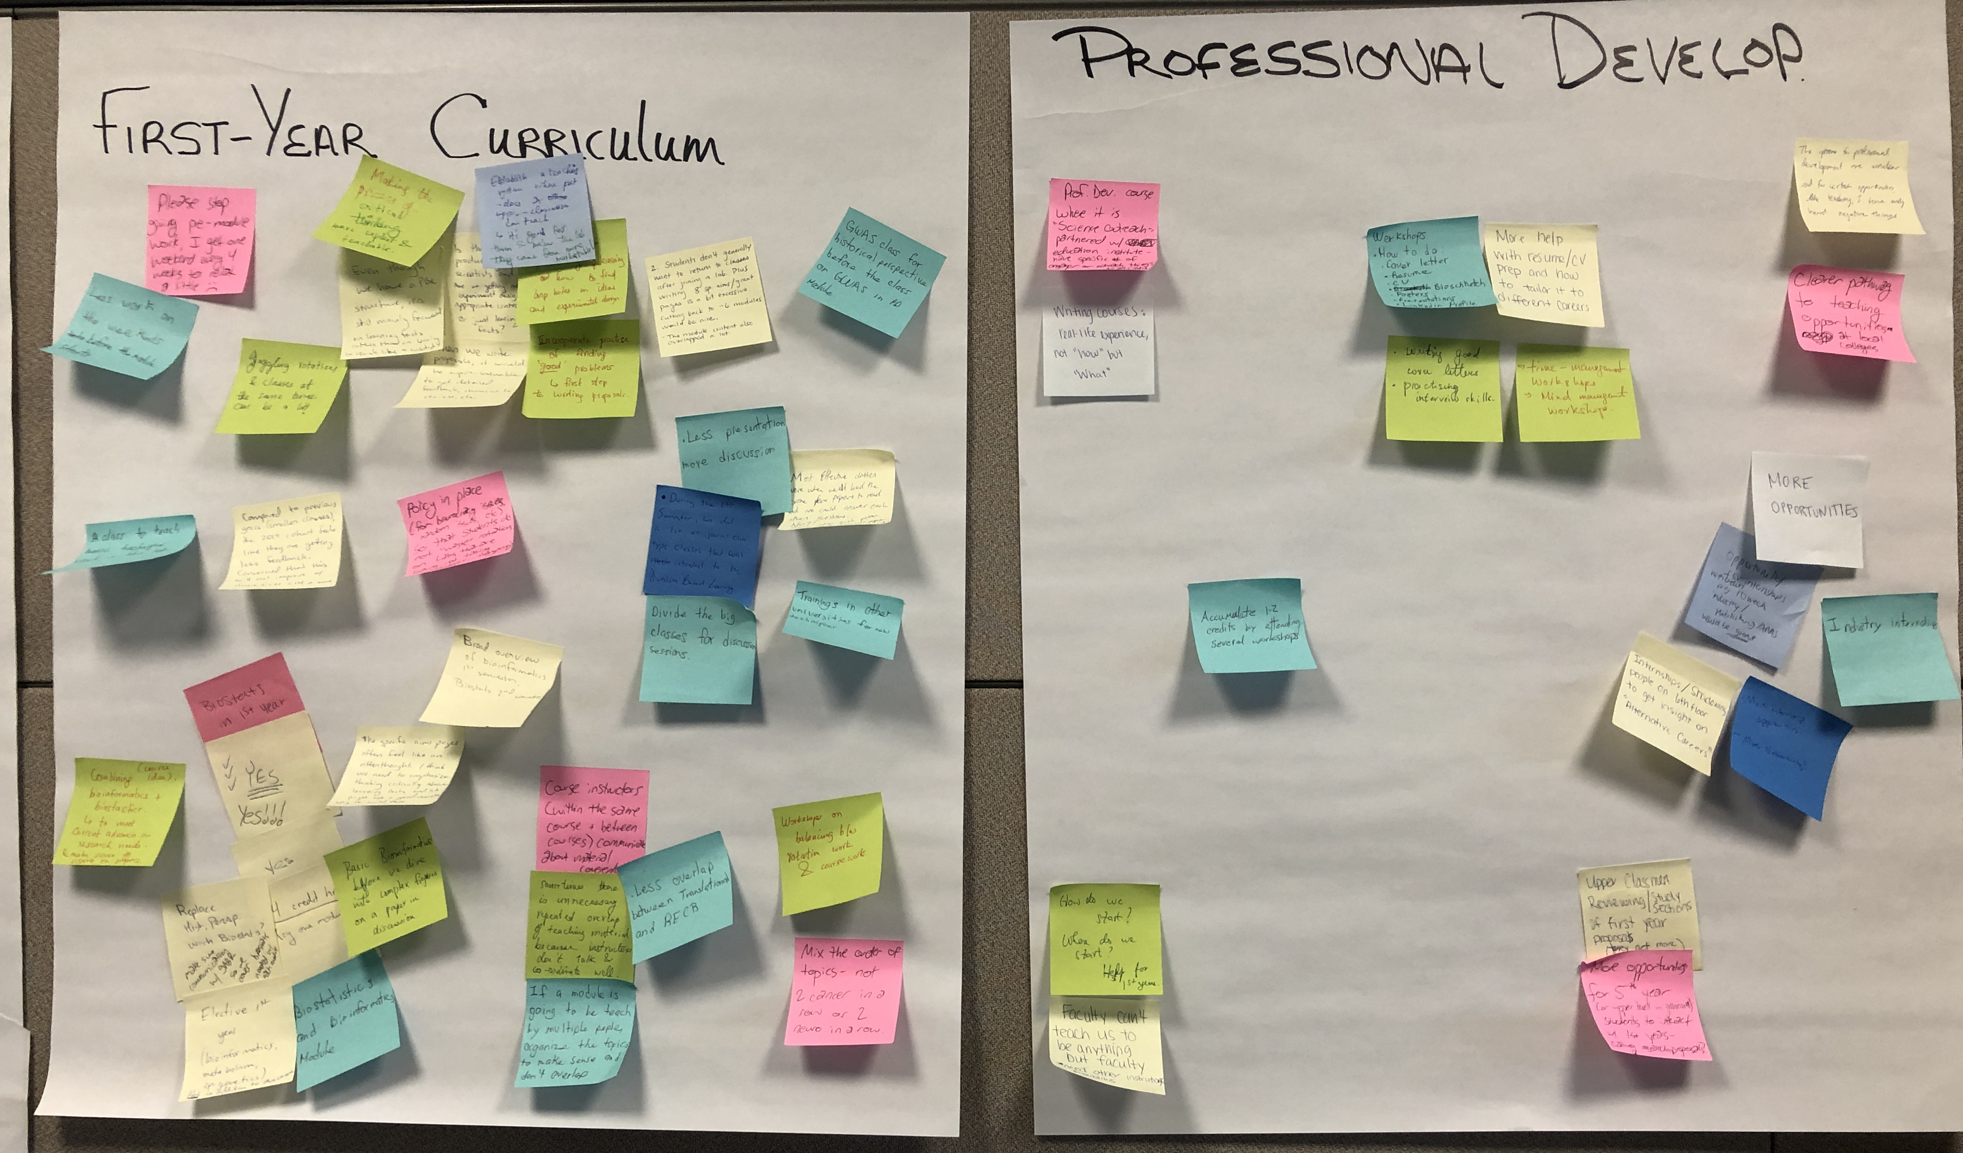
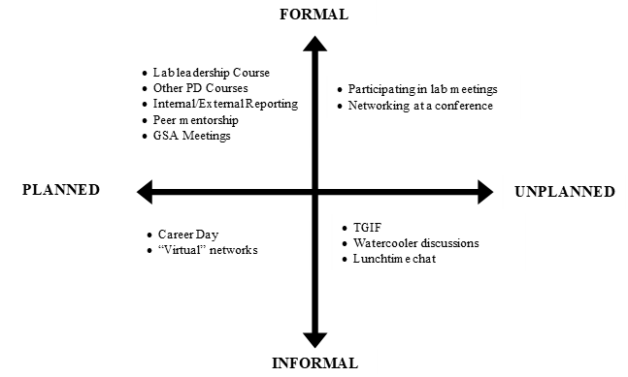
Clinical Courses
Professional Development Courses
Rounds
Networking at conferences
Clinical rotations
Bedside
Social events
Watercooler discussions
Lunchtime chats
Question:
Where does learning happen?
Formal curriculum
Bedside, Clinic
????
Notes:
Focus groups one of the most widely used and widely useful methods of qualitative research, especially for applied research used in developing polices and programs. The number of participants should be enough to make the discussion engaging, but not so many that the size inhibits engagement, about 6 to 12 (Remler & Ryzin, pg. 70).
Start with an open, easy general discussion: What are some issues or concerns you have in your everyday life as a trainee?
Steer the discussion towards a topic: What are some of your specific concerns, or issues regarding ______________? What is not working or could work better?
Focus on a specific topic by using probing questions (not all at the same time!): You’ve brought up __________ in your current discussion. Can you tell me more about that? What kinds of___________? Where, when, etc.
Confirm/validate points

Slide 11
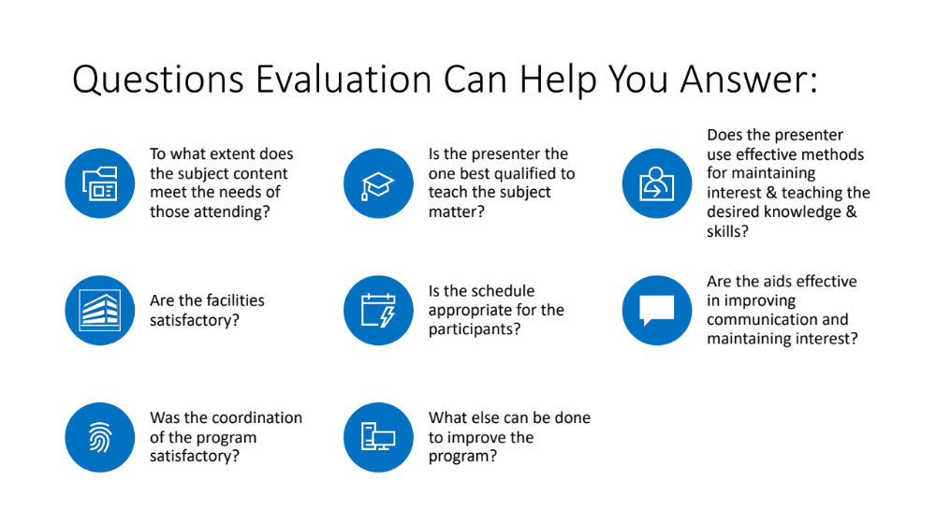
Questions Evaluation Can Help You Answer:
To what extent does the subject content meet the needs of those attending?
Is the presenter the one best qualified to teach the subject matter?
Does the presenter use effective methods for maintaining interest & teaching the desired knowledge & skills?
Are the facilities satisfactory?
Is the schedule appropriate for the participants?
Are the aids effective in improving communication and maintaining interest?
Was the coordination of the program satisfactory?
What else can be done to improve the program?
Program Reviews

Slide 12

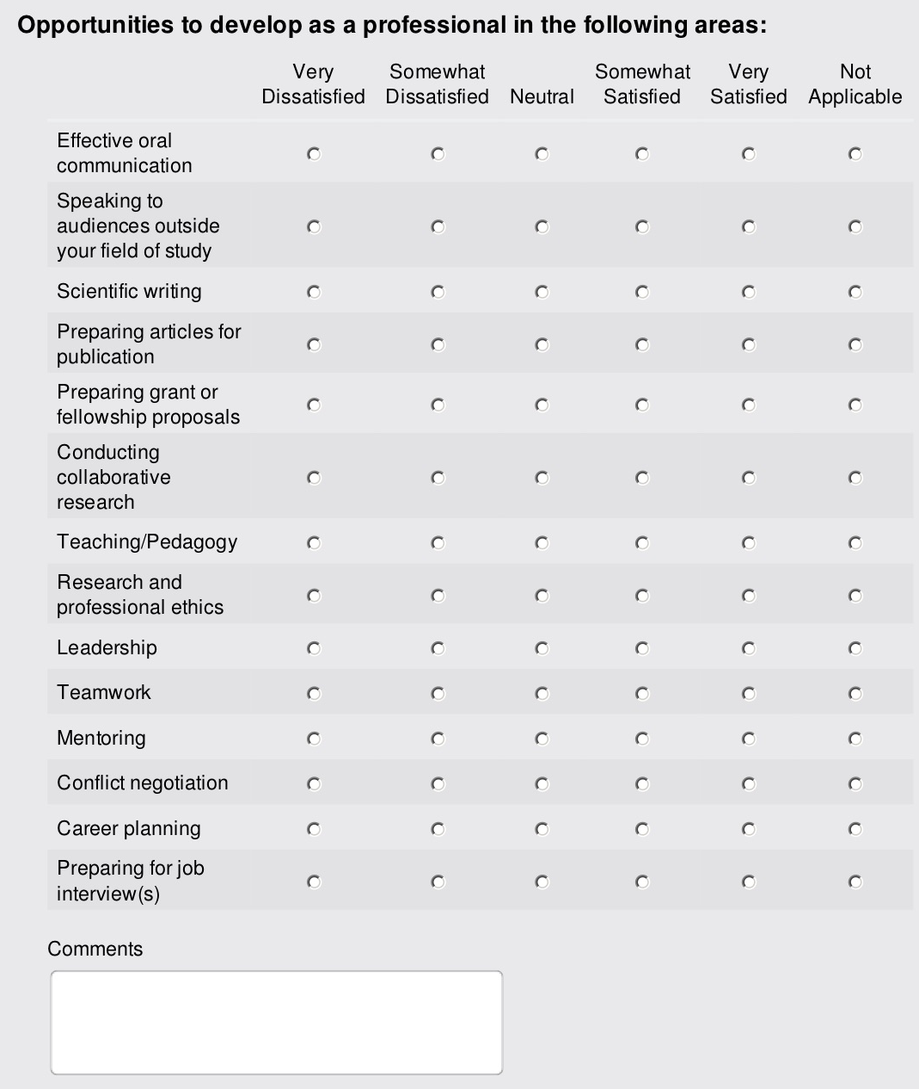

91%
(Focus Group Response)
Writing course should focus on real-life,
not “how” but “what”
This Photo by Unknown Author is licensed under CC BY-NC-ND

Slide 13
Clinical Courses
Professional Development Courses
Rounds
Networking at conferences
Clinical rotations
Bedside
Social events
Watercooler discussions
Lunchtime chats
Question:
What do we want to know about learning in the context of….
Formal curriculum
Bedside, Clinic
????
Where does learning happen?

Slide 14

Pause for
Questions???

Slide 15

Equity-minded assessment entails the following actions:
Check biases and ask reflective questions
Use multiple sources of evidence
Include student perspectives and act based on their perspectives.
Increase transparency in assessment results and actions taken.
Ensure collected data can be meaningfully disaggregated and interrogated.
Make evidence-based changes that address issues of equity that are context-specific.

Slide 16
Key Points from the Articles
URMs tend to self-censor, especially in environments where they are continually marginalized and/or are the recipients of consistent bias and aggression.
URMs tend to question their ability or worth
URMS adjust their behavior and natural forms of expression to a “protocol of don’ts”

Slide 17
Discussion Questions Related to Equity-minded Assessment from Readings
What signals have you picked up that under-represented trainees in your department or discipline may have similar experiences as those described in the paper?
  How has your department or program formally gathered information about the experiences of URM trainees?
  How are they using that information?
Given recent events, how are you and your colleagues thinking about how you might assess your practices in serving, informal rules, and expectations of trainees? How are you centering the voices of and protecting against undue emotional labor by under-represented colleagues and trainees in this process?
From your perspective, how does the culture of health professions education (i.e.. practices, informal rules, policies, expectations) contribute to trainees’ racialized experience being “hidden” or “ignored” by faculty, staff, administrators, or even patients?”

Slide 18
Table 2. Paradigm Assumptions
Assumption | Question | Quantitative | Qualitative
Ontological | What is the nature of reality? | Reality is objective and singular, apart from the researcher. | Reality is subjective and multiple as seen by participants in a study.
Epistemological | What is the relationship of researcher to the researched? | Researcher is independent from that being researched. | Researcher interacts with that being researched.
Axiological | What is the role of values? | Value-free and unbiased | Value-laden and biased
Rhetorical | What is the language of research? | Formal Based on set definitions Impersonal voice Use of accepted quantitative words | Informal Evolving decisions Personal voice Accepted qualitative words
Methodological | What is the process of research? | Deductive process Cause and effect Static design - categories isolated before study Context-free Generalizations leading to prediction, explanation, and understanding Accurate and reliable through validity and reliability | Inductive process Mutual simultaneous shaping of factors Emerging design - categories identified during research process Context-bound Patterns, theories developed for understanding Accurate and reliable through verification
Notes:
Source: Based on Firestone (1987); Guba & Lincoln (1988); McCracken (1988).

Slide 19
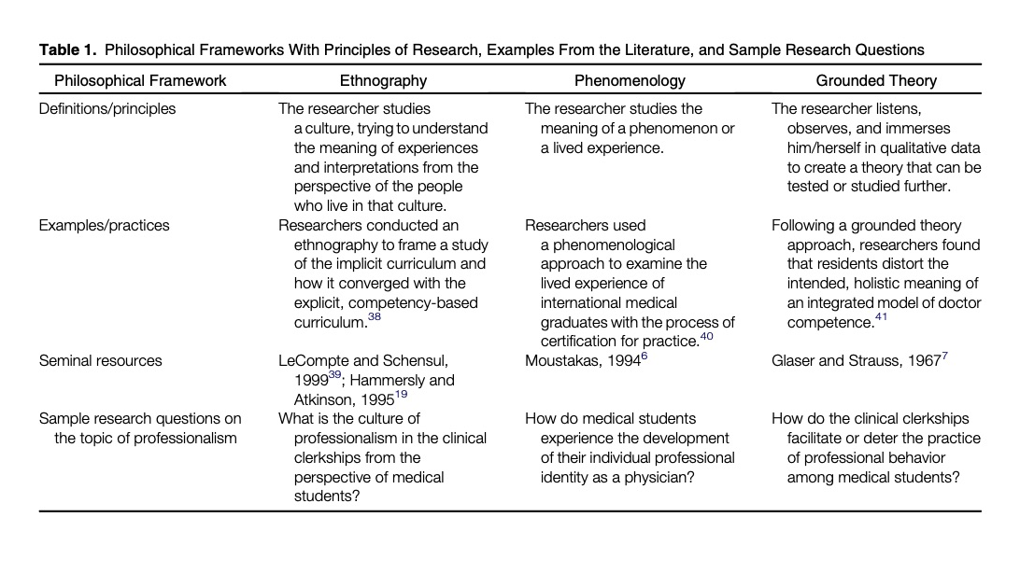
Hanson, Et. al, pg. 376

Slide 20

Evaluation & Assessment Framework
Kirkpatrick and Phillip’s Five Level Framework

Slide 21
Evaluation & Assessment Framework
Level 1: Reaction and Satisfaction
Level 2: Learning
Level 3: Application & Implementation
Level 4: Business Impact
Level 5: Return on Investment

Slide 22
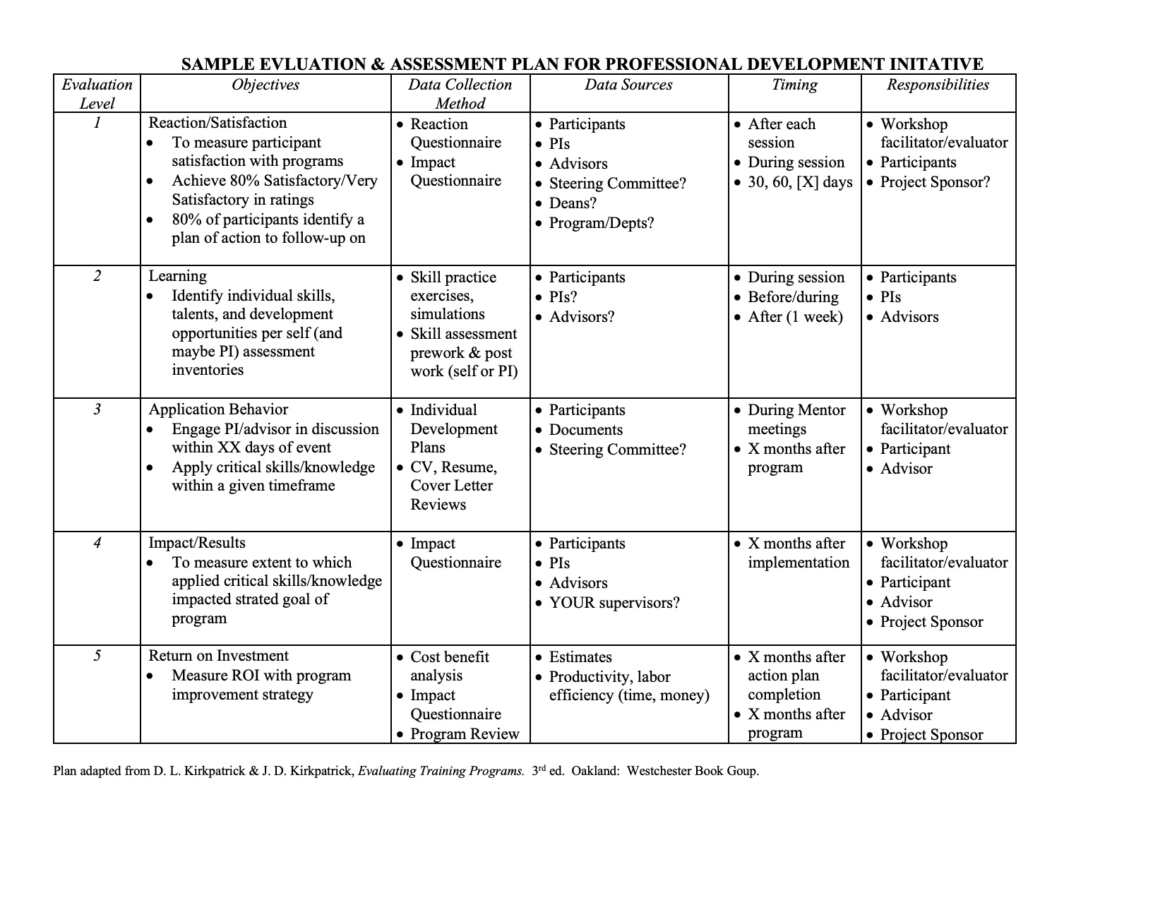
Evaluation & Assessment Framework

Slide 23

Evaluation & Assessment Framework

Slide 24



Slide 25
Contact Information
John A. Vasquez, PhD
Director for Assessment & Professional Development
John.Vasquez@vai.edu
vaigs.vai.org
www.johnvasquezphd.com

Slide 26
References
American Educational Association, American Psychological Association, & National Council on Measurement in Education. (1999). Standards for educational and psychological testing. Washington, D.C.: American Educational Research Association.
Angelo, T and Cross, K.P. 1993. Classroom assessment techniques a handbook for college teachers. Jossey-Bass A Wiley Imprint, San Francisco, CA. Pp 427.
Assessment of Student Learning in STEM disciplines. A Duke University ‘Teaching IDEAS workshop’ presented by Ed Neal, Ph.D. Director of Faculty Development, Center for Teaching and Learning, University of North Carolina.
D. Russ-Eft & H. Preskill. (2009). Evaluation in Organizations: A Systematic Approach to Enhancing Learning, Performance and Change (2nd ed.). New York, NY: Basic Books.
Miller, G. (1990). The assessment of clinical skills/competence/performance. Academic Medicine, 65(9), S63-7.
Shah, S., McLaughlin, J. E., Eckel, S. F, Mangun, J., & Hawes, E.. (2016). Evaluating the Quality of Competency Assessment in Pharmacy: A Framework for Workplace Learning. Pharmacy, 4(1), 4.

