Slide 1
Self-Reflective Tool Workshop
Prepared by Afaf Hourani
Supervised by Drs. Lindsay Demers and Molly Cohen-Osher
Notes:
Hello Everyone, I am honored and humbled to be standing before you and thankful to the GMS HSE program for affording me the opportunity to present this workshop by merging my prior experience with teachings I received from great faculty.
I am the AD of the… and I am currently enrolled in the Masters of HSE program.
Thank you for attending this workshop.

Slide 2
Outline
Introduction and Pre-survey
Learning Objectives
Review of Concepts
Situations Self-Reflective Tool SRT can help
SRT Application
SRT Discussion Group
Post-Survey
Adjourn
Notes:
I would recommend changing discussion to before post-survey, but not sure if there is a reason you have it this way…

Slide 3
Learning Objectives
By the end of this workshop learners will be able to:
Describe the importance of reflection for healthcare professionals
Discuss the intersection of mindfulness and experiential learning
Discuss the role of reflection in professionalism
Observe and analyze thoughts and feelings through deep breathing and acceptance
Evaluate and apply new perspectives using SRT
Notes:
You have the option of engaging in a study that we are conducting on this workshop. We will take five minutes NOW to complete : SRT pre-survey if you wish to be in the study.

Slide 4
“We Do Not Learn from Experience, We Learn from Reflecting on Experience”
John Dewey 1859-1952

Slide 5
Reflection-on-Action: a Process in Which Individuals Reflect on Actions and Thoughts After They Have Taken Place
Donald Schön, 1987

Slide 6
Experiential Learning Theory (ELT)
(Kolb, 1984)
  The process whereby knowledge is created through the transformation of experience.
  Knowledge results from the combination of grasping and transforming experience

Slide 7
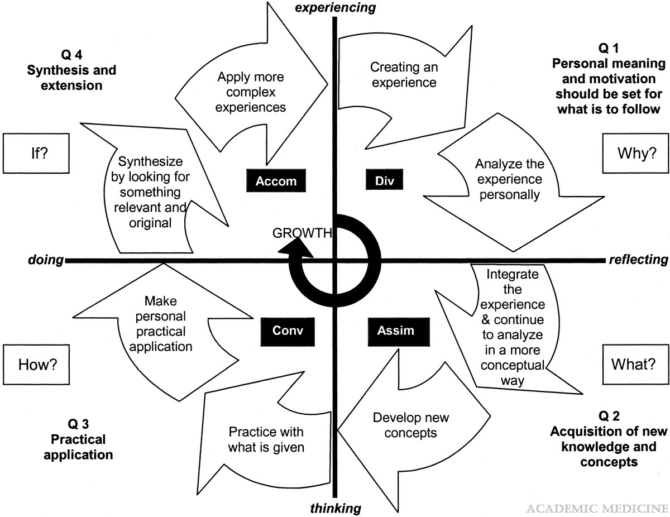
Figure 2
Every learning experience should begin at quadrant 1 and move through the cycle shown in the figure to its natural conclusion in quadrant 4.
Grasp and Transform
Shift from thinking to doing
Notes:
How Can Physicians’ Learning Styles Drive Educational Planning?
Armstrong, Elizabeth; Parsa-Parsi, Ramin
Academic Medicine 80(7):680-684, July 2005.
doi:
Illustration of learning styles

Slide 8

Mindfulness being present in the moment, non-judgmental and purposeful
Mindfulness comprises two types:
Meditative mindfulness, the Eastern ancient secular practice which is the core of Buddhist meditation (Kabat Zinn, 1994)
Socio-cognitive mindfulness, the Western modern type, developed by social psychologists (EJ Langer in 1997)
Notes:
Now let us look at some definitions

Slide 9
Mindfulness Experiential Learning is the socio-cognitive stream of mindfulness in Experiential Learning
(Yeganeh, Kolb, 2009)
Mindfulness helps us understand the processes by which the mind is aware, intentionally and accepting
Experiential Learning Theory helps us understand the mental architecture of learning
Using the two together unlocks a powerful tool for empowered adult learning in organizations
Notes:
Do you have questions for me

Slide 10
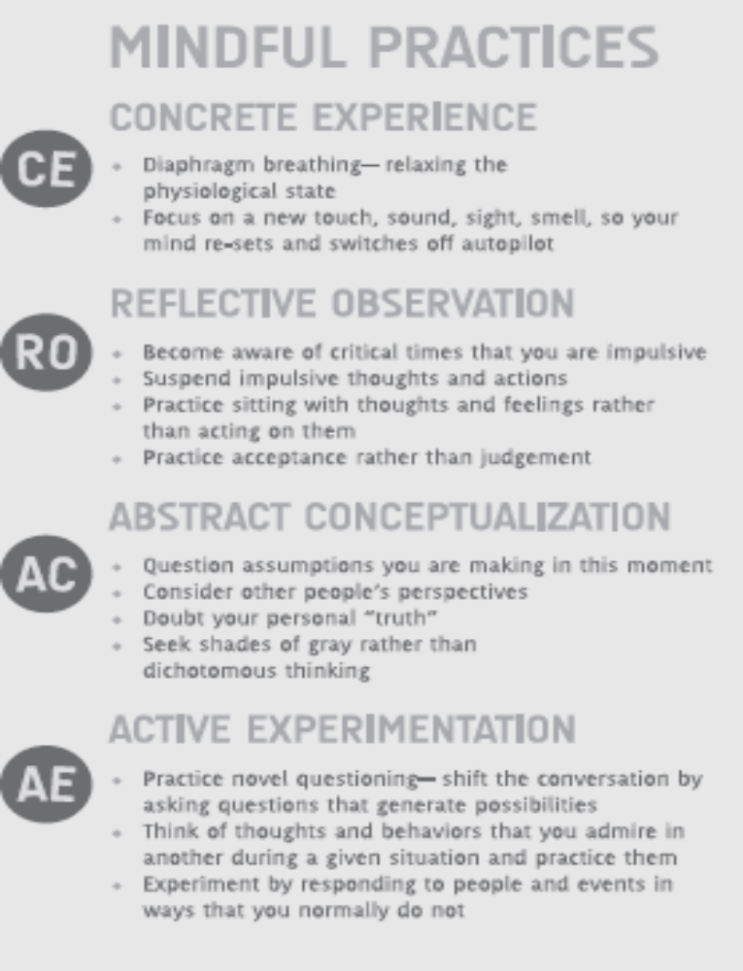
Mindful Experiential Learning Practice Guide by Yeganeh, Kolb 2009
Notes:
I would put this down here, so you demonstrate what you just said on the last slide about putting the two of them together…

Slide 11
Socio-cognitive Mindfulness
The process of drawing novel distinctions leading to greater attention to the present moment and sensitivity to context
(EJ Langer,1997)

Slide 12
When we are mindful, we implicitly or explicitly
  view a situation from several perspectives
  see information presented in the situation as novel
  attend to the context in which we perceive the information, and eventually
  create new categories through which this information may be understood
  (EJ Langer,1997)

Slide 13
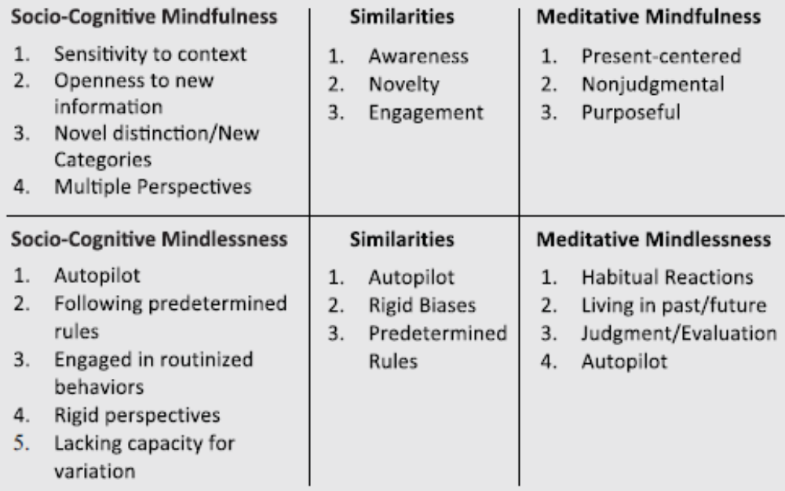
Mindlessness ≠ Mindfulness
Meditative and Socio-Cognitive Mindfulness/Mindlessness Comparison
(Yeganeh/Kolb 2009)

Slide 14
In this workshop, we have adopted the approach as shown above
and
developed a modified version to be used for reflection as shown below
Notes:
Distribute SRT development forms which attendees can keep

Slide 15
Situations that the Self-Reflective Tool Can Help
Encounter of concern during practice with patients or colleagues
Unprofessional act
Unsatisfactory outcome of a procedure
Aggressive encounter
Unresponsiveness to a situation in need
Unconscious biases –ve or +ve
Any situation a person is not satisfied with the outcome

Slide 16
Our Family Secrets: On Being a Doctor
Annals of Internal Medicine
Doctors do encounter situations that need to be addressed through reflection:
to help themselves to overcome the feelings of helplessness
to be prepared to pass on professional behaviors to their students.
Notes:
No need to go over the story. I am not going to talk about it, just simply refer to it as an encounter that happens and have copies of the article available.
This story shows the lack of professionalism and points to the importance of using a reflection tool when an encounter happens. Had this doctor been taught to reflect on the encounter while he was a 3rd year medical student, he would have been better prepared to teach his students a lesson on professionalism. He missed the opportunity because he was not prepared himself and his students were left with no answers on how to behave in the future.

Slide 17
SRT
1-Practice Here & Now
2- Identify Issue of Concern
3- Observe, Examine, Stop Auto-Pilot
4- Distraction is Natural
5- Learn from the Experience by Reflecting on it
6- Experiment and Apply New Perspectives
7- Internalize the New Perspective
8- Repeat and Replay Mentally
Notes:
I will discuss each item and at the end we will take ten minutes to create your own SRT using the form.

Slide 18
1-Practice Here & Now
intentionally
deep breathing
calming left nostril breathing
any other relaxation modality
be mindful of presence in the moment

Slide 19
2- Identify Issue of Concern
become aware of a challenging situation
difficult encounter
any situation you are not completely satisfied with

Slide 20
3- Observe, Examine, Stop Auto-Pilot
observe and examine existing issue
all angles
without judgment
doubt and question your own assumptions
and perspectives

Slide 21
4- Distraction is Natural
just observe other thoughts
without judgement
take a deep breath
go back the issue in question

Slide 22
5- Learn from the Experience by Reflecting on it
  look at the situation with new lenses by reframing the situation
  consider other perspectives

Slide 23
6- Experiment and Apply New Perspectives
  practice novel questioning
  be mindful of how you would want the situation to be
  Take a deep breath, hold and release with a sigh of relief

Slide 24
7- Internalize the New Perspective
embrace the new perspective
hold such feeling
gain insight of this reflection

Slide 25
8- Repeat and Replay Mentally
inserting a new habit into the subconscious mind
takes weeks to few months

Slide 26
Tips
Just be an observer of your thoughts
How to stop auto-pilot: take deep breathing and refocus
Be intentional and non-judgmental
Distraction is natural – when your mind wanders just refocus
Refocusing rewires the brain to exercise memory for calmness
Experiment this exercise in other situations that need resolve
Notes:
You can take few minutes to reflect on your issue
You can share it if you feel like it.
Now we can take 10 minutes for a discussion group
Then we can take 5 minutes to complete the post-survey.

Slide 27
You can take few minutes to reflect on the issue
You can share it if you feel like it
Now we can take 5 minutes for a discussion group
Then we can take 5 minutes to complete the Post-survey
Notes:
I would have them fill out the post-survey after the discussion

Slide 28
Discussion Group (Answers are confidential)
Q1 Why were you interested in participating in the SRT workshop?
Q2 What were the most valuable aspects of the SRT workshop for you?
Q3 What would have made your experience at the SRT workshop more valuable?
Q4 Do you have recommendations for how we can improve the workshop in the future?
Q5 Are there any other aspects of the workshop process that you would be interested in having additional training for? Workshop, seminar, follow-up survey, etc.
Q6 Do you have any other comments that have not yet been addressed?
Q7 Do you plan to commit using SRT on yourself?
  o Definitely yes
  o Probably yes
  o Might or might not
  o Probably not
  o Definitely not

Slide 29
Thank you for your attention

