Slide 1
Leading Change
DoM Admin Grand Round
Sept 19th 2017
Mick Verran

Slide 2

The pace of change in healthcare is accelerating.

Slide 3
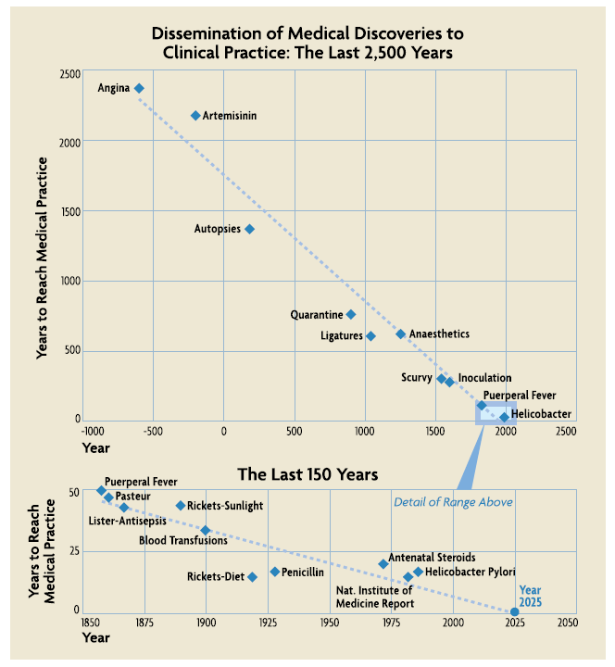
The pace of change in healthcare is accelerating.
https://www.cs.umd.edu/~ben/papers/Gillam2009healthcare.pdf

Slide 4
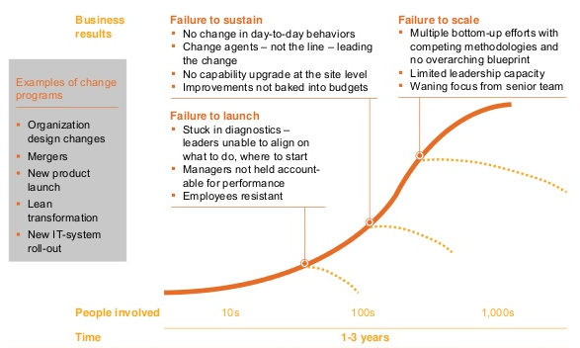
70% of change efforts fail to achieve the target impact.
McKinsey Quarterly Transformation Executive Survey 2008

Slide 5


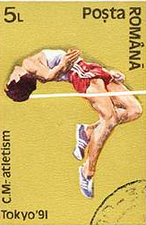

Winning height – men’s high-jump, Summer Olympics
Significant change in behavior is usually required to achieve and sustain gains.
2.6
2.4
2.2
2
1.8
1.6
Fosbury
Flop
Western
Roll
Straddle
Scissors
1896 1920 1940 1960 1980 2000

Slide 6
Five perceived attributes of an innovation seem to explain how quickly it will be adopted.
How visible the results of the innovation are to observers;
The relative advantage of the innovation over prior ideas;
Its complexity;
How easily a potential adopter can try the innovation;
Its compatibility with the beliefs, values, needs, and experiences of the potential adopter.
Rogers EM. Diffusion of Innovations. 5th ed. New York: Free Press; 2003
Notes:
http://www.psychiatrictimes.com/articles/diffusion-medical-innovation
https://www.cs.umd.edu/~ben/papers/Gillam2009healthcare.pdf

Slide 7
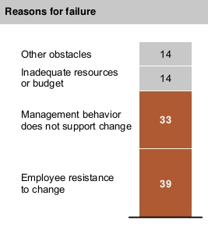
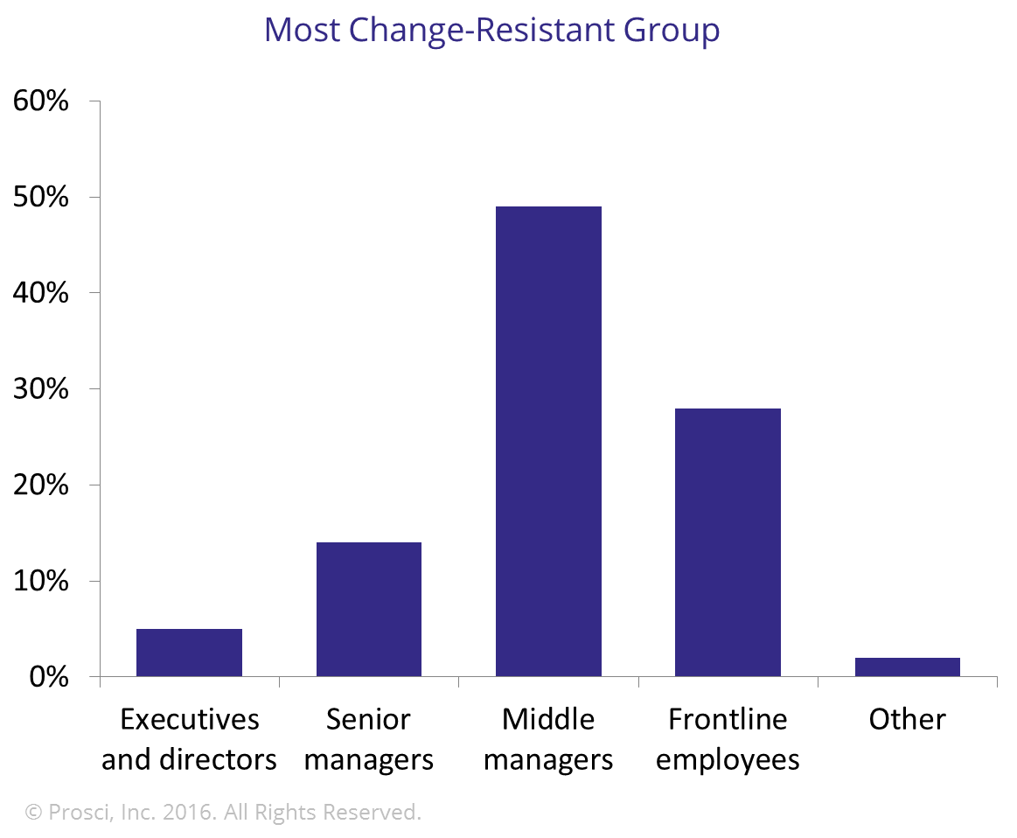
Front-line leaders are vital to success …,
McKinsey (ibid.) + Prosci survey of 4,500 change leaders
Notes:
4 boxes; 2 hidden

Slide 8
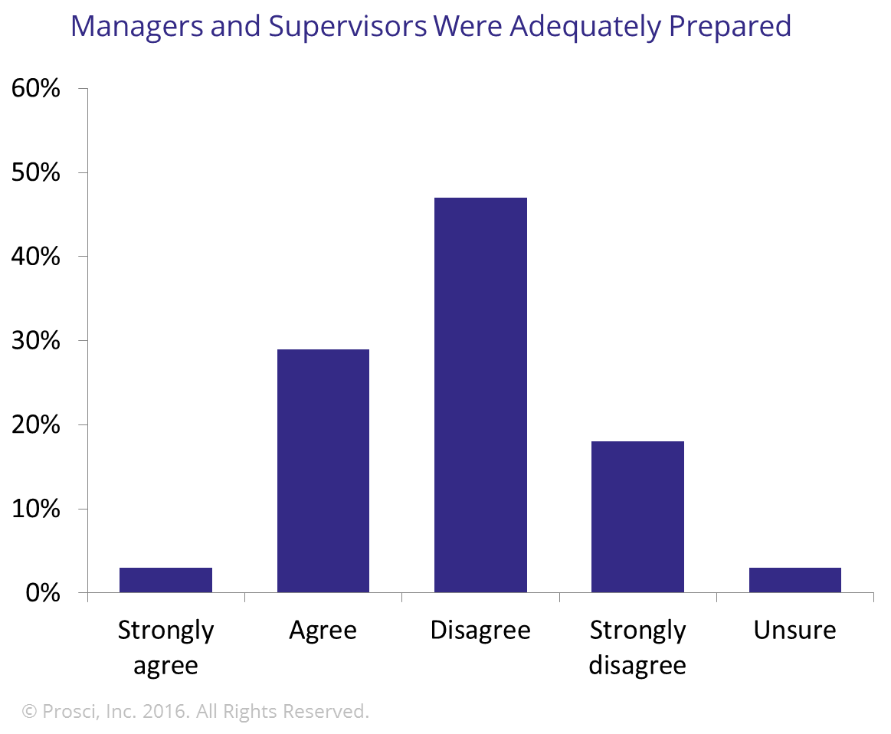
… but are usually inadequately equipped.
Middle Managers & Front-Line Supervisors
Late to the party, when decisions have been made that set the path middle managers must follow.
Don’t have time to internalize the change before they are required to ‘sell it’ to employees.
Face pressures for short-term efficiency (emphasizing stability and control) and long-term innovation (requiring risk-taking and experimentation).
McKinsey (ibid.) + Prosci survey of 4,500 change leaders
Notes:
4 boxes; 2 hidden

Slide 9
Participation improves engagement and decisions and willingness to change.
Engagement is lowest in the lower tiers of companies AND amongst employees who deal directly with customers – employees who know intimately which aspects of the business annoy customers and which delight them.
2013 Bain & Company survey
http://www.bain.com/publications/articles/whos-responsible-for-employee-engagement.aspx
There is a strong positive association between involvement in decision-making and employee commitment.
2011 UK Government study
http://webarchive.nationalarchives.gov.uk/20141206182038/https://www.gov.uk/government/uploads/system/uploads/attachment_data/file/336651/bis-14-1008-WERS-first-findings-report-fourth-edition-july-2014.pdf
Engaged employees are more productive, record lower absenteeism and turnover, have fewer safety incidents, and make fewer errors.
They innovate, make decisions, embrace change, develop new skills, and deliver a superior customer experience.
2015 Gallup survey
http://www.gallup.com/poll/188144/employee-engagement-stagnant-2015.aspx

Slide 10
Change Leadership Process

Slide 11
We have a process and tools for leading the people and organizational elements of change.
Develop a Shared Vision
1 Enroll key stakeholders in a Steering Team
2 Calibrate needs and expectations
3 Create a shared vision
Create
the Plan
4 Plan the Transformation
5 Develop the team’s leadership role
6 Create short-term wins
Engage and
Align
7 Engage the entire organization
8 Align processes and new
practices
9 Remove barriers
Execute the
Plan
10 Implement the
Go-Live Plan
11 Help individuals adapt
12 Monitor, measure, and adjust progress
Consolidate the Benefits
13 Consolidate and leverage gains
14 Review and apply learnings
15 Recognize and celebrate successes
Envision Plan Align Execute Consolidate
Notes:
Challenges
1 - An open mind

Slide 12
What makes it challenging to … Develop A Shared Vision?
Steps & Strategies
1 Enroll key stakeholders in a Steering Team
2 Calibrate needs and expectations
3 Create a shared vision
Notes:
Common Challenges
Don’t want to hear things you don’t want to hear
Don’t want to spend the time teaching other people what you already know
Don’t want to deal with objections you’ve already resolved in your own mind
Concerned about provoking opposition before you have the answers that would satisfy the objections
Think you already know all that you need to know

Slide 13
What makes it challenging to … Create the Plan?
Steps & Strategies
4 Plan the Transformation
5 Develop the team’s leadership role
6 Create short-term wins

Slide 14
What makes it challenging to … Engage and Align?
Steps & Strategies
7 Engage the entire organization
8 Align processes and new practices
9 Remove barriers

Slide 15
What makes it challenging to … Execute the Plan?
Steps & Strategies
10 Implement the Go-Live Plan
11 Help individuals adapt
12 Monitor, measure, and adjust progress

Slide 16
What makes it challenging to … Consolidate the Benefits?
Steps & Strategies
13 Consolidate and leverage gains
14 Review and apply learnings
15 Recognize and celebrate successes

Slide 17
Change Leadership Skills

Slide 18
Change Management requires …
Making the right change
Management Skills
Apply technical knowledge
Solve problems
Manage the change
Exercise control over the process
Sustaining the gains
People and Organizational Skills
Create shared, meaningful goals
Align effort
Facilitate teamwork & collaboration
Engage individual accountability
Notes:
Watch from the balcony
Listen to the echo

Slide 19
Task (what) and Process (how) Behaviors
Task-oriented Behaviors
Identifying goals
Setting standards
Assigning responsibilities
Giving information and opinions
Proposing action
Making decisions
Reviewing progress
Process-oriented Behaviors
Encouraging morale
Harmonizing conflicts
“Gate-keeping”
Testing for agreement
Compromising
Seeking information
Reviewing the process
Setting Direction
Advocacy
Bringing in Information
Leading Action
Inquiry
Evaluating Options

Slide 20
Acts of Leadership
EXPLAIN
Reinforce Line Of Sight to our goals
Stories of; – behaviors that drive achievement of our goals, – critical moments that determine the outcome, – successes.
EMBED
Take advantage of every opportunity
Budget discussions Work assignment Goal-setting Measures Project reviews Recognition & Rewards Team meetings Personal interactions
ENCOURAGE
Keep the focus on change
What are you doing to improve your results & performance? How are you developing your own skills? What more can we do to help you?
EXEMPLIFY
Model effective Leadership practices
Establish your expectations Reinforce accountability Reward development Provide direct feedback Coach Take advice

Slide 21
What are the opportunities for change in your part of BMC?
SIGNS
Control Optimize Transform
TASK
Opportunities
Effort
GOAL
RIGHT WAY | BEST WAY | NEW WAY

Slide 22
Thanks for your time, and input
Mick.Verran@BMC.org

