Slide 1
Department of Medicine Faculty Meeting October 24, 2017
Announcements
Single Cell Sequencing Core Update
Discussion of Report on Clinician Satisfaction

Slide 2
Announcements
BU changing all phones in BU space to VOIP by the end of 2018 (http://www.bumc.bu.edu/it/ bumc-voip/)
Vice Chair for Research RFA to be solicited soon
R38 application for resident research being submitted (PI’s: Ramachandran and Upadhyay)
Evans Days reflections
Planning for housing clinics and offices in Crosstown building accelerating pending purchase of the building by BMC
Please complete Emergency Management training on-line, and TB/Mask fit testing

Slide 3
Announcements
2017 Evans Clinicians
Eric H. Awtry, MD
Ioana Bica, MD
Gretchen Gignac, MD
Sandra S. Looby-Gordon, MD
Arthur C. Theodore, MD
David P. Nunes, MD
2017 DOM AWARD WINNERS:
Research Mentoring: Joseph P. Mizgerd, Sc.D.
Jr. Faculty Mentoring: Ryan Z. Chippendale, MD
Citizenship: Gretchen A. Gignac, MD & Jude T. Deeney, PhD
Quality Improvement: Dong Wook Kim, MD
Clinical Innovation: Alexander Walley, MD, MSc and the Addiction Consult Team
Special Recognition Teaching: Jennifer Siegel, MD & Lynn L. Moore, DSc
Clinical Excellence: Heidi P. Auerbach, MD.
Notes:
Dr. Coleman- Need to be updated

Slide 4
BU Medical Group Awardees
Excellence in Care Award
James Hudspeth, M.D.
Clinical Excellence Society:
James Hudspeth, M.D. (GIM)
Kristen Lee, M.D. (GIM)

Slide 5
Faculty Development Seminars
Responding to Microaggressions as a Bystander
Kermit Crawford
November 7th from 12-1pm in Wilkins
What to Think About When You Are Thinking about Retirement
BU HR
November 15th from 3-5pm in Wilkins
CV Boot Camp
Appointments & Promotions Committee Members
December 5th from 12-1pm in Wilkins

Slide 6
DOM Networking Dinners
Under-Represented Minorities & Allies’ Dinner (with post docs, residents & fellows)
November 9th from 6:30 to 8:30
Women’s Dinner (faculty, post docs, residents, fellows)
November 28th from 6:30 to 8:30
Enjoy good food and meaningful discussion with your DOM colleagues.
Emelia Benjamin’s home in Brookline
RSVP to Robina Bhasin at rbhasin@bu.edu

Slide 7
Congratulations to Faculty Development & Diversity Grant Recipients
Pablo Buitron de la Vega - GIM
Aysha Gueye - GIM
Shakun Karki – Cardiology
Hans Meier-Ewert - Cardiology
Elizabeth Pearce - Endocrinology
Katrina Traber - Pulmonary
Sharmeel Wasan - GI

Slide 8
Upcoming Grant Deadlines
Faculty Development & Diversity Grants
Open to ALL DOM FACULTY at all levels seeking to further their professional development
Next deadline is January 15th
http://www.bumc.bu.edu/facdev-medicine/grants/

Slide 9
Writing from the Front Lines of Clinical Care, Education, and Research
New DOM program launching 2018
Target—clinicians, educators, scientists
Thursday 4-6 pm, monthly January-June
Develop narrative skills through reflective writing, reading, listening, & peer mentoring
Goal to submit piece June 2018
Applications open soon
For information or interest please contact Christy Di Frances, PhD at christyd@bu.edu

Slide 10
Single Cell Sequencing Core Facility
W. Evan Johnson
Associate Professor
10/24/2017

Slide 11
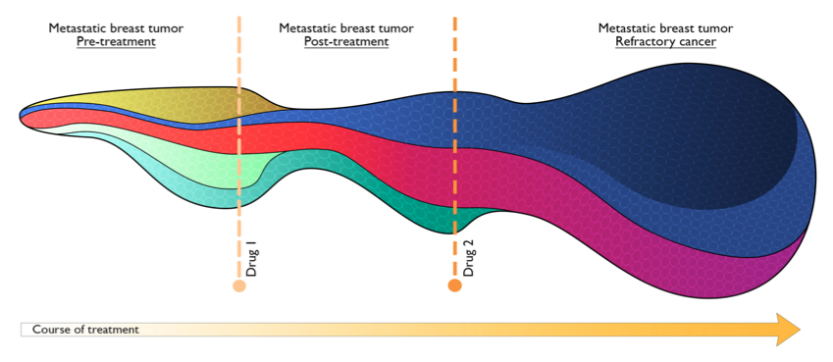
Single Cell Profiling
Notes:
reduce barriers of entry as much as possible for novice users without oversimplifying the workflow to make it customizable for more advanced users

Slide 12
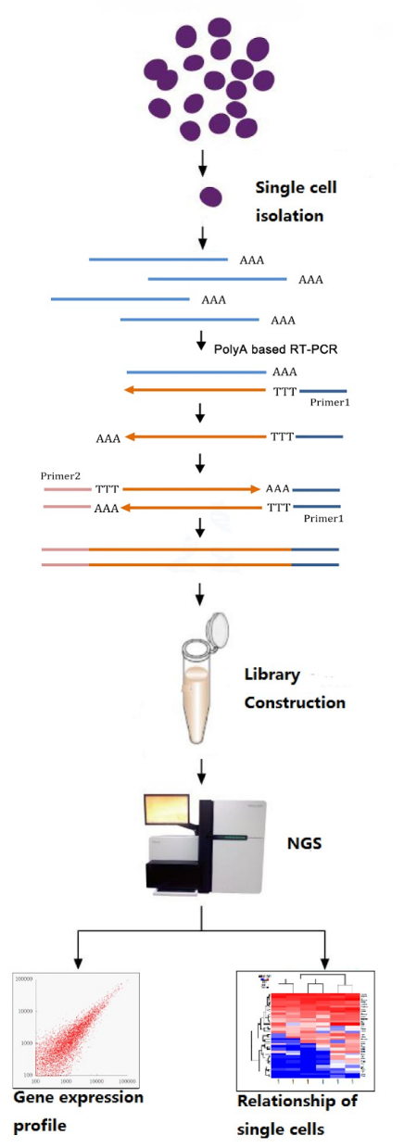
Single Cell Profiling
Applications for Single Cell Sequencing:
Cancer: intra-tumoral heterogeneity
Development: characterize every cell in blastocyst
Other applications: novel/rare cell type discovery
Infectious Diseases: combine with metagenomics to explore host response (e.g. TB)
And more!
The Future of RNA-sequencing

Slide 13
DOM Single Cell Core
Personnel:
Administrative and Technical Director: Dr. Yuriy Alekseyev
Scientific Co-directors: Dr. Josh Campbell and Dr. Evan Johnson
Research Scientist: TBD (soon)
Lab Technician: TBD
Bioinformatician: Andres Breton (starts next week)

Slide 14
DOM Single Cell Core
Services offered by BU Single Cell Core:
Sample dissociation. Mechanical and enzymatic digestion to isolate individual cells. Research Scientist will aid molecular labs to conduct this step or do it for them.
Cell isolation, sorting, and biobanking.
FACS. BU Flow Cytometry Core (Drs. Jennifer Snyder-Cappione and Anna Belkina) isolate single cells. Cells can be stored for long periods of time, selected subsets of samples/cells can later be profiled.
Microfluidics. Commercial microfluidic devices will take cells in solution, perform cell isolation, and prepare libraries for each individual cell automatically. Including 10x Genomics Chromium (Core), Fluidigm C1 and Polaris (CReM), and Illumina/BioRad ddSeq (Tarik Haydar).
Library preparation. Libraries from cells stored in 96-well plates using ‘CEL-seq’
Next-generation sequencing. Sequencing with Illumina HiSeq 2500 in the high-throughput genomics core (Dr. Avrum Spira and Gang Liu) or with the Illumina Nextseq500 in the BU Microarray and Sequencing core (led by Dr. Yuriy Alekseyev)
Data analysis and interpretation. The added complexity of single cell data introduces challenges in the analysis. The core bioinformatician (Andres Breton) will be available to help with the Bioinformatics

Slide 15
Clustering consistency in PBMCs
First dataset produced by the Single Cell Sequencing Core:
10X Genomics
2 PBMC datasets, each given one NextSeq run:
“HIGH”: ~5,000 cells (27,000 reads/cell)
“LOW”: ~800 cells (120,000 reads/cell)
First pass analysis: Cell Ranger

Slide 16
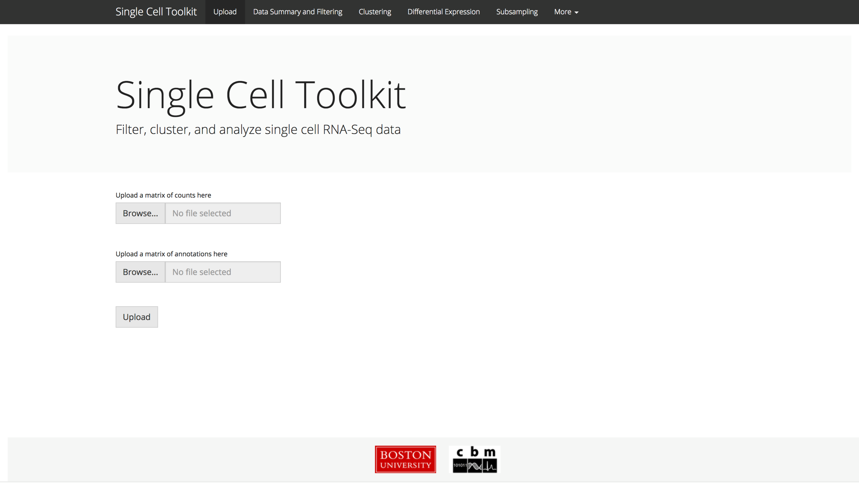
Shiny ‘tabPanel’ – easy to expand to add additional tabs.
Creates SingleCellExperiment object, stores counts and annotations as “reactiveValues” objects. Can be modified and triggers functions to run.
You can also upload a SingeCellExperiment or SummarizedExperiment object here or from the R console when you load the app.

Slide 17
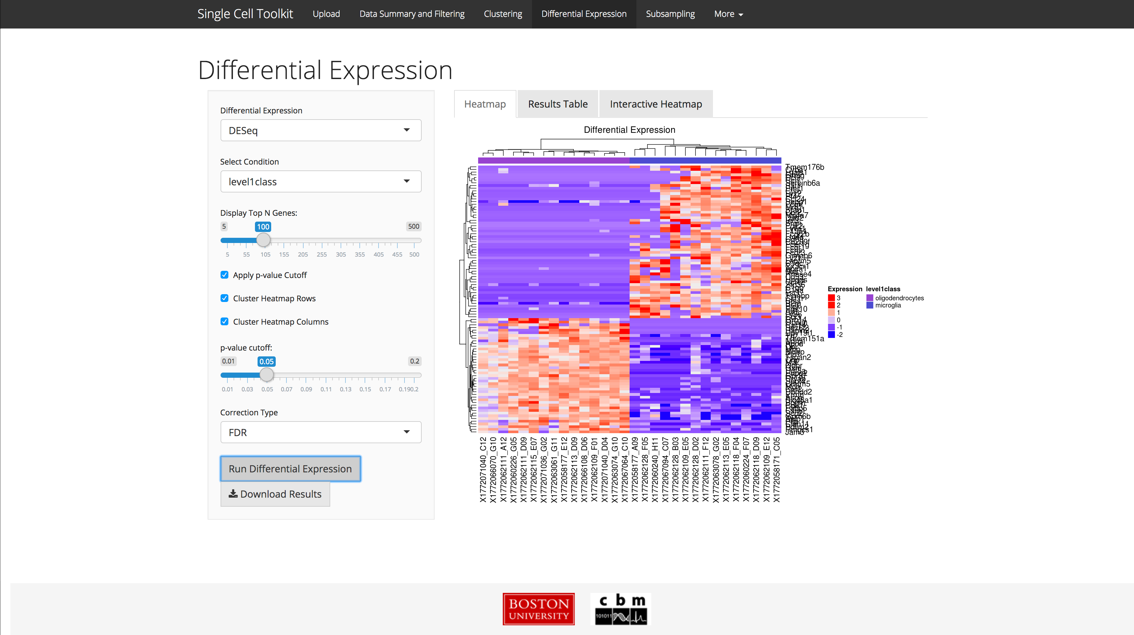
“selectInput”
“sliderInput”
“checkboxInput”
“plotOutput”
rendered with
renderPlot call
“actionButton”

Slide 18
Clinician Satisfaction Survey/Interview Report
Clinician Satisfaction/Advocacy Advisory Group
Alice Jacobs - Chair
Tom Barber – GIM
Emelia Benjamin - Cardiology
Robina Bhasin - Director, Faculty Development and Diversity
Joanna Dafflitti – GIM
Fred Little – Pulmonary
Catherine Rich - GIM
Josh Safer - Endocrinology
Kelsey McRichards - DOM Director of Operations and Strategy
Advisory Group Liaisons:
Jane Liebschutz - GIM
Sharon O'Brien - Pediatrics
Susannah Rowe - Ophthalmology

Slide 19
Background
BMC and healthcare systems navigating through a series of changes that directly impact our jobs, our lives and how we practice medicine
Discontent among our faculty and a general sense of dissatisfaction
Presented idea for Clinician Satisfaction Advisory Group to DOM Ambulatory and Inpatient Leaders and obtained support and suggestions
Established a Clinician Satisfaction/Advocacy Advisory Group to consider how best to undertake a new initiative focused on restoring clinician satisfaction and enjoyment in clinical practice.
Initial plan to launch a survey and interview to confirm what we "think" we know and to involve the faculty from the outset

Slide 20
Survey and Interview Methodology/Process
Invited faculty to participate in Advisory Group and to be interviewed
Provided lists of clinical faculty by section and received suggestions for potential interviewees
Mix across faculty rank and years on faculty
Learned qualitative interviewing skills and how to ask questions, garner responses
Modeled questions after ACIT project led by Sheila Chapman and Josh Safer
Did not interview own section members
Interview responses blinded to all but interviewer; data reviewed by Group in blinded fashion

Slide 21
Number of Interviewees = 25

Slide 28
What are the best parts about your job that keep you here at BU/BMC?
Clinical work environment: colleagues and patient population – ‘ethos of shared goals and mission’.
“There is a common sense of mission and people who are here want to be here as part of a community. We have shared goals.”
“I came from another institution where there was more discord and less collegiality.”
Opportunity for varied roles in an AMC – teaching, admin, research
“Getting to work in multiple clinical areas; Would not stay at BMC without ability to do this.”
Mentorship – approachability of senior faculty, clinical leadership
“There is a camaraderie here that doesn’t exist elsewhere. There’s no intimidation or barriers to reaching out to senior faculty.”
“The environment is comfortable and non-competitive and there are shared values; I didn’t have that feeling at MGH.”
Having an impact on scholarly activity and the community
“People are proud to be here (although this may be changing now that the financial and productivity pieces are in your face a lot more).”

Slide 31
Biggest sources of dissatisfaction? Productivity pressure (RVU metric) with poor support
“Private practice” expectations without parallel support
Unsupported administrative burden is inefficient
Substantial additional effort and time are required to overcome the inefficiencies in clinical practice at BMC
Impact on morale of the RVU system which only penalizes physicians – with numerous system failures outside of MD control
RVU system has resulted in a culture change away from the mission of the institution for many
Notes:
MD’s feel that their work in clinic is overwhelming due to a lack of appropriate support
They primarily would like to reduce the amount of non-MD work they do, including referrals. Many cited missed opportunities for nurses or other staff to partner w/ MD’s in caring for patients.

Slide 32
Biggest sources of dissatisfaction? Lack of quality support/staff
Providers spend significant amounts of time on non-provider tasks
data entry of questions that could be asked on forms and entered by support staff
Simple processes to improve efficiency are not uniformly done
exam rooms stocked and ready to go, patients ready to go with interpreters
Insufficient physical space, inefficient allocation of support staff, poor navigation for patients,

Slide 33
Biggest sources of dissatisfaction? Increased unsupported administrative burden
No effective effort to make the EMR help make things more efficient.
Time spent dealing with mandates of dubious benefit that seem to have been imposed with no understanding of the time required.
“It takes longer to document clinical work than to perform it”
“The amount of work since Epic has increased by a couple of hours every day”
Notes:
“bait and switch phenomenon”

Slide 34
Biggest sources of dissatisfaction? Lack of alignment between physicians and BMC
Lack of meaningful enlistment of physicians in strategy for benefit of patient care and BMC
Priorities felt to be top down and not clinical practice driven
Sense of a lack of trust as well as a sense that leadership doesn’t work well together
“Solutions to generate revenue don’t account for time required for paperwork or the lack of infrastructure”
Notes:
“bait and switch phenomenon”

Slide 36
What changes would yield the most improvement? Better Clinic Support
Minimize non-MD tasks done by MDs
Create a culture of success and teamwork
Hold staff accountable
Reward excellence
“When I put in an order, I want someone to have the responsibility of making sure it gets done.”
“Accountability for everyone to work at the top of their license.”
Notes:
MD’s feel that their work in clinic is overwhelming due to a lack of appropriate support
They primarily would like to reduce the amount of non-MD work they do, including referrals. Many cited missed opportunities for nurses or other staff to partner w/ MD’s in caring for patients.

Slide 37
What changes would yield the most improvement? Recognition and Listening
Clinicians feel senior leadership does not listen
Appreciate contributions outside of wRVU and clinical requirements
Research, education, program innovation
Show appreciation in non-monetary ways:
Positive feedback instead of asks
More direct ‘listening’ from administrative leadership

Slide 38
What changes would yield the most improvement? Time
Our most valued commodity
Academia = Flexibility, Creativity
Burden of on-line administrative tasks grown
“Death by 1000 paper cuts”
“Physicians don’t mind extra hours and working when that time is used for things like patient care, extra call and academic work, but all the EPIC and administrative requirements are now sucking up the time that used to be spent on those activities.”
Notes:
“bait and switch phenomenon”

Slide 39
How do you think the Clinician S/A Committee can have the best impact on you and your peers?
Faculty believe that our institution has many silos, with variation in clinical practice, support for research, support by leadership among sections and departments
We should focus on a limited set of themes across multiple sections: “support new staff; provide more quality support in clinics; be systematic.”
Better align goals and expectations among sections, departments, BUSM and BMC.
Faculty feel overwhelmed by mandated tasks
Minimize requirements for documentation, forms, on-line systems (eg. CME)
Faculty ask for transparency, for example, results of this survey
Seek and implement ways to improve morale; “listen to us”

