Slide 1
Procurement Overview
Friday, February 03, 2017
BU Sourcing & Procurement

Slide 2
Agenda
Overview of Procurement Process
Reports: Shopping Carts All vs BW Reporting
Procurement Policies
Onboarding a Supplier
Shopper’s Guide/Training Newsletter
Questions

Slide 3
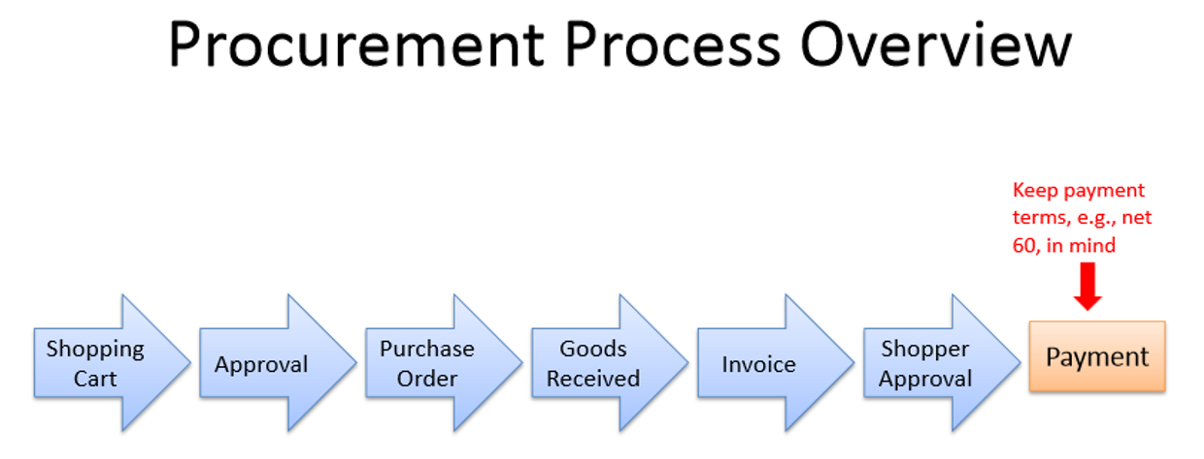

Slide 4
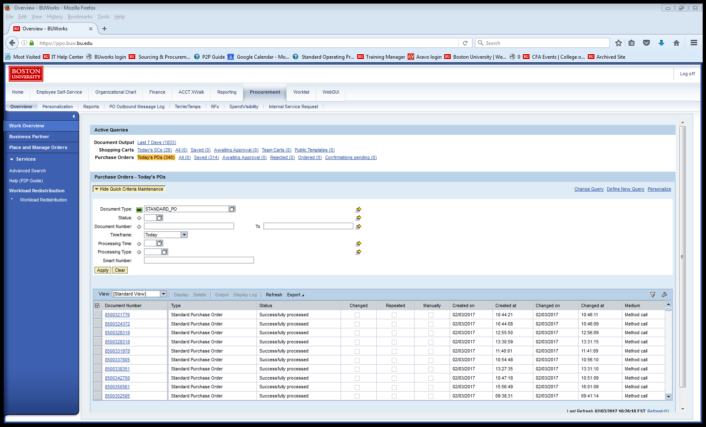
BUworks Procurement

Slide 5
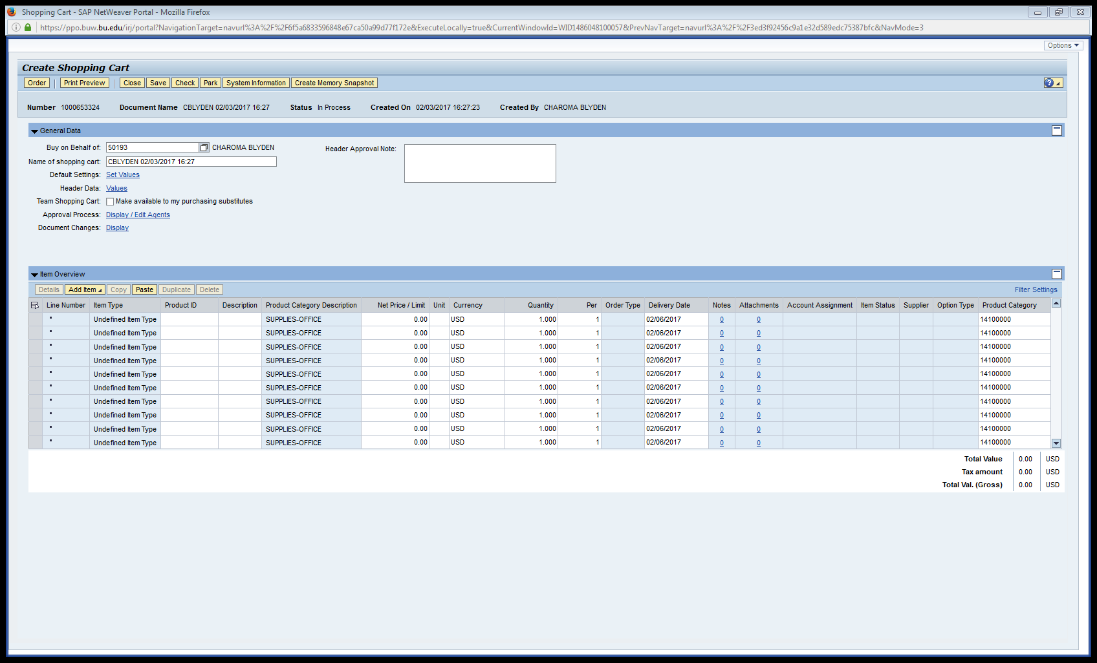
Shopping cart screen

Slide 6
Reports
Shopping Carts- All query
View your own shopping carts
Access to drill into carts/purchase orders
Can be customized and exported
BW – SRM Reports
View shopping carts by broader category (funds center/shopper etc.)
Access to drill into carts/purchase orders
Can be customized and exported

Slide 7
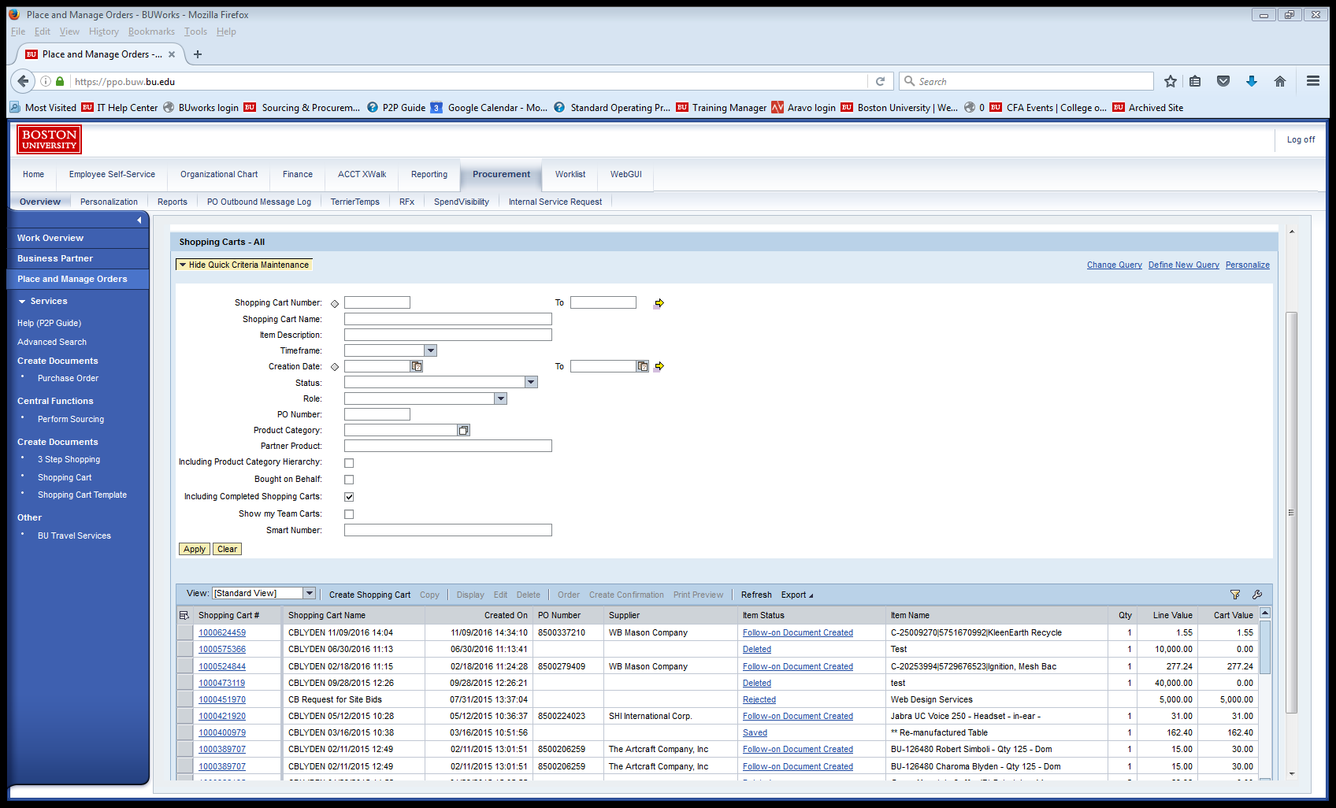
Shopping Carts All

Slide 8
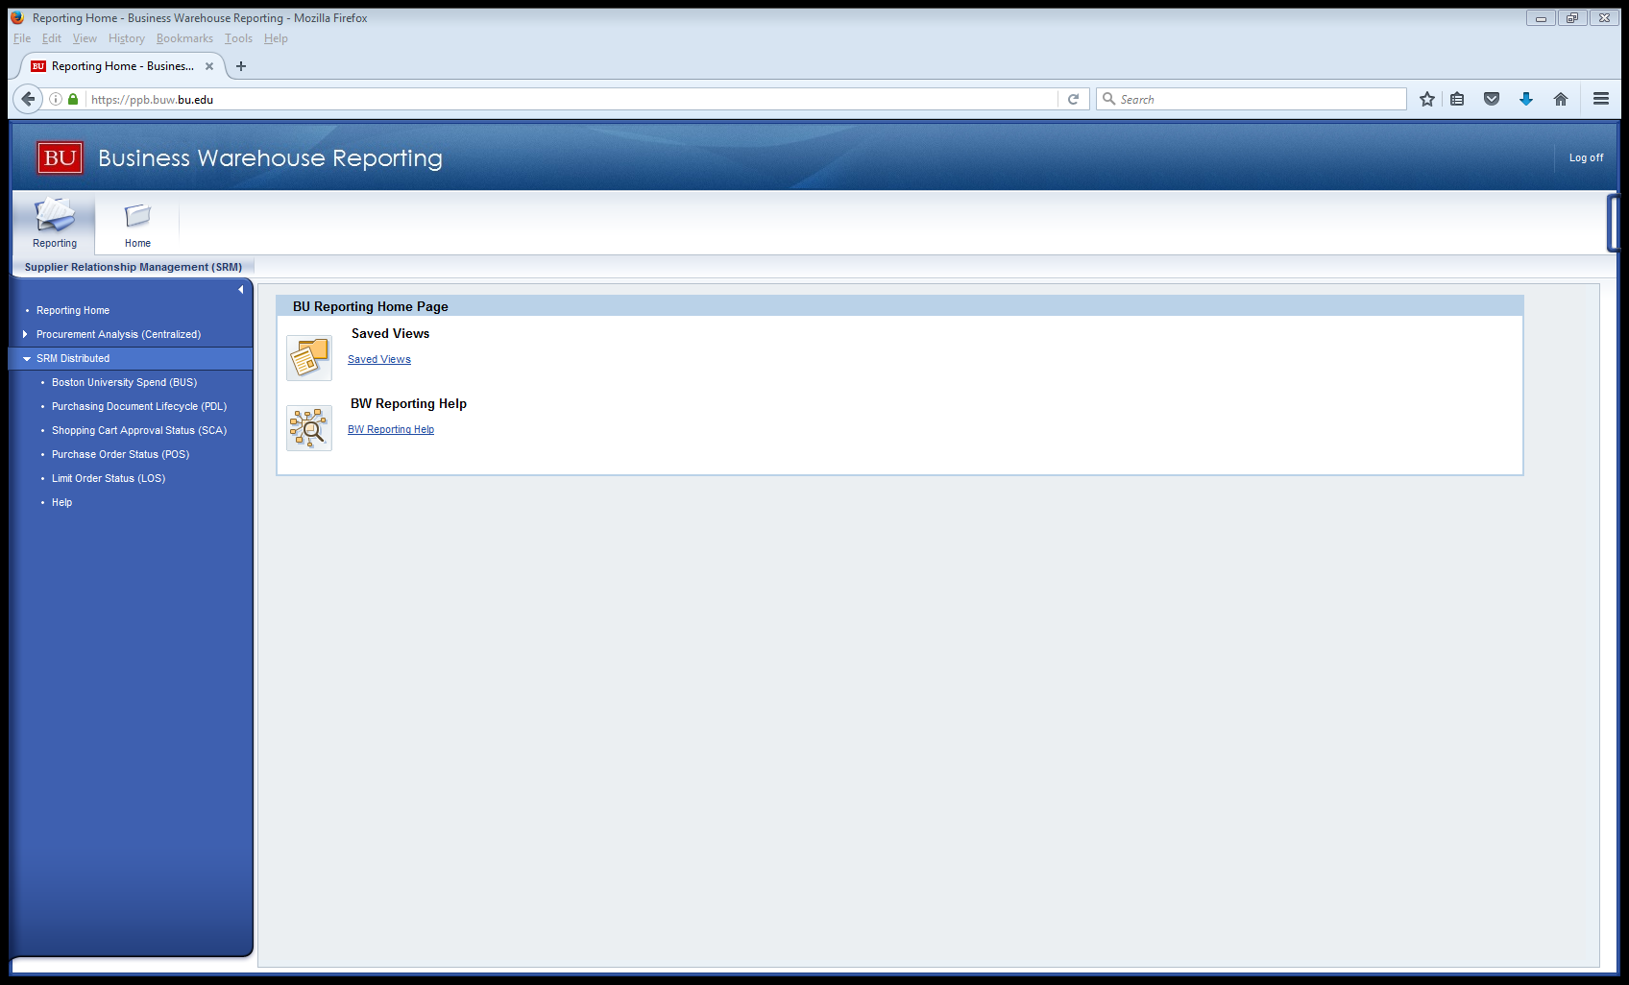
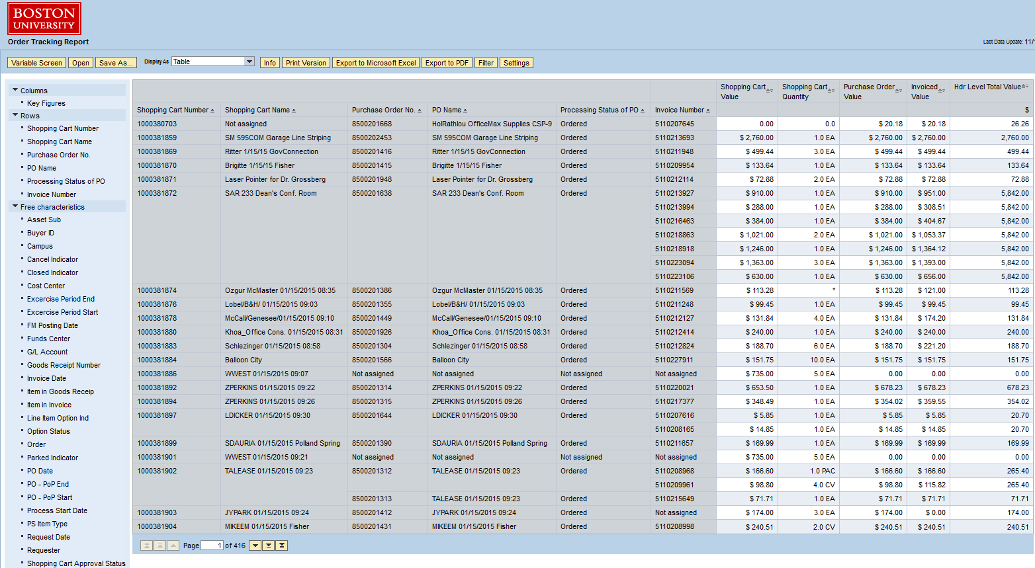
Supplier Relationship Management Reports

Slide 9
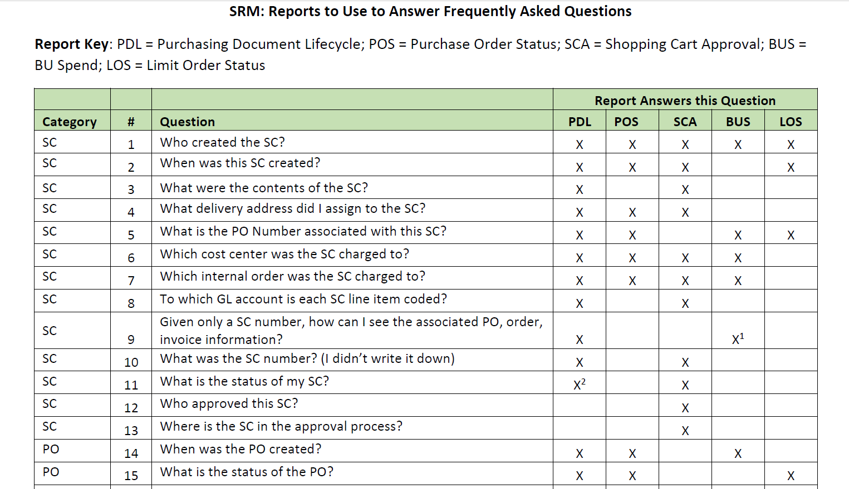
Complete document: http://www.bu.edu/tech/files/2016/02/SRM-FAQ-and-reports-to-use-for-answers.pdf

Slide 10
BW SRM Reports
Boston University Spend (BUS)
Purchasing Document Lifecycle (PDL)
Purchase Order Status (POS)
Shopping Cart Approval Status Overview (SCA)
Limit Order Status (LOS) – new report

Slide 11
Sourcing & Procurement Policies
Bid Policy
Non-competition Policy
RFP Process
Limit Order Guidelines
Ordering/Contracting Policy
Registering Suppliers
Research-related Engagements

Slide 12
Bid Policy
Boston University employees participating in a procurement process are responsible for purchasing goods and services at the best value or lowest total cost to ensure purchases are made at competitive market prices.
Purchases less than $25,000
  Shopper’s department is responsible for determining fair and reasonable pricing and must retain such documentation
Purchases between $25,000 - $99,999
  Shopper’s department must demonstrate the vendor with the best value was selected by submitting bid documentation with the shopping cart
Purchases greater than $100,000
  Shopper’s department is required to complete a competitive bid process which will include:
    An assessment of the market and the supply base
    Written scope of work and award criteria
    A Request for Proposal (RFP) drafted and distributed to vendors
    An analysis of vendors’ responses to the RFP
    Execution of a written contract or purchase agreement prior to award

Slide 13
Non-competition Policy
For all purchases that exceed $25k not sourced using the competitive bid process, the shopper is responsible for supplying Sourcing & Procurement a justification for non-competition.
The justification must:
Address why the full quantity to be contracted needs to be purchased without using competitive procedures
Discuss relevant pricing issues, including the basis for determining that the anticipated price/cost will be fair and reasonable.
Include market research/efforts to obtain competition
Outline actions being taken to overcome future barriers to competition
Contain approval of purchase by Boston University authority (Dean, VP)

Slide 14
RFP Process
An RFP is a Request for Proposal and is performed typically for orders greater than $100,000
Process
  Submit a shopping cart with the following information (either in the internal note or as an attachment): description of project, timeline, expected value, University contact, and list of proposed vendors.
  Once received in Sourcing, the project will be assigned to the appropriate resource who will contact the department and provide applicable RFP documents for completion – e.g. RFP template*, pricing spreadsheet, scope overview, etc.
  The RFP will be released through Sourcing’s eSourcing tool, Ariba, which allows vendor responses to be submitted electronically and downloaded to be analyzed in a side-by-side format.
* Once the RFP template has been populated with business questions and returned to Sourcing, the department should anticipate about one week for final edits before the RFP can be published.
Please note, IT-related projects may be assigned a Project Manager from IS&T’s Project Management Office

Slide 15
Limit Order Guidelines
A Limit Order is a master purchase order that permits tracking of multiple transactions related to a single vendor and/or agreement.
Limit purchase orders may be used:
For services when the ordering department has an executed contract and the payment frequency and/or amounts are variable.
For supplies when the ordering department has a contract, price agreement, or quotation, and must make repetitive purchases of low dollar supplies with variable costs when a supplier will not take a procurement card (PCard) for payment and the supplies or materials are not available in the Terrier Marketplace.
Format:
Date range should include a beginning and end date consistent with the agreement.
The value should be for the entire agreement value and term.
Supporting documentation (contract, price agreement, or quotation) much be attach to the shopping cart.
Time or dollar extensions of a current limit purchase order must be in writing and include proper supporting documentation.

Slide 16
Ordering/Contracting Policy
In general, the preferred method of ordering goods and services from registered suppliers at Boston University is via a shopping cart using BUworks Central. However, there are certain circumstances (listed below) where alternate methods of ordering and payment are acceptable to allow efficiency and greater convenience.
These methods include:
PCard – Low-dollar PCard transactions (less than $1,000)
Travel Card – Travel and entertainment expenses
Direct Pay – disbursement transactions. (Direct Pay describes the process for direct payment of purchases of certain goods and services outside the Sourcing & Procurement function)
The Ordering and Contracting Policy grid will help you determine which method you may use for payments. Click the link below to be taken to the policy page.
http://www.bu.edu/policies/finance/ordering-and-contracting/

Slide 17
Supplier Registration
A Shopping Cart is the first step!
The first step to engage a service provider, consultant, contractor, or freelancer (hereafter, “Service Provider”) is to submit a shopping cart prior to the services being performed for the projected value of the services.
The following information must be included in the shopping cart prior to submission:
Service provider name and contact information
Description of services
Start date and end date
Supporting documentation (contract, price agreement, quotation, etc.)
Notes:
To look up all of your created shopping carts.
- You can choose to set a time frame (leaving blank will give you all existing carts)
Check “Including Completed Shopping Carts” if you also want to see carts that have had PO’s created.
Hitting apply will set your settings. You will have to manually change if you want different criteria next time.

Slide 18
Research Related engagements $25k or less and lasting less than 12 months
2 Available Processes…
The combined questionnaire & contract process has fewer steps, and allows the department to complete more of the process on the consultant’s behalf, but is more paper intensive.
The Shopping cart/PO process is electronic, reducing the risk of lost paperwork and invoice payment delays, but requires the consultant to interact directly with the University’s central offices.
Notes:
To look up all of your created shopping carts.
- You can choose to set a time frame (leaving blank will give you all existing carts)
Check “Including Completed Shopping Carts” if you also want to see carts that have had PO’s created.
Hitting apply will set your settings. You will have to manually change if you want different criteria next time.

Slide 19
A few tips when onboarding a supplier…
Inform suppliers of the supplier registration process to manage expectations.
Always fill out a Description of Services form and upload it to the shopping cart.
Do not sign anything on behalf of the University
Notes:
To look up all of your created shopping carts.
- You can choose to set a time frame (leaving blank will give you all existing carts)
Check “Including Completed Shopping Carts” if you also want to see carts that have had PO’s created.
Hitting apply will set your settings. You will have to manually change if you want different criteria next time.

Slide 20
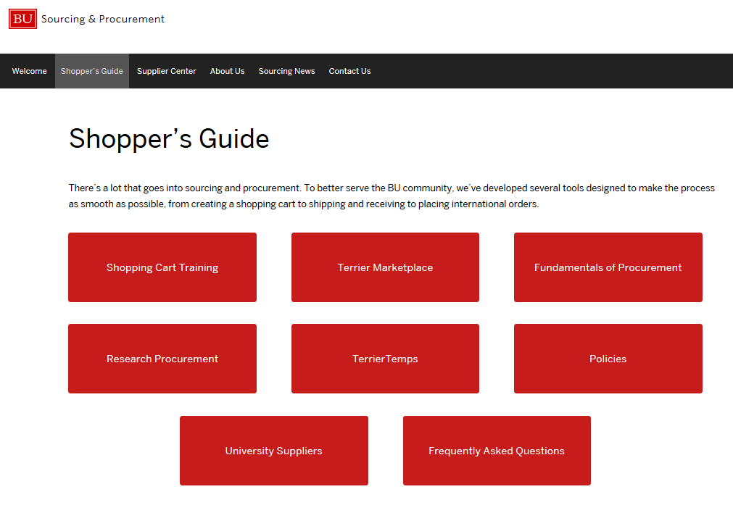
Procurement Resources
Shopper’s Guide
Training Documents
Training Videos
Policies and
Procedures
Contact
sourcing@bu.edu or 617-353-2370
Notes:
http://www.bu.edu/sourcing/shoppers-guide/

Slide 21
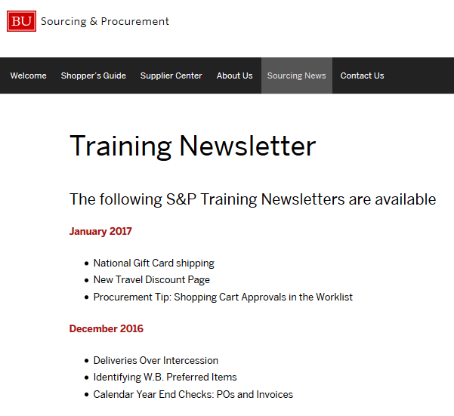
Training Newsletter
Collaboration with the BUworks functional areas: HR, Finance, S&P, and BW Reporting to produce monthly training newsletter.
News
Tips/Training info
Upcoming classes

Slide 22
Questions?

Slide 23
Thank you!

