Slide 1

Management Development Program
Business of Healthcare at BMC

Slide 2
Session Objectives
  By understanding the business side of BMC, participants will be better able to:
    Connect their management roles to the overall business goals of BMC
    Explain how changes to the market and business environment affect BMC
    Improve our ability to respond to changes in the business environment.
    Increase employee engagement with the use of tools to better communicate business operations to your teams
Notes:
Why a Business of Healthcare at BMC program? We want to help managers understand what goes on behind the scenes, workings of the hospital. Many of you are focused on keeping our patients healthy—we want to stay financially healthy so that we can continue to give exceptional care without exception.
Be sure to mention how some people may already know some of this information. This class is a baseline program to make sure everyone is on the same page and has the same basic understanding about the Business of BMC.

Slide 3
Session Outline
Introduction, Session Objectives and Outline
Hospital Facts and “Hot Topics”
        How does BMC make money?
        Patient and Revenue Cycles
Volume, Volume, Volume!

Slide 4
Hospital Facts and Hot Topics
Notes:
The following is not just a list of statistics and fun facts meant to bore you all.
It is meant to give everyone a higher view or perspective of the organization. To help you understand how we size up against other Academic Centers and quantify our mission.

Slide 5
Hospital Types
Hospitals are registered with the American Hospital Association as one
of the following types:
General Provide patient services, diagnostic and therapeutic, for a
variety of medical conditions. Boston Medical Center is a “General” Acute Care Hospital.
Specialty Provide diagnostic and treatment services for patients who have specified medical conditions, both surgical and nonsurgical
Rehabilitation and Chronic Diseases Provide diagnostic and treatment services to disabled individuals requiring restorative and adjustive services
Psychiatric Provide diagnostic and therapeutic services for patients who require psychiatric-related services
Notes:
Before showing all the types, ask the class: Who can name some AHA types of hospitals?
Click for all to appear.

Slide 6
Hospital Types
Hospitals are organized as
Public hospitals
In general, public hospitals provide substantial services to patients living in poverty.
Federal hospitals serve specific purposes or communities
Public hospitals are often funded in part by a city, county, tax district, or state.
Private, not-for-profit hospitals
Are nongovernment entities organized for the sole purpose of providing health care. Roughly 87 percent of nonfederal community hospitals are not-for-profit. In return for providing charitable services, these hospitals receive numerous benefits, including exemption from federal and state income taxes and exemption from property and sales tax.
Private for profit hospitals
The remaining nonfederal community hospitals are investor-owned, which means that they have shareholders that may benefit from profits generated by the hospital. For-profit hospitals do not share the charitable mission of not-for-profit hospitals (though many do provide some charity services), and they must pay taxes.
Boston Medical Center is a private, not-for-profit hospital.
Notes:
Hospitals are then broken down even further by what their mission is or what population they serve.
Question: Who can identify some examples of public hospitals?
Answer: Veteran’s Hospitals, Military Hospitals
Which type does BMC fall into? Click mouse and BMC will appear.

Slide 7
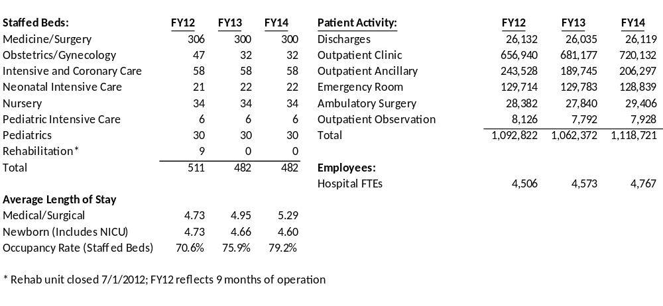
Boston Medical Center
Hospital Facts Sheet
Notes:
Speaking point:
Highlight/direct attention to change in discharges and outpatient (volume will be discussed in further detail later on).
PwC prepared a report surveying 27 academic medical centers across the nation (including BMC). For FY11 the average of all these AMCs had 7,029 FTEs, 796 licensed beds, and an occupancy rate of 78.8%. FY11 statistics for BMC is the middle column.

Slide 8

Hot Topics – Revenue
How does BMC make money?
Notes:
Just like any business, we need to get paid. (click so money bags appear)
But how do we get paid?
Let’s think about it very simply. We offer a service. A commodity service. (a marketable service provided to satisfy wants or needs) To keep people coming and money flowing in, we need to be the best commodity – Right care Model.

Slide 9
Hospital Revenue Terminology
Typically, hospitals get their revenue in a variety of ways:
By providing medical services
For nonmedical services
Through donations and grants from individuals, foundations, or the government
Through gains on investments
Hospitals group the way they make money into three different categories:
Operating Revenue: delivery of patient care
Other Operating Revenue: nonpatient care activities
Non-Operating Revenue: peripheral business activities
Notes:
Operating revenue is further defined in your handout (page 1). And if you’re curious as to how these roll up to a typical financial statement, please refer to page 2 of your handout.
Under nonmedical services refer to Research, monies raised from parking, cafeteria.

Slide 10
Hospital Revenue - Payers
To understand how hospitals generate revenue for patient services, it is important to understand the “payers” in the healthcare industry.
Public payers include federal and state governments—which fund Medicare and Medicaid
Private payers are insurance companies.
Finally, there is the uninsured population, which includes people who are expected to pay for their own health care, unless they qualify for “charity/free care” as defined by the hospitals internal policies.
Notes:
What do you think is meant by our payers? Who would they be?
Answer: most comment responses will probably be BCBS, Harvard Pilgrim, the government.
Click mouse so 3 main categories appear.
The uninsured group can also be the “self pay” group, which may be people WITH insurance, but are seeking an uncovered procedure such as Laser vision correction.
Further definitions of each of these types are in your handouts (pp. 3-5).

Slide 11
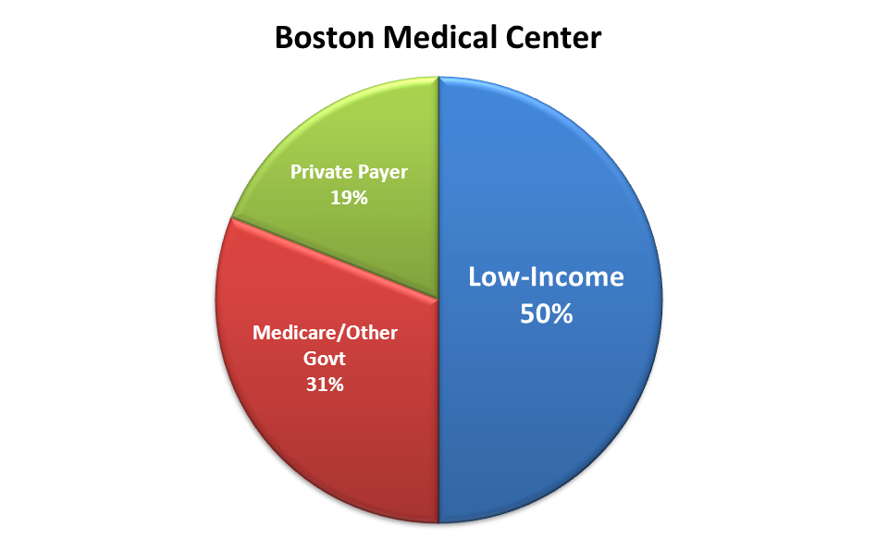
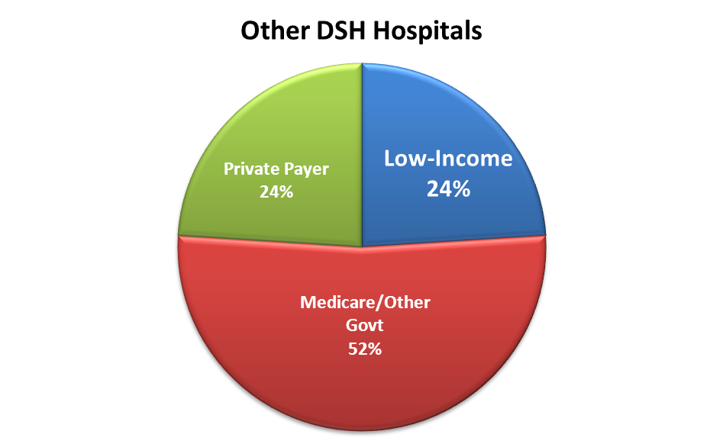
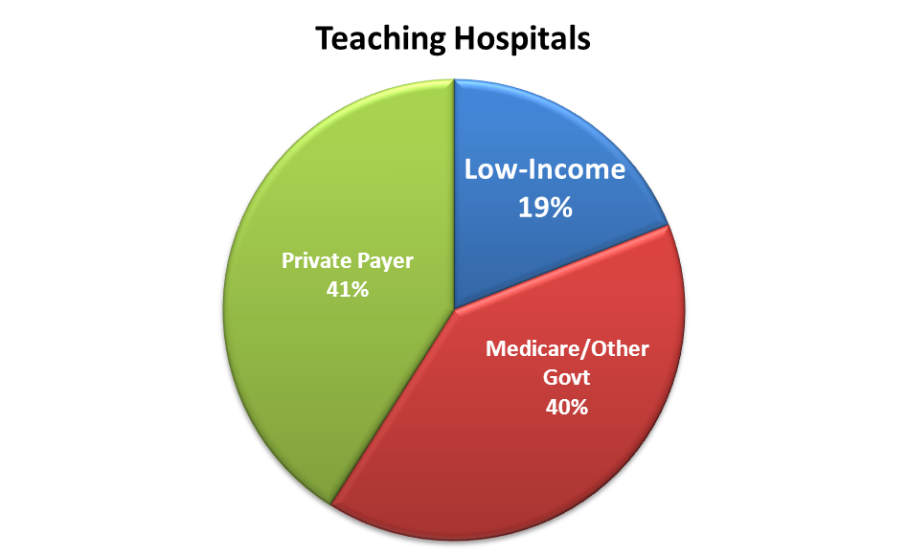
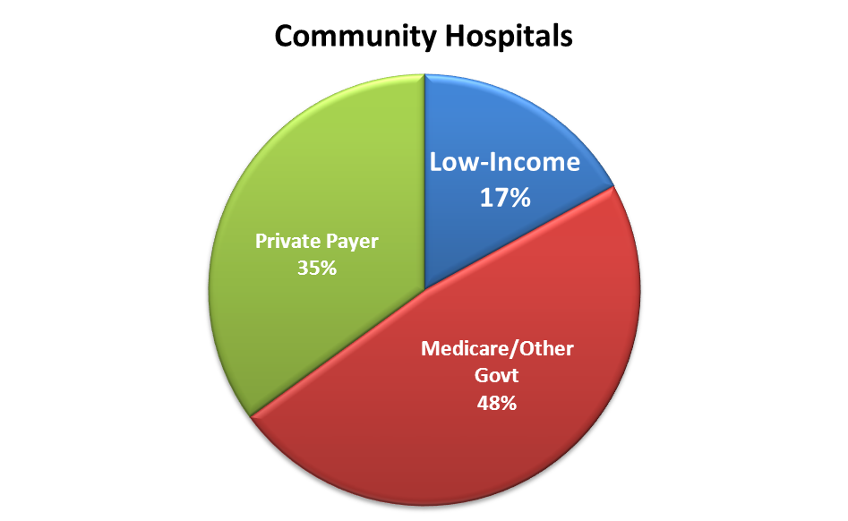
Patient Demographics
Highlights:
BMC’s payor mix is substantially different from other hospitals
81% of BMC revenue comes from governmental sources
Governmental rates of payments are generally not negotiable
Any payments shortfalls are magnified by BMC’s payor mix
Notes:
Highlights our patient mix compared to other Hospitals and our heavy reliance on governmental sources.
DHS = Disproportionate share hospital
Disproportionate Share Hospital (DSH) adjustment payments provide additional help to those hospitals that serve a significantly disproportionate number of low-income patients; eligible hospitals are referred to as DSH hospitals.

Slide 12
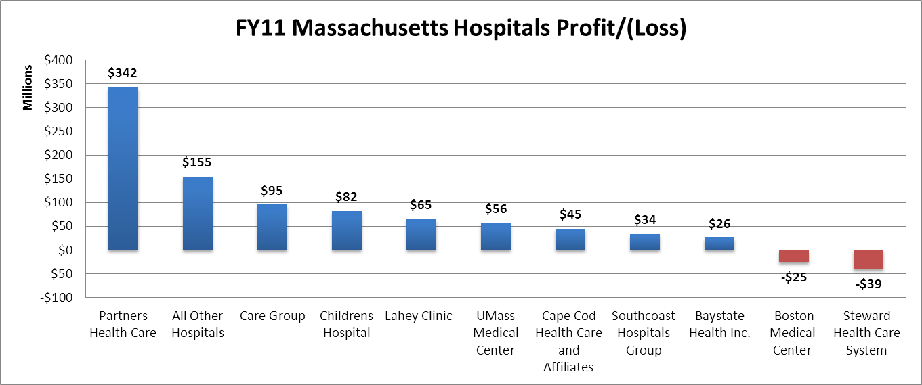
Acute Hospital Financial Performance, by Hospital System: FY11
Highlights:
Partners and Care Group hospital systems make up 52% of the entire profit in the state.
Mass General Hospital alone makes up 24% of the entire profit in the state.
BMC had the largest loss for an individual hospital in the state.
Steward Health Care System (10 hospitals) had the largest combined loss in the state.
Notes:
This is how we compare to other entities in the area in FY11.
Generally speaking, other hospital payor mix is better (i.e. more commercial payors and better rates) and that their cost per volume is lower than BMC’s.

Slide 13
Hot Topics – Patient and Revenue Cycles
Patient/Revenue Cycle
Notes:
Now we’re going to move along and talk about the Patient/Revenue Cycle, the Patient Experience overlaid with the Financial piece.
We’ll walk you through the patient experience and then the revenue cycle.
This section will review how everyone has their part in ensuring BMC gets paid for quality patient care.

Slide 14
Revenue Cycle Overview
CLINICAL
DOCUMENTATION
CODING &
CHARGE
CAPTURE
HIM,
CODING
UTILIZATION
REVIEW /
CASE MGMT
CLAIMS
EDITING
SUBMISSION
FINANCIAL
THIRD PARTY
COUNSELING
Patient Care
COLLECTIONS
COPAYMENT
PAYMENT
COLLECTION
POSTING
REGISTRATION
DENIALS / AUDIT
MGMT
PRE-
CONTRACT
REGISTRATION
SCHEDULING
MGMT
Notes:
Question to the class: What areas of this cycle are you most familiar with?
Notes: split out documentation and coding and charge capture because with outpatient care, those don’t get sent to HIM (health information management).
Tasks not specifically highlighted include reporting, benchmarking and regulatory payor management processes.

Slide 15
The Changing Economy
  Revenue Related Challenges:
  Reduction/Lag in Governmental Dollars Owed to BMC
  Governor’s Budgetary Powers
  Future Years Not Yet Secured
  Reduced Demand for Healthcare, Fewer Elective Procedures
  Changes to insurance reimbursements: tiers and pay for performance
  Change from fee-for-service to payment for population management

Slide 16
Volume, Volume, Volume!
Notes:
.

Slide 17
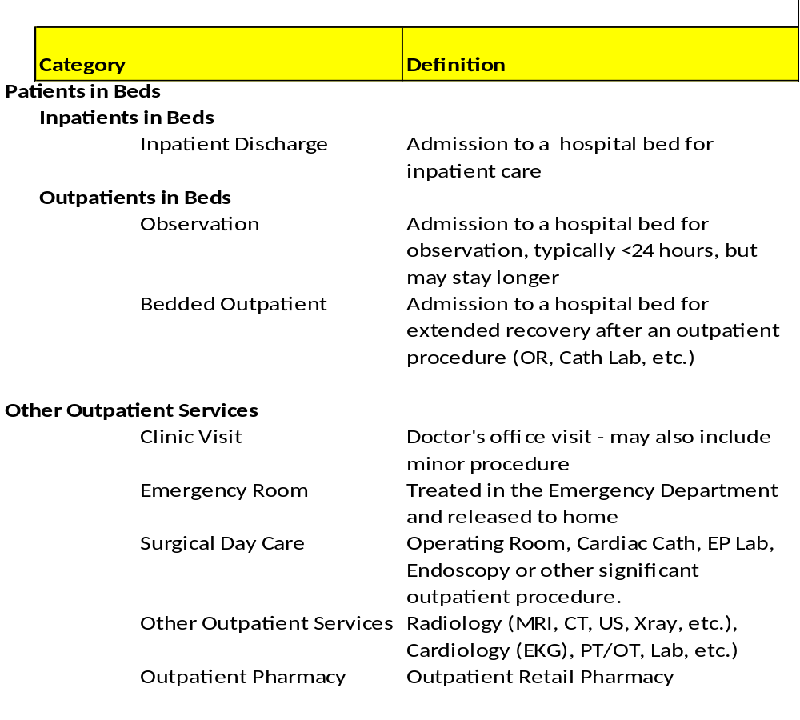
Types of Patient Volume
Bedded outpatients: BMC typically receives payment for the procedure (SDC) but no added payment for the care on the inpatient nursing unit.
16
Notes:
In FY13 we expect inpatient volume loss to slow.
Important note: The embedded schedule contains approximate revenue per patient and by type and FY12 % of NPSR (double click to see full schedule). Please use as discussion points.

Slide 18
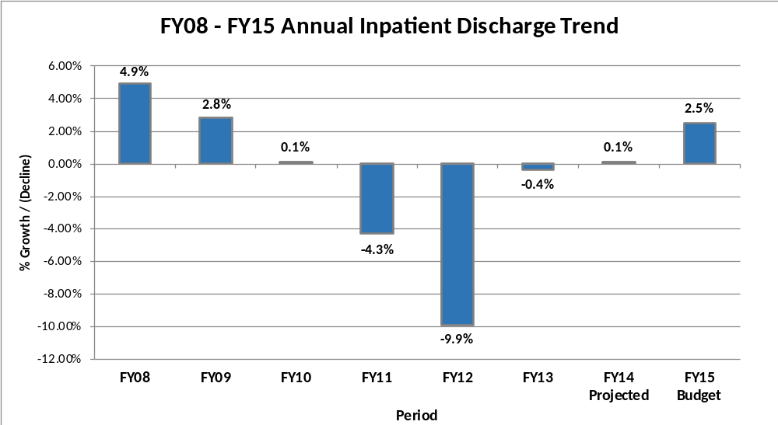
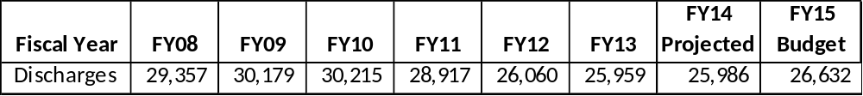
Annual Inpatient Discharge Trend
Highlights
FY15 IP discharges are projected to grow 646 discharges (or 2.5%) to 26,632 from FY14 projection of 25,986
FY14 IP discharges are projected to increase 0.1% from FY13 associated with strong inpatient Medicine discharge volumes

Slide 19
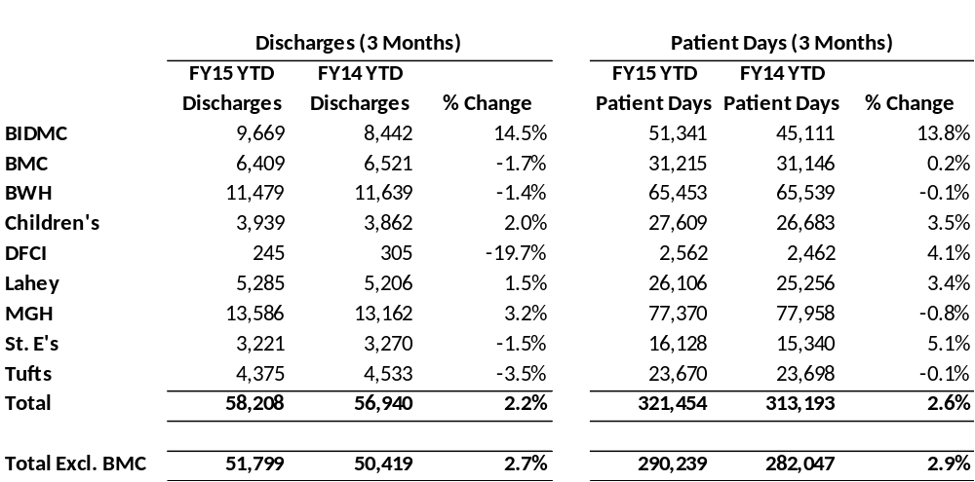
Boston Organization of Teaching Hospital Financial Officers (BOTHFO): December 2014 Volume Report
Highlights
As of December of FY15, BMC’s inpatient discharges were down 1.7% for the year while the average for other BOTHFO hospitals was up 2.7%.

Slide 20
Market Forces are Leading to Lower Inpatient Volumes
Stricter Requirements for Inpatient Admission
Changing technology and requirements for inpatient admission resulting in more observation and surgical day care patients
Care Management
Medical home model leading to lower admission rates from Medicine and Family Medicine
Reduced readmission rates due to penalties (Medicare, Medicaid)
Efforts to limit Emergency Room usage
Competitors
New emergency rooms and service guarantees from other Boston ER’s, along with efforts to attract specific patient populations (Carney marketing to Vietnamese patients).
Falling ER volume (walk-ins, ambulance and trauma) from BMC’s core market areas.
Competitors consolidating referral networks and cutting out BMC
      For example: New Steward arrangement with Partners for trauma care
Rate differentials make it difficult for BMC to grow its network
Financial Pressures on Patients
The economic downturn, combined with increased prevalence of high-deductible health plans, results in fewer elective procedures

Slide 21
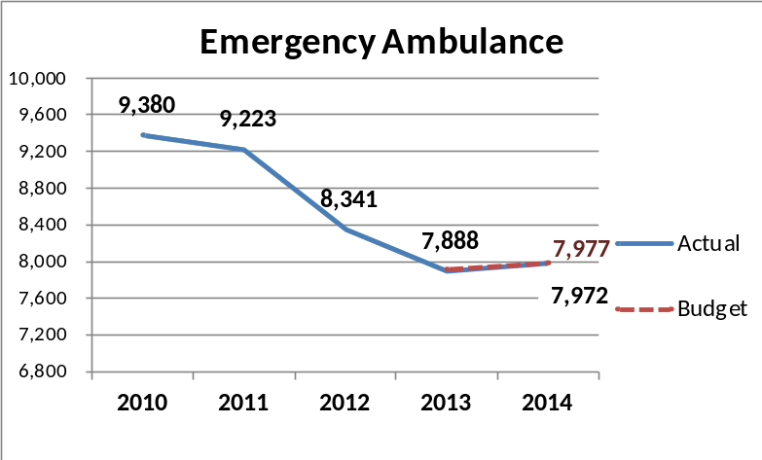
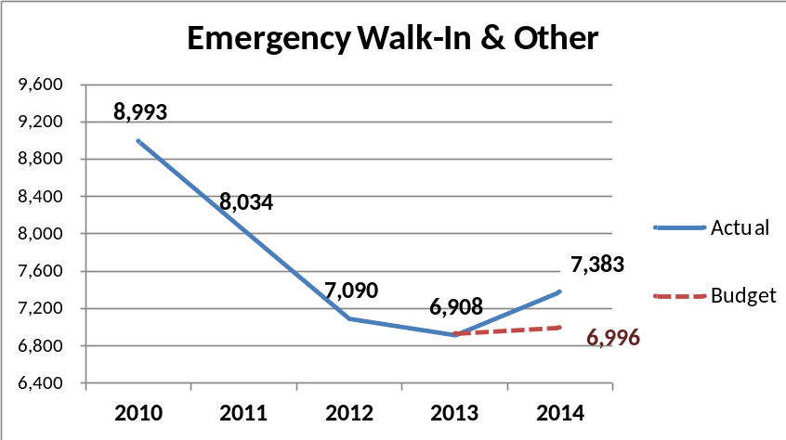
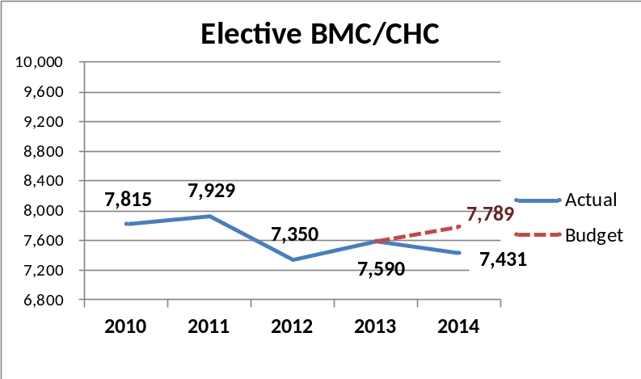
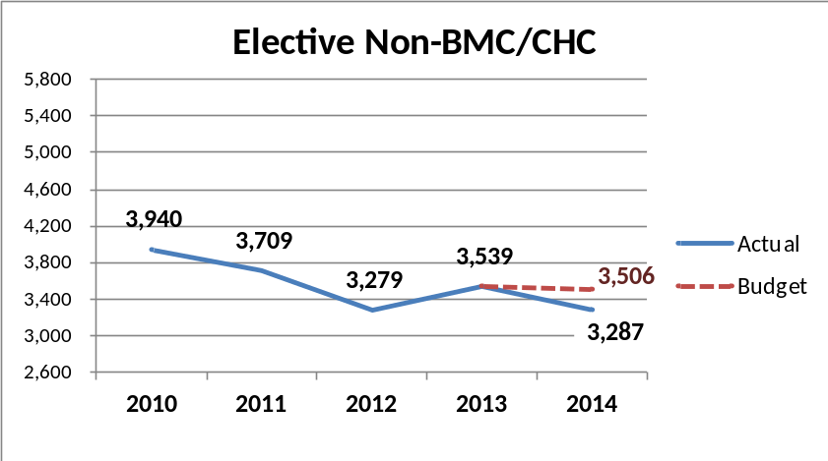
The Right Care…no more, no less
Can only work if there is volume!
Patients can be divided into 4 groups based on the “front door” they use to arrive at BMC:
Notes:
In this slide we separate our patients by the “front door” they use: Each Front Door has different drivers and trends. In FY12 all were in decline, but in general we have seen the steepest decline in elective admissions from outside the BMC/CHC PCP network, and from Emergency non-ambulance (i.e. walk-ins and other). Those are the patients that have the greatest degree of choice and where competitors are actively seeking to lure patients away.
In FY13 all segments projected to shrink except BMC elective procedures which are projected to grow due to new surgeons hired in Orthopedics and Vascular Surgery, as well as growth initiatives described later in the document

Slide 22
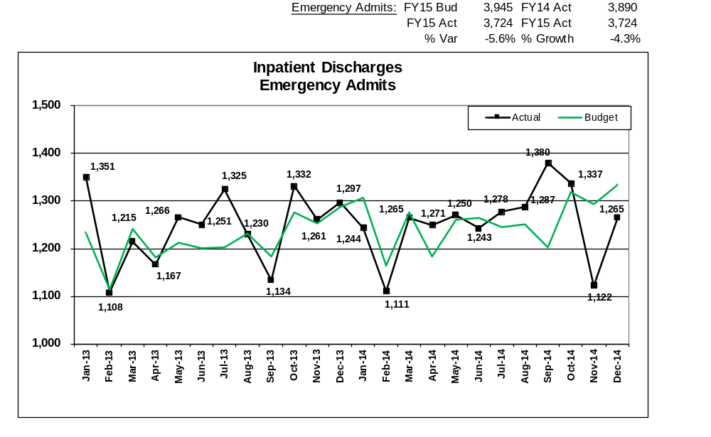
Emergency Admissions -- Volume vs Budget
January 2013 to December 2014
Emergency admissions in FY15 are down 5.6% from budget (221 discharges) and 4.3% from prior year. ED admissions account for 72% of the total inpatient variance to budget.

Slide 23
Monthly Walk-in Volume Trend
Walk-in volume has been decreasing since June 2014 (on average 511 visits per month for the last 7 months).

Slide 24

Questions?

Slide 25
Wrap-Up
24
Thank You!
Notes:
24
Thank everyone for coming and their participation. Wish them well and offer them support with their learning plans.
Handout the course evaluation and ask that it be completed and turned in before leaving.

