Slide 1
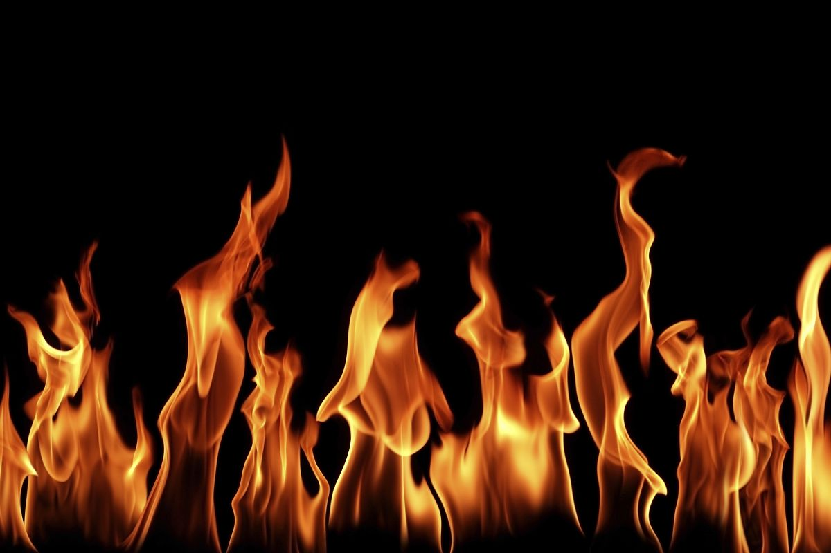
Evaluation of the Febrile Patient Fevers and Fevers of Unknown Origin A case-based approach
Richard Serrao MD
Assistant Professor of Medicine, BUSM
Sections of Internal Medicine and Infectious Diseases

Slide 2
The febrile patient
Fevers: Relatively straightforward approach
Definitions
Fever vs hyperthermia vs hyperpyrexia
Mechanisms
Initial approach
Fevers of unknown origin: More complex, more fun to chase
Definition
Spectrum
Fun Cases and categories

Slide 3
What is a fever?
Elevation in body temperature above normal range from increase in temperature regulatory set point : 99.5–100.9 °F
Mouth >99.9
Axilla/otic >99.0
Anus >99.5-100.9
Hyperpyrexia: typically not infectious
104–106.7 °F
Set points vary depending on clinical setting

Slide 4
Fever versus hyperthermia
Fever: resetting of the thermostatic set-point in the anterior hypothalamus and the resultant initiation of heat-conserving mechanisms until the internal temperature reaches the new level
If acute (and less commonly chronic), infection unless proven otherwise
Hyperthermia: an elevation in body temperature that occurs in the absence of resetting of the hypothalamic thermoregulatory center
Usually not mediated by infectious diseases
The difference between these two is mechanism

Slide 5
Mechanisms of fever (in 3 sentences)
Pyrogens (endogenous and exogenous) trigger fevers via release of prostaglandin E2 → hypothalamic stimulation → vasoconstriction, then shivering → temp rise
Endogenous: IL1, 6,8, TNF, IFNa,b,g → arachidonic acid pathway activated
Can be released in collagen vascular, malignancy
Exogenous: i.e. LPS → binds to lipopolysaccharide binding protein → release of IL-1
Typically infectious

Slide 6
Mechanisms of fever: Examples of Common Bacterial pyrogens
Lipopolysaccharide (LPS) endotoxin of GNRs
binds to LPS-binding protein and is transferred to CD14 on macrophages, which stimulates the release of TNFα.
Staphylococcus aureus enterotoxins
Staphylococcus aureus toxic shock syndrome toxin (TSST)
Both Staphylococcus toxins are superantigens and activate T cells leading to the release of interleukin (IL)-1, IL-2, TNFα and TNFβ, and interferon (IFN)-gamma in large amounts
Group A and B streptococcal toxins
Exotoxins induce human mononuclear cells to synthesize not only TNFα but also IL1 and IL-6

Slide 7
Fever types (by severity): Mechanisms of hyperthermia/hyperpyrexia
Excessive heat production:
exertional hyperthermia, thyrotoxicosis, pheochromocytoma, cocaine, delerium tremens, malignant hyperthermia
Disorders of heat dissipation:
heat stroke, autonomic dysfunction
Disorders of hypothalamic function:
neuroleptic malignant syndrome, CVA, trauma
All non infectious!

Slide 9
General approach to Fevers
Chase the symptom
Headache, meningismus, pharyngitis, dysuria, diarrhea, abdominal pain, etc.
Makes it obvious!
Start with the basics: ua/urine culture, CXR, blood cultures
Follow the pattern
Look at everything for patients in whom the pattern is inconsistent
Most fevers diagnosed early (i.e. not an FUO yet) will have an infectious cause…

Slide 10
…ergo: The preliminary work-up
History
PE
CBC with diff
Blood cultures (3 sets drawn from different sites over at least several hours OFF abx)
Chem 7 and LFTs
Hepatitis serologies if LFTs abnormal
UA, urine culture
CXR
Most patients will have the answer here

Slide 11
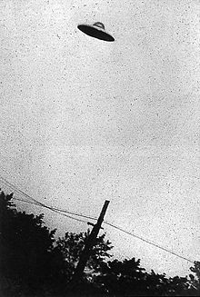
“A patient with a fever that has not had a basic work up yet does not an FUO make”

Slide 12
Fever of Unknown Origin (FUO)- Petersdorf and Beeson 1961
“Fever > 38.3 (101) on several occasions, persisting without diagnosis for at least 3 weeks in spite of at least 1 week’s investigation in hospital.”

Slide 13
Categories of FUO/updated criteria
Featureª | Nosocomial | Neutropenic | HIV-associated | Classic
Patient’s situation | Hospitalized, acute care, no infection when admitted | Neutrophil count either <500/µL or expected to reach that level in 1-2 days | Confirmed HIV-positive | All others with fevers for ≥3 weeks
Duration of illness while investigated | 3 days^{b} | 3 days^{b} | 3 days^{b} (or 4 weeks as outpatient) | 3 days^{b} or 3+ outpatient visits
Examples | Septic thrombophlebitis, sinusitis, C. difficile colitis, drug fever | Perianal infection, aspergillosis, candidemia | MAI^{c} infection, TB, non-Hodgkin’s lymphoma, drug fever | Infections, malignancy, inflammatory diseases, drug fever
ªAll require temperatures of ≥38.3°C (101°F) on several occasions.
^{b}Includes at least 2 days’ incubation of microbiology cultures.
^{c}M. avium/M. intracellulare.
Modified from DT Durack, AC Street, in JS Remington, MN Swartz (eds):
Current Clinical Topics in Infectious Diseases. Cambridge, MA, Blackwell, 1991.

Slide 14
The changing spectrum
Over decades, the etiology has been shifting
3 classic categories are consistent:
Infections
Malignancies
Connective tissue diseases
True FUOs are uncommon
Excessive use of empiric antibiotics can mask/delay diagnosis of occult abscesses/infections; drug fevers increasing
MDR organisms, lengthy ICU and chemo regimens changing the flora

Slide 15
Notes:
No diagnosis early in century because of limited diagnostic tests. True FUOs later in century gone down because better diagnostic tests, the fraction of cases that are undiagnosed has gone back up.

Slide 16
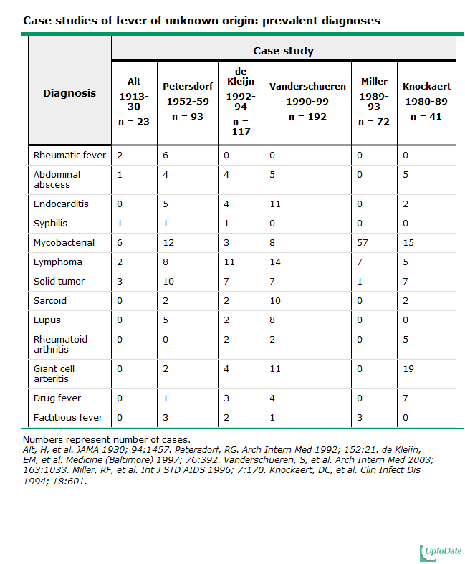
Notes:
Mycobacterial high in HIV

Slide 17
The changing spectrum
Undiagnosed FUOs has gone from 75% to <10%, but the fraction of FUOs that are undiagnosed has increased
More connective tissue diseases are being diagnosed
Extrapulm TB, solid tumors and intrabdominal abscesses are less prevalent due to CT scanning
CT guided IR has replaced ex-laps for diagnosis
Better blood culturing techniques has reduced IE as an etiology for FUO
Culture negative or fastidious organisms (bartonella) remain as FUOs
The longer a patient has a fever, the less likely an ID cause will be found

Slide 18
Case #1
72 y.o, male with cirrhosis, diabetes and is on chronic steroids for RA who is s/p partial colectomy for recurrent diverticular disease

Slide 19
Case #1: (Occult) abscess
usually located in the abdomen or pelvis
cirrhosis, steroid or immunosuppressive medications, recent surgery, and diabetes are predisposing factors
arise in locations of disrupted barrier in bowel wall (appy, tics, IBD).
develop in subphrenic, omental, pouch of Douglas, pelvic, and retroperitoneal locations.
Pyogenic liver abscesses in setting of biliary tract disease, appendicitis or diverticulitis.
Amebic liver abscesses can look like pyogenic abscesses; check e histolytica serologies.
Splenic abscesses occur from hematogenous seeding: look for concominant endocarditis
Perinephric abscesses can have normal UA/urine culture

Slide 20
When an infection is the cause of FUO by disease
Intraabdominal abscess (liver, splenic, psoas, etc)
Appendicitis
Cholecystitis
tubo-ovarian abscess
Intracranial abscess
Sinusitis
dental abscess
Chronic pharyngitis
Tracheobronchitis
lung abscess
Septic jugular phlebitis
mycotic aneurysm
Endocarditis
intravenous catheter infection
vascular graft infection
Wound infection
Osteomyelitis
infected joint prosthesis
Pyelonephritis
prostatitis
Things that are hidden, may give false negative blood cultures, or have an unrevealing (missed on) exam
We’re getting better at finding these things!

Slide 21
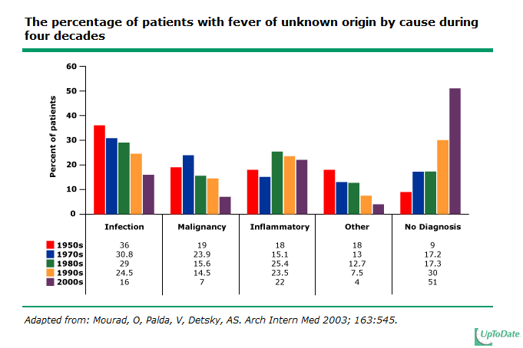
We’re getting better at finding infections and cancers thereby reducing the total FUOs seen, but leaving
many undiagnosed cases
Notes:
The fraction of undiagnosed FUOs dropped from over 75 percent in the 1930s to less than 10 percent in the 1950s. Since then, the fraction of FUOs that go undiagnosed has steadily increased because we’re getting better at picking up cancers and infections.

Slide 22
True FUOs rare
2800 hospital beds over 2 year period (2003-2005); only 73 cases of FUOs found
Noninfectious inflammatory diseases (vasculitis, SLE, PMR) — 22%
Infection — 16%
Malignancy — 7%
Miscellaneous — %
No diagnosis — 51%
Bleeker-Rovers et al. Medicine (Baltimore). 2007 Jan;86(1):26-38.

Slide 23
Case #2
45 y.o G5, P5 woman from subsaharan Africa with HIV who presents with daily fevers as high as 103.
She has no cough, SOB, headache. She is on no meds.
Her LFTs are mildly elevated with mild hepatomegaly and ascites. HAV/HBV/HCV negative.
CXR is negative.
CBC demonstrates microcytic anemia with teardrop cells.
She is not on HAART and has a CD4 of 376, VL 28,000

Slide 24
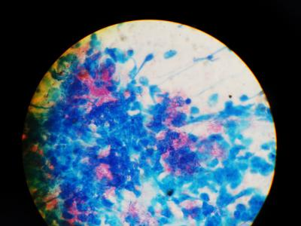
Case #2
Ascites fluid is lymphocytic predominant. Blood cultures, ascitic fluid: no growth.
BM aspirate:
oraclesyndicate.twoday.net

Slide 25
Case #2: Tuberculosis as an FUO
single most common infection in most FUO series.
Can be extrapulmonary, miliary, or occur in the lungs of patients with significant preexisting pulmonary disease, or immunodeficiency
pulmonary tuberculosis in AIDS patients is subtle; CXR normal in up to 20%
Readily treatable
PPD positive in <50%
Sputum + in only 25%
May require lymph node, BM or liver biopsy
Isolator blood cultures need incubation for >16 days

Slide 26
Geography and FUOs
Developing world
TB
Typhoid
Amebic liver abscesses
AIDS
Returning traveler
Malaria
Brucellosis
Kala azar
Filariasis
Schistosomiasis
Lassa fever

Slide 27
Worldwide “FUOs”
Ease of travel can increase risk for non endemic (autochthonous) infections to be present in the recent traveler given long incubation period
malaria, brucellosis, kala azar, filariasis, schistosomiasis, Lassa fever
the most common infections among series of FUOs have not changed over the century:
typhoid fever, TB, amebic abscesses, malaria.
FUOs are more often caused by an atypical presentation of a common entity than by a rare disorder

Slide 28
Case: Fever in the states
56 y.o. male HIV+, CD4 332, VL ND on HAART presents in Nov with fever 104.0 q day, shaking chills, myalgias and malaise. Mild diffuse HA. Evanescent rash noted on left shoulder
Recent hiking in NH
PE: flushed, ill but not toxic. No focality
Pancytopenia (new), AST 150, ALT 161, TB 0.4

Slide 29
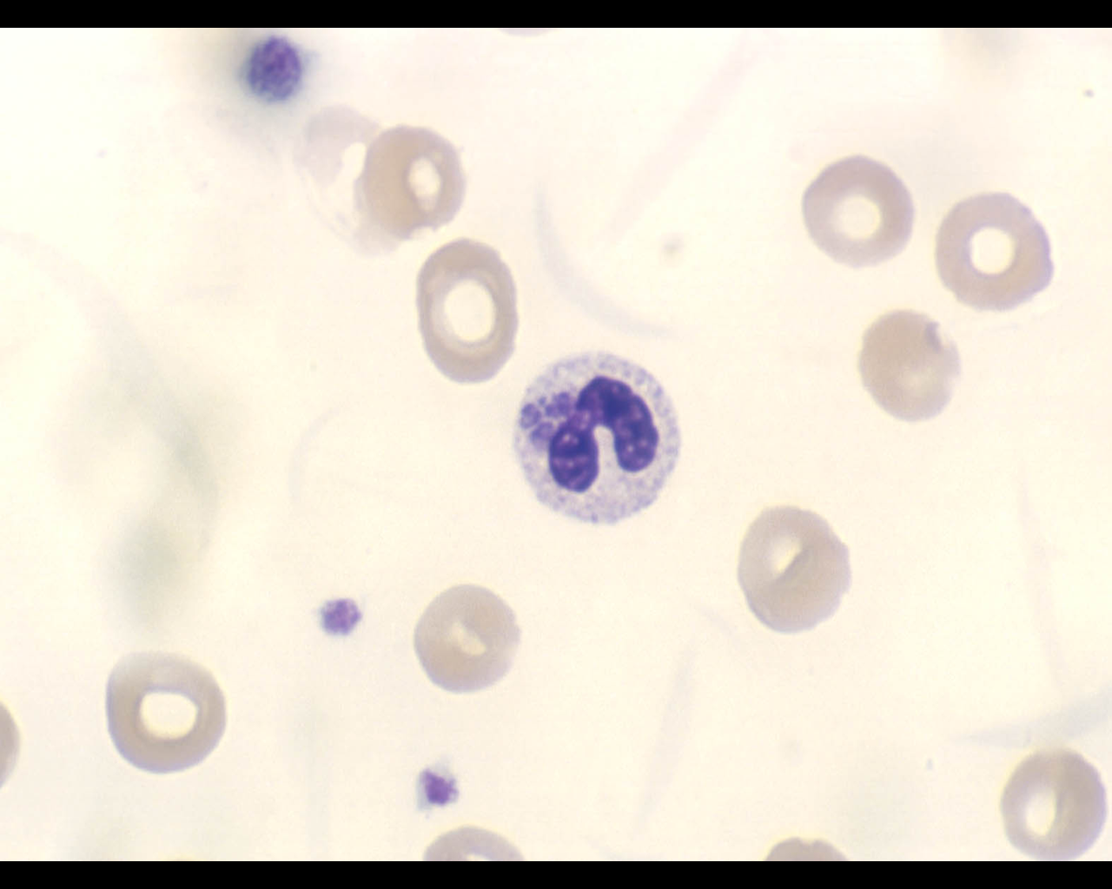

Slide 30
Anaplasmosis (Ehrlichiosis)
Always look at peripheral smear in presumptive BM disorders
Intraleukocytic/intraerythrocytic inclusions
<60% recall tick exposure
Search for coexistent lyme and babesiosis

Slide 31
When an infection is the cause of FUO by pathogen
Tuberculosis, Mycobacterium avium complex, syphilis, Q fever, legionellosis
Salmonellosis (including typhoid fever), listeriosis, ehrlichiosis,
Actinomycosis, nocardiosis, Whipple’s disease
Fungal (candidaemia, cryptococcosis, sporotrichosis, aspergillosis, mucormycosis, Malassezia furfur)
Malaria, babesiosis, toxoplasmosis, schistosomiasis, fascioliasis, toxocariasis, amoebiasis, infected hydatid cyst, trichinosis, trypanosomiasis
Cytomegalovirus, HIV, Herpes simplex, Epstein-Barr virus, parvovirus B19

Slide 32
Subpopulations of FUOs
HIV/AIDS:
79% infections
50% mycobacterial (2/3 atypical mostly MAC)
8% malignancies: NHL; disseminated KS rare
9% no diagnosis
Neutropenia
Most due to bacteremia
Fungi as source of FUO increases after 7 days (fungemia, then aspergillus)
Confounders include: cancer, drugs, blood products
Fever when neutropenia resolves: hepatosplenic candidiasis
Age:
Children: 30% self limited viral syndrome
Age >65: 30% caused by PMR, vasculitis, GCA, sarcoid; 22% infections; 12% cancers

Slide 33
Case #3: FUO in AIDS
55 y.o. HCV/HIV+, CD4 5, VL 115,000 noncompliant with HAART. CC: confusion, fever, anisocoria
Head CT: mass lesion with hemorrhage; CT body: no lymph node enlargement
CSF: normal
Pyrimethamine/sulfadiazine started empirically for toxo

Slide 34
Case #3: FUO in AIDS
Within 2 days, >20 SC erythematous tender nodules on shins and buttocks

Slide 35
Fever with erythema nodosum (panniculitis)
Rheumatic fever
Sarcoidosis
Drug induced
Post-streptococcal
Mycoplasma
Coccidioidomycosis
Other fungal
TB/nontuberculous mycobacteria
SLE
Vasculitis
syphilis

Slide 36
Case #3: FUO in AIDS: Skin Biopsy

Slide 37
Case #3: FUO in AIDS: Culture results: Mycobacterium avium intracellulare
Blood and skin grew Mycobacterium avium intracellulare
Patient recovered with Clarithromycin, rifampin and ethambutol
Tandon R, Kim K, Serrao R. Disseminated mycobacterium avium-intracellulare
infection in a person with AIDS with cutaneous and CNS lesions. The AIDS
Reader. 2007; 17(11): 555-560

Slide 38
FUO in AIDS case 2
36 y.o. male with ? PMH of PCP PNA 1yr PTA and several suicide attempts with benzos/percocets
BIB family members who noted patient to be lethargic, c/o chills and RUQ pain
Exam notable for T102.6, HR 110, 100/55, O2 sat 90% RA, lethargic, conjunctival injection, thrush, ? Nuchal rigidity, dry crackles, mod RUQ tenderness, hepatomegaly, +/- guarding
Admitted to ICU with dx of acute hepatic failure secondary to probable tylenol overdose (sister saw empty bottles in room)
Grew up in Chicago

Slide 39
WBC: 12 (90P), 11/33, Plts 90
134/3.3/102/9/34/2.3 AG 23
LFTs: AST 2344, ALT 2688, Alk Phos 113
PT 15, PTT 42
DIC screen +
Acetominophen level, pancultures pending
CXR: diffuse interstitial infiltrates

Slide 41
Patient started on ceftriaxone 2g iv q 12, vanco 1 g q 12, ampicillin 2 q 8 and high dose Bactrim.
N-acetylcysteine administered empirically
STAT RUQ ultrasound read as hepatomegaly with TNTC punctate lesions throughout parenchyma of liver; no bil dil; no stones

Slide 43
Disseminated histoplasmosis

Slide 44
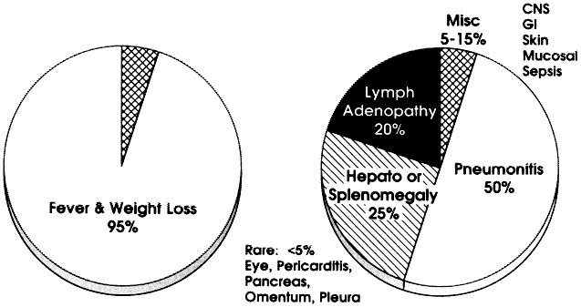
Disseminated histoplasmosis

Slide 45
Disseminated histoplasmosis
Consider in immunocompromised host (AIDS, solid organ transplant) with transaminase elevations, unexplained fever, reticulonodular pulmonary infiltrates from endemic area

Slide 46
Case #4
35 y.o. recuperating counts after prolonged neutropenia for AML who has been on cefepime and vanco and defervesced early.
C/o RUQ tenderness, LFT abnormalities, febrile
CT abdomen reveals multiple punctate small echogenic lesions

Slide 47
CT Scan shows multiple hypodense lesions in the
liver and spleen .
Curr Probl Diagn Radiol, November/December 2004

Slide 48
Case #4: Hepatosplenic candidiasis
Complication of prolonged neutropenia that required systemic antimicrobials when fever abates
Due to duration of systemic antimicrobials (as compared to aspergillus which is due to duration of neutropenia)
Treat with fluconazole/echinocandins if suspect glabrata

Slide 49
Case #5
71 y.o. male c/o fevers, night sweats, weight loss for 3 months. Generalized muscle aches and difficulty getting up from chair
PMH: sulfa allergy, noted to be anemic 1 yr ago, negative blood loss w/u
PPD neg
Labs anemic & leukopenic with monocytosis. ANA, DS DNA, and LFTS nl
ESR 102, elevated serum ferritin

Slide 50
Temporal artery biopsy in giant cell (temporal) arteritis. Left panel: Granulomatous and lymphocytic inflammation of the adventitia and medial wall of the temporal artery. Right panel: Elastic tissue stain showing disruption of the elastica (arrows) due to immunologically mediated destruction of the elastica.
Courtesy of Cynthia Magro, MD via uptodate.com
Notes:
Temporal arteritis

Slide 51
DDx of FUO in elderly
Temporal arteritis/PMR/vasculitis/sarcoid: 30%
Infectious: 22%
Endocarditis
Cryptogenic intraabdominal abscess
Extrapulm TB
Malignancy: 12%
Lymphoma
Hepatoma
Renal cell ca
Unusual to cause FUO: colon ca, leukemia, MDS

Slide 53
Approach to FUO: Clues
Clues on exam and labs:
11 diagnostic clues/patient in history and physical
3/patient in laboratory tests
81% of these clues are misleading
Ask about:
Travel
Animal exposure (pets, living on a farm, occupational)
Immunosuppression
Drug and toxin history
Localizing symptoms
Bleeker-Rovers CP et al Medicine. 2007 Jan;86(1):26-38.

Slide 54
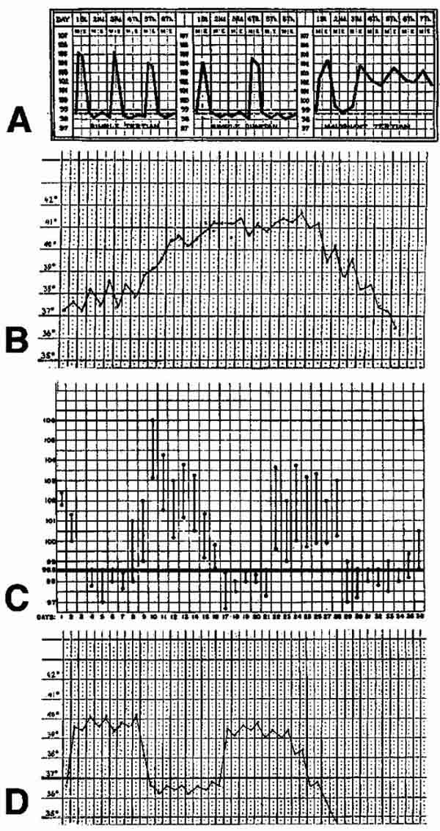

Slide 55
Clues: Fever types (by curves)
Intermittent: fever for a certain period, cycling back to normal: Malaria, kala-azar, sepsis
Quotidian fever, with a periodicity of 24 hours, typical of Plasmodium falciparum or Plasmodium knowlesi
Tertian fever (48 hour periodicity), typical of Plasmodium vivax or Plasmodium ovale malaria
Quartan fever (72 hour periodicity), typical of plasmodium malariae
Continuous: Temperature remains above normal throughout the day and does not fluctuate more than 1 °C in 24 hours:
lobar pneumonia, typhoid, UTI, brucella or typhus
Pel-Ebstein fever: high for one week, low for the next:
Hodgkins lymphoma
Remittent fever: Temperature remains above normal throughout the day and fluctuates more than 1 °C in 24 hours
Infective endocarditis

Slide 56
Old school curves
Malaria
Typhoid fever
Hodgkins (Pel Ebstein)
Borreliosis (relapsing fever)
Specificity of these curves is still generally poor
Hirschmann Clin Infect Dis. 1997 Mar;24(3):291-300; quiz 301-2
www.bioscience.org

Slide 57
Clues: Fever types (by severity)
Hyperpyrexia >106.7
Intracranial hemorrhage most common
Sepsis
Kawasaki syndrome
Neuroleptic malignant syndrome
Drug fever
Serotonin syndrome
Thyroid storm

Slide 58
Clues: ID associated relative bradycardia
Typhoid fever
Malaria
Typhus
Yellow fever
Leptospirosis
Dengue
RMSF
Q fever

Slide 59
Clues: Fever after travel
Malaria
Typhoid fever
Acute HIV
Kala-azar
Amebic liver abscess
Tuberculosis
Brucellosis
meloidosis

Slide 60
Case #5: interesting clue
27 y.o. female presents with sore throat, fever
and diffuse myalgias/arthralgias
-WBC 14.3, ESR 67, CPK slightly incr. Neg CXR, blood cxs neg
-CT abd/pelvis: splenomegaly.
-RF, ANA, ANCA neg
-Unprotected sex 2 months ago
http://www.dailystrength.org/groups//media/611476

Slide 61
Case #5
HIV 1,2 Ab negative
HIV-RNA PCR (viral load) returns at 121 copies

Slide 62
Still’s disease (Juvenile Rheumatoid Arthritis)
Arthralgias, fevers, elevated ferritin and salmon colored evanescent rash
1.5 cases per 100,000-1,000,000 population
Bimodal distribution: 15–25 and second peak between ages of 36–46
Diagnosis of exclusion

Slide 63
Diagnostic criteria: need 5 (at least 2 of them major)
Major criteria:
fever >39C for > 1 week
Arthralgias or arthritis for at least two weeks,
Nonpruritic salmon colored rash (usually over trunk or extremities while febrile),
Leukocytosis ( 10,000/microL or greater), with granulocyte predominance
Minor criteria:
Sore throat,
Lymphadenopathy,
Hepatomegaly or splenomegaly,
Abnormal liver function tests,
Negative tests for antinuclear antibody and rheumatoid factor
What infectious disease does this sound like?
Mono syndrome: HIV/EBV/CMV

Slide 64
Collagen vascular disease as FUO
SLE and ANCA+ disorders rare
Polymyalgia rheumatica
Temporal arteritis
Giant cell arteritis
Adult still’s disease
Behcets
Kikuchi’s disease
Again, most of these in older patients

Slide 65
Case #6: interesting clue (?)
55 y.o. female presents with 4 months of persistent night sweats, fevers
Visited a farm with kids and watched a goat give birth 5 months ago

Slide 66
Q fever (and culture neg endocarditis)
Caused by coxiella burnetii (serologies): “parturient cats,” sheep, goats, cattle; aerosolization/contact with body fluids/ingestion of infected milk; ticks as reservoirs; ILI, painless hepatitis, atypical pna, prolonged FUO; dx: serologies
Cultures are negative in 2-5% in all cases of BE especially in partially treated
Culture negativity common with Coxiella Burnetii, tropheryma whippeli, brucella, mycoplasma, chlamydia, histoplasma, legionella, bartonella
HACEK: haemophilus spp, actinobacillus, cardiobacterium, eikenella and kingella: alert lab to incubate cultures for 7-21 days
Peripheral manifestations are rare
TEE reveals veg in 90% of SBE presenting as FUO
Treated with tetracycline

Slide 67
The algorithmic approach to workup/labs/imaging

Slide 68
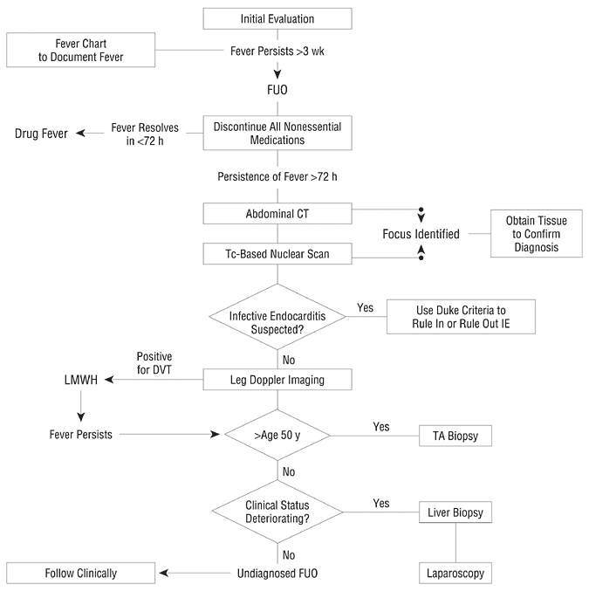
Mourad, et al. Arch Intern Med. 2003;163:545

Slide 69
Laboratory work up: False positive rate=rate of a helpful result
ESR and crp: TB,osteo, CA, CVD >100
LDH: lymphoma, PJP
PPD or quantiferon: TB
HIV ab (consider viral load): HIV
3 blood culture sets over several hours (prior to antibiotics): bacteremia
RF: rheumatoid arthritis
CPK: PMR, polymyositis
Heterophile ab (children, young adults): mono (EBV)
SPEP: MM
ANA: autoimmune process
CT of abdomen and chest: r/o lymphadenopathy, nodules

Slide 70
Utility of ESR: good negative predictive value
ESR > 100
Malignancy (lymphoma, myeloma, metastatic colon or breast): 58%
Infections: endocarditis, TB, osteo: 25%
Collagen vascular disease: 25%
Less serious causes causing ESR > 100
Drug hypersensitivity
Thrombophlebitis
Renal disease (nephrotic syndrome)
Normal ESR suggests that a significant inflammatory process, of whatever origin, is absent
can be seen in GCA, however
Zacharski et al JAMA. 1967 Oct 23;202(4):264-6.

Slide 71
Utility of CT, tagged WBC and PET Scanning
Useful to pick up lymphadenopathy, granulomas
Lymphomas, tuberculous, fungal
Gallium-67 and/or indium-111: highly sensitive for whole body but not specific
PET scan data is limited in FUO
Start with CT/ultrasounds, then tagged wbc/PET later

Slide 72
Additional tests
Dictated by history
Subtle nervous system signs: LP
Travel to midwest or southwest: investigate cocci, histo, blasto
Trauma: LENI
Biopsies:
Liver biopsy generally low yield for miliary tb, granulomatous hepatitis or sarcoid
Lymph nodes: better for lymphoma, cat scratch
Temporal artery: low yield in minimal clinical signs
BM: generally high yield in thrombocytopenic/anemic, otherwise low in immunocompetent
Therapeutic antibiotic trials: do not do
Bleeker-Rovers CP et al. Medicine (Baltimore). 2007;86(1):26

Slide 73
Outcomes
Treatment of fever alone is generally not necessary except in hyperpyrexia (>106.7)
Outcome depends on underlying diagnosis
Children: 88% with infections have no sequelae
Adults: most who remain undiagnosed after extensive evaluation have a good prognosis

Slide 74
Pattern recognition: a couple more classic and interesting cases

Slide 75
Fever in patient with “spider bites” and back pain
21 y.o. male presents for the 3rd time to local ER for back pain. H/o narcotic abuse. Sent out after toradol injections and ibuprofen. Each visit noted to have temps of 99.8. Multiple “spider bites” near buttocks

Slide 76
Vertebral discitis
Strongly consider in IVDU
Plain films notoriously negative
Blood cultures can have high yield if concominant endocarditis
Detailed neurologic exam necessary
Urgent imaging if focal neuro deficits
Need to rule out osteomyelitis, epidural abscess

Slide 77
Sterile pyuria
46 y.o. male with poorly controlled DM, chronic active HCV, and active IVDU presents with 1 month of dysuria and eventual fevers
Several outpatient cultures negative
Admitted with acute B obstructive uropathy, pyelo, and ureteral “clots”

Slide 82
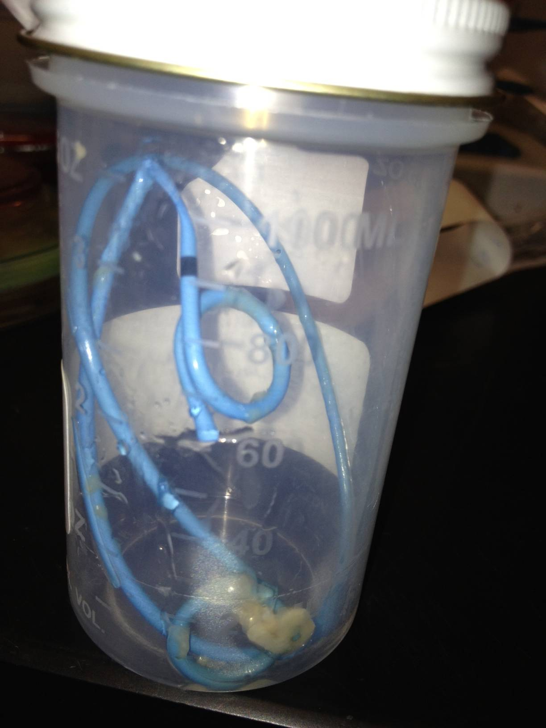

Slide 83
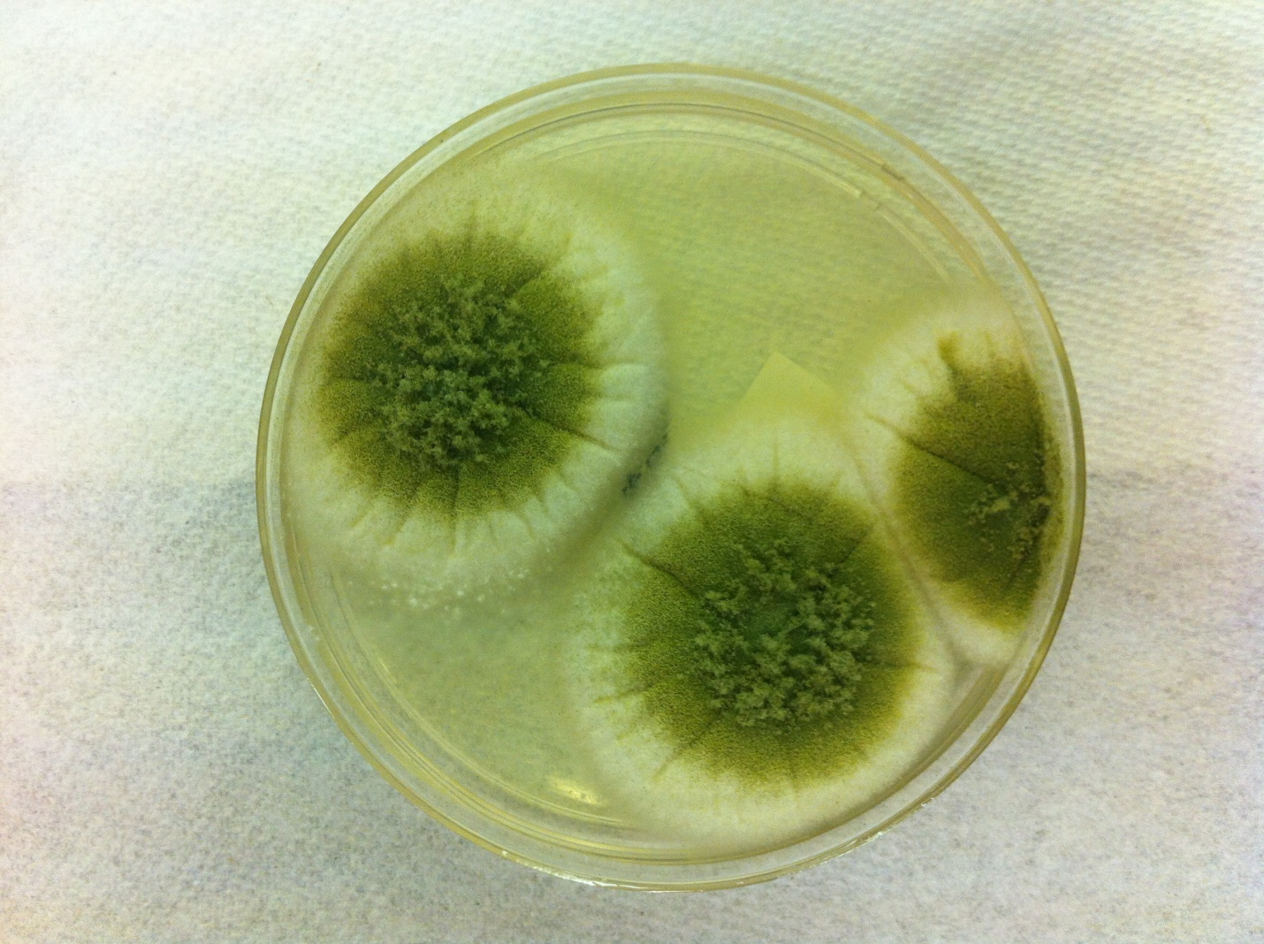

Slide 84
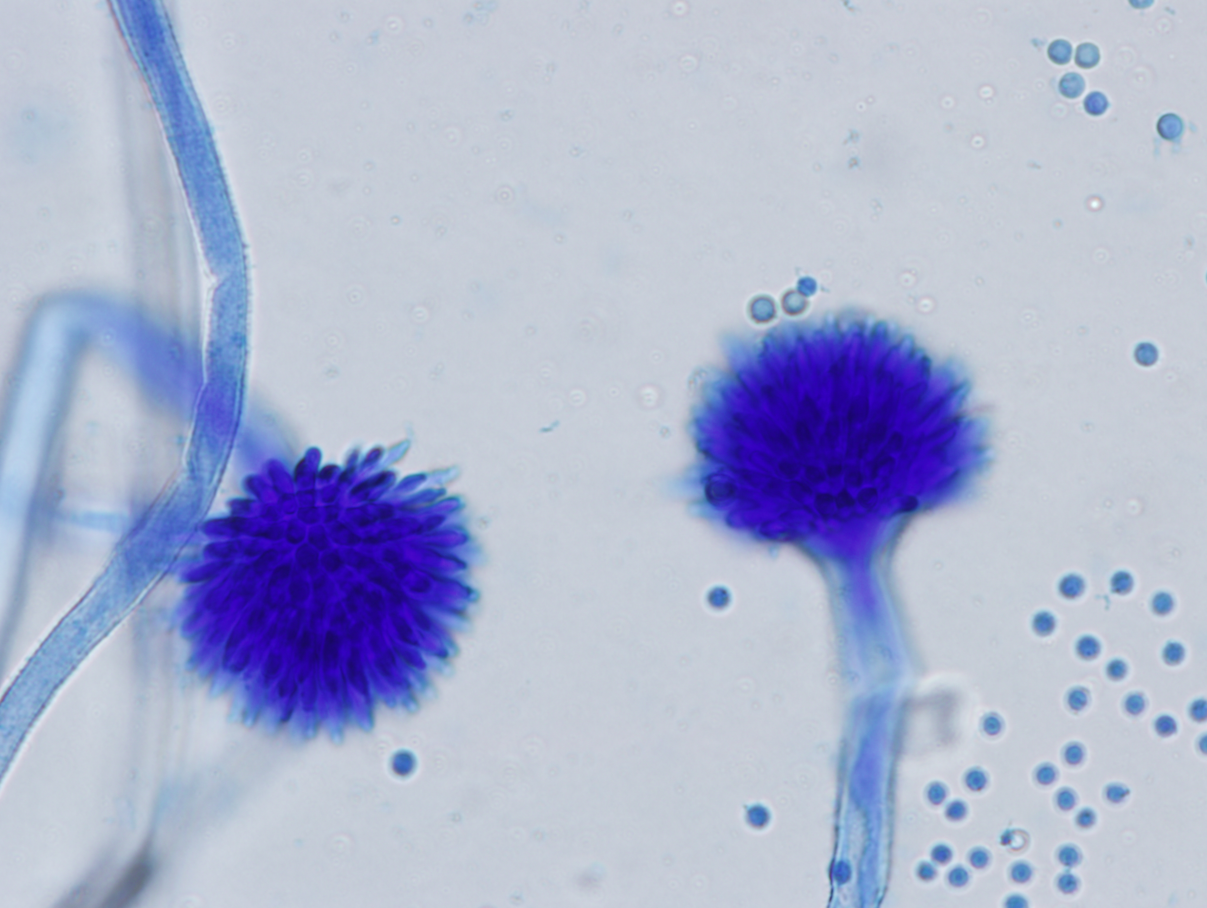

Slide 85
Bilateral renal aspergillus obstructive uropathy
Suspect TB in patient at risk for tuberculous pyelo as top cause for ID diff for sterile pyuria
In non-endemic area, IVDU/HCV/DM suspect aspergillus

Slide 86
Fever and bullous eruption
78 y.o. female with COPD/CHF intubated x 1 week in ICU. She is on vancomycin, cefepime. She has mild eosinophilia. Her hands look like this:

Slide 87
http://www.jaoa.org/content/104/4/157/F4.expansion

Slide 88
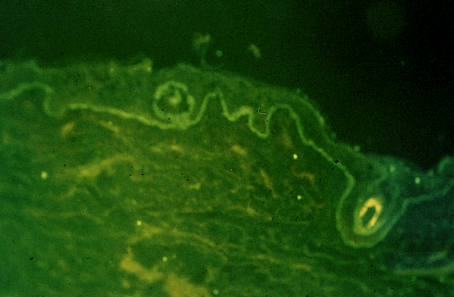
Drug allergies
Vancomycin mediated linear IgA: appears like bullous pemphigoid
Responds to drug cessation/steroids
Generally requires biopsy

Slide 89
Drug fevers
30% of hospitalized patients suffer from adverse drug reactions; outpatients can develop drug fever years later after starting a drug
Eosinophilia and rash are only seen in 25% of drug fevers
Most common drugs:
Antimicrobials: sulfonamides, penicillins, nitrofurantoin, vancomycin, antimalarials
H1 and H2 blocking agents
Antiepileptics: barbiturates, phenytoin
Iodide contrast media
NSAIDS
Antihypertensive drugs: hydralazine, methyldopa
Antiarrythmics: quinidine, procainamide
Antithyroid
Contaminants such as quinine (in heroin or cocaine)
Rarely cause:digoxin, aminoglycosides
25% of AIDS patients develop drug fever usually manifest as nausea and vomiting
Diagnosis: therapeutic trial off drug: wait at least a week before ruling in/out

Slide 90
The “at-risk” patient
82 y.o. male s/p urgent partial colectomy for diverticular abscess. NPO, NGT, on vanco and zosyn, TPN, vented, triple lumen left IJ. Yeast in sputum, febrile daily with negative cxr, UA, abdominal CT

Slide 91
Fungemia
Strongly consider empiric or pre-emptive treatment in patients on broad spectrum antibiotics, TPN, intrabdominal surgery, central lines, critically ill
If fungemic, check ophtho and TTE to rule out endophthalmitis/endocarditis.
Consider line/mucosa/bowel as source
Discontinue antimicrobials asap to minimize pressure for fungemia

Slide 92
The culture negative “impetigo”
25 y.o. female presents with intermittent fevers for past week and painful facial lesions
Temp 103
HgB 9.2, WBC 2 (50% pmns), platelets 60
BM Bx: myelodysplastic syndrome
Patient remains febrile despite broad spectrum abx and systemic antifungals for 1 week

Slide 93
Biopsy reveals PMNs, neg gram stain, neg culture
Dermis.net

Slide 94
Neutrophilic dermatosis: Sweet’s syndrome
Acute onset of fever, leukocytosis, erythematous plaques infiltrated by neutrophils with no evidence of vasculitis or infection
Responds to steroids

Slide 95
Final word on esoteric causes
Factitious fevers: psych patients, munchausens
Disordered heat homeostasis: follows hypothalamic dysfunction (CVA, anoxic brain injury) or abnormal heat dissipation (skin conditions such as ichthyiosis); hyperthyroidism
Dental abscess: 20 case reports in literature: defervesced after removal of decayed teeth; consider concominant brain abscess, meningitis, mediastinal abscess, endocarditis
Other infections (previously described): with pulm manifestations: Q fever, leptospirosis, psittacosis, tularemia, meliodosis; without pulm manifestations: secondary syphilis, disseminated gonococcal infections, chronic meningococcemia, whipple’s disease, yersiniosis
Alcoholic hepatitis: fever, hepatomegaly, jaundice, anorexia

Slide 96
Final word on esoteric causes
PE: 14%
Hematoma
Hyperthyroidism and subacute thyroiditis
Pheochromocytoma
Heriditary: FMF, tumor necrosis factor receptor-1-associated periodic syndrome (TRAPS), hyper-IgD syndrome, Muckle-Wells syndrome, and familial cold autoinflammatory

Slide 97
Thank you and, please, don’t get burned

