Slide 1
Board Review: Select disorders of the Pericardium and Myocardium
Julian Lel

Slide 2
Pericarditis

Slide 3
Causes are multiple…
Infectious –
Viral 20% of all cases (HIV w/u if risk factors, otherwise none)
Bacterial- suspect with bacteremia, endocarditis, contiguous infection
Fungal- immunocompromised with signs of disseminated disease
TB- consider it
Uremic- check BUN, Cr
Auto-immune- 20-40% of SLE pts will have pericarditis at some point
Acute MI
Post-MI
Post-pericardiectomy- occurs >1 week after cardiac surgery
Neoplasm- lung, breast, lymphoma, leukemia. Large effusions, no response to NSAIDs
Medications- hydralazine, procainamide, warfarin, heparin, doxorubicin, penicillins
Chest irradiation- may occur decades after irradiation
Trauma
Aortic dissection with leakage into pericardial cavity
Acute pericarditis recurs in up to 30% of pts, sometimes for years

Slide 4
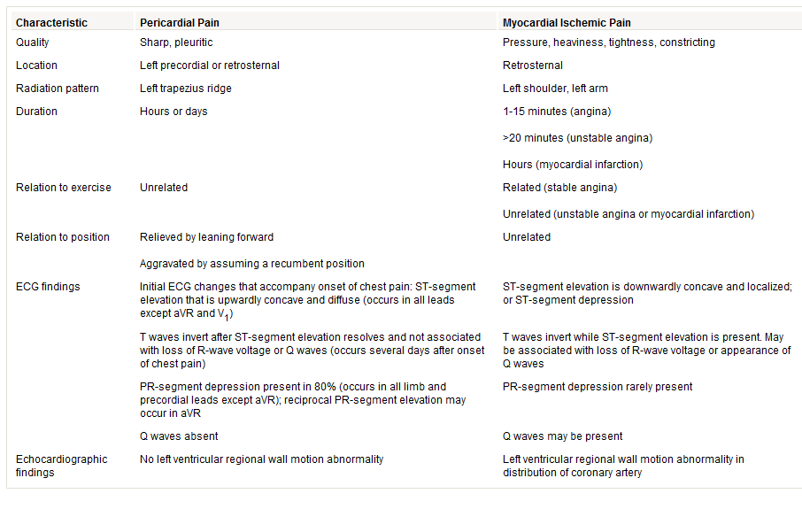

Slide 5
Diagnosis
2/3 of the following:
-Pleuritic chest pain
-Friction rub
-diffuse concordant ST-segment elevation on electrocardiography (ECG), often with depression of the PR segment
The Rub…
-Best heard at LLSB
-Best at inspiration or full expiration
-Pt leaning forward
Other tests:
CXR- mostly to exclude other things (PNA, PTX)
Labs- Not very helpful
TTE- urgently if hypotensive, pulsus >10 mm Hg, symptoms of heart failure

Slide 7
Treat as outpatient when stable and serious causes of CP, and mod-severe effusion excluded
ASA preferred when MI’s the cause
Corticosteroids used when inflammation or uremia’s the cause. Early use of steroids in acute pericarditis is associated with relapse.
Colchicine good for recurrence, helps with prevention
Avoid warfarin and heparin due to risk of hemopericardium. Continue heparin as indicated for ACS unless pericardial effusion develops or increases.

Slide 8
Constrictive Pericarditis
Dyspnea
Fatigue
JVD
Hepatomegaly and ascites
Edema
Neck veins distend with inspiration (Kussmaul’s sign)
Pericardial knock (early diastolic sound)
Afib in 20%
Causes:
Cardiac surgery
Viral infection
Acute pericarditis
Mediastinal irradiation
Rheumatoid arthritis, CTD

Slide 9
Management
Diurese with caution
Rate-control with caution
2-3 month trial of conservative measures prior to pericardiectomy
Pericardiectomy indicated in:
NYHA Class II or III with persistent symptoms
In NYHA Class IV and those with cachexia, cirrhosis, markedly reduced cardiac output, benefit of surgery is negligible

Slide 10
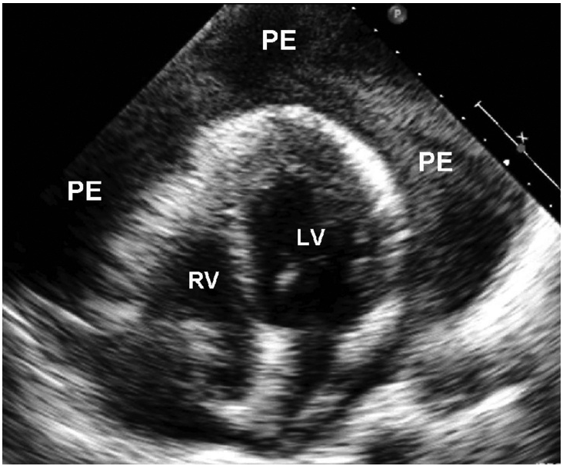
Pericardial effusions

Slide 11
The asymptomatic effusion…
Work-up
Labs: CBC, Chem 7, TSH, ANA
Fluid Studies: Culture, cytology, adenosine deaminase
Pericardial biopsy more sensitive than fluid for neoplasm, systemic disease
Follow-up, management
Serial TTE to follow for progression, regression
Pericardiocentesis if persists >3 months
Avoid anticoagulants

Slide 12
Tamponade
Dyspnea
Tachycardia
JVD
Hypotension
Pulsus >10 mm Hg supports dx
Urgent TTE!
TTE Findings:
Effusion
Diastolic collapse of right-sided chambers
Increased respiratory variation of peak inflow velocities through TV and MV
Dilated IVC without respirophasic variation

Slide 13
Management
Hemodynamically stable:
IVF, close monitoring, serial pulsus, serial TTE, treat underlying cause
Unstable:
-Aggressive IVF
-Dobutamine if underlying LV dysfunction
-Pericardiocentesis or surgery
-IABP for refractory hypotension
-Minimize PEEP
Crumping = Drain that fluid!

Slide 14
Restrictive Cardiomyopathy
Delayed diastolic relaxation
Decreased compliance
Elevated filling pressures
Preserved EF (initially)
Symptoms of left and right sided heart failure
Kussmaul’s sign
S3
Conduction abnormalities

Slide 15
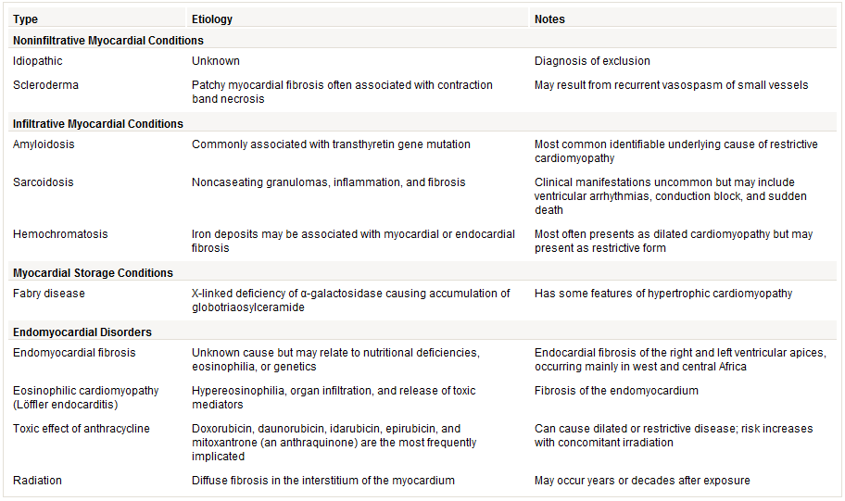
Causes of Restrictive Cardiomyopathy

Slide 16
Treatment
General
Specific causes
Not much works for HFpEF
Gently use… diuretics, beta blockers, CCBs
ACE-i’s
Restore rhythm to sinus
Pacemaker, ICD
Hemochromatosis: phlebotomy, iron chelation
Amyloid: stem cell transplant
Sarcoid: steroids

Slide 17
Hypertrophic cardiomyopathy

Slide 18
Inherited disorder (autosomal dominant with variable penetrance)
Men>Women
Black>White
Diffuse or focal myocardial hypertrophy
Diastolic dysfunction
Dynamic LVOTO
Increased risk of sudden cardiac death
Continuous-wave Doppler echocardiography demonstrates a high-velocity late-peaking systolic waveform (arrow) across the left ventricular outflow tract from a dynamic obstruction in hypertrophic obstructive cardiomyopathy.

Slide 19
HOCM
Symptoms, signs
Progression
None
Syncope, palpitations, lightheadedness, chest pain, dyspnea
BP drop or <20 mm Hg increase with exercise
LVOTO murmur: harsh mid-systolic best over LLSB, increased with Valsalva and standing, diminished with handgrip, leg lift and squatting
EKG: LVH, LAE, anterior TWI
10% progress to dilated CMY
Afib precedes heart failure
SCD risk 1% over 5 years

Slide 21
Genetic testing and screening
Routine genetic testing of pts with HOCM not recommended
If done, pt should be screened for multiple mutations. If culprit mutation found, relatives should be tested only for that specific mutation
Screening with TTE in 1st degree relatives:
Adolescents: YEARLY
Adults: every 5 years

Slide 22
HOCM Mgmt
Medical Mgmt
Interventional
Improve diastolic filling (beta blocker, verapamil, disopyramide)
Maintain sinus rhythm
Maintain afterload (avoid vasodilators)
Avoid hypovolemia
Avoid strenuous exercise. Keep athletes from competitive play
ICD for pts with high risk of SCD
Alcohol septal ablation or surgical myectomy for pts with LVOTO, septal wall >18 mm, and NYHA Class III or IV symptoms who are refractory to medical therapy

Slide 23
Cardiac tumors
Primary
Metastatic, direct extension
Atrial myxoma
Lipomatous hypertrophy of intra-atrial septum
Papillary fibroelastoma
Sarcoma
Angiosarcoma
Rhabdomyosarcoma
Osteosarcoma
Lung
Breast
Renal cell carcinoma
Hepatocellular carcinoma
Adrenal carcinoma

Slide 24
Atrial Myxoma
Globular LA mass attached to the intra-atrial septum, mobile, often protruding through mitral valve during diastole
May mimic mitral stenosis
Symptoms: heart failure, chest pain, embolic events, conduction abnormalities, constitutional symptoms
Evaluation: Initially with TTE. Usually TEE, CT or MRI needed
Treatment: benign cardiac tumors need to be excised

Slide 25
QUESTION 1
A 46-year-old man is evaluated in the emergency department for a 3-day history of progressively worsening dyspnea on exertion to the point that he is unable to walk more than one block without resting. He has had sharp intermittent pleuritic chest pain and a nonproductive cough with myalgias and malaise for 7 days and has had orthostatic dizziness for 2 days. He is taking no medications.
On physical examination, temperature is 37.7 °C (99.9 °F), blood pressure is 88/44 mm Hg, pulse is 125/min, and respiration rate is 29/min; BMI is 27. Oxygen saturation on ambient air is 95%. Pulsus paradoxus is 15 mm Hg. Estimated central venous pressure is 10 cm H₂O. Cardiac examination discloses muffled heart sounds with no rubs. Lung auscultation reveals normal breath sounds and no crackles. There is 2+ pedal edema. Blood pressure and heart rate are unchanged after a 500-mL intravenous normal saline challenge.
Twelve-lead electrocardiogram shows sinus tachycardia, diffuse low voltage, and no ST-segment shifts. Echocardiogram shows a large circumferential pericardial effusion, right ventricular and atrial free wall diastolic collapse, normal left ventricular systolic function, and an ejection fraction of 70%. Chest radiograph shows an enlarged cardiac silhouette and no pulmonary infiltrates.
What is the most appropriate treatment?
Dobutamine
Levofloxacin and tobramycin
Pericardiocentesis
Surgical pericardiectomy

Slide 26
Correct Answer: C. Pericardiocentesis
This is likely cardiac tamponade. Physical examination reveals tachycardia, reduced blood pressure, distended jugular veins, elevated pulsus paradoxus (>10 mm Hg), and an unremarkable lung examination. This constellation of signs should always raise the possibility of cardiac tamponade but is not pathognomonic. Other acute conditions, such as pulmonary embolism or myocardial infarction, could account for these findings. However, cardiac tamponade is confirmed by echocardiography, specifically by a pericardial effusion with associated right atrial and ventricular free wall diastolic collapse. In addition, this patient presents with symptoms consistent with an infectious illness. A viral pericarditis is the most likely source. The definitive treatment for this patient’s hemodynamic derangement is pericardiocentesis, which is typically performed via a percutaneous route but may be performed surgically if indicated.
Cardiac tamponade is typically caused by a circumferential pericardial effusion, but a loculated pericardial effusion also can cause tamponade, particularly in patients with prior cardiac surgery. The rapidity of fluid accumulation, rather than the absolute size of an effusion, is the major determinant of developing tamponade. Thus, a small but rapidly developing effusion may cause tamponade, whereas a large but slowly accumulating effusion may not.
Wrong answers:
Dobutamine: vigorous LV function on TTE, unlikely to be of benefit. Aggressive IVF are indicated, which were given.
Levofloxacin and tobramycin: findings more consistent with tamponade than septic shock.
D. Surgical pericardiectomy: would be appropriate treatment for constrictive pericarditis after 3 months of conservative mgmt

Slide 27
QUESTION 2
A 45-year-old man is evaluated for a 6-month history of progressive dyspnea on exertion and lower-extremity edema. He can now walk only one block before needing to rest. He reports orthostatic dizziness in the last 2 weeks. He denies chest pain, palpitations, or syncope. He was diagnosed 15 years ago with non-Hodgkin lymphoma, which was treated with chest irradiation and chemotherapy and is now in remission. He also has type 2 diabetes mellitus. He takes furosemide (80 mg, 3 times daily), glyburide, and low-dose aspirin.
On physical examination, he is afebrile. Blood pressure is 125/60 mm Hg supine and 100/50 mm Hg standing; pulse is 90/min supine and 110/min standing. Respiration rate is 23/min. BMI is 28. There is jugular venous distention and jugular venous engorgement with inspiration. Estimated central venous pressure is 15 cm H₂O. Cardiac examination discloses diminished heart sounds and a prominent early diastolic sound but no gallops or murmurs. Pulmonary auscultation discloses normal breath sounds and no crackles. Abdominal examination shows shifting dullness, and lower extremities show 3+ pitting edema to the level of the knees. The remainder of the physical examination is normal.
BUN 40 mg/dL, Cr 2.0 mg/dL, ALT 130 U/L, AST 112 U/L, Albumin 3.0 g/dL, UA negative for protein,
What’s the most likely diagnosis?
A. Cirrhosis
B. Constrictive pericarditis
C. Nephrotic syndrome
D. Systolic heart failure

Slide 28
Correct Answer: B. Constrictive pericarditis
This patient has symptoms and signs of heart failure. The physical examination is notable for findings of right heart failure (jugular venous distention, peripheral edema) in the absence of left heart failure (clear lung fields, absence of gallop). The most important physical examination findings are a Kussmaul sign (accentuated jugular venous pressure during inspiration) and an early diastolic sound (pericardial knock). These findings help to confirm constrictive pericarditis as the most likely diagnosis.
Constrictive pericarditis is characterized by thickened, fibrotic, and adherent pericardium that restrains ventricular diastolic expansion, leading to impaired filling. Orthostatic hypotension may occur as an adverse effect from excessive diuresis in patients with constrictive pericarditis, as seen in this patient, who was being treated with a high dosage of furosemide. Constrictive pericarditis is a well-known complication of chest irradiation therapy and may occur 10 to 15 years after exposure. Mediastinal radiation therapy results in approximately a three-fold increase in the risk of cardiac death. Most deaths are due to myocardial infarction, and the remainder are due to heart failure, constrictive pericarditis, cardiomyopathy, or valvular heart disease.
Wrong answers:
A. Cirrhosis: Cirrhosis with portal hypertension could account for this patient’s peripheral edema and ascites. However, it would not explain the elevated right heart pressures, orthostatic hypotension, pericardial knock, or Kussmaul sign. In addition, the patient does not have any cutaneous findings of chronic liver disease such as gynecomastia, spider angioma, or palmar erythema. The elevated aminotransferase levels reflect passive hepatic congestion and are a feature of constrictive pericarditis.
C. Nephrotic syndrome: Nephrotic syndrome is a reasonable consideration in a patient with diabetes mellitus, hypercholesterolemia, hypoalbuminemia, and peripheral edema. However, the absence of proteinuria excludes this diagnosis. In addition, nephrotic syndrome would not explain the jugular venous distention, pericardial knock, or orthostatic hypotension.
D. Systolic heart failure: Systolic heart failure can explain many of the patient’s findings, including dyspnea on exertion, elevated central venous pressure, and peripheral edema. However, systolic failure is also associated with crackles on pulmonary auscultation and an S₃, which are absent in this patient. Furthermore, murmurs characteristic of mitral regurgitation and tricuspid regurgitation are frequently associated with systolic failure but are absent in this patient. Systolic failure cannot explain the pericardial knock or Kussmaul sign.

Slide 29
QUESTION 3
A 34-year-old woman is evaluated for sharp intermittent pleuritic chest pain that has persisted for 1 week. The pain is worse when she lies down in the supine position. She has had no fever, chills, cough, or weight loss. She had acute viral pericarditis 6 months ago that was treated initially with ibuprofen, but when she failed to respond after 3 days, a 10-day tapering dosage of prednisone was instituted, leading to resolution of clinical symptoms. She has a 10-year history of essential hypertension, and she takes hydrochlorothiazide and potassium chloride.
On physical examination, temperature is normal, blood pressure is 98/54 mm Hg, pulse is 99/min, and respiration rate is 20/min. Cardiac examination discloses a pericardial friction rub at the lower left sternal border but no gallops. Pulmonary auscultation reveals normal breath sounds and no crackles. There is no jugular venous distention and no chest-wall tenderness. Laboratory studies reveal a serum creatinine level of 1.0 mg/dL (76.3 µmol/L). EKG is performed. CXR shows normal sized cardiac silhouette and clear lung fields.
What’s the most appropriate treatment?
A. Colchicine
B. High dose aspirin
C. High dose ibuprofen
D. Prednisone

Slide 31
Correct answer: A. Colchicine
This young patient has a history of acute viral pericarditis and presents with pleuritic chest pain and a pericardial friction rub. The likely diagnosis is recurrent pericarditis. The ST-segment elevation on the electrocardiogram is concave upward and PR-segment depression is present, further supporting the diagnosis. Prior treatment of acute viral pericarditis with prednisone predisposes to recurrent pericarditis. Because of its efficacy, colchicine has emerged as the treatment of choice for acute bouts of recurrent pericarditis and can be useful in the prevention of recurrences. Treatment duration is 6 months. Treatment of pericarditis with colchicine is an off-label use. Colchicine is contraindicated in patients with chronic kidney disease. However, this patient has no signs of chronic kidney disease.
Wrong answers:
B. High dose aspirin: High-dose aspirin and NSAIDs are first-line agents for the treatment of an initial episode of viral or idiopathic pericarditis. However, high-dose aspirin therapy is less effective in the treatment of recurrent pericarditis and is complicated by gastrointestinal adverse effects with long-term use.
C. High dose ibuprofen: High-dose NSAIDs, such as ibuprofen, are useful adjuncts to colchicine therapy in the treatment of recurrent pericarditis, but are less effective as first-line agents in the treatment of recurrent bouts of pericarditis.
D. Prednisone: The use of systemic corticosteroids early in the course of acute pericarditis is associated with an increased frequency of relapse, as was seen in this patient. Corticosteroids are considered third-line agents for refractory cases of recurrent pericarditis.

Slide 32
QUESTION 4
A 58-year-old man presents to the emergency department within 4 hours of worsening pleuritic chest pain, which has become progressively more severe. Ten days ago, he had an acute anterior ST-elevation myocardial infarction and underwent successful thrombolytic therapy within 2 hours of the onset of symptoms. He has a history of hypertension. Medications include metoprolol, clopidogrel, simvastatin, aspirin, and isosorbide mononitrate.
On physical examination, temperature is 37.9 °C (100.2 °F), blood pressure is 110/70 mm Hg, pulse is 60/min, and respiration rate is 18/min. There is no jugular venous distention. Cardiac examination discloses a two-component pericardial friction rub but no murmurs or gallops. Crackles are heard on pulmonary auscultation. There is no pedal edema.
ESR 60 mm/hr, WBC 12,000/mcL, BUN 15 mg/dL, Cr 1.0 mg/dL
Twelve-lead electrocardiogram during an episode of chest pain shows normal sinus rhythm with diffuse, concave, upward 1.0- to 1.5-mm ST-segment elevation and 1-mm PR-segment depression in leads II, III, and aVF.
What’s the most appropriate treatment?
A. Colchicine
B. High dose aspirin
C. High dose ibuprofen
D. Prednisone

Slide 33
Correct answer: B. High dose aspirin
The correct diagnosis in this middle-aged man is acute pericarditis associated with post–myocardial infarction syndrome, or Dressler syndrome. Post–myocardial infarction syndrome develops several weeks (rarely within a week) to months after an ST-elevation myocardial infarction and is characterized by pleuritic chest pain, pericardial friction rub, fever, leukocytosis, and, sometimes, pleural effusion or pulmonary infiltrates. This is distinguished from infarction pericarditis, which is characterized by a pericardial friction rub with or without chest pain and typically occurs within 1 to 2 days of the myocardial infarction. On electrocardiogram, acute pericarditis is characterized by diffuse ST-segment elevation that is characteristically concave upward (as opposed to downward, as in the case of a myocardial infarction) and PR-segment depression, which is nearly pathognomonic for pericarditis.
Anti-inflammatory therapy is the mainstay of treatment for pericarditis. Treatment with aspirin is preferred over NSAIDs if an acute myocardial infarction is the cause of acute pericarditis because its antiplatelet effects are beneficial and because of a prevailing concern that NSAIDs may promote ventricular rupture by impairing myocardial scar formation. Although animal data support this proposition, no definite proof for this concern exists in humans. However, expert opinion supports avoidance of these agents in this setting until further evidence is available.
Wrong answers:
A. Colchicine: Colchicine is an effective drug in the treatment of acute bouts of recurrent pericarditis. In addition, colchicine added to aspirin has been reported to be more effective than aspirin alone in the treatment of a first episode of idiopathic acute pericarditis. However, its efficacy in the treatment of acute pericarditis in the setting of myocardial infarction has not been firmly established. Colchicine therapy has no specific role in the treatment of patients after myocardial infarction. Thus, it would not be the best choice in this patient.
C. High dose ibuprofen: See above.
D. Prednisone: Corticosteroids such as prednisone may promote the development of recurrent pericarditis and should be avoided if possible in the treatment of acute pericarditis. They should be considered only in patients who are refractory to or have contraindications for the use of all alternative agents (aspirin, NSAIDs, and colchicine).

Slide 34
QUESTION 5
An 85-year-old woman is admitted to the coronary care unit following successful thrombolytic therapy for an acute anterior wall ST-elevation myocardial infarction (STEMI). Prior to the myocardial infarction she had been active without any medical problems and was taking no medications. Blood pressure is 120/70 mm Hg and heart rate is 90/ min. There is no jugular venous distention and no cardiac murmurs. The lung fields are clear and there is no peripheral edema. Medications started in the hospital are aspirin, low-molecular-weight heparin, intravenous nitroglycerin, and oral metoprolol. The electrocardiogram shows Q waves in the anterior leads with upsloping ST segments.
On hospital day 3, the patient experiences acute onset of respiratory distress, and her systolic blood pressure falls to 80 mm Hg. Her oxygen saturation remains at 80% despite the administration of 100% oxygen by face mask. She is given dopamine and intravenous furosemide. On physical examination, blood pressure is 96/40 mm Hg, pulse rate is 100/min, and respiration rate is 28/min. Findings include jugular venous distention, crackles throughout both lung fields, and a grade 4/6 systolic murmur associated with a thrill. A pulmonary artery catheter is placed via the right internal jugular vein. The pulmonary capillary wedge pressure tracing shows prominent v waves.
What’s the best immediate treatment option?
Mitral valve repair
Pericardiocentesis
Pulmonary artery thrombectomy
Ventricular septal defect repair

Slide 35
Correct answer: D. Ventricular septal defect repair
Mechanical complications occur in roughly 0.1% of patients with ST-elevation myocardial infarction (STEMI) and usually occur 2 to 7 days after infarction. Late complications following STEMI include cardiogenic shock, ventricular septal defect, mitral regurgitation, free wall rupture, and left ventricular thrombus. This patient’s progressive hypotension, respiratory distress, and new systolic murmur and thrill suggest either ischemic mitral regurgitation or a ventricular septal defect. Either mitral regurgitation or a ventricular septal defect can result in a prominent v wave in the pulmonary capillary wedge pressure tracing. However, only a ventricular septal defect results in the “step-up” in oxygen saturation from the right atrium to the right ventricle seen in this patient. Following echocardiography to confirm the diagnosis, this patient should undergo emergent surgery to repair the defect. Although treatment for a ventricular septal defect is emergent surgery, in-hospital mortality remains high at approximately 60%.
Wrong answers:
A. Mitral valve repair would be the correct answer for a patient with severe ischemic mitral regurgitation.
B. Pericardiocentesis: Pericardial tamponade from rupture of the left ventricular free wall usually leads to sudden hypotension and death. Ventricular free wall rupture typically occurs 1 to 4 days after acute myocardial infarction; rarely, it occurs up to 3 weeks after myocardial infarction. Patients usually present with cardiovascular collapse, tamponade, or pulseless electrical activity.
C. Pulmonary artery thrombectomy: A massive pulmonary embolism may produce cardiovascular collapse and hypoxemia but cannot explain the new systolic murmur, left heart failure, prominent v wave, and step-up of oxygen saturation. Therefore, a pulmonary artery thrombectomy is not indicated.

Slide 36
QUESTION 6
A 42-year-old man is hospitalized for progressively worsening dyspnea on exertion for 6 months, now occurring with minimal activities. He has had frequent episodes of dyspnea at rest, progressive fatigue, leg edema, and a 9.1-kg (20.0-lb) weight gain over the last 4 weeks. He reports symptoms of three-pillow orthopnea and nocturnal dyspnea but does not have chest pain, palpitations, syncope, or cough. There is no family history of sudden cardiac death. He has no other medical problems. His medications are metoprolol, disopyramide, and furosemide.
On physical examination, temperature is normal, blood pressure is 100/50 mm Hg, pulse is 48/min, and respiration rate is 28/min. Jugular venous distention is noted, with brisk carotid upstrokes. Estimated central venous pressure is 10 cm H₂O. Cardiac examination reveals an S₃ gallop at the apex and a grade 3/6 midsystolic murmur along the lower left sternal border that accentuates with a Valsalva maneuver and diminishes with a hand-grip maneuver. Pulmonary examination discloses dullness to percussion in the posterior lung fields at the bases, crackles in the basilar posterior lung fields, and no wheezing. The lower extremities show 3+ edema.
Hb 13.5 g/dL, WBC 8300/mcL, BUN 50 mg/dL, Cr 2.0 mg/dL, Albumin 4.0 g/dL, iron studies WNL, TSH 2.5 mU/L, BNP 2045
Twelve-lead electrocardiogram shows sinus bradycardia, left atrial enlargement, and left ventricular hypertrophy. Echocardiogram shows hyperdynamic left ventricular systolic function, a left ventricular ejection fraction of 80%, asymmetric septal hypertrophy, left ventricular dynamic outflow obstruction with a peak gradient of 144 mm Hg, left ventricular diastolic dysfunction, and left atrial enlargement. Septal thickness is 26 mm. Chest radiograph discloses no infiltrates, an enlarged cardiac silhouette, and small pleural effusions.
What’s the most appropriate treatment?
Carvedilol
Implantable cardioverter-defibrillator
Permanent pacemaker
Surgical septal myectomy

Slide 37
Correct answer: D. Surgical septal myectomy
This young man presents with progressively worsening dyspnea and New York Heart Association (NYHA) functional class III symptoms. Biventricular heart failure is evident by symptoms (dyspnea, fatigue, weight gain) and signs (jugular venous distention, S₃ gallop, crackles, peripheral edema). Echocardiography confirms a hypertrophic obstructive cardiomyopathy (HOCM) with diastolic dysfunction, marked septal hypertrophy, and a severe outflow tract obstruction. The patient’s heart failure has been refractory to aggressive medical therapy, including negative inotropic and chronotropic agents and diuretics. Surgical septal myectomy should be considered in patients with outflow obstruction who are NYHA functional class III or IV and whose symptoms are refractory to medical therapy. Septal myectomy has been beneficial in improving symptoms of heart failure and may lead to a better prognosis. Thus, this patient who is refractory to medical therapy with no significant comorbidities should undergo surgical septal myectomy.
Wrong answers:
A. Carvedilol: Beta blockers are useful, however pt is already on metoprolol.
B. An implantable cardioverter-defibrillator is not indicated in this patient with no significant predictors of sudden cardiac death.
C. Permanent pacemaker: Ventricular pacing reduces the vigor of left ventricular septal contraction by causing an asynchronous or disorganized pattern of contraction. This reduces left ventricular outflow tract obstruction in HOCM. However, permanent pacing has not shown long-term benefit in improving heart failure in patients with HOCM. Thus, this approach is not the best treatment choice.

Slide 38
QUESTION 7
A 40-year-old black man is hospitalized for heart failure. He has had fatigue and progressive dyspnea on exertion for 12 months, pedal edema for 6 months, paroxysmal nocturnal dyspnea for 3 months, and recent onset of orthostatic lightheadedness. These symptoms have worsened over the past week, prompting the hospitalization. He has a history of sickle cell anemia with frequent painful hemolytic crises and numerous blood transfusions. Medications are furosemide, metolazone, diltiazem, lisinopril, hydroxyurea, and folic acid.
On physical examination, temperature is normal, blood pressure is 115/70 mm Hg supine and 80/50 mm Hg standing, pulse is 90/min supine and 122/min standing, and respiration rate is 30/min. Oxygen saturation on ambient air is 95%. There is jugular venous distention that worsens with inspiration. Cardiac examination discloses a right-sided S₄ gallop, no pericardial friction rub, and a grade 2/6 holosystolic murmur at the lower left sternal border. Pulmonary auscultation reveals normal breath sounds and faint bibasilar crackles. The abdomen is distended with shifting dullness. There is 3+ lower extremity edema to the level of the knees.
Hb 8 g/dL, ferritin 650 ng/mL, iron 512 mcg/dL, transferrin saturation 78%
Twelve-lead electrocardiogram shows normal sinus rhythm and normal QRS voltage. Echocardiogram shows severe biatrial enlargement, normal left ventricular wall thickness, a left ventricular ejection fraction of 70%, normal ventricular cavity size, and restrictive left ventricular filling without respiratory variation in peak filling velocity. Endomyocardial biopsy is positive for iron deposits.
What’s the most appropriate treatment?
Heart transplant
Increase the dosage of furosemide
Iron chelation
Phlebotomy

Slide 39
Correct answer: C. Iron chelation
This patient has signs and symptoms of heart failure, particularly of the right side of the heart (peripheral edema, jugular venous distention, and Kussmaul sign or inspiratory increase in jugular venous distention). Disproportionate involvement of the right side of the heart should always raise the suspicion for restrictive cardiomyopathy, particularly in a patient at risk for iron overload. This patient’s iron studies confirm an acquired iron-overload state, or acquired hemochromatosis.
Hemochromatosis is the only cause of restrictive cardiomyopathy that is potentially reversible by medication therapy that induces regression of symptoms. Because the body lacks an intrinsic method of increasing elimination of excessive iron, therapeutic methods are needed. Restrictive cardiomyopathy from iron overload may improve with removal of iron by chelation therapy in iron-overload states, such as lifelong transfusion-dependent anemias. Iron chelation therapy is indicated only in patients who cannot tolerate phlebotomy therapy, such as those with significant anemia. Iron chelation therapy would be the most appropriate treatment in this patient.
Wrong answers:
A. Heart transplant has been used with variable results for treatment of refractory cases of restrictive cardiomyopathy due to hereditary hemochromatosis. Heart transplant has not been studied and is not of proven benefit in restrictive cardiomyopathy from acquired hemochromatosis. In addition, in this setting the ongoing need for blood transfusions would subject the transplanted heart to iron deposition.
B. Increase the dosage of furosemide: Diuretic therapy plays a major role in the symptomatic treatment of patients with restrictive cardiomyopathy. Importantly, because of these patients’ pathophysiologic dependence on maintaining higher atrial pressures (preload) to achieve adequate ventricular filling, excessive diuresis often results in orthostatic hypotension by lowering atrial pressures. This patient has evidence of orthostatic hypotension that is probably related to his diuretic therapy. Thus, increasing furosemide (a loop diuretic) would not be the best treatment for this patient.
D. Phlebotomy: Phlebotomy would exacerbate anemia in patients with sickle cell anemia, and thus is not a feasible treatment option.

Slide 40
QUESTION 8
A 35-year-old black woman is admitted to the hospital after experiencing two episodes of syncope in the same day. The episodes were brought on by standing, with abrupt loss of consciousness for 5 minutes. There were no prodromal symptoms and the episodes were nonexertional. She had no associated nausea, vomiting, diaphoresis, or postictal confusion. She has had a 12-month history of chest pain, cough, and dyspnea. Exercise thallium stress testing done 2 months ago demonstrated patchy uptake of radionuclide throughout the ventricular myocardium and no demonstrable ischemia. Her mother died suddenly at age 45 years.
On physical examination, the patient is afebrile, blood pressure is 110/60 mm Hg without orthostasis, pulse is 65/min, and respiration is unlabored at a rate of 16/min. Yellowish-brown maculopapular lesions are present around the lips and eyelids. Jugular veins are distended. Pulmonary auscultation reveals faint scattered expiratory wheezes. Cardiac examination discloses normal heart sounds with no murmurs or gallops. Trace pedal edema is noted.
Twelve-lead electrocardiogram shows sinus rhythm, first-degree atrioventricular block, and left bundle branch block. Chest radiograph shows hilar lymphadenopathy and scattered interstitial infiltrates. Twenty-four-hour electrocardiographic monitoring shows frequent premature ventricular ectopic beats and nonsustained ventricular tachycardia. Endomyocardial biopsy discloses noncaseating granulomata.
What’s the most appropriate management option?
Amiodarone
Cardiac magnetic resonance imaging
Electrophysiologic study
Implantable cardioverter-defibrillator placement
Implantation of permanent pacemaker

Slide 41
Correct answer: D. Implantable cardioverter-defibrillator placement
This patient has a probable family history of sudden cardiac death, and her recurrent episodes of syncope are consistent with a cardiac etiology, as evidenced by the lack of associated prodromal symptoms and no evidence of seizure activity. Jugular venous distention and pedal edema are consistent with right-sided heart decompensation. Furthermore, electrocardiography shows conduction abnormalities, and 24-hour monitoring demonstrates ventricular ectopy and nonsustained ventricular tachycardia. A prior thallium stress test showed no ischemia but did reveal patchy myocardial uptake. This is a nonspecific finding but can be seen in cardiac sarcoidosis. Further findings support a clinical diagnosis of sarcoidosis in this patient, namely the maculopapular eruptions and chest radiograph findings of hilar lymphadenopathy and infiltrates. Endomyocardial biopsy findings of noncaseating granulomata confirm cardiac sarcoidosis.
Young black women have an apparent increased frequency for sarcoidosis as compared with other race and/or sex cohorts. Thus, this patient’s race, sex, and age are characteristic for patients who more commonly present with sarcoidosis. Sudden death accounts for up to 65% of deaths due to cardiac sarcoidosis, presumably caused by ventricular tachyarrhythmias or conduction block. Symptomatic or electrocardiographically evident arrhythmias or conduction abnormalities typically become evident prior to sudden cardiac death. This patient’s history of recurrent syncope, ventricular tachycardia, conduction abnormalities, and family history of sudden death place her at high risk for sudden death. The most appropriate management for this patient is placement of an implantable cardioverter-defibrillator (ICD), which has defibrillation and pacing capabilities for treatment of ventricular tachyarrhythmias and bradyarrhythmias, respectively.
Wrong answers:
A. Amiodarone has not been shown to effectively reduce the incidence of sudden cardiac death. However, in patients with an ICD, amiodarone can be used to reduce the frequency of episodes of ventricular tachycardia and subsequent firing of the ICD.
B. Cardiac magnetic resonance (CMR) imaging is useful for detection of localized myocardial high-intensity areas due to cardiac sarcoidosis and, when performed with late gadolinium enhancement, has a reported sensitivity of 100% and specificity of 78% for the disease. In this patient with confirmed cardiac sarcoidosis by endomyocardial biopsy, however, CMR imaging is not indicated. CMR imaging is a useful screening technique, but owing to the possibility of false-positive results, biopsy may still be necessary to determine the need for an ICD.
C. Electrophysiologic testing identifies patients with cardiac sarcoidosis who are likely to have sustained ventricular tachyarrhythmias or sudden death. However, such testing should be reserved for those patients who are stratified prior to testing in an intermediate-risk group. This patient is at high risk for sudden cardiac death based on documented cardiac involvement from sarcoidosis, syncope, nonsustained ventricular tachycardia on 24-hour ambulatory monitoring, and family history of sudden death. Thus, a negative electrophysiologic study would likely be a false negative and, therefore, would not obviate the need for an ICD.
E. A permanent pacemaker would not protect against sudden death from ventricular tachyarrhythmias and thus would not be sufficient treatment for this patient.

Slide 42
QUESTION 9
A 58-year-old woman is hospitalized for acute left-sided flank pain. She has had fever and night sweats for 1 month and a 9.1-kg (20-lb) weight loss over 6 months.
On physical examination, temperature is 37.7 °C (99.8 °F), blood pressure is 135/88 mm Hg, pulse is 88/min, and respiration rate is 18/min. Heart sounds are normal. There is an early diastolic low-pitched sound after the S₂ with a diastolic murmur at the apex. There is tenderness of the left costophrenic angle. The abdomen is soft with normal bowel sounds and no tenderness. She does not have rash or petechiae, splinter hemorrhages, or Janeway lesions. Funduscopic examination is normal.
WBC 14,000/mcL, BUN 14 mg/dL, Cr 1.3 mg/dL, UA: microscopic blood, no protein or crystals
Twelve-lead electrocardiography shows normal sinus rhythm. Echocardiogram shows a 5- by 4-cm left atrial echogenic mobile globular mass attached to the atrial septum with diastolic protrusion into the left ventricle. Abdominal radiograph shows a normal gas pattern and no renal calculi. Contrast-enhanced CT scan of the abdomen and pelvis shows a wedge-shaped hypoperfusion defect in the upper pole of the left kidney. Mean transmitral valve inflow gradient is 15 mm Hg. Three sets of blood cultures are negative for growth after 5 days.
What’s the most appropriate treatment?
Cardiac surgery for resection of mass
Mitral valve replacement
Systemic anticoagulation with heparin
Vancomycin and tobramycin

Slide 43
Correct answer: A. Cardiac surgery for resection of mass
This patient has evidence of a systemic embolism to the left kidney causing flank pain and hematuria. No evidence of renal calculi is present. The history of fever, night sweats, and weight loss is consistent with a systemic illness. Echocardiography shows a left atrial mass with features consistent with a tumor, as evidenced by attachment to the atrial septum, echogenic texture, mobility, and protrusion into the mitral valve orifice obstructing inflow. This mass is most likely a left atrial myxoma, the most common tumor type of the left atrium. A left atrial myxoma does not metastasize to other organs, but it has significant associated morbidity. Left atrial myxoma causes fever, night sweats, and weight loss, and may embolize to the brain or other organs such as the kidney, as seen in this patient. Cardiac surgery to remove the left atrial mass is the best treatment and would be curative if the mass is a benign tumor. A primary malignant tumor is also a possibility, but surgical removal would also be the correct approach.
Wrong answers:
B. Mitral valve replacement: Echocardiography in this patient shows severe transmitral valve obstruction with a mean gradient of 15 mm Hg. Rheumatic mitral stenosis on auscultation can cause an early high-pitched diastolic sound (an opening snap) and a diastolic decrescendo murmur, similar to the findings in this patient. However, the opening sound in this patient is a low-pitched sound associated with a left atrial myxoma, a so-called “tumor plop.” Furthermore, the patient’s echocardiogram is inconsistent with primary mitral valve disease. The diastolic murmur in this patient is secondary to obstruction of the mitral valve orifice by the tumor, effectively a functional mitral stenosis. Thus, the appropriate cardiac surgery is removal of the left atrial mass rather than mitral valve replacement.
C. Systemic anticoagulation with heparin: The left atrial mass is highly unlikely to be a thrombus given the presence of sinus rhythm and not atrial fibrillation. Systemic anticoagulation with heparin is not indicated.
D. Vancomycin and tobramycin: The presentation of fever, night sweats, and weight loss is typical of endocarditis, and thus this diagnosis should be considered. However, blood cultures failed to confirm bacteremia, and echocardiography showed no vegetations. Empiric antibiotic therapy with vancomycin and tobramycin for presumed endocarditis in this patient who is hemodynamically stable and has an alternative explanation for her symptoms is not warranted.

Slide 44
QUESTION 10
A 20-year-old female college student is evaluated at the student health center to establish care. She had no major medical problems prior to college, and there is no family history of cardiovascular disease.
On physical examination, blood pressure is 110/60 mm Hg and pulse is 70/min. S₁ and S₂ are normal and there is an S₄ present. There is a harsh grade 2/6 midsystolic murmur heard best at the lower left sternal border. The murmur does not radiate to the carotid arteries. A Valsalva maneuver increases the intensity of the murmur; moving from a standing position to a squatting position, performing a passive leg lift while recumbent, and performing isometric handgrip exercises decrease the intensity. Rapid upstrokes of the carotid pulses are present. Blood pressures in the upper and lower extremities are equal.
What’s the most likely diagnosis?
Aortic coarctation
Bicuspid aortic valve
Hypertrophic cardiomyopathy
Mitral valve prolapse
Ventricular septal defect

Slide 45
Correct answer: C. Hypertrophic cardiomyopathy
This patient has a systolic murmur. The most common diagnoses to consider in the differential diagnosis include a primary valve source, such as a bicuspid aortic valve, aortic stenosis, mitral valve prolapse, and a benign murmur. Other cardiac abnormalities associated with a systolic murmur include hypertrophic cardiomyopathy, ventricular septal defect, and aortic coarctation.
In this patient, the physical examination is most consistent with hypertrophic cardiomyopathy. The systolic murmur of hypertrophic cardiomyopathy is caused by turbulent flow and obstruction in the left ventricular outflow tract from the thickened interventricular septum. In severe cases, systolic anterior motion of the mitral valve apparatus into the left ventricular outflow tract contributes to the systolic murmur. If mitral valve leaflet coaptation is affected, there may be concurrent mitral regurgitation. The stand-to-squat maneuver and passive leg lift transiently increase venous return (preload), which increases left ventricular chamber size and volume. As a consequence, there is less relative obstruction and turbulence in the left ventricular outflow tract, decreasing murmur intensity. The Valsalva maneuver and the squat-to-stand maneuver transiently decrease venous return, with the septum and anterior mitral leaflet brought closer together. Turbulent flow—and the murmur—are increased. Handgrip exercise increases afterload and decreases the relative pressure gradient across the left ventricular outflow tract, so murmur intensity for hypertrophic cardiomyopathy is decreased. Transthoracic echocardiography can confirm a diagnosis of hypertrophic cardiomyopathy.
Wrong answers:
A. Aortic coarctation in an adult is characterized by hypertension and a continuous or late systolic murmur that may be heard over the back. Because pulses distal to the aortic obstruction are decreased, aortic coarctation is also associated with abnormal differences in upper and lower extremity blood pressures. The carotid upstroke is normal in coarctation.
B. Bicuspid aortic valve:The murmur of aortic stenosis is an early systolic murmur that often radiates superiorly, toward the carotid arteries. Hypertrophic cardiomyopathy is associated with rapid upstrokes of the carotid arteries, helping to distinguish it from aortic stenosis (of either a bicuspid or tricuspid aortic valve), which is associated with a carotid artery pulsation that has a slow up-rise and is diminished in volume.
D. Mitral valve prolapse: The murmur associated with mitral valve prolapse and regurgitation is a holosystolic to late systolic murmur that is apically located and associated with a midsystolic click. In a patient with mitral valve prolapse, the Valsalva maneuver moves the click murmur complex earlier in systole and may increase the intensity of the murmur. Similarly, decreased preload (smaller left ventricular chamber size) increases systolic buckling of the valve leaflets, and the murmur lengthens or intensifies. The carotid upstroke is normal in mitral valve prolapse.
E. Ventricular septal defect: The murmur associated with a ventricular septal defect is a harsh systolic murmur located parasternally that radiates to the right sternal edge and may be associated with a palpable thrill but no change in the carotid artery pulsation. Maneuvers that increase afterload, such as isometric handgrip exercise, increase the left-sided murmurs of mitral regurgitation and ventricular septal defect.

