Slide 1
Dermatology Board Review
Tamanna Singh, PGY III
July 16, 2013

Slide 2
Common Rashes
Today:
  Eczematous
  Papulosquamous
  Drug Reactions
For another day:
  Pigmented Purpuric Dermatoses
  Miliaria
  Acantholitic Dermatosis

Slide 3
Eczematous
Contact
Stasis
Atopic
Features
  Pruritic, red, scaly, vesicular-to-crusted rash, serum leaks from scratched lesions
  Histo: Spongiosis – intracellular edema of skin causing spongy consistency

Slide 4
Eczematous
Contact Dermatitis
  Allergic
    Common in women, pts with atopic dermatitis
    Type IV (delayed) HS reaction, rash appears 24-48h post exposure
    Vesicles can be common
    Ex: poison ivy (uroshiol), nickel, cobalt, neomycin, bacitracin, dyes
  Irritant contact dermatitis
    Nonimmunologic
    Pain, pruritic, lichenification, fissuring
    Vesicles are rare
  Hand dermatitis
    Common in people who have prolonged contact with water or solutions

Slide 5
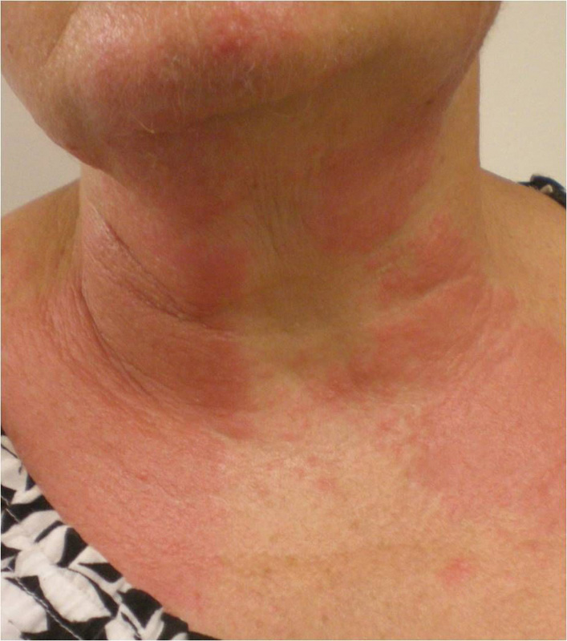
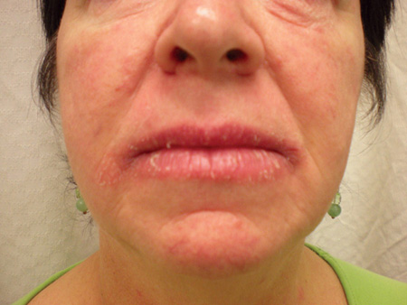
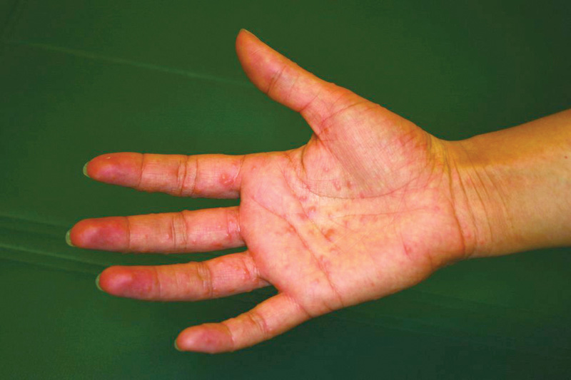
Eczematous
Allergic Contact Dermatitis
Irritant Contact Dermatitis
Hand Dermatitis

Slide 6
Eczematous
Dx: gold standard is epicutaneous patch testing
Treatment
  Avoid exposure
  Mid/high-potency topical corticosteroids bid until clears (triamcinolone, clobetasol)
  Petroleum, moisturizers
  PUVA
Notes:
CS gradient: clobetasol/betamethasone/halobetasole > lidex (fluocinonide), desoximetasone (topicort) > triamcinolone, mometasone, > fluocinolone, hydrocortisone
PUVA = psoralen + UVA if recalcitrant (psoralen sensitizes skin prior to UVA exposure, taken orally or applied)

Slide 7
Eczematous
Statis Dermatitis
  Venous insufficiency from varicosities, trauma, DVT
  Worse w/CHF, liver failure, obesity
  Cx: edema, erythema, hemosiderin deposition, petechiae, woody changes
  Dx: clinical
  Tx: compression stockings, leg elevation
  Complications: ulcers
Notes:
High levels of venous pressure transmitted to capillaries and causes disruption of vessel wall and fibrosis

Slide 8
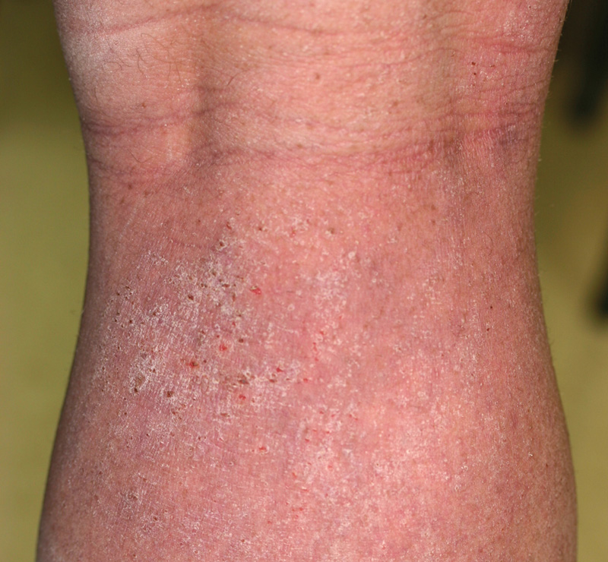
Eczematous
Atopic Dermatitis
  Childhood to adult, intermittent flares 2/2 heat, stress, skin infxn
  Wrists, antecubital, popliteal fossae
  a/w asthma/allergies
  Intermittent topical CS use (lowest strength), calcineurin inhibitors, ointments
  Chlorine bleach baths
  Eczema herpeticum
Notes:
Atopic/Allergy: immune system favors type 2 T helper cells response with elevated serium IE, eosinophilia, and dysregulation of TH ype 1 responses
Calcineurin inhibitors = pimecrolimus, tacrolimus
Chlorine bleach baths = reduce risk of S aureus skin infxn
Eczema herpeticum – HSV infxn that develops in abnormal skin, sudden onsetn of 2-4mm erosions (uniform), vesicles or pustules → febrile, ill → tx = systemic antiviral, ophtho consultation if eye involvement

Slide 9
Papulosquamous
Psoriasis
Lichen Planus
Pityriasis Rosea
Seborrheic Dermatitis

Slide 10
DISEASE | MORPHOLOGY | TYPICAL DISRIBUTION | DIAGNOSTIC STUDIES | FIRST-LINE THERAPY
PSORIASIS | Pink-red patches, plaques Dry, silvery scale | Scalp, elbow, knees, nails | KOH Biopsy | Topical CS Topical Vit D analogues
LICHEN PLANUS | Pink-purple papules, plaques Variable scale Wickham striae | Wrists/arms, ankles/legs, mouth, nails | KOH Biopsy | Topical CS
PITYRIASIS ROSEA | Pink patches Fine trailing scale | Herald patch, then “Christmas tree” on back | KOH Serology for syphilis Biopsy | Spontaneous resolution in 1-3 months Mid-potency topical CS if pruritic
SEBORRHEIC DERMATITIS | Faint pink patches Yellow-greasy scale in hair | Scalp, brow, ears, nose, chest | KOH | Low-potency topical CS Antifungal cream, shampoo Dandruff shampoo

Slide 11
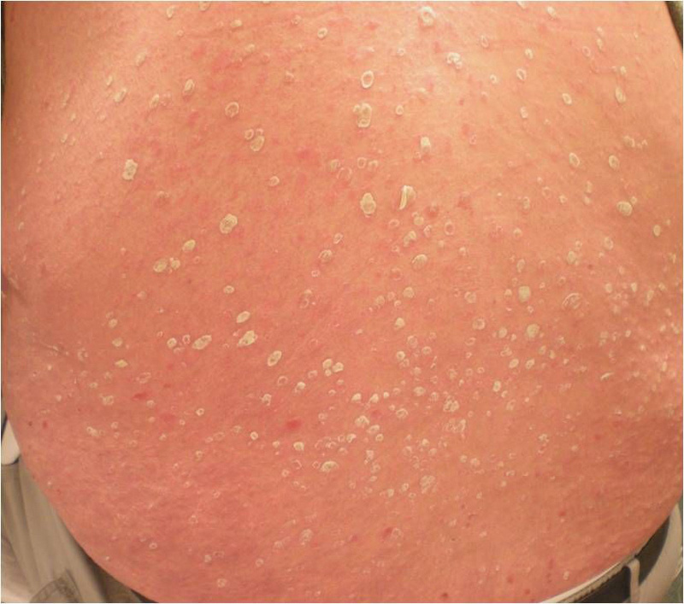
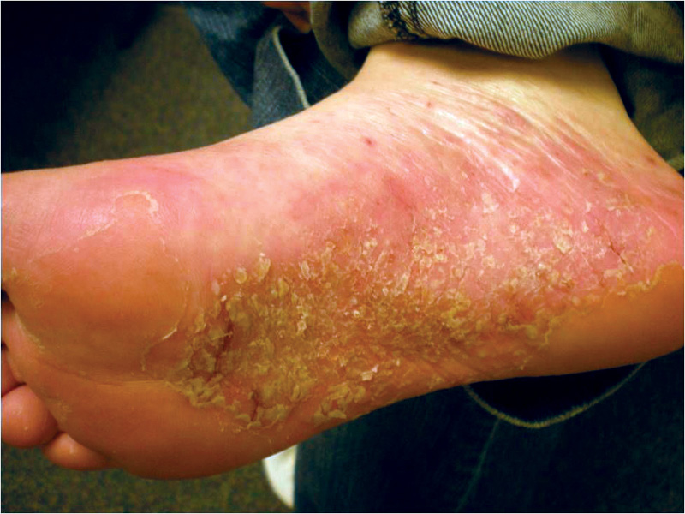
Notes:
Strep pharyngitis → guttate psoriasis
obesity, smoking, IBD, CAD

Slide 12
PSORIASIS
Notes:
Strep pharyngitis → guttate psoriasis
obesity, smoking, IBD, CAD

Slide 13
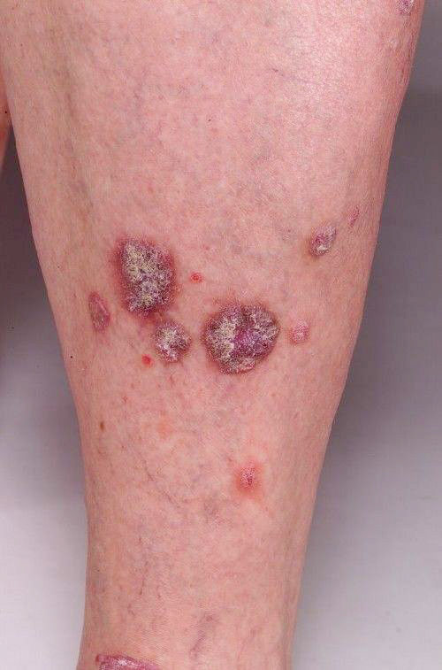
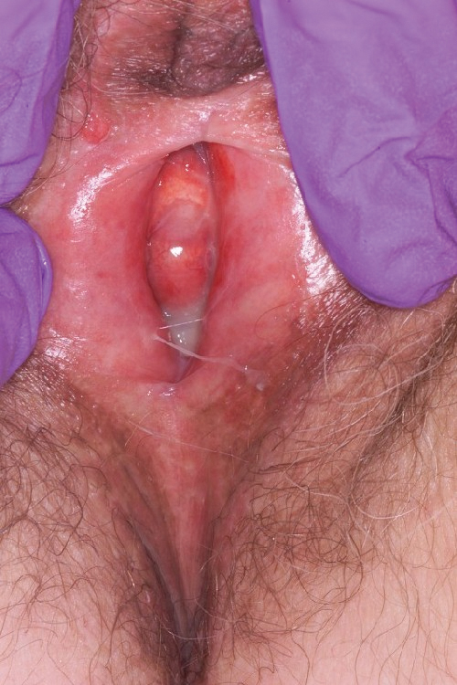
Notes:
Wickham striae = reticulated network of fine white lines on surface
Koebner phenomenon – development of typical lesions following injury to skin
Weak assocation w/HCV (unknown pathogenesis)

Slide 14
LICHEN PLANUS
Notes:
Wickham striae = reticulated network of fine white lines on surface
Koebner phenomenon – development of typical lesions following injury to skin
Weak assocation w/HCV (unknown pathogenesis)
Oral CS, hydroxychloroquine, acitretin for deblilitating or recalcitrant disease – long term treatment with oral CS NOT recommended

Slide 15
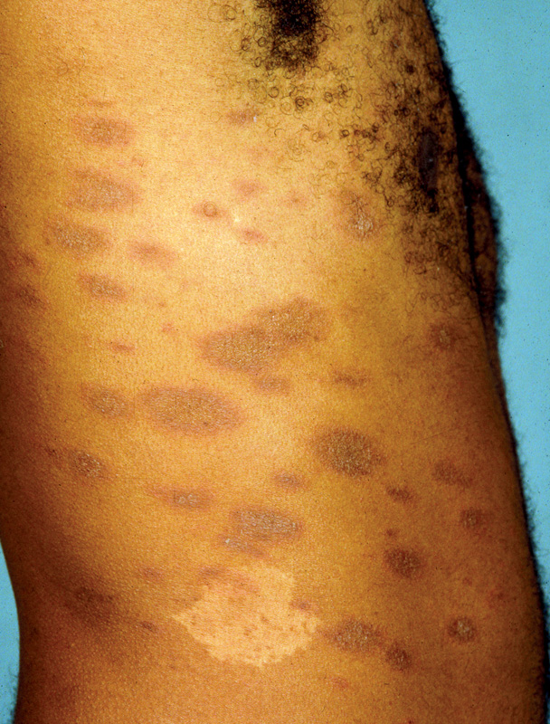
Notes:
Trailing scale = area of scaling that follows advancing border or rash usually a/w annular lesions
Light therapy with narrow band UVB for extensive/persistent dz

Slide 16
PITYRIASIS ROSEA
Notes:
Trailing scale = area of scaling that follows advancing border or rash usually a/w annular lesions
Light therapy with narrow band UVB for extensive/persistent dz

Slide 17
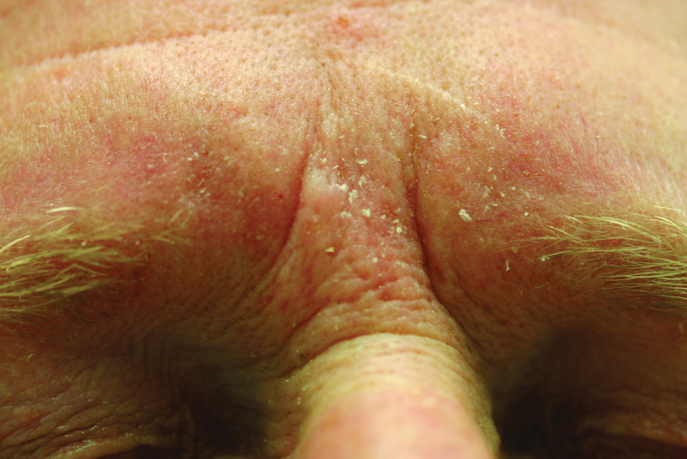

Slide 18
SEBORRHEIC DERMATITIS
Notes:
Dandruff shampoos w/zinc pyrithione or selenium sulfide
Highly CS responsive – 1% hydrocortisone cream 3x/wk – avoid chronic use esp on face

Slide 19
Drug Reactions
Morbilliform exanthems are most common
Abx: beta-lactams, macrolides, metronidazole, TMP-SMX
Antifungals: fluconazole, griseofulvin, terbinafine
Acetaminophen, NSAIDs
Barbiturates, anti-epileptics (mcc of drug-induced HS syndrome)
Notes:
Drug induced HS syndrome i.e. drug rxn w/eosinophilia and systemic sx – fever, facial edema, widespread erythema, fever, LAD, skin necrosis, purpura → LABS: check fo rosinophilia, hepatitis, nephritis → Tx = systemic CS wks to mths

Slide 20
 | Morbilliform | Hypersensitivity | Urticaria | Photosensitivity
Morphology | Coalescing erythematous macs and paps | Erythematous pink paps coalescing into plaques Facial edema | Puffy, pink plaques w/annular configuration | Erythematous patches in sun-exposed areas
Symptoms | Pruritus | Pruritus | Pruritus | Pruritus, Pain
Causative Rx | Antibiotics Diuretics Others | Antiepileptics Minocycline TMP-SMX Allopurinol Dapson Abacavir | Antibiotics Radiocontrast Most drugs | Diuretics Tetracyclines Fluoroquinolone Amiodarone Sulfonamides Psoralens Phenothiazines
Onset/Timing | 8-11d s/p initiation or 1-2 days after cessation | w/in 12 wks of initiation | w/in days of iniitation | At any time during therapy
Management | Topical CS, oral anti-his, EBV/CMV testing | Systemic CS, anti-his | Anti-his, systemic CS, epi | Topical CS, oral anti-his

Slide 21
Dermatologic Urgencies/Emergencies
Erythema Multiforme (EM)
Stevens-Johnson Syndrome (SJS)
Toxic Epidermal Necrolysis (TEN)
Erythroderma

Slide 22
 | EM | SJS | TEM
Morphology | Typical 3-zoned target | Atypical targets & confluent erythema w/sloughing | Extensive, confluent erythema w/sloughing
Distribution | Favors extremities, palms, soles | Trunk, extremities Up to 10% BSA | Trunk, extremities Up to 30% BSA
Mucosal Disease (oral, eye, GU) | 1-2 sites | 2+ sites | 2+ sites
Constitutional Sx | + | ++/+++ | +++
Caused by infection (%) HSV or Mycoplasma | 30-80 | 22 | 6
Caused by Rx (%) | Up to 50 | 73 (anti-epileptics, sulfa, bea-lactam abx, pantoprazole, zoloft, NSAIDs, allopurinol, tramadol) | 94 (anti-epileptics, sulfa, bea-lactam abx, pantoprazole, zoloft, NSAIDs, allopurinol, tramadol)
Mortality (%) | 0 | 5-13 | 25-39
Notes:
EM – more often caused by infection (HSV: eruption 1-3 wks later), ages 20-40, target iris lesions on palms and soles
SJS – more often caused by meds
SJS AND TEN – more lethal b/c of widespread skin and mucosal necrosis → distinguish based on BSA infolvement
SJS 1/100K and TEN 1/1 million → MCC = meds
SJS and TEN -> occur within 8 wks of drug initiation (4-28 days most commonly)
Nikolsky’s sign = shearing off epidermis w/lateral pressure on skin

Slide 23
Dermatologic Urgencies/Emergencies
Clinical dx, biopsy is supportive (epidermal necrosis)
Bx cannot distinguish among EM, SJS or TEN
SCORTEN
  Severity-of-illness score for TEN
  Blood Sugar (> 252), Cancer presence, Older age (>40yrs), heart Rate (>120), Ten percent or more BSA involvement on day 1, Electrolytes (bicarb < 20), BUN (> 28)
  Number of variables present directly correlates with mortality

Slide 24
Dermatologic Urgencies/Emergencies
Treatment
  EM: short courses of systemic CS, antivirals as 70% recurrent 2/2 HSV
  SJS and TEN:
    D/c meds, wound care, IVF, electrolyte repletion, nutritional support
    IVIG and CS controversial
    PPX Abx not recommended though infection is significant cause of mortality
  Antimicrobial tx if HSV or mycoplasma peumoniae is trigger of EM or SJS
Notes:
CS and IVIG controversial for SJS and TEN

Slide 25
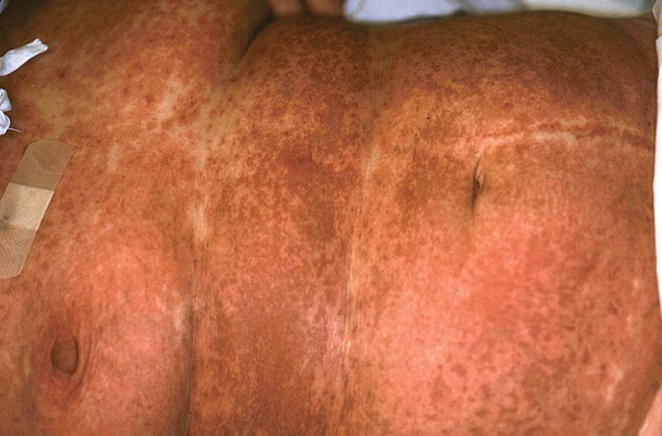
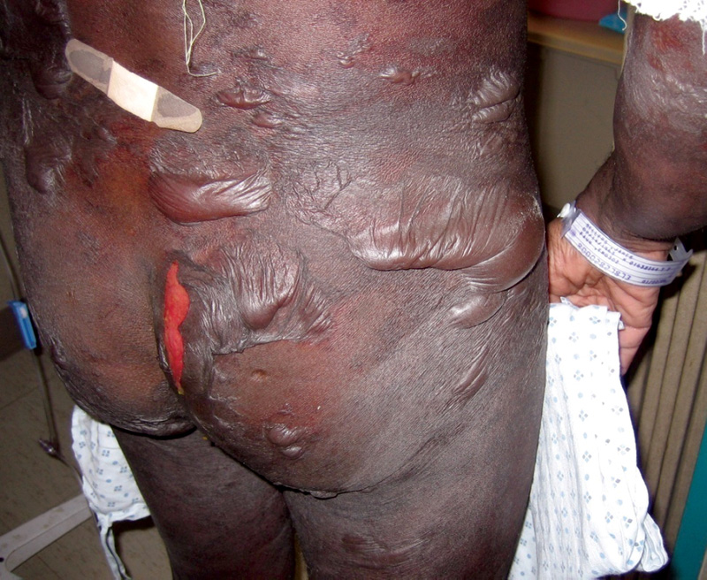
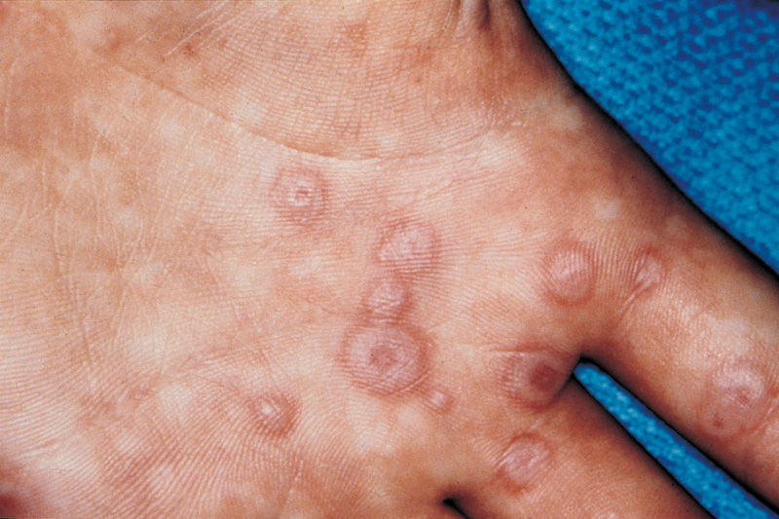
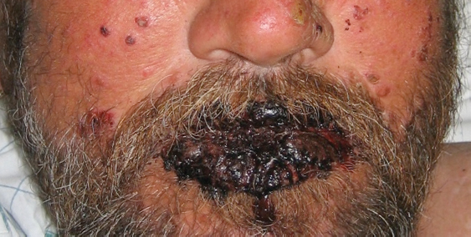

Slide 26
EM
TEN
SJS

Slide 27
Dermatologic Urgencies/Emergencies
Erythroderma
  Involves 80-90% skin surface
  Peripheral edema, erosions from severe pruritus, scaling, LAD
  25-40% idiopathic, most cases 2/2 uncontrolled existing dermatosis or drug reaction, infection, autoimmune disease, malignancy
  Alopecia, nail dystrophy, thickening of palms and soles indicative of long-standing etiology (T-cell lymphoma, graft vs. host disease, psoriasis)
Notes:
Existing derm: psoriasis, atopic eczema, allergic, LP, pityriais
Drugs: exanthem, DRESS (drug HS synd), acute generalized exanthematous pustulosis, TEN
Infection: staph-scalded skin syndrome, tinea corporis, scabies, viral infection
Autoimmune disease: pemphigus foliaceus and vulgaris, bullous pemphigoid, linear IgA disease, lupus, dermatomositis
Malignancy: cutaneous T cell lymphoma (mycosis fungoides), paraneoplastic syndrome w;internal malignancy
Other: sarcoidosis, graft vs host, idiopathic

Slide 28
Dermatologic Urgencies/Emergencies
Diagnostic studies:
  CBC (wbc, eosinophilia)
  CXR for LAD
  Skin scrapings (scabies), patch testing (allergy), immunofluorescence studies (autoimmune)
  Bx non-specific in 30-40%
Tx
  d/c implicated med if 2/2 Rx hypersensitivity
  IVF, lytes, treat infection, emollients
  Topical CS and antihistamines for pruritus
  Prognosis dependent upon etiology

Slide 29
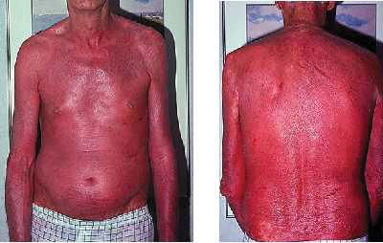
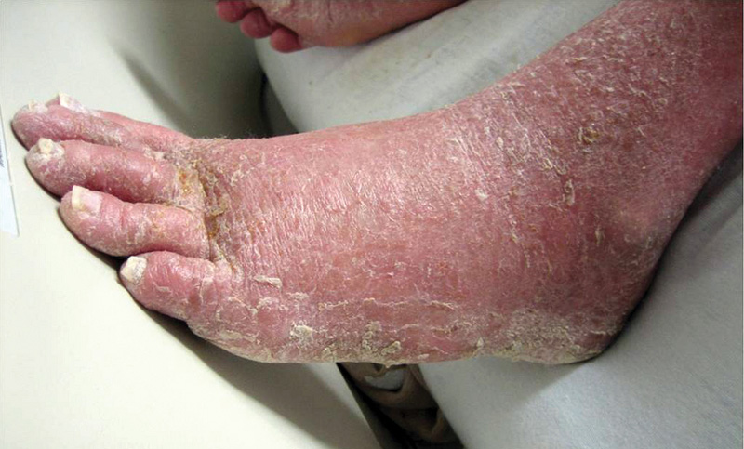
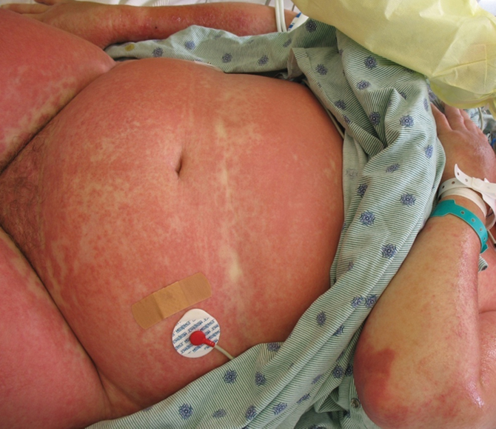
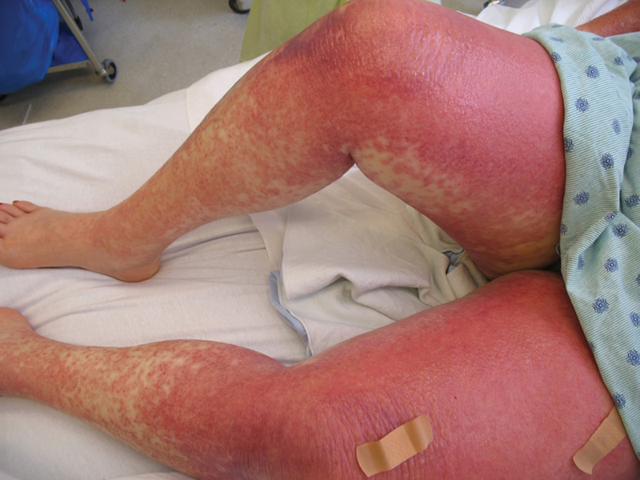

Slide 30
Questions

Slide 31
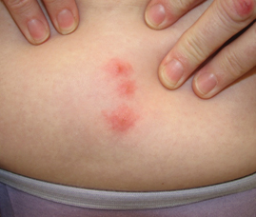
A 49 yo F is evaluated for a several-day history of pruritic lesions on the abdomen. She first noticed them when she returned from a business trip to a large northeastern city. She didn’t see any bugs in the hotel. Her husband is not itching and has no visible lesions, although he shared the same room and bed. She reports no new medications or exposures to other persons with similar rashes. Medical history is unremarkable, and she takes no medications.
Which of the following is the most appropriate treatment?
A. Oral doxycycline
B. Oral ivermectin
C. Topical permethrin cream
D. Topical triamcinolone acetonide cream

Slide 32
D. Topical triamcinolone acetonide cream
Explanation:
Epidemiology – common in large cities; variation in response that different individuals have to the bites so it is possible for different persons sharing the same room to have reactions ranging from no visible marks to larger, urticarial wheals
Recognize bed bugs – linear pattern of grouping with series of bites close together on the skin; small punctum or bite mark may be visible in the center of the bump
Treatment – topical triamcinolone acetonide and oral antihistamines to alleviate pruritus; heal spontaneously without meds within several days; can become infected if scratched but only treat with antibiotics (doxycycline) if there is a surroundign cellulitis
**Bedbugs do NOT infest the skin so treatment w/pediculicides (topical permethrin, oral ivermectin) is not indicated
Key Point: Topical corticosteroids and oral antihistamines may provide symptomatic relief of bedbug bites

Slide 33
A 46 yo F is evaluated for a 4-day history of an intensely pruritic rash on her face and neck. She started using a new facial moisturizer about 1 week before the onset of the rash. She has stopped using moisturizer, but the rash has persisted. She has treated the rash with calamine lotion without improvement. Medical history is otherwise unremarkable, and she takes no meds.
On physical examination, she has poorly defined, red, weepy, eczematous-appearing patches on the cheeks and neck. A few fine vesicles, along with some serous crusting, are seen within the rash.
Which of the following is the most appropriate corticosteroid cream for this rash?
A. Betamethasone dipropionate
B. Clobetasol propionate
C. Desoximetasone
D. Hydrocortisone valerate

Slide 34
D. Hydrocortisone valerate
Explanation:
Diagnosis – allergic contact dermatitis to moisturizer
Steroid choice is based on anatomic site being treated and the nature of skin disease: the safest choice for face and neck treatment is lower potency corticosteroid hydrocortisone valerate
Adverse effects of topical steroids – skin thinning, development of striae and hypopigmentation, telangiectasias with chronic use; therefore, only use CS as long as it is necessary
Clobetasol (ultrapotent) > betamethasone and desoximetasone (high-potency) – avoid both for face and high-risk areas (around the eyes, occluded areas of skin e.g. axillae, inguinal folds, under breasts and abdominal pannus)
Key Point: High-potency topical corticosteroids cause thinning of the skin and should be avoided on the face, in intertriginous skin folds, and on atrophic skin where absorption may be enhanced

Slide 35
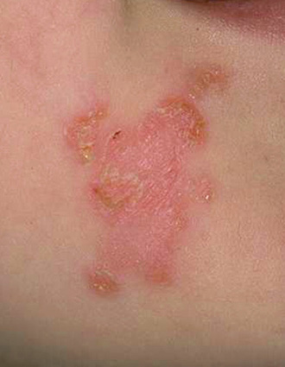
A 20 yo M is evaluated for a single erythematous macule on his left arm that rapidly changed to fluid-filled lesions, some of which were cloudy. On physical examination, vital signs are normal. Skin findings are shown:
Which of the following is the most appropriate topical treatment?
A. Bacitracin
B. Clotrimazole
C. Hydrocortisone
D. Mupirocin

Slide 36
D. Mupirocin
Explanation:
Impetigo – superficial skin infection characterized by yellowish, crusted surface that may be caused by staph or strep (straph > strep); most cases are nonbullous, which is acquired by direct person-to-person contact, rapid spread
Staph – secretion of exfoliative toxin leads to superficial blister formation
- Bullous impetigo indicates S. aureus infection
- Staphylococcal scalded skin syndrome – systemic spread of exfoliative toxins
Topical treatment of choice – mupirocin
Complicated/widespread cases – oral beta-lactamase resistant antibiotics (Keflex)
Bacitracin – active against gram (+) organisms but has high rate of allergic contact dermatitis
Topical clotrimazole – effective against fungal infections, not bacterial
Topical hydrocortisone – can mask symptoms and worsen infection
Key Point: Localized impetigo can be treated with topical mupirocin
Notes:
Mupirocin = bactroban

Slide 37
A 65-year-old woman is evaluated for a prodrome of pain on tip of the nose followed by painful eruption involving the right periorbital tissue. On physical examination, all vital signs are normal. There are grouped viselces on an erythematous base on the tip of the nose and above the right eye.
Which of the following is the most appropriate first step in management of this patient?
A. Apply warm compresses
B. Begin ophthalmic corticosteroids
C. Begin valacyclovir and obtain urgent ophthalmology consultation
D. Obtain bacterial culture and start cephalexin

Slide 38
C. Begin valacyclovir and obtain urgent ophthalmology consultation
Explanation:
Shingles – reactivation of VZV occurring anytime after primary varicella infection; prodrome of intense pain, > 90% have pruritus, tingling, tenderness, hyperesthesia; dermatomal
Ophthalmic zoster – requires prompt treatment as it can lead to blindness; 100% of patients in prospective multicenter study presented who developed moderate-severe eye disease presented with red eye.
Hutchinson sign – zoster eruption on the tip of the nose; not predictive of clinically relevant eye disease
Clinical diagnosis but fluorescent-antibody testing or by PCR is confirmatory
Treatment – immediate ophtho referral + empiric treatment w/antiviral (acyclovir, valacyclovir, or famciclovir); ophthalmic CS frequently an adjunctive agent to antivirals but are administered by specialist
Key Point: Ophthalmic herpes zoster infection should be considered a medical emergency that requires prompt referral to an ophthalmologist and initiation of an antiviral agent.

Slide 39
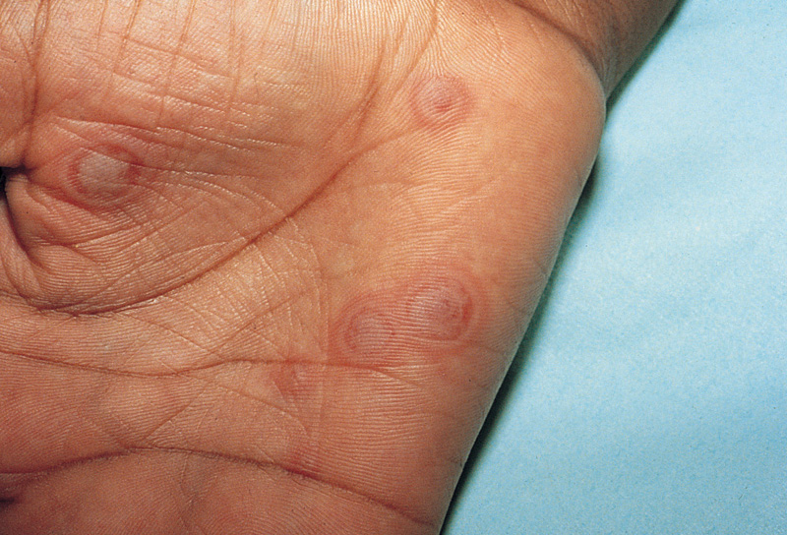
A 22 yo M is evaluated for lip erosions and a new rash on the palms. A representative example of the skin findings is shown:
Which of the following infections is most commonly associated with this skin finding?
A. Herpes simplex virus
B. Parvovirus B19
C. Streptococcus, group A
D. Varicella zoster

Slide 40
A. Herpes simplex virus
Explanation:
Diagnosis – erythema multiforme: several mm to several cm lesions consisting of erythematous plaques with concentric rings of color; dusky center can become necrotic and form a discrete blister or eschar
Recurrent HSV infection causes recurrent EM eruptions; most patients tend to be 20-40 yo
Presentation – few to hundreds of lesions develop within several days, most commonly on extensor surfaces of extremities (hands and feet); 70% of patients have mucosal lesions (cutaneous and mucosal lips, gingival sulcus, sides of tongue); lesions last 1-2 wekes before healing, hyperpigmentation may persist
Treatment – symptomatic, systemic CS can be used but are associated with complciations; antivirals do not shorten EM outbreak in HSV-associated infection BUT continuous ppx antiviral tx can help prevent future episodes
Strep does not cause EM but EM can be triggered by abx used to treat strep
Parvovirus B19 & VZV are rarely associated with EM
Key Point: Erythema multiforme is an acute dermatosis of the skin and mucosae that can be triggered by infections, most commonly herpes simplex virus

Slide 41
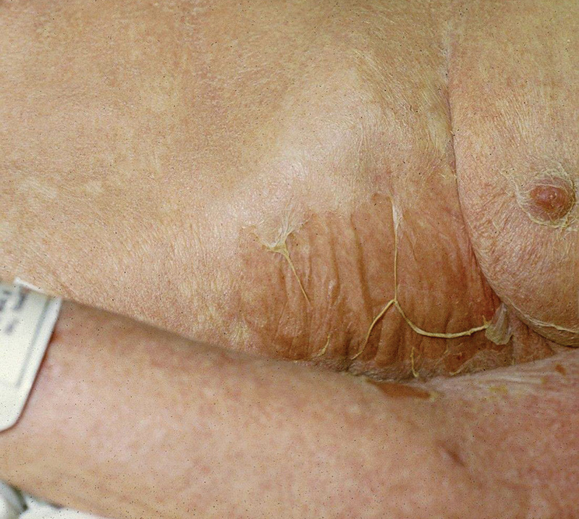
A 75 yo F is evaluated in the emergency department for skin blistering. Her symptoms began 4 days ago when she developed fatigue, malaise, and headache. Her eyes felt dry and gritty 2 nights ago. When she awoke yesterday, her skin was pink-red and blistered with some broken blisters oozing fluid and leaving patches of raw skin. The lesions have rapidly progressed over the past 24 hours. Ten days ago, she received TMP-SMX for a UTI.
On physical examination, T 102.4F HR 115 BP 100/75 RR 20. There is generalized erythema of the entire body, with blistering and erosions affecting greater than 30% of the body surface area. Lateral pressure on erythematous, nonblistered skin causes the skin to slough. There is conjunctival hyperemia, the lips are crusted, and there are ulcers inside the mouth. Skin findings are shown:
The leukocyte count is 12,5000 with 15% eos.
The serum ALT and AST levels are elevated.
Which of the following is the most likely diagnosis?
A. Erythema multiforme
B. Pemphigus foliaceous
C. Staphylococcal scalded skin syndrome
D. Toxic epidermal necrolysis

Slide 42
D. Toxic epidermal necrolysis
Explanation:
TEN – epidermal detachment in > 30% BSA, positive Nikolsky sign (lateral pressure on nonblistered skin leads to denudation); 80% cases – 2+ mucosal surfaces involved
MCC are medications – antiepileptics, NSAIDs, antibiotics, pantoprazole, sertraline, tramadol, allopurinol; occur within 8 wks of drug initiation (usually 4-28 days)
Increased risk with HIV, CKD, autoimmune disease
Prodrome (fever, sore throat, burning sensation in eyes) occurs 1-3 days before skin lesions appear
Skin findings – TEN “with spots” (flat, atypical, pupuric targetoid lesions that coalesce into dusky poorly demarcated confluent patches) vs. “without spots” (confluent, tender erythema without identifiable individual lesions)
Involved epidermis blisters and slouphs leaving behind denuded dermis; prominent skin pain
Diagnosis – clinical, biopsy is supportive but cannot distinguish among EM, SJS, & TEN
Key Point: Toxic epidermal necrolysis is a potentially lethal drug eruption with active onset of widespread skin and mucosal necrosis

Slide 43
A 27yo F is evaluated because of a many-year history of eczema. It started in childhood, and she continues to experience intermittent outbreaks of widespread, pruritic dermatitis on her trunk and extremities. She uses emollients but has had the best results using topical corticosteroids such as triamcinolone. Medical history is remarkable for hay fever; her only medication is hydroxyzine.
On physical examination, she has widespread eczematous dermatitis with erythema, fine papules, and excoriations on much of the trunk and extremities. Dermatitis involves the anticubital and popliteal fossae. Lichenification is present on areas of the legs. No vesicles or pustules are observed. The patient will be prescribed topical triamcinolone ointment twice daily on the trunk and extremities for 7 days.
Which of the following commercially available sizes of triamcinolone should be prescribed to ensure that she has sufficient medication to treat her dermatitis as prescribed?
A. 15 g
B. 20 g
C. 60 g
D. 80 g
E. 454 g

Slide 44
E. 454 g
Explanation:
Triamcinolone is available in a 1-pound (454 g) jar
Common for providers to prescribe insufficient medication, resulting in treatment failure
Body surface estimates
- Leg = 18%
- Arm = 18%
- Front torso = 18%
- Back torso = 18%
- Head = 9%
Whole body x percentage needing medication = amount necessary per app
BID application to trunk + 2 legs + 2 arms = 30g x [(2x0.18) + (2x0.18) + 0.18]
= 27 g per app → 54 g per day → 378 g for 7 day course
Key Point: An average of 30 g, or about 1 oz, of a given topical medication is needed to cover the “average” 70-kg (154-lb) patient

Slide 45
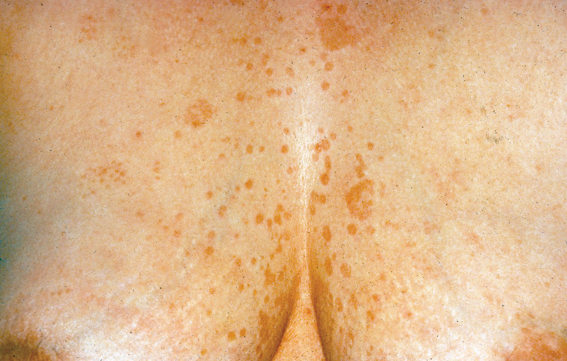
A 35-year-old woman is evaluated for recurrent salmon-colored oval lesions on the chest and upper back, which are occasionally itchy. She has tried over-the-counter selenium sulfide-based shampoo with only modest improvement. The lesions seem to reappear every year during hot, humid weather.
On physical examination, vital signs are normal. Potassium hydroxide (KOH) testing of the scale shows a “spaghetti and meatballs” pattern. Skin findings are shown:
Which of the following is the most appropriate next step in treatment?
A. Oral ketoconazole, single dose
B. Topical corticosteroids
C. Topical ketoconazole
D. No treatment

Slide 46
C. Topical ketoconazole
Explanation:
Diagnosis – tinea versicolor: caused by the yeast Malassezia furfur (aka pityrosporum ovale or pityrosporum orbiculare)
Confirm with KOH prep from scrapings – “spaghetti and meatballs”
Treatment – topical imidazole agents (ketoconazole, bifonazole, miconazole, econazole, clotrimazole, ciclopirox)
Oral azoles – reserved for patients with recalcitrant TV or extensive skin invovlement making topical tx impractical; when systemic therapy is prescribed, longer durations of treatment and higher doses produce greater cure rates
- Ketoconazole 200mg qd x 10 days
- Itraconazole 200mg qd x 7 days OR 100mg qd x 2 weeks
- Fluconazole 300mg q week x 2-4 wks
Single doses of oral azoles are LESS effective than multiple doses over several days/wks
Topical CS may relieve pruritus but would worsen infection and allow yeast to flourish
Key Point: Ketoconazole shampoo and the imidazole or traizole creams are effective topically and are preferred to systemic therapy as initial treatment

Slide 47
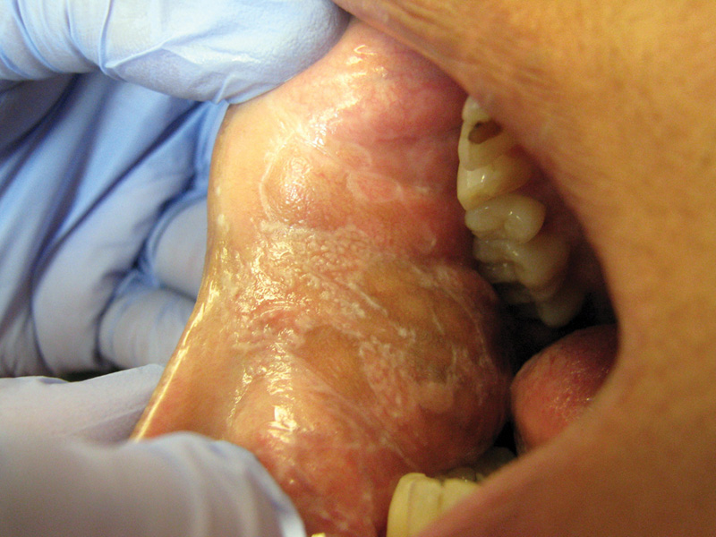
A 35 yo M presents with a 6-month history of small polygonal violaceous papules on the wrists bilaterally and a white, lacy discoloration on the buccal mucosa of the cheeks bilaterally. The white lacy areas do not come off when scraped with a tongue depressor. The affected areas in the mouth occasionally ulcerate and become tender. The patient is in excellent health, takes no medications, has no history of chronic disease or immunosuppression. Oral mucosal findings are shown:
Which of the following is the most likely diagnosis?
A. Aphthous ulcers
B. Candidiasis
C. Lichen planus
D. Oral hairy leukoplakia

Slide 48
C. Lichen planus
Explanation:
LP – autoimmune disease affecting skin, mucous membranes, scalp, nails; mall polygonal violaceous papules distributed symmetrically on wrists, flexural aspects of arms and legs, lower back, genitals
Wickham striae – white-reticulated network on the buccal mucosa
Increased frequency in patients with liver disease (HCV), unknown reasons
Drugs causing LP – ACEI, thazides, furosemide, gold, antimalarials, d-penicillamine, beta blockers
Diagnosis – confirmed with biopsy
Treatment – topical corticosteroids, calcineurin inhibitors
Key Point: Common clinical findings in mucosal lichen planus are a white-reticulated network on the buccal mucosa; desquamative gingivitis; and chronic, painful erosions on the oral or vulvar mucosa
Notes:
Oral hair leukoplakia – white plaques appear corrugated and are on lateral aspect of tongue; adherent, not retiform pattern like LP
Calcineurin inhibitors (cyclosporine, tacrolimus)

Slide 49

A 58 yo M is evaluated for a 3-year history of an itchy, scaly rash. It began as patches and plaques but over the past several months has progressed to a generalized, red skin rash. The pruritus is intense and interferes with his life. His only other medical problem is hypertension for which he has taken lisinopril for the past 5 years.
On physical examination, vital signs are normal. He has erythema with scales affecting more than 90% of the body surface area. Skin findings are shown:
He also has alopecia thickening of the nails, palms, and soles, and nail dystrophy. Generalized lymphadenopathy is also present.
Which of the following is the most likely diagnosis?
A. Cutaneous T-cell lymphoma
B. Drug hypersensitivity reaction
C. Pustular psoriasis
D. Staphylococcal scalded skin syndrome

Slide 50
A. Cutaneous T-cell lymphoma
Explanation:
Erythroderma – erythematous eruption that involves > 90% of the BSA; most common causes are drug eruptions, psoriasis, atopic dermatitis, and cutaneous T-cell lymphoma; can be idiopathic
Cutaneous T-cell lymphoma – patches, plaques, tumors, generalized erythroderma
Long-standing disease – suggested by alopecia, nail dystrophy, thickening of the palms and soles
Diagnosis – skin biopsy with hematoxylin and eosin staining in every patient
Drug hypersensitivity reaction – acute erythroderma onset 3-6 wks after starting new med (common causativ emeds: allopurinol, antiepilpetics, dapsone, NSAIDs, sulfonamides, lamotrigine); facial edema, cervical LAD, hepatosplenomegaly
SSSS – most common in children < 6 yrs but can affect adults with underlying immunosuppression or AKI; perioral crusting and fissuring, early involvement of intertriginous areas; clinical dx but can confirm with bacterial culture
Key Point: The most common causes of erythroderma are drug eruptions, psoriasis, atopic dermatitis, and cutaneous T-cell lymphoma
Notes:
Oral hair leukoplakia – white plaques appear corrugated and are on lateral aspect of tongue; adherent, not retiform pattern like LP
Calcineurin inhibitors (cyclosporine, tacrolimus)

Slide 51


