Slide 1
Board Review
Shock
Emergent Disorders in Critical Care

Slide 2
Shock
Decreased tissue perfusion → inadequate O2 delivery → tiessue ischemia
Common Clinical Features of Shock
1. HYPOTENSION
SBP < 90 mm Hg
MAP <60 mm Hg
Acute decreased in SBP of > 40 mm Hg
Lack of MAP response to initial fluid challenge
2. END_ORGAN DYSFUNCTION DUE TO HYPOPERFUSION
Decreased urine output
Change in mental status
Increased serum lactic acid level

Slide 3
Key Hemodynamic Parameters of Shock
Ohm’s Law: V=RI
CO = SVR x BP

Slide 4
Blood Pressure
Cardiac output
(decreased in cardiogenic shock)
Systemic Vascular Resistance
(decreased in distributive shock)
Heart Rate
Stroke Volume
Preload
(decreased in
hypovolemic shock)
Contractility
Afterload

Slide 5
Type of Shock | Decreased parameter | Example
Cardiogenic | Cardiac output | Acute heart failure, massive pulmonary emboli
Distributive | Systemic vascular resistance | Sepsis, anaphylaxis
Hypovolemic | Preload | Acute hemorrhage, severe dehydration

Slide 6
Agent (dose) | Receptors | Clinical Use | Common Side Effects or Contraindications
Norepinephrine | a₁ > B₁ | First line in septic shock | Some arrhythmias, digital ischemia
Dopamine (low) | DA > B₁ | Historically used fir kidney failure (no evidence of effectiveness | Highest arrhythmia risk and ischemia
Dopamine (medium) | B₁ > B₂ | Septic or cardiogenic shock
Dopamine (high) | a₁ > B₁ | First line in septic shock
Epinephrine (low) | B₁ > B₂ | Second line for septic or cardiogenic shock | Arrhythmias and ischemia
Epinephrine (high) | a₁ = B₁ | Second line for septic shock
phenylephrine | a₁ | Milder shock states, least risky through peripheral IV | Lowest arrhythmia risk, not as powerful as other vasopressors
Vasopressin | Vasopressin Receptors | Second vasopressor for septic shock only | Splanchnic ischemia, no indication for non-septic shock

Slide 7
A 71M is evaluated in the ED for septic shock secondary to a UTI.
On P/E, he is lethargic and confused.
Vitals: T: 101.3, BP: 80/35, Pulse: 122/min, RR: 23
Right CVA ttp is noted.
Labs: hematocrit: 33%, WBC: 15600
UA: innumerable leukocytes and gram negative bacteria.
Blood and urine culture results are pending.

Slide 8
Which of the following should be accomplished in the next hour?
Attain hematocrit greater than 35%
Begin low-dose dopamin
Initiate antibiotic therapy
Insert a pulmonary artery catheter

Slide 9
Empiric antibiotic therapy should be initiated whithin 1 hour of recognition of sepsis after cultures have been taken from the blood and other suspected sites of infection. (#timetoantibiotic)

Slide 10
A 41F is admitted to the ICU for a 1-day hx of progressively worsening AMS and jaundice. Her MHx is significant for autoimmune hepatitis dx’ed 10 yrs ago.
On P/E:
Vitals: T: 91.4, BP: 105/55, pulse rate: 110/min, RR: 27/min; BMI: 18
She is unresponsive to sternal rub and is jaundiced. The lungs are clear and cardiac examination is normal. Abdominal examination reveals a distended abdomen with a detectable fluid wave. The extremities are WWP.
Lab: WBC: 9800, Cr: 1.6, lactic acid level: 6 – UA: unremarkable. Blood and urine culture results are pending.
Imaging: CXR: nl
IVF and epiricbroad-spectrum antibiotics are begun.

Slide 11
Which of the following is the most appropriate next step in management?
Abdominal CT
Diagnostic paracentesis
Dopamine
Hydrocortisone

Slide 12
The primary goals of sepsis management are infection source control and early antibiotics

Slide 13
A 78F is treated in the ICU for a 24-hr hx of AMSthat has been progressively worsening. She is a resident of a nursing home, and her MHx is significant for Alzheimer disease.
On arrival to the ED, she was disoriented, febrile, tachycardic with a HR of 115/min, and hypotensive with a BP of 82/40.
Labs:
WBC: 33,000 – hemoglobin: 11 – urine dipstick was positive for nitrites and leukocyte esterase. – Blood and urine culture results are pending.
Imaging:
CXR: normal
Central access was obtained and she was started on broad-spectrum antibiotics. A 1000-ml normal saline fluid challenged was administered over 30 minutes.
Current examination in the ICU shows the patient to have an unchanged mental status. BP is now: 85/45 mm Hg and HR: 100/min. Her P/E is unchanged

Slide 14
Which of the following is the most appropriate immediate next step in management?
Erythrocyte transfususion
Hydrocortisone
Norepinephrine
Normal Saline at 200 ml/h

Slide 15
Vasopressor therapy is indiacted to maintain a MAP of greater than or equal to 65 mm Hg or CVP measurement of 8-12 mm Hg in patients with sepsis who have failed to respond to an initial crystalloid fluid challenge.

Slide 16
Emergent Disorders in Critical Care
Acute Inhalational Injuries
Anaphylaxis
Hypertensive Emergencies
Hyperthermic Emergencies
Hypothermic Emergencies
Toxicology

Slide 17
Acute Inhalational Injuries
Burn victims
Approximately half of deaths associated with with burns are due to complications of inhalational injury
When the inhalational exposure is brief and the inhaled toxins are water soluble → tissue damage is greates in the proximal airways
When inhalational injuries include less water-soluble toxins or prolonged heat exposure → damage can extend into distal airways and lung parenchyma

Slide 18
Complications: pulmonary edema, airway stenosis, RADS, bronchiolitis obliterans, bronchiectasis and parenchymal fibrosis
CO, Cyanide toxicity common in smoke inhalation
Burn victims at high risk of secondary infections: staph, pseudomonal

Slide 19
Supportive Care of patients with Acute Inhalational Injuries:
IV fluids
Intubation for mechanical ventilation
Chest physiotherapy
Bronchoscopic debridement and suctioning
Inhaled racemic epinephrine
Antibiotics

Slide 20
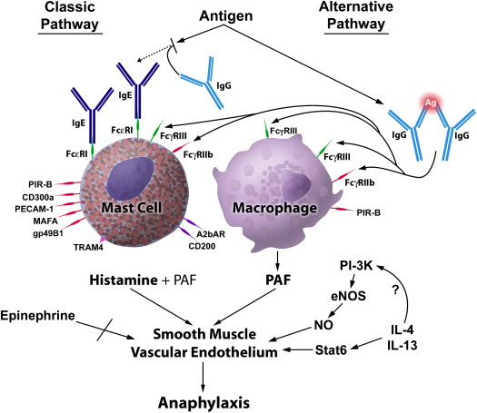
Anaphylaxis

Slide 21
Clinical Features of Anaphylaxis
Urticaria
Tachycardia (sometimes bradycardia)
Stridor, hoarseness, wheezing
Hypotension
GI Sx: cramping abdominal pain, vomiting and diarrhea

Slide 22
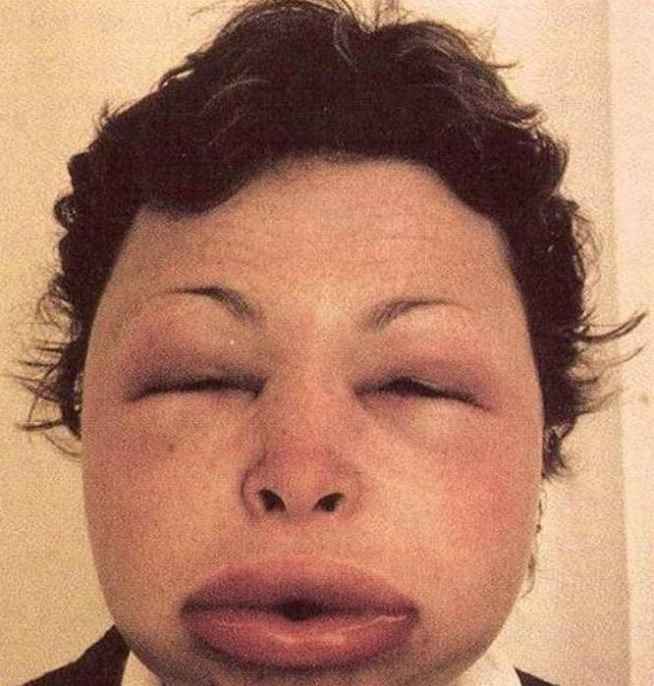
Angioedema
A component of anaphylaxis
ACEIs and familial (C1 inhibitor deficiency)

Slide 23
Management of Anaphylaxis:
O2 and IV fluids
Epinephrin (SQ or IM) – higher doses or continuous for patients on BBs
Antihistamines or coticosteroids (strong evidence is lacking)
Inhaled bronchodilators → reduce bronchospasm and airway edema
Airway support
With timely supportive care, anaphylaxis is rarely fatal

Slide 24
Hypertensive Emergencies
Episodes of elevated BP associated with end-organ damage
Men, black patients and elderly patients with poorly controlled essential hypertension
CNS (presenting with stroke in 25%), renal (AKI), cardiovascular (ischemic chest pain or acute heart failure)

Slide 25
BP should be measured in both arms and in both supine and standing positions
A careful neuro exam including mental status and visual fields and acuity
Lab studies: CBC, BMP, cardiac biomarkers, UA, drug levels including cocaine and amphetamines
EKG, CXR, brain imaging (AMS, neuro findings suggestive of stroke)
Aortic dissection is always a possibility (CT-angio, TEE)

Slide 26
BP should be lowered by no more than 25% initially
Systolic and diastolic targets over the next 2-6 hours: 160/110 with gradual correction after that

Slide 27
Agent (Class) | Notes | Adverse Effects
Nitroprusside (vasodilator) | Easy to titrate; often 1st choice for acute situations | Risk for cyanide toxicity
NTG (vasodilator) | Used for MI; tolerance develop | Headache, bradycardia
Hydralazine (vasodilator) | Safe in pregnancy | Nausea, headache and tachycardia
Labetolol (alpha and beta blocker) | Can be switched to oral | Bradycardia, heart block, nausea, bronchospasm
Enalaprilat (ACEI) | Can be switched to oral; good for LV failure | Prolonged hypotension
Nicardipine (CCB) | Often used for patients with stroke | MI, tachycardia, headache
Fenoldopam (dopamine agonist) | Can be titrated up slowly; may be protective of kidneys | Flushing, headache, nausea, tachycardia, possibly increased MI
Phentolamine (alpha blocker) | Used for dx of and surgery for pheochromocytoma | Nausea, arrhythmia

Slide 28
Hyperthermic Emergencies
A rise in core body temperature > 40 C (104.0 F)
Clinical features: AMS (including seizures), muscle rigidity, and rhabdomyolysis (with kidney failure) – severe cases: DIC, ARDS
Heat stroke
Malignant hyperthermia
Neuroleptic malignant syndrome

Slide 29
Heat Stroke
Failure of the body’s thermoregulatory system
Impaired thermoregulation: elderly and patients treated for conditions that lead to dehydration and anhidrosis
Overwhelmed thermoregulation: athletes and military recruits who are required to exercise strenuously in hot and humid weather

Slide 30
Patients should be cooled to lower their core body temperature
Do not respond to centrally acting antipyretic medications
Evaporative cooling methods and ice packs are usually most effective
In severe cases, cold gastric or peritoneal lavage may be attempted
BZD decrease discomfort and shivering during these treatments

Slide 31
Malignant Hyperthermia
Reaction to certain classes of drugs including inhaled anesthetics (halothane and others) and depolarizing neuromuscular blockers (succinylcholine and decamethonium [syncurine])
Markedly increased intracellular calcium → increased cellular metabolism → sustained muscle tetany
Susceptibility to malignant hyperthermia is inherited

Slide 32
Severe muscle rigidity, masseter spasm, hyperthermia with core T up to 45, cardiac tachyarrhythmias, and rhabdomyolysis are common manifestations.
Mortality rate: 10%
Triggering agent should be stopped
Fluids and cooling methods should be initiated
Dantrolene is given q 5-10 min until hyperthermia and rigidity resolve
Dantrolene can also prevent recurrence in patients with a hx of malignant hyperthermia if given before administration of the triggering agent

Slide 33
Neuroleptic Malignant Syndrome
Idiosyncratic reaction to neuroleptic antipsychotic agents
Characterized by muscle rigidity, hyperthermia and autonomic dysregulation
Delirium is common
Potent “typical” neuroleptics are most commonly implicated
Often occurs after medication is started or uptitrated – it occasionally occurs after years of problem-free use
Concomitant Li use may be a risk factor

Slide 34
Mortality rate: 10-20%
Treatment include: stopping the neuroleptic agent, maintaining BP stability, IVF, lowering the elevated T, BZD for agitation
Dantrolene and bromocriptine are also used, but the evidence for these agents is weak

Slide 35
Hypothermic emergencies
Core T below 35 (95 F)
Exposure to cold weather and submersion in cold water
Causes cellular dysfunction and lyte abnormalities, esp. hyperkalemia
Mild hypothermia [32-35 C (89.6-95 F)] → shivering, AMS, ataxia, polyuria
Moderate hypothermia [28-32 C (82.4-89.6 F) → decreased HR, CO, more severe AMS, cardiac arrhythmias
Severe hypertormia [<28 C (82.4)] → pulmonary edema, coma, hypotension, areflexia, ventricular arrhythmias and cardiac arrest

Slide 36
J Wave (osborne wave)
A 47-year-old man with chronic schizophrenia was hospitalized after prolonged hypothermia. The initial electrocardiogram revealed Osborn waves (arrowheads) similar in amplitude to the R waves. Characteristic sinus bradycardia and prolongation of the QRS interval and the corrected QT interval (QTc) were also noted. During rewarming, the Osborn waves diminished in amplitude, and they disappeared after 24 hours. The baseline tremor artifact caused by shivering (arrows) resolved on normalization of the patient's core body temperature. In 1953, Dr. John Osborn described the J wave as an “injury current” resulting in ventricular fibrillation during experimental hypothermia. More recent findings suggest that hypothermia increases the epicardial potassium current relative to the current in the endocardium during ventricular repolarization. This transmural voltage gradient is reflected on the surface electrocardiogram as a prominent J, or Osborn, wave. The differential diagnosis of prominent Osborn waves includes early repolarization, hypercalcemia, and the Brugada syndrome.

Slide 37
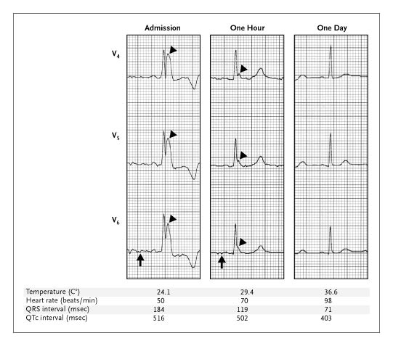

Giant Osborn Waves in Hypothermia
Krantz MJ, Lowery CM. N Engl J Med 2005;352:184-184.
Notes:
A 47-year-old man with chronic schizophrenia was hospitalized after prolonged hypothermia. The initial electrocardiogram revealed Osborn waves (arrowheads) similar in amplitude to the R waves. Characteristic sinus bradycardia and prolongation of the QRS interval and the corrected QT interval (QTc) were also noted. During rewarming, the Osborn waves diminished in amplitude, and they disappeared after 24 hours. The baseline tremor artifact caused by shivering (arrows) resolved on normalization of the patient's core body temperature. In 1953, Dr. John Osborn described the J wave as an “injury current” resulting in ventricular fibrillation during experimental hypothermia. More recent findings suggest that hypothermia increases the epicardial potassium current relative to the current in the endocardium during ventricular repolarization. This transmural voltage gradient is reflected on the surface electrocardiogram as a prominent J, or Osborn, wave. The differential diagnosis of prominent Osborn waves includes early repolarization, hypercalcemia, and the Brugada syndrome.

Slide 38
Toxicology
Syndrome | Manifestations | Representative Drugs
Sympathomimetic | Tachycardia Hypertension Diaphoresis Agitation Seizures Mydriasis | Cocaine Amphetamine Ephedrine Caffeine
Cholinergic | “SLUDGE” Confusion Brochorrhea Bradycardia Miosis | Organophosphates (insecticides, sarin) Carbamates Physostigmine Edrophonium Nicotine

Slide 39
Toxicology
Syndrome | Manifestations | Representative Drugs
Anticholinergic | Hyperthermia and dry mucous membranes Agitation, delirium Tachycardia, tachypnea Hypertension Mydriasis | Antihistamines TCA Antiparkinson agents Atropine Scopolamine
Opioids | Miosis Respiratory depression Lethargy, confusion Hypothermia Bradycardia hypotension | Morphine and related drugs Heroin

Slide 40
Alcohols
Alcohol | Common Name | Toxic Metabolite | Nontoxic Metabolite | Anion Gap | Osmolar Gap | Toxicity | Antidote
Methanol | Wood alcohol | Formic acid | --- | YES | YES | Retina | Fomepizole, ETOH, Dialysis
Ethylene glycol | Antifreeze | Glycolic, Glyoxolic and oxalic acid | --- | YES | YES | Renal Tubules | Fomepizole, ETOH, Dialysis
Isopropyl alcohol | Rubbing alcohol | --- | Acetone | NO | YES | CNS Depression | Fomepizole, ETOH, Dialysis

Slide 41
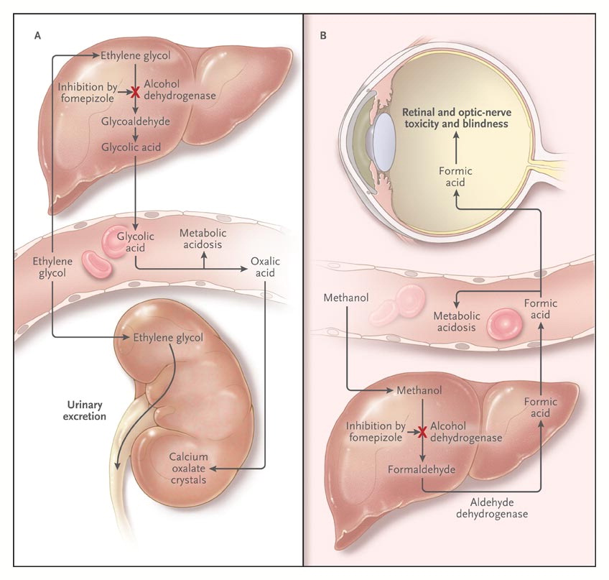
Effect of Fomepizole on the Pathophysiological Effects of Poisoning from Ethylene Glycol and Methanol.
Brent J. N Engl J Med 2009;360:2216-2223.
Notes:
Figure 1. Effect of Fomepizole on the Pathophysiological Effects of Poisoning from Ethylene Glycol and Methanol. Panel A shows the metabolic transformation of ethylene glycol to glycolic acid, which is responsible for metabolic acidosis. Glycolic acid is further metabolized through the intermediate glyoxylic acid to oxalic acid. When the solubility product of calcium oxalate is exceeded, precipitates form in the renal tubules, causing acute kidney injury. In severe cases, calcium oxalate crystals deposit diffusely in multiple organs. Panel B shows similar effects of fomepizole on methanol metabolism.

Slide 42
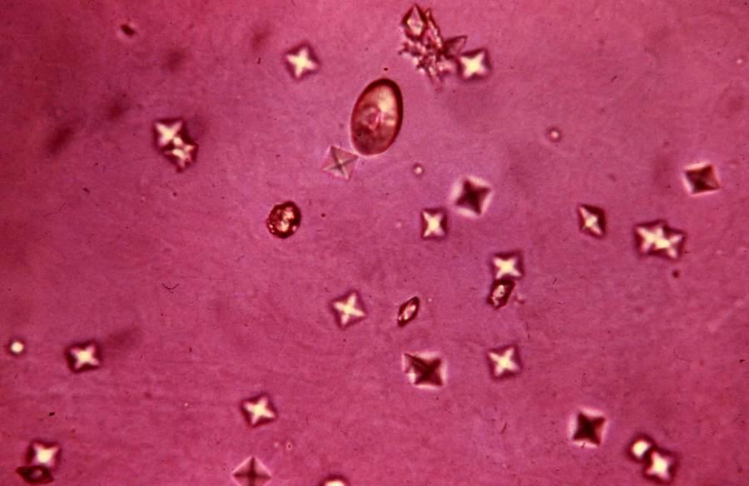

Slide 43
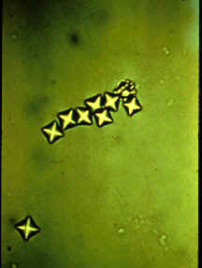

Slide 44
Toxicity of Drugs of Abuse
Agent | Toxic Dose (or serum level) | Toxic effect or syndrome | Pharmaceutical antidote | Other interventions
Acetaminophen | 7.5 g in 8 hrs | Acute hepatitis, fulminant hepatic failure | NAC PO or IV within 8 hrs (may give later as well) | Charcoal within 4 hours
BZD | variable | CNS and respiraory suppression | Flumazenil (caution if risk of seizures) | Ventilatory and hemodynamic support
BB | variable | Bradycardia, heart block, hypotension | Glucagon, CaCl2 | Transcutaneous or transvenous pacing
CCB | variable | Bradyarrhythmia; heart block, hypotension | Glucagon, CaCl2 | Transcutaneous or transvenous pacing
Digoxin | Serum levels have poor correlation with toxicity | Bradyarrhythmia and tachyarrhythmia; chronic toxicity, CNS and GI Sx | Digoxin-specific Ab | HEMODIALYSIS IS NOT EFFECTIVE

Slide 45
Toxicity of Drugs of Abuse
Agent | Toxic Dose | Toxic Effect or Syndrome | Pharmaceutical Antidote | Other Interventions
Sulfonylureas | One tablet in a child or non-diabetic patient may cause hypoglycemia | Hypoglycemia and related Sx | Dextrose, Octreotide, glucagon for short term while dextrose is delayed | Beware recurrent hypoglycemia even after initial response
Lithium | Most overdoses are chronic (serum level upper limit is 1.2 mEq/L for acute mania, 0.8 mEq for maintenance; 3 indicates severe toxicity) | Tremor, nausea, polyuria, DI, arrhythmias, photosensitivities, cardiogenic shock due to CNS effect | NO ANTIDOTE FOR Li; medical treatments for secondary arrhythmias, seizures, hypotension | Hemodialysis for AMS, anuria or seizures; IV fluid hydration with careful monitoring of lytes, esp in DI
Salicylates | Levels > 30-40 mg/dL usually mean clinical toxicity; chronic toxicity is more common and more dangerous | Metabolic acidosis, hyperventilation, dehydration; severe intoxication can cause seizure, hypoglycemia and lyte abnormalities | Sodium bicarbonate infusionto achieve urine output of > 2 mL/kg/h and pH of >8 (pH is more important than diuresis) | HD for severe toxicity or poorly tolerated medical therapy

Slide 46
Agent | Toxic Dose (or serum level) | Toxic Effect or Syndrome | Pharmaceutical Antidote | Other Interventions
Theophylline | Therapeutic range 10-20mcg/mL, but toxicity can occur in this range | Nausea, nervousness, CNS stimulation, HTN, tachypnea, seizures, atrial and ventricular arrhythmias, hypokalemia, hyperglycemia, status epilepticus | Activated charcoal can be given | Charcoal hemoperfusion is treatment of choice, but HD can also be used if hemoperfusion is not available; cardioversion, seizure control, airway management, electrolyte correction
TCA | Levels do not correlate well with toxicity; better to follow clinical signs and Sx | Sudden or delayed onset of seizures, severe arrhythmias, hypotension, rhabdomyolysis, and kidney failure | Bicarbonate infusion titrated to QT interval improvement on EKG | HD is not effective, monitor and correct lytes, defibrillation, pacing for bradycardia (avoid atropine or cathecholamines)

Slide 47
A 55M is evaluated in the ED after being found unconscious on the ground outside of his home by family members. He was difficult to arouse and was confused. He was breathing spontaneously, but his breaths were rapid and shallow.
P/E:
Vitals: T: 97.7 BP: 135/91, pulse 110/min, RR: 24/min
Other than tachycardia, the cardiopulmonary examination is normal. The abdomen is soft, no focal findings on neuro exam

Slide 48
Labs:
BUN: 14
Cr: 1.9
Lytes: Na: 138 K: 4.1 Cl: 90 Bicarb: 12 glucose: 90
Lactic acid: 2.8
Serum osmolality 390
ABG: pH: 7.24 PCO2: 28 PO2: 102
Serum Tox: negative for ETOH, opioids, BZD and common recreational drugs
Imaging:
CXR: no lung infiltrates or masses.
There is very little urine in the bladder, but urine obtained by catheterization contains many erythrocytes and envelope-shaped crystals.

Slide 49
Which of the following is the most appropriate treatment?
Hemodialysis
Intravenous ethanol
Intravenous fomepizole
Intravenous fomepizole and hemodialysis
Supportive care

Slide 50
Calculated serum osm:
2 Na + Glucose/18 + BUN/2.8 =
2 (138) + 90/18 + 14/2.8 = 276 + 5 + 5 = 376
Osmolality gap = observed – expected
Osm gap = 390 – 376 = 14

Slide 51
#classicHACadmission
A 39 yo M is admitted to the hospital for new-onset agitation, fluctuating level of consciousness and tremors. He is diagnosed with acute alcoholic hepatitis.
On P/E,
Vitals: T: 101.8, BP: 95/55, HR: 130 and RR: 30
Jaundice is noted. The abdomen is protuberant with ascites, but is soft with no abdominal rigidity or guarding. There’s no blood in stool. The patient is agitated and disoriented, is unable to maintain attention and appear to be having visual hallucination. He believes that the nurse has stolen his wallet (which is in his bedside drawer) in order to obtain his identity. He is diaphoretic and tremulous. Asterixis is absent, and the remainder of neurologic examination is normal.

Slide 52
Which of the following is the most appropriate management?
Ceftriaxone
CT of the head
Haloperidol
Lactulose enema
Lorazepam

Slide 53
Delirium tremens is characterized by fluctuating level of consciousness, disorientation, reduced attention, global amnesia, impaired cognition and speech and often hallucinations and delusions.

Slide 54
A 21 yo M is evaluated in the ED for shortness of breath after a bee sting. He feels lightheaded and describes a sense of puffiness in his face.
On P/E:
Vitals: T: 100.4, BP: 98/60, HR: 100 RR: 24/min
He is agitated, bilateral wheezing is noted. There is no stridor and no evidence of facial, tongue or oropharyngeal swelling. There’s no rash. CXR shows hyperinflation.

Slide 55
Which of the following is the most appropriate treatment?
Endotracheal intubation and mechanical ventilation
Intramuscular epinephrine and inhaled albuterol
Intravenous diphenhydramine and methylprednisolone
Intravenous epinephrine, methylprednisolone, and diphenhydramine

Slide 56
A 19-year-old woman is evaluated in the ED after taking an overdose of medication in an apparent suicide attempt.
On P/E: she is intubated and on mechanical ventilation. She is obtunded.
Vitals: T: 100.2, BP: 96/60, HR: 92, RR on assisted mode of ventilation: 18/min.
The remainder of the physical exam is normal.

Slide 57
Laboratory studies reveal a plasma glucose level of 100. Qualitative urine toxicology screen reveals the presence of benzodiazepines and tricyclic antidepressants. No other toxins are identified in her serum or urine.
Initial EKG shows sinus tachycardia with a QRS duration of 90 ms. – EKG in the ICU several hours later shows a QRS duration of 130 ms.

Slide 58
In addition to isotonic saline and vasopressors, which of the following is the most appropriate next step in management?
Naloxone
Procainamide
Saline diuresis
Sodium bicarbonate infusion

Slide 59
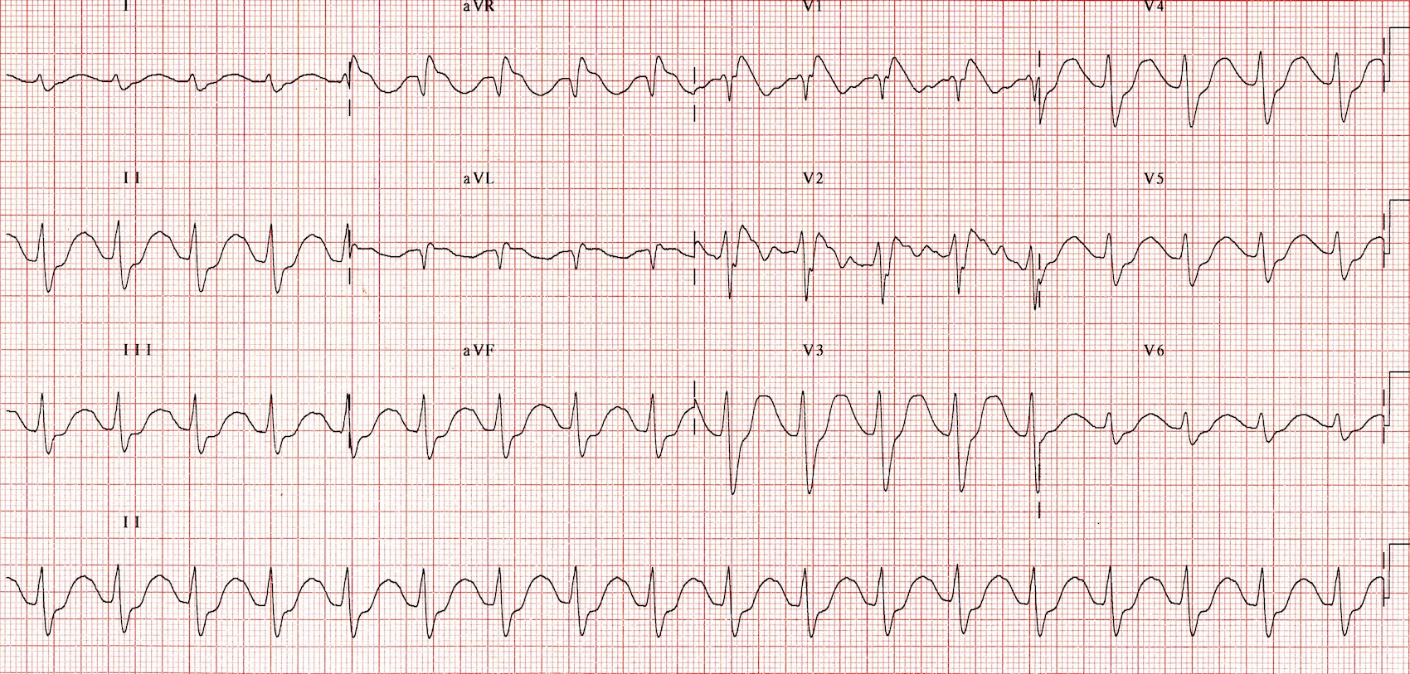
TCA (Na-channel blocker) Toxicity

Slide 60
TCA (Na-channel blocker) Toxicity
Sinus tachycardia with first-degree AV block (P waves hidden in the T waves, best seen in V1-2).
Broad QRS complexes.
Positive R’ wave in aVR.

Slide 61
A 62yo M is evaluated in the ED for headache and confusion. He does not have chest pain or discomfort. His medical hx is significant for essential hypertension, transient ischemic attack, type 2 DM (controlled by diet), and high cholesterol. His current medications are HCTZ, amlodipine, aspirin andatorvastatin.

Slide 62
On P/E:
Vitals: T: normal, BP: 220/135 (same in both arms), HR: 88, RR: 20; BMI: 31.
He is intermittently lethargic and agitated, and he’s oriented to self and place but not date and time. Funduscopic exam cannot be performed owing to agitation. There is no focal weakness or loss of sensation, the cranial nerves are intact, and the gait is slow but otherwise normal. The lungs are clear. Pedal edema is noted.
Labs:
Lytes, CBC, Ti, UA → all normal
Imaging:
CXR: normal
CT-head w/o contrast: evidence of old lacunar infarct but no signs of acute stroke or bleeding.

Slide 63
Which of the following is the most appropriate initial target blood pressure for this patient?
130/80 mm Hg
140/90 mm Hg
185/110 mm Hg
200/120 mm Hg

Slide 64
A 50yo M is admitted to the hospital for pneumonia. He was started on antibiotics in the ED. He has a hx of bipolar disorder that is controlled with Li and risperidone.
On the eveing of admission, he becomes agitated and confused. He is given IV haloperidol, and he develops fever and muscle rigidity.

Slide 65
On P/E:
Vitals: T: 39.9 (103.8), BP: 187/108, pulse rate: 110/min, RR: 32/min. Diaphoresis, rigidity and agitation are present. No stridor or signs of respiraory failure are noted.

Slide 66
In addition to IVF therapy, which of the following is the most appropriate initial treatment?
Acetaminophen
Atracurium
Intubation and mechanical ventilation
Lorazepam
Nitroprusside

Slide 67
An 18 yo F is evaluated in the ED after being rescued from a burning house. She was unconscious for a few minutes at the scene and on the way to the hospital, but she regained consciousness in the ED.
On P/E: she is agitated but follows commands and is oriented
Vitals: T: 99.3, BP: 145/80, pulse rate: 20/min, SaO2: 98% on RA
She coughs frequently. There are no skin burns. No cyanosis, respiratory stridor, sputum production, or soot around airway orifices is noted.

Slide 68
Labs:
Lactic acid level: 41
ABG:
 | Initial Assessment | 25 minutes later
pH | 7.46 | 7.45
Arterial PCO2 | 27 | 30
Arterial PO2 | 86 | 89
Carboxyhemoglobin | 29% | 27%
CXR: shows no lung infiltrates

Slide 69
In addition to placing the patient on 100% O2, which of the following is the mostappropriate next step in management?
Blood cyanide level measurement
Hyperbaric oxygen therapy
Intubation and initiation of mechanical ventilation
Pulse oximetry

Slide 70
In patients with CO toxicity and high levels of carboxyhemoglobin, hyperbaric O2 therapy greatly speeds the clearance of carboxyhemoglobin and has been shown to reduce the incidence of delayed neurocognitive impairment.

