Slide 1
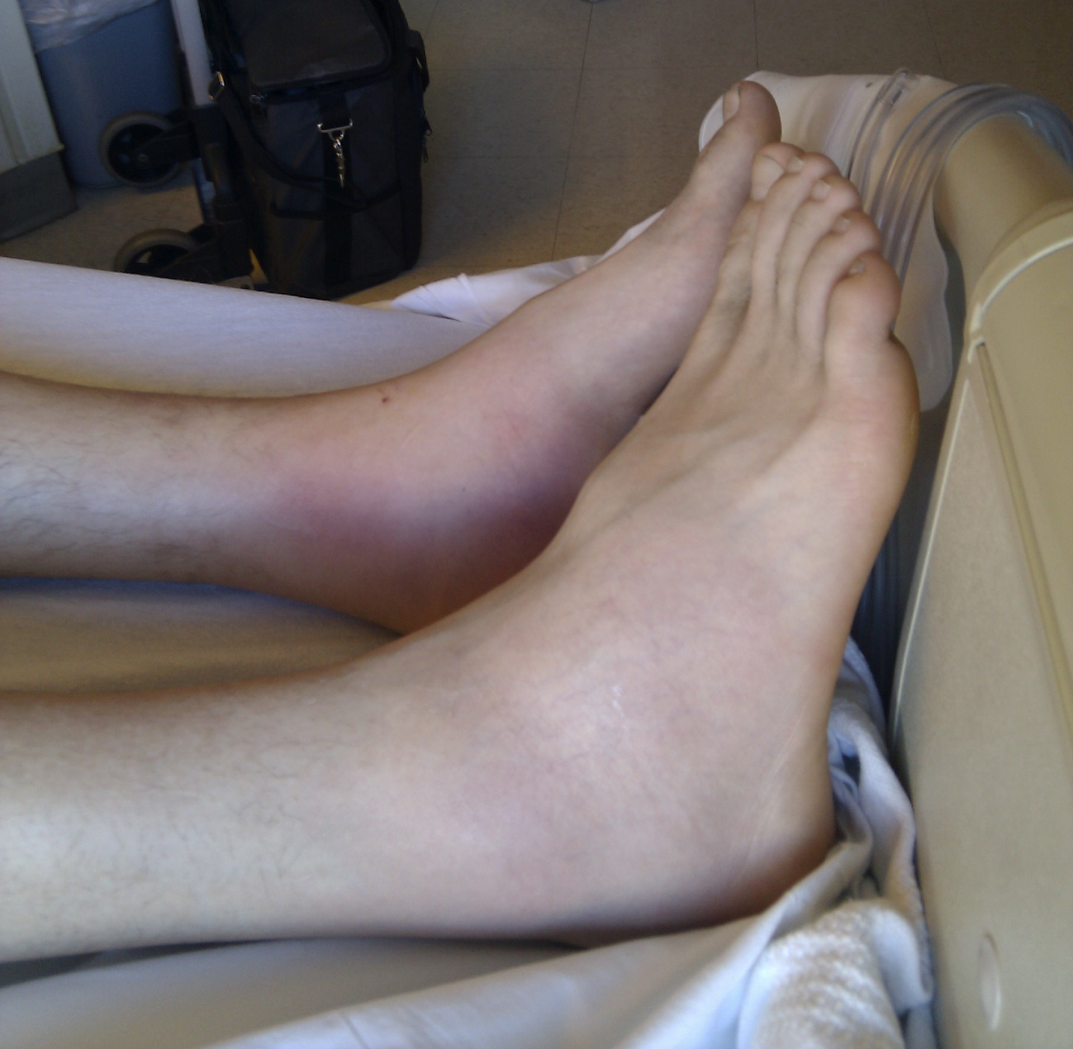
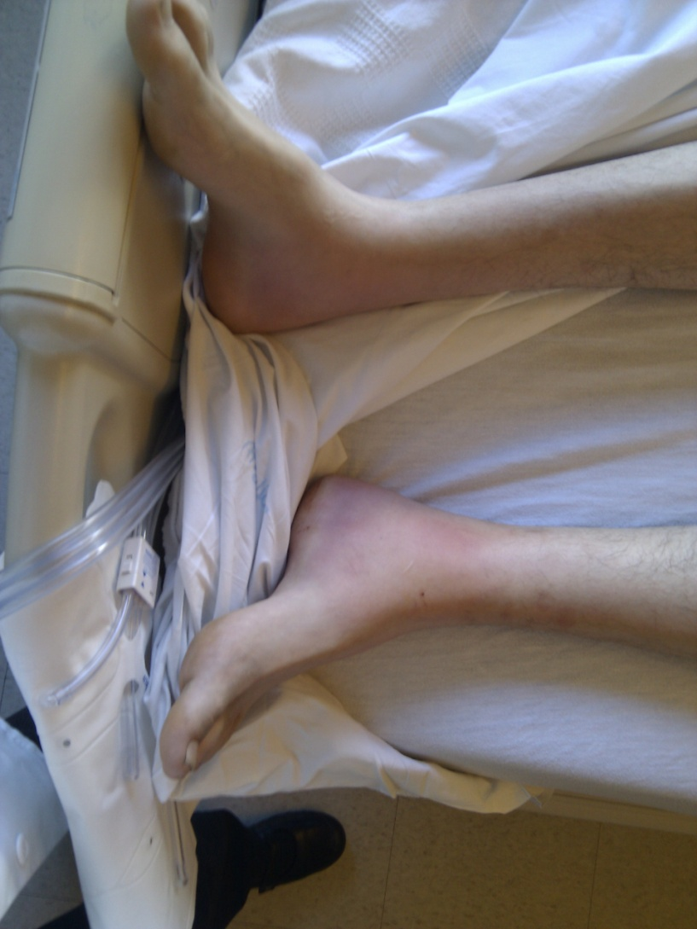

Slide 2
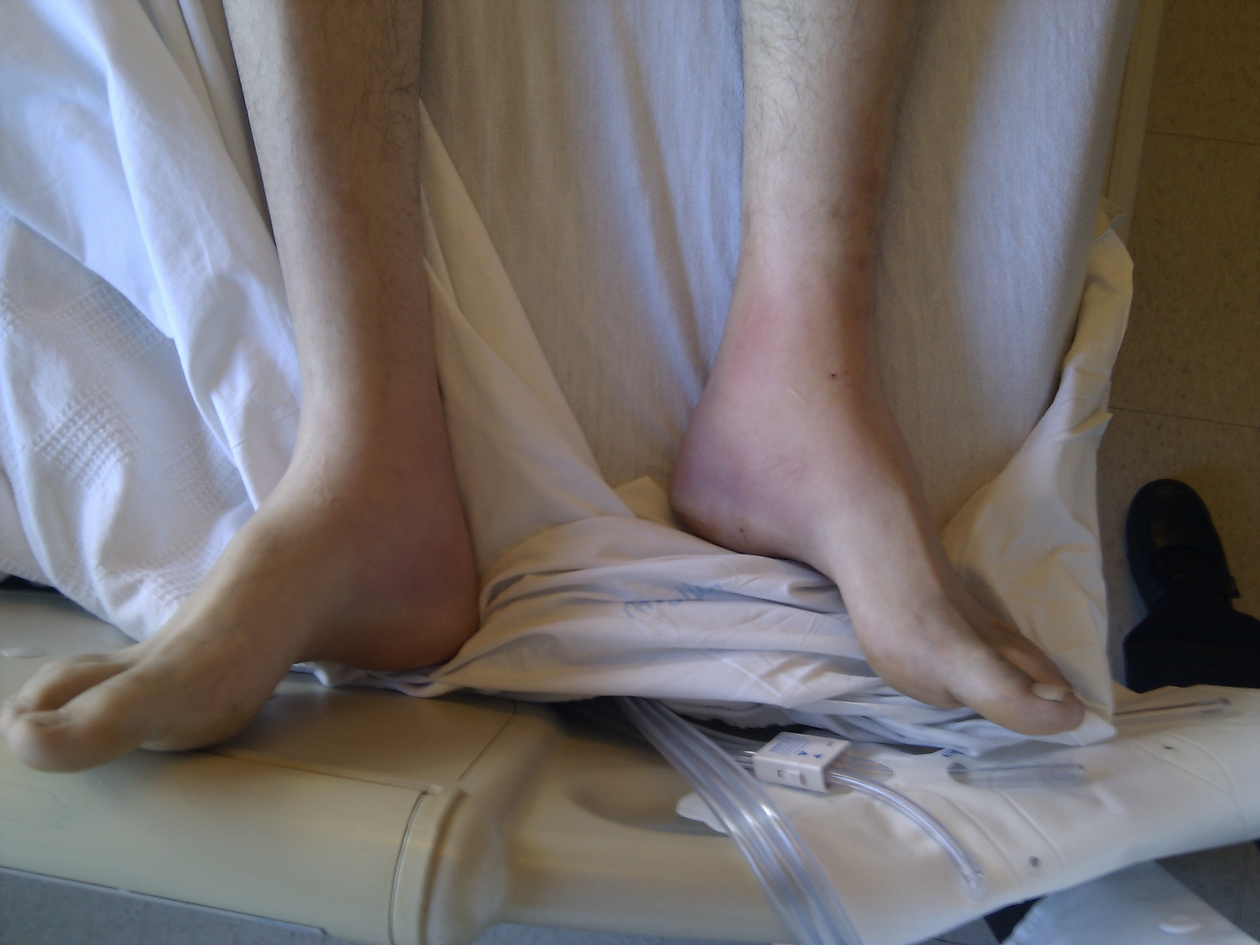

Slide 3
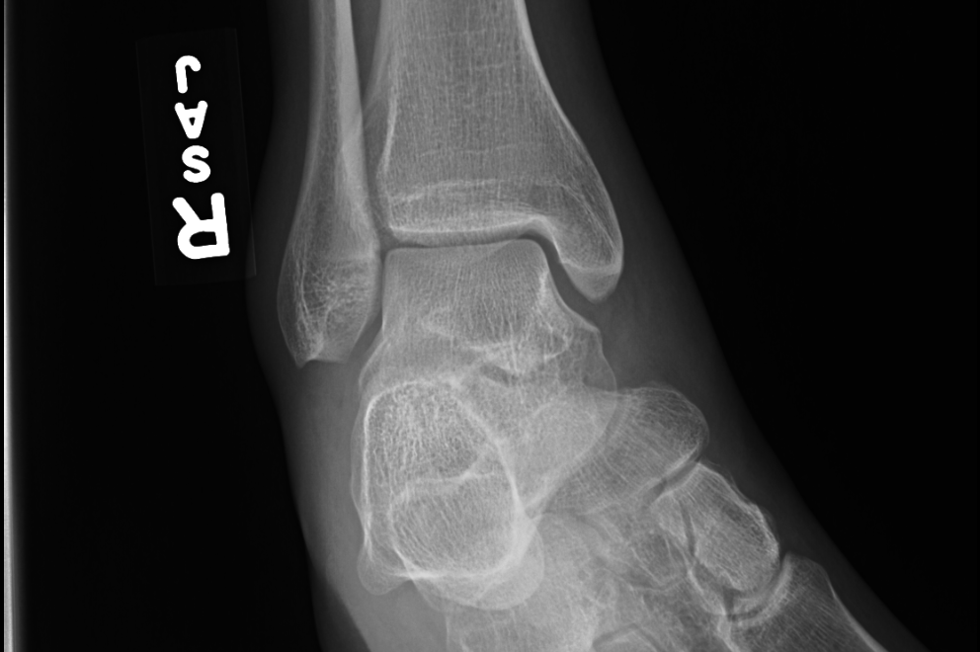

Slide 4
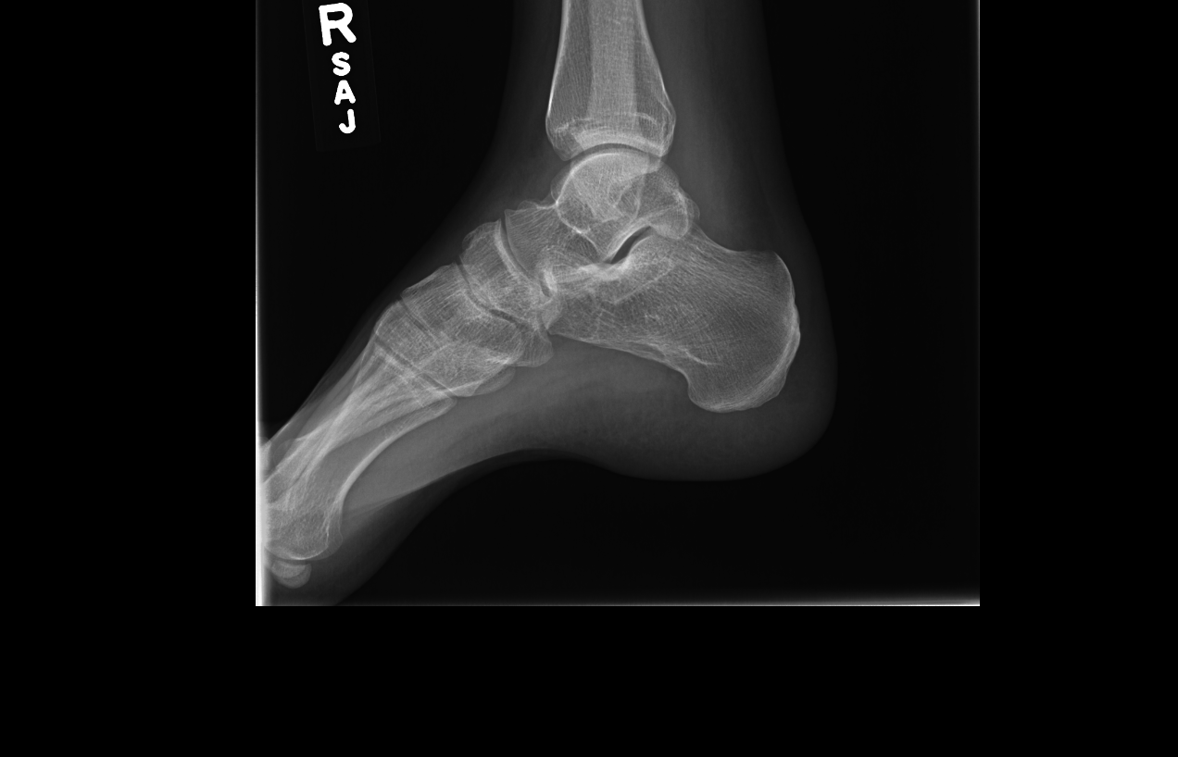
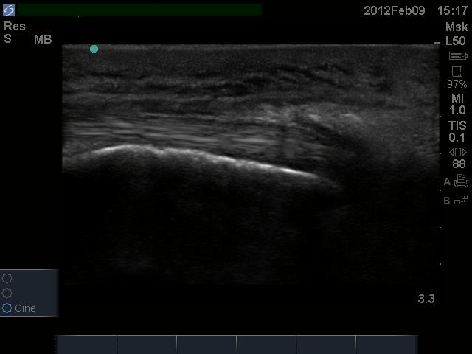

Slide 5
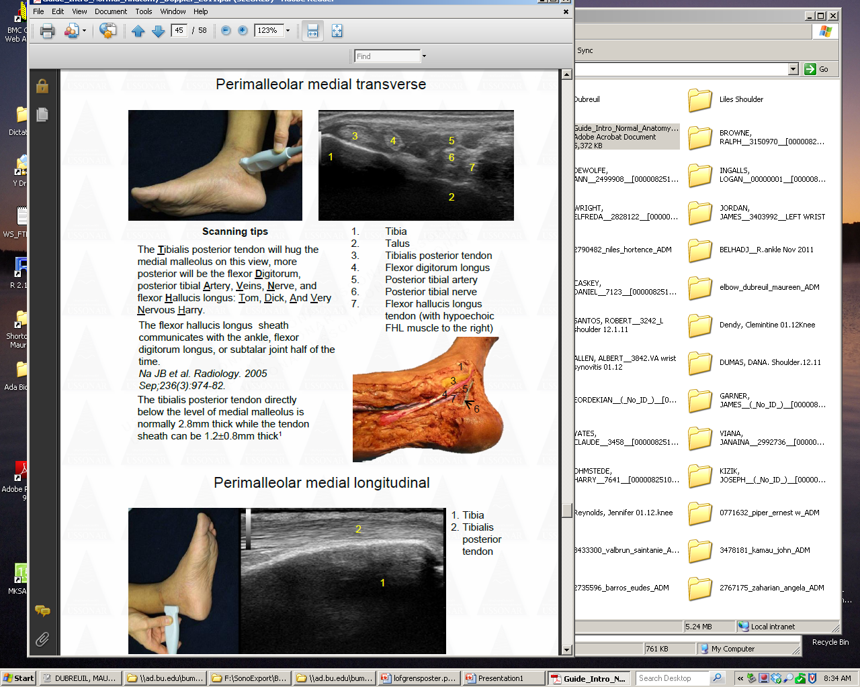
Ankle Ultrasound- Perimaleolar Medial Longitudinal
PT Tendon
Tibia
NORMAL
2
1
PATIENT
“Normal” images courtesy of USSONAR, may be used only with their permission

Slide 6
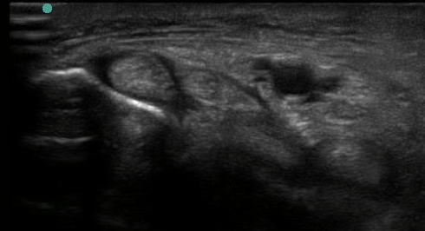
Ankle Ultrasound- Perimaleolar Medial Tranverse
NORMAL
FLUID IN TENDON SHEATH
3
5
4
1
6
7
2
PATIENT
“Normal” images courtesy of USSONAR, may be used only with their permission

Slide 7
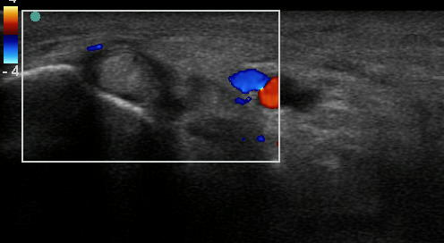
Ankle Ultrasound- Perimaleolar WITH DOPPLER
NORMAL
HYPEREMIA BY DOPPLER SIGNAL
3
4
5
1
6
7
2
PATIENT-
with Doppler
“Normal” images courtesy of USSONAR, may be used only with their permission

Slide 8
Differential diagnosis-
“Periarthritis” of the ankles
Sarcoidosis/ Lofgren’s syndrome
Tuberculosis
HIV
Disseminated gonococcal infection
Reactive arthritis
Other seronegative arthritides
  Inflammatory bowel disease
  Psoriatic
  Ankylosing Spondylitis
Less likely: Rheumatoid arthritis, SLE

Slide 9
What would you do next
PPD
Urine N. gonorrhea PCR
Infectious work up as indicated by history
CXR
HIV testing

Slide 10
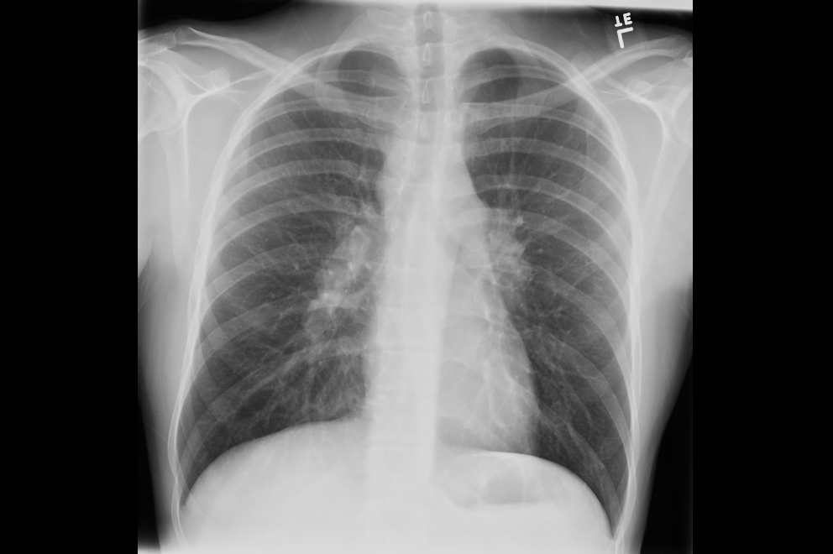
Notes:
Bilateral hilar lymphadenopathy

Slide 11
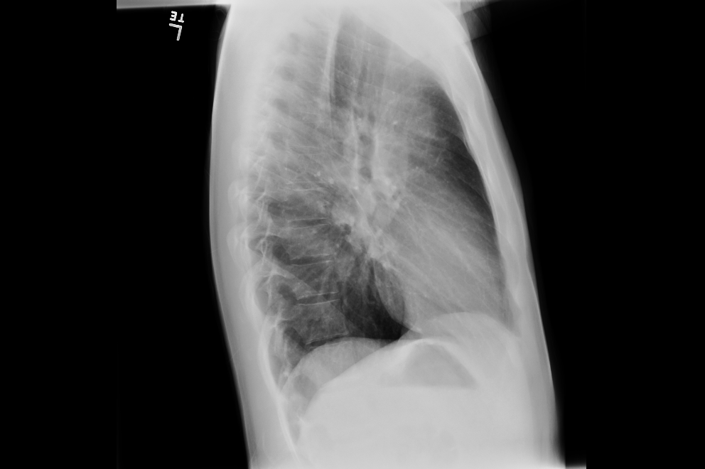

Slide 12
Lofgren’s Syndrome
Described by Sven Lofgren
Presentation of acute sarcoidosis

Slide 13
Lofgren’s Syndrome
Bilateral hilar lymphadenopathy
Fever
Erythema nodosum
+/- ankle arthritis or periarticular inflammation

Slide 14
Lofgren’s Syndrome
Other manifestations:
  Arthralgia
  Anterior uveitis
Exclusion of
Positive PPD

Slide 15
Epidemiology
    Annual incidence varies with location and ethnicity
      2.9 cases per 100,000 in Oslo (Kvein et al 1996)
      1.0-1.5 cases per 100,000 in Spain (Fité E et.al)
      14 cases per 100,000 in Norway (Glennas et. al 1995)
      6 Japanese case reports exist; may reflect underdiagnosis
      Rare in black Americans
    Median age of onset: 37 years
    85% of cases in adults are in women
      Prior to puberty, incidence is similar in males and females
    Half of all cases begin between April and June

Slide 16
Prognosis
Typically favorable, self-limiting
Mean duration 3 weeks to 3.7 months
Better outcome in pts with HLA-DQB1*0201

Slide 17
Treatment
NSAIDs
Saturated solution of potassium iodide (SSKI)
Steroids

Slide 18
References
Kumiko Matsui, Mayumi Adachi, Yasufumi Kawasaki,Kazuhiro Matsuda and Kenji Shinohara Intern Med. 2007;46(17):1471-4. Epub 2007 Sep 3
Am J Respir Crit Care Med. 2007 Jan 1;175(1):40-4. Epub 2006 Oct 5. Comment in: Am J Respir Crit Care Med. 2007 Jan 1;175(1):4-5. Sex-specific manifestations of Löfgren's syndrome. Grunewald J, Eklund A. http://www.pubmedcentral.nih.gov/picrender.fcgi?artid=1899259&blobtype=pdf
Am J Med. 1999 Sep;107(3):240-5. Löfgren's syndrome revisited: a study of 186 patients. Mañá J, Gómez-Vaquero C, Montero A, Salazar A, Marcoval J, Valverde J, Manresa F, Pujol R. Pdf in email
Rados J, Lipozencić J, Celić D, Loncarić D. Löfgren's syndrome presenting with erythema nodosum-like eruption. Acta Dermatovenerol Croat. 2007;15(4):249-53. ILL requested 5/16
Intern Med. 2006;45(12):745-6. Epub 2006 Jul 18. The incidence of Lofgren's syndrome in Japanese: the number of patients affected, number of patients diagnosed and number of cases reported. Ohno S, Ishigatsubo Y. Pdf in email
Respirology. 2006 Jul;11(4):456-61. Analysis of 87 patients with Löfgren's syndrome and the pattern of seasonality of subacute sarcoidosis. Sipahi Demirkok S, Basaranoglu M, Dervis E, Bal M, Karayel T. Pdf in email
Intern Med. 2006;45(9):659-62. Epub 2006 Jun 1. Acute-onset sarcoidosis with erythema nodosum and polyarthralgia (Löfgren's syndrome) in Japan: a case report and a review of the literature. Ohta H, Tazawa R, Nakamura A, Kimura Y, Maemondo M, Kikuchi T, Ebina M, Nukiwa T. Pdf in email
Am J Respir Crit Care Med. 2003 Nov 15;168(10):1162-6. Epub 2003 Jul 25. Comment in: Am J Respir Crit Care Med. 2003 Nov 15;168(10):1142-3. C-C chemokine receptor 2 and sarcoidosis: association with Lofgren's syndrome. Spagnolo P, Renzoni EA, Wells AU, Sato H, Grutters JC, Sestini P, Abdallah A, Gramiccioni E, Ruven HJ, du Bois RM, Welsh KI. Pdf in email
J Rheumatol. 1996 May;23(5):874-7. Comment in: J Rheumatol. 1997 Jan;24(1):239. Periarticular ankle sarcoidosis: a variant of Löfgren's syndrome. Mañá J, Gómez-Vaquero C, Salazar A, Valverde J, Juanola X, Pujol R requeded IOL 5/16
Slides borrowed from Rheumatology Fellow Maureen Dubreil

