Slide 1

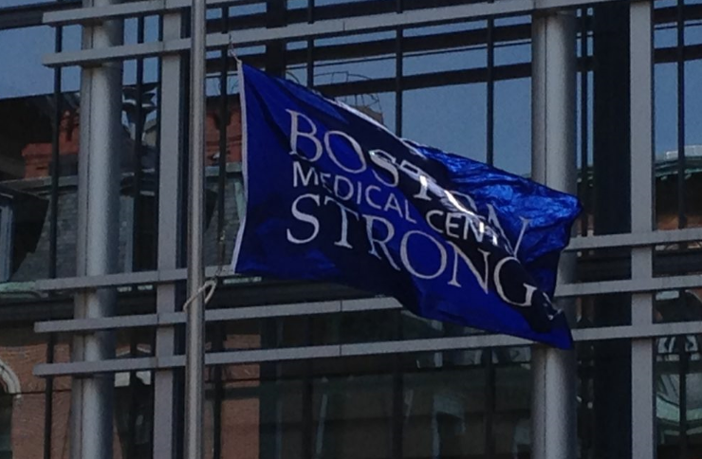
Welcome to Boston Medical Center
Notes:
Welcome to Boston Medical Center – we are very excited that you are here.

Slide 2
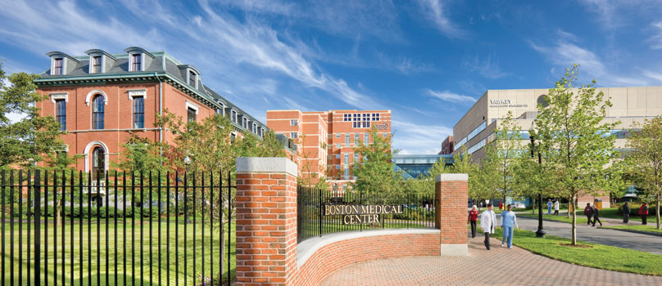
Our Mission
Our Core Purpose
Exceptional care. Without exception.
Notes:
Thank you Gen Surg.
Amidst our innovations, our mission remains the same- to provide exceptional care, without exception. As the largest safety-net hospital in New England, Boston Medical Center has a long-standing commitment to providing accessible, community-oriented health services to all in need regardless of their status or ability to pay.

Slide 3
Massachusetts / Boston Demographics 2019 Census
Massachusetts Boston
Total Population 6,892,503 692,600
(10% of the population of Mass lives in Boston)
Race % of MA % of Boston
Black or African American 8.9% 25.3%
Hispanic or Latinx 12.3% 19.7%
Asian 7.1% 9.6%
White 80.8% 52.6%
Native Hawaiian / Other Pacific Islander 0.1% 0%
Two or more races 2.5% 5.1%
*US Census Bureau at www.census.gov
Notes:
Being a provider in Boston it is important that you know the population you serve. I want to start with the population of Mass and Boston broken down by race. 10% of the population of Mass lives in Boston.
Of that 10%
25.3% identify as Black/AA
19.7% identify as Hispanic/Latinx
52.6% identify as White
The AA and Hispanic population combined make up 45% of the population of Boston

Slide 4
Commitment to Diversity: Our Patients
Notes:
Knowing from the previous slide that 45% of the population of Boston is AA and Latinx , the data on this slide confirms for us the negative effects of health disparities. AA and Latinx patients combined made up 70% of our ED visits compared to 19% of our white patients between 6/2019 – 5/2020.

Slide 5

Commitment to Diversity: Our Patients
  ~70% of our patients identify as Black or Hispanic
  ~30% do not speak English as their primary language
  > 50% have an annual household income below $20,400 (close to the federal poverty line for a family of 3)
Notes:
Our patients reflect the diversity of Boston and the surrounding communities. The largest proportion of our patients represent communities that are traditionally underserved including communities of color, low income communities, immigrant and refugee communities, and communities where English is not the primary language.

Slide 6
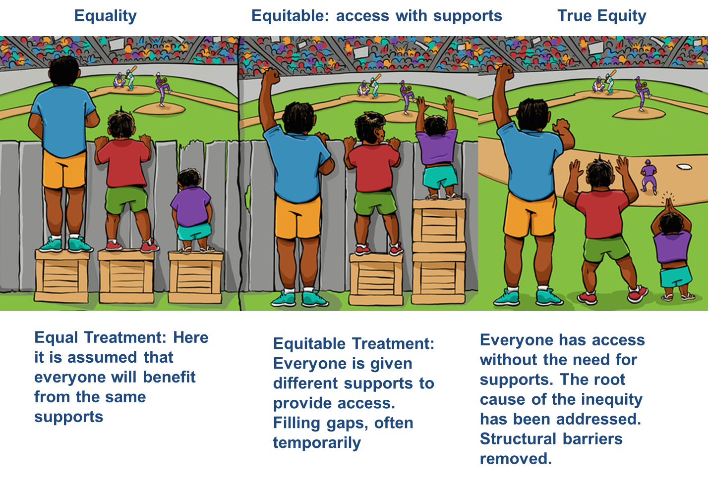
Commitment to Health Equity
Notes:
Our commitment to health equity means we strive for the highest possible standard of health for all of our patients, giving the greatest attention to those at greatest risk. At BMC we aim to ultimately eliminate disparities in health by working to address the social conditions and systemic policies that sustain them.

Slide 7
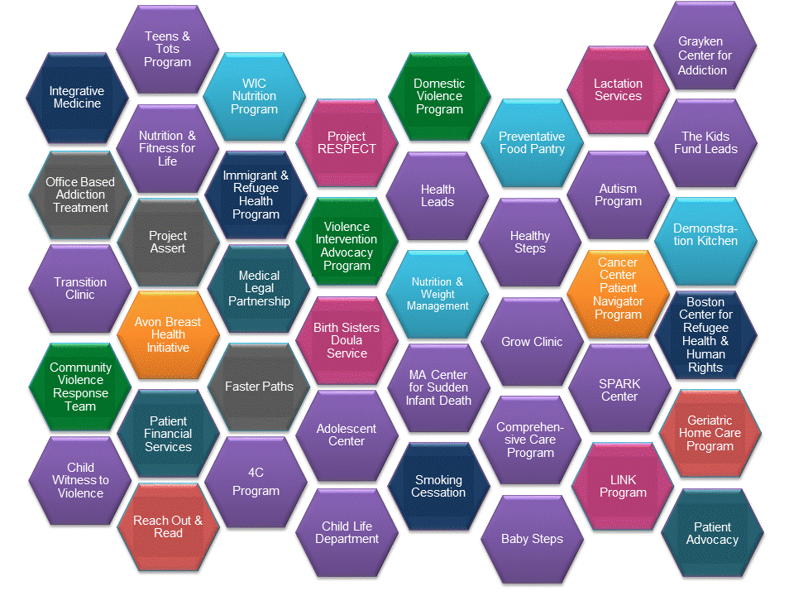
Commitment to Health Equity
Notes:
Given our commitment to health equity, Boston Medical Center provides a wide range of programs and services that extend beyond the traditional medical model to directly address the social determinants of health impacting our community. This is a snapshot of the many programs we have at BMC to support out patients. Just to name a few…
There is the Grayken Center for Addiction
We have a wonderful team in our Patient Advocacy group
and our Adolescent Center has a program called CATCH, their team provides gender affirming care for adolescents and their families.

Slide 8
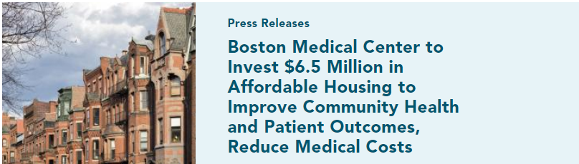

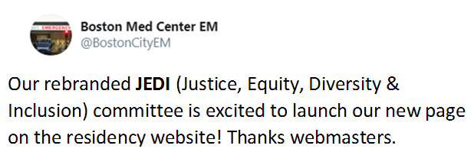
Commitment to Health Equity
Notes:
Our entire institution is committed to health equity. Our organization is investing in our communities. For example, BMC made an investment in affordable housing and businesses which employ people from the neighborhoods where our patients live. Our residents are leading change locally and across the organization. Two examples are…
our general surgery department started a “Socially Responsible Surgery” group. Among other things the focus of this group is to introduce future generations of surgeons to concepts of disparities in surgical care and provide surgeons with the tools to advocate for their patients and communities.
and our EM residency developed the JEDI committee. This committee works with the programs leadership to improve recruitment of URM residents.

Slide 9
Commitment to Health Equity
Notes:
Our entire institution is committed to health equity. Our organization is investing in our communities. For example, BMC made an investment in affordable housing and businesses which employ people from the neighborhoods where our patients live. Our residents are leading change locally and across the organization. Two examples are…
our general surgery department started a “Socially Responsible Surgery” group. Among other things the focus of this group is to introduce future generations of surgeons to concepts of disparities in surgical care and provide surgeons with the tools to advocate for their patients and communities.
and our EM residency developed the JEDI committee. This committee works with the programs leadership to improve recruitment of URM residents.

Slide 10
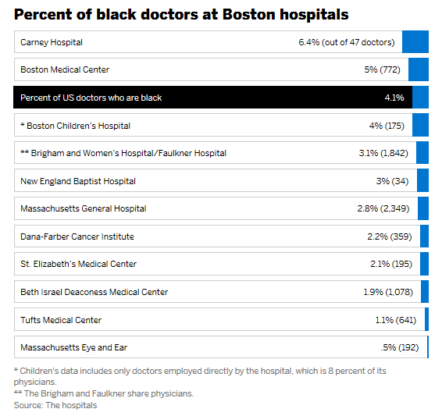
Diverse Patients Need Diverse Providers
Source: The Boston Globe 2017
Notes:
BMC’s commitment to URM physician recruitment has made us 2nd on the list out of 11 major hospitals in Boston that hire and retain physicians of color.

Slide 11
Commitment to Diversity: Our House Staff
The national average of active URM providers in the US of 10.8%
Notes:
We believe that the diversity of our employees, including our residents and fellows, should reflect the diversity of our patient population in many ways, including race and ethnicity. As an institution we are committed to creating a representative housestaff, and over the past five years the number of under-represented minority trainees has increased. We had a small drop-off for AY20, but we are optimistic that we will see a return to our steady increase this coming year. These numbers are measured against the national benchmark just over 9%. We have made a commitment to ourselves that we will be at 20% in 2024.

Slide 12
Overall BMC Self Identified URM Trainees for AY2020-2021
As of AY 2020 – 2021 17% of BMC residents and fellows
self identified as URM
52 (7%) Black/African American
67 (9%) Hispanic/Latinx
5 (0.6%) Native Hawaiian / Pacific Islander
Notes:
This is the breakdown of our overall total BMC URM residents by race.

Slide 13
BMC Incoming Trainees Self Identified URM Trainees 2020
Total Incoming PGY1 BMC Trainees 152
Self Identified URM 34 ( 22% of total incoming)
African American 18 ( 12% of incoming)
Hispanic/Latinx 15 ( 10% of incoming)
Native Hawaiian / Pacific Islander 1 ( 0.6% of incoming)
Notes:
This is the breakdown of our total incoming PGY1 trainees by race.

Slide 14
Commitment to Diversity: Our House Staff
“We are a ‘safety net’ hospital but a very unique one-one with resources and always leading with nuanced ideas- never afraid to do what is unusual and never afraid to do what has not been done before.” - Dr. Thea James, Vice President of Mission
White Coats for Black Lives at Boston Medical Center
Notes:
On June 5th this year (2020) at noon, the healthcare workers, from over 25 Massachusetts facilities, united in a moment of silence. Healthcare workers at Boston Medical Center held an 8-minute 46-second moment of silence in memory of George Floyd and other members of the Black and brown community who have lost their lives to police violence. A very powerful picture that reminds me every time I see it that BMC is really one big family.

