Slide 1
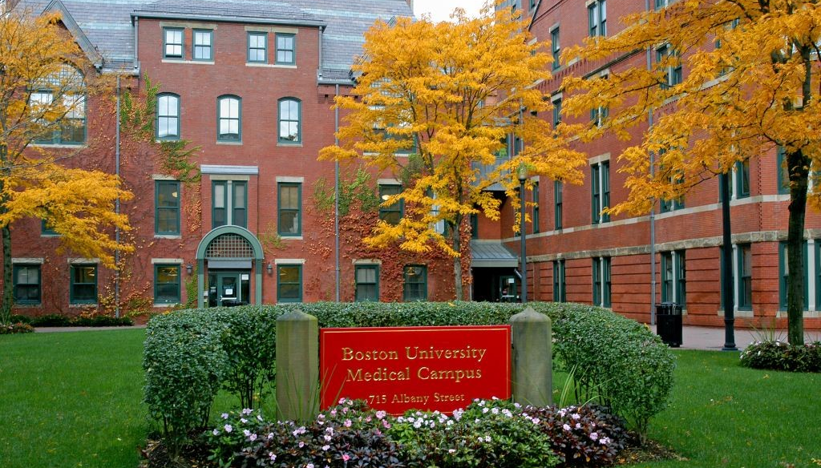
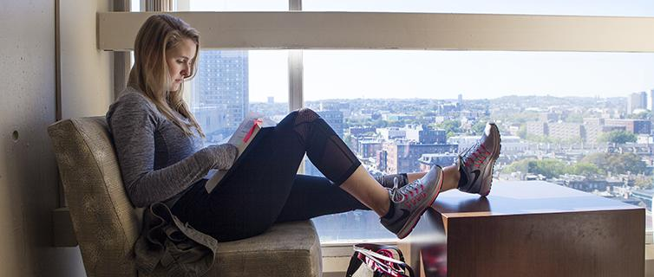
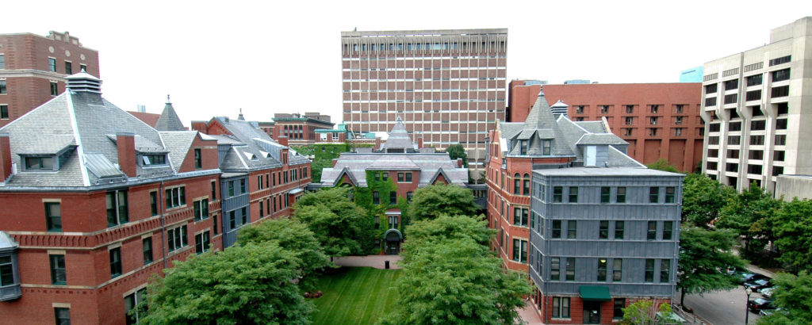
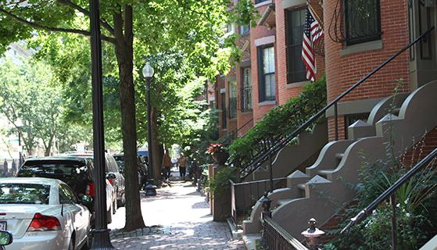
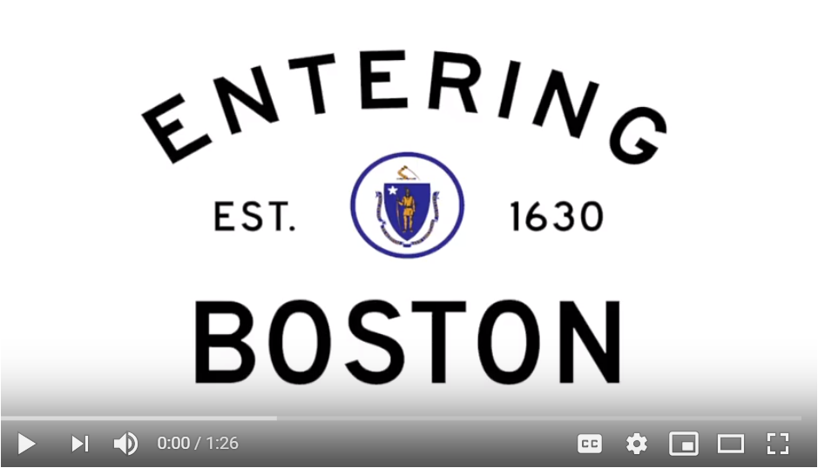
Get to Know Boston Neighborhoods
Things All Renters Should Know
The medical campus is located in Boston’s South End neighborhood
Nearby neighborhoods: Back Bay, Fenway/Kenmore, and Lower Roxbury
Get to know the Boston neighborhoods here and where our students live here
Students often live close to the medical or Charles River Campus for easy commuting
Pay attention to distance from campus!
Familiarize yourself with Boston’s rental market
Know your Tenant’s Rights in Massachusetts
Use a budget worksheet, and consider roommates to reduce housing costs
Make sure you know all of the documents necessary to rent an apartment
For more details, see the Boston Housing Reference Sheet
Answers to FAQs you may have
GMS Housing Resources
Searching for Housing
Other Student Resources
There is no “on-campus” graduate housing on the medical campus, but some graduate housing is available at Fisk House (for graduate women) and through BU Real Estate
Try starting your apartment & roommate search at BU’s Off-Campus Services
Consider using the websites listed here or getting a realtor to assist your search
Consider Nesterly, which pairs local homeowners who have empty rooms with graduate students willing to exchange help around the house for cheaper rent
HOUSING RESOURCES
Student Renter’s Guide
Apply to be a Graduate RA
International Students
Before Moving In
GETTING AROUND TOWN
The BUS (BU shuttle)
Boston Transportation
Understanding the MBTA
STUDENT LIFE VIDEO

