Slide 1
Transferrable Skills
Lauren Celano
Ph: 215-370-2285
Lauren@propelcareers.com
Confidential; Not for Distribution. June 13, 2012

Slide 2
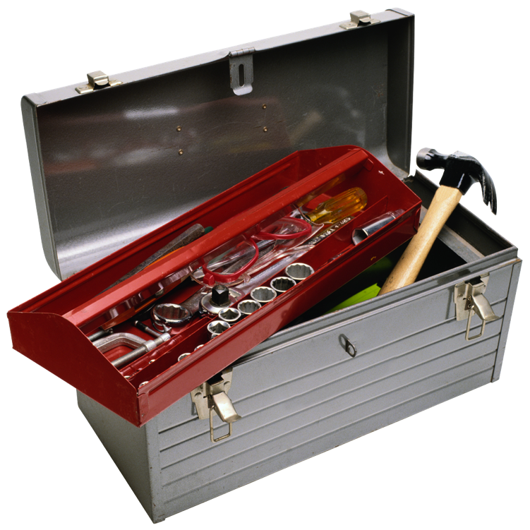
Transferrable Skills – “Your Tool Kit”

Slide 3

These Define your Personal Brand

Slide 4
Outline
What are Transferrable Skills
Why are these important
How to highlight them

Slide 5
The Importance of Transferable Skills
Working in a lab is not only about the science. There are many OTHER skills that you have which are transferrable to non-academic careers.
Transferrable skills are applicable to many career opportunities.
These assets are important to highlight!

Slide 6
What Graduate School Teaches You
Excellent Scientific Foundation!
Data analysis skills
Ability to synthesize information/learn new areas
Ability to ask questions
Writing ability – abstracts, papers, grants
Work ethic and drive
Work independently and be accountable

Slide 7
Getting a job requires more than just your “hard skills

Slide 8

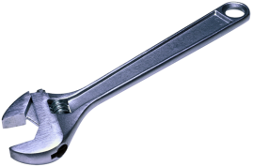

Transferrable Skills – “Your Tool Kit”
A leader
Organized
A negotiator
A networker
A manager
A presenter
An excel guru
Good writer
Detail oriented
A communicator
Artistic/Creative
Good at keeping track of projects
Skilled at Programming

Slide 9

Industry Emphasizes
  Teamwork
  Communication skills
  Working in cross functional teams
  Project Management / organizational skills

Slide 10

Why is this Important
Confidential; Not for Distribution. June 13, 2012

Slide 11
Transferrable Skills for Specific Roles
Business development
scientific knowledge, commercial
perspective, financial skills, networking
Marketing
writing, creative skills, branding insight/experience
Product/project management
organization, working with
various people, detail oriented, strong communication
Strategy consulting
analytical and logic, scientific knowledge,
presenting, evaluating trends, larger picture view
Research and development
strong scientific foundation,
adaptability, working cross functionally, commercial focus

Slide 12
Tailoring Resume and Cover Letter
Tailor your resume for particular jobs
Customize your cover letter
You can choose what to highlight among your experiences

Slide 13
How to Highlight your Transferrable Skills
Confidential; Not for Distribution. June 13, 2012

Slide 14

Organizational Skills
Managed multiple projects on time and budget
Managed multiple people to accomplish a goal
Organized a national conference for ___ group
Completed Ph.D. in 5 years while working part-time
Organized a gala event to raise money for ____ charity

Slide 15

Networking and Leadership Skills
Have you taken leadership roles within your institution?
Are you involved in a local or national chapter of a networking group?
  AWIS, AAPS, ACS, WEST, HBA, etc.?
  Do you have a leadership role in one of these above organizations?
Community Service

Slide 16
Management Skills
Managed a undergraduate / graduate researcher
Managed summer interns to complete scientific experiments
Managed a research budget
Managed collaborations among ____universities
Managed a team of people to organize the ____ conference
Managed the review process for a grant

Slide 17
Presentation Skills
Presentations at meetings
  local, regional, national, international
Teaching experience
Toastmasters

Slide 18

Writing and Communication Skills
Papers and Grants
Journal Reviewer
Blog writer
Write for University Paper
Write for magazine

Slide 19
Transferrable Skills for Specific Roles
Business development
scientific knowledge, commercial
perspective, financial skills, networking
Marketing
writing, creative skills, branding insight/experience
Product/project management
organization, working with
various people, detail oriented, strong communication
Strategy consulting
analytical and logic, scientific knowledge,
presenting, evaluating trends, larger picture view
Research and development
strong scientific foundation,
adaptability, working cross functionally, commercial focus

Slide 20
Contact Details
Lauren Celano
Founder and CEO
Propel Careers
cell: 215-370-2285
email: Lauren@propelcareers.com
Blog: http://www.propelcareers.com/blog/ Twitter: http://twitter.com/Propel_Careers
Facebook: Propel Careers Linked in: Propel Careers
Fueling Innovation. Fostering Leaders.
www.propelcareers.com

