Slide 1
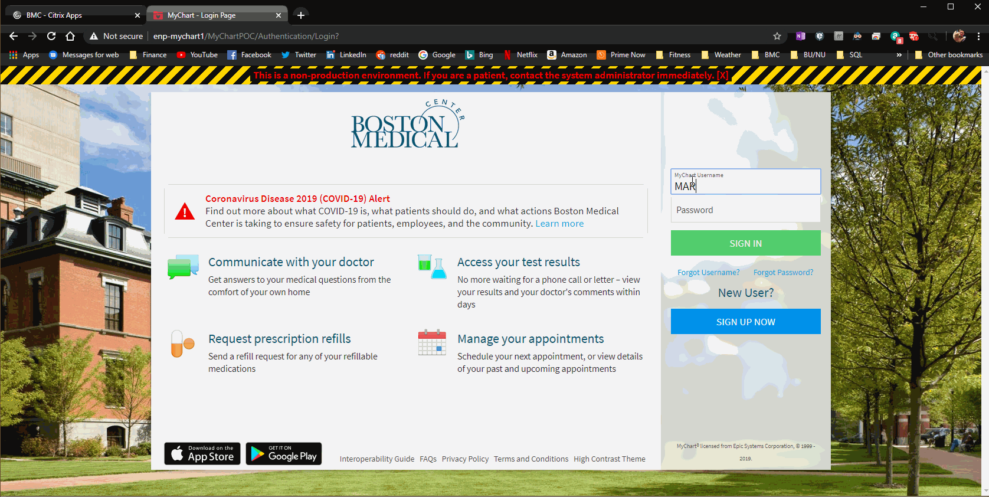
MyChart video visit – patient

Slide 2
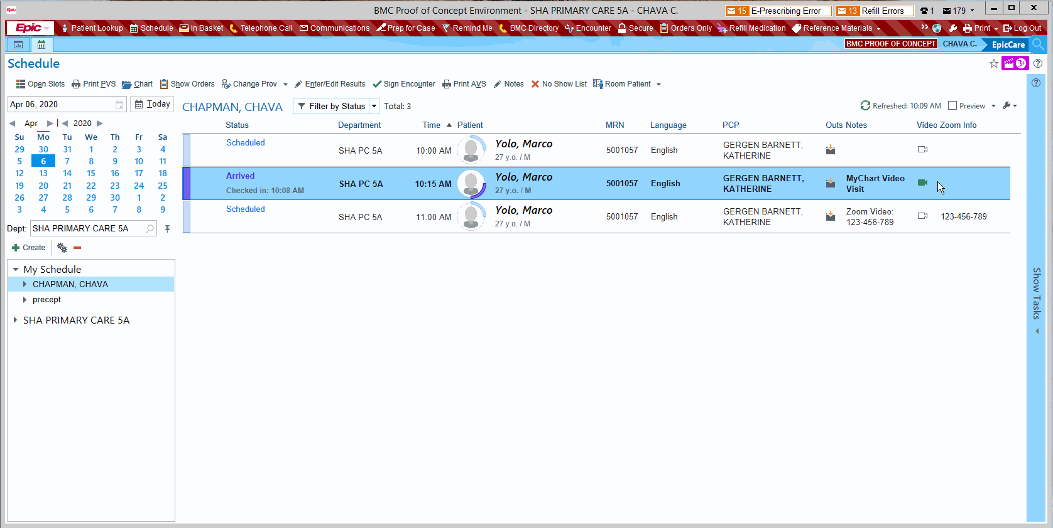
MyChart video visit – provider

