Slide 1
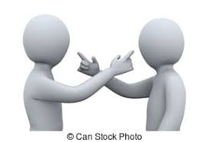
Communication Under Stress
Faculty Development Workshop
1/22/2020
Lauren Kearney and Gopal Yadavalli

Slide 2
Learning Objectives
Identify a “crucial conversation”.
Describe skills to Promote PRODUCTIVE dialogue.

Slide 3


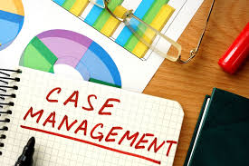
Notes:
Pre-work – Think of a situation in the last month where you had a challenging conversation with a colleague (intern, co-resident, consultant, nurse, attending, case management)
What happened?
What could have gone differently?
3. What was the outcome?
Group activity – What makes these conversations so charged and difficult?
Hierarchy
Gender
Personalities
Generational
Differences in language and jargon
Emphasis on rapid decision making
High stakes

Slide 4
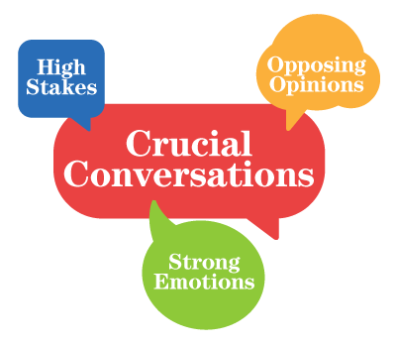

Slide 5
Patient safety
Burn-out
Notes:
https://www.ncbi.nlm.nih.gov/pubmed/14744724 - patient safety
https://www.ncbi.nlm.nih.gov/books/NBK2637/#
Communication failures are the leading root cause of the sentinel events reported to the Joint Commission from 1995 to 2004. More specifically, the Joint Commission cites communication failures as the leading root cause for medication errors, delays in treatment, and wrong-site surgeries, as well as the second most frequently cited root cause for operative and postoperative events and fatal falls.¹

Slide 6
So you find yourself in a Crucial Conversation…
How can we do better?

Slide 7
1. Meet face to face
2. Perspective taking
3. Establish your motive
4. Understand your argument
5. Apologize
6. Fix misunderstanding

Slide 8
1. Meet face to face | Avoid written communication. In person discussion is preferred to over the phone.
2. Perspective taking
3. Establish your motive
4. Understand your argument
5. Apologize
6. Fix misunderstanding
Notes:
Chart wars = bad

Slide 9
1. Meet face to face
2. Perspective taking | What does the other person think and feel?
3. Establish your motive
4. Understand your argument
5. Apologize
6. Fix misunderstanding
Notes:
How do nurses feel
Ask the others “concern”, “opinion”, “thoughts”
Reflective listening, repeat what you understand their argument to be

Slide 10
1. Meet face to face
2. Perspective taking
3. Establish your motive | Decide what your goal is and continue to remind yourself.
4. Understand your argument
5. Apologize
6. Fix misunderstanding
Notes:
Mutual purpose is not a technique – it can not be faked
Disrespect leads to highly charged conversation -> emotions of fear and anger
Respect people you do not respect –
Look for ways we are similar – not ways we are different
We all have weaknesses
HUMILITY and EMPATHY

Slide 11
1. Meet face to face
2. Perspective taking
3. Establish your motive
4. Understand your argument | Be honest about your knowledge.
5. Apologize
6. Fix misunderstanding

Slide 12
1. Meet face to face
2. Perspective taking
3. Establish your motive
4. Understand your argument
5. Apologize | “Sorry” is a powerful word. Only say it if appropriate and if you mean it.
6. Fix misunderstanding

Slide 13
1. Meet face to face
2. Perspective taking
3. Establish your motive
4. Understand your argument
5. Apologize
6. Fix misunderstanding | Identify and address remaining failures of understanding.
Notes:
A Don’t/Do Statement
Don’t: Explain what you don’t intend;
This addresses other’s concerns that you don’t respect them or that you have a malicious purpose.
Do: Explain what you do intend;
This confirms your respect or clarifies your real purpose
Sometimes being honest and blatant is the only solution

Slide 14
1. Meet face to face
2. Perspective taking
3. Establish your motive
4. Understand your argument
5. Apologize
6. Fix misunderstanding

Slide 15
References
Adekolujo, O. S., Roskos, S. E., & Adekolujo, O. O. (2019). Teaching medical residents to collaborate with specialist consultants. International Journal of Medical Education, 10, 172–173. doi: 10.5116/ijme.5d6b.85bc
Fisher, R. (2013). Getting to Yes. Yuan Liu/Tsai Fong Books.
Harvard Business Review Press. (2017). Harvard Business Review Guide to Dealing with Conflict. Boston, MA.
Hughes, R. (n.d.). Patient Safety and Quality: An Evidence-Based Handbook for Nurses. S.l.: Agency for Healthcare Research and Quality (US).
Itri, J. N., Yacob, S., & Mithqal, A. (2017). Teaching Communication Skills to Radiology Residents. Current Problems in Diagnostic Radiology, 46(5), 377–381. doi: 10.1067/j.cpradiol.2017.01.005
Patterson, K., Grenny, J., McMillan, R., & Switzler, A. (2002). Crucial conversations: Tools for talking when stakes are high.
Notes:
https://www.ijme.net/archive/10/collaborate-with-specialist-consultants/?ref=linkout
https://www-sciencedirect-com.ezproxy.bu.edu/science/article/pii/S0363018816301621?via%3Dihub
https://www.ncbi.nlm.nih.gov/books/NBK2637/
Patterson, K., Grenny, J., McMillan, R., & Switzler, A. (2002). Crucial conversations: Tools for talking when stakes are high.

Slide 16
Communication Under Stress
Faculty Development Workshop
1/22/2020
Lauren Kearney and Gopal Yadavalli

