Slide 1
Electronic Tools for
Time Management
eMail Jail: Get Out & Stay Out
Advanced eMail Methods
Christopher W. Shanahan, MD MPH FACP
Assistant Professor of Medicine , Dept. of Medicine, BUSM
Section of General Internal Medicine

Slide 2
Outline
Triage!!!
Email Jail: Get out & Stay Out
The Problem – Another Look
Basic Principles
Using Electronic Tools Effectively
An Information Management System
Tactics
Effective Reference System
Efficient Environment / Automation
Personal eMail policy

Slide 3
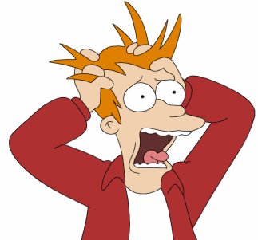
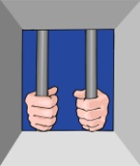
How did I get here?

Slide 4
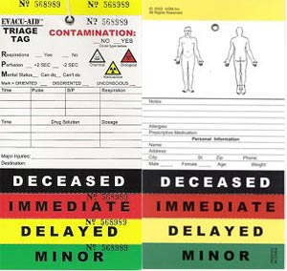
Triage !!!
eMail Jail
Using Electronic Tools Effectively

Slide 5
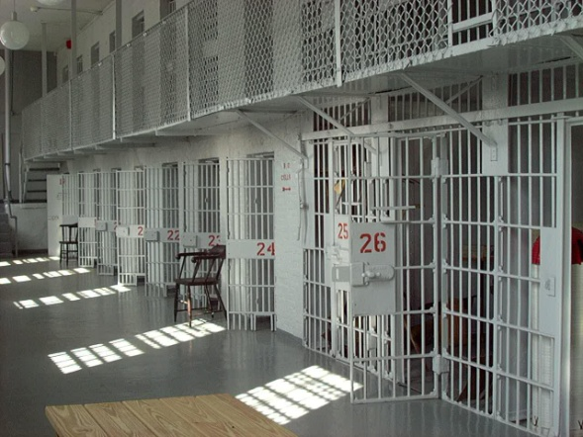
eMail Jail
Definition
The inability to send eMail due to the fact that the IT guys have limited your mailbox size. Indication of eMail Jail is the message 'your mailbox is over the size limit'. Cursing the IT guys does not get you out of eMail jail.
Cause:
Outlook used as File Cabinet a/o ‘To Do List”
Poorly tuned Auto-Archive settings
Sending / Receiving lots of very large file attachments
http://www.urbandictionary.com

Slide 6
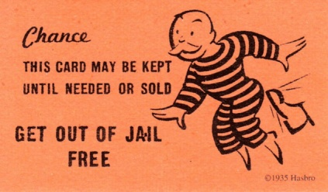
Steps to Freedom
Get Out of eMail Jail
Admit you have a problem
Tell yourself the truth
Commit to changing your behavior…EVERYDAY
Use the past to automate the future
Commit to do it better…EVERYDAY

Slide 7
Key Commitment 1
Get Out of eMail Jail
Create a new folder called “JAIL”
Move all your eMail into it
Process it over time
Is it still needed?
Delete / Act / Answer
Use advanced eMail methods

Slide 8
Work down Jail Mail everyday until gone
Determine a Daily Goal
Daily # of eMail
to Process
# of eMail in Jail
=
# workdays to complete
Daily # of eMail
to Process
2500
=
=
250 messages
10

Slide 9
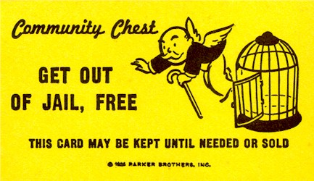
Key Commitment 2 - Zero your Inbox
Get Out of eMail Jail
Deal with every eMail by end of every workday till gone
YOU MUST ACT
Is it still needed? No? Delete it.
Do (Answer or Ask or Own)
Use advanced eMail methods

Slide 10
Get Out of eMail Jail
Zero your Inbox - Go on a Diet
eMail In &  eMail Out  Shrink Inbox
Don’t invite it or let it in……Get rid of it faster
Opt-out of listserves, eMail lists, newsletters
Use and Turn up sensitivity on Spam filters
Delete…Delete…Delete
Act…Act
File

Slide 11
Deal with Daily eMail
Zero your Inbox - Daily
Daily Actions
Delete (Sort ⇨ group delete)
Store (File it)
Act
Respond
Convert to task (Flag)
Ask & track response (Follow) or
Own it & Do it (Convert to a Task)
Automate
Maintain your “Blocksender” list
Create & Tune Filters

Slide 12
One eMail at a Time - Quickly
1. What does this message mean to me, and why do I care?
2. What action, if any, does this message require of me?
3. What’s the most elegant (& fastest) way to close out this message & the action it contains?
50% fail 1st question  delete.
Most of remainder fail 2nd question  1-2 line reply
Learn to quickly turn valuable messages into actions or action placeholders

Slide 13
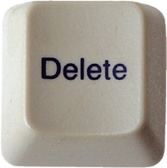
Decide What Information to Keep or Delete
Four Simple Tests…
Relates to your objectives?
If No…Delete
Can be found elsewhere
e.g. SharePoint site, intranet, Internet?
If Yes…Delete
Likely to refer to within 6 months?
If No…Delete
Need to keep for legal / HR reasons?
If No…Delete

Slide 14
Maybe, but… All eMail is not created equal
One to One
For you ….Worth your time.
Usually…a Question, Request, or Communication
Probably need to take action
One to Few
eMail applies to you, but may not require action.
No rush to read it. (…That moment…)
One to Many
May or may not…
Be relevant to you, require action, be worth your time.
To determine if applies to you may waste Your time

Slide 15
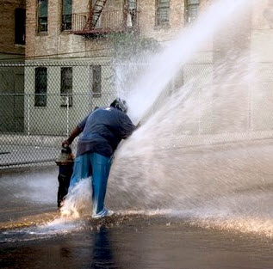
The Problem – Another Look

Slide 16
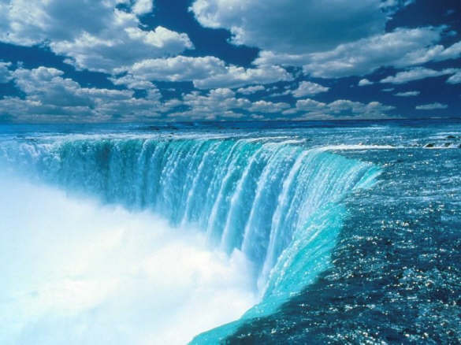
Overwhelming eMail: Symptom of a Bigger Problem
Too much “X” for allotted time & approach
Everything can not be done
Priorities
Define
Actions must relate

Slide 17
Basic Principles
Optimize work environment
Eliminate repetitive activities
Do Today’s Work Today
Touch a Document only once

Slide 18
Using Electronic Tools Effectively

Slide 19
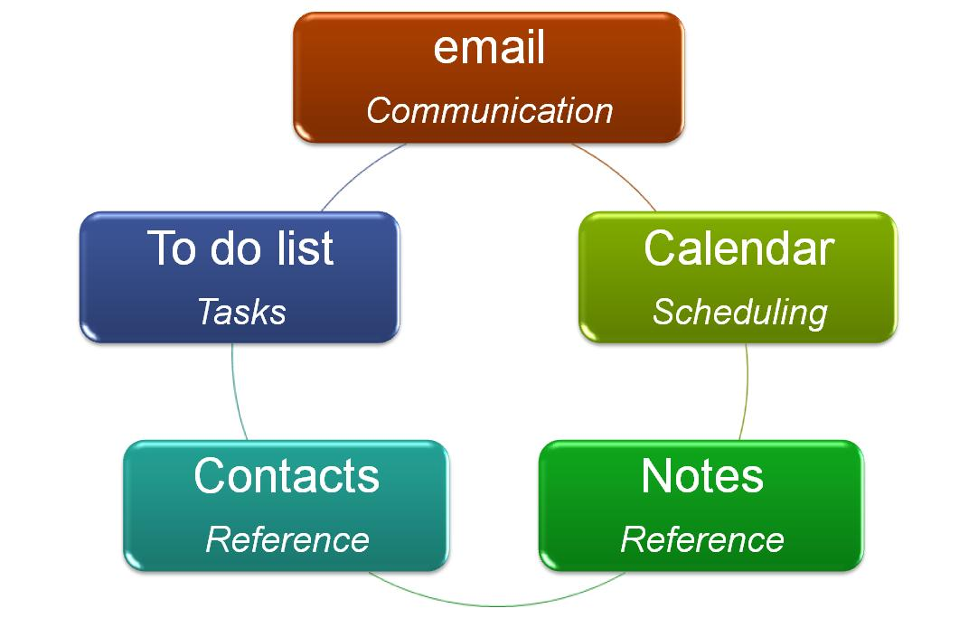
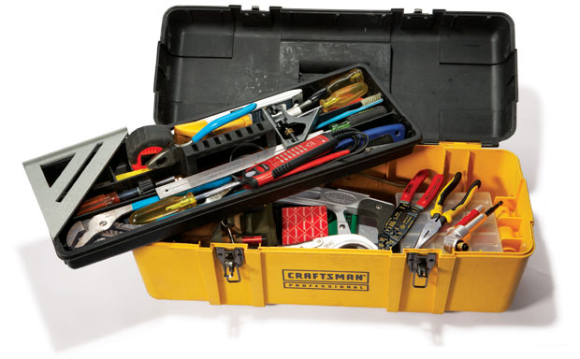
Tools for the Job

Slide 20
An Information Management System
eMail
Communication
Calendar
Scheduling
Contacts
Reference
Notes
Reference
To do list
Tasks
CORE Information Management System

Slide 21
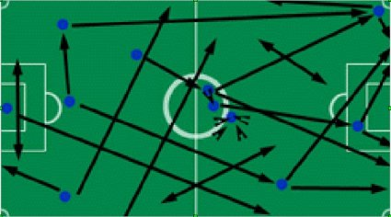
Tactics
eMail
Create Actions
Send to Reference
To Do (Task) List
Use daily / Prioritize ruthlessly
Delegate / Outsource
Break large tasks into smaller tasks
Calendar
Make appointments with yourself & others
Link to Tasks

Slide 22
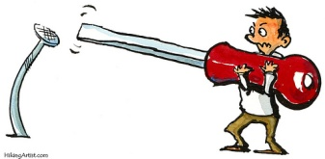
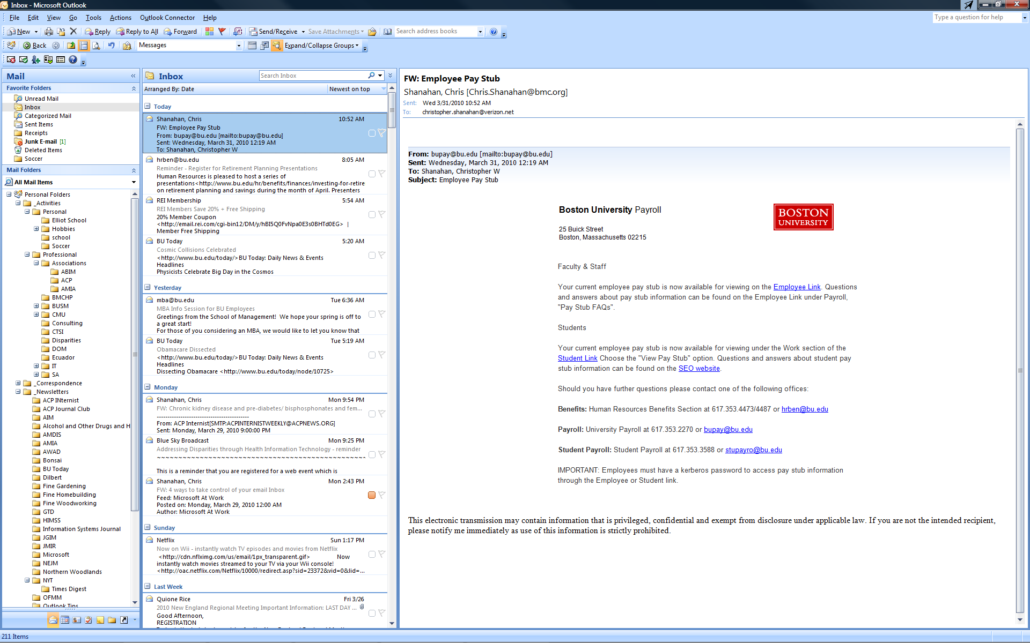
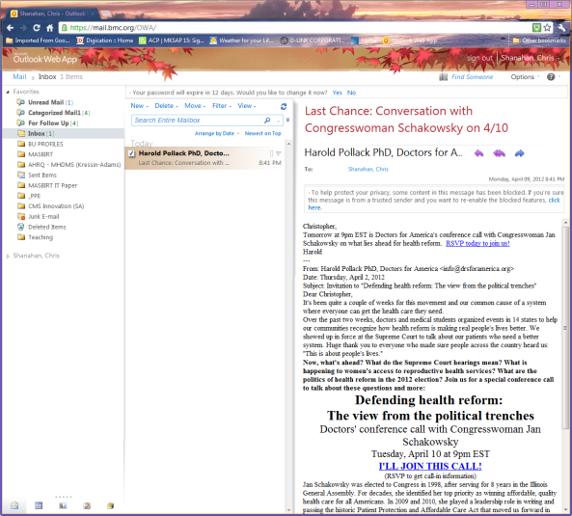
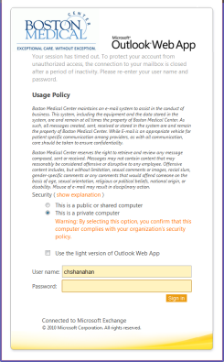
Use the Right Tool for the Job Avoid the eMail Web Client.
www.myBMC.org

Slide 23
Dealing with eMail
System... Discipline …
Zero Inbox
Reference System
Policy
Understand Policy
Focus &
Do Job
Create an Effective Structure
Maintain & Improve
Understand Structure
Use Tools
Follow Rules

Slide 24
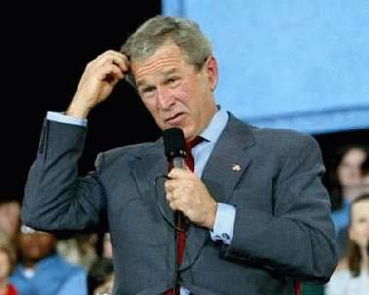
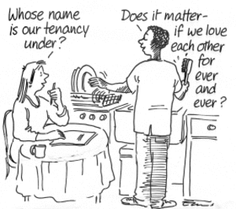
Reference vs. Action Information
Often Confused
Difference is Important

Slide 25
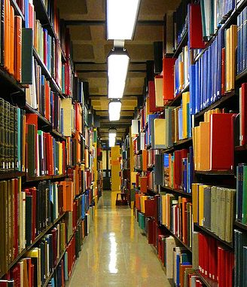
Reference Information
Not required to carry out an action
Keep to refer to later
Stored in a reference system
e-mail reference folders
My Documents folder
company intranet sites
File cabinets

Slide 26
Action Information
Data required to complete an action
Store with the action on either….
To-do list vs. Calendar
Do not store in eMail

Slide 27
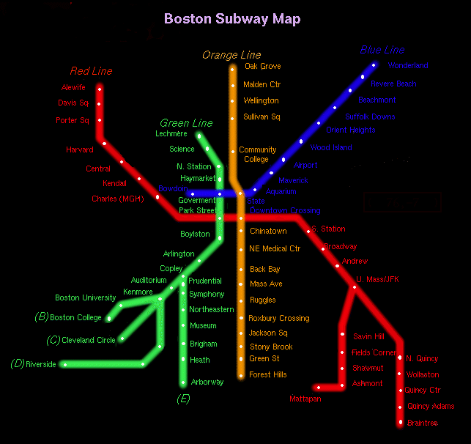
Create an Effective Reference System
Align/Build Folder Structure
(A Filing System)
Based on most important activities (Objectives & Projects)
maintain professional connection & focus
Same system used for storing both Documents & eMail

Slide 28
File Folders
Email Folders

Slide 29
Create an Effective Reference System
Facilitates tracking / flagging eMail for follow-up
Makes it easy to decide:
What to delete, What to keep, Where to keep it
Makes it easy to find saved eMail
Makes is possible to deal with attached documents
File  Remove
Create a logical filing and naming system
Use dates & version numbers

Slide 30
Track eMail Tasks
Create Colored Categories indicating what to do with/about eMail
Read/Do
Read/Respond
Waiting on Them
Hold/Limbo
Sort on these Categories
Track emails sent that request responses or actions of others

Slide 31
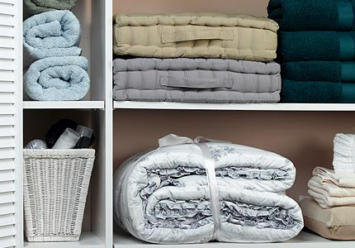
Create an Efficient Environment
Activate & Configure Reading Pane
Sort eMail Folder View
Date / Conversation / Category
Colors / Flag / Group
Create
A Favorites Folder
Search Folders
Shortcuts
Set up Resources

Slide 32
Configure the eMail Client
Optimize the View
View Navigation Pane
View Favorites
View Reading Pane
View To-Do Bar
Arrange eMail
Create Folders
In Outlook
Storage
Search folders
Pin key folders to Favorites
In My Documents

Slide 33
Personal eMail Policy
Do…
Stop Auto-check, Desktop display, & Audio alerts
Turn off or set to 30 - 60 min
Aim for Zero Inbox by end of every day
Schedule time to answer eMail received
Touch each eMail ONLY once
Categorize everything that is saved
Assign a color to every category
Take action
Do (Read, Think, Write, Speak) / Delegate / Defer for later response / Delete / Archive
When responding to eMail:
Do so immediately ONLY if < 2 minutes or so important can’t wait
Write less (Less is more)
Sometimes a phone call is better

Slide 34
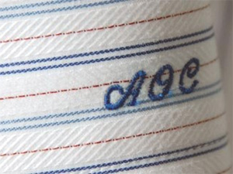
Personal eMail policy
Do NOT...
Use Inbox as a “To Do List.”
Use Inbox as a filing cabinet.
Read / Answer eMail all day long or during most productive time of day.
e.g. First thing in AM
Look for interruptions by checking eMail on demand.

Slide 35
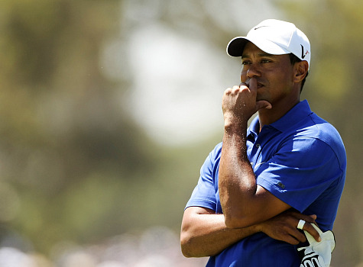
Deal with Attached Documents
Information in eMail not important,
Save document in My Documents (G: Drive)
Delete e-mail message
Information in eMail important
Save document in My Documents (G: Drive)
Save in eMail in Outlook Folder reference system.
Document not meaningful without e-mail
save both in your e-mail reference system
minimize to avoid storage issues

Slide 36
Be Efficient
Use Short cuts
Ctrl-N, Ctrl-R, Ctrl-F, Ctrl-Shift R, Ctrl-D
Be even more efficient
Convert eMail immediately:
Into actions
(Tasks)
Into action place holders
(e.g. Appointments)

Slide 37
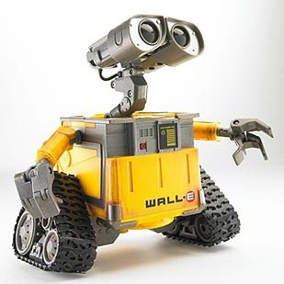
Automate
Create rules “on-the-fly”
Junk mail
“Block Senders list”
Regular eMail
Tune & Maintain
Search Folders
Auto-archiving

Slide 38
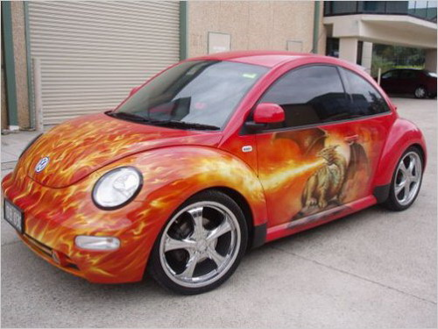
Customize….Even More!
Enhance the Tool Bar
Create Categories
Expand / Collapse Button
Assign Colors to Categories
Create a Resources Folder

Slide 39
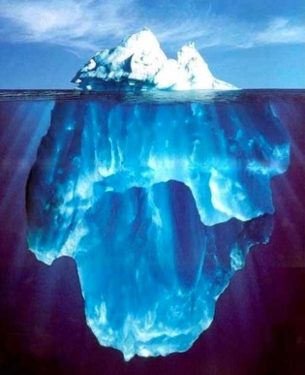
More Information
Where to learn more or get help
Microsoft at Work
http://www.microsoft.com/atwork/default.aspx
Microsoft Office On-line: Help and How-to
http://office.microsoft.com/en-us/help/default.aspx
BU Subscription to Element K
http://www.bumc.bu.edu/bumc-oit/webinfo/elementk/

Slide 40
Questions?

