Slide 1
Significance and Innovation
Significance- The positive effect something is likely to have on other things
Innovation- A new and substantially different way of considering or addressing something, which results in a positive change
These justify the need for what you propose

Slide 2
Significance- reviewers view point
Does the project address an important problem or a critical barrier to progress in the field? If the aims of the project are achieved, how will scientific knowledge, technical capability and/or clinical practice be improved? How will successful completion of the aims change the concepts, methods, technologies, treatments, services, or preventive interventions that drive this field?

Slide 3
Significance- Applicants charge
Explain the importance of the problem or critical barrier to progress in the field that the proposed project addresses. Explain how the proposed project will improve scientific knowledge, technical capability, and/or clinical practice in one or more broad fields. Describe how the concepts, methods, technologies, treatment, services, or preventive interventions that drive this field will be changed if the proposed aims are achieved.

Slide 4
Suggestions for writing the Significance section
1) Provide a critical analysis of the literature that expands on what was touched on briefly in the specific aims.
  Not a complete review of the literature but highlight studies that support the need for your studies
  Identify a gap in the knowledge or a barrier that prevents continued progress in the field
  State your expected contributions (link directly to the gap/barrier identified above and in SA)
  “The contribution of the proposed research project is expected to be…..” Be as specific as possible!

Slide 5
Significance section continued
2) A statement identifying the significance of the project.
  Simple, direct statement as to why the expected contribution is important (significant, impact). What is the positive impact your project will have- why/how will completion of your project advance your field vertically
  “This contribution will be significant because….”
  This must be specific and substantive, not generalities

Slide 6
Significance section continued
3) Validate your assertion of significance (positive effect on some other thing)
Significance is derived from the benefits that could credibly be expected to occur as a result of your contributions
  Discussion of the benefits, use literature to support
  Benefits must be relevant to NIH’s mission (decreased morbidity/mortality, improvements in the quality of life/medical outcomes, reduction in medical costs)
  Fringe benefits (benefits to other fields following extrapolation of your findings)
  Typically Significance section is about a page but take the space required to accomplish your goal. This section is extremely important for getting the reviewer excited about the overall impact of your project

Slide 7
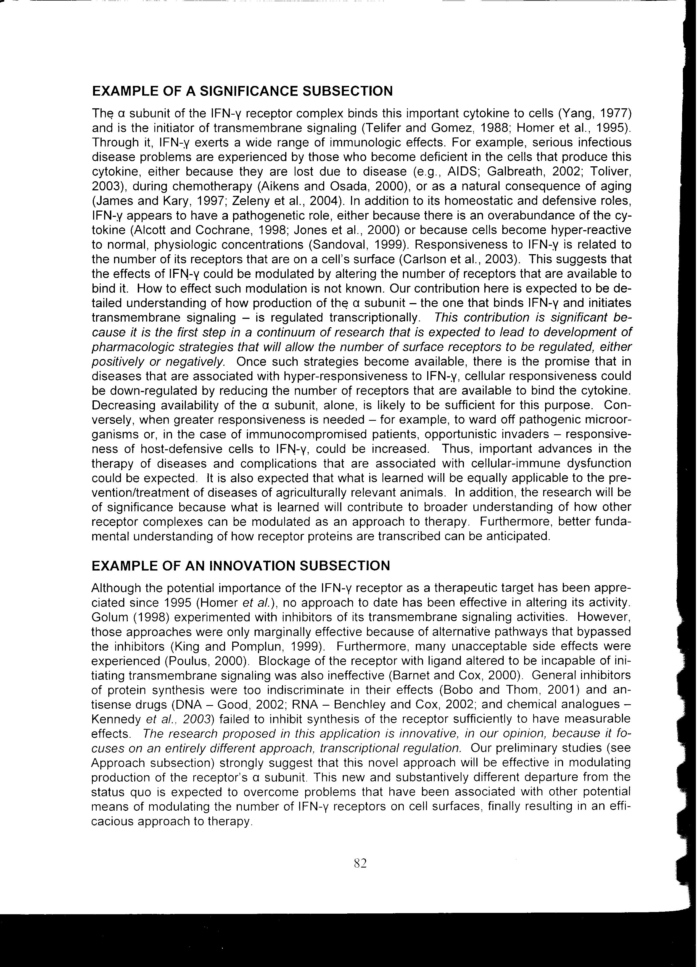
1
2
3

Slide 8
Innovation- reviewers view point
Does the application challenge and seek to shift current paradigms by using novel theoretical concepts, approaches or methodologies, instrumentation, or interventions? Are the concepts, approaches or methodologies, instrumentation or interventions novel to one field of research or novel in a broad sense? Is a refinement, improvement or new application of theoretical concepts, approaches or methodologies, instrumentation, or interventions proposed?

Slide 9
Innovation- Applicants charge
Explain how the application challenges and seeks to shift the paradigms. Explain any novel, or refinement in existing, theoretical concepts, approaches or methodologies, etc.
Describe in detail and in exciting terms a new and substantially different way of considering/addressing an important, public health relevant problem that results in substantial departure from the status quo.
How are you enabling new horizons??

Slide 10
Suggestions for writing the Innovation section
1) You need to present what the current status is in the field. Use selected literature to highlight the barriers to progress or better understanding of a health-related problem, and why different approaches have failed to overcome the barriers (build on what was briefly described in the SA)
  It may be an alternative, innovative, interpretation of past work. Use literature and careful discussion to highlight shortcomings of the previous work
  Reviewers should have a good understanding of the current status of the field with clear ideas of what the obstacles are to progressing to the next step

Slide 11
Innovation section continued
2) After detailing the current status in the previous section you now state how your project will circumnavigate the problem.
  You can state, “The proposed research is innovative because…..” and complete the sentence with details on how your innovative approach distinguishes your project from the status quo
  There should be a perceivable positive impact using your novel, clearly achievable, approach

Slide 12
Innovation section continued
3) Demonstration that your novel approach is feasible. Present data to support your claim.
Remember that the positive impact stems from the advancement that would have been unlikely without substantive, not incremental, departure from the status quo
Impact may be the same for both Significance and Innovation however there is a different emphasis for each
Innovation section should be about a page but again allow sufficient space to achieve your goal

Slide 13
1
2
3

