Slide 1
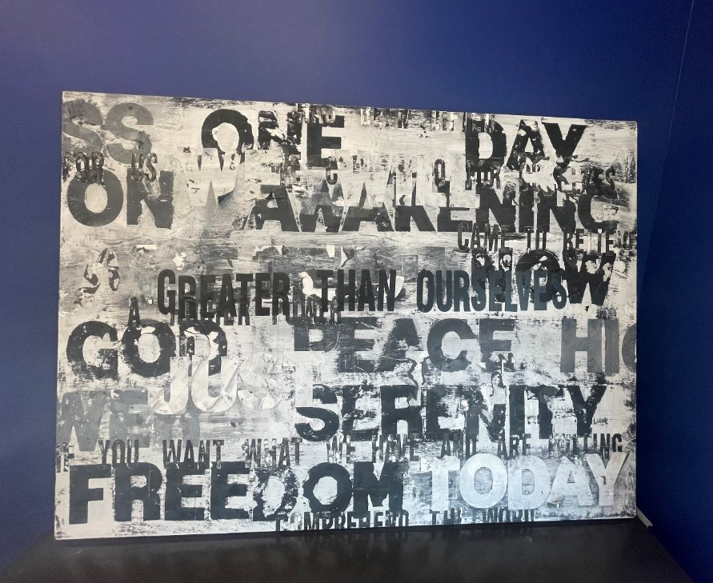
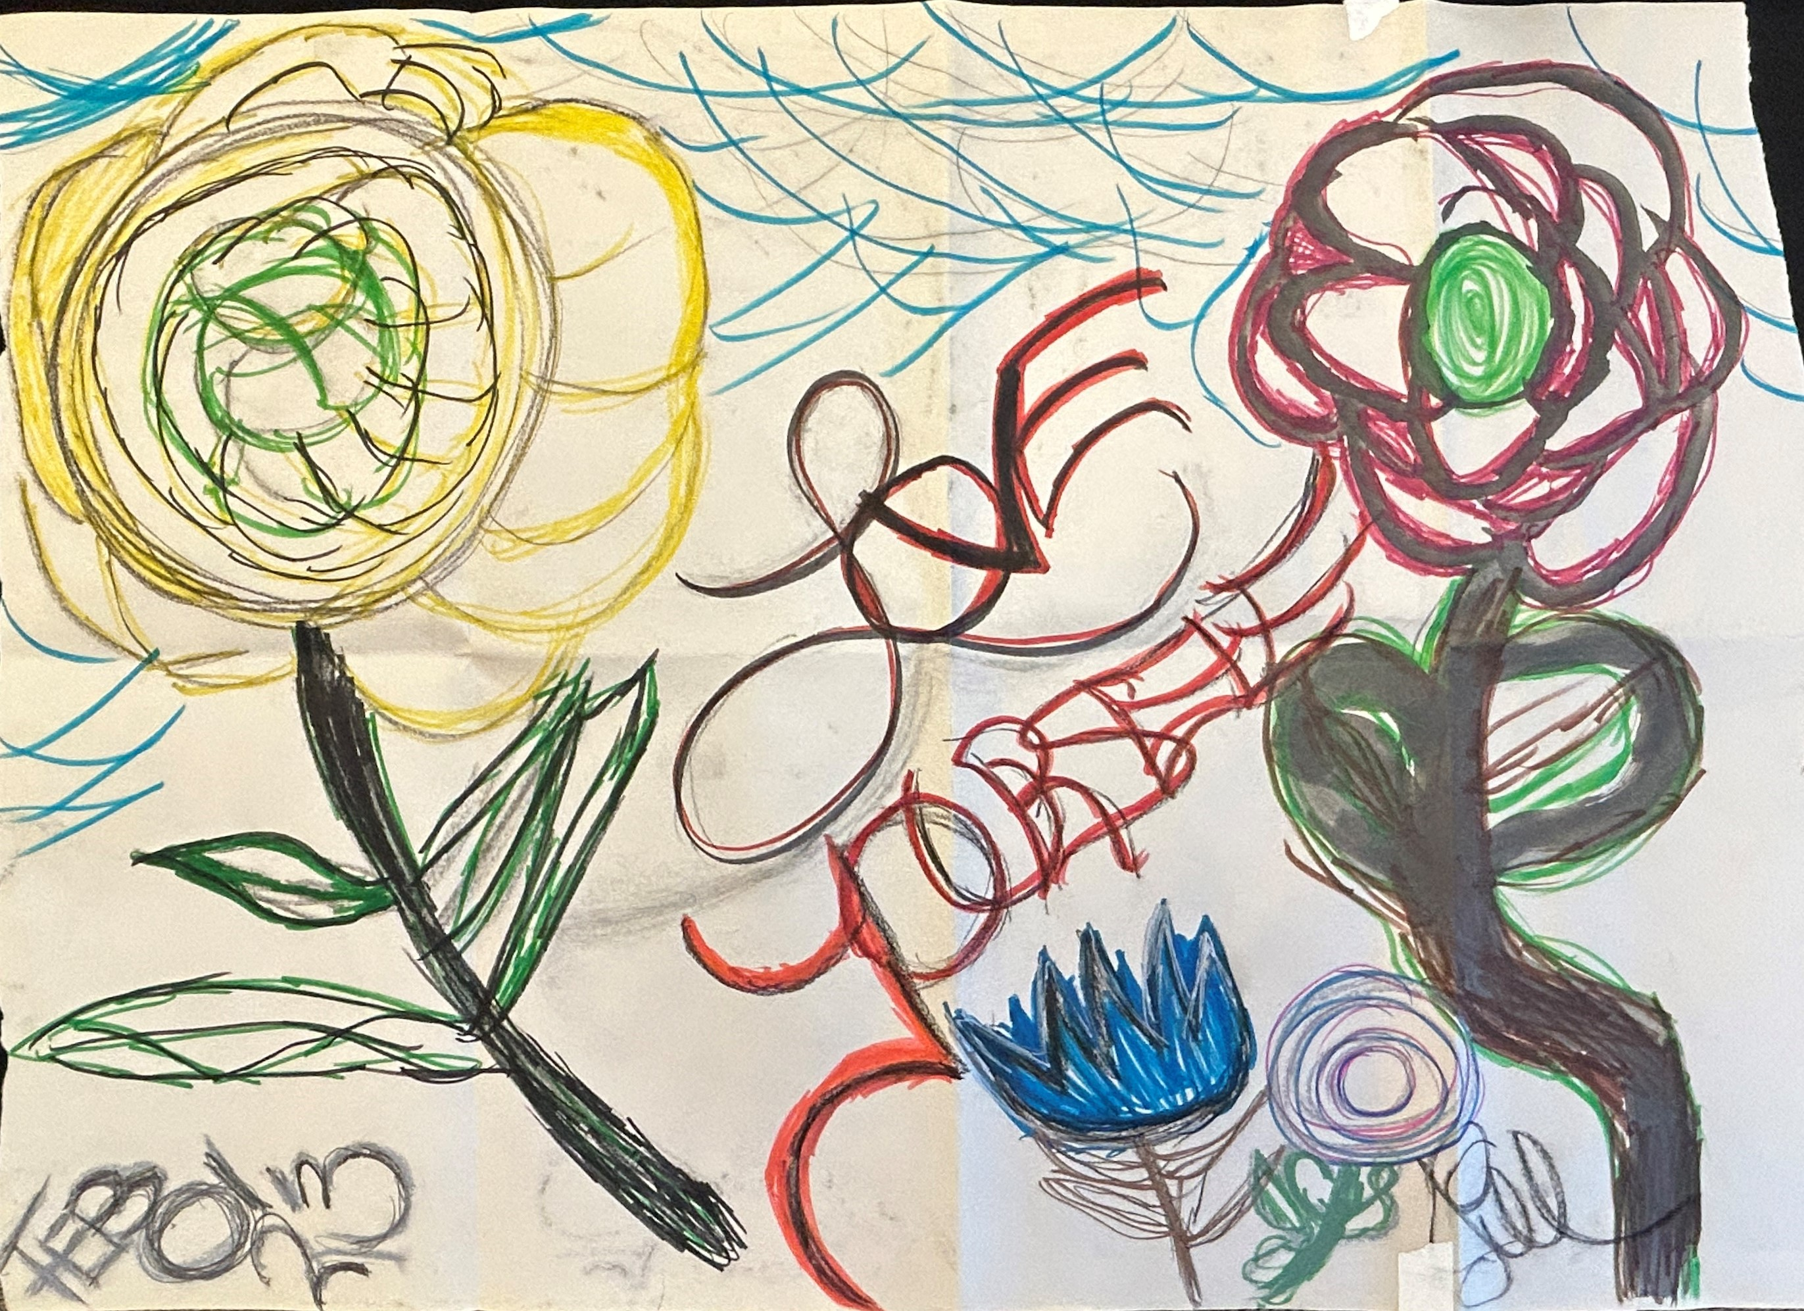
Stimulants:
Cocaine & Methamphetamine
CRIT/FIT/CFS program – April 2025
Alex Walley, MD, MSc
Notes:
I’m faculty in the Department of Family Medicine and am the Medical Director for START - stimulant treatment and recovery team, which is an extension of BMC’s Office Based Addiction Treatment Program that offers support and management for people with stimulant use disorders.
And today I’ll be giving an overview of stimulant use disorders. We host an drop in art group for START and OBAT patients and these are 2 pieces of art done by our patients.

Slide 2
Learning Objectives
At the end of this session, participants will be able to:
Understand how and why people use stimulants
Describe the characteristics of stimulant intoxication and withdrawal syndromes
Identify the medical complications of using stimulants
Treat stimulant use disorders and manage overamping
Notes:
Our objectives today are to
Understand how and why people use stimulants (focusing on cocaine and methamphetamine
And we’ll talk through the medical complications of stimulant use, current treatment options for stim use disorders and we’ll close by discussing stimulant intoxication – also known as overamping - and techniques to manage this.

Slide 3
Basics of Cocaine & Methamphetamine

Slide 4
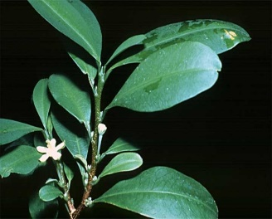
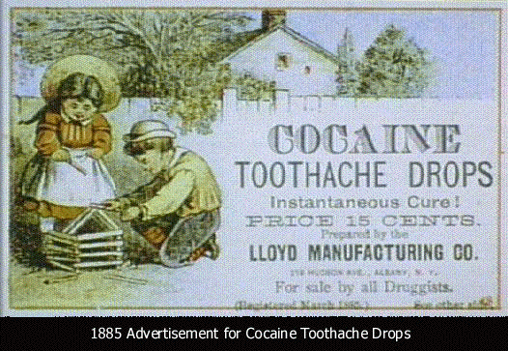
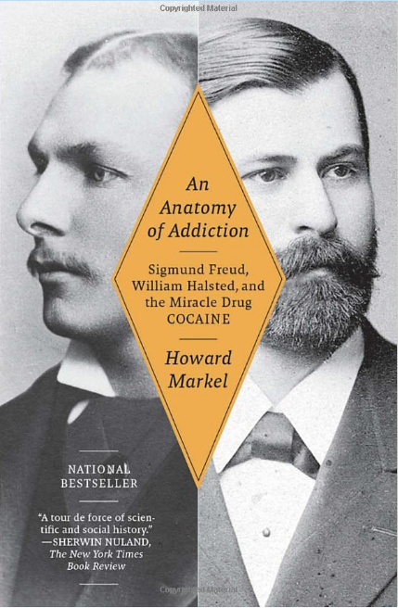
Overview: Cocaine
Derivative: erythroxylum coca leaves in Andes
History of Use:
Used in medicines and beverages until early 1900s
Street preparations 10-50% cocaine
Hydrochloride powder is sniffed or injected; Blow, Snow, Powder
Alkaline rocks (aka crack) are smoked; Crack, Rock, Base
Routes of Use: Intranasal, Intravenous, smoked/inhalation
Metabolized: Rapidly absorbed, metabolized (liver), and excreted in the urine. Benzoylecgonine = metabolite
*Prevents the reuptake of dopamine*
Half-Life: IV 20-60 min, IN 60-90 min, smoked 5-15 min
IN slower onset and prolonged action v. IV or smoked.
Notes:
(Harris, et al, 2003, Clinical Pharm)
(Hatsukami, 1996)
Stimulants or psychostimulants are commonly called “uppers” and are drugs that increase activation of the central nervous system.
Cocaine was original derived from coca leaves, it’s been used overtime in food and medicine
There are a couple different preparations (water-soluble hydrochloride salt; water-insoluble hydrochloride base)
Most common route of use for cocaine IN use or hydrochloride salt (sniffing or snorting powder cocaine)
Hydrochloride salt can be transformed into a base form of cocaine that is smokable by processing the drug with diluents (ammonia or bicarb) and water and heating to remove the hydrochloride
Most street preparations have impurities, diluents (baking soda, talcum powder, cornstarch) and adulterants or they are cut with other substances (like procaine – local anesthetic, levamisole – an antiparasitic medication; fentanyl, or other amphetamines) so actual cocaine 10-50% of the product
Here are some terms you may hear in reference to crack or cocaine
It is rapidly absorbed, metabolized (mostly in the liver) and excreted in the urine.
Intranasal use has the slower onset of action and more prolonged activity (with a ½ life up to 90 mins) when compared to injection use or smoking (which has the shortest ½ life)
Freebasing is a technique to remove impurities and produce a “purer” (and more potent) form of cocaine. It involves creating a base cocaine (mix hydrochloride salt with bicarb and water and heating with the final step being the addition of an organic solvent, like diethyl-ether). Dangerous b/c these solvents are highly flammable.
Hatsukami, D. K. (1996). Crack cocaine and cocaine hydrochloride. Are the differences myth or reality? JAMA: The Journal of the American Medical Association, 276(19), 1580–1588. https://doi.org/10.1001/jama.276.19.1580

Slide 5
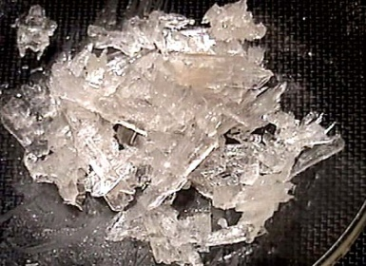
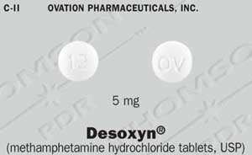
Overview: (Meth)amphetamine
Derivative: lab derived from ephedrine components
Tina, Speed, Crystal, Crank, Ice, Meth
History of Use: 1893 methamphetamine first synthesized in Japan as decongestant
Route of Use: Smoked/Inhalational, Intranasal, Rectal, Intravenous
Metabolized: Renal and hepatic clearance, highly bioavailable, slowly metabolized
*Increases dopamine in synaptic terminal AND prevents its reabsorption*
Half-Life: Peaks ~2-4 hours after use
Long ½ life, between 10-12 hours, independent of route of use
Lineberry 2006
Notes:
(Harris, et al, 2003, Clinical Pharm) (Goodwin, et al, 2009)
Methamphetamine (or meth) is lab derived from ephedrine components and other easily obtained chemicals (like acetone, anhydrous ammonia, phosphorus, ether, lithium). In the top right is a picture of the crystalline product.
These are some terms in reference to meth
Historically used by German, English, American, and Japanese military in WWII for performance enhancement.
It can be smoked, injected, used intranasally or intrarectally, or taken orally
Meth has a high bioavailability, is highly lipophilic and can cross the blood brain barrier easier than many stimulants and is slowly metabolized in the body with a long ½ between 10-12 hours, and bc of this can cause significant neurotoxicity
It has many of the same acute medical risks as cocaine but is associated with more clinically significant psychosis, mostly bc of the neurotoxic effects
Goodwin, J. S., Larson, G. A., Swant, J., Sen, N., Javitch, J. A., Zahniser, N. R., De Felice, L. J., & Khoshbouei, H. (2009). Amphetamine and Methamphetamine Differentially Affect Dopamine Transporters in Vitro and in Vivo. The Journal of Biological Chemistry, 284(5), 2978–2989. https://doi.org/10.1074/jbc.M805298200

Slide 6
PK: Cocaine
 | IV | Smoked | Snorted
Time to effect | 10-60sec | 3-5sec | 1-5min
Peak concent. | 3-5min | 1-3min | 15-20min
Half-life | 20-60min | 5-15min | 60-90min
Lange, R. A. and L. D. Hillis (2001). "Cardiovascular complications of cocaine use." N Engl J Med 345(5): 351-8.
PK: Methamphetamine
 | IV | Smoked | Snorted | Ingested
Time to effect | 15-30 sec | Immediate | 3-5 min | 15-20 min
Peak concent. | 2-4 h | 2-4 h | 2-4 h | 2-4 h
Half-life | 10-12 h | 10-12 h | 10-12 h | 10-12 h
Lineberry 2006
Notes:
To review, smoking, injection use (and intrarectal use for methamphetamine) have the fastest onsets of action. But you’ll notice the ½ life for MA is very high, this become important when we talk about binge use and the consequences of that in a moment

Slide 7
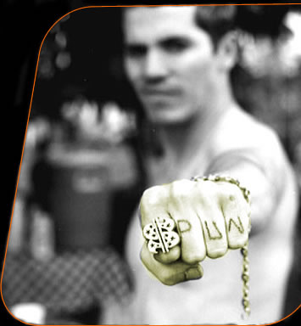
Health Consequences of Chronic Stimulant Use
Dental
Darkened teeth
Periodontal disease
Neuro-psychiatric
Stroke
Seizure
Depression
Anxiety
Mania
Psychosis (paranoia, AH/VH/TH)
Liver
Drug-induced hepatitis
Cirrhosis or liver failure
Pulmonary
Acute pulmonary edema
Pulmonary HTN
Inhalation injury
Cardiovascular
Hypertension
Arrhythmias
Cardiomyopathy
Acute Coronary Syndrome
Aneurysm/dissection
Erectile dysfunction
Renal/Metabolic
Rhabdomyolysis
AKI/CKD
Hyperthermia
Infectious
HIV/AIDS
HCV/HBV
STIs
SSTIs
Skin
Superficial/deep tissue wounds/infections
Excoriations
Chemical burns
Notes:
These are examples of some of the health consequences from both acute and chronic cocaine or methamphetamine use.
As you can see, it can impact nearly every organ system.
Liver damage from cocaine: conversion to a toxic metabolite as a result of P450 metabolism. Also results in hyperthermia, both of which can cause hepatic ischemia/necrosis
Liver damage from methamphetamine: thought to be linked to hyperthermia induced damage to the hepatocytes leading to liver injury

Slide 8
Epidemiology

Slide 9
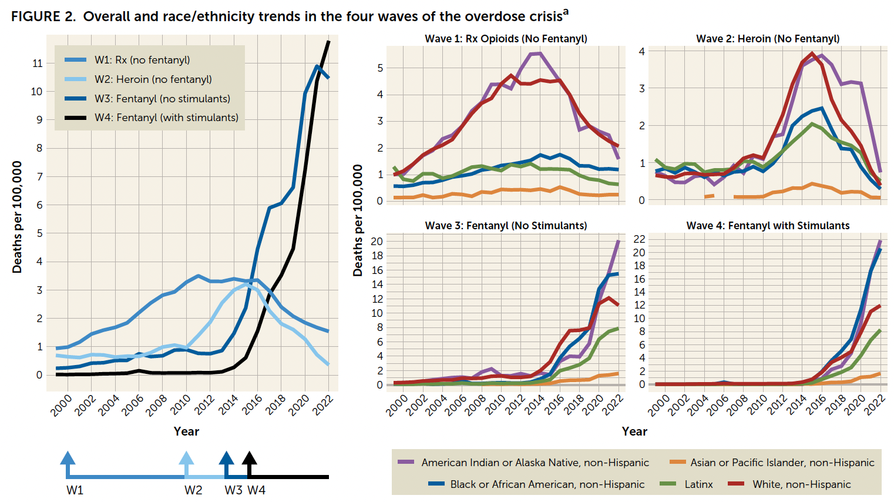
Overlapping Waves of Opioid Overdose Deaths
Friedman JR, Nguemeni Tiako MJ, Hansen H. Understanding and Addressing Widening Racial Inequalities in Drug Overdose. Am J Psychiatry. 2024 May 1;181(5):381-390.
Notes:
Friedman JR, Nguemeni Tiako MJ, Hansen H. Understanding and Addressing Widening Racial Inequalities in Drug Overdose. Am J Psychiatry. 2024 May 1;181(5):381-390. doi: 10.1176/appi.ajp.20230917. PMID: 38706336; PMCID: PMC11076008.
This rise in opioid overdose deaths can be outlined in three distinct waves.
The first wave began with increased prescribing of opioids in the 1990s, with overdose deaths involving prescription opioids (natural and semi-synthetic opioids and methadone) increasing since at least 1999³.
The second wave began in 2010, with rapid increases in overdose deaths involving heroin⁴.
The third wave began in 2013, with significant increases in overdose deaths involving synthetic opioids, particularly those involving illicitly manufactured fentanyl^{5,6,7}. The market for illicitly manufactured fentanyl continues to change, and it can be found in combination with heroin, counterfeit pills, and cocaine.⁸
Many opioid-involved overdose deaths also include other drugs^{9.10}.
https://www.cdc.gov/opioids/basics/epidemic.html
Ciccarone D. The triple wave epidemic: supply and demand drivers of the US opioid overdose crisis. Int J Drug Policy. 2019;71:183-188. doi:10.1016/j.drugpo.2019.01.010 2.
Ciccarone D. The rise of illicit fentanyls, stimulants and the fourth wave of the opioid overdose crisis. Curr Opin Psychiatry. 2021;34(4):344-350. doi:10.1097/YCO.0000000000000717

Slide 10
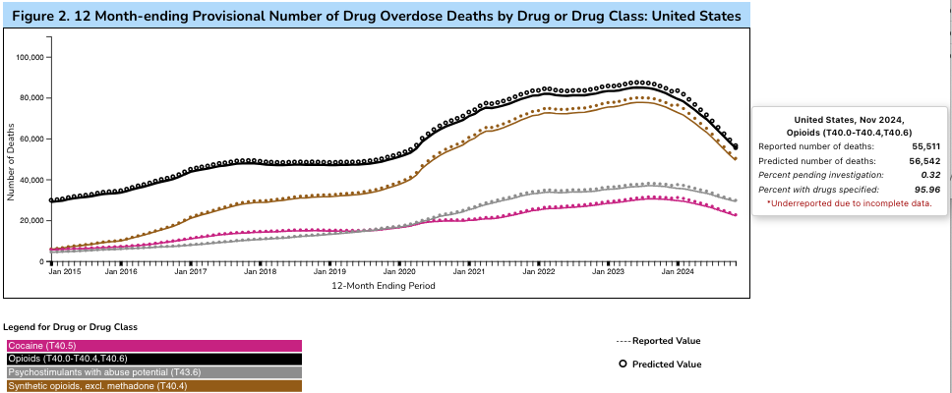
Overdoses are dropping,
but less for cocaine and methamphetamine
Source: https://www.cdc.gov/nchs/nvss/vsrr/drug-overdose-data.htm

Slide 11
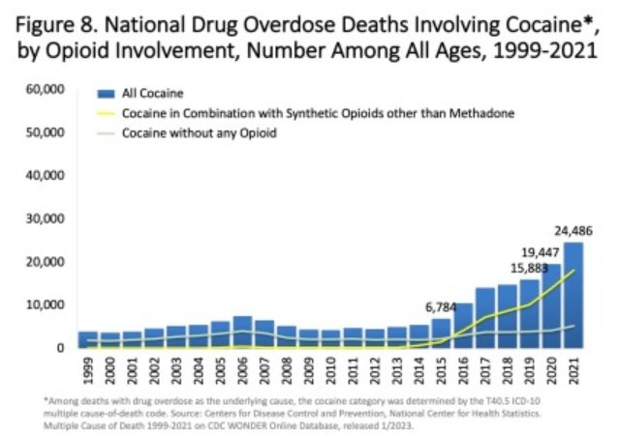
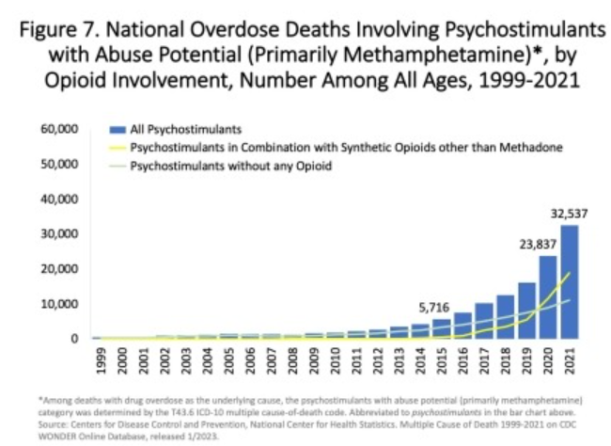
Stimulant-involved overdose deaths surging with opioids
CDC, 2023
Notes:
https://nida.nih.gov/research-topics/trends-statistics/overdose-death-rates
Stimulant involved overdose deaths from both cocaine on the left and psychostimulants mostly methamphetamine on the right have been increasing steadily since about 2015, with or w/o opioid involvement. But, you see that synthetic opioids like fentanyl are really driving stimulant-involved death, c/w what we know about our contaminated drug supply.

Slide 12
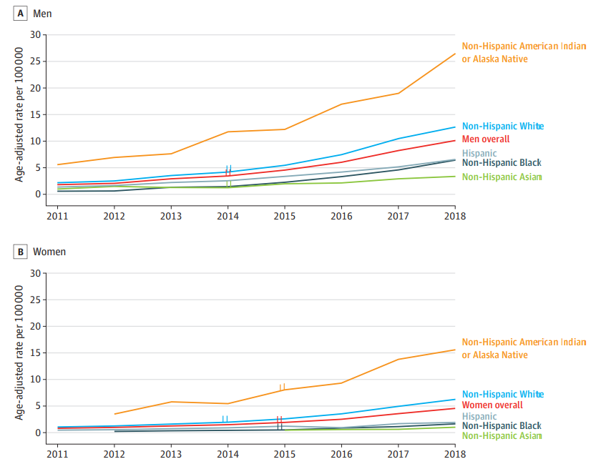
Disparities in Methamphetamine-Involved Overdose Deaths
Native American/ Indigenous communities have the highest rates of methamphetamine related overdose death
Overdose rate for AI/AN men: 26.4/100,000
Overdose rate for AI/AN women: 15.6/100,000
Han et al, JAMA Psych, 2021
Notes:
You can see here the disparity in overdose death rates from methamphetamine by race/ethnicity, in people ages 25-54. Indigenous people have a significantly higher overdose death rate from methamphetamine. Deaths in indigenous communities more than quadrupled from 2011 to 2018.
US overdose deaths involving methamphetamine in people ages 25-54

Slide 13
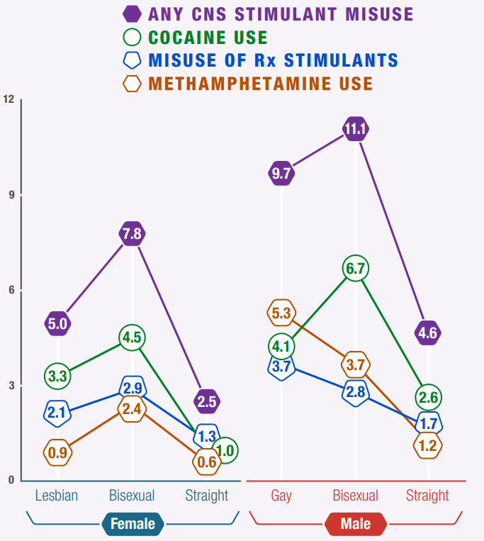
Stimulant Use and Sexuality
Sexuality diverse patients are twice as likely as heteronormative counterparts to have any type of stimulant use disorder
Highest rates of methamphetamine use are among gay identifying men
Highest rates of cocaine use among bisexual men and women
SAMHSA, 2023
SAMHSA, 2020; NSDUH, 2015
Notes:
GSD groups (MSM, WSW, transgender individuals) have much rates of stimulant use than do heteronormative individuals.
And bisexual women and gay men have the have the highest rates of reported methamphetamine use.
Both cocaine and methamphetamine are more prevalent among gender and sexuality diverse groups, cocaine use particularly common among gay and bisexual women.

Slide 14
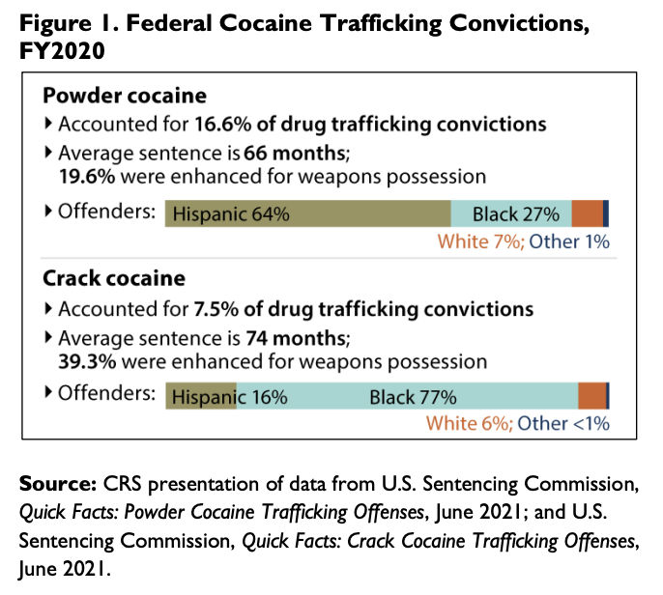
War on Crack and Structural Racism
1972 Controlled Substances Act: did not distinguish powder from crack cocaine
1986 Anti Drug Abuse Act: mandatory min sentencing for trafficking (100:1 ratio - 5 yrs for 5g crack vs 500g of powder)
1988 Anti-Drug Abuse Act: 5 year min for simple possession of crack
2010 Fair Sentencing Act: reduced sentencing disparity to 18:1 ratio crack:powder cocaine
2018 First Step Act: applied the 2010 rules retroactively and allowed for resentencing
From 1985 to 2013, crack use declined less than powder cocaine and other drugs not included in sentencing policies, thus harsh mandatory minimum sentencing did not appear to specifically reduce crack use.
Walker LS, Mezuk B. Mandatory minimum sentencing policies and cocaine use in the U.S., 1985-2013. BMC Int Health Hum Rights. 2018 Nov 29;18(1):43.
SAMHSA, 2020; NSDUH, 2015
Notes:
Many of disparities we see in patterns of use, overdose death rates from stimulant use, cocaine in particular, and in the inequitable rate of incarceration for BIPOC are the result of intentional and racist drug policy. For example, in the 1980s anti drug abuse act imposed a 100 to 1 sentencing disparity for crack cocaine (mostly used in Black communities) vs powder cocaine (used more commonly by affluent white folks). This has led in part to the disproportionate incarceration of Black folks overtime.
2018 First Step Act – applied the 2010 rules retroactively to allow for resentencing

Slide 15
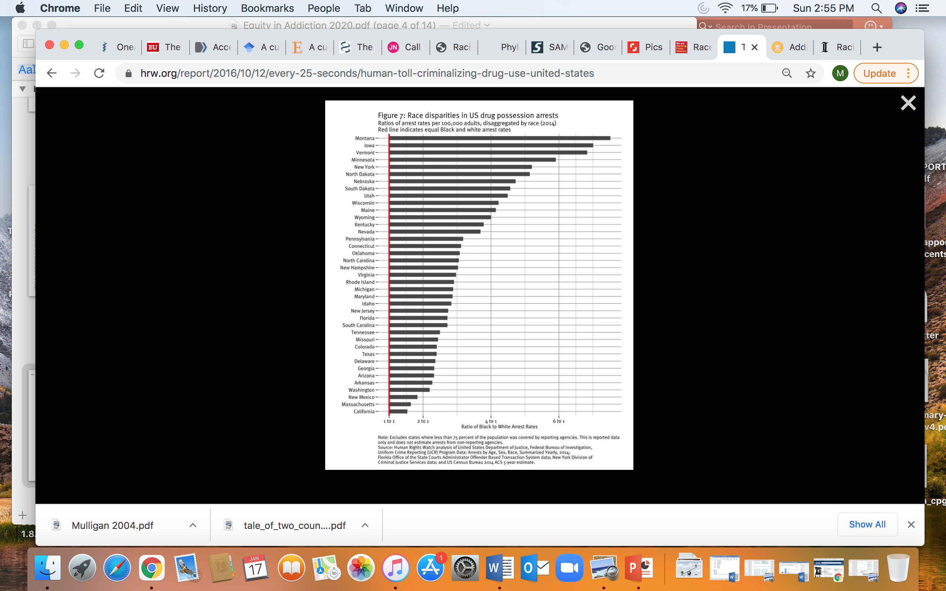
Substance use rates are similar across racial and ethnic groups,
yet people of color are much more likely to be arrested for drug possession
In NSDUH from 2006-2019, no difference in prevalence of past 12-month cocaine use between White and Black adults – 2-2.5%
Mustaquim D, Jones CM, Compton WM. Trends and correlates of cocaine use among adults in the United States, 2006-2019. Addict Behav. 2021 Sep;120:106950. doi: 10.1016/j.addbeh.2021.106950. Epub 2021 Apr 20. PMID: 33940336; PMCID: PMC10032475.

Slide 16
Stimulants: Why & How
Notes:
Here, we’ll talk about why people use stimulants, how cocaine and methamphetamine work in the brain, and some key points about stimulant use patterns and health effects.

Slide 17

Why do people use stimulants?
Euphoria / rush
  Onset and intensity depends on delivery method
Increased energy, attention/focus
Increased vigilance (survival)
Diminished social inhibition
Sexual enhancement (libido)
Decreased appetite
To counteract the sedative effect of opioids
Notes:
There are many reasons why people use stimulants.
For one, stimulant can highly re-enforcing and feel good.
Others use to increase energy and help with focus or attention. To increase wakefulness (thinking about people experiencing homelessness or sex working and needing to stay vigilant at night or in certain environments, for survival). For many, sexualized drug use (often called chemsex) enhances sexual experiences. We see this in particular among men or transwomen who have sex with men. Some use in combination with other sedating drugs like opioids to counteract the depressant effects of those drugs.

Slide 18
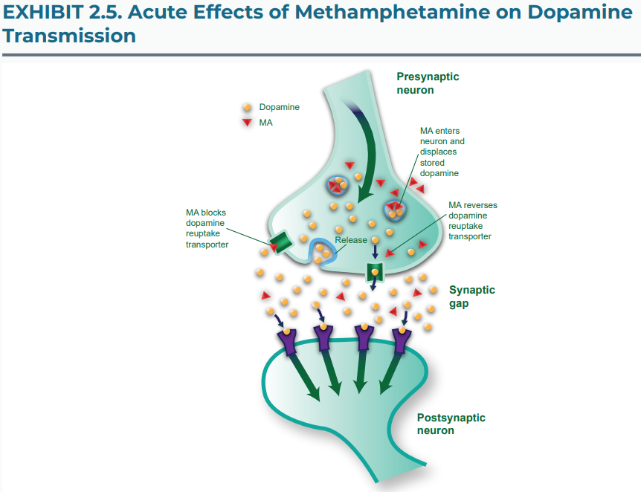
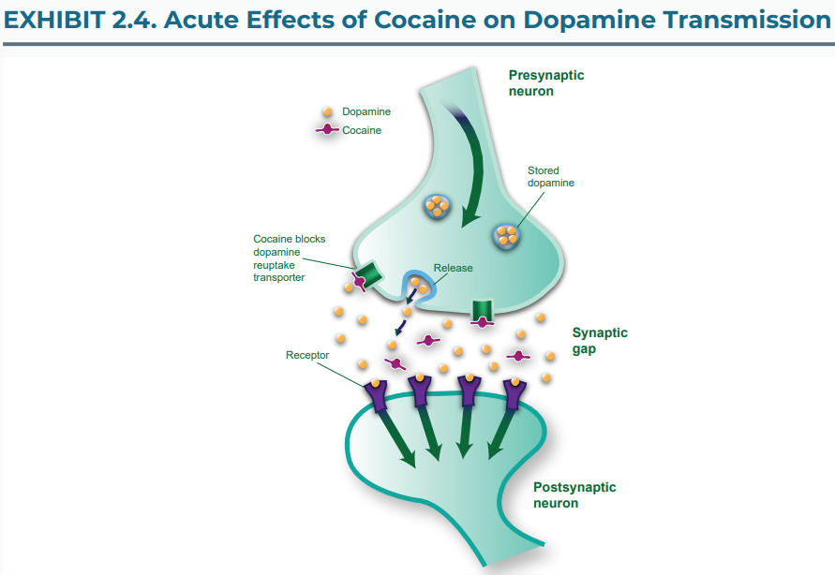
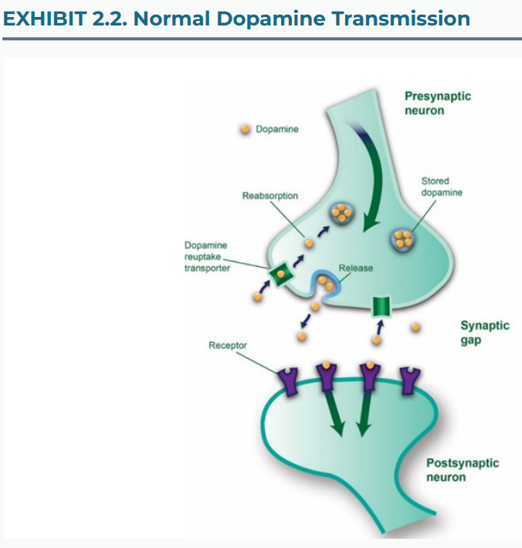
Neurochemical Impact
Cocaine prevents the reuptake of dopamine from the synapse.
Methamphetamine both increases dopamine in the synaptic terminal AND prevents its reabsorption.
Excessive dopamine with stimulant use is responsible for many of the motor and mood symptoms
Alternatively, a dopamine deficit with abstinence contributes to the typical acute and post-acute withdrawal symptoms
(Paulus & Stewart, 2020)
(Myers & DeWall, 2017)
Notes:
Normally, dopamine is released into the synapse, neurochemical transmission occurs and the dopamine is taken back up and stored in the presynaptic neuron waited to be re-released.
With cocaine, dopamine is released but the reabsorption (or reuptake) of the neurotransmitter is blocked, causing excess neural activation of dopaminergic pathways. With meth, dopamine reuptake is also blocked AND dopamine release into the synapse is increased, leading to much higher concentrations of dopamine.
This increased dopamine release and then blockage of reuptake both elevates dopamine levels more and for longer periods of time than natural rewards do and more than other substances (alcohol, opioids, cannabis), as Susan Weis discussed earlier.
This excess dopamine is responsible for many of the motor activity/impulsivity and mood symptoms we see if stimulant intoxication/overamping.
Overtime, with continued use of meth or cocaine, dopamine receptors are downregulated and less available.
For people who use methamphetamine chronically, it can take 12-18 months of abstinence to reverse the reduction in dopamine transporters (DAT). And even then, some people will never see complete repletion of dopamine, which can contribute to chronic memory, motor, and mood deficits (severe depression, suicidality, fatigue, insomnia, and parkinsonian symptoms).
Myers/DeWall, 2017 https://www.macmillanhighered.com/BrainHoney/Resource/22292/digital_first_content/trunk/test/pel4e/asset/img_ch13/myerspel4e_fig_13_05.html
Paulus, M. P., & Stewart, J. L. (2020). Neurobiology, Clinical Presentation, and Treatment of Methamphetamine Use Disorder: A Review. JAMA Psychiatry, 77(9), 959. https://doi.org/10.1001/jamapsychiatry.2020.0246
Dopamine- reward, pleasure, high levels (high levels of motor activity/impulsivity)

Slide 19





Notes:
Stimulant binge
Euphoria - Rush
Onset and intensity depends on delivery method
Increased energy, alertness, libido
Diminished social inhibition
Decreased appetite
For methamphetamine, there is acute tolerance to the euphoric/ rewarding effects, but the andrenergic effects persist and thus accumalte with repetitive use.
We see binge use more often with stimulants than with other substances
In effort to recapture initial rush, people use repetitively, despite mounting levels drug. Acute tolerance to this rush develops, leading to a state of overamping. Eventually use ceases, perhaps after days, ending in crash into nonrestful sleep.

Slide 20
Binge Patterns of Use
Binge patterns may include using sporadically or may occur multiple days in a row
During a binge, initial substance use increases the desire to use more.
Decreased desire to use varies based on stimulant:
  Cocaine – 46 hours
  Methamphetamines – day 4-5
Binge use patterns may result in more severe side effects and adverse events at the end of a binge episode.
Notes:
We see binge use more often with stimulants than with other substances
In effort to recapture initial rush, people use repetitively, despite mounting levels drug. Acute tolerance to this rush develops, leading to a state of overamping. Eventually use ceases, perhaps after days, ending in crash into nonrestful sleep.

Slide 21
Addressing Stimulant Intoxication

Slide 22
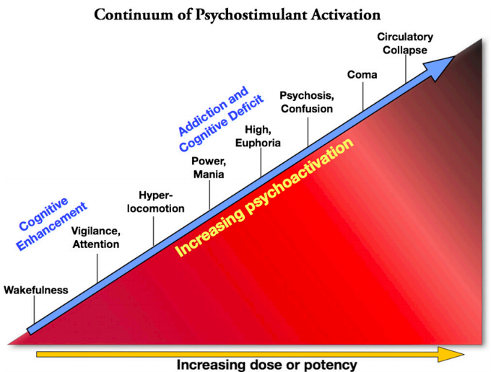
Overamping
Wood et al., 2014
Notes:
Citation: Wood S, Sage JR, Shuman T, Anagnostaras SG. Psychostimulants and cognition: a continuum of behavioral and cognitive activation. Pharmacological Reviews. 2014 ;66(1):193-221. DOI: 10.1124/pr.112.007054.
https://europepmc.org/article/pmc/pmc3880463

Slide 23
Signs of Overamping
Physical | Psychological
Headache | Paranoia
Jaw grinding | Altered perceptions of reality
Spasticity/dyskinesia | Persecutory delusions
Xerostomia (dry mouth) | Auditory hallucinations
Chest pain | Visual hallucinations
Seizure | Tactile hallucinations/disturbances
Hyperthermia
Hypertension | Protective behaviors: hypervigilance, fear, anxiety, panic, agitation, increased sensory awareness
Syncope

Slide 24
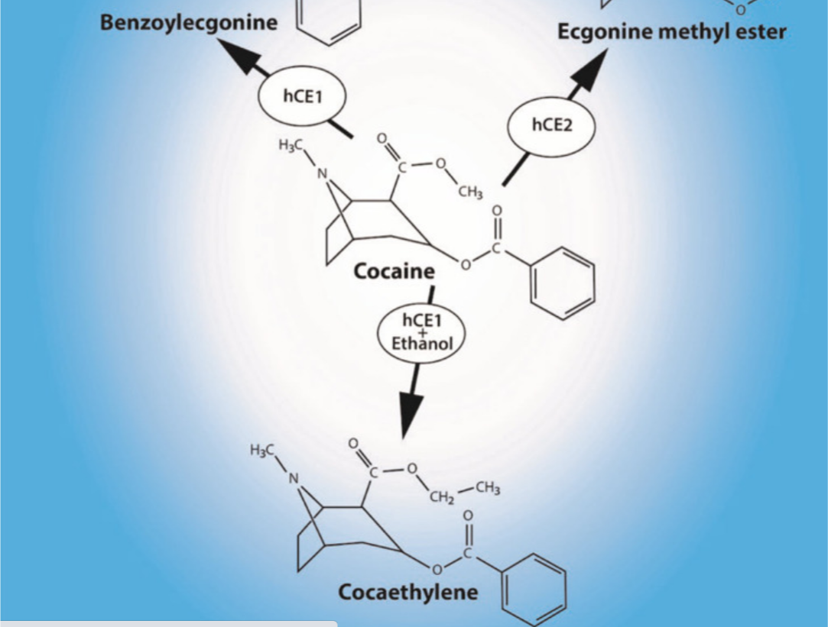
Cocaethylene Toxicity
Cocaethylene = psychoactive substance produced when cocaine is used in presence of alcohol
  Alcohol interferes with metabolism of cocaine
Longer ½ life, more potent, larger volume of distribution
60-90% of people who use cocaine also use alcohol
  Alcohol as a “landing gear” from cocaine
  Prolongs and/or potentiates effects of cocaine
Estimated to be 10x more cardiotoxic than cocaine alone
Increased likelihood of liver injury, neurologic effects (seizures), death
Notes:
Wanted to spend just a minute talking about cocaethylene toxicity, this is often an overlooked but really critical point about concurrent cocaine and alcohol use. So many of our patients use both, so this is a important conversation to have with patients
Cocaethylene is a psychoactive substance formed when cocaine and alcohol are used together. Alcohol is often to “come down” from cocaine use, but can also be used to prolong and/or potentiate the effects of cocaine
Cocaethylene – more potent, larger volume of distribution and is longer lasting with a ½ life 2x that of cocaine alone
Cocaethylene is thought to be about 10x more cardiotoxic than cocaine alone, in part bc it’s a more potent Na channel blocker
There is significantly increased likelihood of liver injury and death.
So the bottom line here is to screen for alcohol use when you encounter cocaine and to talk with patients about the disproportionate effects of using both together.

Slide 25
De-escalation
A | G | R | O | +
Assess | Gauge | Respond | Observe | Positive Reinforcement
Using a patient-centered focus, asses the cause of the patient’s agitation. CALMLY engage the patient in conversation. | How are you feeling? Be mindful of the feelings that you may be projecting that may escalate or de-escalate the patient. | Be calm yet firm in your interactions. Use open ended questions and empathetic listening to respond to the patient’s concerns. | Observe verbal and non-verbal cues. Is this working? | As the patient starts to de-escalate offer them something. A place to sit, a glass of water, a snack.
Australian Clinical Guideline CG284, 2019
Notes:
When thinking about how to manage overamping, it depends on the severity
Ten Domains of De-escalation
Richmond JS, Berlin JS, Fishkind AB, et al. Verbal De-escalation of the Agitated Patient: Consensus Statement of the American Association for Emergency Psychiatry Project BETA De-escalation Workgroup. West J Emerg Med. 2012;13(1):17-25.
1. Respect personal space
2. Do not be provocative
3. Establish verbal contact
4. Be concise
5. Identify wants and feelings
6. Listen actively; respond appropriately
7. Agree or agree to disagree
8. Lay down the law and set clear limits
9. Offer choices and optimism
10. Debrief the patient and staff.

Slide 26
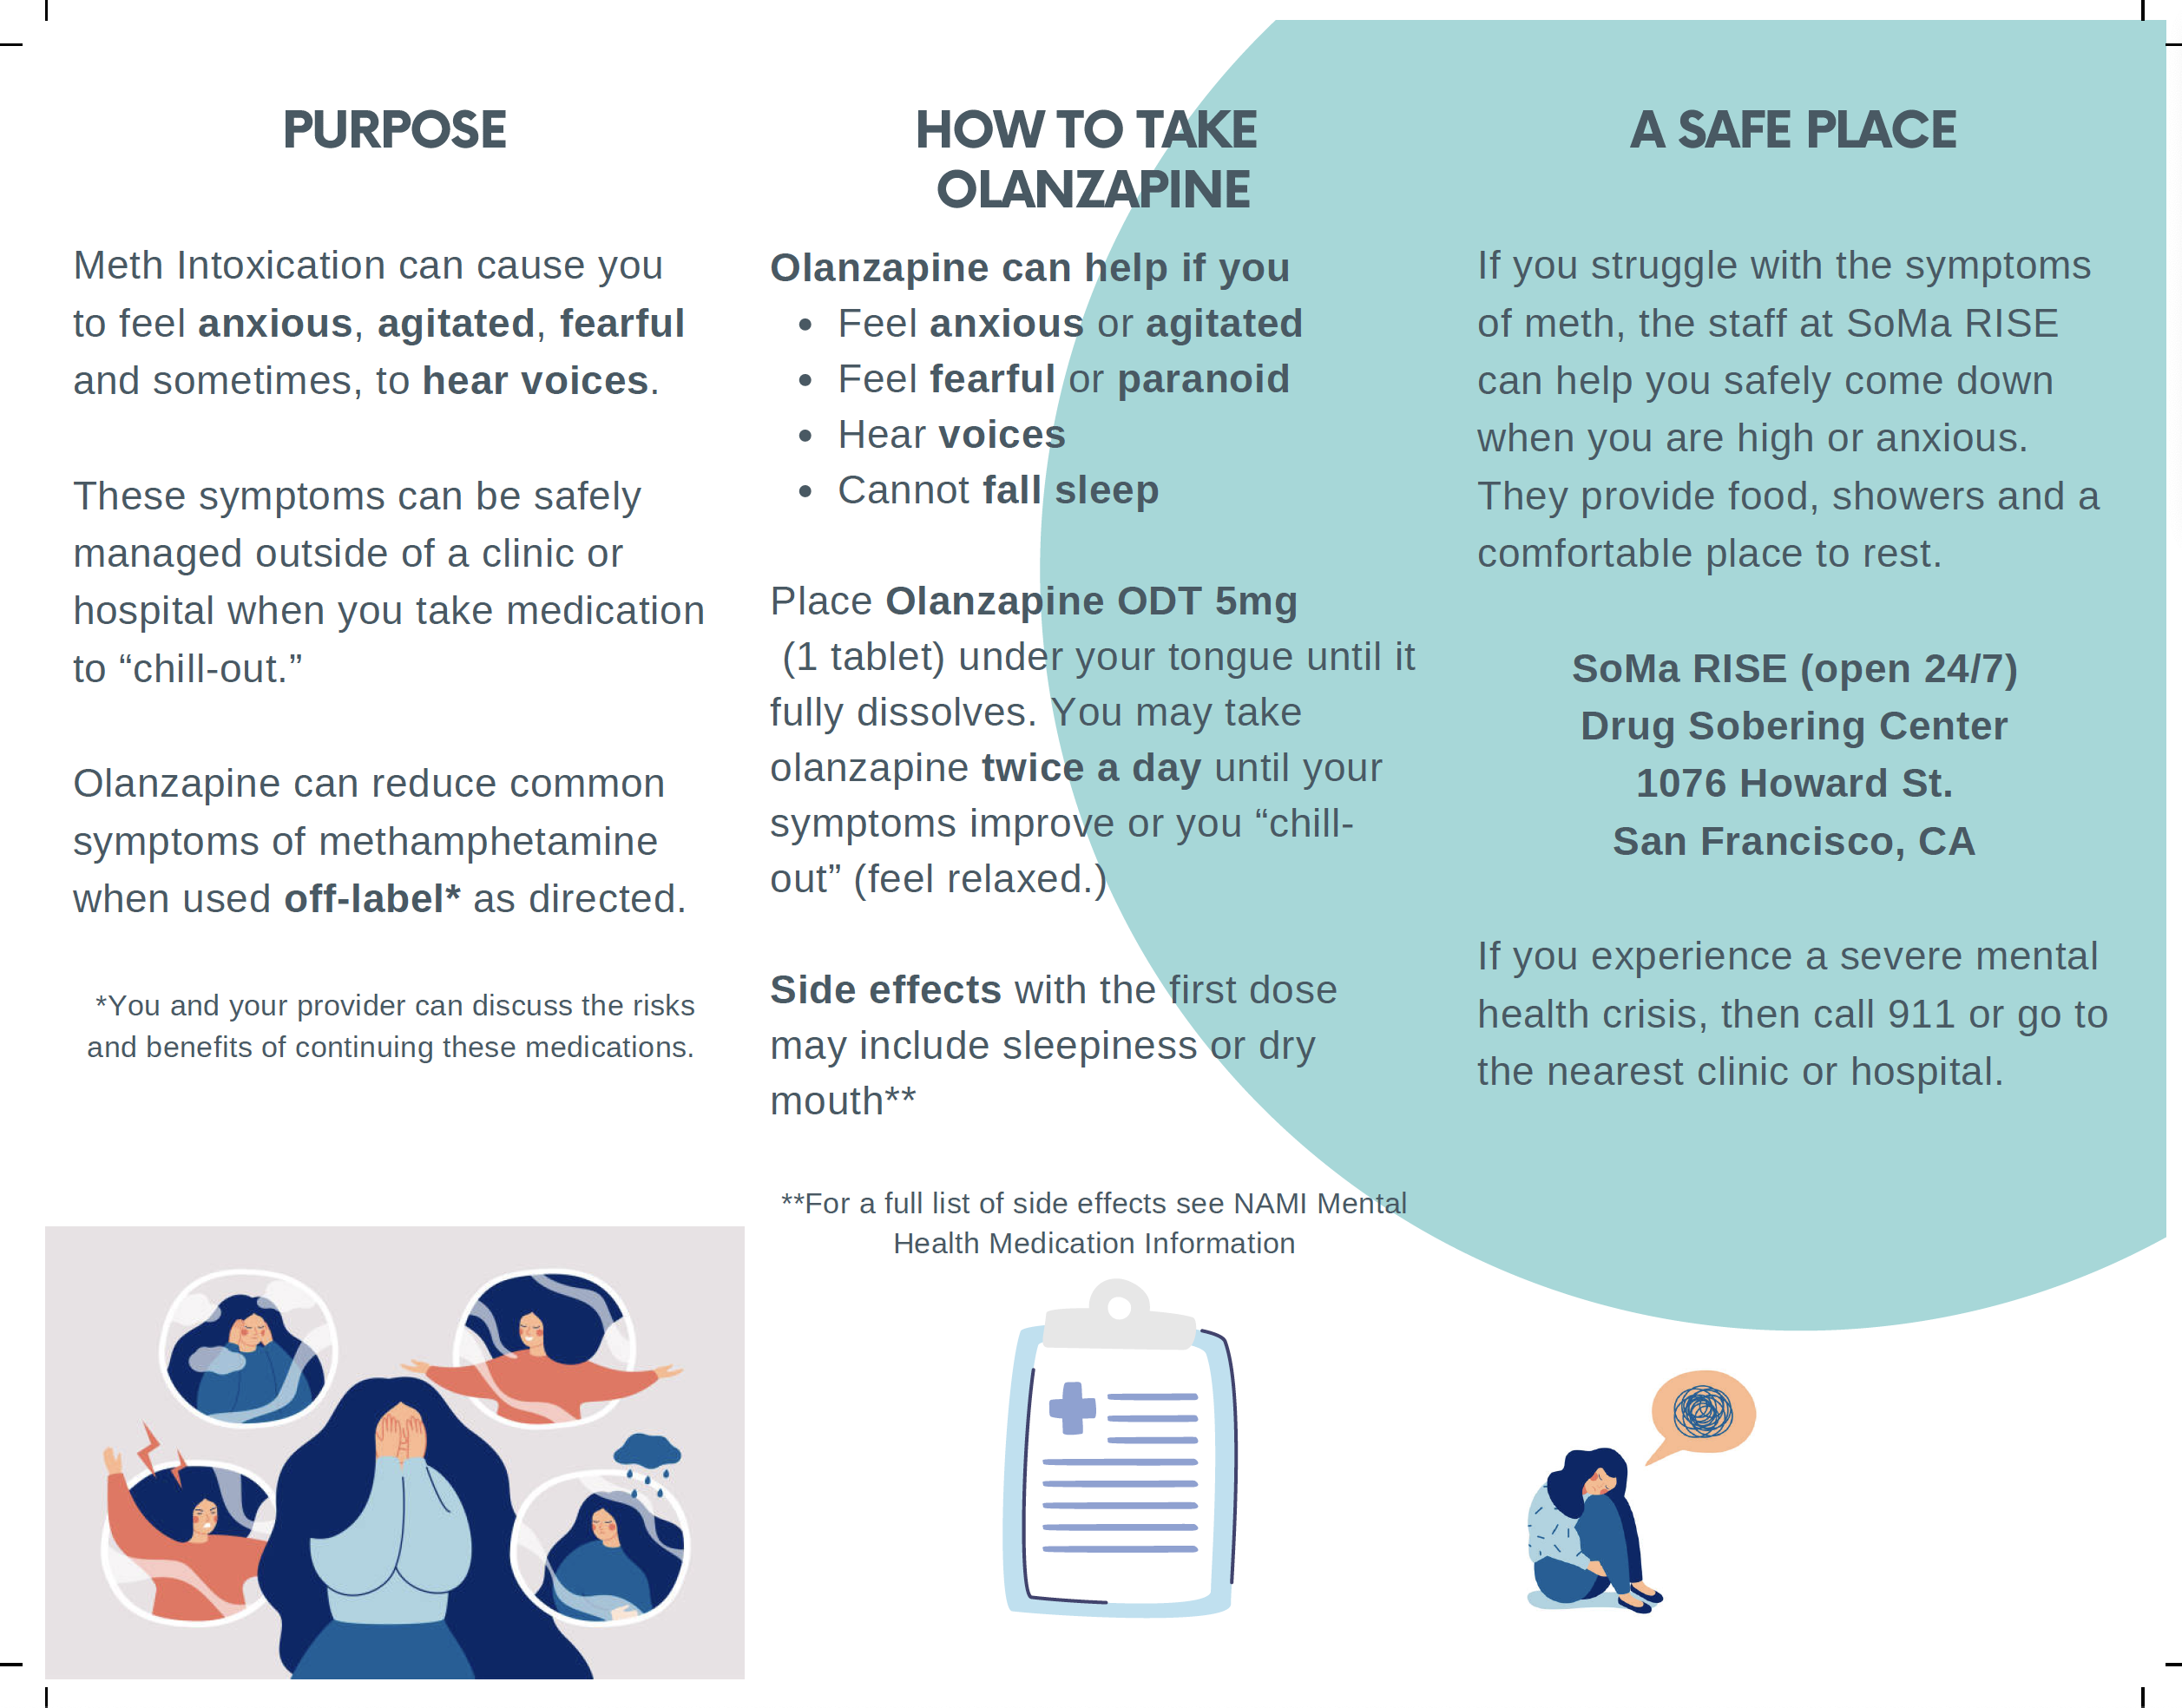
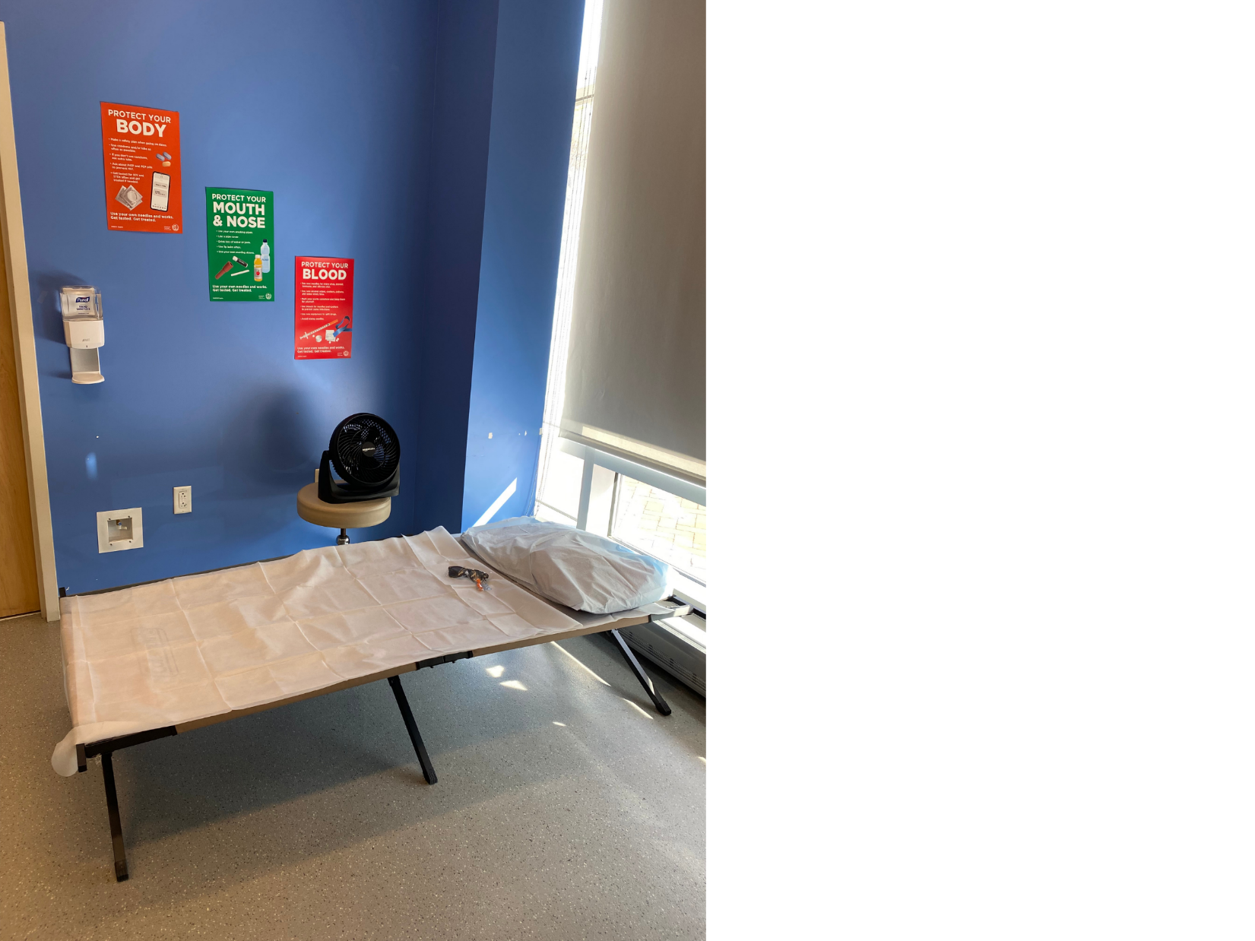
Interventions
Cool down space to reduce stimuli:
Quiet, low light setting; white noise machine
Eye mask or sunglasses & earplugs
Place to lie down/rest (cot or exam room table or floor mat)
Address appetite/hydration
Offer snacks
Offer water, gum for dry mouth; chapstick
Pharmacologic Interventions:
Benzos for anxiety
Neuroleptics (eg. olanzapine) for agitation
  4x 5mg olanzapine +instructions + referral
For increased BP+HR, use CCB or non-selective beta-blockers
Treat hyperthermia (external cooling)
Notes:
This is a picture of the START Clinic at BMC.
START, we maintain our cool down space on one side of our group room.
Our cool down space is for patients who come in with symptoms of overamping.
Our staff (from the front desk, to our medical assistants, nurses, and providers) have been trained in de-escalation. And this cool down space offers a place for patients to sleep and eat/hydrate with the goal to eliminate the need to call public safety, to increase trust and engagement with START staff, and ultimately to decrease ED visits, hospital admissions and health system costs related to stimulant use.
In recognition that space in most places of care is in short supply, including our clinic space, this can equally as well be done in an exam room if available, without a dedicated cot, etc. turn off the lights, get some snacks and water. Let the rest. Would be good to invest in low cost cot or floor mat so can have a place other than exam table for patients to rest if needed.
Coffin PO, Chang YG, McDaniel M, Leary M, Pating D, McMahan VM, Goldman ML. Evaluation of methamphetamine assist packs: As-needed antipsychotics for self-management of methamphetamine-associated psychiatric toxicity. Int J Drug Policy. 2024 Jul;129:104480. doi: 10.1016/j.drugpo.2024.104480. Epub 2024 Jun 10. PMID: 38861841; PMCID: PMC11305928.

Slide 27
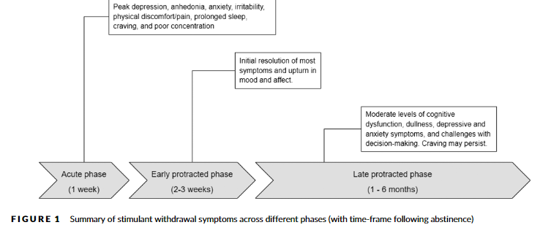
Psychostimulant Withdrawal
53-97% of people experience withdrawal with abstinence after prolonged use
Dopamine stores may take 12-18 months to recover, if at all, after chronic methamphetamine use
Withdrawal symptoms may last weeks to months:
  Acute (1-7 days): (severe) depression, anhedonia with suicidal ideation, anxiety, fatigue with hypersomnia or insomnia, intense cravings, poor concentration, irritability, physical discomfort (myalgias), psychomotor retardation or agitation
  Post-acute (early protracted, 2-4 wks): vivid/unpleasant dreams,
  intermittent cravings w/nighttime awakenings
  Late protracted (> 4 weeks): mild cognitive dysfunction,
  ”cognitive dullness”, impairments in memory and
  executive functioning, moderate depression/anxiety
  intermittent cravings
Li, M; Shoptaw, S; Addiction, 2022
(S3 Practice Guidelines, 2016)

Slide 28
Psychostimulant Withdrawal
53-97% experience withdrawal with abstinence after prolonged use
Eat, hydrate, sleep, repeat!
  vivid/unpleasant dreams, intermittent cravings w/nighttime awakenings
Li MJ, Shoptaw SJ. Clinical management of psychostimulant withdrawal: review of the evidence. Addiction. 2023 Apr;118(4):750-762. doi: 10.1111/add.16093. Epub 2022 Dec 12. PMID: 36401591; PMCID: PMC10069411.
(S3 Practice Guidelines, 2016)
Notes:
Li MJ, Shoptaw SJ. Clinical management of psychostimulant withdrawal: review of the evidence. Addiction. 2023 Apr;118(4):750-762. doi: 10.1111/add.16093. Epub 2022 Dec 12. PMID: 36401591; PMCID: PMC10069411.
Coffin PO, Chang YG, McDaniel M, Leary M, Pating D, McMahan VM, Goldman ML. Evaluation of methamphetamine assist packs: As-needed antipsychotics for self-management of methamphetamine-associated psychiatric toxicity. Int J Drug Policy. 2024 Jul;129:104480. doi: 10.1016/j.drugpo.2024.104480. Epub 2024 Jun 10. PMID: 38861841; PMCID: PMC11305928.

Slide 29
Treatment of Stimulant Use Disorders

Slide 30
Pharmacologic Management
No FDA approved medications for stimulant use disorders
Preliminary research with some promise for:
  IM naltrexone + bupropion (methUD)
  mirtazapine (methUD)
  mixed amphetamine salts (CUD + ADHD, meth withdrawal)
  topiramate (CUD)
  topiramate + mixed amphetamine salts (CUD)
  modafinil (post-acute stimulant withdrawal)
(S3 Practice Guidelines, 2016)
Notes:
I’m not going to spend a lot of time on pharmacologic management bc the evidence base is strongest for behavioral interventions. I’m happy to answer questions in the Q&A or individually afterwards.
Lot of medications have been studied, none that are currently FDA approved meds for StUD, but a few with promise and that we do use in the START Clinic based on the research that we do have.

Slide 31
Promising medications for Methamphetamine Use Disorder
MA Use Disorder | Comparison | Population | Outcomes | Limitations
Coffin PO et al. JAMA Psychiatry 2020 77(3):246-255 | Mirtazapine 30mg vs. placebo once daily + counseling | 120 men who have sex with men who use methamphetamine | At 24 weeks RR of 0.75 for MA use RR <0.52 for multiple sex partners, condomless anal sex Improved depressive symptoms and insomnia severity | Medication adherence was almost 40%
Trivedi MH et al. N Engl J Med. 2021 384(2):140-153 | IM-NTX 380mg Q3wks +Bupropion 450mg vs. placebo | 403 with MA UD in stage 1 and 225 with MA UD in stage 2 | At 12 weeks BPP+NTX 13.6% vs. Placebo 2.5% (3 of 4 MA negative urine tox) | Adherence to medication was 75-86%, Adverse events: Nausea, vomiting, dizziness
Notes:
Mirtazapine 30-45mg was the first medication to demonstrate efficacy in treating methamphetamine use disorder among Cisgender Men and Transgender Women Who Have Sex With Men. There have been 2 independent RCTs, most recently published in 2020.
NEJM 2021 study found that IM naltrexone 380mg q3 wks + ER bupropion 450mg/day was effective in reducing methamphetamine use in ppl w/mild to mod MUD
JAMA Psych (2020): Coffin et al; Effects of Mirtazapine for Methamphetamine Use Disorder Among Cisgender Men and Transgender Women Who Have Sex With Men
Looking at reduction of meth use and HIV risk over 24 wks of treatment (6 mo) and 12 wk (9 mo) followup post-intervention
2013-2017 randomized to mirtaz 30 vs placebo with background counseling (mean age 43, 50% white, 25% Black, 12.5% Latinx
primary outcomes – pos UDS over 12, 24, 36, wks
Secondary outcomes – sexual risk behaviors (#partners, episodes of condomless anal sex with serodiscordant partners, episodes of condomless receptive anal sex with serodiscordant partners
Results:
meth + UDS significantly decreased by week 12 for mirtaz group, also in weeks 24 and 36 (9 mo)
Sexual risk behaviors sign declined by week 24
Depression, insomnia improved in mirtaz group all despite similarly suboptimal adherence in both groups
NEJM 1/2021 (Trivedi et al): Bupropion and Naltrexone in Methamphetamine Use Disorder
Multisite, double blind RCT to evaluate efficacy/safety of ER IM naltrexone 380mg q3 wks + ER bupropion 450mg/day in ppl w/mild to mod MUD
In 2 stages, over course of 12 wks. After 12 weeks they found that 13.6% of participants in the medication group had a response compared to 2.5% in the placebo group.
Primary outcomes was a response (at least 3 or 4 meth-negative urine samples at end of stage 1 or 2 (each 6 wks long), weighted avg of 2 stages is reported
First stage (403 participants) 16.5 vs 3.4% had response; second stage (225 participants) 11.4% vs 1.8% had response
weighted average: 13.6% med group vs 2.5% placebo had response
A few other medications have some evidence of efficacy, though we haven’t used them yet in

Slide 32
Promising medications for Cocaine Use Disorder
Cocaine Use Disorder | Comparison | Population | Outcomes | Dropout
Nuijten M et al. Lancet. 2016; 387:2226-34. | Dexamphetamine 60mg QD vs. placebo | 73 Dutch patients with cocaine UD with OUD on MOUD (methadone) | At 12 weeks Fewer days of cocaine use More cocaine-neg tox tests No differences in craving, use of other substances, or criminality | 11% dropout
Levin FR et al. JAMA Psychiatry. 2015 1;72:593-602. | Mixed amphetamines (MAS-ER) 60-80mg QD vs. placebo | 126 US patients with adult-ADHD and cocaine UD | At 13 weeks Reduced ADHD symptoms: 60-75% vs 40% 3-wk abstinence: 30-17% vs. 7% | 26% dropout
Dakwar E et al. Am J Psychiatry. 2019 176(11):923-930. | 40 min infusion of ketamine at 0.5mg/kg vs. midazolam + All 5-wks counseling | 55 inpatients with cocaine UD | At 5 weeks Abstinence: 48% vs. 11% Cravings: Ketamine 58% lower | dropout: 26% ketamine; 57% midazolam
Levin FR et al. DAD 2020 206:107700. | MAS-ER at 60mg QD + topiramate 100 BID vs. placebo | 127 adults with CUD using at least 9 days in the prior month | At 3 weeks Abstinence: 14% vs. 0% | 20% discontinued for elevated HR/BP
Notes:
For cocaine disorder:
2 DB, RCT found topiramate up to target of 150mg BID effective in promoting abstinence (as measured by neg UDS) and decreasing cravings when compared to placebo
2 DB, RCTs over span of yrs found that combo of topiramate (100mg BID) + ER-MAS (like Adderall) highly effective in promoting abstinence over 3 wks timeframe compared to placebo
DB, RCT - ER MAS in robust doses (60-80mg/day) + CBT are effective for treatment of co-occurring ADHD and cocaine use disorder, both improving ADHD symptoms and reducing cocaine use (as measured by weekly cocaine neg UDS, and consecutive weeks of abstinence up to 13 wks).
*MAS = (like Adderall, lisdexamphetamine - vyvanse, and dextroamphetamine)
Topiramate (antiepileptic):
Double blind RCT (2005-2011), published in 2013. Johnson et al
140 participants over 12 wks. Primary outcome – weekly abstinence, secondary outcome – cocaine free uds, cravings, functional outcomes (self rated) -> overall: reduction in cocaine use days topiramate
Conclusion: topiramate (increasing doses up to target 150mg BID in weeks 6-12) is more efficacious than placebo at increasing the mean weekly proportion of cocaine nonuse days and associated measures of clinical improvement among cocaine-dependent individuals.
2018 systematic review and meta-analysis – 6 double blind RCTs. Conflicting results (reduction in short-term use).
Psychostimulants: Mixed (low to moderate quality evidence)
2020 Tardelli et al - systematic review and meta-analysis of 2889 participants: prescription amphetamines (modafinil, methylphenidate – Ritalin, concerta- or amphetamines (mixed amphetamine salts – Adderall, lisdexamphetamine - vyvanse, and dextroamphetamine – Dexedrine were particularly efficacious in:
Promoting sustained abstinence (2-3 wks) in patients with cocaine use disorder [RR = 2.44, 95% CI = (1.66, 3.58)
higher doses of PPs were particularly efficacious for treatment of cocaine use disorder [RR = 1.95, 95% CI = (1.38, 2.77)] (moderate quality evidence)
Treatment with prescription amphetamines also yielded more cocaine-negative urines [MD = 8.37%, 95% CI = (3.75, 12.98)].
There was no effect of PPs on the retention in treatment.
Conclusion Rx psychostimulants, particularly prescription amphetamines given in robust doses, have a clinically significant beneficial effect to promote abstinence in the treatment of individuals with cocaine use disorder.
2016 systematic review (Spain): 2300 participants, low quality evidence that psychostimulants improved abstinence, but retention was low (so cannot rule out attrition bias)
2020 Fran Levin out of Columbia: A double-blind, randomized placebo-controlled trial, testing the combination of mixed amphetamine salts extended-release (MAS-ER) – doses 60mg/day- and topiramate -100mg BID- or placebo over a 12-week medication phase was conducted. Conducted as a proof of concept (had previously been published on before).
The two-site outpatient trial included 127 adults (96 males) with CUD using at least 9 days in the prior month.
The primary outcome was the proportion of individuals who achieved three consecutive abstinent weeks at the end of the study (EOS) as measured by urine toxicology and self-report.
Results: The proportion of participants achieving three abstinent weeks at the EOS was signiﬁcantly (P = .03) larger in the treatment (14.1%) compared to the placebo group (0.0%). Similar conclusion as prior study.
2015 Fran Levin: 13 wk, double blind RCT, placebo-controlled trial of 126 participants with diagnosed ADHD and cocaine use disorder conducted between December 1, 2007, and April 15, 2013, at 2 academic health center substance abuse treatment research sites.
Conclusion: ER MAS in robust doses (60-80mg/day) + CBT are effective for treatment of co-occurring ADHD and cocaine use disorder, both improving ADHD symptoms and reducing cocaine use (by weekly cocaine neg UDS, and consecutive weeks of abstinence).

Slide 33
Stimulant maintenance for people with concomitant ADHD or HUD
73 Dutch patients with cocaine UD on heroin+methadone maintenance
Dexamphetamine SR 60mg once daily observed vs. placebo
11% dropout
At 12 weeks
  45 versus 61 days of cocaine use
  21% versus 8% >= 1 cocaine-negative urine in last 4 weeks
  No differences in craving, use of other substances, or criminality
Nuijten M et al. Lancet. 2016; 387:2226-34.
126 US patients with adult-ADHD and cocaine UD
Mixed amphetamine salts SR 60 or 80mg once daily vs. placebo
Weekly CBT groups
26% dropped out
At 13 weeks
  Reduced ADHD symptoms: 60-75% vs 40%
  3-wk abstinence: 30-17% vs. 7%
Levin FR et al. JAMA Psychiatry. 2015 1;72:593-602.

Slide 34
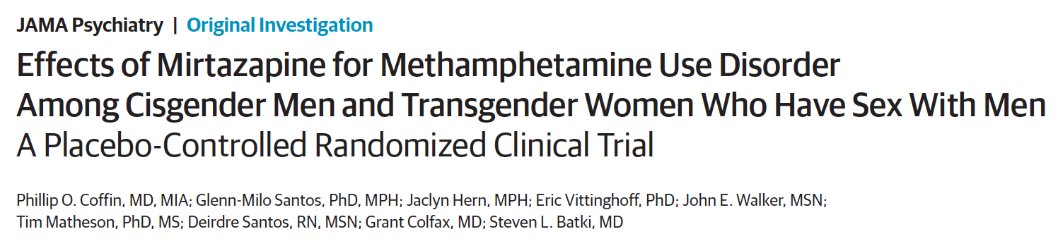
120 men who have sex with men who use methamphetamine
Randomized to mirtazapine 30mg or placebo once daily for 24 week + counseling
Medication adherence was almost 40%
Mirtazapine group had at 24 weeks
  RR of 0.75 for MA use
  RR <0.52 for multiple sex partners, condomless anal sex
  Improved depressive symptoms and insomnia severity
Notes:
Coffin PO, Santos GM, Hern J, Vittinghoff E, Walker JE, Matheson T, Santos D, Colfax G, Batki SL. Effects of Mirtazapine for Methamphetamine Use Disorder Among Cisgender Men and Transgender Women Who Have Sex With Men: A Placebo-Controlled Randomized Clinical Trial. JAMA Psychiatry. 2020 Mar 1;77(3):246-255. doi: 10.1001/jamapsychiatry.2019.3655. PMID: 31825466; PMCID: PMC6990973.

Slide 35
Bupropion and naltrexone in MA use disorder
BPP is stimulant-like antidepressant that may mitigate MA withdrawal. NTX may decrease MA rewards and craving.
403 with MA UD in stage 1 and 225 with MA UD in stage 2 randomized to IM-NTX+BBP 450mg vs. placebo
Outcome – 3 of 4 MA negative urine tox at 6 weeks
Result: BPP+NTX 13.6% vs. Placebo 2.5% (Weighted average)
  Adherence to medication was 75-86%, but missing urine tox was 30-50% and counted as positive
Adverse events: Nausea, vomiting, dizziness
Trivedi MH et al. Bupropion and Naltrexone in Methamphetamine Use Disorder. N Engl J Med. 2021 Jan 14;384(2):140-153

Slide 36
Single infusion of ketamine for cocaine use disorder
55 inpatients with CUD were randomized to a 40minute infusion of ketamine at 0.5mg/kg vs. midazolam. Both arms received 5-weeks of mindfulness based relapse prevention counseling, daily for 4 days, then weekly for 4 weeks
Ketamine 48% vs. midazolam 11% 2-week abstinence at 5weeks
Ketamine group 53% less likely to relapse
Ketamine group 58% lower craving scores
44% reported 6mo abstinence in ketamine group; 0 in the midazolam group
Dropout: 7 of 27 ketamine; 16 of 28 midazolam
Dakwar E, Nunes EV, Hart CL, Foltin RW, Mathew SJ, Carpenter KM, Choi CJJ, Basaraba CN, Pavlicova M, Levin FR. A Single Ketamine Infusion Combined With Mindfulness-Based Behavioral Modification to Treat Cocaine Dependence: A Randomized Clinical Trial. Am J Psychiatry. 2019 Nov 1;176(11):923-930.
Notes:
Dakwar E, Nunes EV, Hart CL, Foltin RW, Mathew SJ, Carpenter KM, Choi CJJ, Basaraba CN, Pavlicova M, Levin FR. A Single Ketamine Infusion Combined With Mindfulness-Based Behavioral Modification to Treat Cocaine Dependence: A Randomized Clinical Trial. Am J Psychiatry. 2019 Nov 1;176(11):923-930.

Slide 37
Non-pharmacologic Management
Notes:
But non-pharm management is really the bread and butter of treatment for stim use disorder.

Slide 38
Behavioral Interventions for StUD
Evidence-Based Treatments | Description of Treatment | References
Contingency Management | Provides reinforcers ($, gift cards, motivational encouragement, etc) for treatment adherence. | (Bach et al., 2020; Brown & DeFulio, 2020; Lake et al., 2020; Minozzi et al., 2016; Okafor et al., 2020)
Community Reinforcement Approach | Using therapeutic modalities, job training, education, behavioral skills training, social training, relapse prevention and relationship counseling. | (Meyers et al., 2011; Riccardo De Giorgi et al., 2018; Stitzer et al., 2011)
Matrix Model | An 8-16-week structured intensive outpatient group utilizing group therapy, connection to self-help, and exploration of underlying causes of disease. Regular UDS screening. | (Huber et al., 1997; Rawson et al., 1995, 2002)
Exercise Supported Recovery | Varying exercise programs have been described, but those with a combination of daily aerobic and anaerobic exercise are associated with long term recovery. | (Huang et al., 2020; Killeen et al., 2020; Liu et al., 2021; Zhou et al., 2021)
Trauma-Informed Care Seeking Safety | A therapeutic model for the treatment of co-occurring PTSD and SUD that emphasizes the need to be safe in order to explore and cope with trauma. | (Lange-Altman et al., 2017; Lenz et al., 2016; Morley et al., 2016; Murphy et al., 2019; Najavits & Anderson, n.d.; Sperlich et al., 2021; Takahashi et al., 2020)
Notes:
Here are some of the evidence-based behavioral interventions for Stimulant use disorders
CRA – clinicians lead patients through a functional analysis to identify triggers to use, short and long-term rewards and consequences of use, and from there help patients reorganize their social environment. This may involve job hunting or role playing, help plugging into sober community activities, etc.

Slide 39
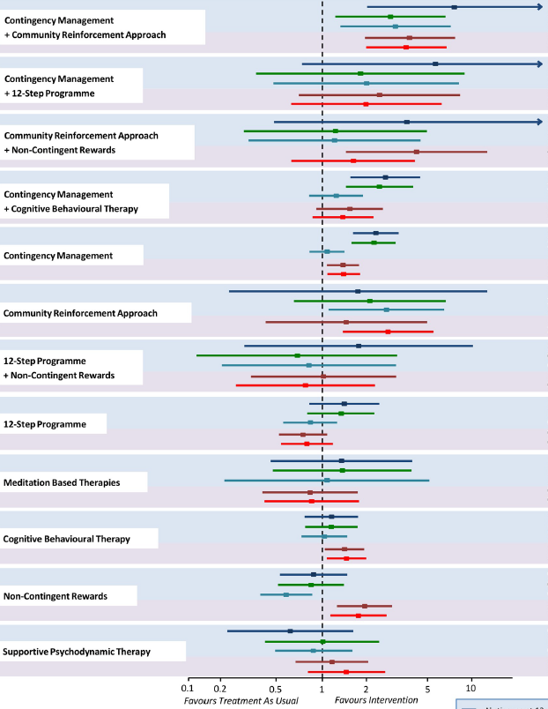

CM + CRA
Comparing Behavioral Health Approaches
CM + 12 Step
CRA + Incentives
Research indicates that a combination of behavioral health approaches are most effective in producing abstinence at 12 weeks
Contingency management combined with any additional behavioral health approach improves outcomes
CM + CBT
CM
CRA
12 Step +Incentives
12 Step
Meditation
CBT
Incentives
DeCrescenzo, et al, 2018
Psychodynamic therapy
CRA=Community Reinforcement Approach, CM=Contingency Management,
CBT=Cognitive Behavioral Therapy
Notes:
This meta-analysis by decrescenzo published in 2018 is one of the most comprehensive assessments we have of evidence based behavioral health interventions for stimulant use disorders. It includes an analysis of 76 studies describing over 50 RCTs between 1993 and 2016 and compares 12 psychosocial interventions in participants with stim use disorder, most of whom had comorbid alcohol or opioid use disorders on MOUD.
The colored lines indicate abstinence at different time points and dropout rates.
You can see the CM + CRA and CM + 12 step were most efficacious in maintaining 12 wks abstinence, abstinence at EOT and at longest follow-up. Had the lowest drop out rates.
CRA – clinicians lead patients through a functional analysis to identify triggers to use, short and long-term rewards and consequences, and from there help patients reorganize their social environment to facilitate involvement. This may involve job hunting or role playing, help plugging into sober community activities, etc.

Slide 40
Basics of Contingency Management
CM is a behavioral health intervention based in operant conditioning principles that provides tangible reinforcers for evidence of behavior change
Essential theory behind CM: “A behavior that is reinforced in close temporal proximity to its occurrence will increase in frequency” (ex. engagement in care is reinforced with cash given to patient at the visit/point of engagement)
In CM programs that focus on abstinence, the magnitude of reinforcement provided should increase with sustained periods of abstinence
Antecedent
Behavior
Consequence
Petry et al, 2011
Notes:
So what is CM?
CM is based on operant conditioning principles, which if you remember from high school state that the strength of a voluntary behavior is modified by reinforcement or punishment. CM differs from operant conditioning is that it does not involve punishment. Simply reinforcement (positive) or no reinforcement (neutral or no change).
Operants (behaviors that affect one’s environment – like reduction in substance use, abstinence, engagement in care) are conditioned to occur or not occur depending on consequences of that behavior (consequences in our case being reinforcements like money or gift cards).
(Then, refer to slide) – “essential theory…”
Verification of behavior (for instance, neg UDS for stimulants) should be clear to the patient at time of initiation into the program
Reinforcement given as close to time of behavior as possible
Magnitude of reinforcement should increase as the goal behavior continues to be met
ABCs – antecedent (anticipation of reinforcement with behavior), behavior, consequence (reinforcement or no reinforcement)
(distinct from classical conditioning or Pavlovian conditioning – which assign value to previously innoculous stimuli

Slide 41
Evidence for Contingency Management for stimulants
Systematic Review – DeCrescenzo 2018 PloS Medicine – 50 studies
CM in combination with community re-enforcement approach or cognitive behavioral therapy was most efficacious and acceptable
  Increases abstinence
  Improves treatment retention
Barrier: Regulations that restrict the amount of incentives that can be given to patients to $75 per patient per year
RCT in 6 community methadone programs of CM among stimulant users
Usual Care vs.
Intermittent, escalating re-enforcement
  1000 chips
    500 “Good job”
    250 “Small” - $1 value – i.e. toiletries
    209 “Large” - $20 value – i.e. kitchenware
    1 “Jumbo” – $80-100 value – tv, stereo
  # of draws = # of weeks with clean urine
Peirce et al. Arch Gen Psychiatry. 2006;63:201-208.
Notes:
De Crescenzo F, Ciabattini M, D'Alò GL, De Giorgi R, Del Giovane C, Cassar C, Janiri L, Clark N, Ostacher MJ, Cipriani A. Comparative efficacy and acceptability of psychosocial interventions for individuals with cocaine and amphetamine addiction: A systematic review and network meta-analysis. PLoS Med. 2018 Dec 26;15(12):e1002715. doi: 10.1371/journal.pmed.1002715. PMID: 30586362; PMCID: PMC6306153.
Medicare and State Health Care Programs: Fraud and Abuse; Revisions to Safe Harbors Under the Anti-Kickback Statute, and Civil Monetary Penalty Rules Regarding Beneficiary Inducements
•77684 Federal Register / Vol. 85, No. 232 / Wednesday, December 2, 2020 / Rules and Regulations

Slide 42
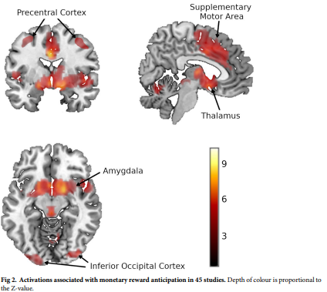
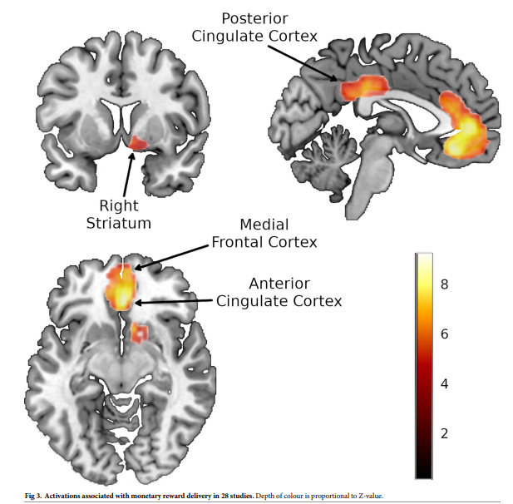
Neuroscience of Reward
Monetary Reward Anticipation
Monetary Reward Delivery
Jauhar et al., PLOS 2021
Notes:
This is a 2021 open access study published by researchers from across europe. It’s the first to relate human reward processing specifically to the ventral striatum, which is a part of the brain that coordinates multiple aspects of cognition (including motor and action planning, decision-making, motivation, reward perception, and reinforcement learning). The ventral striatum receives fibers from dopamine rich areas in the midbrain, which is a primary component of the reward system and is highly impacted by stimulant use.
They looked at fMRI studies and found that the ventral striatrum in particular lights up with BOTH reward anticipation AND reward delivery.
I include this here bc understanding the neuroscience behind reward is really important in conceptualizing why contingency management works to essentially retrain the brain to experience reward or pleasure if you will from positive activities and behaviors in recovery. People who use drugs and especially those in early remission (from stimulants in particular) have a relative depletion of dopamine. CM can be beneficial in retraining those dopamine reward pathways to respond to goal behaviors.

Slide 43

Harm Reduction Practices

Slide 44
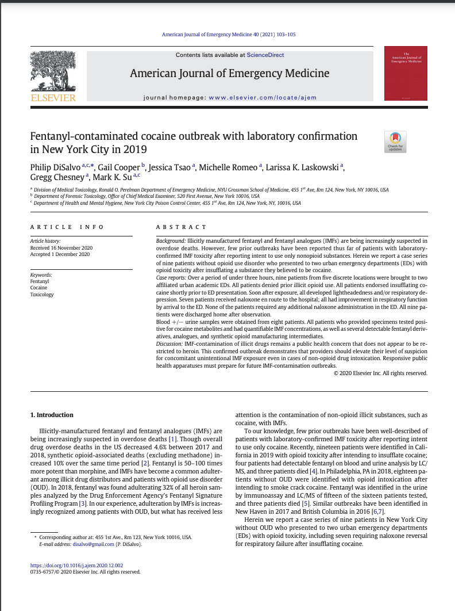
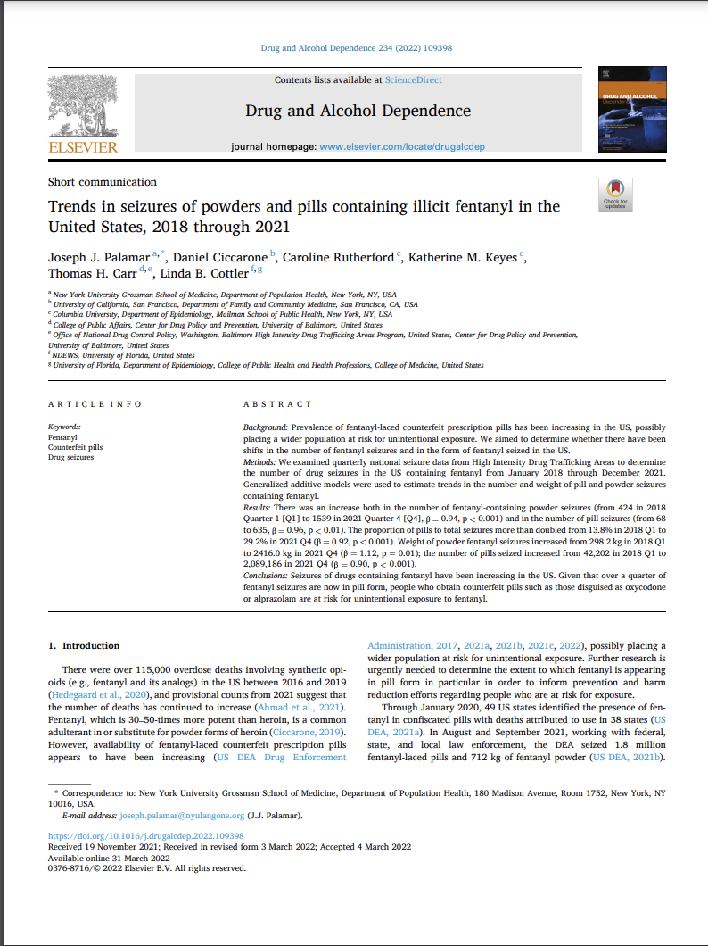
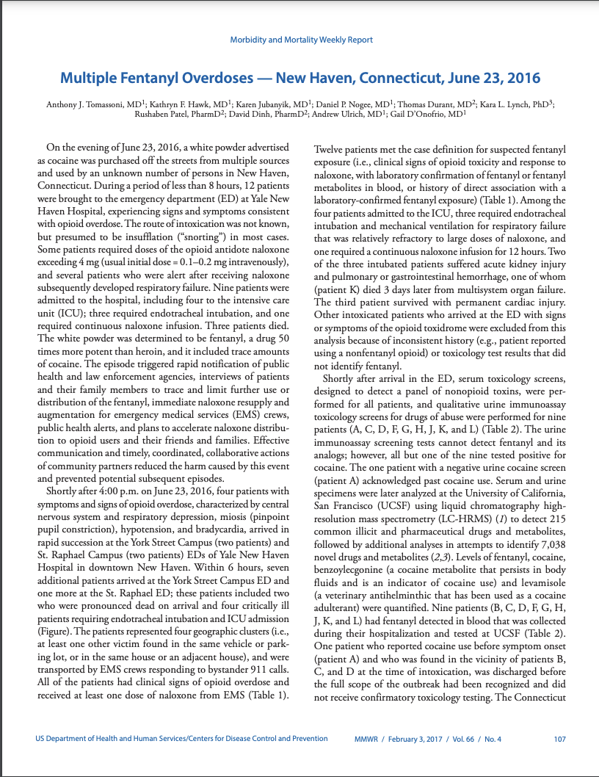
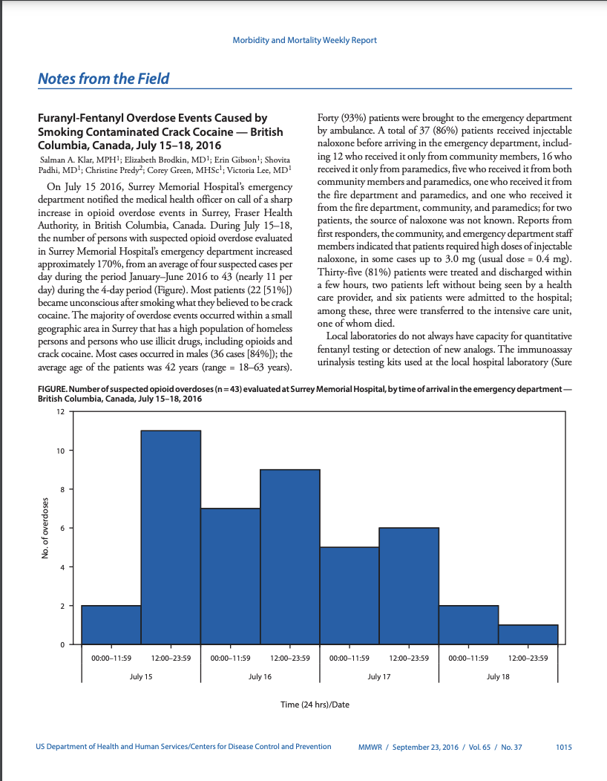
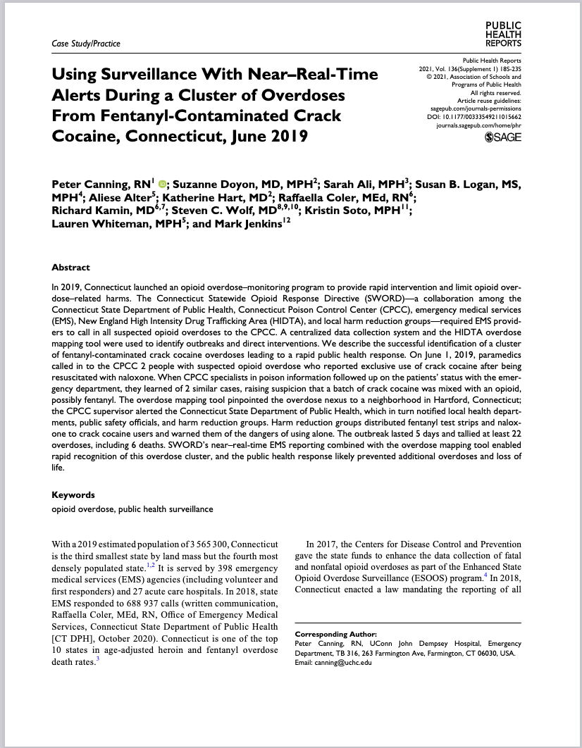
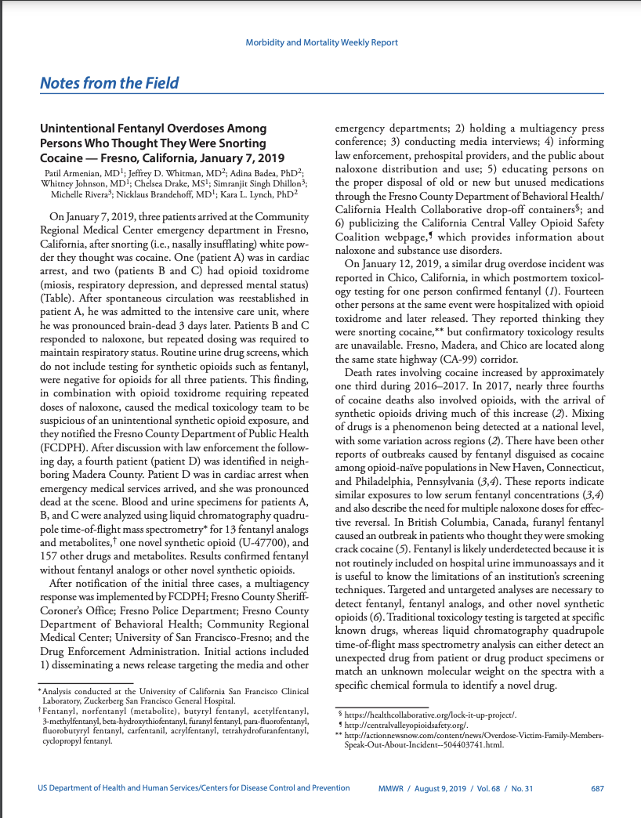
An increasing, but unknown, number of people who do not have opioid use disorder are overdosing due to fentanyl contamination of cocaine, methamphetamine, and counterfeit prescription pills
People without opioid tolerance unwittingly exposed to fentanyl via non-opioids
  Innovate to focus on engaging people who use stimulants and counterfeit non-opioid prescription pills
Notes:
Klar SA, Brodkin E, Gibson E, Padhi S, Predy C, Green C, Lee V. Notes from the Field: Furanyl-Fentanyl Overdose Events Caused by Smoking Contaminated Crack Cocaine - British Columbia, Canada, July 15-18, 2016. MMWR Morb Mortal Wkly Rep. 2016 Sep 23;65(37):1015-1016.
Tomassoni AJ, Hawk KF, Jubanyik K, Nogee DP, Durant T, Lynch KL, Patel R, Dinh D, Ulrich A, D'Onofrio G. Multiple Fentanyl Overdoses - New Haven, Connecticut, June 23, 2016. MMWR Morb Mortal Wkly Rep. 2017 Feb 3;66(4):107-111.
DiSalvo P, Cooper G, Tsao J, Romeo M, Laskowski LK, Chesney G, Su MK. Fentanyl-contaminated cocaine outbreak with laboratory confirmation in New York City in 2019. Am J Emerg Med. 2021 Feb;40:103-105.
Canning P, Doyon S, Ali S, Logan SB, Alter A, Hart K, Coler R, Kamin R, Wolf SC, Soto K, Whiteman L, Jenkins M. Using Surveillance With Near-Real-Time Alerts During a Cluster of Overdoses From Fentanyl-Contaminated Crack Cocaine, Connecticut, June 2019. Public Health Rep. 2021 Nov-Dec;136(1_suppl):18S-23S.
Armenian P, Whitman JD, Badea A, Johnson W, Drake C, Dhillon SS, Rivera M, Brandehoff N, Lynch KL. Notes from the Field: Unintentional Fentanyl Overdoses Among Persons Who Thought They Were Snorting Cocaine - Fresno, California, January 7, 2019. MMWR Morb Mortal Wkly Rep. 2019 Aug 9;68(31):687-688.
Palamar JJ, Ciccarone D, Rutherford C, Keyes KM, Carr TH, Cottler LB. Trends in seizures of powders and pills containing illicit fentanyl in the United States, 2018 through 2021. Drug Alcohol Depend. 2022 May 1;234:109398.

Slide 45
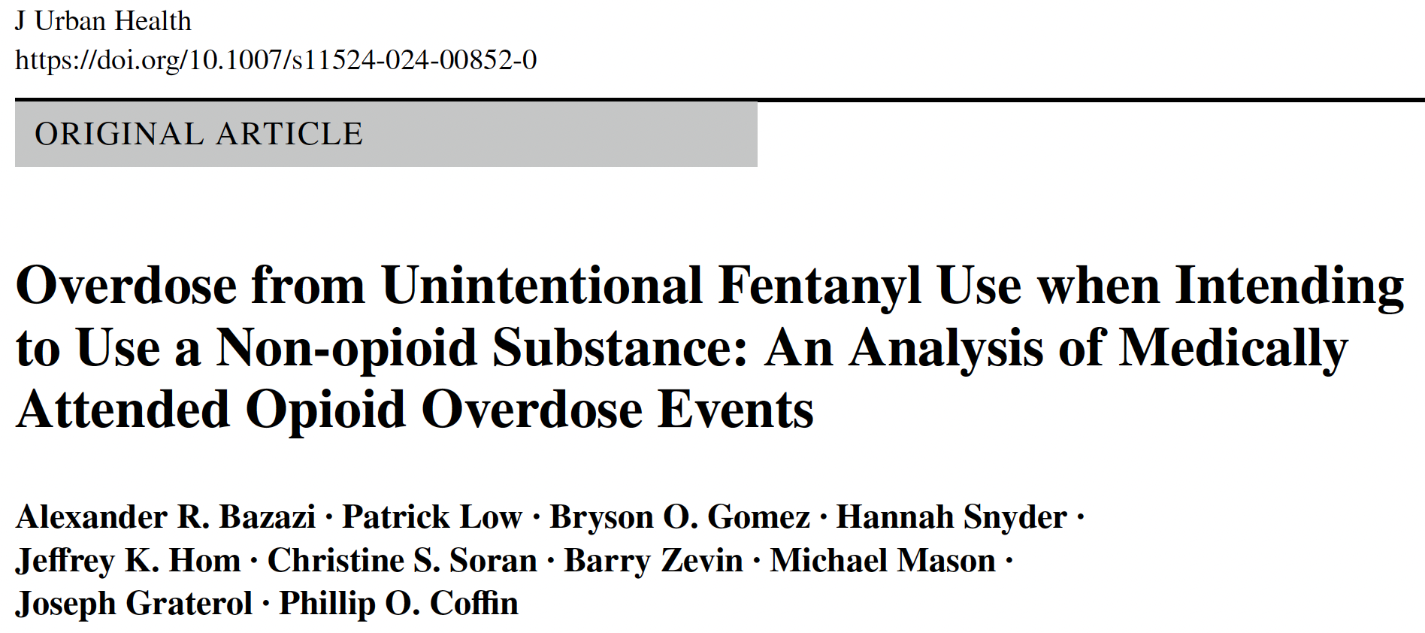
An increasing, but unknown, number of people who do not have opioid use disorder are overdosing due to fentanyl contamination of cocaine, methamphetamine, and counterfeit prescription pills
People without opioid tolerance unwittingly exposed to fentanyl via non-opioids
  Innovate to focus on engaging people who use stimulants and counterfeit non-opioid prescription pills
Among 448 opioid overdose survivors in SF 6/2022-9/2022
57% intended to use opioids
43% intended to use methamphetamine or cocaine
  58% of Black and 52% of Latinx survivors
  29% of White Survivors
Notes:
Bazazi AR, Low P, Gomez BO, Snyder H, Hom JK, Soran CS, Zevin B, Mason M, Graterol J, Coffin PO. Overdose from Unintentional Fentanyl Use when Intending to Use a Non-opioid Substance: An Analysis of Medically Attended Opioid Overdose Events. J Urban Health. 2024 Apr;101(2):245-251. doi: 10.1007/s11524-024-00852-0. Epub 2024 Apr 3. PMID: 38568466.
Klar SA, Brodkin E, Gibson E, Padhi S, Predy C, Green C, Lee V. Notes from the Field: Furanyl-Fentanyl Overdose Events Caused by Smoking Contaminated Crack Cocaine - British Columbia, Canada, July 15-18, 2016. MMWR Morb Mortal Wkly Rep. 2016 Sep 23;65(37):1015-1016.
Tomassoni AJ, Hawk KF, Jubanyik K, Nogee DP, Durant T, Lynch KL, Patel R, Dinh D, Ulrich A, D'Onofrio G. Multiple Fentanyl Overdoses - New Haven, Connecticut, June 23, 2016. MMWR Morb Mortal Wkly Rep. 2017 Feb 3;66(4):107-111.
DiSalvo P, Cooper G, Tsao J, Romeo M, Laskowski LK, Chesney G, Su MK. Fentanyl-contaminated cocaine outbreak with laboratory confirmation in New York City in 2019. Am J Emerg Med. 2021 Feb;40:103-105.
Canning P, Doyon S, Ali S, Logan SB, Alter A, Hart K, Coler R, Kamin R, Wolf SC, Soto K, Whiteman L, Jenkins M. Using Surveillance With Near-Real-Time Alerts During a Cluster of Overdoses From Fentanyl-Contaminated Crack Cocaine, Connecticut, June 2019. Public Health Rep. 2021 Nov-Dec;136(1_suppl):18S-23S.
Armenian P, Whitman JD, Badea A, Johnson W, Drake C, Dhillon SS, Rivera M, Brandehoff N, Lynch KL. Notes from the Field: Unintentional Fentanyl Overdoses Among Persons Who Thought They Were Snorting Cocaine - Fresno, California, January 7, 2019. MMWR Morb Mortal Wkly Rep. 2019 Aug 9;68(31):687-688.
Palamar JJ, Ciccarone D, Rutherford C, Keyes KM, Carr TH, Cottler LB. Trends in seizures of powders and pills containing illicit fentanyl in the United States, 2018 through 2021. Drug Alcohol Depend. 2022 May 1;234:109398.

Slide 46
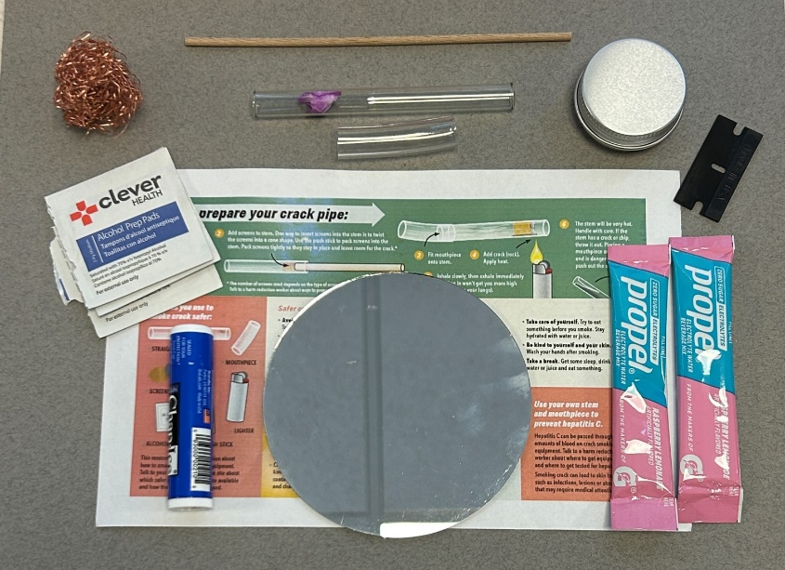
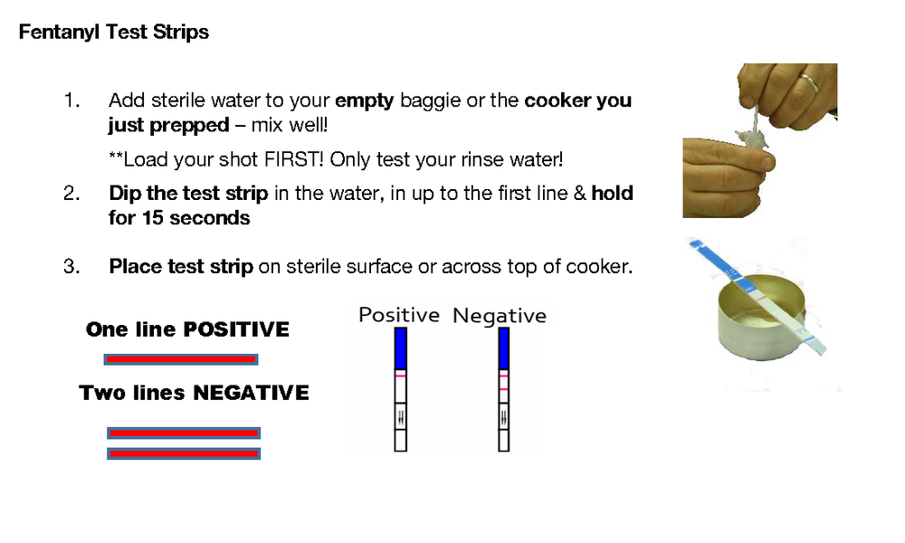
Overdose Prevention
Patient education on contaminated drug supply
Distributing fentanyl test strips
Naloxone education and on site distribution
Safer supply distribution (booty bumping kits, safer smoking kits for meth/cocaine, safer injection equipment)
For people with opioid overdose or repeatedly testing positive for fentanyl, consider MOUD
Notes:
Naloxone is just as a important as in people whose primary substance use is w/opiates. We talk about not using alone if possible, even if someone else in the house who may not be using but who knows they are and can check on them periodically. One tool people can use is fentanyl strips - here on the right, which test the drug supply for the presence of fentanyl. We tell folks to use with caution bc these strips don’t tell us how much fentanyl is in the drug and don’t necessarily detect all the potential analogs of fentanyl, like the more potent carfentanil.

Slide 47
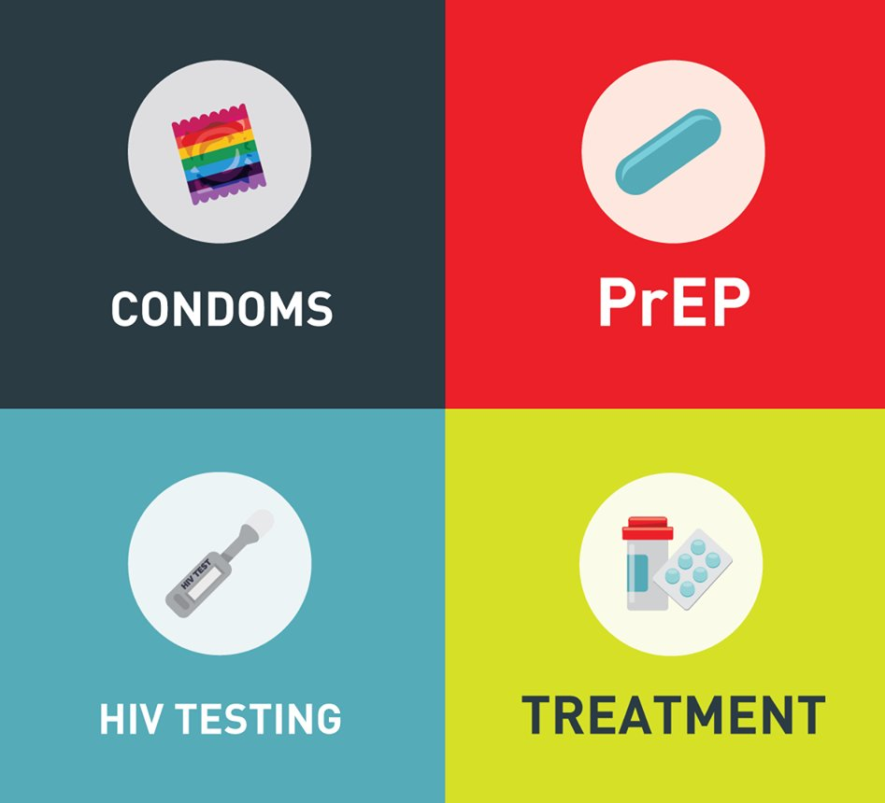
STI and Infectious Disease Screening & Treatment
Screening for STIs and infectious diseases, including HIV, HBV, HCV at frequency based on risk or on a schedule for at risk patients.
  Increased risk for HIV with rectal stimulant use associated with sex (chemsex), though less risk than IVDU
Screening for TB
Screening for syphilis
Screening for GC/CT at *all* sites of contact (throat, genital,
rectal)
Safer sex supplies (condoms, lube, booty bumping kits)
Education/Rx for nPEP and PrEP with low threshold for initiation
  Consider injectable cabotegravir (apretude) if available
Immunize for HAV, HBV, Mpox, HPV, Tdap, influenza, COVID
Notes:
In terms of disease prevention - as a provider, it’s important to screen for STIs and other infectious diseases at a frequency based on risk exposure.
We see high rates of rectal stimulant use with chemsex. We see this particularly in MSM who use methamphetamine - so using/receiving meth rectally, then having receptive anal sex. This route of use is associated with increased risk for HIV transmission. Making sure people are talking with partners about their HIV status. It is absolutely essential for us as providers to learn about and feel comfortable prescribing PrEP (pre-) and PEP (post-). And then of course making sure relevant immunizations are up to date.
Screening questions for chemsex:
Have you used drugs before/during sex in the last 6 months?
If yes, what do you use and how?
How frequently do you use them?
When was the last time you used drugs or alcohol to make sex more enjoyable?
What kind of drugs did you use?
When was the last time that you had sober sex?

Slide 48
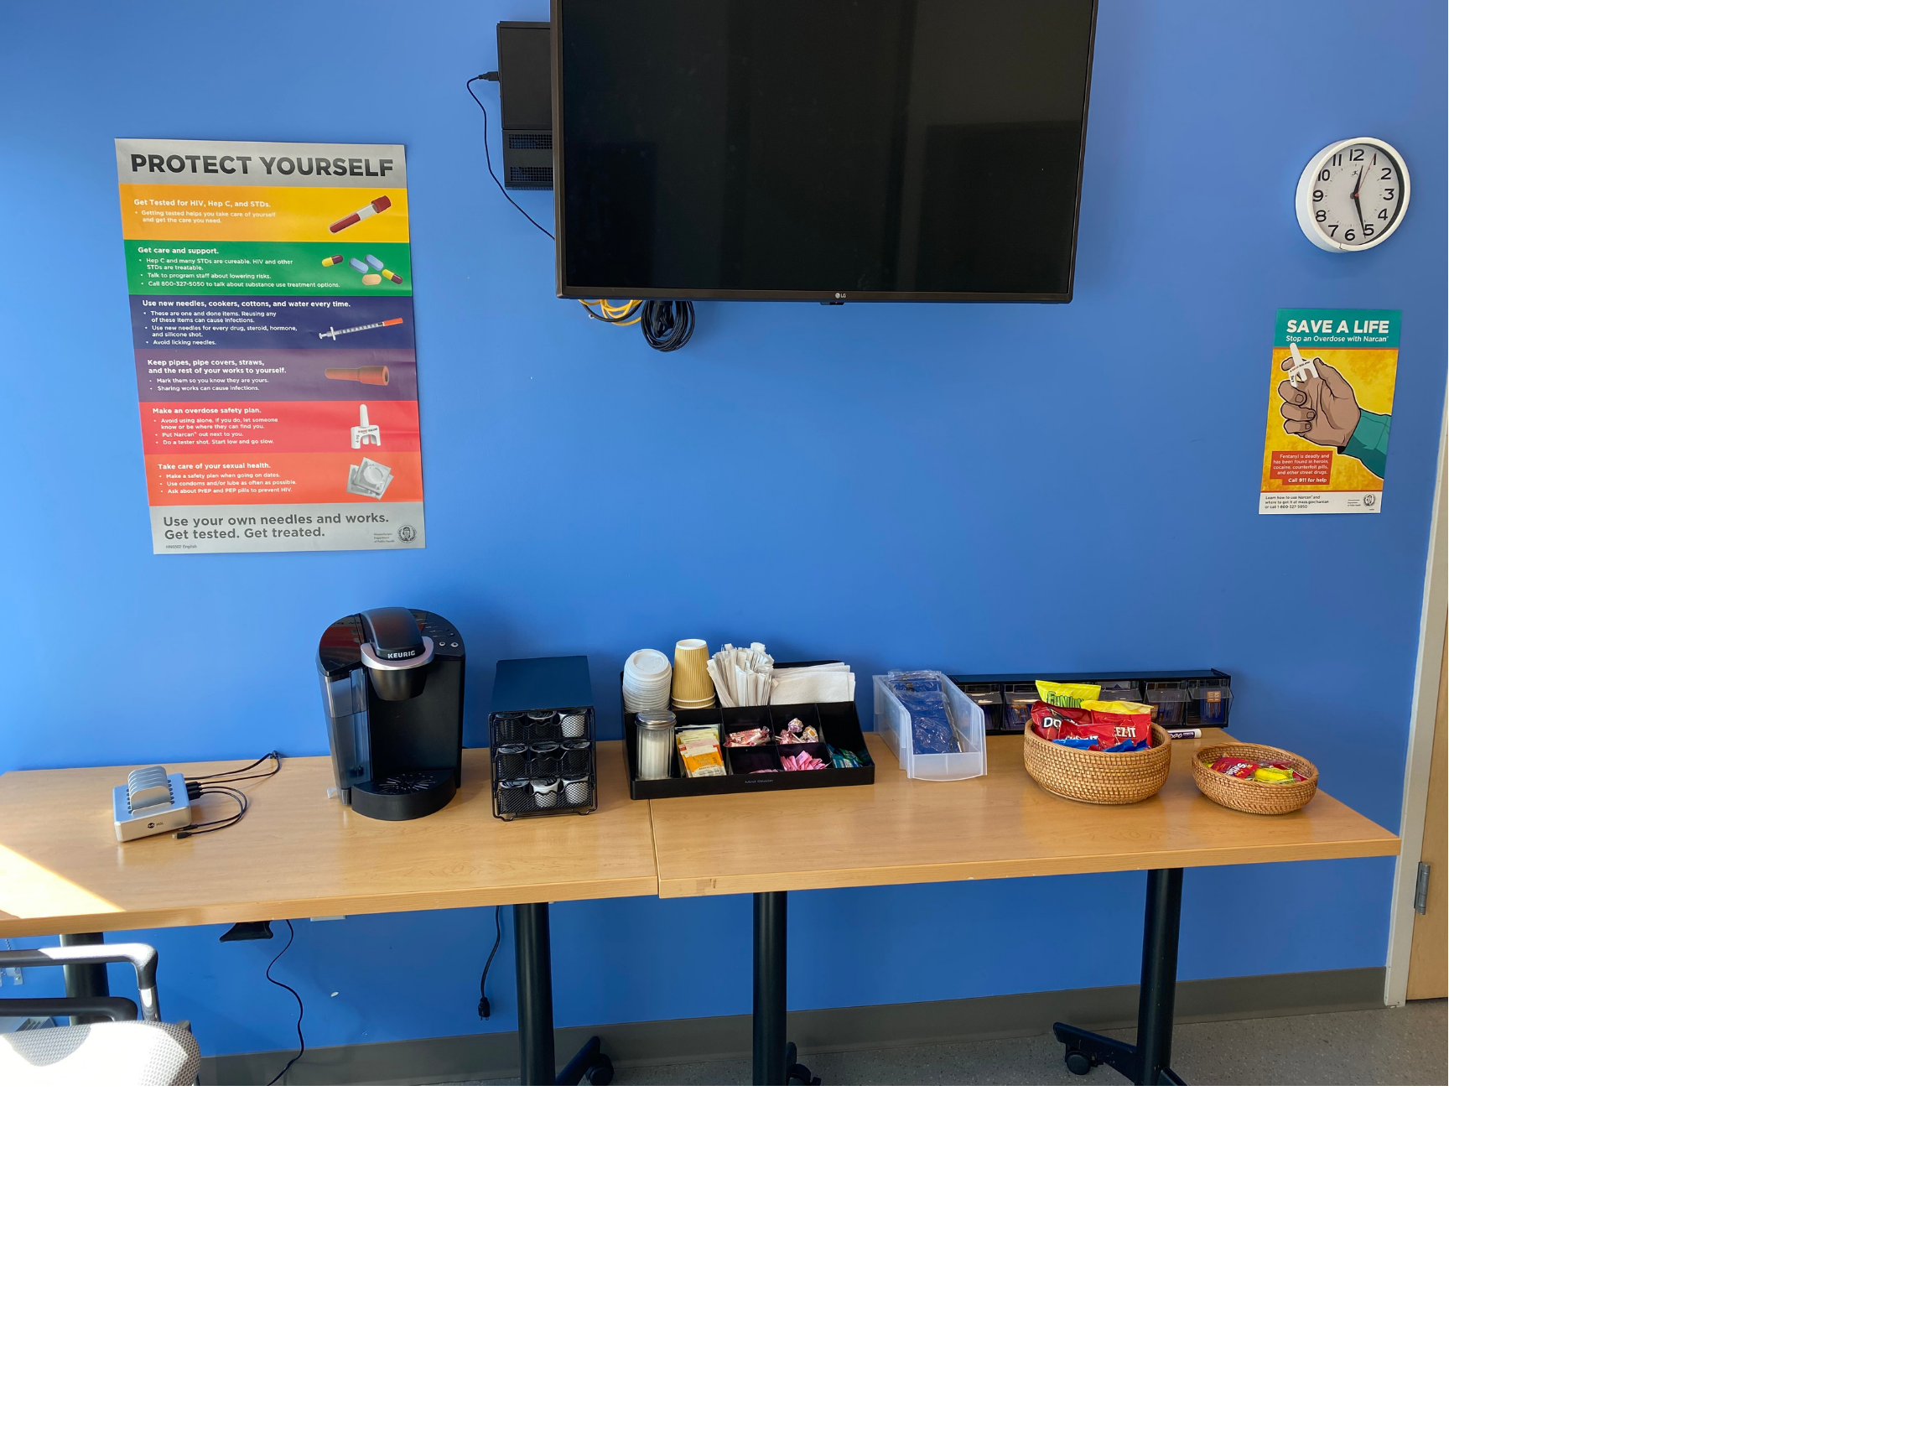
Self Care Planning
Discuss plan for binge use:
  Eat, stay hydrated, and have appropriate supplies including first aid kit and condoms/lubricant
Wash your hands
Take breaks if possible
Identify safe space to crash/sleep
Agitation, depression and anxiety are common post stimulant use
  connect patient with a BH provider or local services
Phone charging station
Safer sex supplies
Coffee + tea
Naloxone pouches
Snacks
Notes:
As far as stimulant specific self care, we know that stimulant use often occurs in binges. So talking with patients about planning ahead for their use is important.

Slide 49
Learning Objectives
At the end of this session, participants will be able to:
Understand how and why people use stimulants
Describe the characteristics of stimulant intoxication and withdrawal syndromes
Identify the medical complications of using stimulants
Treat stimulant use disorders and manage overamping
Notes:
Our objectives today are to
Understand how and why people use stimulants (focusing on cocaine and methamphetamine
And we’ll talk through the medical complications of stimulant use, current treatment options for stim use disorders and we’ll close by discussing stimulant intoxication – also known as overamping - and techniques to manage this.

Slide 50
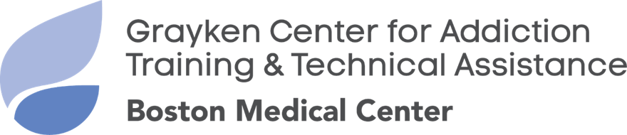
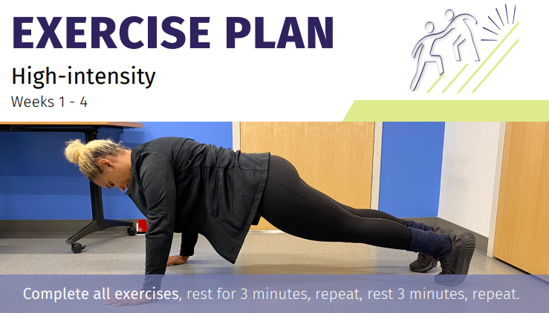
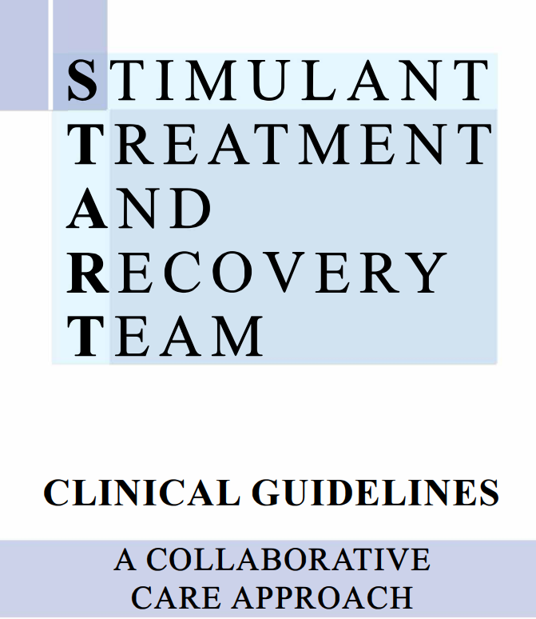
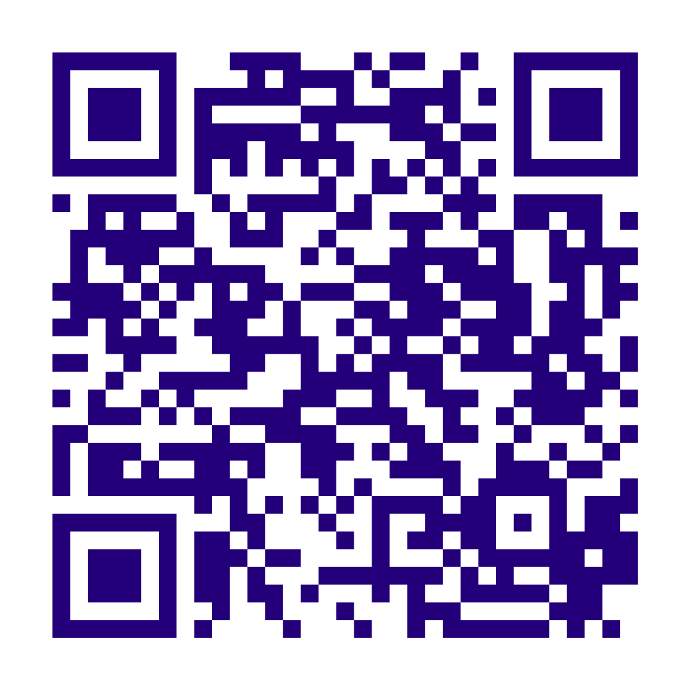

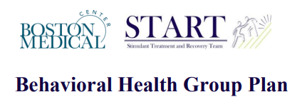
START Resources
Notes:
In the past year, we’ve released our guidelines for outpatient treatment of stimulant use disorder, along with our medical and BH curricula, all of which you can access via this QR code.

Slide 51




Stimulant Trainings
Stimulants 101
Introduction to stimulant treatment in the outpatient setting
1 hour - CME offered
Essentials of Stimulant Use Disorder
Overview of evidence-based interventions for StUD
3 hour - CME offered
Free education with continuing education credits and support funded and supported by:
Register Here
Notes:
If you’re interested in more in depth trainings, which also discuss the literature about medication use for stimulant use disorder, I’d encourage you to take a look at these trainings through the BMC Grayken Center for Addiction TTA.

Slide 52
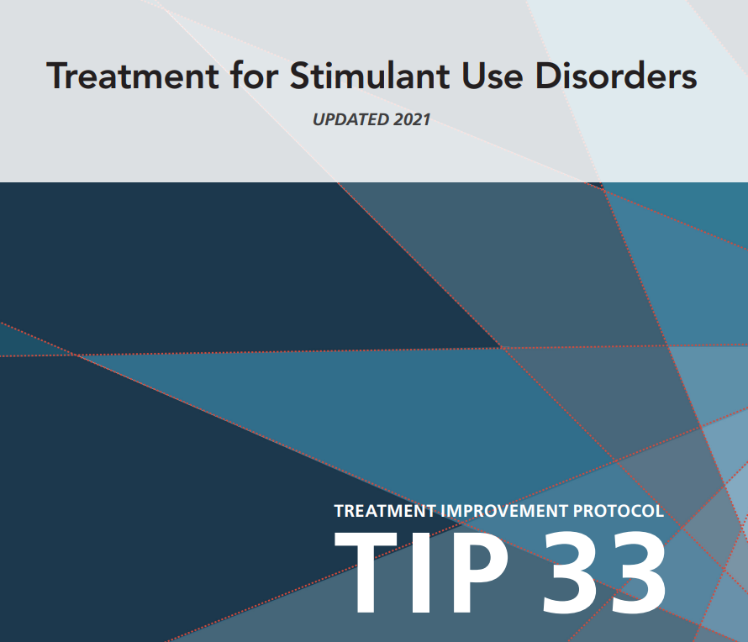
TIP 33
TIP 33-SAMHSA

