Slide 1
Opioid Use Disorder
Immersion Training in Addiction Medicine Programs 2025
April 2025
Hallie Rozansky, MD
Assistant Professor of Medicine

Slide 2
Since 1999, opioid overdose epidemic described in “waves”

Slide 3
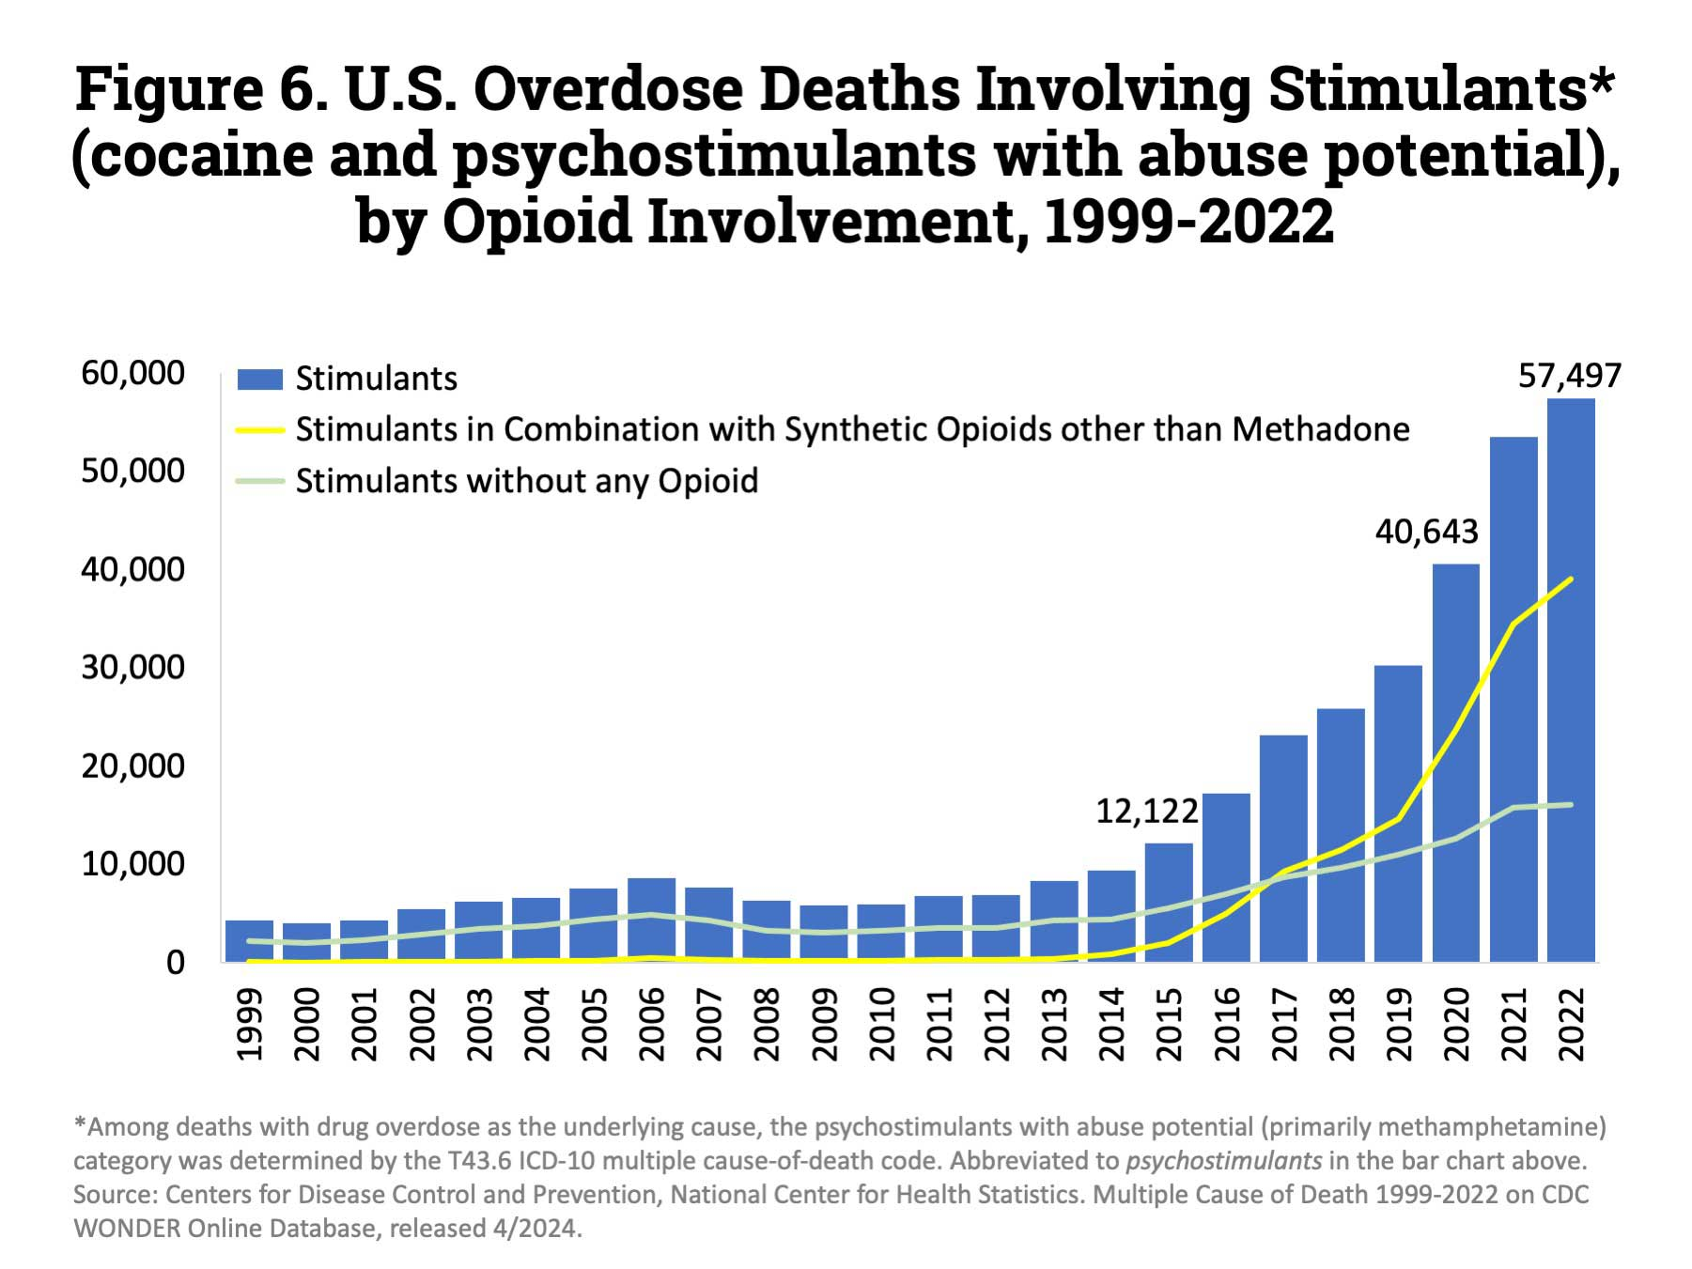
“Fourth wave” – stimulant-involved deaths
National Institute on Drug Abuse August 2024

Slide 4
Street opioid supply is unregulated & evolving
StreetCheck.Org
DEA. October 2023.
Notes:
2
Fent: 30-50x more potent than heroin
Short-acting
Xylazine – cannot be reversed by naloxone & can cause characteristic slow-healing ulcers that can get infected

Slide 5
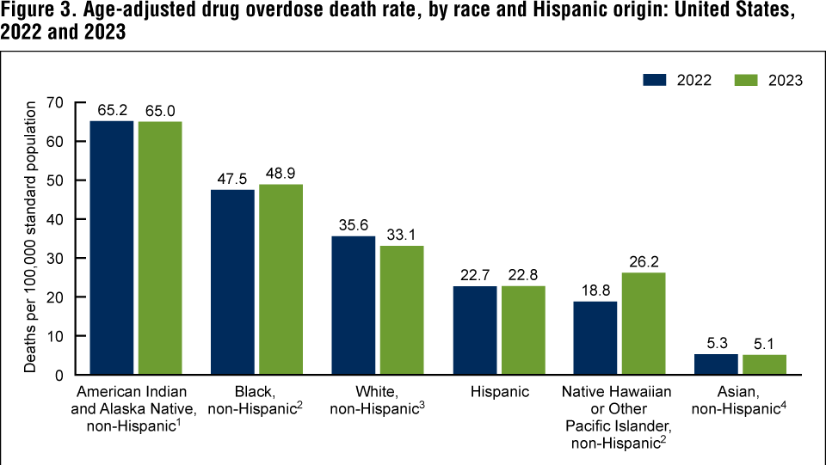
Racial disparities in opioid overdose deaths
White Americans: acceleration 1999 to 2016 with slowing 2016 to 2018
Black Americans: low rate of change 1999-2012 followed by rapid acceleration (intro of street fentanyl)
Opioid crisis response focused on white, middle-class users
Furr-Holden D et al. Addiction. 2020. CDC.gov. 2023.
Notes:
From 2013–2018 average annual precent change significantly higher in Black Americans than White Americans
Results The temporal trends of OOD varied by race. African Americans had a persistently low rate of OOD and statistically non‐significant rate of change in OOD from 1999 to 2012 (APC = 0.47; P > 0.05), with a statistically significant and rapid acceleration in OOD rates in 2012 that persisted to 2018 (APC = 26.16; P < 0.01). Whites had three statistically significant periods of acceleration in OOD rate from 1999 to 2006 (APC = 12.43; P < 0.01), 2006 to 2013 (APC = 4.34, P < 0.01) and the greatest increase from 2013 to 2016 (APC = 18.96; P < 0.01). Whites had a statistically non‐significant decrease in OOD from 2016 to 2018 (P = 0.16). The trend for whites more closely aligned with the CDC‐defined epidemic periods than for African Americans. During wave 1 (1999–2010), the average annual percentage change (AAPC) for African Americans was significantly lower than for whites (0.47 versus 9.42, P < 0.01); however, by wave 3 (2013–current; defined by the introduction of illicitly manufactured fentanyl), the AAPC was significantly higher in African Americans (26.16 versus 13.19, P < 0.01).

Slide 6
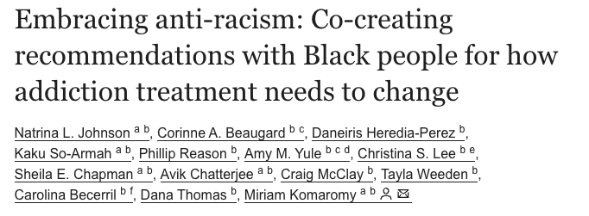
What Can We Do?
Proactively hire Black staff
Educate staff on history of anti-Black racism in healthcare
Invite Black patients to evaluate their care and use feedback to improve care
Alter the physical environment to… reflect the presence / culture of Black people

Slide 7
Case
32-year-old male brought into ED after being found down, endorsed using fentanyl 30 minutes prior
Does not require naloxone
Found to have pneumonia, needs O2 – admitted to the hospital
Chart review shows:
Admitted 3 times / past 6 months for skin & soft tissue infections
Reports daily IV fentanyl use; has been to detox 35 times, never on MOUD
Smokes cigarettes (1 ppd), occasional cocaine/methamphetamine
Unemployed electrician, lives with wife (in recovery); 2 kids live with grandmother

Slide 8
You go to evaluate him
He says he’s in withdrawal (feels “sick”)
He feels awful and doesn’t want to engage
What would you do?
Notes:
2

Slide 9
Inpatient patient/provider experience with OUD & opioid withdrawal is complex
Study on inpatient medical service of a public urban teaching hospital
Qualitative analysis on the interactions with patients with OUD and their medical teams identified 4 common themes
Merrill JO, et al. J Gen Intern Med. 2002

Slide 10
Provider perspective
1. Physician fear of deception
“All of us go through a little bit of a hitch every time we are requested to prescribe narcotics for our patients....Are they trying to get more out of me than they really should have? The last thing I want to do is over-dose them or reinforce this behavior (of) trying to coax more drugs out of you.”
-Senior Medical Resident
Merrill JO, et al. J Gen Intern Med. 2002
Notes:
Physicians question the “legitimacy” of need for opioid analgesics.

Slide 11
Patient perspective
2. No standard approach
“The last time, they took me to the operating room, put me to sleep, gave me pain meds, and I was in and out in two days... This crew was hard! It’s like the Civil War. ‘He’s a trooper, get out the saw’. . .’”
-Patient w/ Multiple Encounters
Merrill JO, et al. J Gen Intern Med. 2002

Slide 12
Patient perspective
3. Avoidance
Patient/Resident Dialogue
Resident: “Good Morning”
Patient: “I’m in terrible pain.”
Resident: “This is Dr. Attending, who will take care of you.”
Patient: “I’m in terrible pain.”
Attending: “We’re going to look at your foot.”
Patient: “I’m in terrible pain.”
Resident: “Did his dressing get changed?”
Patient: “Please don’t hurt me.”
Merrill JO, et al. J Gen Intern Med. 2002

Slide 13
Patient perspective
4. Patient fear of mistreatment
“I mentioned that I would need methadone, and I heard one of them chuckle... in a negative, condescending way… you expect problems getting adequate pain management because you have a history of drug abuse. . .He showed me that he was actually in the opposite corner, across the ring from me.”
-Patient
Merrill JO, et al. J Gen Intern Med. 2002

Slide 14
Goals of OUD Treatment in the Inpatient Setting
Make it a safe(r) space
Prevent/treat acute opioid withdrawal
Diagnose and treat medical illness (Jo Y, et al. Addiction. 2021)
Don’t expect to cure OUD
Withholding opioids will not improve patient’s OUD
Administering opioids will not worsen patient’s OUD
Initiate outpatient addiction treatment referral
Notes:
6
Inadequate treatment may prevent full treatment of medical/surgical condition

Slide 15
Natural history of opioid use disorder
Opioid agonist treatment
Euphoria
Tolerance
Normal
Withdrawal
Physical Dependence
Initial use
Chronic use
Alford DP. http://www.bumc.bu.edu/care/

Slide 16
Inpatient treatment of opioid withdrawal
Opioid agonists + “comfort medications”
Can use any full agonist
Methadone
Morphine
Oxycodone, etc…
Be careful with partial agonist (ie buprenorphine) due to buprenorphine-precipitated opioid withdrawal (POW or B-POW)
Comfort medications
Clonidine (anxiety, restlessness)
Hydroxyzine (anxiety)
Ibuprofen, acetaminophen (muscle aches)
Ondansetron (nausea)
Loperamide (diarrhea)
Notes:
9
Only use bup in folks who have definitively NOT used fentanyl or who know that they do not get BPOW

Slide 17
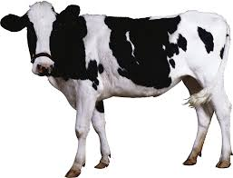
What is (B-)POW?
Buprenorphine binds TIGHTLY to the mu opioid receptor → displaces other opioids
Illicitly-manufactured fentanyl sticks around much longer than effects are felt
>>>
Notes:
9

Slide 18
Case
Just used fentanyl – worried about POW
He wants to start methadone for management of acute opioid withdrawal
Ambivalent about longterm MOUD, finally says he’ll try it
You check contraindications – no liver disease, normal QTc
How do you start?
Notes:
9

Slide 19
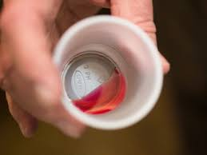
Methadone
Full opioid agonist
PO onset 30-60 minutes; peaks 2-4 hours; steady state 3-5 days
Lasts >24 hours for OUD
OUD dosing:
Up to 50 mg on day 1 for acute withdrawal
> 80 mg for cravings, higher for “blockade”
Higher doses in fentanyl era
Remember: you can always give more methadone, you can’t take it away!
Notes:
24-36 hours for OUD

Slide 20
Case
You give him 30 mg of methadone x1
3 hours later, he is still uncomfortable and alert
You give another 20 mg of methadone x1
He starts feeling better
You uptitrate methadone 10 mg daily x3 days, then hold at 80 mg
The next day, he leaves the hospital as a patient-directed discharge and does not present to the methadone clinic
Notes:
9
Note – if he were older, sicker, etc. would go MORE SLOWY!!!

Slide 21
Two months later, he walks into your bridge clinic
“Sick and tired of being sick and tired”
Thinking about detox vs MOUD, hesitant as this would be the first time on MOUD
Notes:
11

Slide 22
Does “Detox” Work? (Not exactly…)
Low rates of retention in treatment
High rates of relapse post-treatment
< 50% abstinent at 6 months
< 15% abstinent at 12 months
Increased rates of overdose due to decreased tolerance
O’Connor PG JAMA 2005; Mattick RP, Hall WD. Lancet 1996; Stimmel B et al. JAMA 1977

Slide 23
What About MOUD? (Yes!)
Occupies mu opioid receptor:
Suppresses withdrawal
Alleviates craving
Normalizes brain changes
Options
Opioid Agonist Therapy (OAT)
Methadone (full agonist)
Buprenorphine (partial agonist)
Naltrexone (full antagonist)
Euphoria
Normal
OAT
Withdrawal
Initial use
Chronic use:
Tolerance & Physical Dependence
Alford DP. http://www.bumc.bu.edu/care/

Slide 24
Too Few People Receive MOUD
Retrospective cohort of overdose survivors in MA (N=17,568)
In 12 months after overdose only 17% received buprenorphine, 11% received methadone, 6% received naltrexone
Buprenorphine or methadone was associated with a two-thirds reduction in death (all-cause and opioid-related mortality)
Delay between OUD onset and MOUD receipt 4-7 years
Larochelle MR , et al. Ann Intern Med. 2018
National Academies of Sciences, Engineering, and Medicine. 2019. The National Academies Press.

Slide 25
Where Best to Start MOUD? Anywhere.
Buprenorphine initiation via telemed started during COVID pandemic à continued
Primary care: multiple models
Low-barrier “Bridge Clinics”
Acute care settings – ED, inpatient – can be “reachable moments”
MOUD inpatient (even in patients not seeking addiction treatment) → more engagement with addiction care and less self-reported opioid use
Reduced LOS, readmissions, and self-directed discharges
D'Onofrio et al. JAMA 2015. Herring et al. JAMA Network Open 2024. O'Rourke et al. Drug Alc Depend 2022. Martin and Krawczyk. JAMA Network Open 2024.
Notes:
Significantly more individuals received OUD-related telehealth services (20% vs 0.6%) and MOUD (13% vs 11%) during the pandemic
Receipt of OUD-related telehealth services is associated with increased odds of MOUD retention, imrpoved treatment access, reduced barriers to care
33% lower odds of overdose in one study of COVID-era telehealth
Majority of patients would feel comfortable receiving MOUD via primary care (De Pozo et al 2024)
Millions of people have OUD in the US and only several thousand doctors are addiction specialists
Pharmacotherapy
Provider education
Psychosocial support
Low barrier, transitional SUD care settings that offer urgent care (typically same or next day) appointments
Often accommodate walk-ins
Multiple models – outpatient hospital-based, emergency department-based, virtual
Typically offer MOUD as well as harm reduction services
More recently some have leveraged 72-hour rule to provide short-term methadone while connecting to OTP
Patients enjoy flexibility of appointments and dedicated nonjudgmental setting
Studies have shown increased linkage to longer-term care though data currently limited

Slide 26
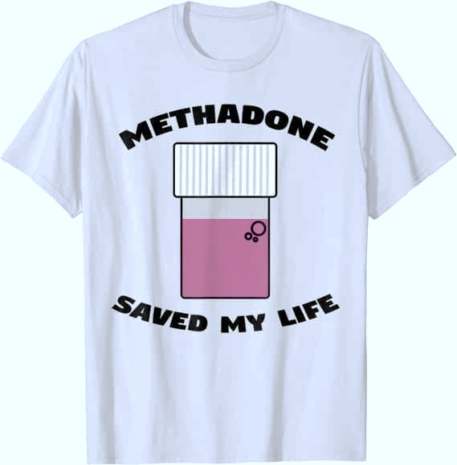
Methadone Effectiveness
JAMA 1965
Increases treatment retention
Decreases illicit opioid use
Decreases hepatitis and HIV seroconversion
Decreases mortality
Increases employment
Improves birth outcomes

Slide 27
Methadone Limitations
Only available via federally licensed opioid treatment programs (OTPs)
Limited access
Limited take-homes
Inconvenient & highly punitive
Lack of privacy
Stigma
Buresh et al. 2022. J Subst Abuse Treatment. https://doi.org/10.1016/j.jsat.2022.108832.
Volkow 2021. World Psychiatry.

Slide 28
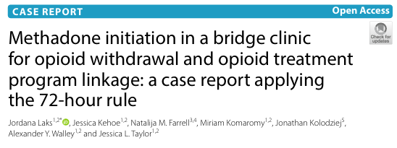
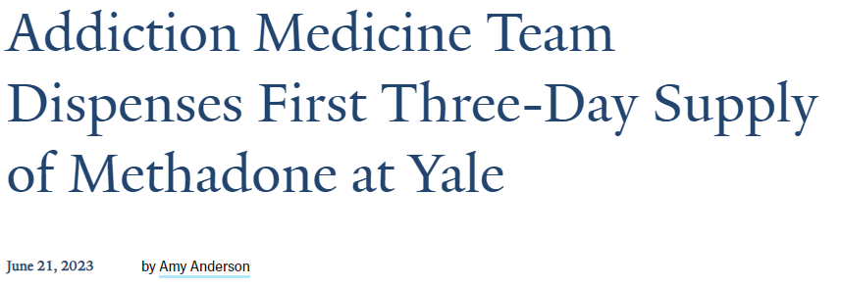
72-Hour Rule and Methadone
“72-hour rule” (21 CFR 1306.07(b)) allows non-OTP facilities to administer opioids for emergency withdrawal management for ≤ 72 hours
Emergency departments utilize this
Non-emergency department settings can too
Clinics could consider this as a “bridge” to local OTPs
Code of Federal Regulations. 21 CFR 1306.07(b). Laks et al. Addiction Science and Clinical Practice 2021. Taylor et al. Drug and Alcohol Dep 2022. Yale SOM 2023.
Notes:
Updated in 2022 – can dispense in addition to directly administering

Slide 29
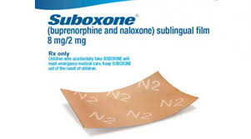
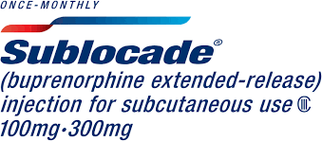
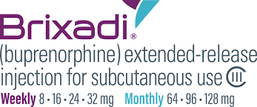
Buprenorphine Effectiveness
Ceiling effect on CNS & respiratory depression
Kappa-opioid antagonist: antidepressant / anxiolytic effects
RCTs show buprenorphine (16-24 mg) equally effective as moderate doses (80 mg) methadone for:
Retention in treatment
Abstinence from illicit opioid use
Decreased opioid craving
Decreased mortality
Improved occupational stability
Improved psychosocial outcomes
Sordo L et al. BMJ 2017; Mattick RP et al. Conchrane Syst Rev 2014; Parran TV et al. Drug Alcohol Depend 2010; Johnson et al. NEJM 2000; Fudala PJ et al. NEJM 2003; Kakko J et al. Lancet 2003
Notes:
Formulations:
Sublingual tab or film (+/- naloxone)
Weekly & monthly SQ injections (administered by healthcare provider)
FDA approved 2002 as schedule III – up to 5 refills

Slide 30
Buprenorphine Limitations
Access limited (but improving)
Waiver no longer required, no patient limits
Less structured than methadone
Not a full agonist – may not be sufficient for some patients
Can cause precipitated withdrawal if given “too early” after use of a full opioid agonist

Slide 31
Starting Buprenorphine: Traditional Induction
For patients using non-fentanyl opioids
Many "oxycodone" pills are “pressed” – if not sure, confirm with toxicology
For induction:
Wait at least 6-12 hours after last use of opioids AND until COWS (Clinical Opioid Withdrawal Score) is >12
Take 2-4 mg buprenorphine, repeat every ~2 hours until symptoms resolved
SAMHSA. Buprenorphine Quick Start Guide.

Slide 32
Starting Buprenorphine: Low-Dose Induction
In patients using illicitly manufactured fentanyl, to avoid POW, consider “low-dose induction”
Increasing doses of buprenorphine overlapping with full agonist opioid (decreasing or stable)
Multiple approaches; one example here
Day | Total daily buprenorphine dose | Buprenorphine-naloxone film strength | Instructions | Full opioid agonist
1 | 0.5 mg | 2-0.5 mg films | Take 0.25 mg (1/8 film) twice daily | Continue
2 | 1 mg |  | Take 0.5mg (1/4 film) twice daily | Continue
3 | 2 mg |  | Take 1 mg (1/2 film) twice daily | Continue
4 | 4 mg |  | Take 2 mg (1 film) twice daily | Continue
5 | 8 mg | 8-2 mg films | Take 4 mg (1/2 film) twice daily | Continue
6 | 16 mg |  | Take 8 mg (1 film) twice daily | none
Spreen et al. Pharmacotherapy 2022. Hammig et al. Subst Abuse Rehab 20616. Randhawa et al. CMAJ 2020. Brar et al. Drug Alcohol Rev 2021. Shalapour et al. JAM 2024.
Notes:
Concept of macroinducion

Slide 33
Long-Acting Buprenorphine Formulations
SQ formulations: brand names Brixadi® (weekly and monthly) and Sublocade® (monthly)
Sublocade® approved 2017
Brixadi® approved 2023
Sublocade® may be easier to get approved; leaves a residual pellet
Brixadi® does not leave a residual pellet, wider dosing range
Sublocade.com. Brixadi.com.

Slide 34
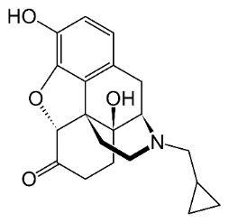
Naltrexone Pros and Cons
Opioid antagonist (must be opioid-free 7-10 days)
Daily PO naltrexone
Well-tolerated, safe, lasts 24-48 hours
Poor retention unless mandated
Monthly IM naltrexone
In-office, administered by provider
Increased abstinence (90% vs 35%
Poor retention (40% at 3 months, <10% at 6 months)
Risk: loss of tolerance to opioids
Minozzi S et al. 2011; Krupitsy E, et al. Lancet, 2011; Cousins SJ et al. J Sub Abuse Treat 2016
Notes:
Only patients with physical dependence need to be opioid free 7-10d
Naltrexone PO – no statistically significant effect compared to PBO due to poor retention

Slide 35
Nonpharmacologic Treatment For OUD
Behavioral therapies alone: limited efficacy, less than MOUD alone
Psychosocial treatments help most often when combined with MOUD
Buresh M et al. BMJ. 2021

Slide 36
Your patient decides to start buprenorphine.
Does not want to go to a daily OTP
He does not think he can abstain from fentanyl long enough for traditional induction
Agree on low-dose induction – he will use fentanyl to manage withdrawal symptoms for first few days
Ultimately reaches dose of 8 mg TID and feels much better
He returns 6 months later and tells you that he has had a relapse
Notes:
11

Slide 37
Managing a Patient Who Relapses
Increase support:
Comorbid psychiatric disease
Behavioral therapies, peer support
Brainstorm triggers (Hungry, Angry, Lonely, Tired, or Bored)
Adjust medications
Review adherence, drug-drug interactions, consider dose change
Motivational interviewing - work together to develop next steps
Whole Health Library. VA.gov 2022. Guenzel and McChargue. StatPearls 2023.
Notes:
Lapse is brief resumption, relapse is return to uncontrolled / continued use

Slide 38
Barriers to Starting and Continuing MOUD
Stigma; perpetuated by some mutual support organizations
Inadequate education of health professionals
Distance from treatment center
Lack of insurance
Non-voluntary treatment engagement
Homelessness
Concomitant stimulant use
National Academies of Sciences, Engineering, and Medicine. 2019. The National Academies Press.; Villamil et al 2024. ; Stafford et al 2022.; Krawczyk et al 2022.
Notes:
14,358 initiated MOUD
85% SL buprenorphine
8% XR naltrexone
6% methadone
1% XR buprenorphine
Treatment discontinuation rates (3m)
34% SL buprenorphine
50% XR buprenorphine
58% methadone
65% XR naltrexone
Morgan JR, et al. Drug Alcohol Depend. 2021

Slide 39
Case continued
Following his relapse, your patient and you discuss next steps
He decides to start SL buprenorphine again and then transition to SQ buprenorphine
Also decides to try out AA and sign up for a peer recovery coach
He sees you in primary care as a new patient the following month for his second shot and is doing well ☺
Notes:
11

Slide 40
Thank you!

