Slide 1
Tobacco Use Disorder
Amy Fitzpatrick, MD, MS
Boston Medical Center
Assistant Professor of Medicine
Boston University School of Medicine

Slide 2
Learning Objectives
At the end of the session, learners will be able to:
Review the epidemiology of Tobacco Use Disorder (TUD)
Review the neurobiology of nicotine (briefly)
Review current treatment, both pharmacologic and behavioral for TUD, including potential future medications
Notes:
Review the epidemiology of TUD.
Review the neurobiology of nicotine.
Review current treatment, both pharmacologic and behavioral treatment options for TUD, including potential future medications

Slide 3
Tobacco Use Disorder
Tobacco product use remains the leading cause of preventable disease and death in the United States.
In 2022, 49.2 million (19.8%)—or nearly 1 in 5—U.S. adults reported current tobacco product use.
Combustible tobacco products are the most common forms of tobacco used
1) cigarettes most common
2) e-cigarettes or vapes second most common
Cigarette smoking has declined over past few decades however; e-cigarette use has increased between 2019-2022
Adults, ages 45-64, highest prevalence of cigarette use
Young adults, ages 18-24, highest prevalence of e-cigarette use

Slide 4
Disparities
Cigarette smoking prevalence is highest among following groups:
- Non-Hispanic (NH) American Indian or Alaska Native (AI/AN) adults
- People with disabilities
- People with severe mental health conditions (anxiety, depression, schizophrenia)
Menthol cigarettes more common in Black adults, women, young adults, LGBTQ+, and persons with severe mental distress – believed to be related to aggressive marketing in these populations
Menthol related to initiation of nicotine use
Cigarette smoking decreasing but proportion of menthol users increased
www.aa.org

Slide 5
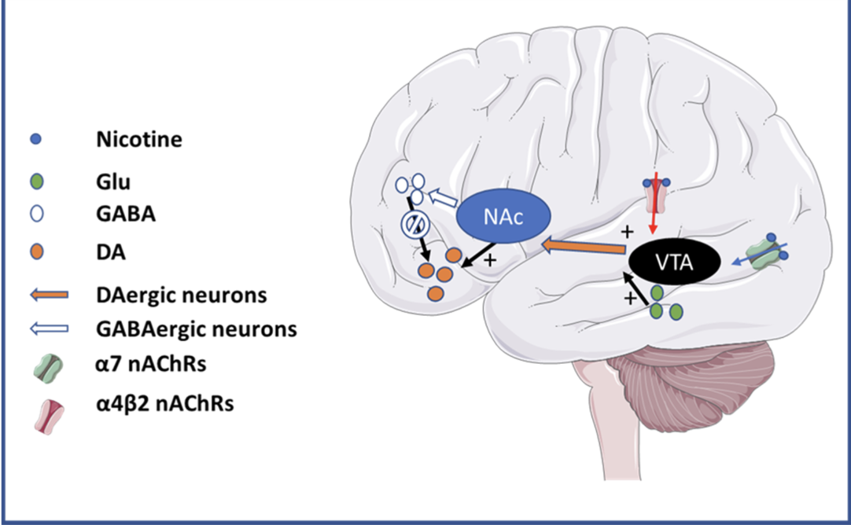
Neurobiology
www.aa.org
Notes:
Figure 1. Schematic diagram showing key nuclei and pathways involved in addiction with strong participation of nAChRs.
Nicotine binding to α7 and α4β2 nAChRs at the ventral tegmental area (VTA) promotes the initiation of addictive behavior by favoring the release of dopamine (DA) in the nucleus accumbens (NAc).
Acetylcholine is endogenous binder to nAChRs
Ventral Tegmental Area VTA
Other neurotramsmitters: norepinephrine, acetylcholine, serotonin, γ-aminobutyric acid (GABA), glutamate, and endorphins

Slide 6
Treatment
Recommendation is always for combination therapy- behavioral paired with medication or NRT or both
Evidence-based behavioral interventions include:
1) individual and group counseling (NicA (Nicotine Anonymous), online support groups, CBT-based groups
2) telephone counseling such as that received through state quitlines (1-800-QUIT-NOW)
3) web- and text-based interventions
4) mobile apps
5) organizational interventions such as smoke-free zones/smoke- free workplace
www.aa.org
Notes:
Higher power- does not have to be god; can be the universe, nature, the fellowship, loved one who has passed away
For atheist, they substitute GOD for Group of Drunks

Slide 7
Pharmacologic: combination of NRT + medication
NRT (Nicotine Replacement Therapy) Five types: patch, gum, lozenge, inhaler, and nasal spray
Varenicline(Chantix)- most effective pharmacologic intervention; black box for cardiovascular adverse events, beware neuropsychiatric
Bupropion SR(Zyban)- less effective than Varenicline; do not use with seizure history; avoid with eating disorders
Potential future medications: cytisine is a naturally occurring plant alkaloid with strong binding affinity for the nAChR, considered first-line therapy in many Eastern European countries
Mecamylamine, a noncompetitive antagonist of nicotinic cholinergic receptors and lobeline, analkaloid and nicotine receptor agonist.
Nicotine vaccines- currently phase 1 and phase 2 clinical trials
Notes:
Nicotine vaccines- produce antibodies that can bind to nicotine to prevent nicotine from acting on receptors,

