Slide 1
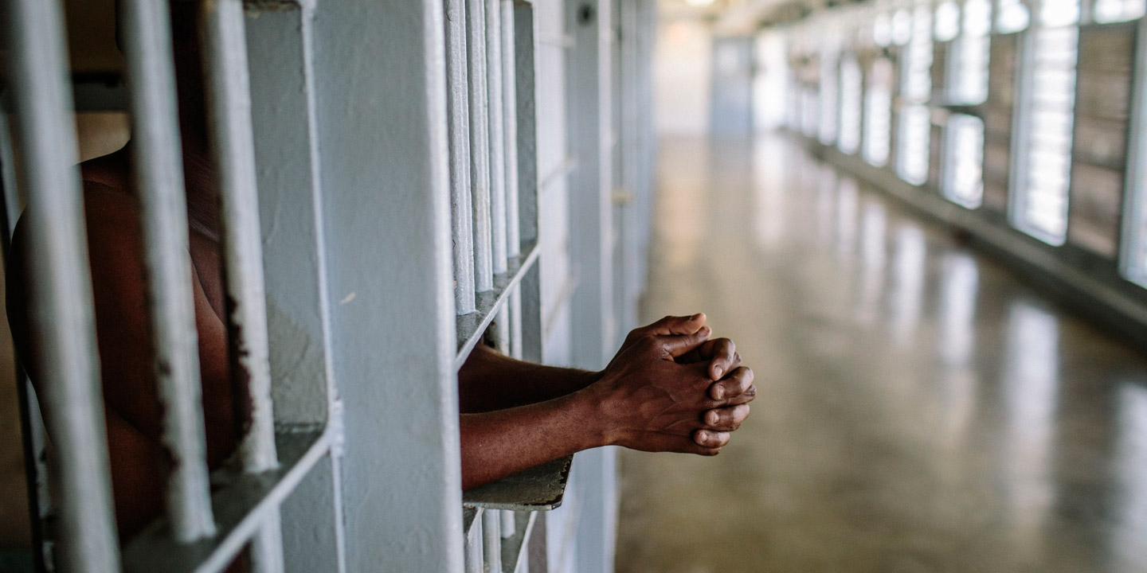
Criminal Justice and Health Impacts in Addiction
Ricardo Cruz, MD, MPH
April 28, 2025

Slide 2
Disclosures
No financial conflicts to disclose

Slide 3
Learning Objectives
Review the correctional system
Review the epidemiology and demographics of mass incarceration.
Recognize health impacts and disparities faced by individuals with addiction and criminal justice involvement.
Discuss clinical efforts to reach this vulnerable population.
Review the drug court model
Notes:
During this presentation:
We are going to talk about the correctional system
Mass incarceration and how it impacts the health of patients we take care of especially those with addiction
Discuss clinical efforts in this area

Slide 4
Case:
Mr. T is a 36-year-old man with a history of opioid use disorder (OUD), multiple prior overdoses, and co-occurring PTSD.
He was arrested for drug possession and brought to jail, despite asking for treatment.
He is currently on parole for prior drug possession conviction and this current arrest violates parole stipulations.
He is re-incarcerated to serve 6 months in the county jail
Notes:
Can I you raise your hands if you taken care of patient with similar experiences.
This is a very common story at Boston Medical Center.
And we are going to follow Mr. T’s experience in the correctional system throughout this talk

Slide 5
Definitions:
Jail:
  short term incarceration facilities
  overseen by local law enforcement agency-county or town.
Prison:
  long term incarceration facilities
  overseen by state and federal correctional authorities
Probation:
  period of supervision in lieu of spending time in a correctional setting
  sentenced to community based supervision-Probation officer
Parole:
  period of supervision after spending time in correctional institution
  conditionally released from prison to serve remaining portion of their sentence in the community-supervised by Parole officer
Notes:
People at times use various terms pertaining to the correctional system interchangeably that I want to define
Jail (house of corrections): short term, under one year for sentenced or people awaiting trial, local town, city, county oversight
Prison-sentenced to greater than one year, State and Federal oversight
Probation vs. Parole-stipulations required

Slide 6
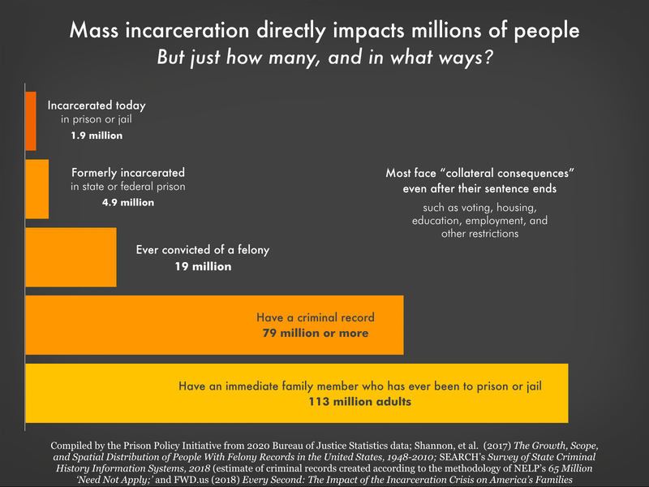
Notes:
In the US we have big issue with Mass incarceration
We make of 4% of total worlds’ population
22% of prison population
1.9 million individuals

Slide 7
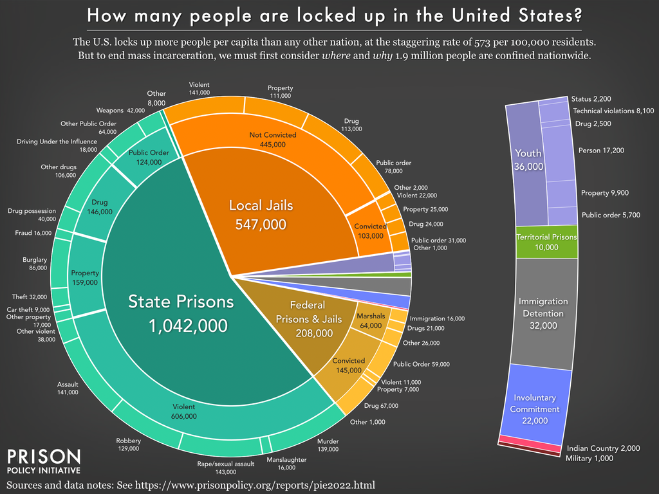
Notes:
People move in and out of the system everyday so very likely to come across a patient with history of criminal justice involvement
650K released from State Prisons on yearly basis
10.6 Million people go in and out of jail each year
The Jail in/out phenomenal is called jail churn
As you can see majority of people in jails have not been convicted and are either awaiting trial or undergoing trial at this time
People can have prolonged stays in correctional settings without being sentenced—and biggest factor for this is monetary bail, lot of folks unable to afford bail
Average bail cost is approx. 10-12,000, which for patients we take care of here confer approx. 8-10 months worth of income, just imagine having to fork up all this money up front to be able to go home to wait for your trial
Also you can see that drug offenses make up a small but significant portion of people being incarcerated approx. 20%

Slide 8
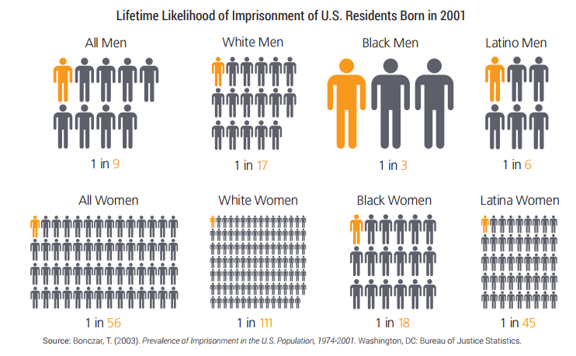
Notes:
This slide highlights the unjust and overall racism that this system promotes
This slide is showing lifetime likelihood imprisonment of US residents born in 2001-
If you are black male 1/3
Latinx male 1/6
same racial/ethnic disparities persist among women

Slide 9
Notes:
Black and White people have to the same rate of substance use at you can see both nearing 10%
However, drug related arrests disproportionately impact Black individuals with a rate 879/100000

Slide 10
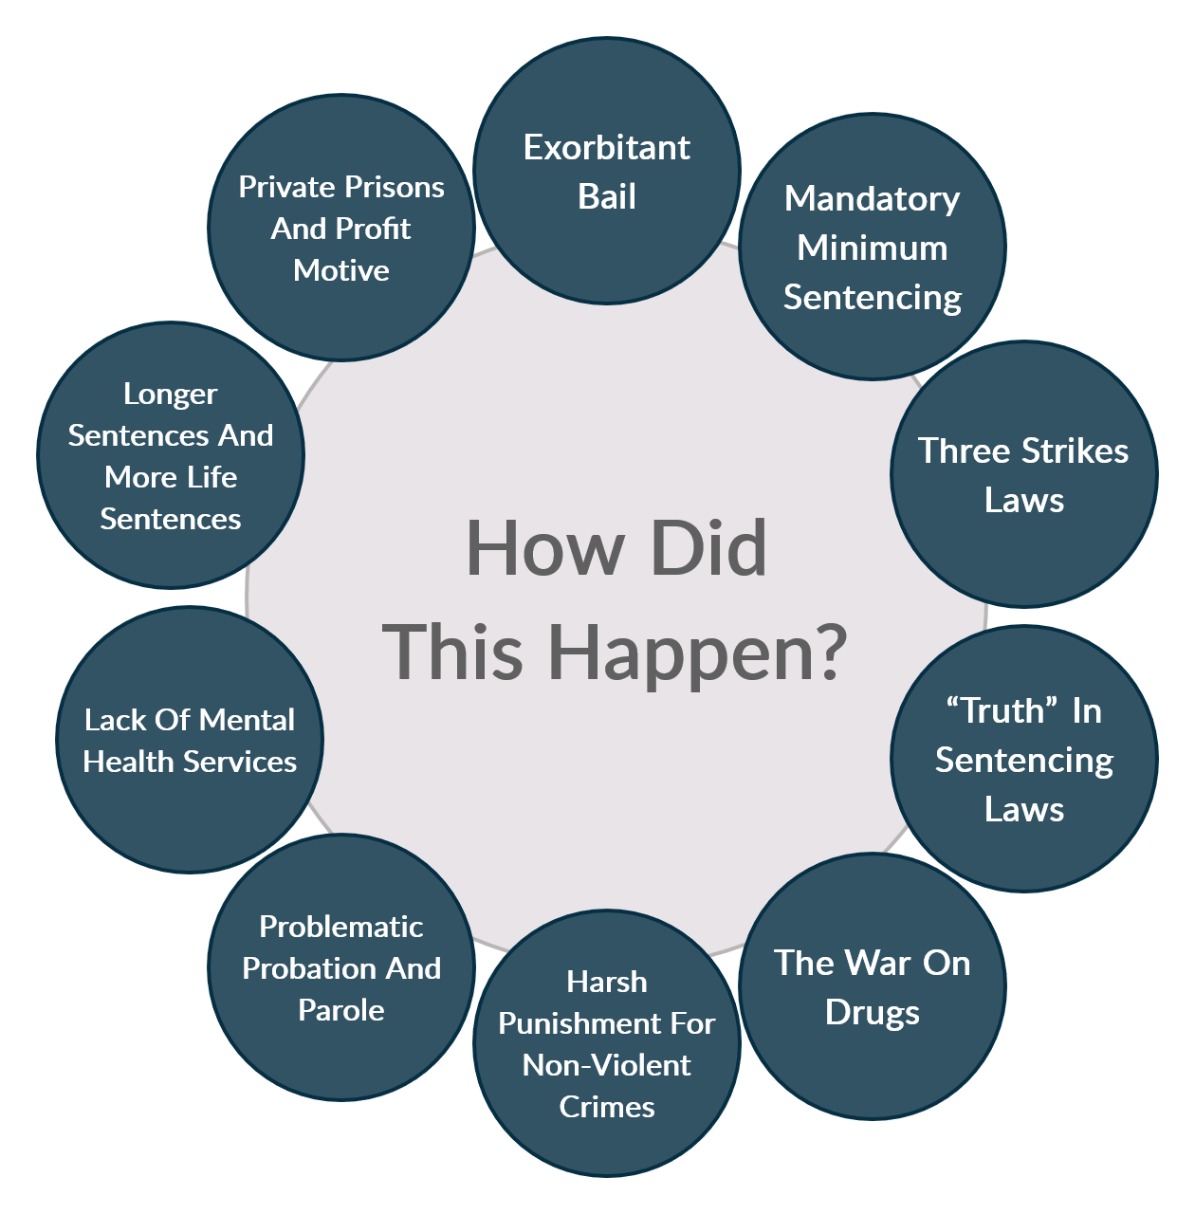
Mass Incarceration
Notes:
Mass incarceration driven by multiple factors but mainly by policy changes
First it was deinstitutionalization of mental health which moved patients with severe mental health out of state run psychiatric asylums to the community but resources including housing did not follow. This lead to homelessness epidemic, substance use, petty crime
1955-1994 300,000 ended up incarcerated.
The major driver was the War on Drugs
1970s War on Drugs
It included the Anti-Drug Abuse Act of 1986, which imposed even more mandatory minimum sentences. Most significantly
five-year mandatory minimum sentence for offenses involving 100 grams of heroin, 500 grams of cocaine or 5 grams of crack cocaine.
1970s: Congress lengthens sentences
1984: Comprehensive Crime Control Act
Mandatory minimums
Eliminated federal parole
1985-1992: lengthen drug sentences
Anti-Drug Abuse Act of 1986
1994: Violent Crime Control and Law Enforcement Act of 1994: “3-strike provision” at federal level
Life without parole if 2 prior convictions
2010: Fair Sentencing Act
Reduced sentencing disparity between crack and powder cocaine

Slide 11
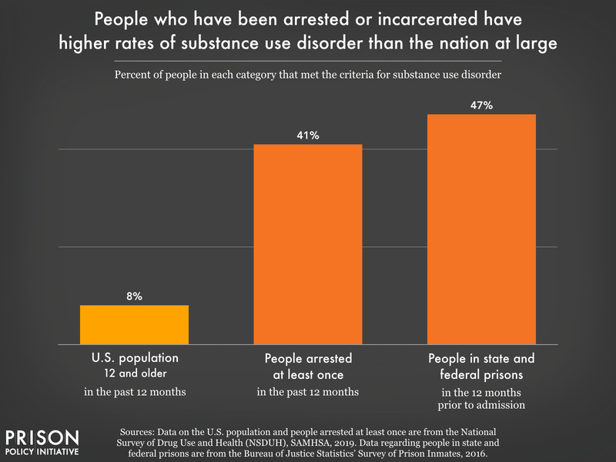
Notes:
As you are probably starting to see is there is a strong intersection of addiction and correctional involvement.
Substance use disorders in jail and prisons outpace rates in the general public
Although there has been progress we still respond to substance use/addiction with punitive measures
Approx 3 million people with SUD are incarcerated in any given year

Slide 12
Back to Mr. T
At intake, Mr. T disclosed his history of addiction and interest in receiving help.
However, the jail did not offer medications for OUD (MOUD), and instead, he was expected to go through withdrawal.
He was offered “detox” in the medical unit. ”Detox” protocol only involved some comfort medications.
He experienced painful withdrawal symptoms
Notes:
As clinicians we should understand and focus on the health impacts and disparities that involvement in this system creates so that we may provide the best care possible for our patients

Slide 13
Healthcare behind bars
Unhealthy environmental factors
Medically vulnerable patients
Inadequate Funding
Poor health outcomes
People in correctional facilities are among the unhealthiest and most medically underserved in society. This is a policy choice!
Healthcare for incarcerated people is not delivered, measured or funded with the same evidence-based structures that exist in the community
Notes:
The only group in this country guaranteed health care are people incarcerated
Estelle v. Gamble (1976) established that incarcerated individuals have a constitutional right to healthcare under the Eighth Amendment. The Supreme Court ruled that deliberate indifference to serious medical needs of prisoners constitutes cruel and unusual punishment.

Slide 14

Chronic Medical Conditions & Infectious Diseases
Incarcerated population
Maruschak LM, Berzofsky M. US DOJ. 2015.
General population
Notes:
When we look a chronic and communicable diseases-Approx 40% of total prison and jail population have a current chronic medical conditions
Communicable/infectious diseases prevalent
HIV-high rates compared to general population
HCV
Studies have shown 16-41% of individuals who are incarcerated carry HCV antibodies
12-31% have advanced/chronic infection

Slide 15
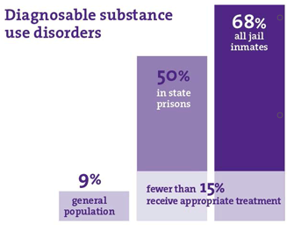
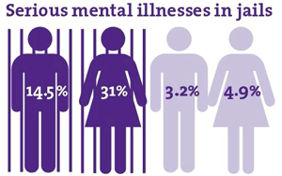
Behavioral Health Disorders Prevalent
Cloud D. Vera Institute of Justice. 2014.
Notes:
Overall 50% of individuals who are incarcerated have mental health problem
Approx 25% have history of serious mental illness such as schizophrenia, bipolar disorder, depression, anxiety
Approx 2/3rds off treatment at time of incarceration
Substance use disorders also prevalent in the jail and prison population
Estimated 65% of US prison population has active SUD
Another 20% did not meet official criteria for SUD but were substance affected at time of their offense.
Unfortunately these conditions could go untreated in the correctional setting-very few individuals get access to appropriate treatment for SUD especially treatment for opioid use disorder
Legislation in MA in 2018 has changed this a bit, this legislation created pilot programs that would offer all three modalities of treatment for OUD albeit with some prerequisites that need to be met including having been on treatment in the community.

Slide 16
Benefits of MOUD in Correctional Facilities
Benefits | Evidence
Reduces illicit opioid use post-incarceration | Mattick, et al., 2009
Reduces criminal behavior post-incarceration | Deck, et al., 2009, Clayman et al., 2025
Reduces mortality and overdose risk post-incarceration | Degenhardt et al., 2011; Kerr, et al., 2007, Martin et al.,2022 Chatterjee et al., 2023, Goldstein et al, 2024
Reduces HIV risk behaviors post-incarceration | MacArthur et al., 2012
Additional social, medical, and economic benefits | Rich et al., 2015; Zaller et al., 2013; McKenzie et al., 2012; Heimer et al., 2006; Dolan et al., 2003
Notes:
There is ample evidence on the benefits of MOUD in correctional facilities
Improves engagement in treatment (Study Forced withdrawal reduced post-release treatment engagement by about 18 percentage points)
Other studies show decrease mortality once study showing 75% reduction in overdose deaths, and other risky behaviors that contribute to addiction related comorbidities such as HIV
Most recently a study by Chatterjee et al in JAMA Network open showed an economic evaluation and simulated model in cost effectiveness and quality adjusted life years
The findings suggest that offering 3 MOUDs during incarceration is a life-saving, cost-effective intervention.

Slide 17
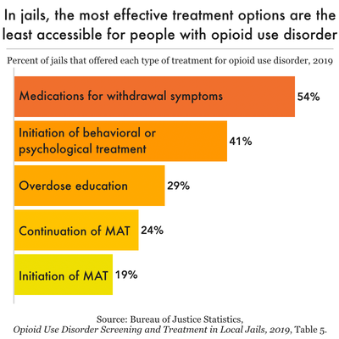
Notes:
Even with this evidence we continue to see that most effective treatment is least accessible to people with OUD in correctional institutions
Even with high prevalence of SUD in jail/prisons
1 in 10 receive actual treatment with medications

Slide 18
Notes:
A study by the NIH Heal Initiative identified significant barriers and facilitators that impede access to MOUD is US jails.
Although 92% of jails provide at least one form of MOUD only 43% provide all three forms of MOUD
Most jails limit provision of medications to certain groups such as pregnant women
Key takeaway across medication modalities:
Funding
Funding a big issue
Stigma and concern for diversion
Key Takeaways:
1. 20% of jails provide MOUD to anyone who is assessed with OUD, yet in fewer than half (43%) of the jails were all three FDA-approved medications available
2. The highest needs among jails are additional funds to cover the cost of medications and clinical staff to administer and monitor MOUD.
3. Jails' second highest needs are resources to support and ensure continuity of care during reentry.
4. Other needs include educating state/local policymakers, correctional staff, and the general public, and logistical support to help minimize diversion and establish systems to screen individuals for OUD.

Slide 19
Back to Mr. T
After serving 6 months in detention without MOUD, he was released without a reentry plan.
He received no prescriptions, no follow-up referrals, and no transportation support.
Thoughts??????
Notes:
Does anyone have concerns with this plan?

Slide 20
Mr. T
Within 10 days of his release he unfortunately relapsed and experienced a near-fatal opioid overdose.
He was revived with naloxone by EMS and brought to the ED.

Slide 21
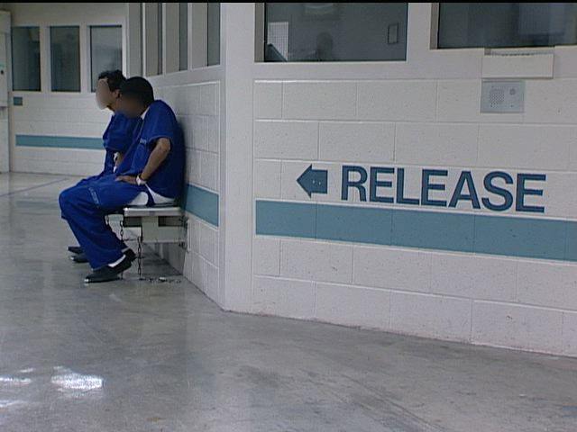
Transitions
Notes:
95% of individuals who are incarcerated will eventually be released sent back to their communities
This period has been determined to be a risky period with increase risk for morbidity and mortality

Slide 22
Mortality Rates Spike During Re-entry Period
Relative risk of death among formerly incarcerated compared with other Washington state residents
Cause of death | RR (95% CI)
Overdose | 12.2 (10.2–14.9)
Homicide | 10.4 (8.0–13.6)
Liver disease | 4.7 (3.2–7.2)
Suicide | 3.4 (2.5–4.7)
Motor vehicle accident | 3.4 (2.4–4.8)
Cardiovascular disease | 2.1 (1.6–2.7)
Cancer | 1.67 (1.2–2.2)
Within first 2 weeks,
aRR is 129
(95% CI 89 to 186)
Binswanger IA, et al. NEJM. 2007.
Notes:
One of the landmark studies looking at this risky period was done by Biswanger et al.
The looked a relative risks of death among formerly incarcerated and found that Drug overdose was the top cause
Overall 12.2 x higher with 129 x higher in the first two weeks

Slide 23

Clinical Innovations
Notes:
Not only did this study highlight this very risky period during re-entry but highlighted an opportunity for innovation and intervention
Only 25% of jails provided naloxone upon released in 2019
Improving
CA 95% by July 2022 had received naloxone kits and training
Community referrals for MAT
28% of local jails in 2019 provided referral and linkage to community based programs
So how can we rethink care for this population when they transition back to the health care system

Slide 24
Back to Mr. T
After he recovered from the overdose he was connected with a social worker in the ED.
Fortunately, there was a Transitions Clinic in the area and was connected to this clinic.
There, he met a community health worker (CHW) with lived experience of incarceration.
In this Transitions Clinic Mr. T was assessed and initiated on buprenorphine, was connected to housing assistance and trauma-informed therapy, and reengaged with primary care

Slide 25




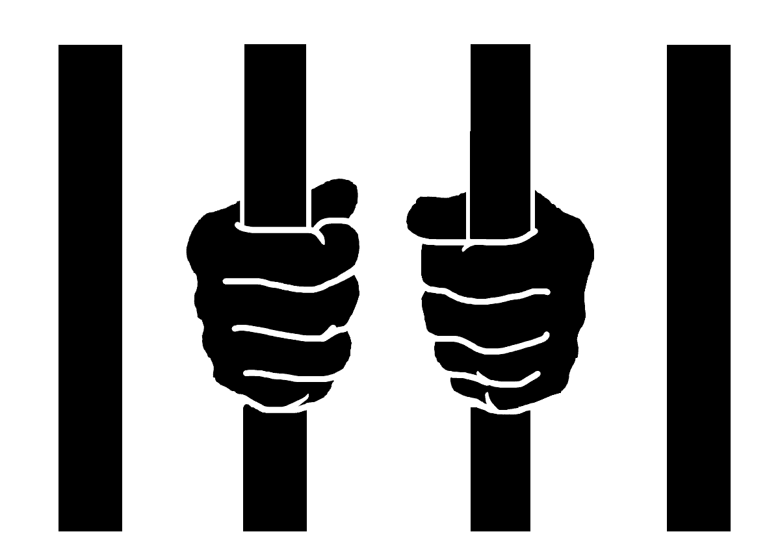
Transitions Clinics Target High-Risk Window
Community organizations
Correctional facilities
Notes:
I want to highlight a model of care that was established in 2006 in San Francisco-Transition clinic model
This clinic was created to provide transitional and primary care and case management for individuals returning to the community from correctional institution.
The aim of the clinic is to provide patient centered primary care
It’s a collaboration among primary care providers and correctional partners to ensure linkage and continuity of care
Close partnerships with local re-entry and social services organizations to address SDOH
The innovative part of this clinic is the use of a community health worker who is a person with lived experience of criminal justice involvement-this person is integrated into the medical team
CHW-connect patients with health and social services in a culturally appropriate fashion

Slide 26
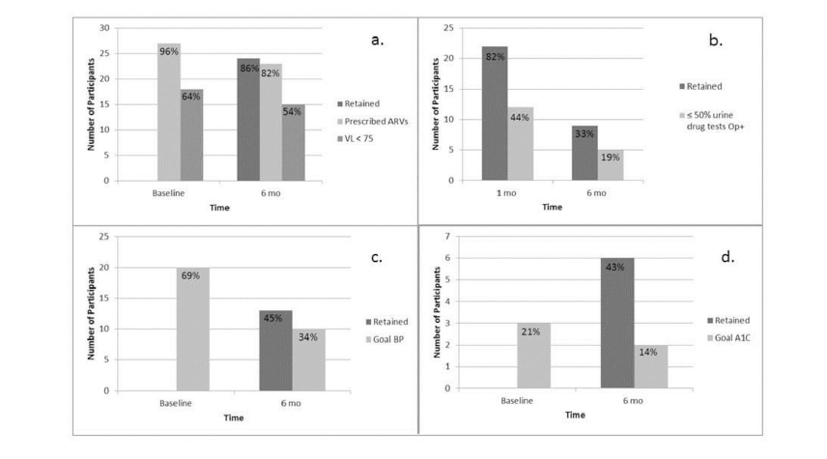
Bronx Transitions Clinic
Retention in medical care and health outcomes (n=135)
HIV (n=28)
Buprenorphine treatment (n=27)
Hypertension (n=29)
Diabetes Mellitus (n=14)
Fox et.al. J Health Care Poor Underserved 2014
Notes:
A study looking at Transition clinic model on impact on health outcomes and retention.
They looked at individuals with HIV, HTN, OUD, and DM Main outcome was 6 month retention and chronic disease control
Demonstrated TCN effectiveness
Primary Care Engagement: Participants in the Transitions Clinic were more likely to establish primary care after release compared to controls.
Chronic Disease Management: Those with HIV had particularly favorable outcomes, benefiting from pre-existing strong linkage-to-care systems and dedicated resources compared to other conditions such as HTN, DM, OUD
Emergency Department Use: Transitions Clinic participants had fewer ED visits than controls, suggesting improved outpatient management.
Role of Community Health Workers: The success of the model was attributed largely to the use of community health workers (CHWs) with lived incarceration experience, who improved trust and facilitated access to care.
Retention in Care: varied among conditions:
HIV 86%, OUD 33%, HTN 45%, Diabetes 43%
They concluded that although access to medical care is necessary it is not sufficient to control chronic health conditions-need to address social conditions/SDOH to improve health which are often impacted by history of criminal justice involvement.
Outcomes also varied
HIV highest achievement in outcomes 54$
OUD/bupe treatment only 19%
Results of this study showed that the group with HIV had better retention, treatment adherence, and controlled Viral loads
Compared to those with DM, HTN, OUD
They determine the difference in retention and outcomes in HIV group likely due to increase access to case management services that may not be available for non HIV patients

Slide 27
Mr. T
Could Mr. T’s arrest, incarceration, and post release overdose been prevented.
Possibly….
There are are pre-arrest deflector programs available that may have avoided this incarceration entirely.
These programs include Drug Courts

Slide 28

Drug Courts

Slide 29
Drug Courts: Definition
Specialized court designed to handle cases involving non-violent substance use offenses
Comprehensive approach
  Treatment (linked to long-term treatment)
  Judicial supervision
  Drug testing/monitoring
  Sanctions/incentives
Individuals may be diverted before conviction or placed in drug court after sentenced
Primary goal:
Promote rehabilitation and reduce recidivism in individuals with SUD.
Divert them from traditional criminal justice pathways (incarceration)
Notes:
Background:
Drug courts are specialized court programs that aim to divert individuals with substance use disorders away from incarceration and into supervised treatment and recovery services.
Key Features:
Treatment over incarceration: Participants receive court-supervised treatment programs (e.g., counseling, medication for opioid use disorder, case management) instead of traditional sentencing.
Regular monitoring: Frequent drug testing, court appearances, and judicial oversight ensure accountability and support.
Multidisciplinary teams: Judges, prosecutors, defense attorneys, treatment providers, and probation officers collaborate to support participant success.

Slide 30
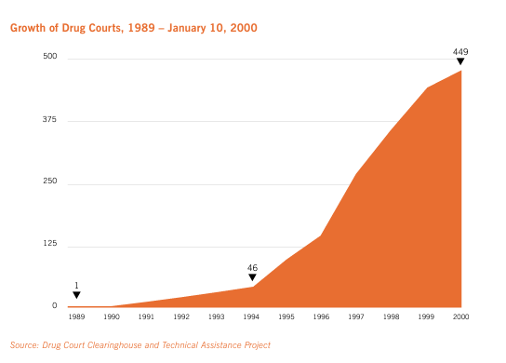
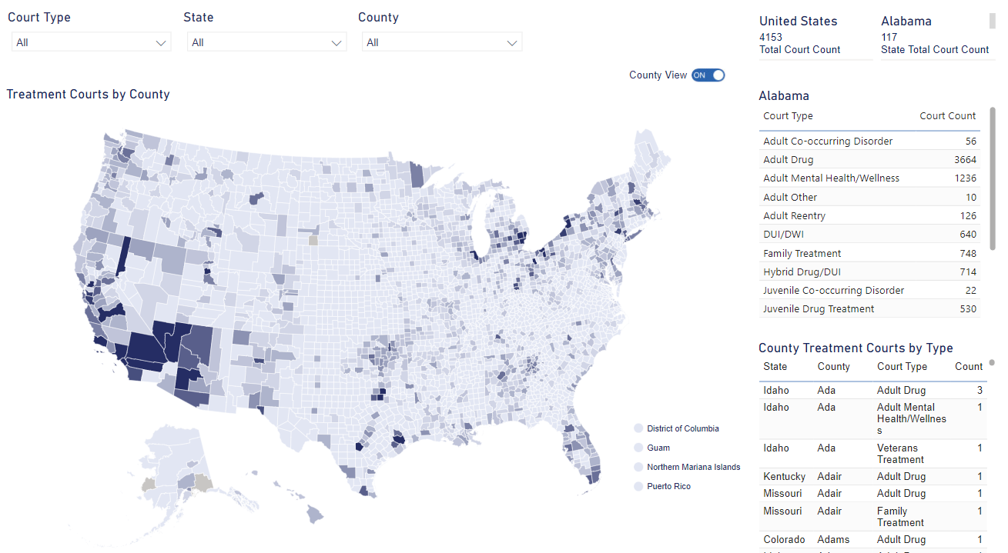
Drug Court Distribution
Notes:
1st Drug Court opened in Dade County, FL in 1989
Developed to address wave of incarceration due to drug offenses
Drug model Quickly exploded to 449 by 2000
As of 2022 approx. 4100 treatment courts throughout the states

Slide 31
Drug Courts: Evidence
Reduce Recidivism:
  Participants who completed drug court program less likely to re-offend (one study reduction of 26%)
Lower rates of substance use
Cost Effectiveness:
  Avoiding criminal justice detainment save tax payers 2-3 dollars for every dollar spent on drug courts
Outcomes for participants:
  Increase rate of employment
  Stable housing
  Improved family relationship
Public safety benefits:
  Reduction in drug related crimes
Bhati, A. S. (2006). The impact of drug courts. Journal of Contemporary Criminal Justice, 22(1), 55-73.
Aos, S., Miller, M. G., & Drake, E. (2006). Evidence-based public policy options to reduce crime and criminal justice costs: Implications in Washington State. Victims and Offenders, 1(2), 139-160.
Carey, S. M., Finigan, M. W., & Pukstas, K. (2008). Blueprint for implementation: The Comprehensive Strategy for Serious, Violent, and Chronic Juvenile Offenders. US Department of Justice, Office of Justice Programs, Office of Juvenile Justice and Delinquency Prevention
Gottfredson, D. C., Kearley, B., Najaka, S. S., & Rocha, C. M. (2007). How drug treatment courts work: An analysis of mediators. Journal of Research in Crime and Delinquency, 44(1), 3-35.
Notes:
Evidence of Impact:
Reduced Recidivism: Drug court participants have lower rates of re-arrest compared to traditional criminal justice processing. Meta-analyses suggest a 12–26% reduction in recidivism.
Improved Treatment Outcomes: Participants are more likely to complete substance use treatment than individuals referred through standard criminal justice pathways.
Cost Savings: Drug courts are generally cost-effective, saving money through reduced incarceration days and improved health and social outcomes.
Health Improvements: Some studies show drug courts contribute to improved mental health and reduced substance use over time, although outcomes vary depending on the availability of evidence-based treatments like MOUD (medications for opioid use disorder).
Limitations and Challenges:
Access to MOUD is often limited in some drug courts, despite its proven effectiveness, which can undermine outcomes for people with opioid use disorder.
Success varies depending on court design, eligibility criteria (e.g., excluding people with violent charges), and access to high-quality treatment services.
average of 60 percent of drug court clients completed a year or more of treatment, and roughly 50 percent graduated from the drug courts (Belenko, 1998, 1999, 2001).
More favorable to retention rates in community based drug treatment prorams
70 percent of clients on probation and parole drop out of drug treatment or attend irregularly within 3 months, and 90 percent drop out in less than 1 year.

Slide 32
Mr. T
After ED visit for the overdose he engaged with the local Transitions clinic
There he engaged in primary care and MOUD
He is currently on buprenorphine-naloxone with current dose 24mg daily and in sustained remission with last use 2 years ago
Currently thinking about pursuing training to become recovery coach

Slide 33
Take Home Points
Criminal justice involvement negatively impacts health
Mass incarceration disproportionally impacts Black and Latinx communities
There is a strong intersection of addiction and correctional involvement
Transition period carries high mortality risk
Evidence supports effective transition care models
Drug courts have been a successful model to divert individuals from correctional institutions for drug offenses
As Educators, we must teach future physicians how to care for people with a history of incarceration and addiction
Notes:
I hope this presentation has provided you with an overview how the criminal justice system negatively impacts the health of patients especially those with substance use and behavioral health issues
Although individuals in the correctional system are the only group guaranteed access to health care in this society it does not mean they get appropriate care
We need to continue to improve the way we provide care for this population especially during the risky re-entry period
As Clinicians/Educators/Researchers we can rethink care for this population and educate future physicians and all learn to use our voice to advocate for reform!

