Slide 1
Substance Use Screening, Assessment and Brief Intervention
Immersion Training in Addiction Medicine Programs 2025
Jeffrey H. Samet, MD, MA, MPH
John Noble Professor of Medicine and Professor of Public Health
Daniel P. Alford, MD, MPH
Professor of Medicine

Slide 2
Substance Use Disorder (SUD)
Substance Use Disorder – (DSM-5) - recurrent use of alcohol or other drugs causing significant impairment, such as health problems, disability and failure to meet major responsibilities, craving, withdrawal and tolerance
It combines the DSM-IV categories of substance abuse and substance dependence into a single disorder measured on a continuum from mild, moderate, or severe
Addiction indicates the chronic stage of SUD (synonymous with “moderate to severe SUD”)
*American Psychiatric Association DSM-5 (2013)

Slide 3
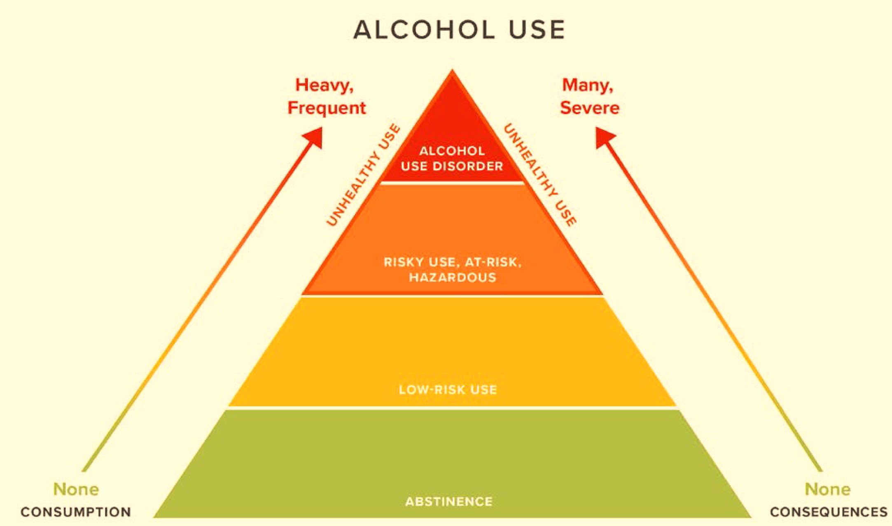
Unhealthy Substance Use Spectrum
Adapted with permission from Saitz R. New Engl J Med 2005

Slide 4
Case
A 28-year-old resident enjoys 2-3 beers 2-3 times a week after work.
Is the resident’s alcohol use unhealthy or risky?

Slide 6
What is a Standard Drink?

Slide 7
Alcohol Use
Any alcohol use?
↑ All-Cause Mortality (Zhao J. JAMA Network Open. 2023) low-volume alcohol use (1.3-24 g/d), associated with higher all-cause mortality
↑ Cardiovascular Dz (Biddinger KJ. JAMA Net Open. 2022)
Carcinogen (breast, oral, pharynx, liver, esophagus, colorectum)
Teratogen (Fetal Alcohol Spectrum Disorders)
NIAAA and CDC “Excessive/Risky Drinking”
Men (<65)
>14 drinks/week, >4/occasion (“5+ drinks”)
Women (Men 65+)
>7 drinks/week, >3/occasion (“4+ drinks”)
USDA, Dietary Guidelines 2020-25
Men: 2 drinks or less/day
Women: 1 drink or less/day
Drug Use
Any drug use = risky? What about cannabis?
Notes:
43
21
Treatment Need
Injection, use of heroin once, marijuana daily, other drug weekly, or use with prior treatment history

Slide 8
Screen for unhealthy alcohol use in primary care settings in adults, including pregnant women…provide persons engaged in risky or hazardous drinking with brief behavioral counseling interventions to reduce unhealthy alcohol use. (since 1996, updated 2018)
Screen by asking questions about unhealthy drug use in adults…should be implemented when services for accurate diagnosis, effective treatment, and appropriate care can be offered or referred. (Screening refers to asking questions about unhealthy drug use, not testing biological specimens.) (since 2020)

Slide 9
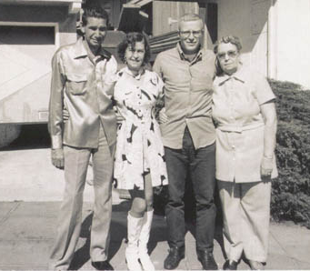
Who in this family has a substance use disorder?

Slide 10
Screening Workflow
Screen for Unhealthy Substance Use (SISQ, AUDIT-C, TAPS)
Notes:
.auditctool
.auditcscoring

Slide 11
‘Single’ Item Screening Questions (SISQ)
Alcohol¹
“Do you sometimes drink beer wine or other alcoholic beverages?”
“How many times in the past year have you had 5 (4 for women) or more drinks in a day?”
Positive = greater than “never” (82% sensitive, 79% specific for unhealthy alcohol use)
Drug²
“How many times in the past year have you used an illegal drug or used a prescription medication for non-medical reasons?”
Positive = greater than “never” (100% sensitive, 74% specific drug use disorder)
NIAAA. Clinicians Guide to Helping Patients Who Drink Too Much, 2007.
¹Smith PC, Saitz R. J Gen Intern Med 2009
²Smith PC, Saitz R. JAMA Intern Med 2010
Other References
Saitz R et al. J Studies Alcohol Drugs. 2014
McNeely J et al. Validation for self-administration. J Gen Intern Med. 2015

Slide 12
Alcohol Use Disorders Identification Test Consumption items (AUDIT-C)
Scored 0 - 12
>4 men
Unhealthy alcohol use: (sensitivity: 86%, specificity 72%); AUD: (sensitivity 79%, specificity 56%)
>3 women
Unhealthy alcohol use: (sensitivity 66%, specificity 94%); AUD: (sensitivity 80%, specificity 87%)
Bradley KA, et al. Alcohol. Clin. Exp. Res. 2007; Bush K et al. Arch Intern Med. 1998; Bradley KA et al. Arch Intern Med. 2003

Slide 13
Screening for Unhealthy Substance Use Tobacco, Alcohol, Prescription meds and other Substances (TAPS)
(TAPS-1) In the past 12 months, how often have you:
Used any tobacco product (cigarettes, e-cigarettes, cigars, pipes or smokes tobacco)?
Had (5 [males], 4 [females]) or more drinks containing alcohol in one day?
Used any drugs including marijuana, cocaine or crack, heroin, methamphetamine, hallucinogens, ecstasy?
Used any prescription medications just for the feeling, more than prescribed, or that were not prescribed for you? (e.g., opioid pain relievers, medications for anxiety or sleeping, medications for ADHD)
Response options:
Daily or almost daily
Weekly
Monthly
Less than monthly
Never
If positive on TAPS-1 (i.e., other than “never“) use TAPS-2, which consists of brief substance-specific questions to determine risk level ranging from “problem use” to “use disorder”
McNeely J et al. Ann Intern Med. 2016
Notes:
This quick substance use screening has only 1-2 questions for alcohol and 1 question for drugs. These questions are validated screening tools, and should be asked as presented here.
The single item alcohol screening question is, “Do you sometimes drink beer, wine, or other alcoholic beverages?”
If someone says no, you can follow up with the question, “Why not?” because it’s so normative for people to drink occasionally. Maybe the person’s in recovery, maybe they have a family history of unhealthy substance use, and those would be important things to find out.
If they say yes, which most people will, you’ll want to find out whether they are drinking unhealthy amounts. For men under 65 years old the question is, “How many times in the past year have you had five or more drinks in a day?” For women and men 65 or older, it’s four or more drinks in a day.
The single item drug screening question is “How many times in the past year have you used an illicit drug or used a prescription medication for nonmedical reasons?”
If asked what non-medical reasons are, you can say taking a medicine you weren’t subscribed or taking more than prescribed (this is also mentioned in slide 4 – keep here, there, or both?)
The way these questions are asked is important. It’s not asking people, “you don’t drink a lot do you?” That’s very easy to say no to. The questions are asked in a very normative way so that people feel comfortable answering - “how many times in the past year.”

Slide 14
Screening Workflow
Screen for Unhealthy Substance Use (SISQ, AUDIT-C, TAPS)
Screen negative
for unhealthy substance use
Screen positive for unhealthy substance use
Positive reinforcement
Screen (Assess) for SUD
DSM-5, AUDIT
Notes:
.auditctool
.auditcscoring

Slide 15
DSM-5 Substance Use Disorders (SUD)
1.
Tolerance
2.
Withdrawal
3.
Larger amounts and/or longer periods
4.
Inability to cut down on or control use
5.
Increased time spent obtaining, using or recovering
Physiologic
Loss of Control
6.
Craving/
Compulsion
7.
Role failure: work, home, school
8.
Social, interpersonal problems
9.
Reducing social, work, recreational activity
10.
Physical hazards
11.
Physical or psychological harm
Continued Use Despite Negative Consequences
Mild SUD: 2-3 Criteria
Moderate SUD: 4-5 Criteria
Severe SUD: >6 Criteria
APA. (2013). Diagnostic and Statistical Manual of Mental Disorders (5th ed.)
Notes:
DSM-5 Opioid Use Disorders
In terms of diagnosing an opioid use disorder, the DSM-V criteria are an agreed upon set of criteria that allow you to assess your patients. So these evaluate tolerance and withdrawal, though it’s important to note that these first two criteria may be seen in patients on prescribed opioids and do not necessarily by themselves constitute a use disorder, and the 11 criteria go on to assess for loss of control and for continued use despite negative consequences. And patients can be stratified into a mild, moderate or severe opioid use disorder based on how many criteria out of these 11 that they meet.

Slide 16
DSM-5 Questionnaire
In the past 12 months…
Hallgren KA et al. Alc Clin Exp Res. 2022
Mild AUD: 2-3 points
Moderate AUD: 4-5 points
Severe AUD: >6 points

Slide 17
Screening for AUD Alcohol Use Disorder Identification Test (AUDIT)
AUDIT C
10 questions (score: 0-40)
Most widely validated in a wide range of racial/ethnic groups
8+ is unhealthy alcohol use
15+ suggests moderate to severe AUD
Saunders et al. Addiction. 1993

Slide 18
CAGE – best acronym but past its prime…
Screening for Alcohol Use Disorder
Have you ever felt you should Cut down on your drinking?
Have people Annoyed you by criticizing your drinking?
Have you ever felt bad or Guilty about your drinking?
Have you ever taken a drink first thing in the morning (Eye-opener) to steady your nerves or get rid of a hangover?
Mayfield D et al. Am J Psych 1974
Notes:
7
Here are the CAGE questions, first published in 1974 by Mayfield.
I’d like to mention just 2 additional issues with the CAGE questionnaire. First, the questions ask if the patient has ever cut down, been annoyed, felt guilty or had an eye-opener, allowing us to identify patients in remission as well as those with acute problems. Second, we translated the CAGE into Spanish, backtranslated it, checked it for accuracy and validated it here in the primary care clinics and found that at least in Carribean Latinos, the test had sensitivity and specificity at least as good as that found for English speakers.
4 items, yes/no
brief, memorizable
detects lifetime problems\
usual cutoff >1 or 2
may miss some hazardous drinkers
Doesn’t ask quantity
CAGE AID validated in 63 elders. 63 elderly (>age 60) persons with drug abuse/dep, 838 controls
>1: 92% sensitive, 48% specific
AGE-AID: 82% sensitive, 69% specific
>2: 81% sensitive, 72% specific
AGE-AID: 77% sensitive, 89% specific
Hinkin 2001

Slide 19
Screening Results in Primary Care
10-20% unhealthy alcohol use
Of those, 20% with AUD
3% unhealthy drug use
Of those, 33% with DUD
Mertens JR et al. Alcoholism: Clinical Exp Res. 2005
In past 12 months…
62% any alcohol use
Of those, 22% with AUD
28% any drug use (marijuana 21%, cocaine 7%, opioids 5%, heroin 4%, sedatives 4%)
Of those, 50% with DUD
Wu LT, McNeely J, et al. Drug Alcohol Depend. 2017
Notes:
Mertens, ACER 2005, HMO, in a pop had 3.2% drug, 7.5% alc, 10% had at least one of the 2
Wu et al.
Methods: This study analyzed data from a multisite validation study of a substance use screening instrument conducted in a diverse sample of 2000 adults aged ≥18 years recruited from five primary care practices in four states. Prevalence and correlates of 12-month DSM-5 SUDs were examined.
Results: Overall, 75.5% of the sample used any substance, including alcohol (62.0%), tobacco (44.1%), or illicit drugs/nonmedical medications (27.9%) in the past 12 months (marijuana 20.8%, cocaine 7.3%, opioids 4.8%, sedatives 4.1%, heroin 3.9%). The prevalence of any 12-month SUD was 36.0% (mild disorder 14.2%, moderate/severe disorder 21.8%): tobacco 25.3% (mild 11.5%, moderate/severe 13.8%); alcohol 13.9% (mild 6.9%, moderate/severe 7.0%); and any illicit/nonmedical drug 14.0% (mild 4.0%, moderate/severe 10.0%). Among past 12-month users, a high proportion of tobacco or drug users met criteria for a disorder: tobacco use disorder 57.4% (26.1% mild, 31.3% moderate/severe) and any drug use disorder 50.2% (14.3% mild, 35.8% moderate/severe); a lower proportion of alcohol users (22.4%) met criteria for alcohol use disorder (11.1% mild, 11.3% moderate/severe). Over 80% of adults with opioid/heroin use disorder met criteria for a moderate/severe disorder. Younger ages, male sex, and low education were associated with increased odds of having SUD.

Slide 20
Screening Workflow
Screen for Unhealthy Substance Use (SISQ, AUDIT-C, TAPS)
Screen negative
for unhealthy substance use
Screen positive
for unhealthy substance use
Positive reinforcement
Screen (Assess) for SUD
AUDIT, DSM-5
SUD unlikely
SUD likely
Brief Intervention
Monitor
Brief Intervention
Treat +/- Refer
Notes:
.auditctool
.auditcscoring

Slide 21
Brief Intervention (BI) for Alcohol 50+ Years of Trials
Efficacy for reducing self-reported consumption
3-4 fewer drinks/week
10-12% less unhealthy use at 1 year
No evidence it prevents developing AUD
Less effect on moderate to severe AUD
Evidence is mixed for ED and inpatient as most patients identified have a mod/severe AUD
BUT repeat, and be available when patients are ready and counsel long-term
USPSTF. JAMA. 2018;320(18):1899-1909.
Jonas DE et al. Ann Intern Med 2012;157:645-54.
Kaner et al. Drug and Alcohol Review 2009;28:301–23
Beich et al. BMJ 2003;327:536
Bertholet et al. Arch Intern Med. 2005;165:986
Kristenson H, et al. Alcohol Clin Exp Res 1983;7:203 (mortality, 3-16 yrs)
Fleming MF et al. Alcohol Clin Exp Res. 2002;26(1):36-43 (cost)
Cuijpers et al. Addiction 2004;99: 839–845 (mortality)

Slide 22
Brief Intervention (BI) for Drugs
Previous studies found BI may help some patients reduce their illicit drug use
RCT in urgent care setting¹
Observational study in general medical settings²
However, RCTs^{3,4} found BI in primary care settings not effective for reducing illicit drug use or prescription drug misuse
With efficacy for BI for drugs uncertain, the goal is to identify, diagnose and treat
“Clinicians should look beyond BI…to more complex longitudinal care to address illicit drug use and prescription drug misuse.”
Saitz R et al. JAMA. 2014
1. Bernstein J, et al. Drug Alcohol Depend. 2005
2. Madras BK, et al. Drug Alcohol Depend. 2009
3. Saitz R, et al. JAMA. 2014
4. Roy-Byrne P, et al. JAMA. 2014
Notes:
Zahradnik A, et al. Addiction. 2009;104(1):109–117
Otto C, et al. Drug Alcohol Depend 2009;105:221-6
Bernstein et al. Drug Alcohol Depend 2005;77:49
Woodruff SI et al. Addict Sci Clin Pract (2014) 9:8.doi:10.1186/1940-0640-9-8
Blow FC et al. Poster, and Abstract book p.14
CPDD 77th Annual Meeting • Arizona Biltmore, Phoenix, Arizona
Bogenschutz JAMA Internal Med 2014;174:1736-45
Gelberg L, et al. Addiction. 2015;110:1777–1790
JAMA. 2014;312(5):502-513. doi:10.1001/jama.2014.7862.
JAMA. 2014;312(5):492-501. doi:10.1001/jama.2014.7860

Slide 23
Brief Intervention
Brief Negotiated Interview (BNI)
Eight Steps:
Follow-up Screening Results (Ask Permission)
Explore Likes and Dislikes
Review Health Risks
Summarize and Ask Key Question
Explore Readiness (Importance Ruler)
Negotiate Goals
Explore Confidence (Confidence Ruler)
Arrange Follow-up
Bernstein E, et al. Ann Emerg Med 1997

Slide 24
Step 1: Follow-Up Screening Results
Ask permission
Ask open ended questions
“Is it OK if we talk about your use of [X]?”
Explore problems mentioned in screening, if present. You mentioned you have cut back on your marijuana use … Can you tell me more about that?”
Notes:
Highlight:
Why do we ask about pros- why are they important- why do we ask them first? Be sure to keep it short.

Slide 25
Step 2: Explore Likes and Dislikes
Ask LIKES
Ask DISLIKES
What do you enjoy/like about [X]? What else?
What do you enjoy less/dislike/regret about your [X] use? What else?
Notes:
Highlight:
Why do we ask about pros- why are they important- why do we ask them first? Be sure to keep it short.

Slide 26
Step 3: Review Health Risks
1. Elicit: information (knowledge) from patient
2. Provide: information
3. Elicit: response from patient to information provided
What do you know about the health effects and/or risks of [X]?
Would it be okay if I shared some additional information* with you? ….Provide the information
*Link any medical problems with [X] use
*For alcohol, review lower risk drinking levels
What do you think about what I just told you?
Elicit
Provide
Elicit
Notes:
Assessing student’s own knowledge
Explain info you have so that it is tangible- avoid medical terminology, avoid lingo
Make sure to break it up
Be aware of pushback, tune out

Slide 27
Step 4: Summarize & Key Questions
1. Summarize what the patient’s said so far
2. Use a key question to elicit response (change talk) from the patient
So, to summarize, on the one hand, you said [pros], AND on the other hand you said [cons] and we discussed [risks]…
Did I get that right?
Where does that leave you with your [X] use?

Slide 28
Step 5: Explore Readiness
To help me understand how you feel about making a change in your [X] use…
On a scale of 0 to 10, how important is it for you right now to change your [X] use?... “0 is not important”, “10 completely important”
Why did you choose a [X] and not a lower number like a 1 or 2?
Importance ruler
2. Ask about lower number
If they choose “a zero” - What would need to happen in your life to consider making a change?

Slide 29
Step 6: Negotiate Goals
You mentioned some reasons to change.
What type of changes might you make?
Is it OK if I share some suggestions that might be helpful?
Cut back to lower risk amounts if:
Risky drinking amounts without reported negative consequences
"You may want to cut back on your drinking in order to avoid risks"
Abstain if:
Negative consequences from [X] use
Known medications or medical conditions that are risky with [X] use
Pregnant or trying to conceive
"You should stop drinking if you are pregnant or trying to get pregnant"
What are your thoughts about that?

Slide 30
Step 7: Explore Confidence
If you decide to change your use of X, on a scale of 0 to 10, how confident are you that you will be successful?
What are some challenges to being successful reaching your goals?
Elicit: How can you overcome those challenges?
Provide: Can I suggest other strategies that have helped other patients? Recommend 1-2 strategies that may help
Elicit: Do you think these strategies might work for you?
1. Explore confidence
2. Explore challenges
3. Suggest other strategies

Slide 31
Step 8: Arrange Follow-up
“I want to see you back soon to see how you are doing with your plan”
“Often times it is more difficult to make a change than initially thought”
“If your plan doesn’t work out as planned, I want to hear about what some of the challenges were”
“I appreciate your willingness to talk to me about this”

Slide 32
Brief Intervention
Brief Negotiated Interview (BNI)
Eight Steps:
Follow-up Screening Results (Ask Permission)
Explore Likes and Dislikes
Review Health Risks
Summarize and Ask Key Question
Explore Readiness (Importance Ruler)
Negotiate Goals
Explore Confidence (Confidence Ruler)
Arrange Follow-up
Bernstein E, et al. Ann Emerg Med 1997

Slide 33
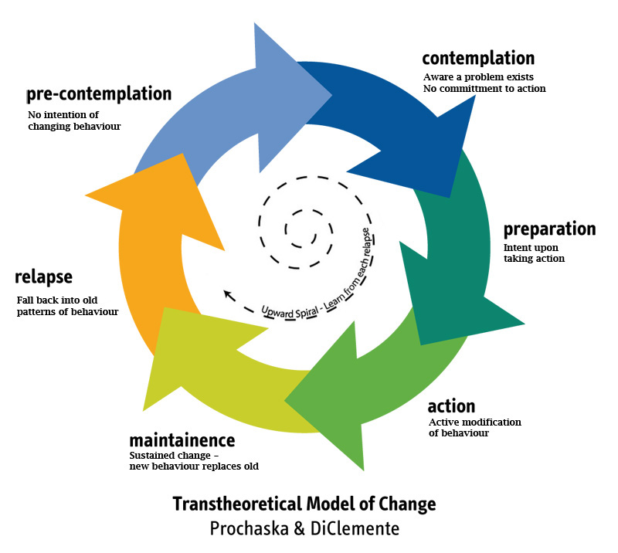
Addressing Different Stages of Change
determination/
Prochaska JO, DiClemente CC. J Consult Clin Psych. 1983

Slide 34
Summary
Substance use disorders (mild, moderate, severe) replace diagnoses of abuse and dependence
Screen to identify the spectrum of unhealthy alcohol and other drug use (i.e., risky use, use disorder)
Screen with validated questions
Use brief negotiated interview to address unhealthy substance use to help motivate patients to change

