Slide 1
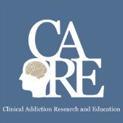



The Science of Addiction
Immersion Training in Addiction Medicine Program 2025
April 2025
Daniel P. Alford, MD, MPH
Professor of Medicine
Associate Dean, Center for Continuing Education

Slide 2
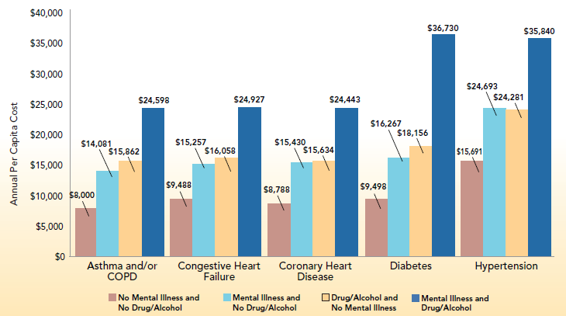
Substance Use Complicates other Chronic Diseases
C. Boyd, et al, Center for Health Care Strategies, Inc. 2010
Notes:
Graph Title: Impact of Behavioral Health Comorbidities on Per Capita Costs among Medicaid-Only Beneficiaries with Disability.
Brief description:
Health care spending is substantially higher for beneficiaries with chronic physical conditions who
also have a mental illness and/or drug and alcohol disorder.
The addition of mental illness for those with common chronic physical conditions is associated with health care
costs that are 60 to 75 percent higher than those without a mental illness. The addition of co-occurring
mental illness and a drug and alcohol disorder for beneficiaries with common chronic physical conditions
results in two- to three-fold higher health care costs. For example, spending for beneficiaries with diabetes and no
mental illness and drug and alcohol disorder average just under $10,000 per year, whereas spending for beneficiaries
with diabetes and a mental illness and drug and alcohol disorder tops $35,000 annually.

Slide 3
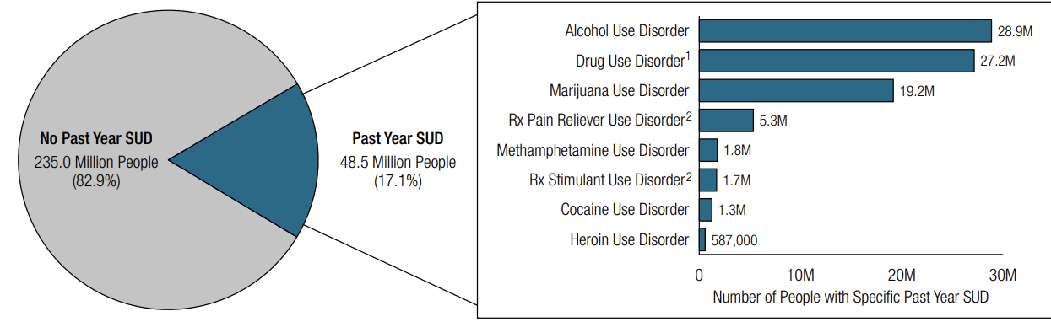
Past Year Substance Use Disorder
SAMHSA. (2024). 2023 National Survey on Drug Use and Health

Slide 4
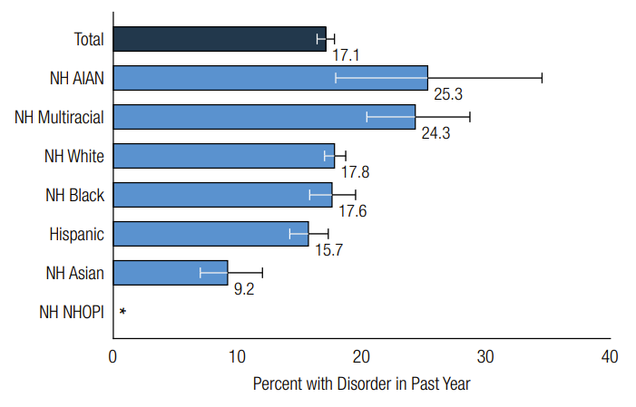
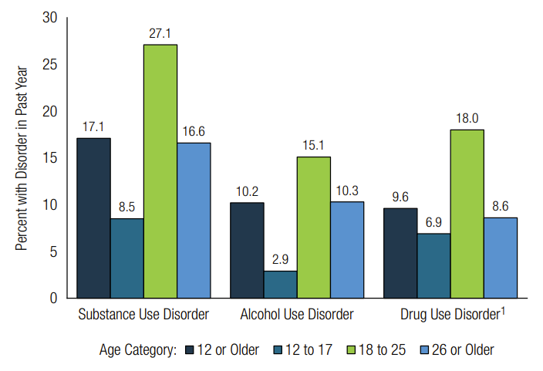
Past Year Substance Use Disorder
Race/Ethnicity
Age
SAMHSA. (2024). 2023 NSDUH

Slide 5
Addiction Is a Developmental Disease
Age at tobacco, alcohol and cannabis dependence, as per DSM IV
1.8
Tobacco
Cannabis
1.6
Alcohol
1.4
Of those with AUD…
16% started drinking before 12
3% started drinking after 21
1.2
1.0
% in each age group to develop
first-time dependence
0.8
0.6
0.4
0.2
0.0
5
10
15
20
25
30
35
40
45
50
55
60
65
70
75
Age
National Epidemiologic Survey on Alcohol and Related Conditions (NESARC), 2003
Notes:
designed to assess the prevalence of alcohol use disorders (AUD) and their associated disabilities in the general population. The survey is the largest ever comorbidity study of multiple mental health disorders among U.S. adults, including alcohol and other substance use disorders, personality disorders, and anxiety and mood disorders. NESARC is designed to be a longitudinal survey with the first wave fielded in 2001–2002. The second wave of interviews was completed in 2004–2005 and used the same sample of respondents.
NESARC is a nationwide household survey with a probability sample representative of US adults. The final sample for Wave 1 was 43,093 respondents; Wave 2 was 34,653 of the Wave 1 respondents.
16% of alcoholics began drinking prior to turning 12 years old, while only 9% first touched alcohol between 15 and 17. This percentage is even lower, at 2.6%, for those who first started the habit after they were 21. These statistics clearly show that introducing a person to alcohol at a very young age can put them at severe risk of dependence or abuse later on in life. Like with alcohol, the earlier someone starts to use drugs, the higher the chance that they will grow to abuse or become dependent on them later on in life.
Most new cases of drug use disorders develop during adolescence. Perhaps there is something special (“sensitive”) about adolescence for developing addiction.
Addiction is also characterized as a developmental disorder characterized by increased risk for substance use disorder for tobacco MJ and alcohol
There are many factor that contribute to the increase in incidence including
-Social/ environmental factors
- Genetic and
Neurobiological factors (Sowell brain volume subtraction method between normal 12-16 year old adolescents and 23-30 year old young adults revealed parietal, temporal and occipital lobes showed little maturational change but, importantly, dorsal, medial and lateral regions of the frontal lobes (purple) those regions involved in executive function and inhibitory control were less developed.
Adolescents with risk haplotype on Chromosome 15 that start smoking before age 15 go on to become more dependent to tobacco as adults than those with other haplotypes
Universal Prevention intervention research is aimed at developing and testing programs that can reduce drug initiation and use during this vulnerable developmental period.

Slide 6
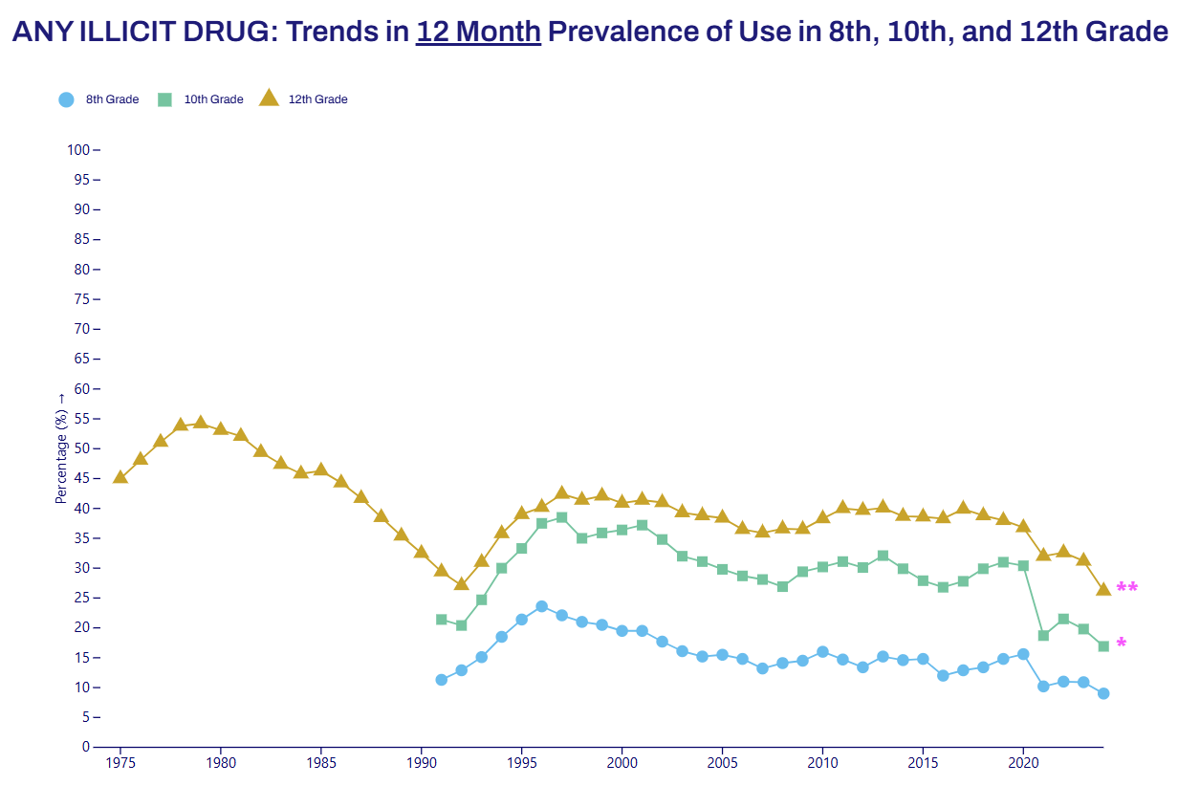
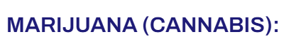
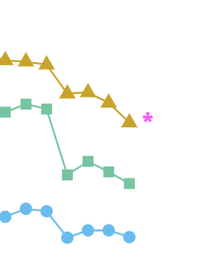
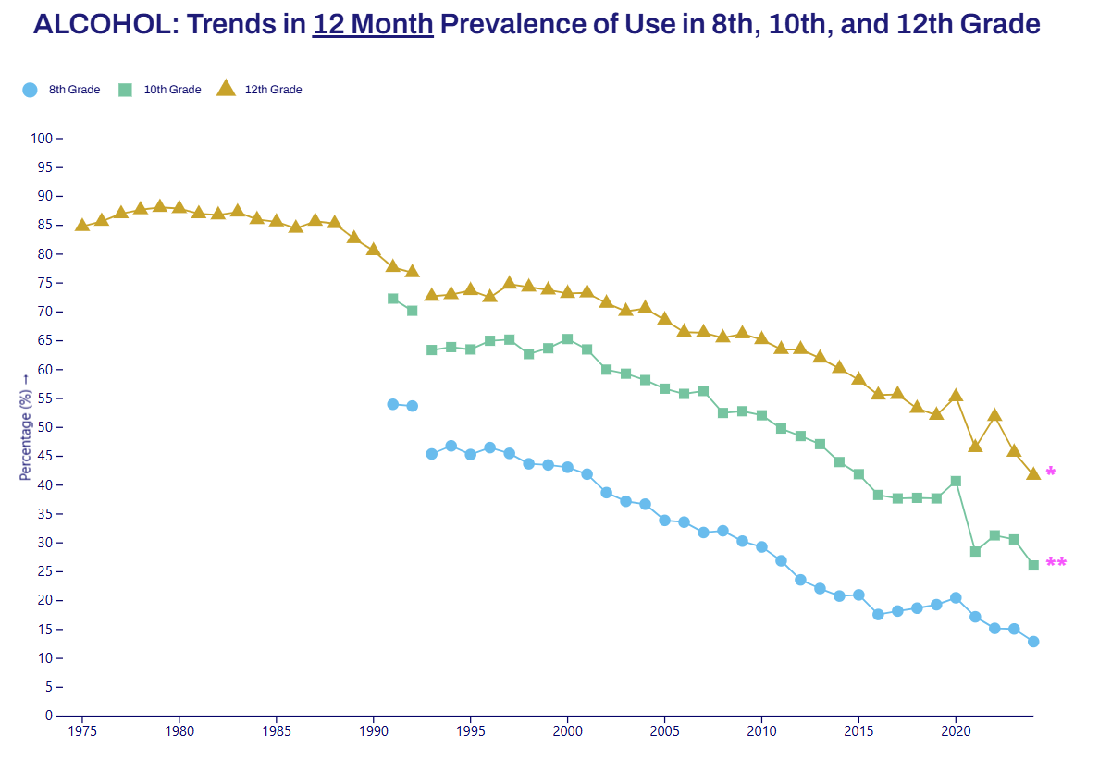
Substance Use Among Adolescents
Miech RA et al. (2025). Monitoring the Future

Slide 7

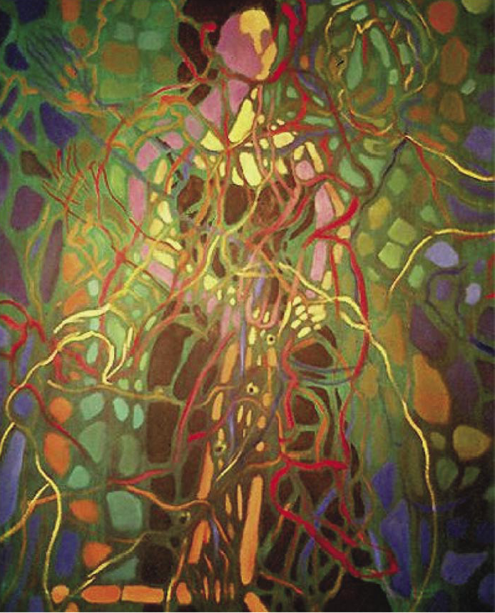
Why do people use substances?
To feel better
To lessen:
Anxiety
Worries
Fears
Depression
Hopelessness
Withdrawal
To feel good
To have novel:
Feelings
Sensations
Experiences
AND
To share them
Drawings courtesy of Vivian Felsen

Slide 8
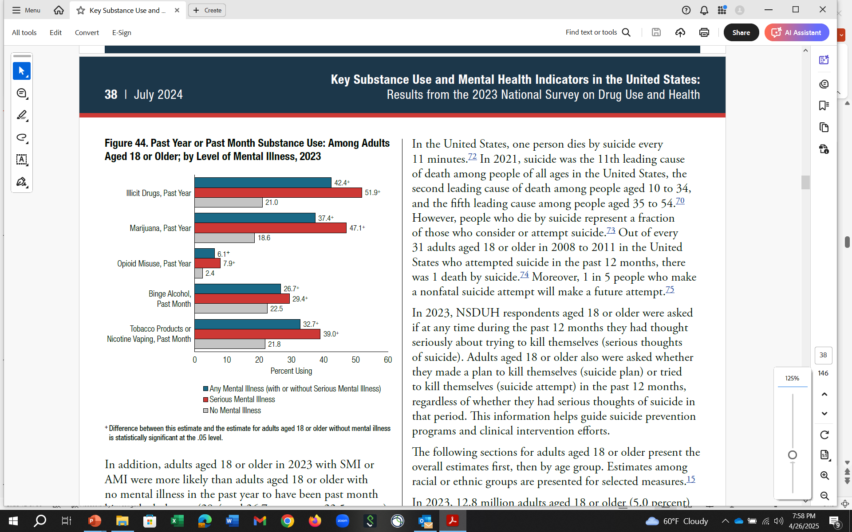
Substance Use by Level of Mental Illness
SAMHSA. (2024). 2023 NSDUH

Slide 9
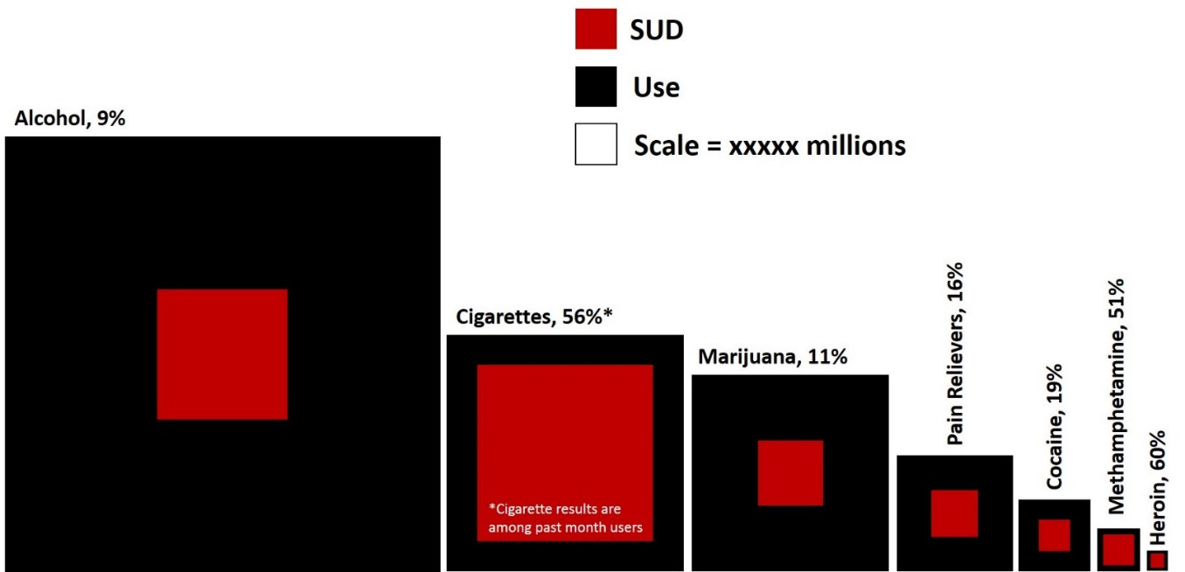

Some Substance More Addictive than Others
A
Alcohol 15 %
Prevalence of
Use and SUD
Population size
Cigarettes 55%
Pain relievers 15%
Cannabis 9%
Cocaine 19%
Meth 51%
Heroin 60%
B
85,000
400,000
>100,000
Drug Related
Mortality
Annual Deaths
Slide from: Susan R.B. Weiss, Director, Division of Extramural Research, NIDA 4/2023

Slide 10
Development of SUD Involves Multiple Factors
Biology
Genes/Development
Environment
DRUG/ALCOHOL USE
Brain Mechanisms
Substance Use Disorder

Slide 11
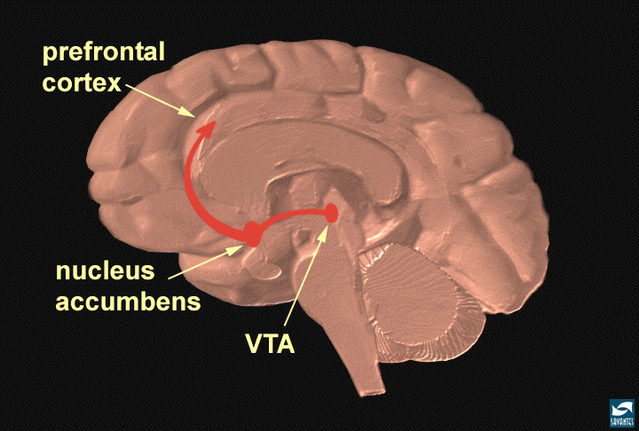
Neuronal Circuits Involved In Substance Use and Addiction
Executive Function
Inhibitory Control
PFC
ACG
OFC
Hipp
SCC
Reward
Motivation
Drive
NAcc
VP
Amyg
Memory
Learning
Notes:
FC – prefrontal cortex; ACG – anterior cingulate gyrus; OFC – orbitofrontal cortex; SCC – subcallosal cortex; NAc – nucleus accumbens; VP – ventral pallidum; Hipp – hippocampus; Amyg – amygdala.

Slide 12
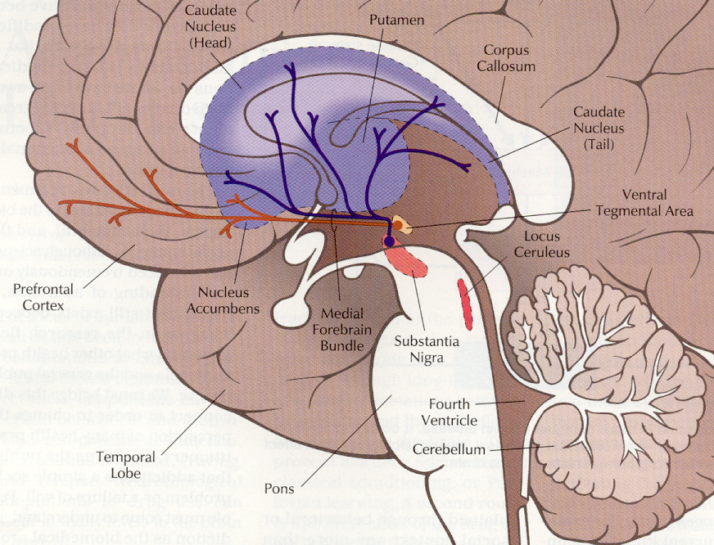
The Reward Pathway
Reward and reinforcement is in part controlled by mu-opioid receptors in the Reward Pathway:
Dopaminergic system
Ventral Tegmental Area (VTA)
Nucleus Accumbens with projections to Prefrontal Cortex
Leshner A. Hospital Practice. 1996

Slide 13
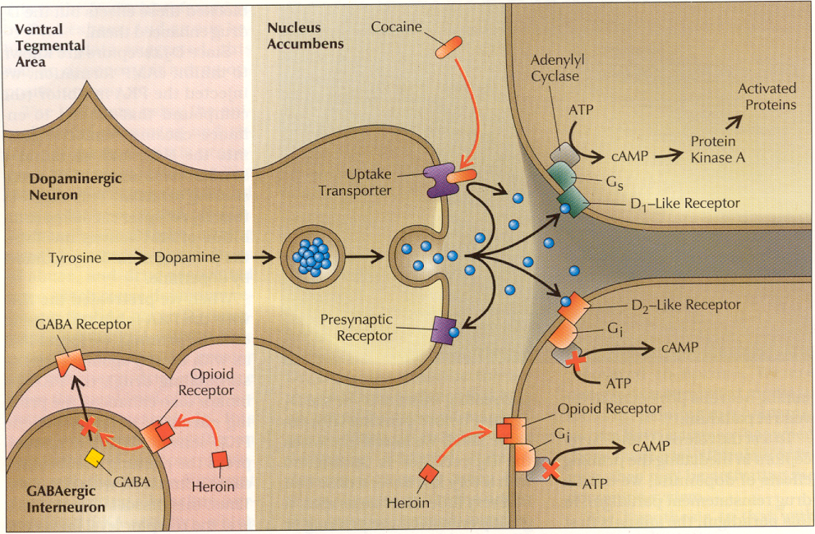
The Reward Pathway
Leshner A. Hospital Practice. 1996

Slide 14
Natural Rewards Elevate Dopamine Levels
Food
Sex
200
200
NAc shell
150
150
% of Basal DA Output
DA Concentration (% Baseline)
100
100
50
Empty
Box Feeding
Female Present
0
0
60
120
180
Sample
Number
1
2
3
4
5
6
7
8
Time (min)
Rat brain dialysis measuring extracellular synaptic dopamine concentration
Di Chiara et al., Neuroscience, 1999
Fiorino and Phillips, J. Neuroscience, 1997
Notes:
14
Natural rewards stimulate dopamine neurotransmission. Eating something that you enjoy or being stimulated sexually can cause dopamine levels to increase. In these graphs, dopamine is being measured inside the brains of animals. Its increase is shown in response to food or sex cues. This basic mechanism of controlled dopamine release and reuptake has been carefully shaped and calibrated by evolution to reward normal activities critical for our survival.

Slide 15
Drugs Elevate Dopamine More/Longer
1100
Amphetamine
400
Cocaine
1000
900
800
300
700
% of Basal Release
600
% of Basal Release
500
200
400
300
200
100
100
0
0
0
1
2
3
4
5
0
1
2
3
4
5
Hrs. after amphetamine
Hrs. after cocaine
250
250
Nicotine
Morphine
200
200
% of Basal Release
150
% of Basal Release
150
100
100
0
0
0
1
2
3
0
1
2
3
4
5
Hrs. after nicotine
Hrs. after morphine
Di Chiara G, Imperato A. Proc Natl Sci. 1988

Slide 16


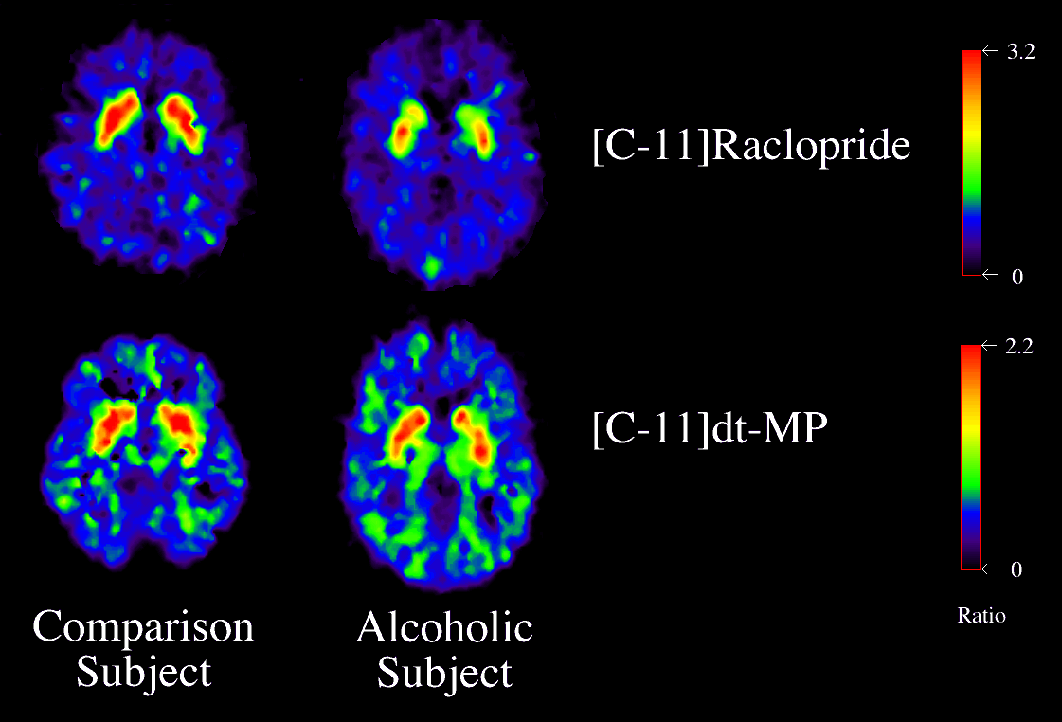
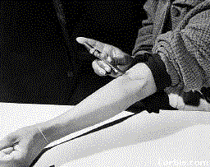
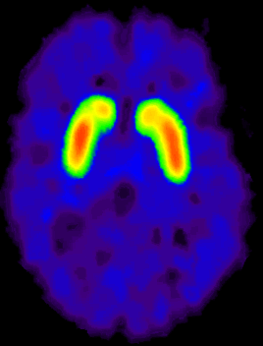
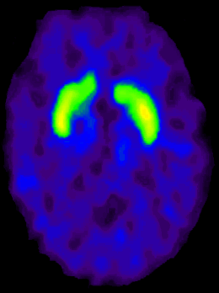
Dopamine Receptors & Function Lower in Individuals with Addiction
“hypo-dopaminergic state”
Volkow et al., Neuro Learn Mem 2002
Clinical Presentation
Protracted abstinence syndrome
  Derangement of endogenous opioid receptor system
  Symptoms
    Malaise, fatigue, insomnia
    Poor tolerance to stress and pain
    Opioid craving
Conditioned cues (triggers)
Priming w/ small dose of drug
Cocaine
DA D2 Receptor Availability
Alcohol
Heroin
Control
Addicted
Notes:
PET studies measuring DA D2 receptors have consistently shown long-lasting decreases in DA D2 receptors in drug abusers when compared with controls (reviewed Volkow & Fowler, 2000) (Table 1) (Fig. 2). We have postulated that the decreases in DA D2 receptors coupled with the decreases in DA brain function in the drug abusers would result in a decreased sensitivity of reward circuits to stimulation by natural reinforcers

Slide 17
Genetics
Gene Environment Interaction
Environment

Slide 18
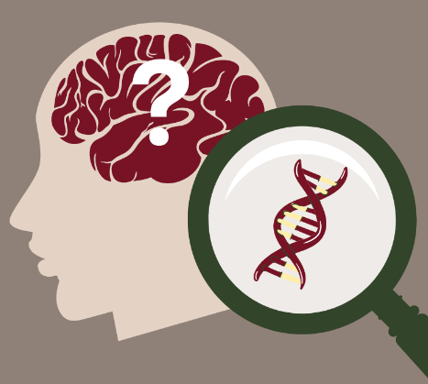
Genetics of SUD
Substance use disorders (SUD) are heritable psychiatric disorders
  Twin and family studies have demonstrated strong familial inheritance pattern
  Genetic influences account for approximately 50% of the SUD risk
  SUDs are highly polygenic with many variants across the genome conferring risk
In addition to substance-specific influences, there are genetic factors that contribute to SUD more broadly
1st generation SUD genome-wide association studies suggest non-uniform genetic influences across substance use (e.g., consumption) and problematic use (e.g., SUD)
Deak JD, Johnson EC. Psychological Medicine. 2021

Slide 19
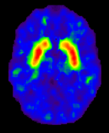
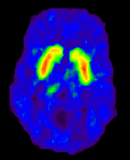
DA Receptor Levels and Predisposition for Drug Use
Striatal Dopamine D2 receptors (D2R) levels and reinforcing responses to the psychostimulant methylphenidate (MP) in nondrug-using subjects (n=7)
Subjects with low D2R levels in the striatum found MP pleasant while those with high D2R found MP unpleasant
Low D2R = “reward deficiency syndrome”
2.5
unpleasant response
0
Striatal D2R modulate reinforcing responses to stimulants and may underlie predisposition for drug use
pleasant response
D2R radioligand and PET imaging
Volkow ND et al. Synapse. 2002
Notes:
We had shown that striatal DA D2 receptors levels predicted the reinforcing responses to the psychostimulant drug methylphenidate in nondrug‐abusing subjects. Here, we assessed the replicability of this finding. We measured D2 receptors with PET and [¹¹C]raclopride (twice to determine stability) in seven nondrug‐abusing subjects to assess if they predicted the self‐reports of “drug‐liking” to intravenous methylphenidate (0.5 mg/kg). DA D2 measures were significantly correlated with “drug‐liking” in both evaluations (r = 0.82 and r = 0.78); subjects with the lowest levels reported the higher ratings of “drug‐liking” and vice versa. These results replicate our previous findings and provide further evidence that striatal DA D2 receptors modulate reinforcing responses to stimulants in humans and may underlie predisposition for drug self‐administration.

Slide 20
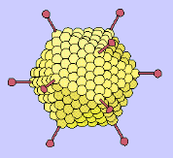
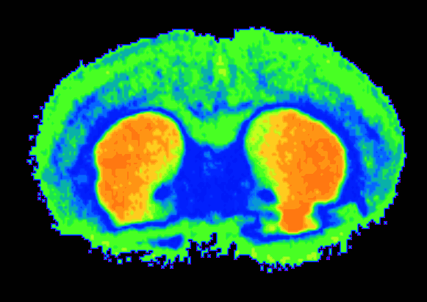
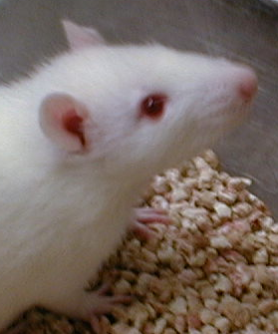
Effects of an Adenovirus Vector Carrying a D2R Gene into NAc
Overexpression of D2R reduces alcohol self-administration
60
1st D2R Vector
p < 0.0005
2nd D2R Vector
50
Rats trained to self-administer alcohol
p < 0.0005
40
p < 0.005
p < 0.005
30
Percent Change in D2R
20
p < 0.10
High levels of D2R may be protective against excessive (risky) alcohol use
10
0
4
6
8
10
Null Vector
0
24
0
-20
DA
DA
-40
p < 0.01
DA
DA
% Change in Alcohol Intake
DA
p < 0.01
DA
-60
DA
p < 0.001
DA
-80
p < 0.001
p < 0.001
-100
0
4
6
8
10
24
Thanos, PK et al., J Neurochem, 2001.
Time (days)
Notes:
The mechanism(s) underlying predisposition to alcohol abuse are poorly understood but may involve brain dopamine system(s). Here we used an adenoviral vector to deliver the dopamine D2 receptor (DRD2) gene into the nucleus accumbens of rats, previously trained to self-administer alcohol, and to assess if DRD2 levels regulated alcohol preference and intake. We show that increases in DRD2 (52%) were associated with marked reductions in alcohol preference (43%), and alcohol intake (64%) of ethanol
preferring rats, which recovered as the DRD2, returned to baseline levels. In addition, this DRD2 overexpression similarly produced signi®cant reductions in ethanol nonpreferring rats, in both alcohol preference (16%) and alcohol intake (75%). This is the ®rst evidence that overexpression of DRD2 reduces alcohol intake and suggests that high levels of DRD2 may be protective against alcohol abuse.

Slide 21
Environmental Factors and SUD
Drug availability
Peers who use drugs
Family problems
Early physical or sexual trauma
Stress
Notes:
Many environmental factors also contribute to a person’s propensity to take drugs of abuse. These include having a history of physical or sexual abuse, witnessing violence, or experiencing other kinds of stressors. Drug availability is, of course, a primary environmental factor in contributing to drug abuse and addiction.

Slide 22
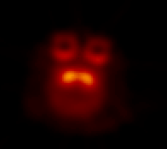
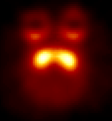
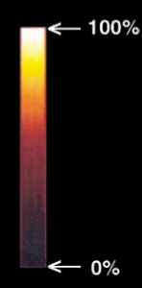
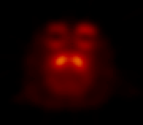
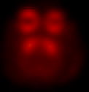
Social Stressors Change D2R Amount & Availability & Propensity to Administer Cocaine
N
Individually
Housed
Group
Housed
Dominant
50
Subordinate
Becomes Dominant
No longer stressed
40
>20% higher D2R
30
*
Reinforcers (per session)
*
20
Social Setting Can Change Neurobiology
10
0
Becomes Subordinate
Stress remains
S
.003
.01
.03
.1
Cocaine (mg/kg/injection)
N=20 monkeys
Morgan, D. et al. Nature Neuroscience, 2002
Notes:
Here we used positron emission tomography (PET) imaging to study brain dopaminergic function in individually housed and in socially housed cynomolgus macaques (n = 20). Whereas the monkeys did not differ during individual housing, social housing increased the amount or availability of dopamine D₂ receptors in dominant monkeys and produced no change in subordinate monkeys. These neurobiological changes had an important behavioral influence as demonstrated by the finding that cocaine functioned as a reinforcer in subordinate but not dominant monkeys. These data demonstrate that alterations in an organism's environment can produce profound biological changes that have important behavioral associations, including vulnerability to cocaine addiction.

Slide 23
Adverse Childhood Experiences (ACE) and SUD
10
Higher prevalence of ACEs in populations with SUD versus general population
Positive association between ACEs and the development and severity of SUD in adolescence and adulthood
Retrospective cohort
(n = 8603
8
6
SUD Odds ratio
4
2
0
0
1
2
3
4
5
ACE Score
Dube SR et al. Pediatrics 2003
Leza L, et al. Drug Alc Depend. 2021
Notes:
Abuse and neglect, parental loss, physically/sexually abuse
23

Slide 24
Memory Circuit
Hipp
Amyg
MEMORY/
LEARNING
“People, places and things…”

Slide 25
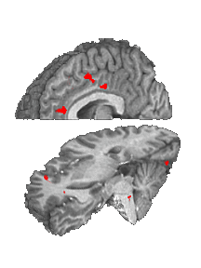

Cocaine Craving
Population (Cocaine Users, Controls) x Film (cocaine )
Cocaine Film
fMRI
Cingulate
Ant Cing
Signal Intensity (AU)
Inf Frontal
Gyrus
Controls (14) Cocaine Users (17)
Garavan H et al. Am J Psychiatry. 2000

Slide 26
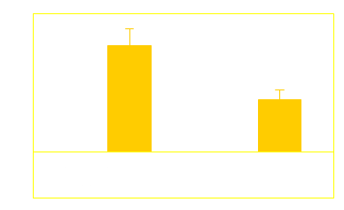
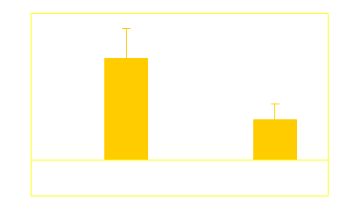

Cocaine Craving
Population (Cocaine Users, Controls) x Film (cocaine, erotic)
Cocaine Film
Erotic Film
fMRI
Cingulate
Ant Cing
Signal Intensity (AU)
Inf Frontal
Gyrus
Controls (14) Cocaine Users (17)
Garavan H et al. Am J Psychiatry. 2000

Slide 27
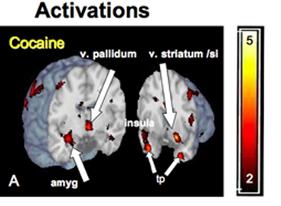
Even Unconscious Cues Can Elicit Brain Responses
Brain Regions Activated by 33 millisecond Cocaine Cues (too fast for conscious recognition)
Childress, et al., PLoS ONE 2008

Slide 28
Treatment

Slide 29
Assessing Treatment Effectiveness
Hypertension Treatment
Addiction Treatment
IT WORKS!
FAILURE!
Stage of Treatment
Stage of Treatment
McLellan AT et al. JAMA 2000

Slide 30
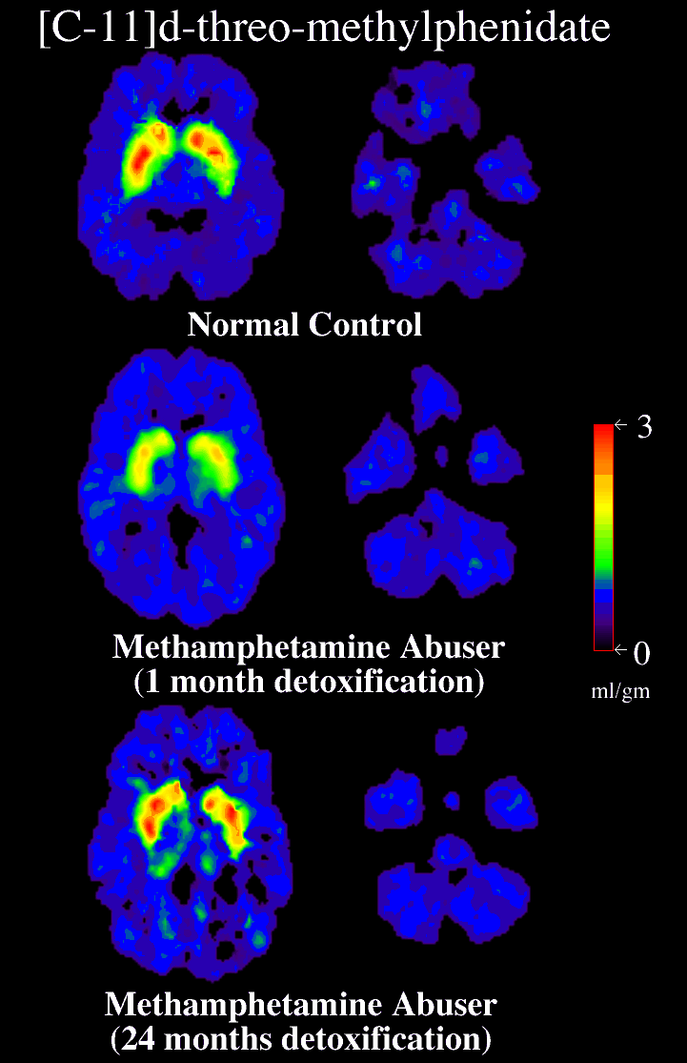
Long Term Recovery Reverses Brain Dopamine Effects
Improvement in brain metabolism with prolonged abstinence from methamphetamine use
3
0
Normal Control
METH User
(1 month)
METH User
(14 months)
ml/gm
Volkow, ND et al., Journal Neuroscience 2001
Volkow, ND et al., Journal of Neuroscience 2001

Slide 31
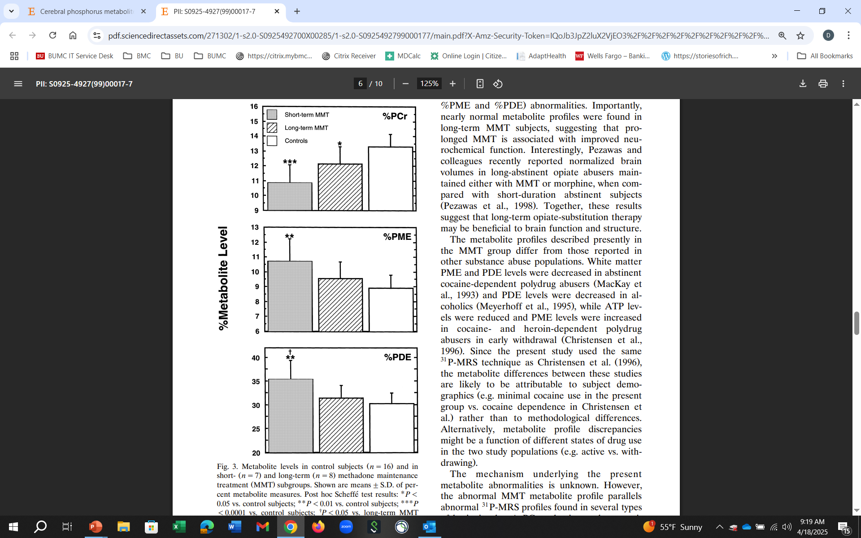
Cerebral Neurochemical Changes on MOUD
Measured cerebral phosphorus metabolites in subjects with OUD on methadone therapy to determined whether metabolite profiles differed based on treatment duration
The nearly normal metabolite profile in subjects on long-term methadone suggests that prolonged treatment may be associated with improved neurochemistry
Kaufman MJ, et al. Psychiatry Research: Neuroimaging. 1999
Notes:
This study evaluated cerebral phosphorus metabolites in opiate-dependent polydrug abusers in methadone maintenance therapy MMT and determined whether metabolite profiles differed based on treatment duration. Phosphorus magnetic resonance spectroscopy P-MRS data were acquired Study subjects included 15 MMT subjects, seven having undergone treatment for an average of 39"23 weeks mean . "S.D. and eight having undergone treatment for 137"53 weeks, as well as an age matched comparison group. The methadone dose
administered on the study day averaged 70.5"17.1 mg and was statistically equivalent in short- and long-term subgroups. MMT subjects. ns15 differed from control subjects in percent phosphocreatine %PCr levels y13% , and in both phosphomonoester %PME, 13% and phosphodiester %PDE, q10% levels, which likely reflect abnormalities in energy and phospholipid metabolism, respectively. In short-term MMT treatment subjects, abnormal %PCr Ž . y18% , %PME20% and %PDE q17% levels were found compared with control subjects. The only metabolite abnormality detected in long-term MMT subjects was decreased %PCr Ž . y9% , in spite of continued illicit drug abuse. From these data, we conclude that polydrug abusers in MMT have 31P-MRS results consistent with abnormal brain metabolism and phospholipid balance. The nearly normal metabolite profile in long-term MMT subjects suggests
that prolonged MMT may be associated with improved neurochemistry

Slide 32
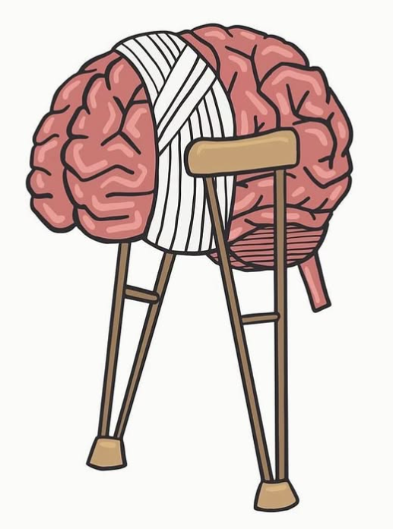
Does the Brain Recovery During Abstinence?
45 studies with neuroimaging to assess neurobiological recovery
  Majority demonstrated at least partial neurobiological recovery with abstinence
  Structural recovery occurs predominantly in frontal cortical regions, the insula, hippocampus, and cerebellum
  Functional and neurochemical recovery was similarly observed in prefrontal cortical regions but also in subcortical structures
  Structural recovery appears to precede neurochemical recovery, which begins soon after cessation
  Functional recovery may require longer periods of abstinence
Paraz MA et al. Drug Alc Depend. 2022

Slide 33
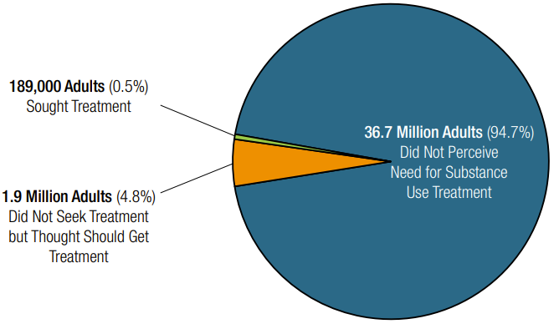
Substance Use Disorder Treatment
Among the 48.5 million adults with a SUD in the past year only 14.6% received treatment in the past year
Of the 94.7% who did not perceive the need…
74% thought able to handle it on their own
66% not ready for treatment
60% not ready to stop use
44% worried about stigma
42% worried about cost
41% not having the time
39% not knowing how to get treatment
35% worried confidentiality
Of those who did not receive treatment…
SAMHSA. (2024). 2023 NSDUH

Slide 34
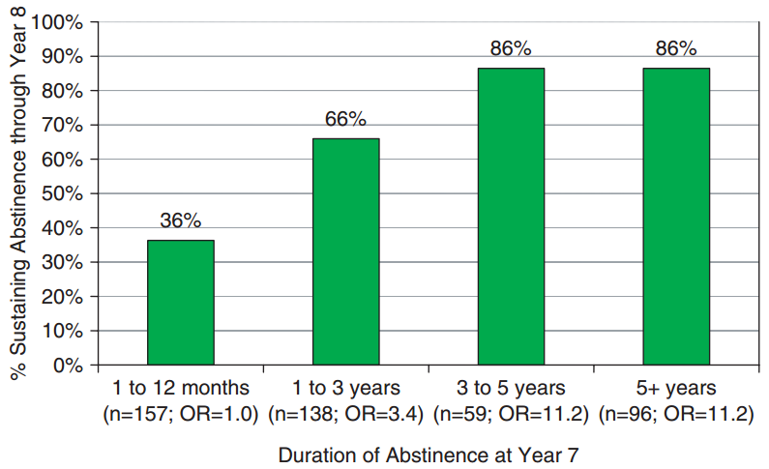
How Long is Treatment Needed?
N=482 abstinent at least a month
Divided into 4 groups based on duration of abstinence at Year 7
Measured continuous abstinence from Year 7 to Year 8
After 3 years in recovery < 15% relapse
It takes a year of abstinence before <50% relapse
Dennis ML et al. Eval Rev. 2007
Notes:
examines how the duration of abstinence at a given point is related to the odds of sustaining abstinence in the subsequent year.
This figure shows the odds of sustaining recovery to year 8 based on the duration of abstinence as of year 7.
Data are from the Pathways to Recovery sample of 1326 patients
Results show that extended abstinence is predictive of sustained recovery.
If abstinent for a year or less, only 36% were likely to still be abstinent the following year.
The odds of remaining abstinent rise above chance if patients had been abstinent 1 to 3 years. 66% percent were still abstinent the following year.
The most telling result is that beyond 3 years of abstinence recovery odds remain high and stable, as indicated by the results for both the 3-5 year group and the greater than 5-year group.
After 5 years of sobriety, their a appears to be a plateau of sustained recovery.

Slide 35
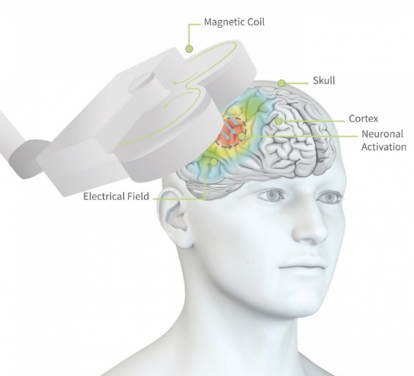
Emerging Treatments
Longer acting medications (new formulations): methadone, buprenorphine, naltrexone
Biologics: Vaccines, monoclonal antibodies
Digital Therapeutics: apps and other interactive modalities
Devices: TDCS (transcranial direct current stimulation); Focused Ultrasound; TMS (transcranial magnetic stimulation)
Other target behaviors: Sleep; Overdose prevention (i.e. reverse respiratory depression)
Deep brain stimulation: Nucleus Accumbens
Psychedelics (Alcohol, nicotine, comorbid depression)

Slide 36
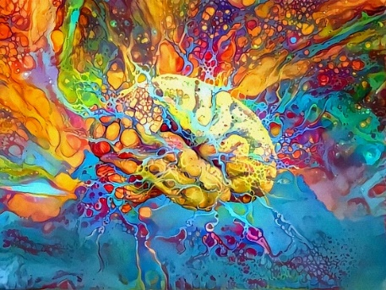

Psychedelics
“Classic” - LSD, psilocybin, mescaline and “non-classic” - ketamine, ibogaine
1st documented in Western medicine in 1934, Bill Wilson, co-founder of AA tried LSD to treat his AUD “Feeling of great peace, spiritual, self-transcendent awakening, can better see what we are and where we are going”
Mechanism unclear, may restore:
  impairments in brain reward processing, salience attribution, impulsivity and inhibitory control and emotional regulation through “re-broadening” reward networks
  neurotransmitter deficits and dysfunction of dopamine/serotonin reward systems
Psychotherapist to prepare patient and help consolidate the experience afterwards
Many outstanding questions about mechanisms, safety, efficacy and effectiveness
Zafar R et al. Front. Psychiatry. 2023
Mehtani NJ et al. JAMA Neurology. 2024

Slide 37
Thanks!

