Slide 1
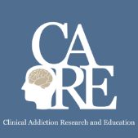
Fetal Alcohol Spectrum Disorders
Immersion Training in Addiction Medicine Program 2025
Addiction Medicine Lightening Rounds
April 2025
Daniel P. Alford, MD, MPH
Professor of Medicine
Associate Dean, Center for Continuing Education
Director, SAFEST Choice National Learning Collaborative

Slide 2
Fetal Alcohol Toxicity
Experimental and clinical studies demonstrate alcohol is a teratogen
Prenatal alcohol exposure can impair brain development throughout all stages of gestation
Alcohol quickly equilibrates between the maternal and fetal compartments and rapidly reaches the fetus
Amniotic sac serves as a reservoir for alcohol, prolonging fetal exposure
Approximately 1 in every 13 infants prenatally exposed to alcohol will develop an FASD
Variables leading to impaired fetal development are complex and interrelated
Maternal and fetal genetics, maternal health and nutrition
Alcohol dose, pattern and timing of exposure
Binge drinking (4+ drinks/occasion) is associated with more severe effects
Lemoine P et al. Ouest Med. 1968
Jones K et al. Lancet 1973
Abel EL et al. J Pharm Exp Ther 1978
Chernoff GF Teratology, 1977
Lebel C, et al. Neuropsychol Rev. 2011
Petrelli B, et al. Biochem Cell Biol. 2018
Warren KR et al. Alc Res & Health. 2011
Popova S, et al. Biochem Cell Biol 2018

Slide 3
PAE and the Brain
Corpus callosum is under-developed in the child with an FASD
The callosum carries information between the right and left sides of the brain and is critical for thinking, learning, memory
Colored image shows how these fibers that fan out into the sides of the brain are underdeveloped in the child with an FASD
Wozniak JR, Muetzel RL. Neuropsychol Rev. 2011.
Notes:
* Not always visible in MRI, can vary
Wozniak JR, Muetzel RL. What does diffusion tensor imaging reveal about the brain and cognition in fetal alcohol spectrum disorders? Neuropsychol Rev. 2011 Jun;21(2):133-47. doi: 10.1007/s11065-011-9162-1. Epub 2011 Feb 25. PMID: 21347880.
Fig. 6 Inter-hemispheric fiber tracking through the corpus callosum in a 12 year-old boy with partial FAS and gross structural abnormalities including partial agenesis of the corpus callosum (left panel) compared with a non-exposed 12 year-old male control subject (right panel). The top panels are DTI tractography images overlaid on fractional anisotropy maps. The bottom panels are T1-weighted anatomical images. Tractography images were generated using the Diffusion Toolkit (http://trackvis. org/dtk)

Slide 4
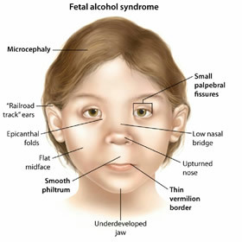
Fetal Alcohol Spectrum Disorders (FASDs)
Few people with FASD have these facial features
FAS: Fetal Alcohol Syndrome
pFAS: Partial FAS
ARND: Alcohol-Related Neurodevelopmental Disorder
ARBD: Alcohol-Related Birth Defects
ND-PAE*: Neurobehavioral Disorder associated with Prenatal Alcohol Exposure
FAS
pFAS
ARND
ARBD
ND-PAE
*included in DSM-5 as “conditions for further study.”
Notes:
May PA, Chambers CD, Kalberg WO, Zellner J, Feldman H, Buckley D, Kopald D, Hasken JM, Xu R, Honerkamp-Smith G, Taras H, Manning MA, Robinson LK, Adam MP, Abdul-Rahman O, Vaux K, Jewett T, Elliott AJ, Kable JA, Akshoomoff N, Falk D, Arroyo JA, Hereld D, Riley EP, Charness ME, Coles CD, Warren KR, Jones KL, Hoyme HE. Prevalence of Fetal Alcohol Spectrum Disorders in 4 US Communities. JAMA. 2018 Feb 6;319(5):474-482. doi: 10.1001/jama.2017.21896. PMID: 29411031; PMCID: PMC5839298.
ARND should be changed to ND-PAE/ARND. ND-PAE stands for neurobehavioral disorder associated with prenatal alcohol exposure This was new to DSM V. The diagnosis of ND-PAE encompasses the behavioral, developmental, and mental health aspects of FASDs
Diagnosis of ND-PAE is appropriate if a child presents with impairment in neurocognition, impaired self-regulation, 2 impairments of adaptive functioning, and a history of more than minimal exposure to alcohol in utero (Table 1), as long as the disorder is not better explained by other factors (eg, genetic or teratogenic syndrome). Although these broad domains overlap with other disorders of childhood, specific deficits within them are indicative of ND-PAE. As
ICEBERG IMAGE: iStock photo ID:452595535 purchased 4/27/21 $12.00

Slide 5
Fetal Alcohol Spectrum Disorders (FASDs)
FASDs are a range of conditions attributable to prenatal alcohol exposure that include behavioral, learning, and physical problems
In the US, FASDs are the most common preventable developmental disabilities
FASDs are permanent
In the US, an estimated 1-5% of 1st grade children may have an FASD¹
FASDs occur in all socioeconomic and ethnic groups²
May PA et al. JAMA. 2018
Popova S et al. BMC Public Health. 2019
Notes:
Although the prevalence of FAS in the United States during the 1980s and 1990s was reported as 0.5 to 2 cases per 1000 live births, recent studies aggressively diagnosing FASD have reported FAS rates and FASD estimates of 6 to 9 cases and 24 to 48 cases per 1000 children (or up to 5%), respectively, while continuing to consider these rates underestimates.14–16 Rates as high as 9 cases per 1000 live births
have long been documented among vulnerable populations, usually related to isolation and socioeconomic impoverishment, such as can be more often found among certain American Indian and other racial/ethnic minority populations.17–19

Slide 6
Challenges to Preventing FASDs
Non-Pregnant Women of Reproductive Age
Unintended Pregnancies
Pregnant Women
54% report alcohol use in previous 30 days¹
18% report binge drinking in previous 30 days ¹
49% of pregnancies are unplanned¹
Pregnancy may not be known for up to 6 weeks or later into the pregnancy²
13.5% report alcohol use in previous 30 days³
5% reported binge drinking in previous 30 days³
Tan CH, et al. Morb Mortal Wkly Rep. 2015
Green PP, et al. Morb Mortal Wkly Rep. 2016
Gosdin LK et al. Morb Mortal Wkly Rep 2022
Notes:
UPDATE
https://www.nytimes.com/2020/10/03/style/am-i-drinking-too-much.html
https://www.rand.org/news/press/2020/09/29.html
Gosdin LK, Deputy NP, Kim SY, Dang EP, Denny CH. Alcohol Consumption and Binge Drinking During Pregnancy Among Adults Aged 18–49 Years — United States, 2018–2020. MMWR Morb Mortal Wkly Rep 2022;71:10–13. DOI: http://dx.doi.org/10.15585/mmwr.mm7101a2external icon
Tan CH, Denny CH, Cheal NE, Sniezek JE, Kanny D. Alcohol use and binge drinking among women of childbearing age - United States, 2011-2013. MMWR Morb Mortal Wkly Rep. 2015 Sep 25;64(37):1042-6. doi: 10.15585/mmwr.mm6437a3. PMID: 26401713.
Green PP, McKnight-Eily LR, Tan CH, Mejia R, Denny CH. Vital Signs: Alcohol-Exposed Pregnancies--United States, 2011-2013. MMWR Morb Mortal Wkly Rep. 2016 Feb 5;65(4):91-7. doi: 10.15585/mmwr.mm6504a6. PMID: 26845520.
Denny CH, Acero CS, Naimi TS, Kim SY. Consumption of alcohol beverages and binge drinking among pregnant women aged 18–44 years – United States, 2015–2017. MMWR Morbidity and Mortality Weekly Report 2019; 68(16): 365-368.

Slide 7
Reasons for Alcohol Use During Pregnancy
4 Themes
Theme 1: Influence of individual beliefs about alcohol
Beneficial properties
Harmful only in specific types and quantities
Less harmful than other prenatal exposures (e.g., smoking)
Theme 2: Influence of culture
Social acceptability and pressure
Part of tradition and custom
Influenced by personal/peer experiences in the community
Popova S et al. Drug Alcohol Rev. 2022

Slide 8
Reasons for Alcohol Use During Pregnancy
4 Themes
Theme 3: Influence of knowledge and advice
Consumed alcohol for other health conditions (e.g., nausea)
Lack of awareness/knowledge of the adverse impacts of alcohol on the fetus
Insufficient or mixed advice from medical practitioners
Theme 4: Influence of pregnancy circumstances
Consumed alcohol as a coping mechanism for adverse events during pregnancy
Unplanned or unwanted pregnancy
Alcohol use disorder
Popova S et al. Drug Alcohol Rev. 2022

Slide 9
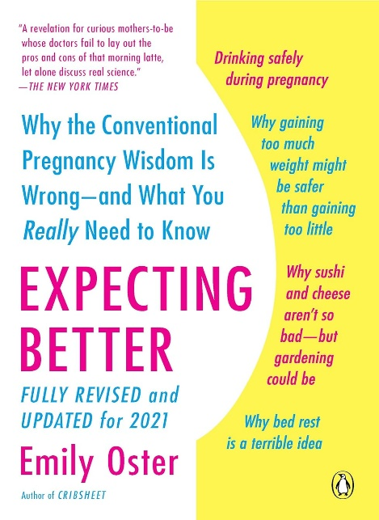
Education Gaps & Mixed Messaging
Lack of education and awareness among health care providers
Only 16% of pregnant persons with known past 30-day alcohol consumption were advised by a health care provider to quit or reduce their alcohol use (Luong J, et al. MMWR 2023)
Mixed messaging…
“more than the occasional drink is likely perfectly fine,...Specifically, one to two drinks a week in the first trimester, and up to a drink a day in the second and third trimester, is likely safe”
Expecting Better by Emily Oster
The correct message is:
“There is no known safe amount of alcohol, type of alcohol, or time of alcohol use during pregnancy or while trying to become pregnant”

Slide 10
Thanks!

