Slide 1
Cannabis
Jessie Calihan, MD MS
General Academic Pediatrics Fellow
Boston Medical Center
April 28, 2025
Notes:
I want to start by acknowledging that lots of people may have strong opinions about cannabis and legalization efforts, which I’m not going to focus on today.
I’m coming to this talk from the perspective of an adolescent medicine provider who cares for lots of young people who use cannabis, and I therefore worry about the particular effects on the developing brain.
And while many of youth I see will never have problems related to their cannabis use, for others it causes substantial disruption to their school engagement and achievement, worsens or precipitates psychiatric symptoms, disrupts relationships with family and peers, and/or leads to system involvement through arrests and incarceration.

Slide 2
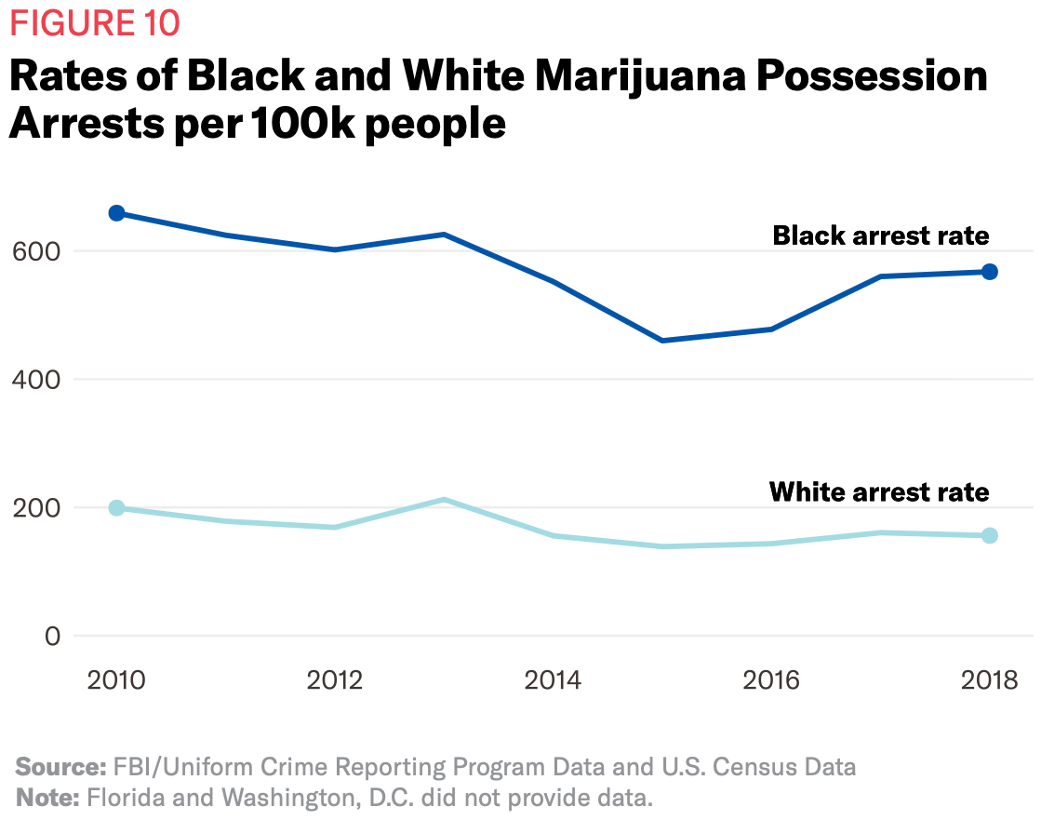
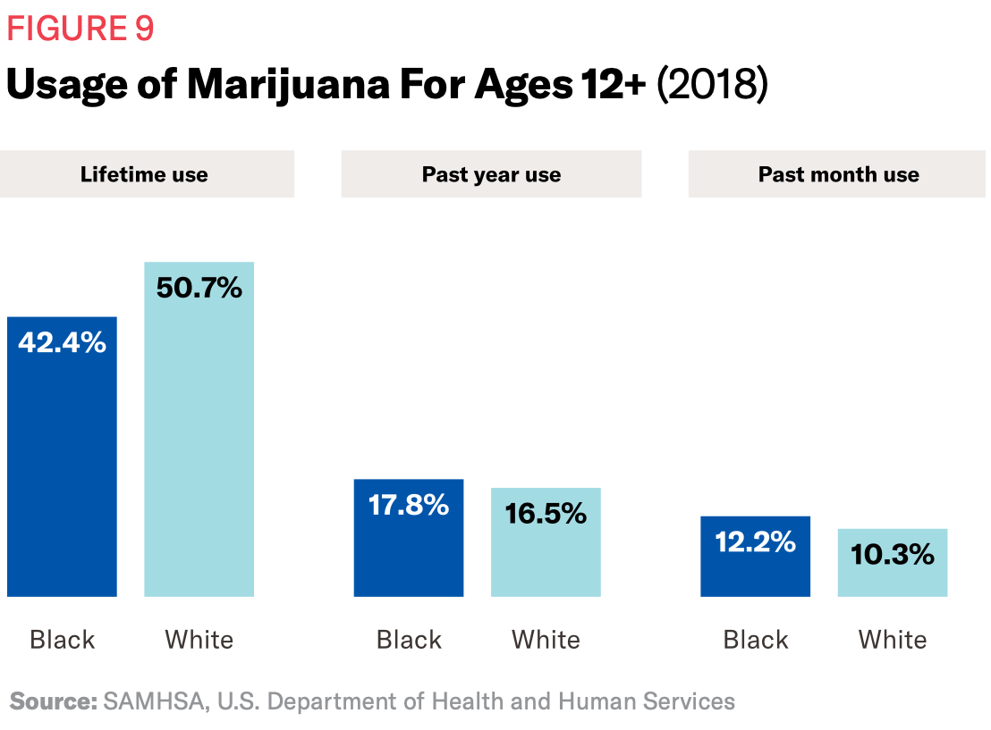
Cannabis & Racism
ACLU. A Tale of Two Countries: Racially Targeted Arrests in the Era of Marijuana Reform. 2020.
Notes:
It’s important to remember that these consequences do not affect all youth equally, which is disturbing and harmful for everyone, particularly those impacted.
These are data from a 2020 report from the ACLU showing that despite similar rates of cannabis use by Black youth, shown in the royal blue bar, and white youth, shown in the lighter teal bar, the black arrest rate per 100,000 people from 2010 to 2018 is substantially higher than the white arrest rate during those years.
Fortunately, across the country, states that legalized marijuana have seen larger average decreases in marijuana possession and sale offense arrest rates than states that only decriminalized marijuana.
I hope this is a useful context for the rest of this presentation, where we will focus on evidence-based information about potential cannabis-related harms and ways to prevent these. This is not about saying that people should never use cannabis, but instead recognizing when use becomes problematic and how effects can differ by age.

Slide 3
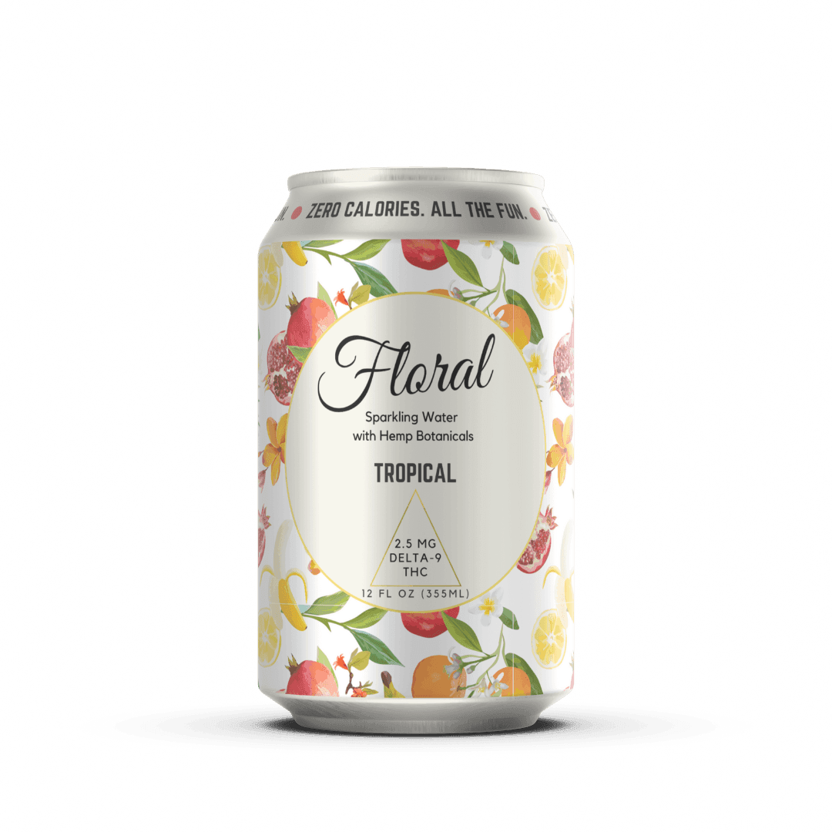
Definitions
Cannabis = all products from plants sativa & indica
100s cannabinoids
Delta 9 tetrahydrocannabinol (THC): partial agonist of CB1 and CB2 receptors
Cannabidiol (CBD): CB1 antagonist
Marijuana = products containing THC
Compounds are not regulated
Notes:
Before going into the rest of this talk, I also want to clarify some terms.
Cannabis refers to all products that come from the Cannabis Sativa and Cannabis Indica plants. These plants contain 1000s of cannabinoids, which bind to cannabinoid 1 receptors in the brain and cannabinoid 2 receptors on immune cells in the periphery and GI system.
Delta 9 tetrahydrocannabinol, or THC, is a partial agonist at both CB1 and 2 receptors with a much higher affinity for CB1 receptors in the brain.
Cannabidiol, or CBD, is a CB1 antagonist so it does not have the same psychoactive effects as THC.
The term marijuana refers to all products containing THC.
And as a reminder, these compounds are not regulated, which I often remind the adolescents I care for.
In this talk, I’m going to generally use the term cannabis to include all products from the plant. However when we talk about epidemiology, I’ll use the word marijuana as that is how the surveys collect data about use and may not capture CBD use.

Slide 4
Learning Objectives
Describe the epidemiology of cannabis use in the United States
Identify adverse health effects of cannabis use.
Council patients on treatment options for cannabis use disorder and withdrawal.
Analyze medical uses of cannabis based on scientific evidence
Notes:
With that background in mind, we’ll use today’s time to
Describe the epidemiology of cannabis use in the United States
Identify adverse health effects of cannabis use.
Council patients on treatment options for cannabis use disorder and withdrawal.
Analyze medical uses of cannabis based on scientific evidence

Slide 5
Describe the epidemiology of cannabis use in the United States
Notes:
Let’s start by describing epidemiology of cannabis use.

Slide 6
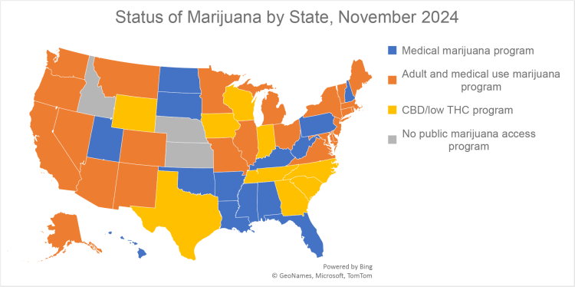
https://klrd.gov/2024/12/18/medical-marijuana-update-2025/
Notes:
It’s helpful to contextualize cannabis use within the legal landscape in the US. This is a recent map of the US showing states with legal medical marijuana in blue, legal recreational and medical adult marijuana use in orange, legal CBD and low THC in yellow, and no legalized cannabis in gray.

Slide 7
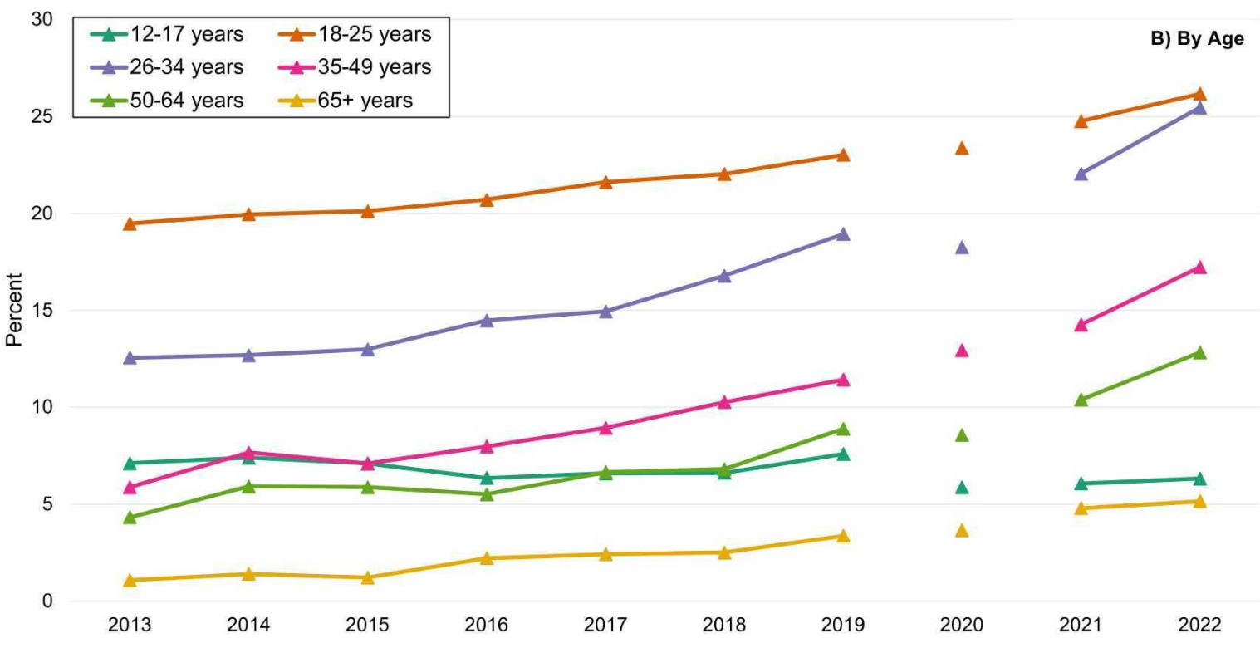
Self-reported past 30-day use by age
Mattingly DT, Richardson MK, Hart JL. Drug Alcohol Depend Rep. 2024;12:100253.
Notes:
Here we are looking at self-reported use of marijuana in the last 30 days in different age groups. These data come from the National Survey on Drug Use and Health.
To contextualize these data, 61.8 million Americans aged 12 and older reported last-year marijuana use and about 2/3 of them (43.6 million) reported last month use in 2023.
For comparison, 134.7 million people reported last month alcohol use and 64.4 million reported past month tobacco or nicotine use of any kind.
So marijuana use remains less common than either of these other legalized substance, but is much more common than any illicit substance use.
To return to these data, the x-axis is years from 2013 to 2022 – note that there was limited and different data collection in 2020 due to the COVID-19 pandemic.
The y-axis is percent of the US population.
Each color represents a different age group.
As you can see, last-month use is most common among 18-25 year olds, then 26-34-year olds.
From 2013 to 2019, use among adolescents 12-17 remained stable while use increased in other age groups. This pattern continued from 2021-2022 except 18-25yo use also remained stable.

Slide 8
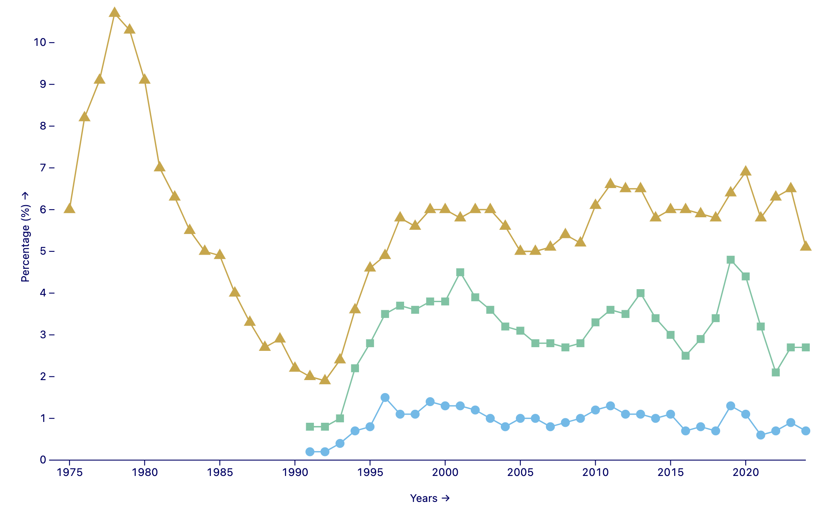
MARIJUANA: Trends in Daily Prevalence of Use in 8th, 10th, and 12th Grade
5.1% 12th graders
2.7% 10th graders
0.7% 8th graders
report daily use
Miech RA et al., Monitoring the Future Monograph Series. Ann Arbor, MI: Institute for Social Research, University of Michigan.
Notes:
Now let’s look at the adolescent data more closely.
These data are from Monitoring the Future, a survey that is distributed to adolescents at a nationally representative set of schools every year to understand trends in substance use and related perceptions.
We’re looking at daily use, which increases risk for adverse consequences, including developing a cannabis use disorder.
This graph shows trends in daily use by 12th graders in yellow, 10th graders in green, and 8th graders in blue. On the x-axis we have years from 1975 to 2023. The y-axis is percent of students.
Marijuana use has decreased amongst 12th graders since the 70s and 80s, however it has increased since a low in the early 1990s and remained very stable since the early 2000s.
We’ll talk about this more on Wednesday, but this stability in use really contrasts with other substance use in adolescents, which has declined pretty dramatically and consistently since the 70s.

Slide 9
Identify adverse health effects of cannabis use and ways to minimize these harms.
Notes:
Now we’re going to transition into talking about adverse health effects. A reminder that I’m coming from the perspective of an adolescent medicine physician and drawing from the available literature.

Slide 10
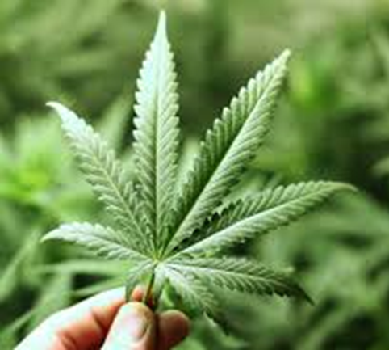
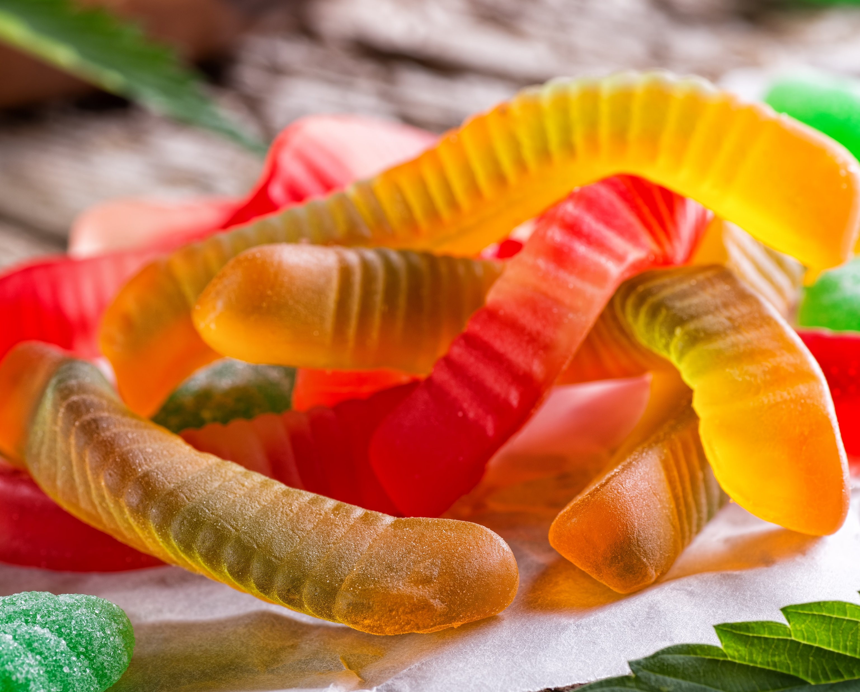
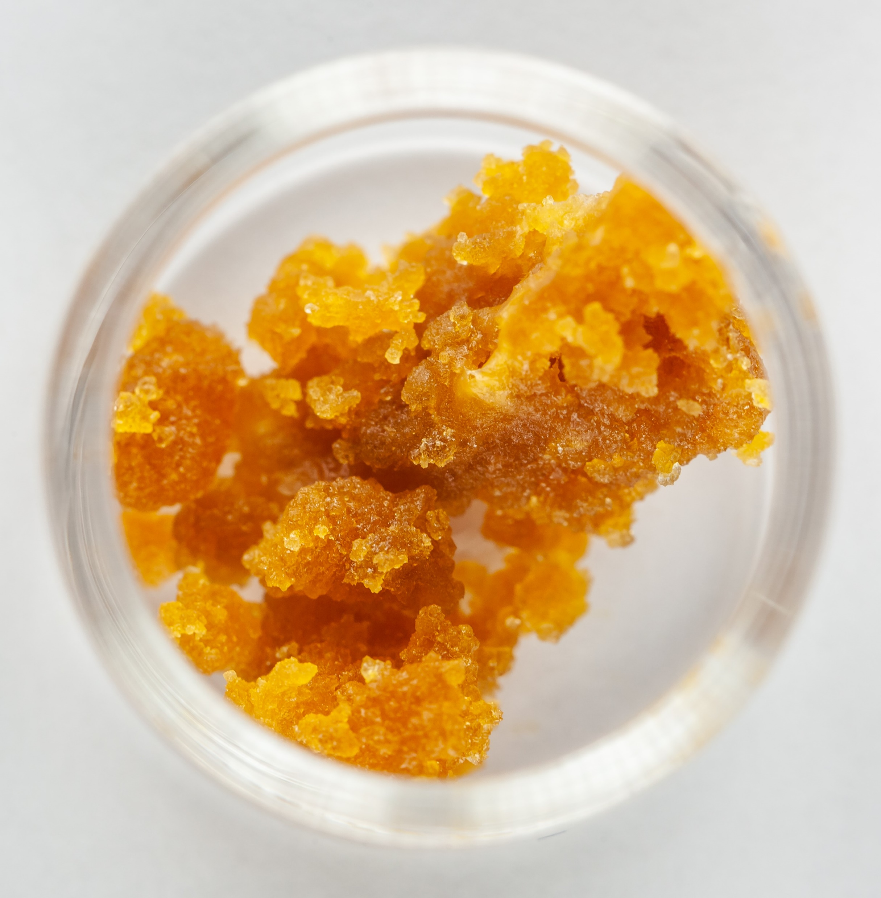
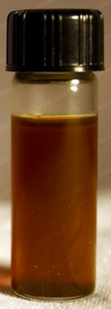
THC content varies by product
The risk of adverse effects from cannabis use increases with increased levels of THC¹.
1980’s: 3% THC
2014: 12% THC²
2017: 17% THC⁴
Varying potency
Dabs - Wax / Shatter
Hash Oil
Variable: 80% to 90% THC³
Notes:
When we talk about the adverse effects of cannabis, it’s crucial to understand that the THC content, which is responsible for effects, varies dramatically between products.
And the risk of adverse effects increases as the THC content increases.
From testing of DEA-seized cannabis products, we know that the THC content in the plant, which is typically smoked or ingested, have increased substantially from 3% in the 1980s to 15-20% in the last decade.
Edibles come in varying potency and serving sizes. I encourage all my adolescents to check serving size and try a small amount first.
Dabs typically use a cannabis wax, often called shatter, with a very high THC concentration. Dabbing is the inhalation of a cannabis vapor from concentrates – oils or wax – through a pen or rig.
Vapes heat oil, dry plant matter, or concentrate to a very high temperature to create a vapor that is then inhaled. There’s no combustion involved. Similar to dabs, this allows the use of very high concentrations of THC. Over half of adolescents and young adults who use cannabis use vapes.

Slide 11
Acute effects of cannabis intoxication
Physiologic effects
Tachycardia (20-50 beats per minute above baseline)
Elevated blood pressure
Bronchial relaxation
Dry mouth and throat
Conjunctival injection
Positive effects
Euphoria
Decreased anxiety
Heightened perception
Increased sociability
Sensation of time slowing
Increased appetite
Decreased pain
Negative effects
Paranoia, anxiety
Psychosis
Irritability
Impaired short-term memory
Poor attention/judgment
Poor coordination/balance
Distorted spatial perception
Altered awareness of time
Slide content courtesy of Dr. Mimi Schizer & Volkow et al., N Engl J Med, 2014.
Notes:
This is a summary of the physiologic, perceived positive, and negative effects of cannabis intoxication. Much of this comes from a nice 2014 New England Journal review written by Nora Volkow.
I’ll point out that in addition to the conjunctival injection we’re all familiar with, cannabis use causes elevations in heart rate and blood pressure.
Many people using cannabis may appreciate the euphoria, decreased anxiety and pain, and increased sociability.
However, I hear from patients that use of high concentration of THC often leads to the negative effects listed here.
Youth are particularly bothered by the anxiety, while their families notice the irritability, and I worry about their impaired memory and poor judgment.

Slide 12
Acute effects of cannabis intoxication
Levy et al., JAMA Pediatrics 2019
Notes:
Studies have shown that these negative effects are quite common, which may be attributable to increased THC concentrations.
This is a 2019 study of 146 adolescents aged 14-18 years presenting for routine primary care who reported past-year cannabis use.
Of those who met criteria for a cannabis use disorder, 48% reported ever experiencing hallucinations and 53% reported ever experiencing paranoia or anxiety while using cannabis. Youth with cannabis use disorder were over 3x as likely to have these symptoms than their peers who did not meet criteria.
Of those who used cannabis at least monthly, 40% reported hallucinations and 47% reported paranoia or anxiety while using cannabis. Youth using at least monthly were over 3x as likely as peers using once or twice a year to report these syptoms.

Slide 13
Volkow et al., N Engl J Med, 2014.
Notes:
In the long-term, use of cannabis causes a number of negative effects, including development of a use disorder, alterations in cognition and brain development, low education attainment, chronic bronchitis, and increased risk of chronic psychotic disorders.
There has been a misunderstanding that there is no such thing as a cannabis use disorder, however almost 20% of those who begin use in adolescence and 25-50% of those using daily will go on to develop a cannabis use disorder. The diagnosis of cannabis dependence or use disorder has been in the DSM since the 80s.

Slide 14
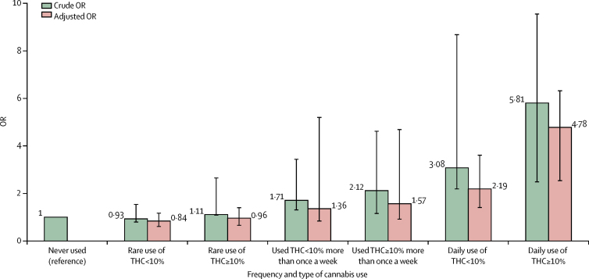
Risk of psychotic disorders for frequency & type of marijuana use
Forti et al., Lancet Psychiatry. 2019; 6(6):427-436.
Notes:
To dig in a bit more on those, these are data from a study of 901 adult patients with first-episode psychosis and 1237 population controls.
Asked about: lifetime and current cannabis use, age of first use, and frequency of use during their most consistent pattern of use
To estimate THC concentration in types of cannabis available throughout Europe, where the study was done, they used data from European Monitoring Centre for Drugs and Drug Addiction
We are looking at the odds ratio, on the y-axis, for a number of conditions describing frequency and potency of cannabis use, on the x-axis. The crude odds ratio is in green and the adjusted odds ratio is in pink.
You can see that more frequent use of higher potency cannabis during patient’s period of most consistent use was associated with an increased risk of psychosis in this large study.
Crude ORs are adjusted only for age, gender and ethnicity and fully adjusted ORs are additionally adjusted for level of education, employment status, and use of tobacco, stimulants, ketamine, legal highs, and hallucinogenics. Error bars represent 95% CIs. OR=odds ratio.

Slide 15
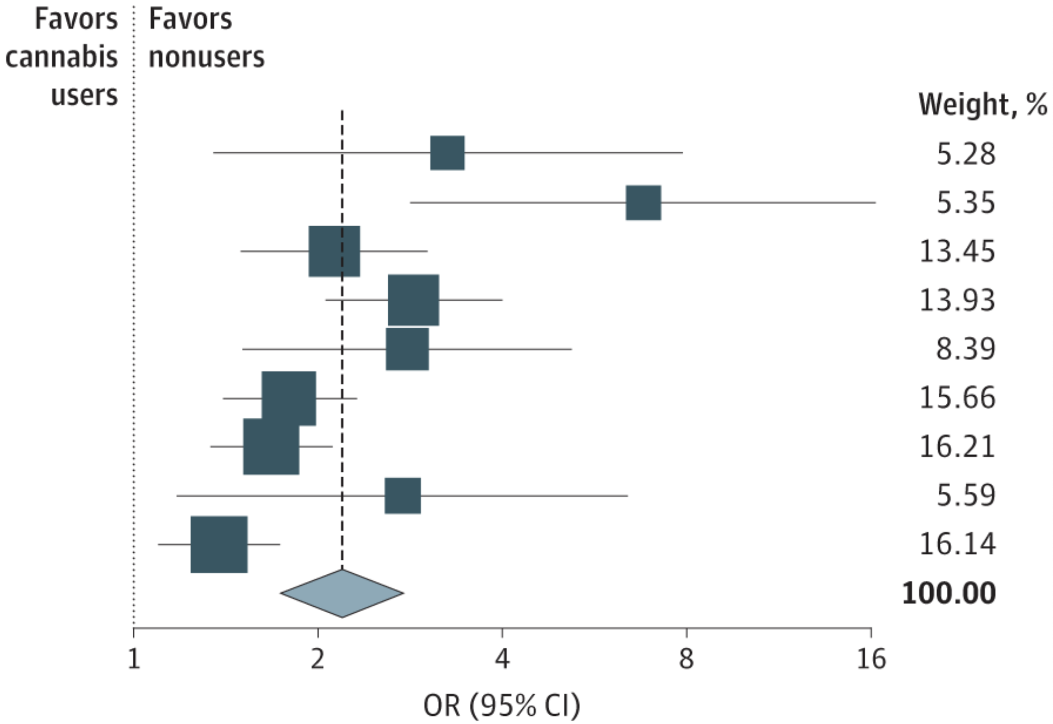
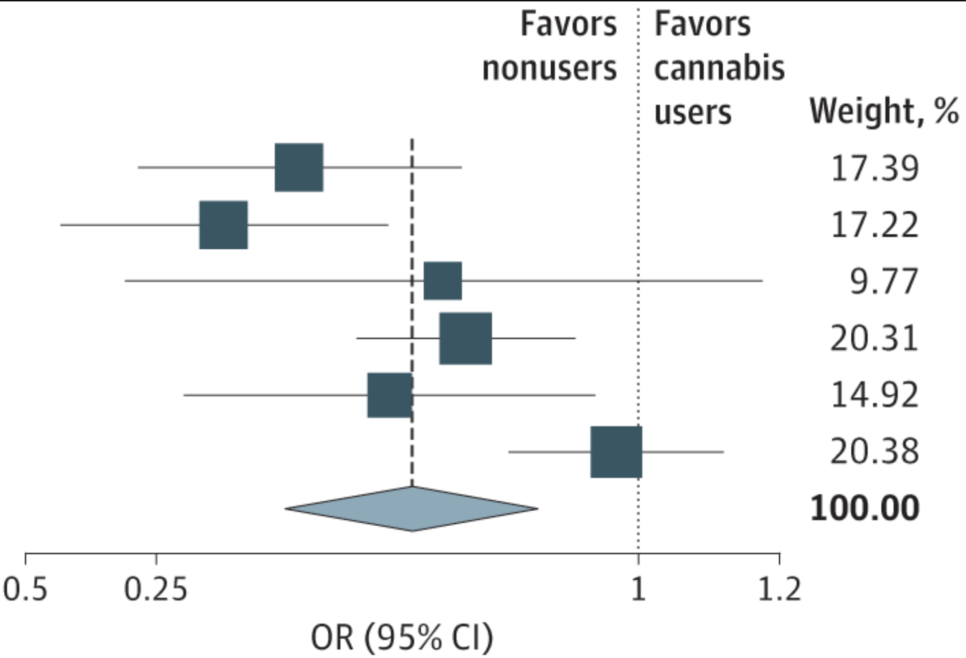
Education Consequences
School Dropout by Cannabis Use
University Enrollment by Cannabis Use
Chan O et al., JAMA Pediatr. 2024;178(12):1280-1289.
Notes:
These data come from a 2024 meta-analysis of 63 studies including over 400,000 individuals that considered the association of cannabis use and educational outcomes.
They found moderate certainty evidence that cannabis use during adolescence and young adulthood is associated with greater risk of school dropout and decreased likelihood of going to college as shown in these two plots. They also found cannabis was associated with lower school grades; decreased likelihood of high school completion, decreased likelihood of postsecondary degree attainment; and increased school absenteeism.
These are the outcomes I really worry about for my adolescents, as disengagement in school has serious consequences for their future.
I’ll also note that we know that systemic inequities and racism have created an educational system that has failed Black and Brown youth living in many communities. As we saw before, Black and Brown youth cannabis use is very similar to that of their white peers. However, because of those systematic inequities, they may be exposed to compounding risks contributing to these educational consequences.
In this meta-analysis of 63 studies including 438 329 individuals, moderate-certainty evidence showed
Low-certainty evidence suggested cannabis use may be associated with increased unemployment.
Study includes 63 observational studies w/ >400,000 AYA
School grades: moderate certainty association; larger association among more frequent cannabis users (weekly/daily)
School dropout: moderate certainty
School absenteeism: moderate certainty; larger assoc among more frequent users
High school completion: moderate certainty assoc; larger among users w/ early onset (<16y)
Univ enrollment: moderate certainty; larger assoc w/ more frequent use
Educational attainment: moderate-certainty; larger assoc w/ more freq use
Unemployment: low-certainty; larger assoc w/ more frequent use
Power et al study from Psychol Med 2021 looking at IQ showed decrease in full scale IQ and verbal IQ. Effect on performance IQ more equivocal.

Slide 16
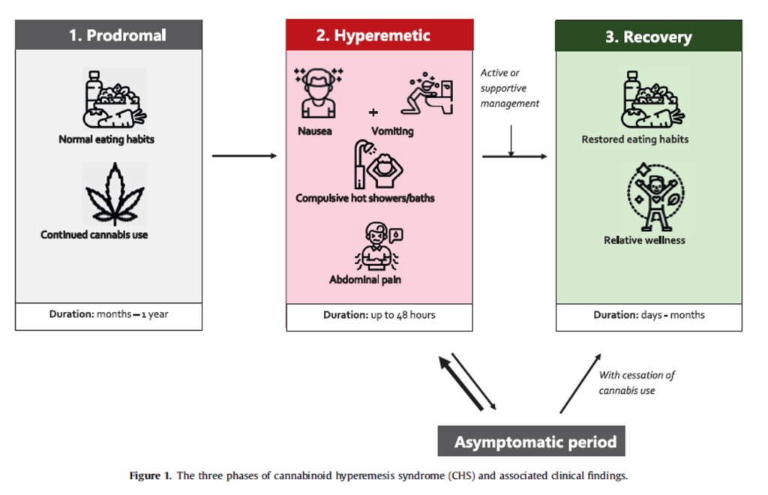
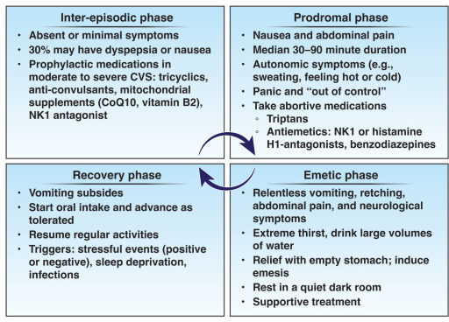
Cannabis Hyperemesis Syndrome
Zhu et al., J of Adol Health, 2021;68(2):246-254.
Notes:
The increase in THC concentration in cannabis products has also been temporally associated with an increase in acute care utilization for cannabis hyperemesis syndrome, which is a functional gastrointestinal disorder caused by chronic disruption of the gut-brain interaction.
It is characterized by stereotypical episodic vomiting at least 3 times annually that mimics cyclic vomiting syndromes in a patient who has used cannabis for more than a year before symptom onset, typically at least 4x/week. Notably symptoms may not resolve until the patient has been abstinent from cannabis for at least 6 months
Patients start in the prodromal period, where they have normal eating habits and are using cannabis. This is followed by the hyperemetic phase with severe nausea, vomiting, and abdominal pain that is often relieved by hot showers or baths.
Patients who continue to use cannabis will go back and forth between this hyperemetic phase and an asymptomatic period.
It’s worth noting that around 30% of patients continue to have nausea, dyspepsia, or abdominal pain during this “asymptomatic period”. This definitely validates my clinical experience, which is that many patients will continue to have bothersome symptoms that, while not severe enough to lead to an ER visit, are very bothersome.
When patients get treatment and ideally stop using cannabis, they’ll transition into the recovery phase.

Slide 17
Council patients on treatment options for cannabis use disorder and withdrawal.
Notes:
Now we’re going to transition to talking about treatment options.

Slide 18
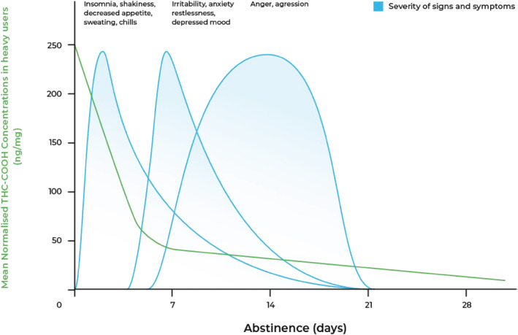
Withdrawal Timeline
Connor JP et al., Addiction. 2022;117(7):2075-2095. Adapted from Goodwin et al. and Queensland Health (2012).
Notes:
First let’s talk about withdrawal.
This graph is from a 2022 review of cannabis withdrawal, which is experienced by about half of people using cannabis.
The y-axis shows the mean THC concentration, which is represented by the green line. The x-axis shows abstinence in days.
The blue lines show the relative intensity of symptoms over time. These are unrelated to the y-axis.
As you can see, during the first days of abstinence people tend to experience insomnia, shakiness, decreased appetite, sweating, and chills.
Within a week they typically have irritability, anxiety, restlessness, and depressed mood.
And then anger and aggression, which can last up to 3 weeks.
Measures of cannabis withdrawal = marijuana withdrawal checklist (16 items), cannabis withdrawal scale (19 item), composite withdrawal scale (14 item, corresponds symptoms in DSM-5)
Meta-analysis found approximately 47% of people using cannabis report withdrawal measured by standardized scales.
Community prevalence = 17%, outpatient samples = 54%, inpatients = 87%

Slide 19
Withdrawal Treatment
Symptom | Medication Options
Anxiety & Agitation | Hydroxyzine Buspirone Gabapentin Dronabinol, Nabilone
Insomnia | Quetiapine Mirtazapine
Nausea & Stomach Pain | Metoclopramide, ondansetron Scopolamine
Appetite suppression | Quetiapine Mirtazapine Cyproheptadine
Psychotic Symptoms & Hallucinations | Antipsychotics (olanzapine, quetiapine)
Brezing CA, Levin FR. Neuropsychopharmacology. 2017;43(1):173-194. Connor JP et al., Addiction. 2022;117(7):2075-2095.
Notes:
Fortunately we do have medications to treat these symptoms, although I’ll note that there are no FDA-approved medications for withdrawal
I most typically use a combination of hydroxyzine for anxiety, mirtazapine for insomnia and appetite suppression, and ondansetron for nausea and stomach pain. Sometimes I add trazadone for insomnia.
Our psychiatry colleagues are typically managing antipsychotics for any psychotic symptoms or hallucinations.
The synthetic THCs – dronabinol and nabilone – have been used off-label to treat withdrawal symptoms, particularly anxiety and agitation.
There have been 2 studies of nabilone. The one using 2mg BID showed no difference from placebo on cannabis cravings or anxiety, while the one that treated patients using cannabis and tobacco with varenicline and nabilone 4mg BID showed attenuation of withdrawal-related mood and sleep symptoms with nabilone, although cravings were not better.
There is only 1 study of dronabinol, a synthetic THC, which enrolled 79 patients with cannabis use disorder and titrated the dose to 20mg BID over a week. This dose was maintained for 8 weeks and then tapered off over 2 weeks. The study found increased treatment retention and reduced withdrawal symptoms with dronabinol.
In a 2016 human lab study, CBD did not alter subjective, reinforcing, cardiovascular effects of smoked cannabis in heavy users (Haney et al., Neuropsychopharmacology. 2016)

Slide 20
Medication Options
Medication | Dose | Notes
N-acetylcysteine “NAC”¹ | 600mg QD x3d > 600mg BID x3d > 1200mg BID | Available as over-the-counter supplement Decreased use in adolescents;¹ no evidence of efficacy in adults² Not FDA approved for CUD
Gabapentin³ | 1200mg/day | Decreased cannabis use, cravings, withdrawal symptoms in adults No evidence in adolescents
Topiramate⁴ | 25mg/day increased by 25mg weekly to 200mg/day | Reduced cannabis use in adolescents High rate of adverse effects & treatment discontinuation Side effects: neurocognitive slowing, memory difficulties, weight loss, poor appetite
Gray et al. American Journal of Psychiatry, 2012. 2. Gray et al., Drug Alcohol Depend 2017. 3. Mason et al., Neuropsychopharmacology. 2012. 4. Miranda R et al., Addiction Biology 2017. 5. Bahji A et al., Intern J of Drug Policy 2021.
Notes:
A number of medications have been tested for cannabis use disorder, including: bupropion, nefazodone, mirtazapine, divalprox, quetiapine, baclofen, zolpidem, dronabinol and nabilone (synthetic cannabis derivatives), cannabidiol, naltrexone, venlafaxine, various SSRIs, buspirone, gabapentin, topiramate, N-acetylcysteine.
These are the 3 most promising medication options, although none of them are FDA-approved for cannabis use disorder.
N-acetylcysteine, which is an over-the-counter supplement, is associated with decreased use in adolescents but did not show benefit in a trial with adults.
Gabapentin has been associated with decreased cannabis use, cravings, withdrawal symptoms in adults, however it has not been studied in youth.
Finally, topiramate was associated with reduced cannabis use in adolescents in 1 trial, however treatment discontinuation was high due to many adverse effects.
Follow up Gray study: Low baseline impulsivity, high medication adherence, and low baseline severity of cannabis use as measured by urine cannabinoid levels predicted a better treatment outcome with higher likelihood of negative urine testing
Note that evidence is stronger for behavioral treatment but access is challenging

Slide 21
Match therapy to readiness to change
Not sure
Total Abstinence
Motivational interviewing
Community Reinforcement Approach
Decrease risky use
Cognitive behavioral therapy (skill building, relapse prevention)
Slide courtesy of Dr. Amy Yule
Notes:
Fortunately there is stronger evidence for behavioral interventions for cannabis use, although access is challenging.
These behavioral interventions, which I’m not going to go into detail about, should ideally be matched to the patient’s readiness to change.
Patients who aren’t sure they want to decrease their use may benefit from motivational interviewing, community reinforcement approach (which we’ll discuss on the next slide), and advise around decreasing risky use.
Patients who want to completely stop cannabis use may benefit from cognitive behvioral therapy to build skills around abstinence and relapse prevention.

Slide 22
Community Reinforcement Approach
↓ positive reinforcement from substance use
↑ the availability and frequency of positive reinforcement from activities not involving substance use
Slide courtesy of Dr. Amy Yule
Notes:
There is particularly good evidence for the community reinforcement approach, which is the basis of CRAFT and A-CRA, the adolescent-focused version.
This approach aims to increase the availability and frequency of positive reinforcement from activities not involving substance use, which family or loved ones can help do, while decreasing the positive reinforcement that comes from substance use.

Slide 23
Role of contingency management
220 youth were randomized to 4 weeks of abstinence-based CM (CB-Abst; n=126) or monitoring (CB-Mon; n=94).
Participants self-reported use frequency & provided urine metabolite levels at baseline, end-of-intervention, and 4-week follow-up.
Decreased cannabis use persisted after trial ending
Cooke M, Drug and Alcohol Dep. 2024;256:111096.
Notes:
There is also some emerging data for contingency management for cannabis use in youth.
In this 2024 study of 220 youth randomized to 4-weeks of abstinence-based contingency management or monitoring, contingency management was associated with decreased cannabis use and greater desire to reduce or abstain cannabis use that persisted even after the incentives ended.

Slide 24
Harm reduction for cannabis use
Transition to lower potency products
Address underlying concerns (anxiety, sleep, low appetite) using other behavioral and/or pharmacologic interventions
Avoid use before/during school, work, driving, sports
Limit use to after school and social settings
Avoid synthetic cannabinoids
What
Why
When
Where
History
Notes:
When patients are not ready to abstain from cannabis, we discuss ways to reduce harms associated with use.
We’ll talk about this more on Wednesday, but this circle shows my general framework for taking a history that I then use to discuss harm reduction opportunities.
We ask about what products patients are using and may recommend transitioning from high-potency products, such as dabs and vapes, to lower potency edibles. We also talk about monitoring serving sizes when patients are using edibles.
We also make sure to evaluate why patients are using substances – what symptoms is it helping them manage. We can then work on addressing the symptoms using other strategies. For example, we may start a SSRI to deal with anxiety, discuss sleep hygiene, or add cyproheptadine to help with appetite.
I always ask about when and where patients are using substances, as this can reveal potential consequences.
I also encourage youth to avoid using cannabis before or during school or work to minimize associated educational or employment consequences, discuss the risks of driving under the influence, and discourage youth to use before sports where I worry the slowed reaction time may result in injuries.
Relatedly, we talk about whether the patient may want to limit their use to just after school or only social settings, which ultimately means they are using less and ideally decreasing risk of consequences.
Lastly, we discuss avoiding synthetic cannabinoids given the high potency and association with hallucinations, paranoia, and psychosis.

Slide 25
Analyze medical uses of cannabis based on scientific evidence.
Notes:
Lastly, let’s look at what the scientific evidence says about medical uses of cannabis.

Slide 26
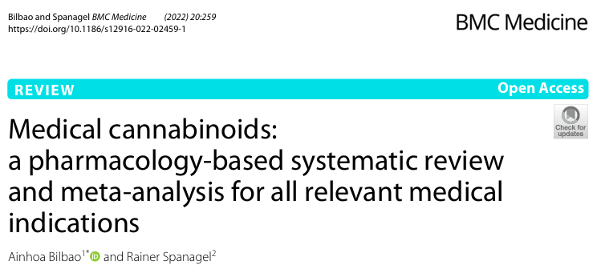
Approved medications
Dronabinol & Nabilone (synthetic THC)
Nausea w/ cancer chemotherapy
Anorexia & weight loss in AIDS
Epidiolex (CBD-derived)
Lennox-Gastaut & Dravet syndrome, seizures associated with TSC
Nabiximols (plant-derived THC & CBD)
Central & peripheral neuropathic pain
Rheumatoid arthritis
Cancer pain
Notes:
There are 3 THC-based medications approved in the united states – dronabinol, nabilone, and epidiolex.
Nabiximols are NOT approved in the US.
Dronabinol and Nabilone are both synthetic, pharmaceutical-grade THC FDA-approved for the treatment of nausea and vomiting assoc w/ cancer chemotherapy in pts who don’t respond to conventional antiemetics. Dronabinol is also approved for anorexia associated w/ weight loss in patients w/ AIDS.
Epidiolex is purified CBD and is the only FDA-approved medication containing a cannabis derivative. It is approved for 2 very rare pediatric epilepsy types – Lennox-Gastaut and Dravet syndrome – and recently was approved for treatment of seizures associated with tuberous sclerosis complex.
Lastly, Nabiximols is a cannabis extract containing THC and CBD that’s an oral spray and is only currently available in 15 countries for the treatment of painful spasticity, cancer-associated pain, neuropathic pain associated with MS, and RA.

Slide 27
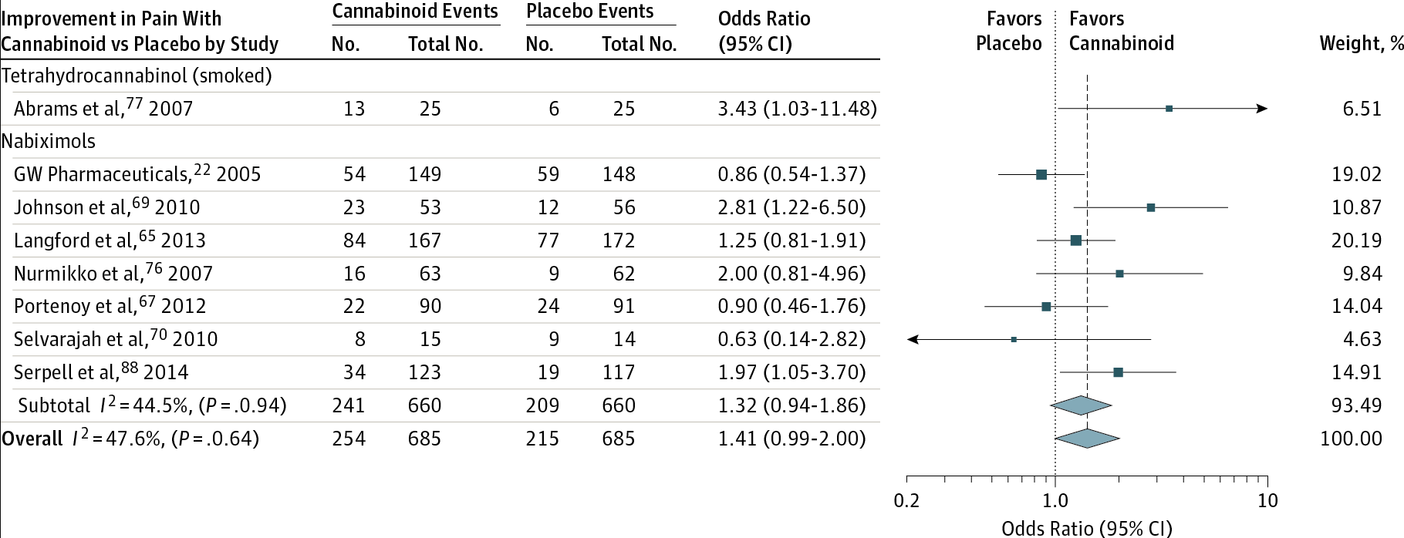
What about chronic pain?
Whiting PF et al., JAMA. 2015;313(24):2456-2473.
Notes:
So what does the literature actually say about the use of cannabis for chronic pain, which is important to consider given 31.0% adults w/ chronic pain have ever used cannabis to manage pain.
This Forest plot is from a 2015 meta-analysis of 79 trials evaluating cannabinoids for multiple indications. This forest plot includes 9 studies comparing cannabinoid to a placebo that found at least 30% reduction in pain w/ cannabinoids and shows that while the overall findings favor cannabinoid, the confidence intervals for most of these studies were quite wide. The authors concluded that there was moderate-quality evidence that cannabinoids may be beneficial for treatment of chronic neuropathic or cancer pain.
I recommend this review because it has a nice summary of the doses and formulations that have been tested for various indications.
Whiting et al., JAMA. 2015;313(24):2456-2473 has nice chart of doses/formulations that have been tested for various indications.
https://jamanetwork-com.ezproxy.bu.edu/journals/jama/fullarticle/2338251
Allan et al: uncertainty around pain improvement but best evidence is for neuropathic pain w/ small benefit.
Reasonable evidence for improving n/v post-chemo
Likely improves spasticity in MS
High rate of side effects
31.0% adults w/ chronic pain have ever used cannabis to manage pain (Bicket MC et al., JAMA Netw Open. 2023;6(1): doi: 10.1001/jamanetworkopen.2022.49797
25.9% used in last 12M
23.2% report last 30d use
94.7% reported other pharmacologic use, 70.6% reported other nonpharm pain tx use
Most (~55%) self-report that use of cannabis decreased use of opioids , rx nonopioids, OTC analgesics - all measured as separate categories
- Also reported decreased use of PT (39%), meditation (19%), CBT (26%)

Slide 28
Quality of evidence
Moderate-quality evidence
Treatment of chronic neuropathic or cancer pain
Smoked THC and nabiximols
Treatment of spasticity due to MS
Nabiximols, nabilone, THC/CBD capsules, dronabinol
Low-quality evidence
Chemotherapy-related N/V
Dronabinol, nabiximols
Weight gain in HIV
Dronabinol
Sleep disorders
Nabilone, nabiximols
Tourette syndrome
THC capsules
“There was an increased risk of short-term AEs with cannabinoid use, including serious adverse events.”
Whiting PF et al., JAMA. 2015;313(24):2456-2473.
Notes:
To summarize the rest of that review, the authors found:
Moderate-quality evidence for using smoked THC and nabiximols to treat chronic neuropathic or cancer-associated pain and moderate-quality evidence for using nabiximols, nabilone, THC or CBD capsules, and dronabinol to treat MS-associated spasticity.
Evidence for using cannabis derivatives to treat chemotherapy-related nausea/vomiting, promote weight gain in HIV, address sleep disorders, or treat Tourette syndrome is low quality.
The study also emphasizes that there was an increased risk of short-term adverse effects, including serious adverse events, with cannabinoids.
There is certainly a substantial need for more research around the potential medical uses of cannabis. Cannabis is currently a Schedule I drug under DEA laws, which makes it difficult to access and study.
There were a ton of different adverse events reported, including GI disorders, nervous system complications, dizziness, dry mouth, nausea, fatigue, somnolence, depressed mood, etc.
Allan et al (https://pmc-ncbi-nlm-nih-gov.ezproxy.bu.edu/articles/PMC5964405/): uncertainty around pain improvement but best evidence is for neuropathic pain w/ small benefit.
Reasonable evidence for improving n/v post-chemo
Likely improves spasticity in MS
High rate of side effects
31.0% adults w/ chronic pain have ever used cannabis to manage pain (Bicket MC et al., JAMA Netw Open. 2023;6(1): doi: 10.1001/jamanetworkopen.2022.49797
25.9% used in last 12M
23.2% report last 30d use
94.7% reported other pharmacologic use, 70.6% reported other nonpharm pain tx use
Most (~55%) self-report that use of cannabis decreased use of opioids , rx nonopioids, OTC analgesics - all measured as separate categories
- Also reported decreased use of PT (39%), meditation (19%), CBT (26%)

Slide 29
Humphreys K and Saitz R. JAMA. 2019;321(7):639-640.
“For the opioid addiction crisis, clearly efficacious medications such as methadone and buprenorphine are under prescribed. Without convincing evidence of efficacy of cannabis for this indication, it would be irresponsible for medicine to exacerbate this problem by encouraging patients with opioid addiction to stop taking these medications and to rely instead on unproven cannabis treatment.”
Notes:
Lastly, I want to briefly discuss the idea that cannabis should be used to replace opioids or that cannabis can be used to treat opioid use disorder. This editorial by Keith Humphreys and Richard Saitz from 2019 emphasized that there is 1 small randomized clinical trials evaluating the use of cannabis as a substitution for opioids for chronic pain and no trials evaluating the use of cannabis alone for opioid use disorder.
There is some evidence that cannabis appears to improve opioid withdrawal symptoms (J Subst Abuse Treat 2020; Bergeria et al- JHH), and there have been some preclinical and observational studies that suggest cannabis may be therapeutic in OUD and addiction, however randomized trials are incredibly limited. The studies looking at use for chronic pain have not compared cannabis head-to-head against opioids with the exception of 1 trial of dihydrocodeine v nabilone that was published in 2008 and showed better pain relief with dihydrocodeine.
Furthermore, unlike other medications that are included in clinical trials, approved by the FDA, and used in clinical practice, medical cannabis is unregulated with variable THC content and therefore variable efficacy and adverse effects.
They ended with this quote, which I think sums the risks of encouraging medications that haven’t been sufficiently studied: “For the opioid addiction crisis, clearly efficacious medications such as methadone and buprenorphine are under prescribed. Without convincing evidence of efficacy of cannabis for this indication, it would be irresponsible for medicine to exacerbate this problem by encouraging patients with opioid addiction to stop taking these medications and to rely instead on unproven cannabis treatment.”
Bergeria et al., JSAT, 2020: naturalistic cannabis use decreases self-reported opioid withdrawal symptoms

Slide 30
Thank you! Jessie Calihan, MD MSc jessica.Calihan@bmc.org

