Slide 1




Science of Addiction
CRIT/FIT
Boston, Ma
April 2023
Susan R.B. Weiss
Director
Division of Extramural Research
National Institute on Drug Abuse

Slide 2
Disclaimer:
The views and opinions expressed in this presentation are those of the author only and do not necessarily represent the views, official policy, or position of the U.S. Department of Health and Human Services or any of its affiliated institutions or agencies.
Financial Disclosure: Merck Shareholder

Slide 3
Learning Objectives
At the completion of this presentation the attendees will be able to:
Summarize the epidemiology and trends in substance use and substance use disorders in the US
Describe the neurobiological basis of addiction
Describe the greatest challenges facing the US today and how
research is attempting to address them
Understand the important role of policy in prevention and treatment of substance use and SUD

Slide 4
Definitions: Substance Use Disorder and Addiction
Substance Use Disorder: recurrent use of alcohol or other drugs causing significant impairment, such as health problems, disability and failure to meet major responsibilities, craving, withdrawal and tolerance
    It combines the DSM-IV categories of substance abuse and substance dependence into a single disorder measured on a continuum of mild, moderate, or severe
    Each specific substance is addressed as a separate use disorder
Addiction: chronic stage of Substance Use Disorder (synonymous with “moderate to severe Substance Use Disorder”)
  Primary, chronic disease of the brain reward, motivation, memory and related circuitry
  Like other chronic diseases, often involves cycles of relapse and remission
  Without treatment, addiction is progressive and can result in disability or premature death
American Psychiatric Association DSM-5 (2013)
Volkow ND et al. N Engl J Med. 2016
Notes:
Using more of a substance than intended or using it for longer than intended.
Trying to cut down or stop using the substance but being unable to.
Experiencing intense cravings or urges to use the substance.
Needing more of the substance to get the desired effect — also called tolerance.
Developing withdrawal symptoms when not using the substance.
Spending more time getting and using drugs and recovering from substance use.
Neglecting responsibilities at home, work or school because of substance use.
Continuing to use even when it causes relationship problems.
Giving up important or desirable social and recreational activities due to substance use.
Using substances in risky settings that put you in danger.
Continuing to use despite the substance causing problems to your physical and mental health.

Slide 5
Epidemiology: Patterns of Use

Slide 6
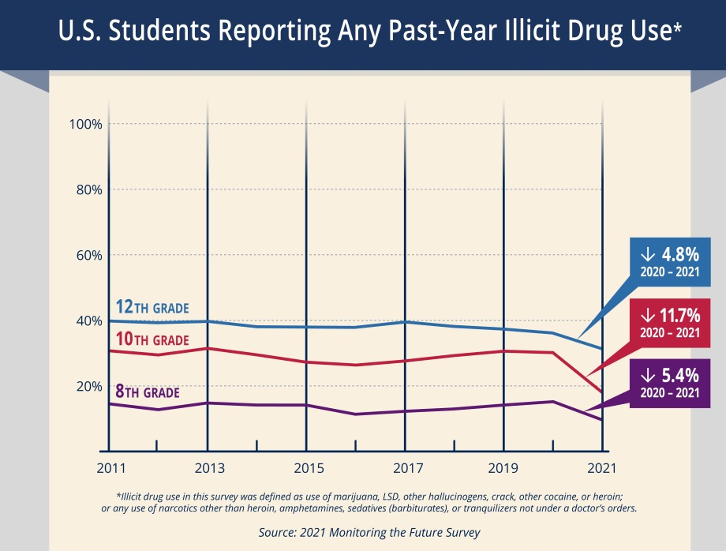
Declining Drug Use in all 3 grades (MTF, 2021)
Sustained in 2022

Slide 7
Past Month Drug Use in 12th Graders
5.8 % report daily or near daily use of marijuana in 2021
Perceived Harmfulness of Smoking Marijuana Regularly is Declining in 8th, 10th, and 12th Graders
Source: University of Michigan, 2021 Monitoring the Future Study
Notes:
MTF: Note that 2020 was before CoVID lockdown and included ~25% of the usual sample; however, statistical analyses suggest that these numbers are likely representative. (Usually around 40,000; 11,000 this year)

Slide 8
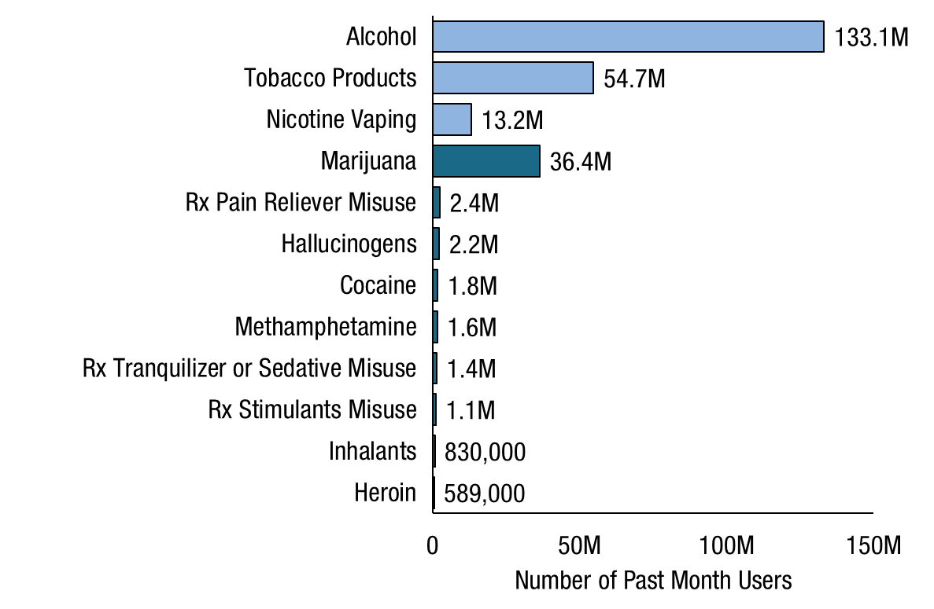

Past Month Substance Use: Among People Aged 12 or Older; 2021
Rx = prescription.
Note: The estimated numbers of current users of different substances are not mutually exclusive because people could have used more than one type of substance in the past month.

Slide 9
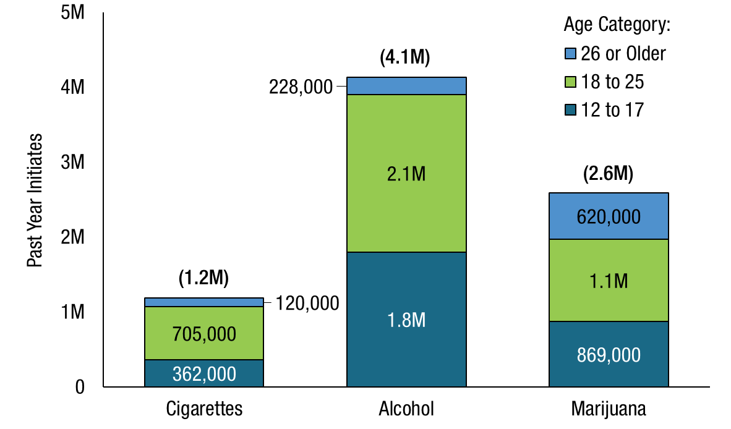
Past Year Cigarette, Alcohol, and Marijuana Initiates: Among People Aged 12 or Older; 2021
Note: The number in parentheses above each bar shows the total number of past year initiates aged 12 or older for that category.

Slide 10
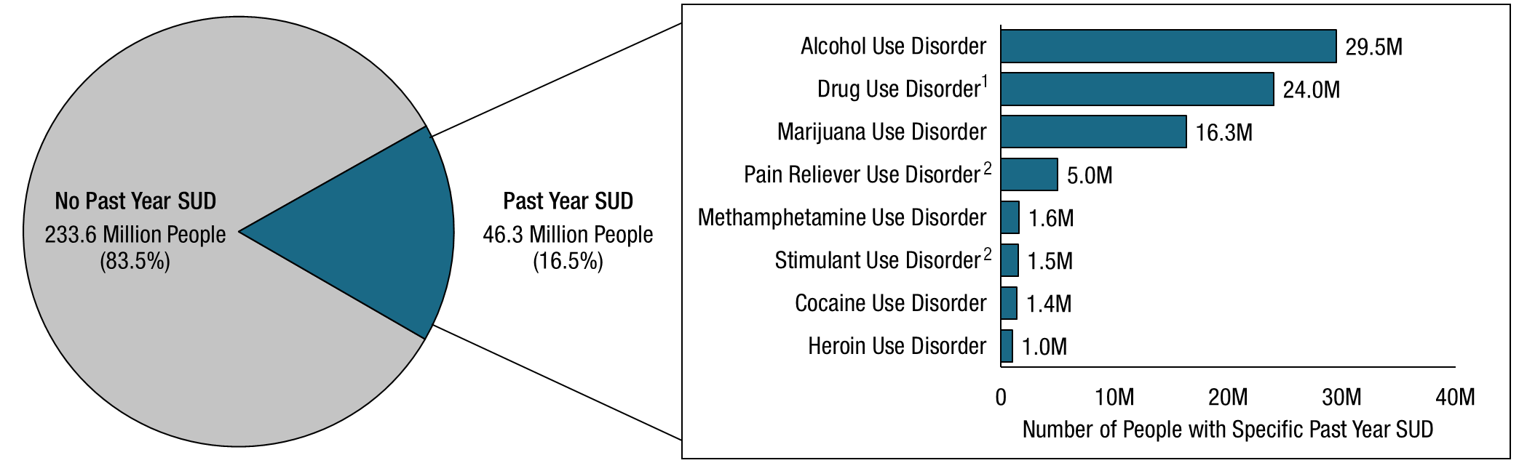
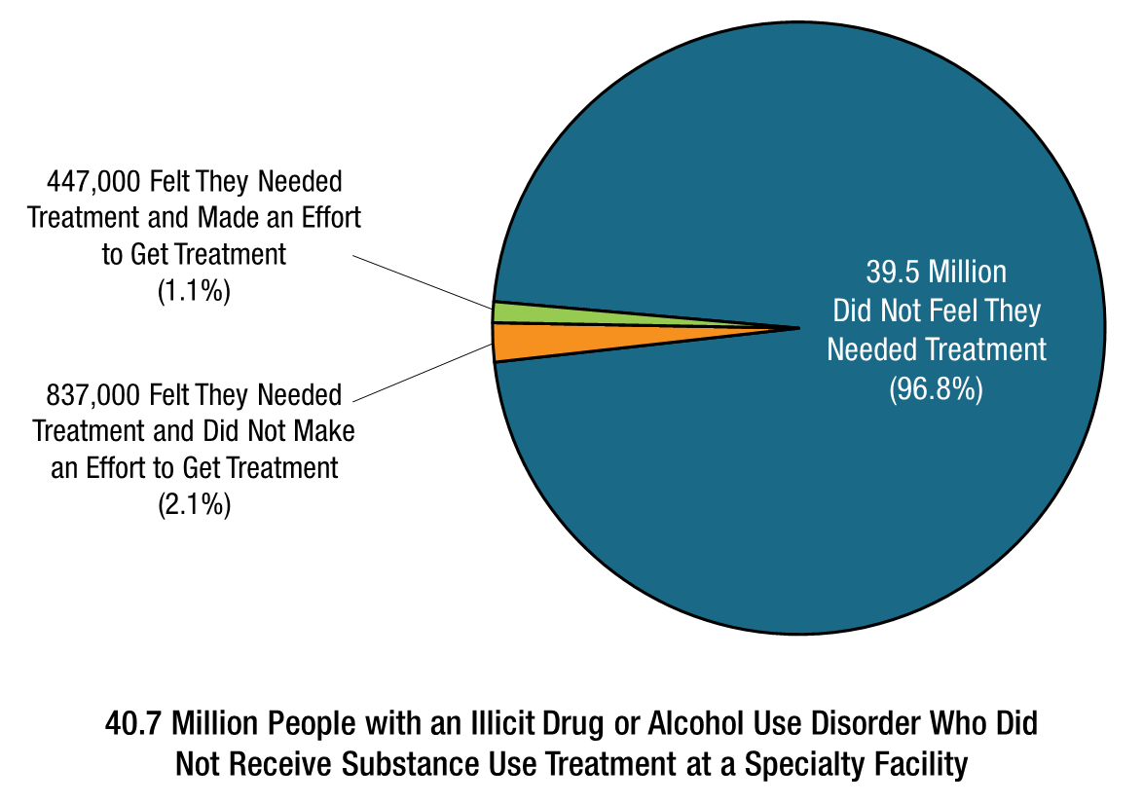
Past Year Substance Use Disorder (SUD) and Perceived need for treatment (2021)
People with a Past Year Illicit Drug or Alcohol Use Disorder Who Did Not Receive Substance Use Treatment at a Specialty Facility in the Past Year
People Aged 12 or Older
Note: The estimated numbers of people with substance use disorders are not mutually exclusive because people could have use disorders for more than one substance.
¹ Includes data from all past year users of marijuana, cocaine, heroin, hallucinogens, inhalants, methamphetamine, and prescription psychotherapeutic drugs (i.e., pain relievers, tranquilizers, stimulants, or sedatives).
² Includes data from all past year users of the specific prescription drug.
Notes:
2 or more criteria

Slide 11
Neurobiology of Drug misuse and addiction

Slide 12
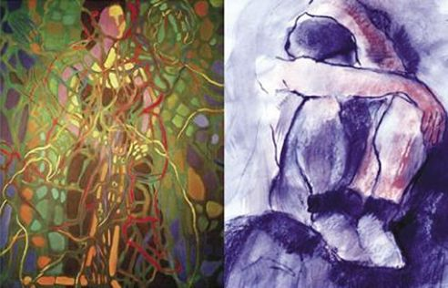
Why Do People Take Drugs in The First Place?
To Feel Good
To have novel:
feelings
sensations
experiences
AND
to share them
To Feel Better
To lessen:
anxiety
worries
fears
depression
Hopelessness
Loneliness
Courtesy: Vivian Felsen
Notes:
Why would anyone use drugs? Research has shown that people generally take drugs to either feel good (i.e., sensation seekers or anyone wanting to experiment with feeling high or different) or to feel better (i.e., self-medicators or individuals who take drugs in an attempt to cope with difficult problems or situations, including stress, trauma, and symptoms of mental disorders).
Images: courtesy of Vivian Felsen

Slide 13
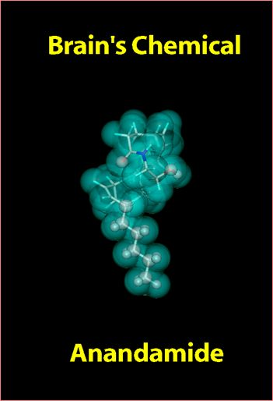
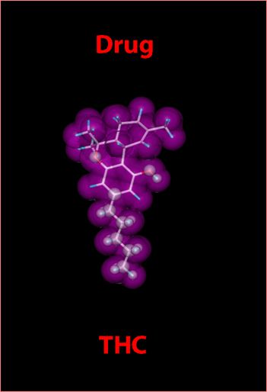

Drugs can mimic natural chemicals
Notes:
How are drugs able to affect brain chemicals? Often, the chemical structure of drugs is similar to brain chemicals or neurotransmitters. Similarity in structure allows them to be recognized by neurons and to alter normal brain messages. Illustrated in this slide is THC, the active ingredient found in marijuana. It’s chemical structure is highly similar to anandamide, which is involved in a variety of functions including regulation of pain, appetite, memory, and mood.

Slide 14
Natural Rewards Elevate Dopamine Levels
But Drugs are amazingly more effective
1100
SEX
1100
AMPHETAMINE
1000
1000
900
900
800
800
700
700
DA Concentration
(% Baseline)
DA Concentration
(% Baseline)
600
600
500
500
400
400
300
300
200
200
100
100
0
0
Female Present
1
2
3
4
5
6
7
8
0
1
2
3
4
5 hr
Sample Number
Time After Amphetamine
Fiorino and Phillips, J. Neuroscience, 1997.
Notes:
Dopamine is a brain chemical involved in many different functions including movement, motivation, reward — and addiction. Nearly all drugs of abuse directly or indirectly increase dopamine in the pleasure and motivation pathways and in so doing, alter the normal communication between neurons.

Slide 15
Drugs Elevate Dopamine More and for Longer than Natural Rewards
1100
AMPHETAMINE
COCAINE
1000
400
900
800
300
700
% of Basal Release
600
% of Basal Release
500
200
400
300
200
100
100
0
0
0
1
2
3
4
5
0
1
2
3
4
5
Hrs. after amphetamine
Hrs. after cocaine
250
250
NICOTINE
MORPHINE
200
200
% of Basal Release
150
% of Basal Release
150
100
100
0
0
0
1
2
3
0
1
2
3
4
5
Hrs. after nicotine
Hrs. after morphine
Source: Di Chiara and Imperato
(DA in N. Accumbens)

Slide 16
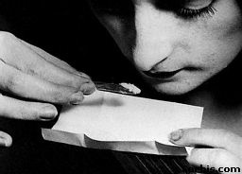

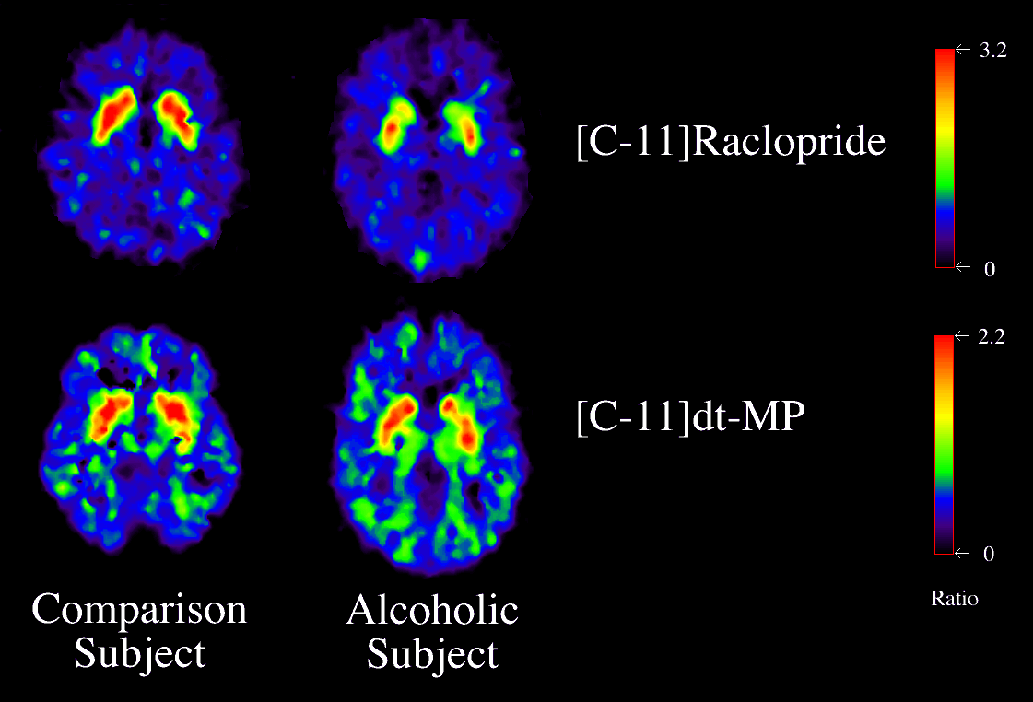
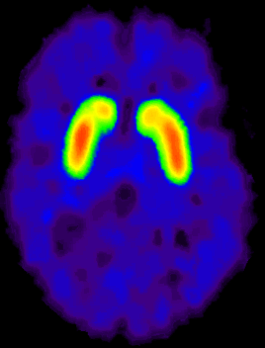
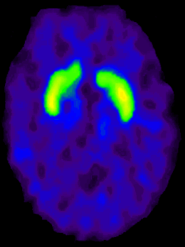
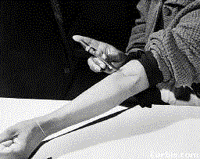
Dopamine Receptor levels are Lower in Addiction
Cocaine
DA Receptor Availability
Alcohol
Heroin
Control
Addiction

Slide 17
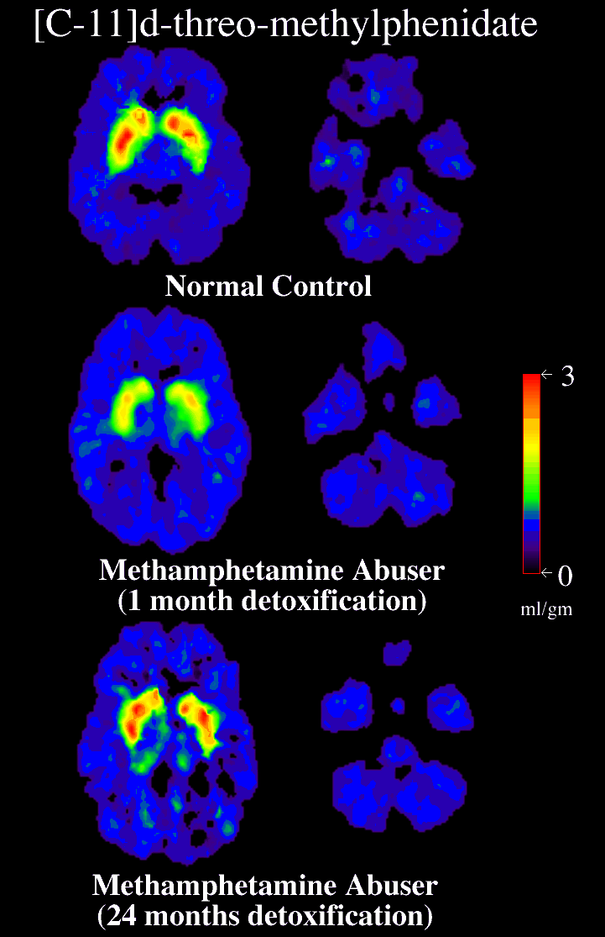
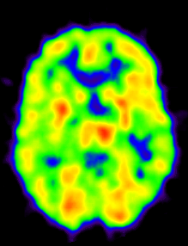
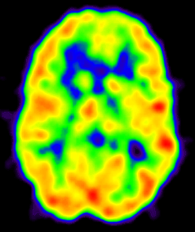
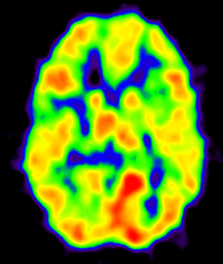
Long Term Recovery Reverses some of the Brain Dopamine Effects
3
0
Volkow, ND et al., Journal of Neuroscience 2001
Normal Control
METH User
(1 month)
METH User
(14 months)
ml/gm
70
Reversal of DAT decreases and Improvement in Brain Metabolism with Prolonged Abstinence from Methamphetamine Use
0
µmol/100g/min
Control Subject
(30 y/o, Female)
METH User
(27 y/o, Female)
3 months detox
METH User
(27 y/o, Female)
13 months detox
G-J Wang et al., Am J Psychiatry 2001

Slide 18
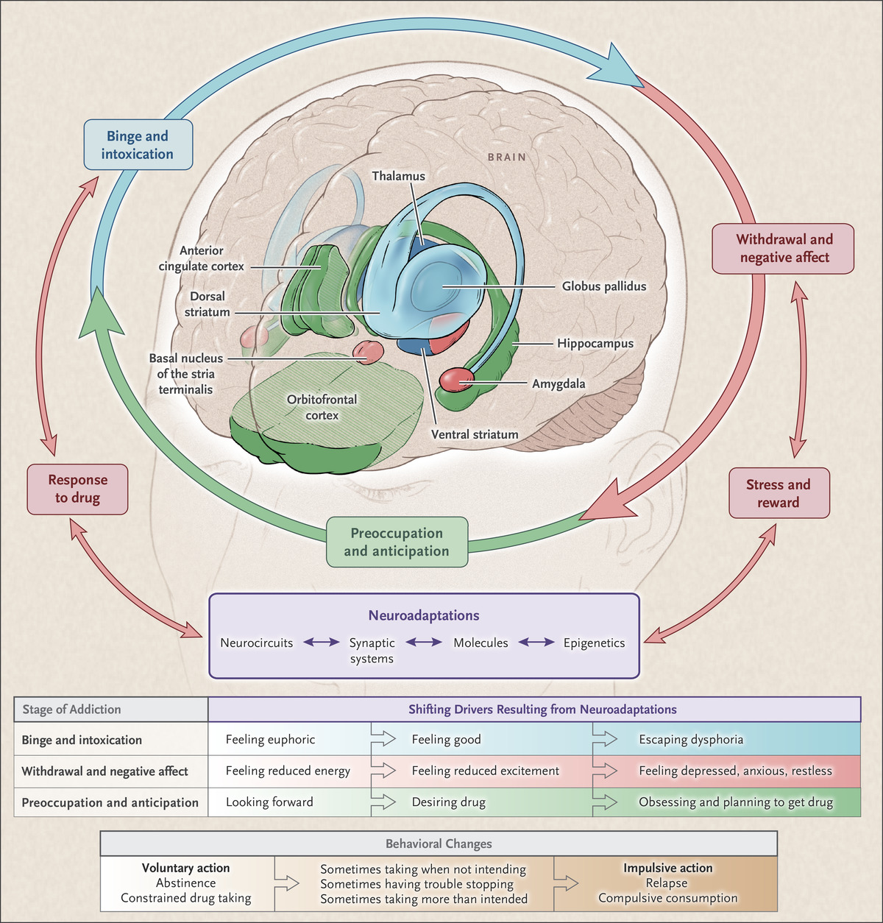

Stages of the Addiction Cycle
Volkow ND et al. N Engl J Med 2016;374:363-371.
Notes:
Figure 1. Stages of the Addiction Cycle. During intoxication, drug-induced activation of the brain’s reward regions (in blue) is enhanced by conditioned cues in areas of increased sensitization (in green). During withdrawal, the activation of brain regions involved in emotions (in pink) results in negative mood and enhanced sensitivity to stress. During preoccupation, the decreased function of the prefrontal cortex leads to an inability to balance the strong desire for the drug with the will to abstain, which triggers relapse and reinitiates the cycle of addiction. The compromised neurocircuitry reflects the disruption of the dopamine and glutamate systems and the stress-control systems of the brain, which are affected by corticotropin-releasing factor and dynorphin. The behaviors during the three stages of addiction change as a person transitions from drug experimentation to addiction as a function of the progressive neuroadaptations that occur in the brain.

Slide 19

Binge and Intoxication
All drugs activate dopamine in reward region
Link to preceding environmental stimuli
Cue-induced anticipatory dopamine release
Conditioned response trigger craving (even after drug use stops)

Slide 20
Withdrawal and Negative Affect
Reduced dopamine levels -> diminished reward system
Increased stress/negative emotions (“anti-reward” system)
Shift from desire for pleasure to avoiding distress

Slide 21
Preoccupation and Anticipation
Prefrontal changes to executive processes
Impaired self-regulation, decision making
Difficulty resisting strong urges
Impulsiveness

Slide 22
“…altered signaling in prefrontal regulatory circuits, paired with changes in the circuitry involved in reward and emotional response, creates an imbalance that is crucial to both the gradual development of compulsive behavior in the addicted disease state and the associated inability to voluntarily reduce drug-taking behavior, despite the potentially catastrophic consequences.”
Volkow, Koob, McLellan, NEJM, 2016

Slide 23
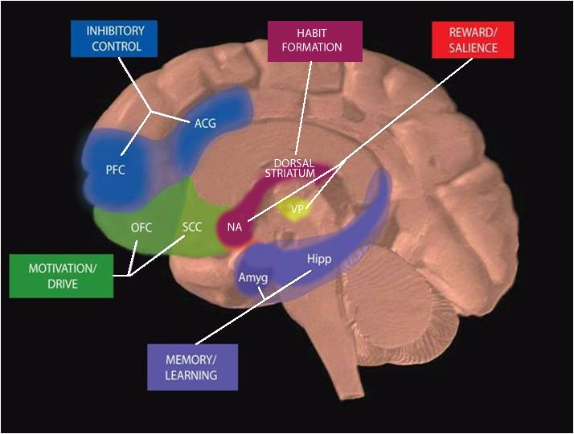
Multiple Circuits Are Involved In Drug Use and Addiction
Multiple Targets for Therapeutics:
Reversing Overdose
Treating Withdrawal
Restoring Function in Affected Circuits
Blunting Craving
Improving sleep
Preventing Relapse
Treating Co-morbidities
Notes:
Research has identified a number of brain circuits that are affected by drug abuse and addiction. Currently, NIDA supports research that study these brain circuits and underlying cellular and molecular mechanisms under normative conditions as well as under drug exposed conditions.
The areas depicted contain the circuits that underlie feelings of reward, learning and memory, habit formation motivation and drive, and inhibitory control. Each of these brain areas and the behaviors they control must be considered when developing strategies to treat drug addiction. May of there receptor, and cellular mechanism involved are candidates for medication development.
Key:
PFC – prefrontal cortex; ACG – anterior cingulate gyrus; OFC – orbitofrontal cortex; SCC – subcallosal cortex; NAc – nucleus accumbens; VP – ventral pallidum; Hipp – hippocampus; Amyg – amygdala

Slide 24
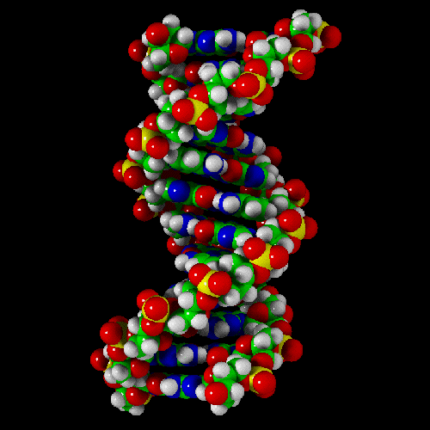

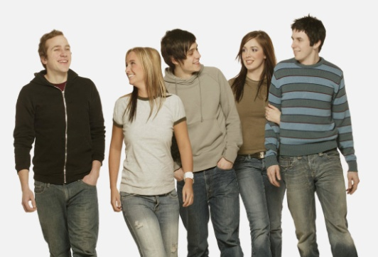

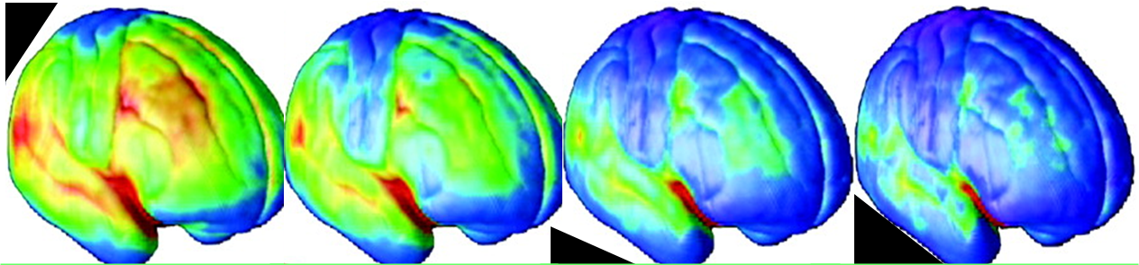
ADDICTION: Disease of Gene-Environment-Development
Biology
Genes/Development
Environment
Drugs/Alcohol
Brain Mechanisms
Addiction
Age

Slide 25
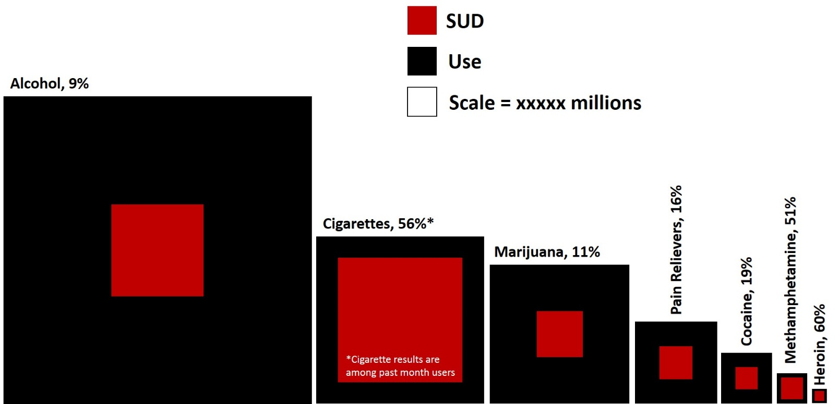

The Drug Matters: Some are more Addictive than Others
A
Alcohol 15 %
US Prevalence of
Use and SUD
Population size
Cigarettes 55%
Pain relievers 15%
Cannabis 9%
Cocaine 19%
Meth 51%
Heroin 60%
B
85,000
400,000
>100,000
Drug Related
Mortality
Annual Deaths

Slide 26
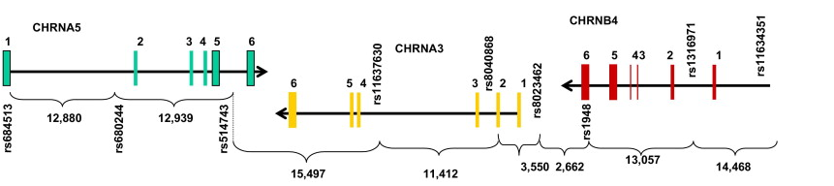
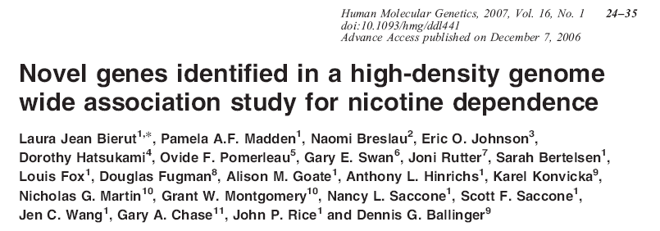
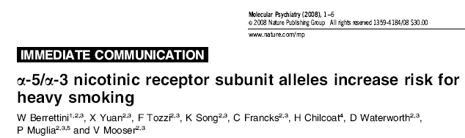
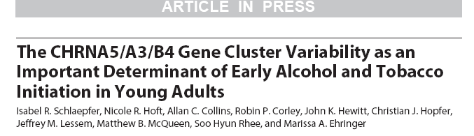
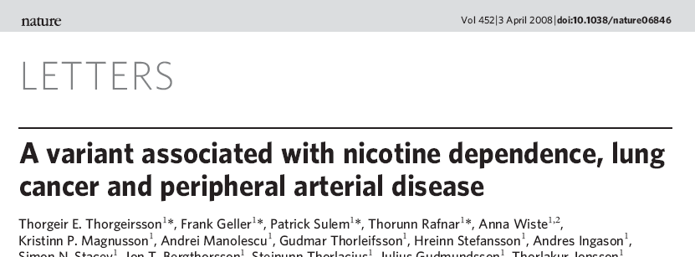
Gene Cluster is Associated with Vulnerability to Nicotine Dependence
Notes:
Genome wide analyses are being used to identify novel candidate genes that increase the risk for addiction. Contrasting individuals who smoke only a few cigarettes per day, or “chippers”, to heavy smoking, nicotine dependent subjects, focuses a genetic study on the transition from smoking to nicotine dependence. This approach has identified distinct genetic variants that contribute to nicotine dependence on chromosome 15 in the region of the α5-α3-β4 family of nicotinic receptor genes. This slide illustrates convergent findings from different laboratories identifiying a cluster of three nicotinic receptor subunit genes (α3 α5 β4) linked to smoking quantity, nicotine dependence, and the risk of two smoking-related diseases––lung cancer and peripheral arterial disease. This new information on genetic vulnerability also suggests novel targets for the development of medications to treat tobacco addiction and related diseases.

Slide 27
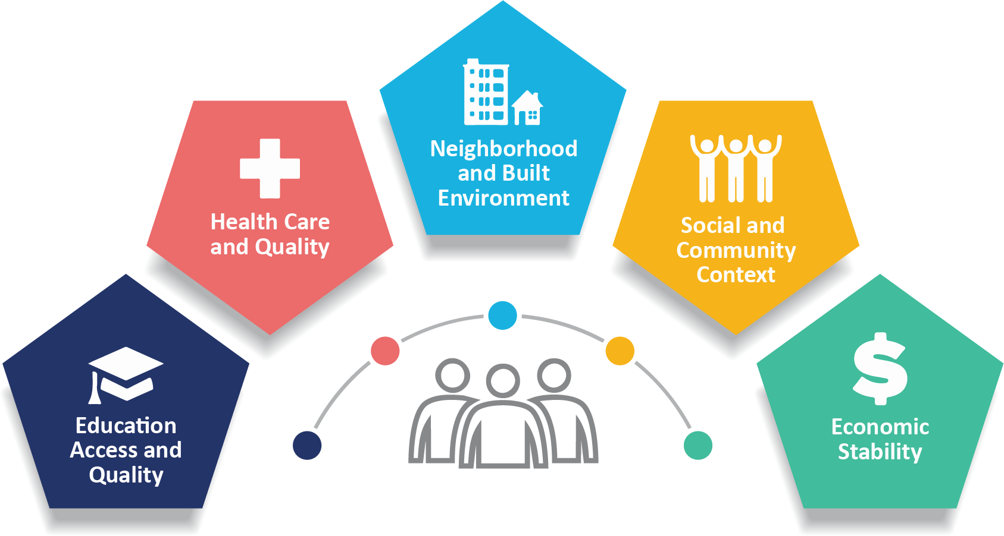
Multiple Environmental Influences on Drug Use and Use Disorders at the Individual, Family, Community, and Policy Level
Drug availability
Peers who use drugs
Parents who use drugs
Family Problems
Physical or sexual abuse
Stress – financial, social
Education Opportunities
Nutrition
Physical activity
Exposure to Art, Music

Slide 28
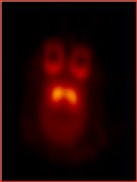
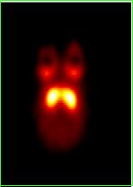
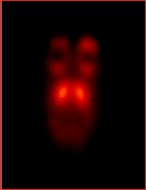
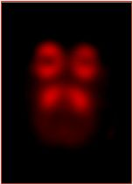
Social Factors Affect Brain DA D2 Receptors and Drug Self-Administration
Individually
Housed
Group
Housed
50
Subordinate
Dominant
Becomes Dominant
No longer stressed
40
30
Reinforcers (per session)
*
*
20
Becomes Subordinate
Stress remains
10
0
S
.003
.01
.03
.1
Cocaine (mg/kg/injection)
Morgan, D. et al., Nature Neuroscience, 2002.
Notes:
How can the environment shape the response to drugs? This study in non-human primates shows how social factors can influence the level of dopamine receptors and the propensity to self administer drugs. Illustrated above are PET images of the brains of monkeys that were initially individually housed (left) and then group housed (right). Those emerging at the top of their social rank – experiencing less stress and more access to natural rewards – expressed more dopamine receptors (bright yellow) and took less cocaine than did submissive monkeys (green symbols on graph).

Slide 29
Adverse Childhood Experiences (ACEs)
and Illicit Drug Use (n = 8603)
Drug Initiation
< 14 years of age
10
10
Ever Addicted
8
8
6
Odds ratio
Odds Ratio
6
4
4
2
2
0
0
0
1
2
3
4
5
0
1
2
3
4
5
ACE Score
ACE Score
ACEs account for one half to two third of serious problems with drug use. PEDIATRICS 111: 564-572, 2003

Slide 30
Addictive Disorders Often Co-Exist
With Other Mental Disorders
Serious Mental Illness
14.1 million
Substance
Use Disorder
44 million
Co-morbid
Disorders
6.4 million
National Survey on Drug Use and Health 2021

Slide 31
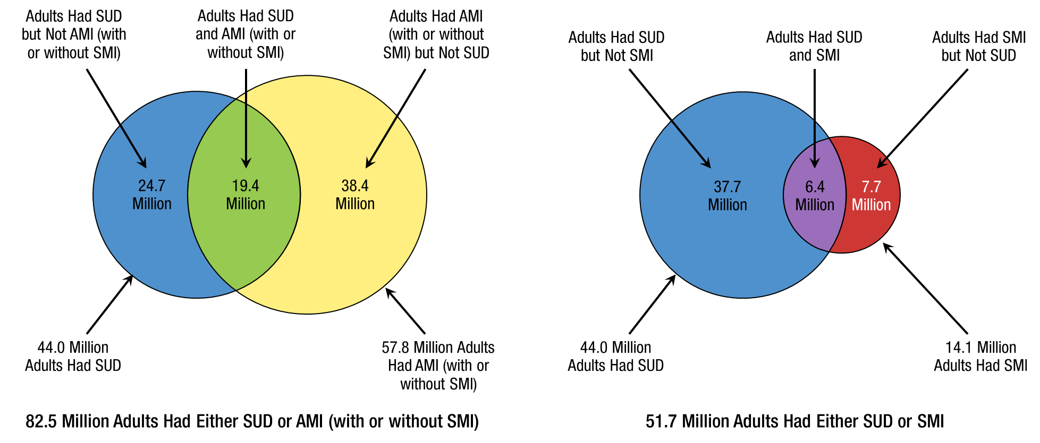
Past Year Substance Use Disorder (SUD), Any Mental Illness (AMI), and Serious Mental Illness (SMI):
Among Adults Aged 18 or Older; 2021

Slide 32
urgent public health challenges today: cannabis legalization, overdose crisis

Slide 33

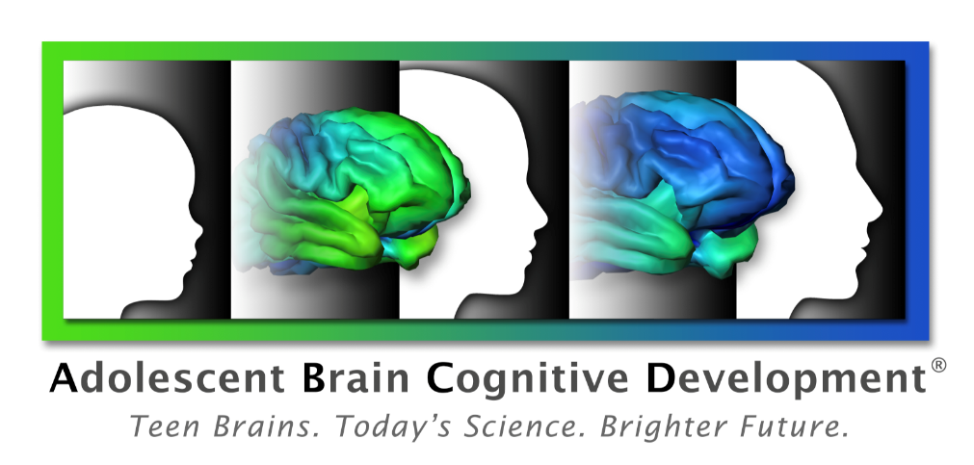
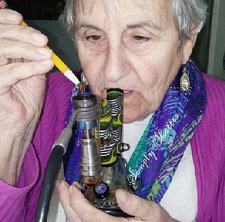

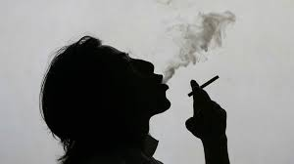
Adverse Health Consequences: Who Is At Greatest Risk?
Mothers/Newborns
Children and Adolescents
Older Adults?
Persons With Mental Illness
Tobacco Smokers

Slide 34

Addiction is a Developmental Disease:
It starts in adolescence and even childhood
1.6%
Alcohol
Risk of Developing a Drug Use Disorder
1.4%
Marijuana
1.2%
1.0%
0.8%
0.6%
0.4%
0.2%
0.0%
5
10
15
18
25
30
35
40
45
50
55
60
65
70
Age at use disorder as per DSM IV
NESARC, 2003

Slide 35
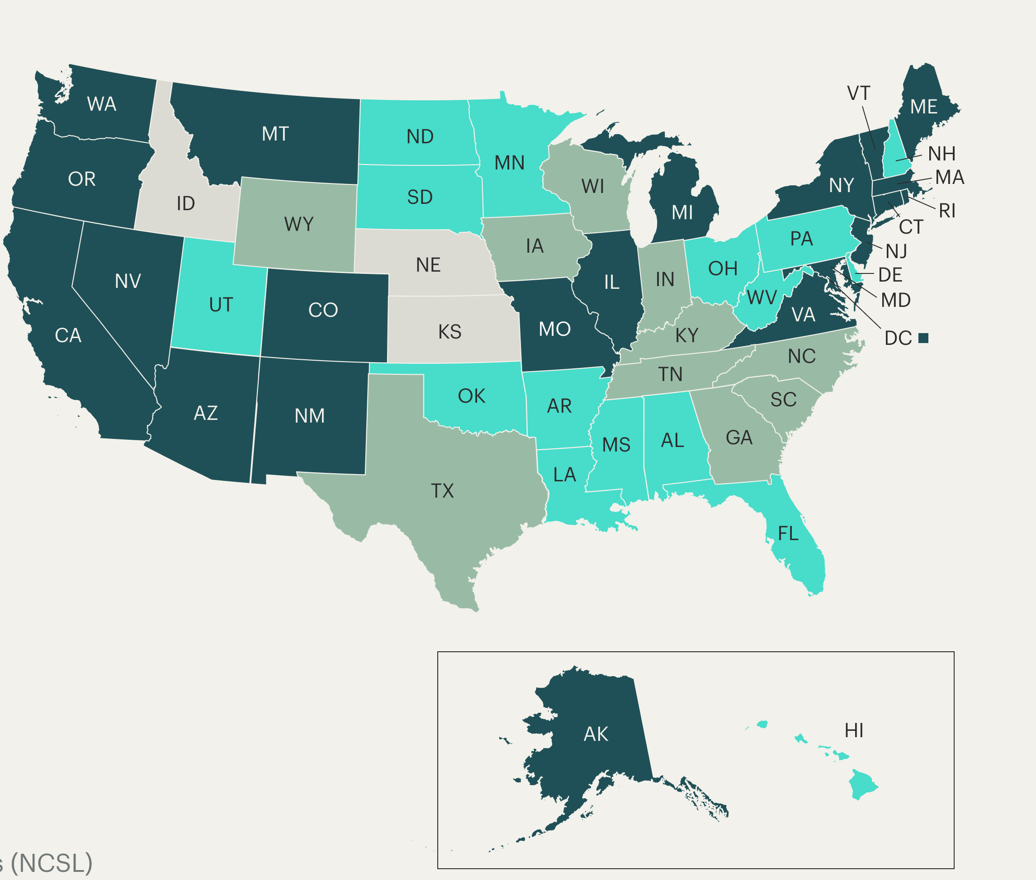
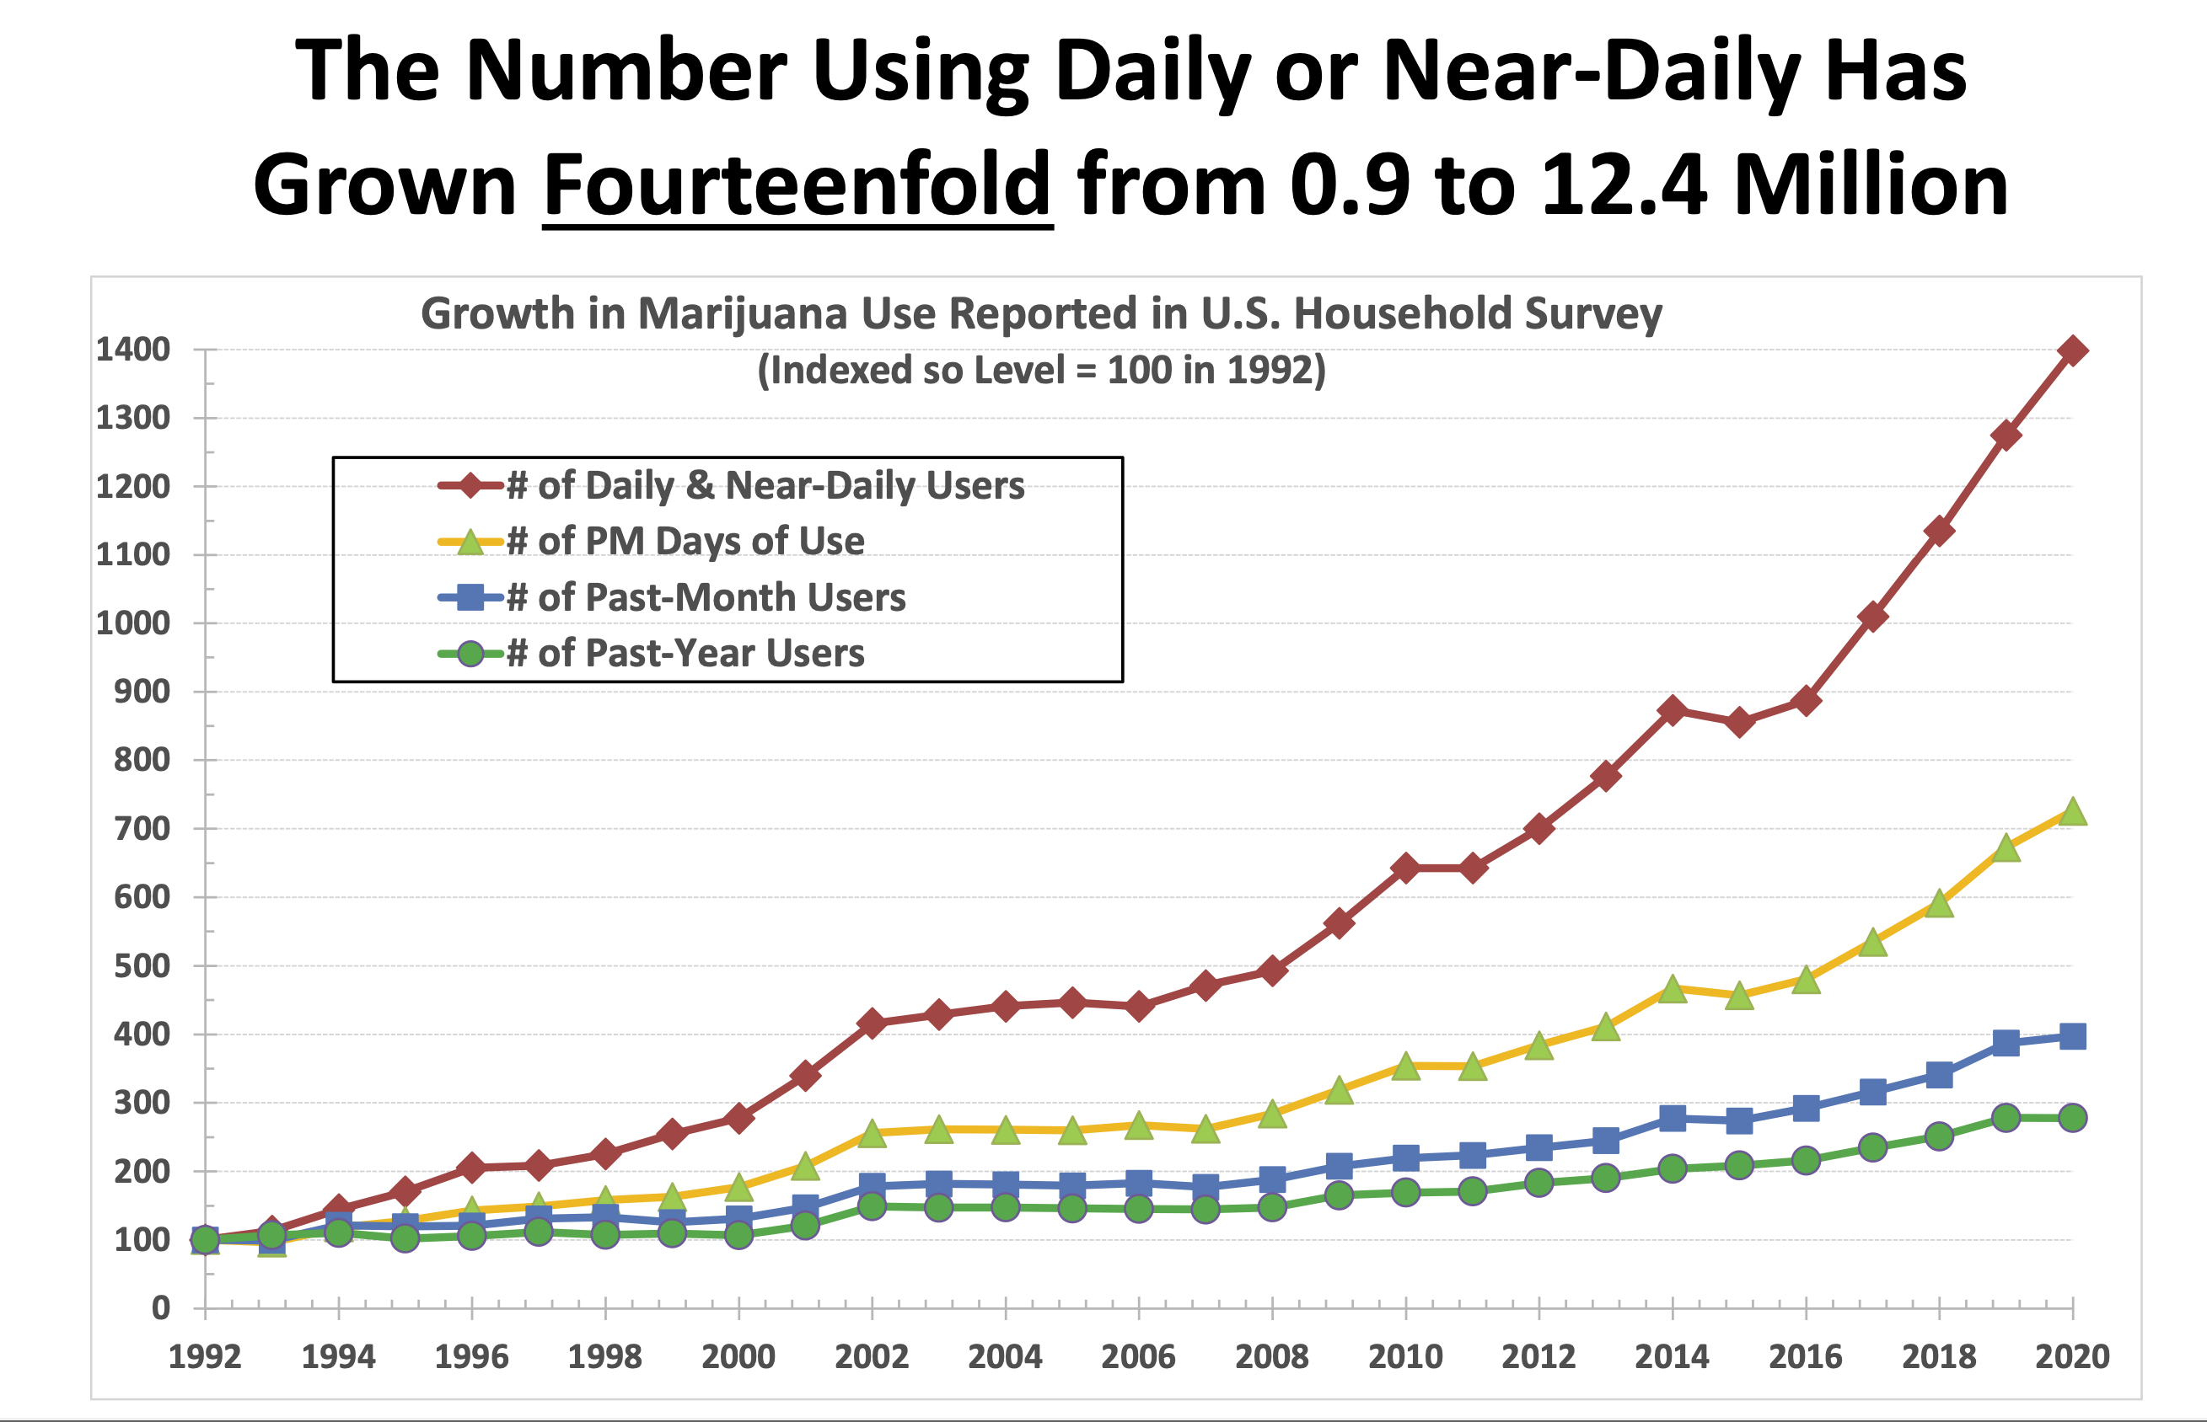
States With Legal Cannabis
Changes in Patterns of Cannabis Consumption 1992 to 2020
Daily users increased 14X
Monthly users quadrupled
Past year users Tripled
-- Recreational Marijuana legal in 21 states & DC.
-- Medical marijuana: legal in 38 states & DC (39 States, including Kentucky)
X

Slide 36

Frequency of Cannabis Use Before Age 17 and
Adverse Outcomes at Age 30 (N=2500-3700)
Adjusted Odds Ratios
Source: Silins E et al., The Lancet September 2014
Notes:
Consistent and dose-response association were found between frequency
of adolescent cannabis use and adverse outcomes

Slide 37

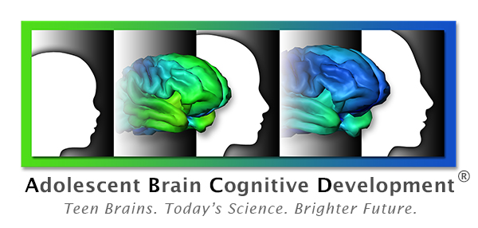
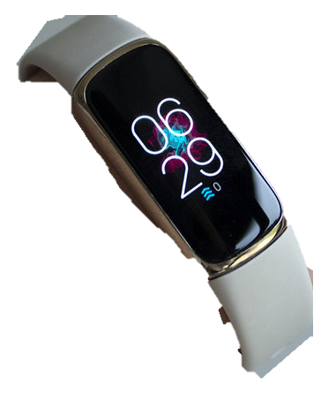
Adolescent Brain Cognitive Development (ABCD) Study
NIDA, NIAAA, NCI, NIMH, NIMHD, NICHD, NINDS, NHLBI, OBSSR, ORWH,CDC, DOJ, NSF, NEA
Ten-year longitudinal study of ~12,000 children starting at ages 9-10 to assess effects of childhood experiences, including use of cannabis and other substances, on individual brain development trajectories through adolescence into early adulthood
Neuroimaging
Mental Health
Geocoded Data
Culture and Environment
Neurocognition
Physical Health
Substance Use
https://abcdstudy.org/
Biospecimens
Novel technology

Slide 38
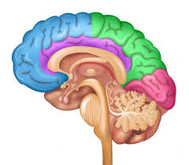




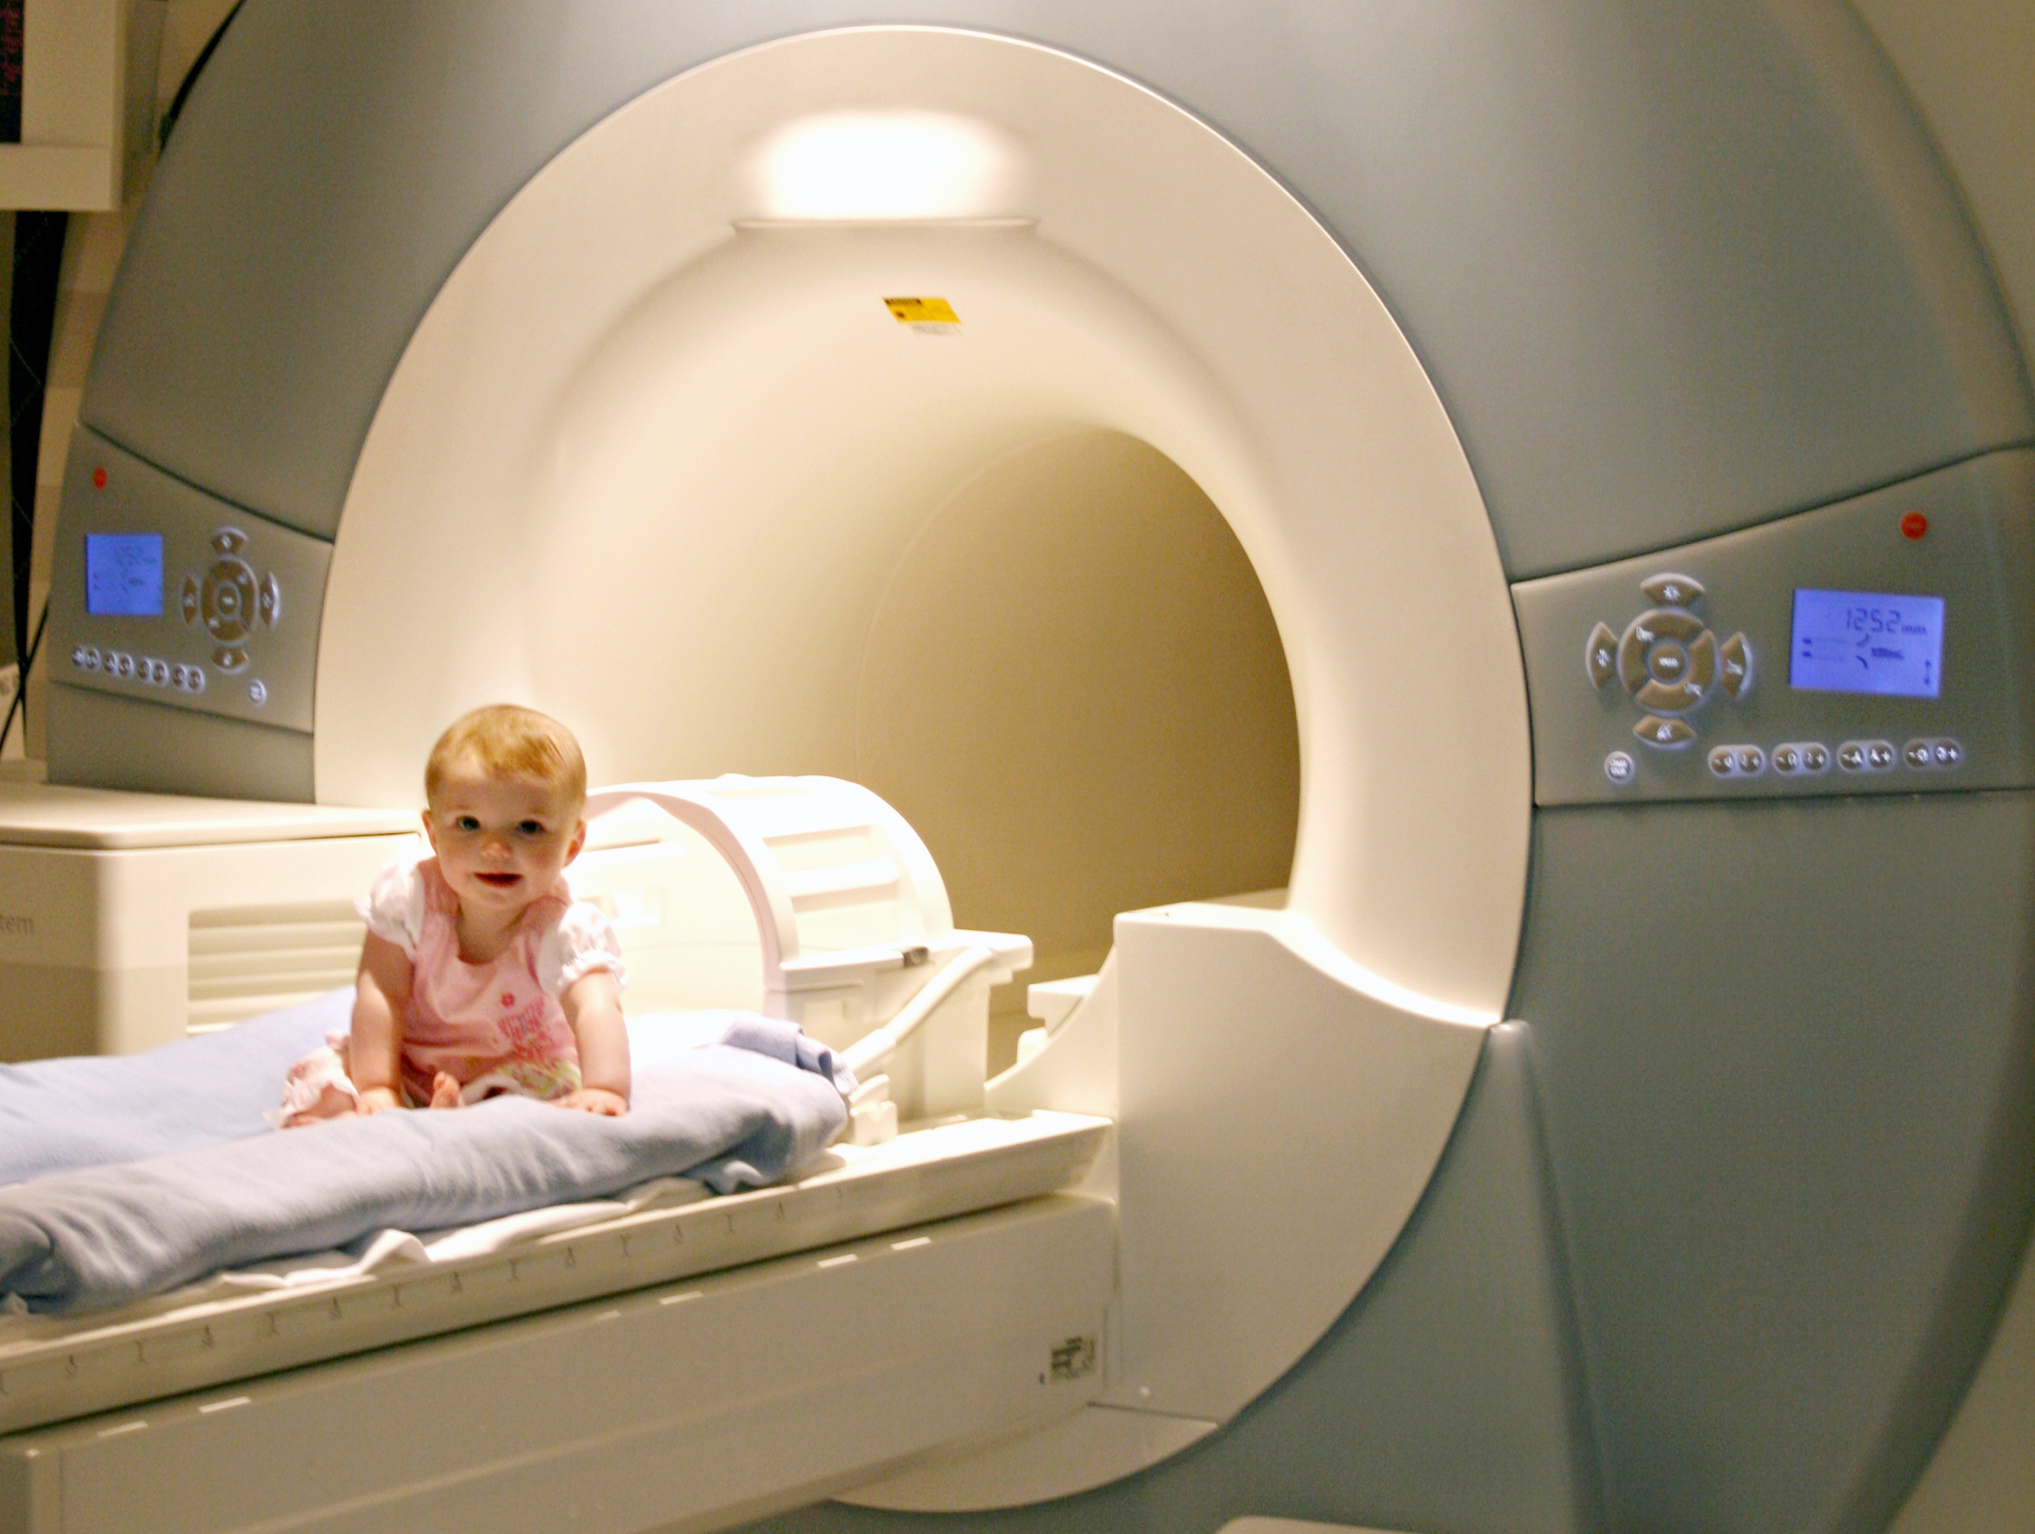
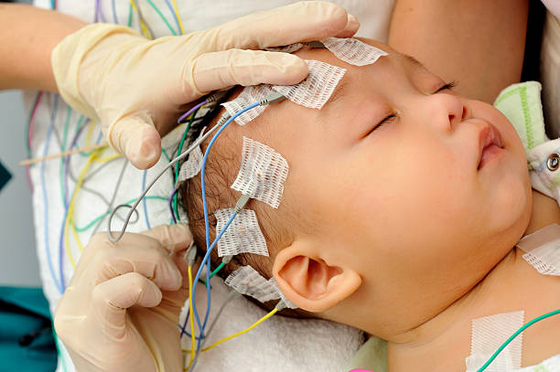
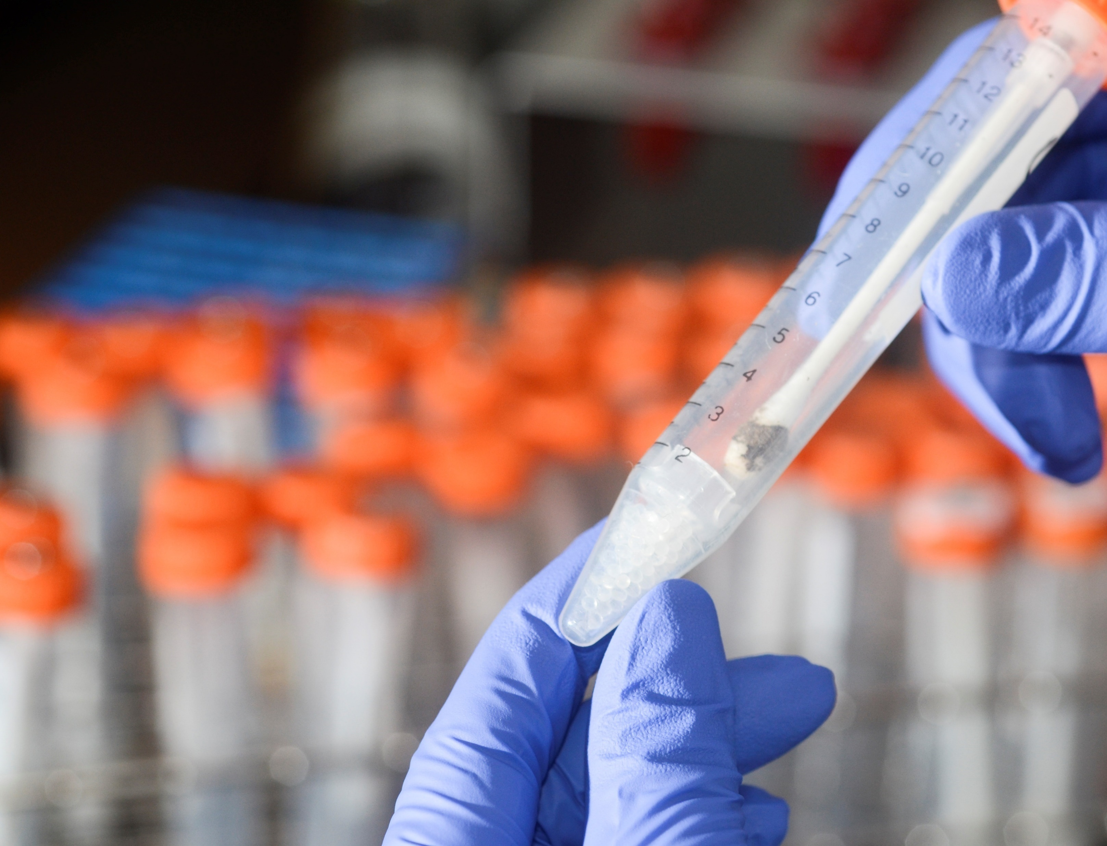
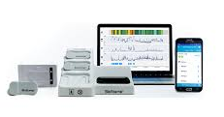
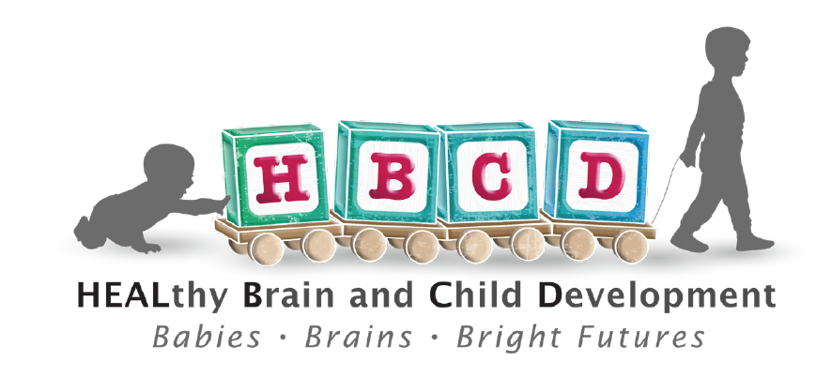
HEALthy Brain and Child Development (HBCD) Study
NIDA, NIMH, NINDS, NIAAA, NICHD, NIBIB, NIEHS, NIMHD, OBSSR, ORWH, NEI, NIH HEAL Initiative
Multi-site longitudinal study (n=7500) examining individual brain development trajectories and behavior from birth through childhood (ages 9-10) including
in utero substance exposure and effects of adverse social environments.
Pregnancy History
Risk and Protective Factors
Behavioral, neurocognitive assessments
MRI
EEG
Biospecimens
Wearables
https://hbcdstudy.org/
https://hbcdstudy.org/

Slide 39
Overdose Deaths Continue to Rise:
Provisional* Drug Overdose Deaths 12-months ending in select months
 | ALL DRUGS | HEROIN | NAT & SEMI SYNTHETIC | METHADONE | SYNTHETIC OPIOIDS (mainly illicit fentanyl) | COCAINE | OTHER PSYCHO-STIMULANTS (mainly meth)
9/2021* | 105,562 | 10,232 | 13,994 | 3,727 | 68,930 | 23,157 | 31,656
12/2021* | 109,179 | 9,411 | 13,906 | 3,765 | 72,484 | 25,174 | 33,637
9/2022* | 106,840 | 6,539 | 12,089 | 3,305 | 72,708 | 26,738 | 33,378
Percent Change 9/21-9/22 | 1.2% | -36.1% | -13.6% | -11.3% | 5.5% | 15.5% | 5.4%
*NCHS Provisional drug-involved overdose death counts are PREDICTED VALUES, 12 months ending in select months.
https://www.cdc.gov/nchs/nvss/vsrr/drug-overdose-data.htm

Slide 40
Evolution of Drivers of Overdose Deaths, All Ages
Analgesics Heroin Fentanyl Stimulants
106,699 Deaths in 2021
80,411 from Opioids (Prescription and Illicit)
Final data
Source: The Multiple Cause of Death data are produced by the Division of Vital Statistics, National Center for Health Statistics (NCHS),
Centers for Disease Control and Prevention (CDC), United States Department of Health and Human Services (US DHHS).

Slide 41
Overdoses Before and During the COVID-19 Pandemic
Men aged 15-34
Women aged 15-34
Rate per 100,000 population
Men aged 35-64
Women aged 35-64
Rate per 100,000 population
NH: non-Hispanic. AIAN: American Indian/Alaska Native. March-August 2020: COVID-19 pandemic.
Han et al., JAMA Network Open, September 21, 2022

Slide 42
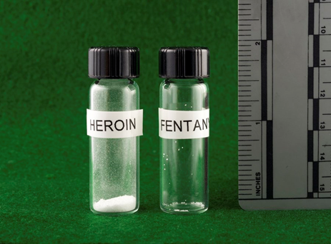
Treating Fentanyl Overdoses
RESEARCH PRIORITIES
How do we reverse fentanyl overdose?
  Should naloxone doses be higher?
  Are long-acting formulations of naloxone needed?
  Are there other medications or medication combinations
  that would be more effective?
What are appropriate detoxification strategies?
How do we treat fentanyl addiction?
  In pregnancy and postpartum?
How do we treat fentanyl involved neonatal abstinence syndrome?
Deaths from fentanyl are increasing despite naloxone (Torralva and Janowsky, 2019).
OD from fentanyl require multiple naloxone doses (Schumann et al., 2007, Somerville et al., 2017)
Shorter duration of naloxone (t_{1/2} 1.3–2.4 h) than fentanyl (t_{1/2} 7-8 h)
Very fast entry of fentanyl into the brain
Chest wall rigidity induced by fentanyl

Slide 43
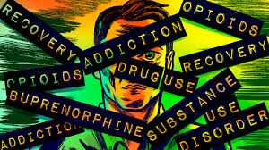
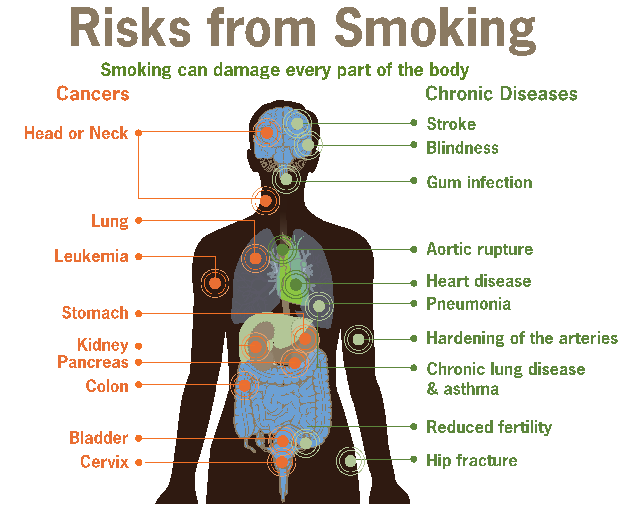


Addiction is a Quintessential Biobehavioral Disorder with Wide Ranging Ramification: Treatment Must Address the Whole Person, Their Community, Comorbidities, Economic Circumstances, etc. AND it Must be Long Term
MEDICAL
Neurotoxicity
HIV/Hep C
Cancer
Heart Disease
Mental illness
SOCIAL
ECONOMIC
Homelessness
Family dissolution
Violence
Crime
Health care
Lost Productivity
Accidents

Slide 44

Fortified
schools
PREVENTION IS KEY
Participation in Sports, Arts
Social Activities
Information Dissemination
Narcan for
everybody
Structural
racism
Social justice
Homelessness
Common sense gun
regulations
Mental Health
Stigma

Slide 45
Treatment

Slide 46

Targeting the Multiple Circuits of addiction
Volkow and Boyle, Am J Psychiatry 2018

Slide 47
Non-pharmacological therapeutics: Devices/Behavioral Therapy
Interfere with Drugs
Reinforcing Effects
Alternative reinforcers
(social interaction)
Contingency
Management
Control
Executive Function
Inhibitory Control
Cognitive Behavioral
Therapy (CBT),rTMS
Saliency
Drive
Saliency
Drive
Strengthen Cortical/
Limbic Connections
Motivational
Therapy
Interfere with conditioned
memories/new learning
Neurofeedback,
conditioning, 12-Step
Memory
Memory
Stress
Reactivity
Counteract stress
responses
Mindfulness
CBT

Slide 48

Emerging Treatments
Longer acting medications (new formulations): methadone, buprenorphine, naltrexone
Biologics: Vaccines, monoclonal antibodies
Digital Therapeutics: apps and other interactive modalities
Devices: TDCS (transcranial direct current stimulation); Focused Ultrasound; TMS (transcranial magnetic stimulation)
Other target behaviors: Sleep; Overdose prevention (i.e. reverse respiratory depression)
Deep brain stimulation: Nucleus Accumbens
Psychedelics (Alcohol, nicotine, comorbid depression)

Slide 49



Psychedelics
Combined with psychotherapy, requires trained therapists to prepare the patient and help them consolidate the experience afterwards.
Long lasting effects reported following a few exposures to the drug.
Labor intensive—therapist remains with patient throughout the drug experience
Many outstanding questions about mechanisms, safety, efficacy and effectiveness

Slide 50

THANK YOU!
Artwork by ABCD Study Participant

