Slide 1
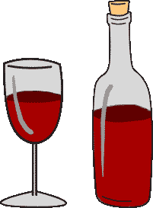
ALCOHOL USE DISORDER
Alyssa Peterkin, MD
Assistant Professor, Chobanian & Avedisian School of Medicine
Grayken Addiction Medicine Fellowship
Boston Medical Center

Slide 2
Learning Objectives
1
Describe the management of alcohol withdrawal
Create a patient centered alcohol use disorder treatment plan
2
Utilize FDA approved treatments for alcohol use disorder and off label alternatives
3

Slide 3
Let's begin with DT who bumped his head after slipping and falling.
Notes:
He is 43 years old

Slide 4
Additional Case Info
T 98, RR 18, HR 115 (regular), BP 136/82
EOMI, supple neck, no tremor; frontal ecchymosis.
A&O x 3. Speech is fluent. Gait normal. Sensorimotor exam non-focal.
Lives alone
67 years old
Reports drinking all day since his mobility reduced due to lumbar disc injury 10 years ago.
Takes no medications, has no allergies
Smokes one pack of cigarettes daily for the last 12 years
Breath alcohol is 210 mg/dL (0.21 g/100mL).

Slide 5
Four hours later, DT becomes tremulous, anxious, and complains of nausea and headache.
BP 157/84, HR 123, ethanol level 146 mg/dl, Mag 0.9, K 2.0, Phos 1.2, Cr 1.7 mg/dL.

Slide 6
Group Discussion
What are the differential diagnoses?
What is appropriate management?

Slide 7
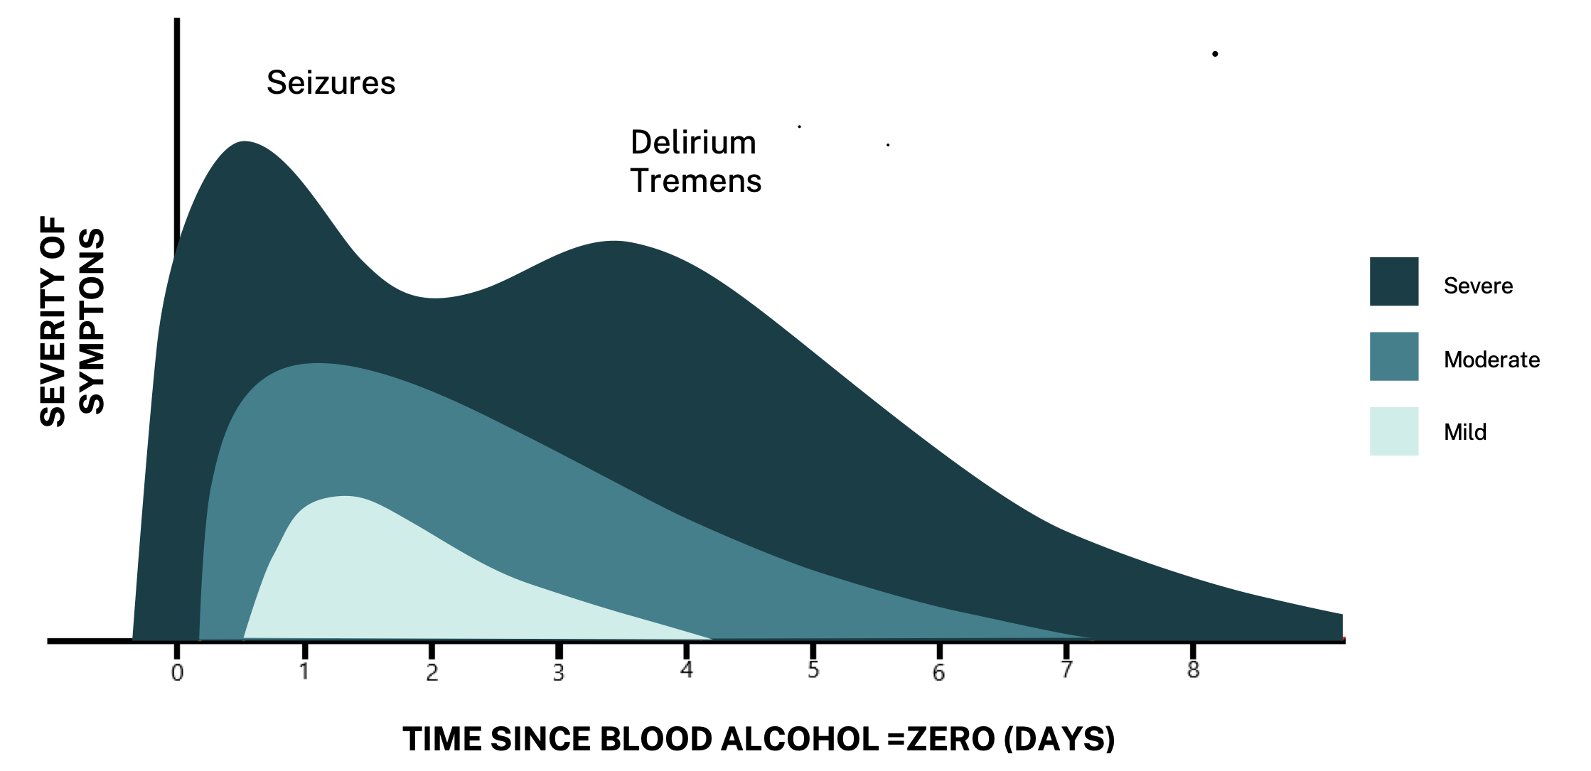
Alcohol Withdrawal Syndrome Timeline
●Insomnia
●Tremulousness
●Mild anxiety
●Gastrointestinal upset, anorexia
●Headache
●Diaphoresis
●Palpitations
health.nsw.gov.au
Notes:
AWS symptoms fall into 3 categories: GI, CNS, Autonomic, Mild alcohol withdrawal symptoms include insomnia, tremors
https://www.health.nsw.gov.au/aod/professionals/Publications/clinical-guidance-withdrawal-alcohol-and-other-drugs.pdf
Mild alcohol resolves with a little more than 48 hours
Hallucinations are most commonly visual or tactile, with imagery or sensations of insects, animals or people, and may last minutes at a time or several days.
OcCUR a patient is in alcohol withdrawal, hallucinations can occur in the context of a clear sensorium or as part of alcohol withdrawal delirium. 12 to 48 hours
Seizure is generalized tonic clinic (grand mal), typical single but also have multiple

Slide 8
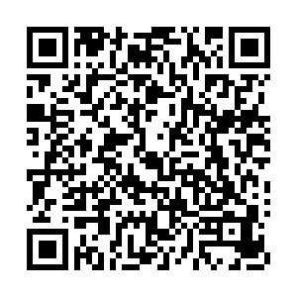
Alcohol Withdrawal Management
The Clinical Institute Withdrawal Assessment Alcohol Scale Revised (CIWA)
Richmond Agitation and Sedation Scale (RASS)
Brief Alcohol Withdrawal Scale
The Clinical Institute Withdrawal Assessment Alcohol Scale Revised (CIWA)
Short Alcohol Withdrawal Scale (SAWS)
Inpatient
Outpatient
Notes:
Be sure to mention the Short alcohol withdrawal scale and CIWA
Brief Alcohol Withdrawal Scale (5 item assessment tool based on CIWA) tremor, diaphoresis, agitation, confusion/orientation, and hallucinations)
ost patients on the BAWS protocol received little-to-no benzodiazepines; severe withdrawal, agitation, delirium, or over-sedation were uncommon. This is the first evaluation of the BAWS protocol on a diverse population of hospitalized patients.

Slide 9
Assessing Risk for Severe Withdrawal
•History of alcohol withdrawal delirium or withdrawal seizure
•Numerous prior withdrawal episodes in patient’s lifetime
•Comorbid medical or surgical illness (especially traumatic brain injury)
•> 65 years old
•Long duration of heavy and regular alcohol consumption
•Seizure(s) during the current withdrawal episode
•Marked autonomic hyperactivity on presentation
• BAL at time of presentation
•Physiological dependence on GABAergic agents such as benzodiazepines or barbiturates

Slide 10
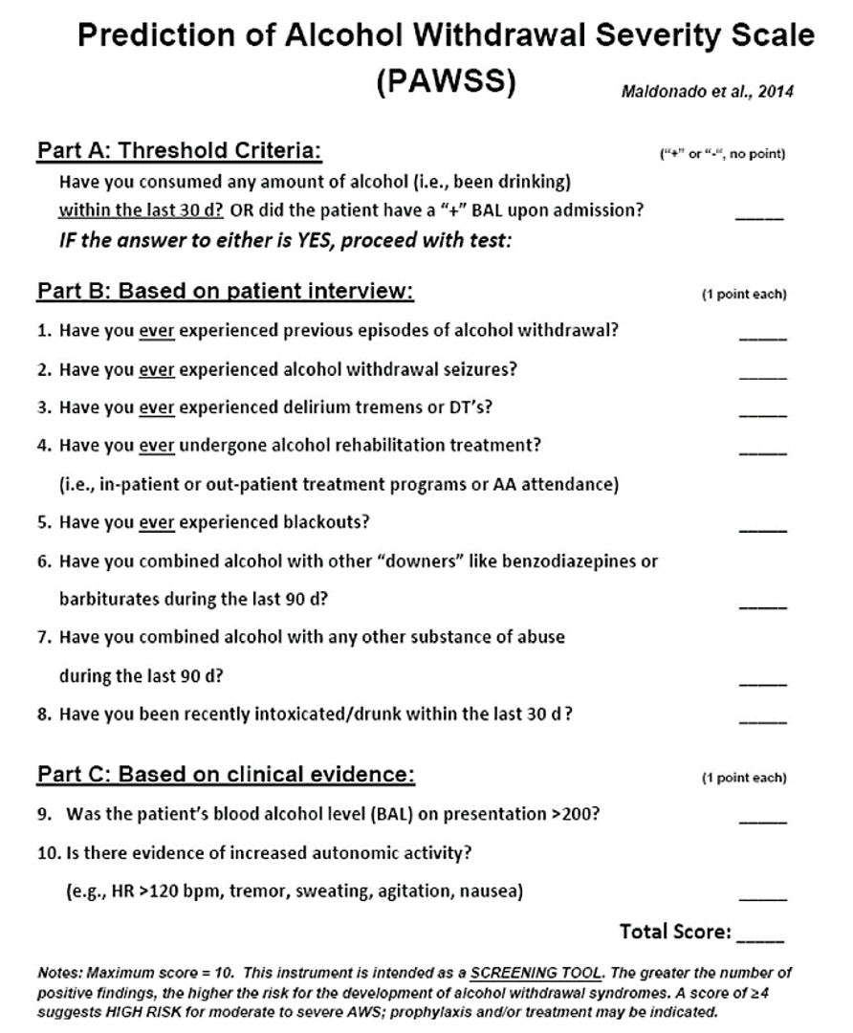
PAWSS
4
MODERATE TO SEVERE ALCOHOL WITHDRAWAL
Maldonado et al 2014
Notes:
Maldonado JR, Sher Y, Ashouri JF, et al. The "Prediction of Alcohol Withdrawal Severity Scale" (PAWSS): systematic literature review and pilot study of a new scale for the prediction of complicated alcohol withdrawal syndrome. Alcohol. 2014;48(4):375-390. doi:10.1016/j.alcohol.2014.01.004

Slide 11
Withdrawal Management Pharmacotherapy

Slide 12
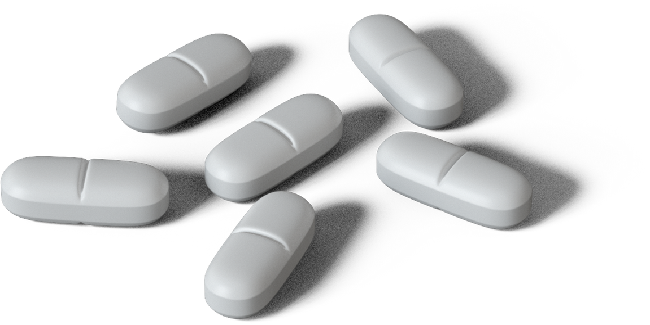
Benzodiazepines
•Augment GABA
•Most evidence-based treatment
•Benzodiazepines reduce incidence of seizures and recurrence
•Benzodiazepines prevent incident delirium tremens
Day | Medication | Fixed Schedule | Symptom Triggered Schedule
1 | Diazepam | 10mg every 6 hours | 10mg every 4 hours
2 | Diazepam | 10mg every 8 hours | 10mg every 6 hours
3 | Diazepam | 10mg every 12 hrs | 10mg every 6 hours
4 | Diazepam | 10mg at bedtime | 10mg every 12 hours
5 | Diazepam | 10mg at bedtime | 10mg every 12 hours
Saitz R, Mayo-Smith MF, Roberts MS, et al JAMA. 1994
Sereny 1965, Kiam 1969, Zilm 1980, Sellers 1983, Naranjo 1983
Tiglao et al 2021
Muncie, Yasinian, Oge, 2013
Cohen, Alexander, Holt 2022

Slide 13
Gabapentin
•GABA Analog
•Individuals with very mild withdrawal (CIWA-Ar<10)
•Favorable option if clinician also plans to use for treatment of AUD
•Efficacy in reducing mild alcohol withdrawal symptoms other than seizure and DTs
Day | Medication | Dose
1 | Gabapentin | 300mg every 6 hours
2 | Gabapentin | 300mg every 8 hours
3 | Gabapentin | 300mg every 12 hours
4 | Gabapentin | 300mg at bed time
Cohen, Alexander, Holt 2022
Notes:
No need to taper if planned for treatment
It is also okay to give a prn doses

Slide 14
Phenobarbital
• Acts on GABA and glutamate signaling
•Inhibits the NMDA-type glutamate receptors
•Increases the duration of the GABA channel opening
NARROW THERAPEUTIC WINDOW
LONG HALF LIFE (75-126 HRS)
ONSET OF ACTION 5-30MIN (IV/IM); 1HR (PO
Outcomes vary by setting.
Effective and well tolerated alternative to BZDs for treatment of alcohol withdrawal.
Emergency Departments:
Phenobarbital when used as an adjunctive to benzodiazepines can be benzodiazepine sparing. Rosenson et al 2013
ICU:
Phenobarbital decreases the need for adjunctive medications- Tidwell et al 2018
Phenobarbital as an adjunct to benzodiazepines is associated with reduced ICU LOS and reduction in mechanical ventilation. Gold et al, 2007
Mechanical ventilation rates were noninferior compared with the previous benzodiazepine-based pathway for the treatment of severe AWS- Bosch et al 2021
Notes:
Bosch NA, Crable EL, Ackerbauer KA, et al. Implementation of a Phenobarbital-based Pathway for Severe Alcohol Withdrawal: A Mixed-Method Study. Ann Am Thorac Soc. 2021;18(10):1708-1716. doi:10.1513/AnnalsATS.202102-121OC

Slide 15
After 3 days in the hospital
DT is no longer showing signs of alcohol withdrawal. He shares that his drinking escalated during the COVID-19 pandemic and his depression worsened. He expresses interest in getting help with drinking problem.

Slide 16
Alcohol and the Pandemic
Alcohol
use disorder
diagnoses
2019
2020
14.5 million
28.3 million
SAMHSA 2021, NSDUH 2020

Slide 17
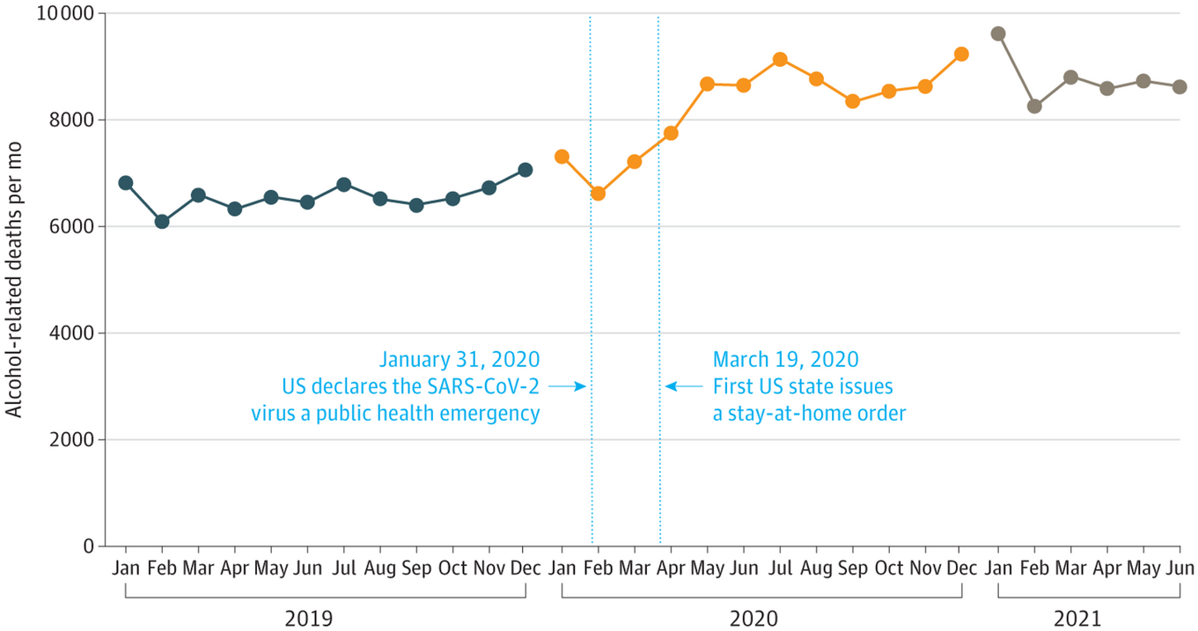
Alcohol and the Pandemic
White et al JAMA 2022
Notes:
Monthly Alcohol-Related Deaths Among People 16 Years and Older
with the largest increases occurring for people aged 35 to 44 year olds,
The number of alcohol related liver disease also increased
Alcohol was increasing involved in opioid over deaths
And rising alcohol behavioral health conditions

Slide 18
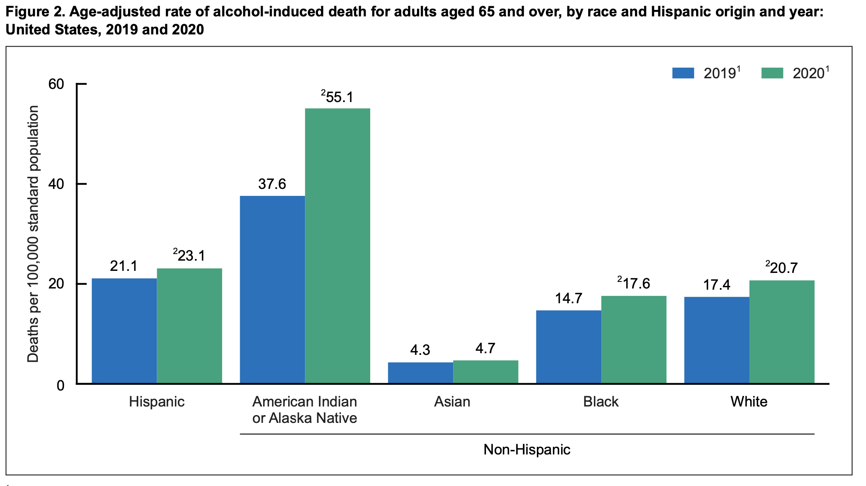
Alcohol and the Pandemic
In 2020, age-adjusted rates of alcohol-induced deaths in adults aged 65 and over were highest for non-Hispanic American Indian or Alaska Native (AIAN) adults followed by rates for Hispanic (23.1)
CDC, 2022
Notes:
Monthly Alcohol-Related Deaths Among People 16 Years and Older
Peakedin ages 55-64 but is who look at who is dying we see rates were very high for American Indian and Alaska natives following by Hispanic people

Slide 19
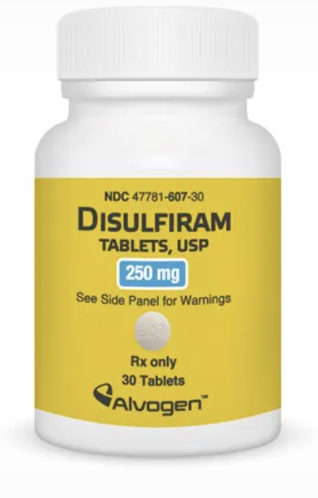
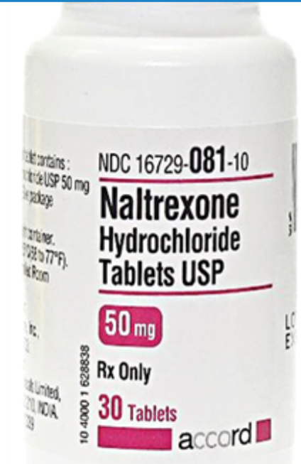
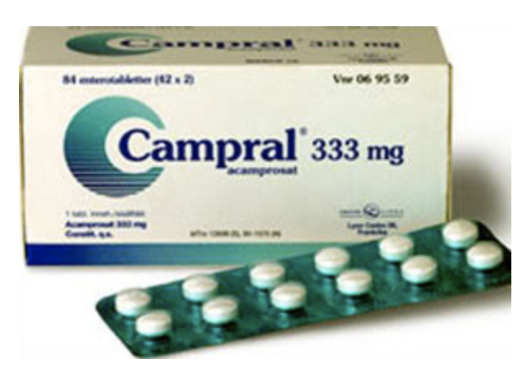
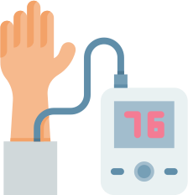
WITHDRAWAL MANAGEMENT IS NOT TREATMENT
Pharmacotherapy
Mutual Support Groups
Counseling, intensive outpatient treatment, recovery coaching
Managing medical and psychiatric co-morbidities
Friedmann PD, Saitz R, Samet JH. JAMA 1998

Slide 20
Abstinence
Improving relationship with family
Decreasing consumption
Avoiding legal consequences
Harm reduction
Being able to maintain employment
What is your patient’s goal?

Slide 21
Treatment Disparities
Black and Latine adults report greater risk to heavy drinking, alcohol-related health concerns and social concerns negatively impacting life.
Native communities suffer health disparities related to SUD. AI/ANs have the greatest unmet need for treatment among all ethnic groups in the U.S
Latine less likely to be offered information on alcohol treatment services than Whites by health care providers.
Pinedo et al. Drug Alcohol Depend 2021
Skewes et al. Am J Community Psychol 2019
Notes:
Pinedo M. Missed opportunities by health care providers to reduce racial/ethnic disparities in the use of alcohol treatment services. Drug Alcohol Depend. 2021;226:108851. doi:10.1016/j.drugalcdep.2021.108851
Skewes MC, Hallum-Montes R, Gardner SA, Blume AW, Ricker A, FireMoon P. Partnering with Native Communities to Develop a Culturally Grounded Intervention for Substance Use Disorder. Am J Community Psychol. 2019;64(1-2):72-82. doi:10.1002/ajcp.12354

Slide 22
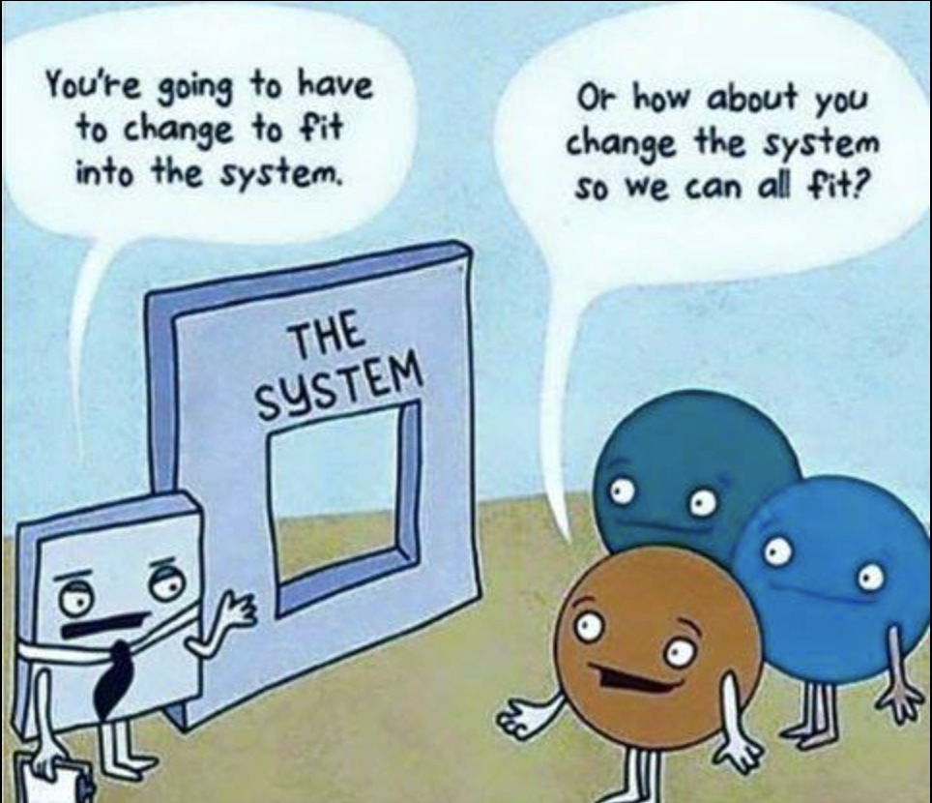
Potential solutions
Cultural adaptation
Increasing accessibility to treatment
Making time to explain MAUD clearly during visit
Taking a holistic view, accounting for historical trauma
Hall et al J Subst Abuse Treat. 2022
Skewes et al Am J Community Psychol. 2019
Notes:
Cultural Adaptation: systematic modification of an evidence-based treatment or intervention protocol to consider language, culture, and context in such a way that it is compatible with the client’s cultural patterns, meaning, and values, general prevention and awareness campaigns tailored to Native communities. strengths and protective nature of Native spirituality and culture ie no alcohol or drugs allowed at pow wows
response to personal trauma and individual experiences, but also as a response to familial and community challenges that this historically marginalized population has faced. In this sense, the majority of participants viewed substance abuse as related to the community’s experience of colonization, displacement, and ongoing racism, which continue to affect the day-to-day health and well-being of tribal members and their families.
Solutions: getting to know community organizations, creating partnerships
Making treatment times more accessible, evening clinics and weekend sessions
For example, only 25 AI/ANs (1.4% of the total sample) participated in Project MATCH, still one of the largest randomized controlled trials of SUD treatments with AI/Ans. COMBINE Study only B/w/h; approx. 20%were from minoritized groups
Hall OT, Jordan A, Teater J, et al. Experiences of racial discrimination in the medical setting and associations with medical mistrust and expectations of care among black patients seeking addiction treatment. J Subst Abuse Treat. 2022;133:108551. doi:10.1016/j.jsat.2021.108551

Slide 23
NALTREXONE
50mg daily
380mg IM monthly
Opioid receptor Antagonist
Metabolized by liver
nausea, headache, dizziness dysphoria
NNT=12
$23.50
$1415.30
Moderate Strength of Evidence
Efficacy: reducing return heavy drinking and number of heavy drinking days
NNT=12
Risk reduction: 61% to 51%
Efficacy varies across race/ethnic backgrounds
Contraindications: acute hepatitis (LFTS >5x upper limit of normal) , severe liver impairment, opioid use
The Medical Letter on Drug Therapeutics 2021
Rösner S, et al. Cochrane Database Syst Rev 2010
Jonas D, et al. JAMA 2014
Ray, Oslin Drug Alcohol Depend 2009
Lopez J Stud Alcohol Drugs. 2017
Notes:
These analyses of the COMBINE Study sought to examine the effects of naltrexone for the treatment of alcoholism among African Americans. Contrary to the reported outcomes for the larger study (Anton et al., 2006), composed primarily of individuals of European Ancestry, the present results did not support the efficacy of naltrexone on percent-days abstinent, time to first heavy drinking day, and global clinical outcome in this subsample of African Americans
Of note, the current sample size was powered to detect medium-to-large effect sizes.
Contrary to other outcome measures of the study, naltrexone was a significant predictor of a good clinical outcome (i.e., abstinence or moderate drinking without problems) for Latino participants. Contrary to other outcome measures of the study, naltrexone was a significant predictor of a good clinical outcome (i.e., abstinence or moderate drinking without problems) for Latino participants.
Ray LA, Oslin DW. Naltrexone for the treatment of alcohol dependence among African Americans: results from the COMBINE Study. Drug Alcohol Depend. 2009;105(3):256-258. doi:10.1016/j.drugalcdep.2009.07.006
López CM, Barr SC, Reid-Quiñones K, de Arellano MA. Efficacy of Naltrexone for the Treatment of Alcohol Dependence in Latino Populations. J Stud Alcohol Drugs. 2017;78(4):629-634. doi:10.15288/jsad.2017.78.629

Slide 24
ACAMPROSATE
666mg PO TID
OR
333mg PO TID
Enhances GABA transmission
Renally Excreted unchanged
diarrhea
NNT = 12
$197.70
Moderate strength of evidence
Modestly improves abstinence
Abstinence rate 25% vs 17%
NNT = 12
Meta-analyses show increased likelihood of continuous abstinence at 12 months compared to placebo.
Contraindications: end stage renal disease
Rösner S, et al. Cochrane Database Syst Rev 2020
Jonas D, et al. JAMA 2014
Cohen, Alexander, Holt 2022
The Medical Letter on Drug Therapeutics 2021
Notes:
Recent paper showing NNT 11
High strength of evidence supporting abstinence and reducing drinking days

Slide 25
DISULFIRAM
250-500mg PO daily
Inhibits aldehyde dehydrogenase
Metabolized by liver
disulfiram reaction, neuropathy
$59.70
Low strength of evidence
Randomized placebo-controlled trials have failed to demonstrate a benefit (difficult to do with this type of drug).
Appears to be effective with compared with no treatment (OR for abstinence 2.2) or when administration is supervised (OR for abstinence 3.9)
Contraindications: severe myocardial disease, history of psychosis
The Medical Letter on Drug Therapeutics 2021
Cohen, Alexander, Holt 2022
Jorgensen CH, et al. Alcohol Clin Exp Res 2011;35:1749.

Slide 26
TOPIRAMATE
200-300 mg/day
start with 25mg to 50mg daily
Enhances GABA transmission
Renally excreted unchanged
Paresthesia, anorexia, taste perversion, difficulty concentrating, renal stones, visual problems
$7.00
Not FDA approved for AUD
Moderate strength of evidence + large side effect profile
Category D, and cleft palate can occur with fetal exposure
Lots of drug interactions
Systematic review including 6 RCTs and total of 979 participants:
Fewer drinks/drinking day (-1.6)
Higher % days abstinent (mean difference 15.5%)
Less heavy drinking (standardized mean -0.44)
The Medical Letter on Drug Therapeutics 2021
Johnson et al JAMA 2007;298(14)
Pani PP, et al. Cochrane Database Syst Rev 2014;2:CD008544
Notes:
Glutamate receptor antagonist & dopamine release inhibitorDIAR PARESTHESIA (50%), ANOREXIA (20%), TASTE PERVERSION (15%), DIFFICULTY WITH CONCENTRATION
Acute visual disturbance, myopia and acute angle closure glaucoma all occur infrequently among those receiving topiramate, mostly at the beginning of the treatment (^{Shank and Maryanoff, 2008}). Cognitive impairment from topiramate can be significant enough in some patients to cause discontinuation. This seems to be driven by topiramate effect on frontal lobe functions (attention, cognitive speed, verbal fluency, short-term memory, and mental flexibility)
Renal impairment decreases topiramate clearance and increases the half-life (Guerrini and Parmeggiani, 2006; Perucca, 2015).
Add major finding from Manhapra, Ajay MD; Chakraborty, Anirban MBBS; Arias, Albert J. MD, MS. Topiramate Pharmacotherapy for Alcohol Use Disorder and Other Addictions: A Narrative Review. Journal of Addiction Medicine 13(1):p 7-22, January/February 2019. | DOI: 10.1097/ADM.0000000000000443

Slide 27
GABAPENTIN
1200mg-1800mg/day
Enhances GABA transmission
Renally excreted unchanged
Fatigue, dizziness, somnolence
NNT varies
$8.40
Not FDA approved for AUD
Low strength of evidence
n= 96, double blind RCT: gabapentin 1200mg/day
No return to heavy drinking (95% CI, 3.1-34.1; P = .02 NNT 5.4)
More total abstinence (95% CI, 1.0-26.7; P = .04; NNT, 6.2)
n=346 10-site trial, Gabapentin ER 600mg BID
No differences in ‘no heavy drinking days’ (28% v. 22%)
No differences in other drinking measures or consequences
n =150, 12-week trial, gabapentin 1800 mg/day was associated with:
Reduction in heavy drinking (55% vs. 77%; NNT=5)
Increase in abstinence (17% vs. 4%; NNT=8)
The Medical Letter on Drug Therapeutics 2021
Mason BJ, et al. JAMA Intern Med 2014
Anton. JAMA Intern Med 2020
Notes:
Some evidence to support for return to heavy drinking

Slide 28
Baclofen
30-300mg daily
GABA-B receptor agonist
Renally excreted unchanged
Fatigue, dizziness, somnolence
$varies by dose
Not FDA approved for AUD
Low strength of evidence
Fever heavy drinking days and more days abstinent compared to placebo
Poor outcomes at high doses
Recent Cochrane review (17 studies)
Compared to placebo, decreases the risk to relapse (risk ratio (RR) 0.87, 95%confidence interval (CI) 0.77 to 0.99; 12 studies, 1057 participants).
High-certainty evidence found that baclofen increases the percentage of days abstinent (mean difference (MD) 9.07, 95% CI 3.30 to 14.85;16 studies, 1273 participants).
Addolorato G et al. The Lancet 2007
, Garbutt et al , Neuropsychopharmacology, 2021
Agabio et al . Cochrane Database Syst Rev. 2023
Notes:
Moderate strength of evidence for reducing return to any drinking
Garbutt JC, Kampov-Polevoy AB, Pedersen C, et al. Efficacy and tolerability of baclofen in a U.S. community population with alcohol use disorder: a dose-response, randomized, controlled trial. Neuropsychopharmacology. 2021;46(13):2250-2256. doi:10.1038/s41386-021-01055-w
Agabio R, Saulle R, Rösner S, Minozzi S. Baclofen for alcohol use disorder. Cochrane Database Syst Rev. 2023;1(1):CD012557. Published 2023 Jan 13. doi:10.1002/14651858.CD012557.pub3
There was no difference between baclofen and placebo in the other primary outcomes: heavy drinking days (standardised mean difference (SMD) −0.18, 95% CI −0.48 to 0.11; 13 studies, 840 participants; moderate‐certainty evidence); number of drinks per drinking days (MD −0.45, 95% CI −1.20 to 0.30; 9 studies, 392 participants; moderate‐certainty evidence); number of participants with at least one adverse event (RR 1.05, 95% CI 0.99 to 1.11; 10 studies, 738 participants; high‐certainty evidence); dropouts (RR 0.88, 95% CI 0.74 to 1.03; 17 studies, 1563 participants; high‐certainty evidence); dropouts due to adverse events (RR 1.39, 95% CI 0.89 to 2.18; 16 studies, 1499 participants; high‐certainty evidence).

Slide 29
How do I teach this?
M
Morning report on withdrawal
C
Chalk Talk on MAUD
A
Ambulatory case on MAUD
P
Pearls at the Bedside
Visit a community organization
J
Journal Club
V

Slide 30
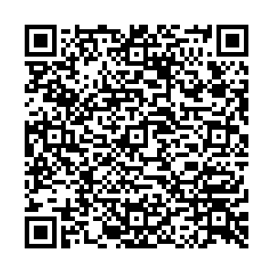
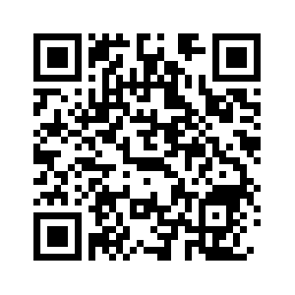
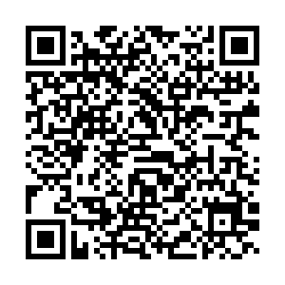
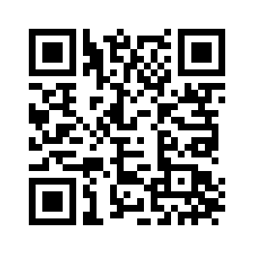
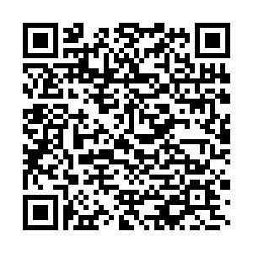
Additional Resources
ASAM Guidelines
British Columbia Center of Substance Use
NSW Withdrawal guidelines
The CurbsiderS podcasts
Ambulatory alcohol withdrawal
Treating alcohol use disorder
AUD Meds
Notes:
Curb siders
Add one more resource: https://www.health.nsw.gov.au/aod/professionals/Publications/clinical-guidance-withdrawal-alcohol-and-other-drugs.pdf

