Slide 1
Cannabis
Clearing the air….
Miriam Komaromy, MD
Professor of Medicine,
Medical Director, Grayken Center for Addiction
Boston Medical Center, Boston University
Miriam.Komaromy@bmc.org
With thanks to Dr. Jeanette Tetrault for an earlier version of these slides…

Slide 2
Your patient, Ms. Smith
47 yo software engineer, single, lives with housemates
Increasing difficulty giving presentations at work and interacting with colleagues
BMI 28; 5 lb weight gain in past year
3-4 glasses of wine per week
Cannabis edibles during the evening to relax and help with sleep

Slide 3
Learning objectives
Define the key components of cannabis and review relevant epidemiology and terminology
Analyze policy issues regarding cannabis legalization
Describe adverse health effects of cannabis use
Counsel patients about cannabis use based on scientific evidence

Slide 4
Learning objectives
Define the key components of cannabis and review relevant epidemiology and terminology
Analyze policy issues regarding cannabis legalization
Describe adverse health effects of cannabis use
Counsel patients about cannabis use based on scientific evidence

Slide 5
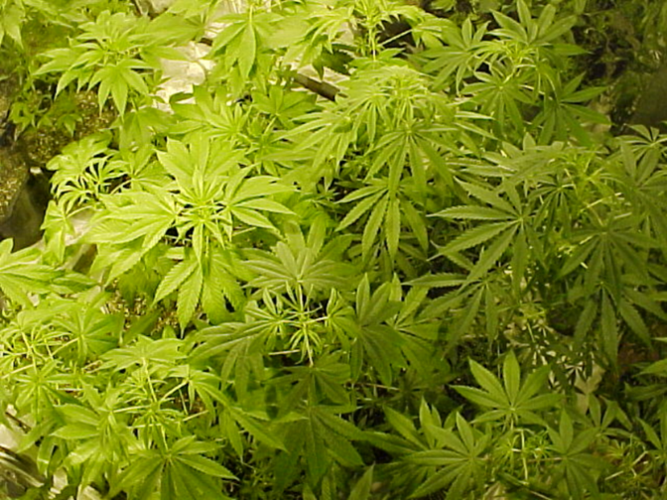
What is cannabis?
Dried flowers, leaves, stems and seeds of Cannabis sativa
Different sub-species:
Sativa
Indica
Two main components:
Terpenes
Cannabinoids
Cannabidiol (CBD)
Δ9-tetrahydrocannabinol (THC)
Potency related to concentration of THC and route of administration

Slide 6
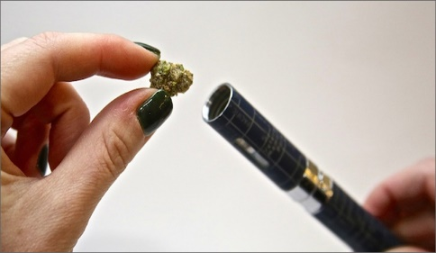
Routes of administration
Vaping – activating raw plant matter without combustion
~40% of individuals with medical cannabis use vape as a route of administration
Smoking
Edibles
Tinctures
Transdermal patch
Suppository
Topical cream
Beverage
Dabbing – inhale cannabis vapor from concentrates, oils or extracts through a “dab rig”
Delivers a high dose of THC in a short period of time

Slide 7
Cannabis Use Disorder DSM 5
Loss of Control
-Larger quantity over longer period of time
-Unsuccessful attempts to cutback or control
-Increased time spent
Consequences a) Failure to fulfill major role obligations
b) Social/Interpersonal problems
c) Activities given up
d) Use in hazardous situations
e) Physical and psychological consequences
Craving
-Craving
-Tolerance
-Withdrawal
A problematic pattern of cannabis use leading to clinically significant impairment or distress, as manifested by two or more criteria within a 12-month period.
Modified by severity:
Mild: Two to three symptoms
Moderate: Four to five symptoms
Severe: Six or more symptoms
Notes:
BEFORE WE GET INTO THE Policy implications and ADVERSE HEALTH EFFECTS, WE NEED TO GET ON THE SAME PAGE REGARDING TERMINOLOGY AND DSM5 DIAGNOSES
DSM 5 combines abuse and dependence into a single construct called substance use disorder with certain modifiers for mild, moderate or server.
A problematic pattern of cannabis use leading to clinically significant impairment or distress, as manifested by two or more of the following within a 12-month period:
Mild: Two to three symptoms
Moderate: Four to five symptoms
Severe: Six or more symptoms

Slide 8
Cannabis withdrawal: New to DSM 5
Cessation of cannabis use that has been heavy and prolonged
Three or more of the following signs and symptoms develop within approximately one week after the cannabis cessation:
Irritability, anger, or aggression
Nervousness or anxiety
Sleep difficulty (eg, insomnia, disturbing dreams)
Decreased appetite or weight loss
Restlessness
Depressed mood
At least one of the following physical symptoms causing significant discomfort: abdominal pain, shakiness/tremors, sweating, fever, chills, or headache
Cause distress or impairment
No other explanation for symptoms
Of note, symptoms generally resolve in 7-14 days but may persist for weeks
Notes:
TIMELY: Just added to DSM IV
NEED TO INCLUDE:
The signs or symptoms cause clinically significant distress or impairment in social, occupational, or other important areas of functioning
The signs or symptoms are not attributable to another medical condition and are not better explained by another mental disorder, including intoxication or withdrawal from another substance
Symptoms generally resolve in 7-14 days but may persist for weeks.

Slide 9
Learning objectives
Define the key components of cannabis and review relevant epidemiology and terminology
Analyze policy issues regarding cannabis legalization
Describe adverse health effects of cannabis use
Counsel patients about cannabis use based on scientific evidence

Slide 10
Policy timeline
1970: Controlled Substances Act passed by Congress, cannabis listed as schedule I drug
1996-2022: 21 states + DC + Guam legalized; 16 states medical; 31 states decriminalized
2005: Supreme Court decision (Gonzales v. Raich)
Federal law enforcement has the authority to arrest and prosecute MDs or patients
2009, 2014: Department of Justice Memorandum
Federal resources should not be used to prosecute those who comply with states laws
2008-2010: IOM, ACP, AMA
Petitioned DEA/FDA to reschedule to schedule II …it remains schedule I to this day
2022: -- MORE Act Passed by House, but not the Senate
Medical Marijuana and Cannabidiol Research Expansion Act passed
Notes:
1970: Controlled Substances Act passed by Congress, cannabis is listed as schedule I drug (i.e. no currently accepted medical use, high potential for abuse, and a lack of accepted safety even under medical supervision)
1985: dronabinol or Marinol (synthetic THC) approved in the US for treatment of intractable nausea
Between 1996-2022:18 states + DC and Guam legalized; 16 states medical; 13 states decriminalized
On the federal level:
In 2005: Supreme Court decision (Gonzales v. Raich)
Regardless of state laws, federal law enforcement has the authority under the CSA to arrest and prosecute physicians who prescribe or dispense marijuana and patients who possess or cultivate it.
In 2009: Department of Justice
Issued a memorandum to U.S. Attorneys stating that federal resources should not be used to prosecute providers and patients whose actions comply with their states’ laws permitting medical use of marijuana.
Between 2008-2010: several medical organizations including the IOM, ACP, AMA individually
Petitioned DEA/FDA to reschedule marijuana to schedule II …it remains schedule I to this day
Jan 2018: Sessions rescinds Obama era memorandum which in turn gives federal prosecutors around the country more discretion about enforcing federal law in marijuana cases, even in the states where it is legal.—this move has received deep criticism from both sides of the aisle.
Schumer's legislation would remove marijuana from the list of scheduled substances under a 1970 law that classifies marijuana as dangerous as heroin for legal and regulatory purposes.
It would establish funding for women- and minority-owned marijuana businesses, require more research on the drug's public health impact, and maintain federal authority to regulate commercial advertising, similar to existing regulations for tobacco and alcohol.
April 1, 2022, The House passed legislation on Friday to decriminalize marijuana at the federal level. The Marijuana Opportunity Reinvestment and Expungement (MORE) Act would remove cannabis from the federal government’s list of controlled substances, impose an 8 percent tax on cannabis products, allow some convictions on cannabis charges to be expunged and press for sentencing reviews at the federal and state levels. It would also make Small Business Administration loans and services available to cannabis businesses while setting standards for them. The Act passed 220-204 in the House, but failed to pass the senate

Slide 11
State-to-state variation
Notes:
Screen shot from cannabisevidence.org 3/26/23 showing the policy landscape.

Slide 12
Racist enforcement of cannabis laws
Between 2010 and 2018 there were > 6 million arrests related to possession of cannabis in the US.
Cannabis use is roughly similar among Black and white individuals, however, Black individuals are 3.73 times more likely to be arrested for possession of cannabis.
ACLU April 2020
Notes:
Cannabis use is roughly similar among Black and white individuals, however, Black individuals are 3.73 times more likely to be arrested for possession of cannabis.

Slide 13
Learning objectives
Define the key components of cannabis and review relevant epidemiology and terminology
Analyze policy issues regarding cannabis legalization
Describe adverse health effects of cannabis use
Counsel patients about cannabis use based on scientific evidence

Slide 14
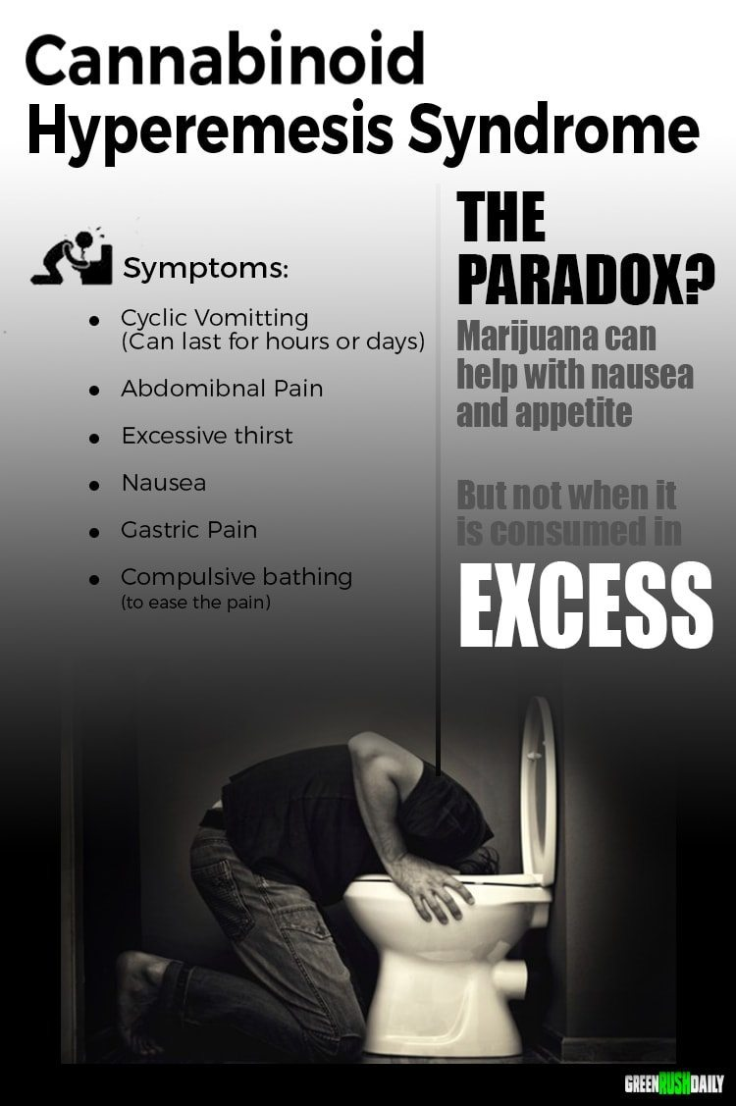
Acute effects
Acute increase in FEV1; increased HR; blood pressure changes; dry mouth; ataxia
Intoxication
Euphoria, perceptual chages
agitation, psychosis, and anxiety
tachycardia and hypertension
Cannabinoid Hyperemesis Syndrome
Pediatric Exposures: edible ingestion predicts PICU admission
Leung MEM, Pediatrics 2021;
Cohen N, Clin Toxicol 2022
https://www.greenrushdaily.com/2016/08/17/cannabinoid-hyperemesis-syndrome-cannabis/
Notes:
We observed a doubling in ED visits for cyclic vomiting after the legalization of medical marijuana in Colorado in 2009 (41 per 113,262 visits prelegalization versus 87 per 129,095 visits postlegalization), although the absolute number of visits remained modest.¹⁸
Public service annoucement add about cannibis hyperemsis syndrome from https://www.greenrushdaily.com/Green Rush Daily is the voice of the cannabis revolution. Providing unbiased, uncensored marijuana news and information.

Slide 15
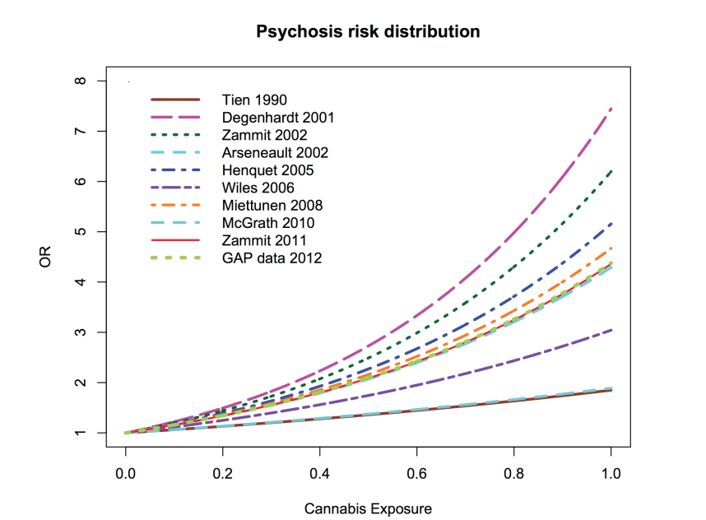
Increased risk of psychosis
Marconi, Schizophrenia Bulletin, 2016
Association or causation? Finnish birth cohort showed prospective 6-fold increased risk over 15 years (Mustonen Br J Psych 2018)

Slide 16
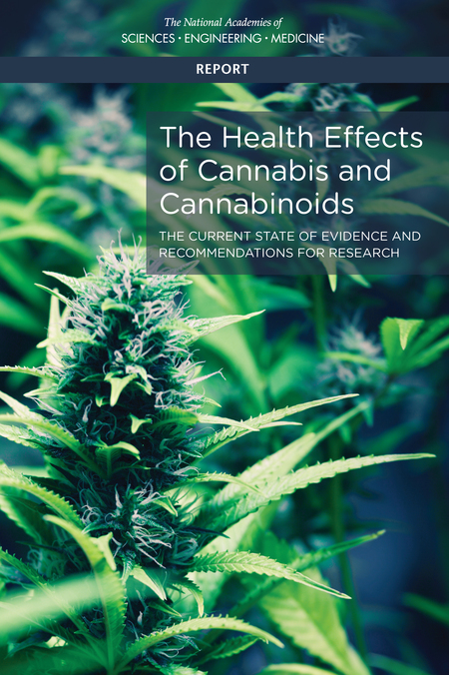
Report of National Academies of Science, Engineering and Medicine. Health Effects of Cannabis and Cannabinoids. 2017
16 person committee reviewed > 10,000 abstracts published since 1999
Focused on recently published systematic reviews and high quality primary research for 11 groups of health effects including both harms and therapeutic effects

Slide 17
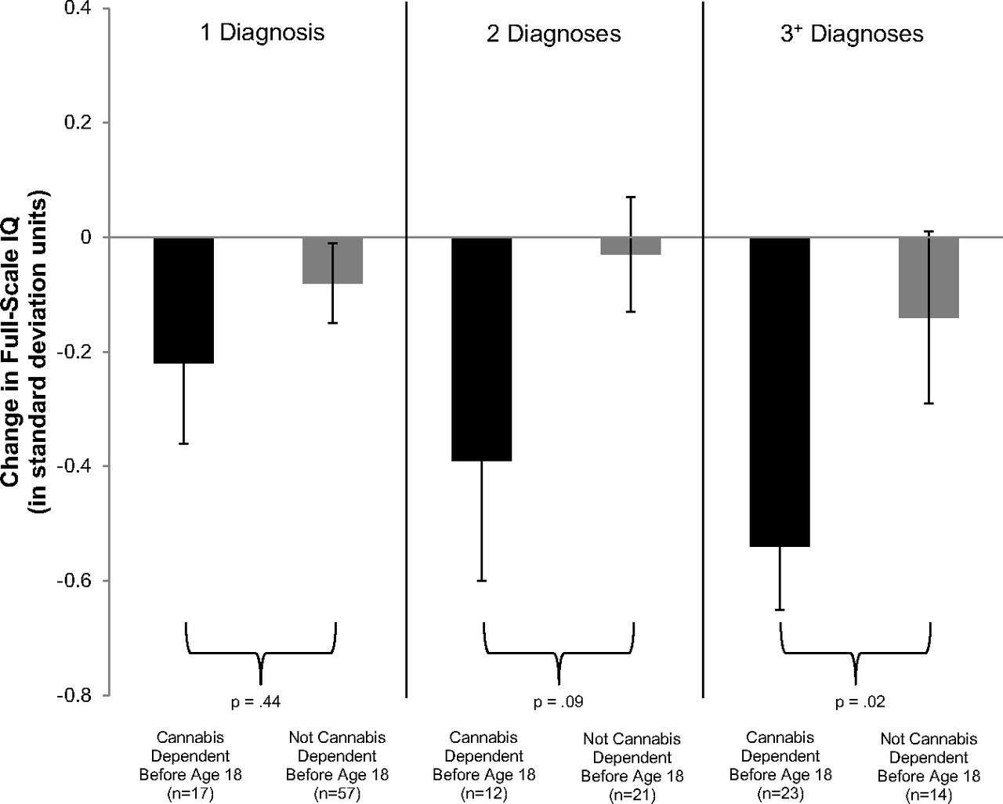
Adolescent vulnerability in IQ decline
Meier M H et al. PNAS 2012
Notes:
Though addiction is concerning especially among individuals who start using in adolescence, so too are concerns about brain development. Here we show data from a
Prospective birth cohort- which followed over 1000 individuals followed from birth to age 38, with multiple testing waves throughout this times period.
This Figure shows Adolescent vulnerability in IQ decline.. Individuals with adolescent-onset cannabis use disorder, shown in black bars, experienced greater IQ decline than individuals with adult-onset cannabis use disorder, shown in gray bars. The IQ decline of individuals with cananbis use beginning in adolescence and persisting into adulthood corresponds to a loss of roughly 8 IQ points.
Follow up data not shown here suggest that those who used cannabis heavily as teenagers and quit using as adults do not recover the lost IQ points. Although the numbers of individuals who met criteria for CUD were relatively small over multiple testing waves, this trend has been replicated in other studies.

Slide 18
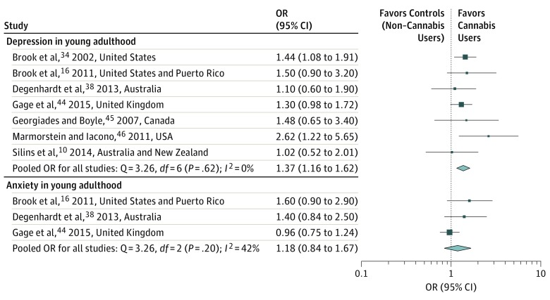
Association between cannabis use in adolescence and mood disorders
Exception: prospective studies show increase in development of social anxiety disorder (Blanco, JAMA Psych, 2016)

Slide 19
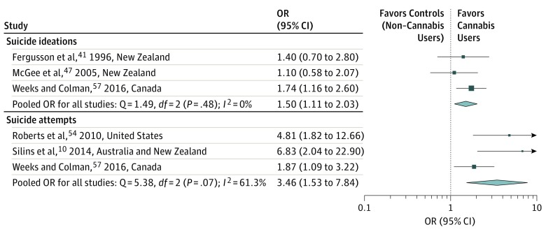
Association between cannabis use in adolescence and suicidality

Slide 20
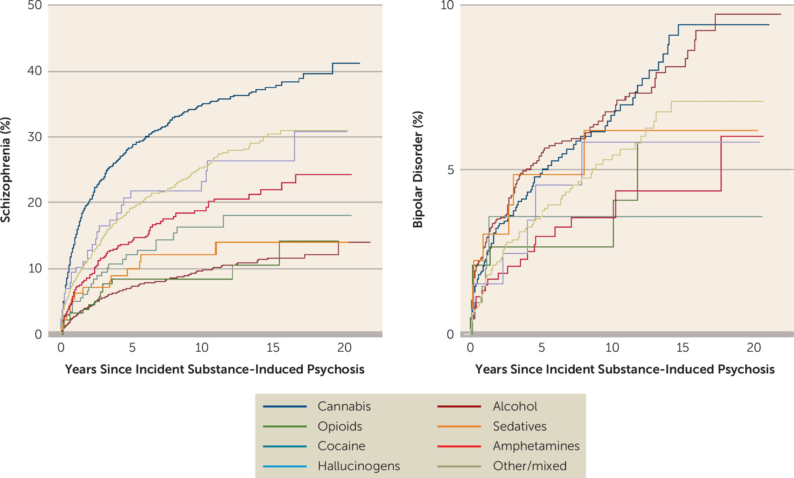
Conversion to schizophrenia and bipolar disorder following substance-induced psychosis
Cannabis
(N=6,788)
Kejser Starzer MS et al, Am J Psychiatry, 2019

Slide 21
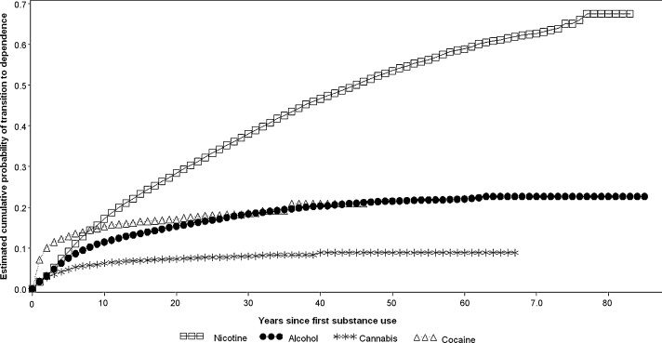
Cumulative Probability of Transitioning to Substance Use Disorder for Nicotine, Alcohol, Cannabis and Cocaine
Develop CUD:
9% of overall,
17% if begin during adolescence,
25-50% if daily use
Lopez-Quintero, C. et al. Drug & Alcohol Dependence 2011
Notes:
The National Academy of Science Engineering and Medicine report noted that
There is substantial evidence that:
Initiating cannabis use at an earlier age is a risk factor for the development of problem cannabis use

Slide 22
Treatment Options for cannabis use disorder
Negotiate treatment goal
Behavioral: first-line treatment
Outpatient cognitive-behavioral therapy combined with motivational enhancement
Contingency management as augmentation
Peer support
Pharmacotherapy
No currently approved medication
N-Acetylcysteine
Gabapentin
Varenicline
Topiramate
Gates, Cochrane 2016
USPSTF June 2020

Slide 23
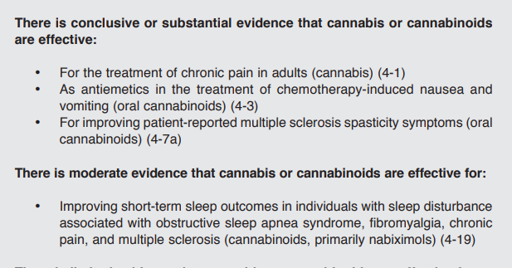
Health effects of cannabis and cannabinoids: Therapeutic effects
Report of National Academies of Science, Engineering and Medicine.
Health Effects of Cannabis and Cannabinoids. 2017
Notes:
Absence of high-quality evidence that cannabis is effective for other types of insomnia; clinical trials ongoing

Slide 24
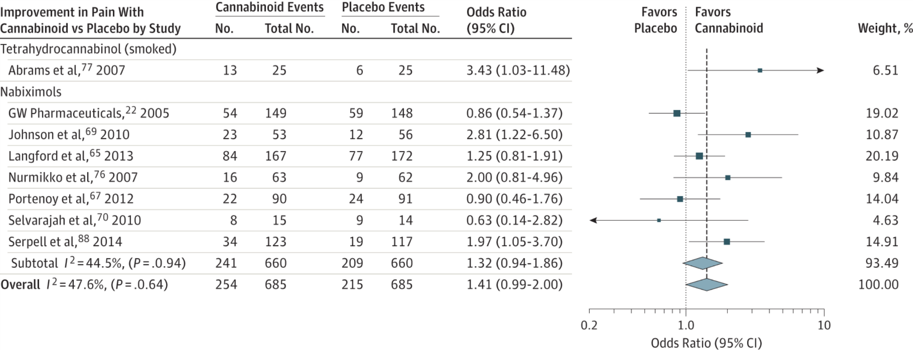
Cannabinoids for medical use: Pain
30% decrease in pain w cannabinoid vs placebo:
OR 1.41 (95% CI, 0.99-2.00)
Whiting PF et al. JAMA.2015;313(24):2456-2473
Notes:
ONE EXAMPLE
There was moderate-quality evidence to support the use of
cannabinoids for the treatment of chronic pain and spasticity. There was low-quality evidence
suggesting that cannabinoids were associated with improvements in nausea and vomiting
due to chemotherapy, weight gain in HIV infection, sleep disorders, and Tourette syndrome.
Cannabinoids were associated with an increased risk of short-term AEs.
Improvement in PainOdds indicate 30% or greater improvement in pain with cannabinoid compared with placebo, stratified according to cannabinoid. The square data markers indicate odds ratios (ORs) from primary studies, with sizes reflecting the statistical weight of the study using random-effects meta-analysis. The horizontal lines indicate 95% CIs. The blue diamond data markers represent the subtotal and overall OR and 95% CI. The vertical dashed line shows the summary effect estimate, the dotted shows the line of no effect (OR = 1).
Change in Ashworth Score for Cannabinoid Compared With Placebo, Stratified According to CannabinoidThe square data markers indicate mean differences from primary studies, with sizes reflecting the statistical weight of the study using random-effects meta-analysis. The horizontal line indicate, 95% CIs. The blue diamond data markers represent the subtotal and overall weighted mean difference and 95% CI. The vertical dashed line shows the summary effect estimate, the solid vertical line shows the line of no effect (mean difference = 0).
NOT Included in the spacticity was the following study:
The Cannabinoid Use in Progressive Inflammatory brain Disease (CUPID) trial: a randomised double-blind placebo-controlled parallel-group multicentre trial and economic evaluation of cannabinoids to slow progression in multiple sclerosis
Health Technology Assessment, No. 19.12; Feb 2015
Susan Ball, Jane Vickery, Jeremy Hobart, Dave Wright, Colin Green, James Shearer, Andrew Nunn, Mayam Gomez Cano, David MacManus, David Miller,Shahrukh Mallik, and John Zajicek.
Headline
The study found that oral dronabinol did not slow down the progression of progressive multiple sclerosis. No major safety concerns were identified in the use of dronabinol

Slide 25
Conclusions
Fundamental tension
Adolescent initiation of heavy cannabis use associated with increased risk of psychosis and schizophrenia, increased risk of CUD, and slight decline in IQ
Otherwise, few serious physical harms from cannabis use, and overdose is unlikely
Risk of end-organ damage appears to be lower than several other legal and illegal substances
Long-term, moderate use seems to be relatively frequent (compared to other drugs)

Slide 26
Learning objectives
Define the key components of cannabis and review relevant epidemiology and terminology
Analyze policy issues regarding cannabis legalization
Describe adverse health effects of cannabis use
Counsel patients about cannabis use based on scientific evidence

Slide 27
Evidence based resource for clinicians
Collaboration by the US VA and OHSU

Slide 28
Your patient, Ms. Smith
47 yo software engineer, single, lives with housemates
Increasing difficulty making presentations at work and interacting with colleagues
BMI 28; 5 lb weight gain in past year
3-4 glasses of wine per week
Cannabis edibles during the evening to relax and help with sleep
Notes:
Cannabis use increases incidence of social anxiety disorder (Blanco, JAMA Psych 2016)
Cannabis not associated with weight gain
But alcohol is
Cannabis edibles associated with ingestion of more THC
Mixed evidence for insomnia, RCTs in process
Could shift to a greater balance of CBD vs THC

Slide 29
Harm reduction for cannabis use
Caution with edibles
Describe long onset of action/labelling concerns
Increased total intake
Safe storage
Certain routes of administration i.e., “dabbing” carry particular risk (Meier MH, Pediatrics, 2019)
25% of adolescents report having used cannabis concentrate
Consider use of products with lower THC, higher CBD
Cut back—employ brief intervention
Avoid synthetic cannabinoids (i.e., spice, K2)
Typically cause frank hallucinations, and frequently psychosis, not detected in urine

Slide 30
“For the opioid addiction crisis, clearly efficacious medications such as methadone and buprenorphine are under-prescribed. Without convincing evidence of efficacy of cannabis for this indication, it would be irresponsible for medicine to exacerbate this problem by encouraging patients with opioid addiction to stop taking these medications and to rely instead on unproven cannabis treatment.”
JAMA. 2019;321(7):639-640. doi:10.1001/jama.2019.0077

Slide 31
Thank you
Questions?
Acknowledgements: several slides adapted from Dr. William Becker (Yale), Dr. Devan Kansagara (OHSU)
Dr. Hilary Kunins (NY DPH), Dr. Jeffrey Hunt (Brown), Dr. Zoe Weinstein (BU)

