Slide 1
Criminal Justice and Health Impacts in Addiction Ricardo Cruz, MD, MPH CRIT/FIT/CFS Presentation April 24, 2023

Slide 2
Disclosures
No financial conflicts to disclose

Slide 3
Learning Objectives
Review the correctional system
Review the epidemiology and demographics of mass incarceration.
Recognize health impacts and disparities in social determinants of health faced by individuals with criminal justice involvement.
Discuss clinical efforts to reach this vulnerable population.
Notes:
During this presentation:
We are going to talk about the correctional system
Mass incarceration and how it impacts the health of patients here at Boston Medical Center
How it impacts the social determinants of health
Discuss clinical efforts in this area

Slide 4
Definitions:
Jail:
short term incarceration facilities
overseen by local law enforcement agency-county or town.
Prison:
long term incarceration facilities
overseen by state and federal correctional authorities
Probation:
period of supervision in lieu of spending time in a correctional setting
sentenced to community based supervision-Probation officer
Parole:
period of supervision after spending time in correctional institution
conditionally released from prison to serve remaining portion of their sentence in the community-supervised by Parole officer
Notes:
People at times use various terms pertaining to the correctional system interchangeably that I want to define
Jail (house of corrections): short term, under one year for sentenced or people awaiting trial, local town, city, county oversight
Prison-sentenced to greater than one year, State and Federal oversight
Probation vs. Parole-stipulations required

Slide 5
We Beat Every Country
4% of total population
22% of prison population
2.3 million individuals
Lopez G. Vox. 2016
Notes:
We Beat Every Country
Olympic event-we would be winning the gold

Slide 6
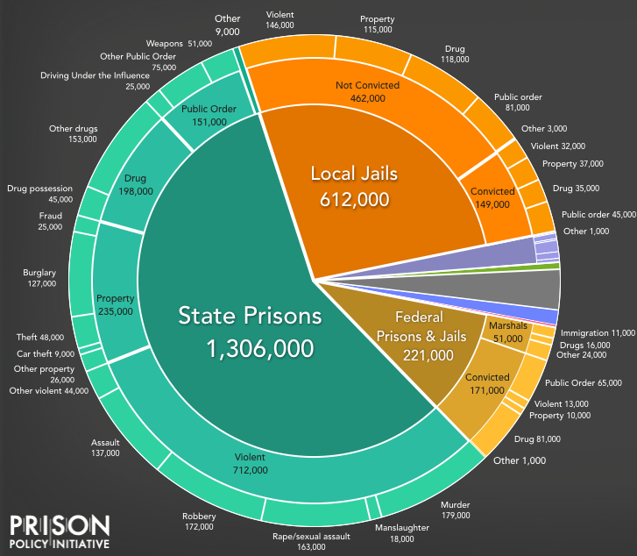
Even if you never provide care within the
System, you will care for these patients
Jail
10.6M go a year
Prison
650k released
Sawyer W, Wagner P.
Prison Policy Initiative. 2019.
Notes:
People move in and out of the system everyday so very likely to come across a patient with history of criminal justice involvement
The Jail in/out phenomenal is called jail churn
As you can see majority of people in jails have not been convicted and are either awaiting trial or undergoing trial at this time
People can have prolonged stays in correctional settings without being sentenced—and biggest factor for this is monetary bail, lot of folks unable to afford bail
Average bail cost is approx. 10-12,000, which for patients we take care of here confer approx. 8-10 months worth of income, just imagine having to fork up all this money up front to be able to go home to wait for your trial

Slide 7
It’s more than just confinement within the system
Sawyer W, Wagner P.
Prison Policy Initiative. 2019.
Notes:
Being involved in the system is more than just confinement to a correctional institution
But like a mentioned in the past slide individuals still are linked to the system via probation and parole mechanisms which adds another 4 million individuals tied to the system
So approx 7 million impacted

Slide 8
Communities disrupted, disparities perpetuated
Notes:
This slide highlights the unjust and overall racism that this system promotes
This slide is showing lifetime likelihood imprisonment of US residents born in 2001-
If you are black male 1/3
Latinx male 1/6
same racial/ethnic disparities persist among women
Very disheartening

Slide 9
History of Mass Incarceration
Notes:
Going to briefly go over the history of mass incarceration

Slide 10
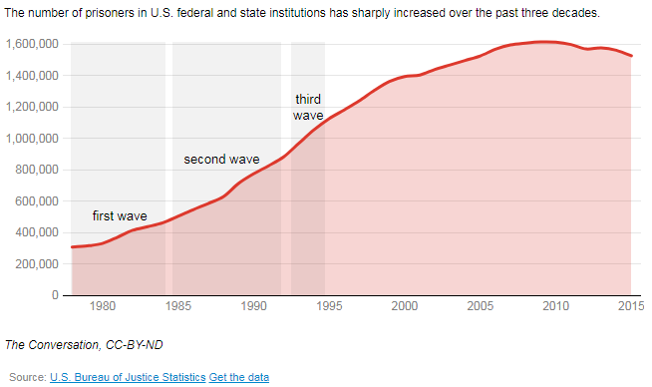
Mass incarceration has been driven by policy changes
1950s – Deinstitutionalization of mental health population
1970s – War on Drugs
1980s – Mandatory minimums and tougher drug sentences
1990s – 3-strike provision
New reference needed
Notes:
Deinstitutionalizaiton of mental health population-Moved mental health patients out of state run psychiatric asylums
Without adequate care or housing provisions-drove homelessness epidemic, substance use, petty crime
1955-1994 300,000 ended up incarcerated
1970s War on Drugs
Lengthy sentences for possession of even small amts of illegal drugs
It included the Anti-Drug Abuse Act of 1986, which imposed even more mandatory minimum sentences. Most significantly
five-year mandatory minimum sentence for offenses involving 100 grams of heroin, 500 grams of cocaine or 5 grams of crack cocaine.
1970s: Congress lengthens sentences
1984: Comprehensive Crime Control Act
Mandatory minimums
Eliminated federal parole
1985-1992: lengthen drug sentences
Anti-Drug Abuse Act of 1986
1994: Violent Crime Control and Law Enforcement Act of 1994: “3-strike provision” at federal level
Life without parole if 2 prior convictions
2010: Fair Sentencing Act
Reduced sentencing disparity between crack and powder cocaine

Slide 11
Health Impacts
Notes:
As clinicians we should understand and focus on the health impacts and disparities that involvement in this system creates so that we may provide the best care possible for our patients

Slide 12
Mass incarceration is more than just a social problem…
Acker J, et al. Robert Wood Johnson Foundation. 2019.
Notes:
Previous slides have shown the societal impact on Mass incarceration.
Racism-poor economic opportunities –coupled by discriminatory policy/legislation leading to unfair policing, arrest, treatment in court leading to incarceration

Slide 13
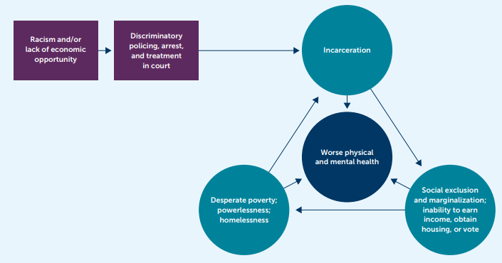
It is a public health problem
Acker J, et al. Robert Wood Johnson Foundation. 2019.
Notes:
But it’s a public health issue as well
The structural vulnerability and impact on social determinants of health incarceration creates leads to worse health outcomes
It creates income inequality, housing insecurity which we all know ultimately impacts overall health
At it becomes a vicious cycle
Unfortunately many individuals end up being re-incarcerated
For Nonviolent offenders approx. 40% are rearrested within 8 years of release , higher for prior state prisoners or violent offenders

Slide 14
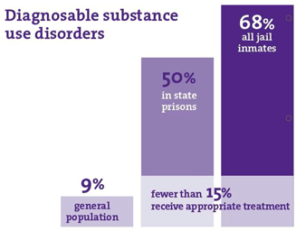
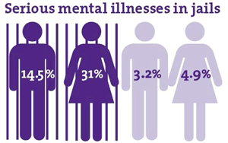
Behavioral Health Disorders Prevalent
Cloud D. Vera Institute of Justice. 2014.
Notes:
Overall 50% of individuals who are incarcerated have mental health problem
Approx 25% have history of serious mental illness such as schizophrenia, bipolar disorder, depression, anxiety
Approx 2/3rds off treatment at time of incarceration
Substance use disorders also prevalent in the jail and prison population
Estimated 65% of US prison population has active SUD
Another 20% did not meet official criteria for SUD but were substance affected at time of their offense.
Unfortunately these conditions could go untreated in the correctional setting-very few individuals get access to appropriate treatment for SUD especially treatment for opioid use disorder
Legislation in MA in 2018 has changed this a bit, this legislation created pilot programs that would offer all three modalities of treatment for OUD albeit with some prerequisites that need to be met including having been on treatment in the community.

Slide 15
Benefits of MOUD in Correctional Facilities
Benefits | Evidence
Reduces illicit opioid use post-incarceration | Mattick, et al., 2009
Reduces criminal behavior post-incarceration | Deck, et al., 2009
Reduces mortality and overdose risk post-incarceration | Degenhardt et al., 2011; Kerr, et al., 2007 Chatterjee et al., 2023
Reduces HIV risk behaviors post-incarceration | MacArthur et al., 2012
Additional social, medical, and economic benefits | Rich et al., 2015; Zaller et al., 2013; McKenzie et al., 2012; Heimer et al., 2006; Dolan et al., 2003
Notes:
There is ample evidence on the benefits of MOUD in correctional facilities
Improves engagement in treatment, decreases mortality and risky behaviors that contribute to addiction related cormorbidities such as HIV
Most recently a study by Chatterjee et al in JAMA Network open showed an economic evaluation and simulated model in cost effectiveness and quality adjusted life years
The findings suggest that offering 3 MOUDs during incarceration is a life-saving, cost-effective intervention.

Slide 16
Notes:
Recent study by the NIH Heal Initiative identified significant barriers and facilitators that impede access to MOUD is US jails.
Although 92% of jails provide at least one from of MOUD only 43% provide all three forms of MOUD
Most jails limit provision of medications to certain groups
Some challenges listed on this graph per medication modality
Funding a big issue
Stigma and concern for diversion
Key Takeaways:
1. 20% of jails provide MOUD to anyone who is assessed with OUD, yet in fewer than half (43%) of the jails were all three FDA-approved medications available
2. The highest needs among jails are additional funds to cover the cost of medications and clinical staff to administer and monitor MOUD.
3. Jails' second highest needs are resources to support and ensure continuity of care during reentry.
4. Other needs include educating state/local policymakers, correctional staff, and the general public, and logistical support to help minimize diversion and establish systems to screen individuals for OUD.

Slide 17
Chronic Medical Conditions & Infectious Diseases
Incarcerated population
Maruschak LM, Berzofsky M. US DOJ. 2015.
General population
Notes:
When we look a chronic and communicable diseases-Approx 40% of total prison and jail population have a current chronic medical conditions
Communicable/infectious diseases prevalent
HIV-high rates compared to general population
HCV
Studies have shown 16-41% of individuals who are incarcerated carry HCV antibodies
12-31% have advanced/chronic infection

Slide 18
Impact on Mortality
For every 1 year served,
life expectancy reduced by 2 years
Patterson EJ. Am J Public Health. 2013.
Notes:
Incarceration has an impact on mortality.
This chart demonstrates the dose response time served in prison on mortality
As you see there is a linear association-for every 1 year served life expectancy was reduced by 2 years

Slide 19
Transitions
Notes:
95% of individuals who are incarcerated will eventually be released sent back to their communities
This period has been determined to be a risky period with increase risk for morbidity and mortality

Slide 20
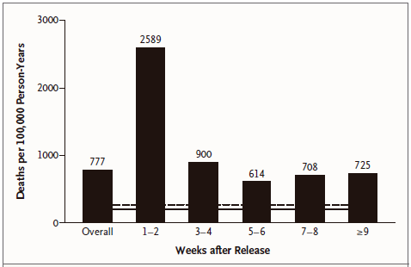
Mortality Rates Spike During Re-entry Period
All residents
During
incarceration
Binswanger IA, et al. NEJM. 2007.
Notes:
First I want to highlight the significant risk to mortality that the re-entry period has
This was a study looking at the mortality risk of individuals being released from WA State prisons
What they found was overall the adjusted risk of death 3.5 times higher in former inmates compared to general population
With the first two weeks being the riskiest having a 12.7 times increase risk of death

Slide 21
Mortality Rates Spike During Re-entry Period
Relative risk of death among formerly incarcerated compared with other Washington state residents
Cause of death | RR (95% CI)
Overdose | 12.2 (10.2–14.9)
Homicide | 10.4 (8.0–13.6)
Liver disease | 4.7 (3.2–7.2)
Suicide | 3.4 (2.5–4.7)
Motor vehicle accident | 3.4 (2.4–4.8)
Cardiovascular disease | 2.1 (1.6–2.7)
Cancer | 1.67 (1.2–2.2)
Within first 2 weeks,
aRR is 129
(95% CI 89 to 186)
Binswanger IA, et al. NEJM. 2007.
Notes:
Next looing at causes
Drug overdose was the top cause
Overall 12.2 x higher with 129 x higher in the first two weeks
Not only did this study highlight this very risky period during re-entry but highlighted an opportunity for innovation and intervention

Slide 22
Clinical Innovations
Notes:
So how can we rethink care for this population when they transition back to the health care system

Slide 23
Transitions Clinics Target High-Risk Window
Community organizations
Correctional facilities
Notes:
I want to highlight a model of care that was established in 2006 in San Francisco-Transition clinic model
This clinic was created to provide transitional and primary care and case management for individuals returning to the community from correctional institution.
The aim of the clinic is to provide patient centered primary care
It’s a collaboration among primary care providers and correctional partners to ensure linkage and continuity of care
Close partnerships with local re-entry and social services organizations to address SDOH
The innovative part of this clinic is the use of a community health worker who is a person with lived experience of criminal justice involvement-this person is integrated into the medical team
CHW-connect patients with health and social services in a culturally appropriate fashion

Slide 24
Transitions Clinic Study
Notes:
Prior studies have shown high ER utilization by individuals recently transitioning out of incarceration and former prisoners have a high hospitalization rate
A study done looking at this Transition clinic model compared to expedited primary care within 2 weeks of release to see if it improved health care utilization
They found that the ED utilization was significantly lower (approx. 15%) in Transitions clinic group than expedited primary care –highlighting that a program tailored/culturally adapted to former prisoners could decrease unnecessary ER utilization
200 recently released prisoners who had chronic medical conditions or >50 years
Randomized to Transitions Clinic: PCP and CHW vs. Expedited primary care apt (within 2 weeks)
Outcomes:
Primary care utilization (2 or more visits to assigned primary care clinic)
ED utilization
Results:
Similar rates of primary care utilization (37.7% vs 47.1%; p = .18)
Transitions Clinic participants had lower rates of ED utilization (25.5% vs 39.2%; p = .04).
Conclusions:
Prisoners with chronic medical disease will engage in primary care if given early access
Program specifically tailored to prisoners decreases ED utilization
Limitations:
Small sample size
One community health worker
Still had measurable impact on ED use

Slide 25
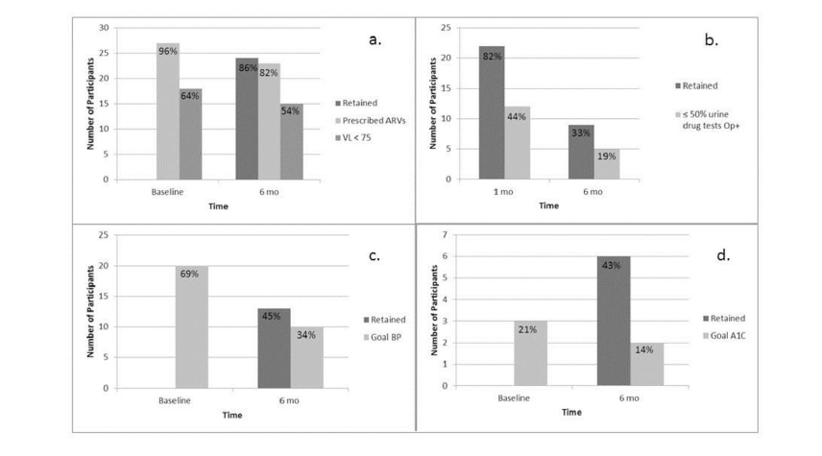
Bronx Transitions Clinic
Retention in medical care and health outcomes (n=135)
HIV (n=28)
Buprenorphine treatment (n=27)
Hypertension (n=29)
Diabetes Mellitus (n=14)
Fox et.al. J Health Care Poor Underserved 2014
Notes:
Another study looking at this Transition clinic model on impact on health outcomes retention
They looked at individuals with HIV, HTN, OUD, and DM Main outcome was 6 month retention and chronic disease control
Results of this study showed that the group with HIV had better retention, treatment adherence, and controlled Viral loads
Compared to those with DM, HTN, OUD
They determine the difference in retention and outcomes in HIV group likely due to increase access to case management services that may not be available for non HIV patients
They concluded that although access to medical care is necessary it is not sufficient to control chronic health conditions-need to address social conditions/SDOH to improve health

Slide 26
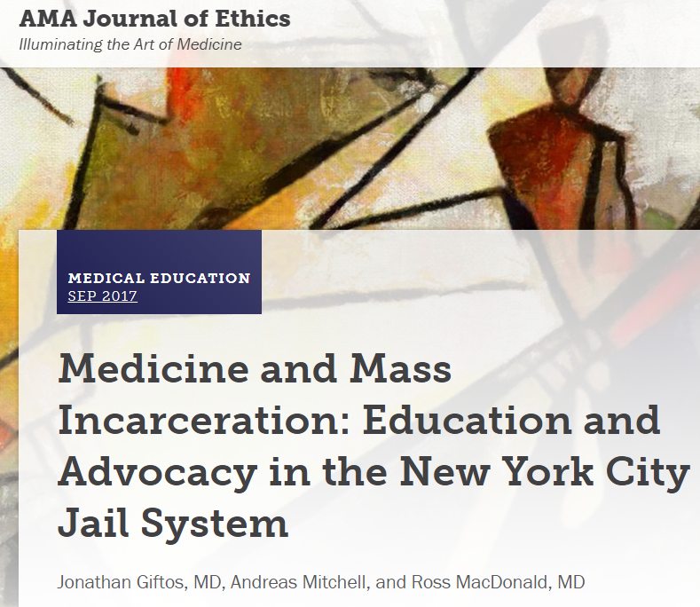
Educational Opportunities
Notes:
Addressing incarceration as a social determinant of health has often been overlooked
Physicians rarely receive training specific to the needs of this population
There is high prevalence of criminal justice involvement in many communities served by academic medical centers.
Left: A study in 2001 surveyed residency directors in various subspecialties found that only 14 percent of programs offer lectures or conferences about healthcare of individuals with criminal justice involvement.
Right: Article in the AMA Journal of Ethics came out in 2017 highlighting the need for education for medical trainees in the health care for individuals with criminal justice involvement.
More training can benefit patients and communities, helps improve the care provided to individuals and engages medical professionals in advocacy and criminal justice reform to help combat this public health crisis of mass incarceration.
This is where you come in as future chief residents and faculty that will be implementing new clinical innovations/curriculum on addition don’t forget to incorporate the impact this system has on patient/care

Slide 27
Take Home Points
Criminal justice involvement negatively impacts health
Mass incarceration disproportionally impacts Black and Latinx communities
Transition period carries high mortality risk
Evidence supports effective transition care models
As Clinician Educators, we must teach future physicians how to care for people with a history of incarceration
Notes:
I hope this presentation has provided you with an overview how the criminal justice system negatively impacts the health of patients especially those with substance use and behavioral health issues
Although individuals in the correctional system are the only group guaranteed access to health care in this society it does not mean they get appropriate care
We need to continue to improve the way we provide care for this population especially during the risky re-entry period
As Clinicians/Educators/Researchers we can rethink care for this population and educate future physicians and all learn to use our voice to advocate for reform!

Slide 29
References
Acker J, Braveman P, Arkin E, Leviton L, Parsons J, Hobor G. Mass Incarceration Threatens Health Equity in America. Robert Wood Johnson Foundation. January 15, 2019. https://www.rwjf.org/en/library/research/2019/01/mass-incarceration-threatens-health-equity-in-america.html.
Binswanger IA, Stern MF, Deyo RA, et al. Release from Prison — A High Risk of Death for Former Inmates. New England Journal of Medicine. 2007;356(2):157-165. doi:10.1056/nejmsa064115.
Cloud D. On Life Support: Public Health in the Age of Mass Incarceration. Vera Institute of Justice. November 2014. https://www.vera.org/publications/on-life-support-public-health-in-the-age-of-mass-incarceration.
Colwell J. Caring for prisoners. ACP Hospitalist. October 2017. https://acphospitalist.org/archives/2017/10/caring-for-prisoners.htm.
Forman B, van der Lugt L, Golberg B. The Geography of Incarceration: The Costs and Consequences of High Incarceration Rates in Vulnerable City Neighborhoods. The Boston Indicators Project. October 2016.
Frank JW, Wang EA, Nunez-Smith M, Lee H, Comfort M. Discrimination based on criminal record and healthcare utilization among men recently released from prison: a descriptive study. Health Justice. 2014;2:6. doi:10.1186/2194-7899-2-6

Slide 30
References (continued)
Lopez G. How America became the world's leader in incarceration, explained in 22 maps and charts. Vox. October 11, 2016. https://www.vox.com/2015/7/13/8913297/mass-incarceration-maps-charts.
Lopez G. How America’s prisons are fueling the opioid epidemic. Vox. March 26, 2018. https://www.vox.com/policy-and-politics/2018/3/13/17020002/prison-opioid-epidemic-medications-addiction
Maruschak LM, Berzofsky M. Medical Problems of State and Federal Prisoners and Jail Inmates, 2011–12. US Department of Justice Special Report. February 2015. https://www.bjs.gov/content/pub/pdf/mpsfpji1112.pdf
Patterson EJ. The dose-response of time served in prison on mortality: New York State, 1989-2003. Am J Public Health. 2013;103(3):523–528. doi:10.2105/AJPH.2012.301148
Rich JD, McKenzie M, Larney S, et al. Methadone continuation versus forced withdrawal on incarceration in a combined US prison and jail: a randomised, open-label trial. Lancet. 2015;386(9991):350–359. doi:10.1016/S0140-6736(14)62338-2
Sawyer W, Wagner P. Mass Incarceration: The Whole Pie 2019. Prison Policy Initiative. March 19, 2019. https://www.prisonpolicy.org/reports/pie2019.html.

Slide 31
References (continued)
Schanzenbach DW, Nunn R, Bauer L, Breitwieser A, Mumford M, Nantz G. Twelve Facts about Incarceration and Prisoner Reentry. The Hamilton Project. October 2016. http://www.hamiltonproject.org/papers/twelve_facts_about_incarceration_and_prisoner_reentry.
States Reporting Corrections-Related Medicaid Enrollment Policies In Place for Prisons or Jails. Kaiser Family Foundation. October 25, 2018. https://www.kff.org/medicaid/state-indicator/states-reporting-corrections-related-medicaid-enrollment-policies-in-place-for-prisons-or-jails/
Transitions Clinic Program. Transitions Clinic Network. https://transitionsclinic.org/transitions-clinic-program/.
Trends in U.S. Corrections. The Sentencing Project. June 2018. http://www.sentencingproject.org/publications/trends-in-u-s-corrections/.
Tuite H, Browne K, O'Neill D. Prisoners in general hospitals: doctors' attitudes and practice. BMJ. 2006;332(7540):548–549. doi:10.1136/bmj.332.7540.548-b
.

