Slide 1



22nd Annual Immersion Trainings in Addiction Medicine
funded by the National Institute on Drug Abuse (NIDA R25DA013582)

Slide 2
History
Began in 2002, funded by the National Institute on Drug Abuse (NIDA)
  2020-2022 due to COVID-19 meetings held virtually via zoom
Chief Residents (CR), Faculty Mentors (FM) w/ CRs, Junior Faculty w/o CRs, Faculty Scholars
  General Internal Medicine, Family Medicine, Emergency Medicine, Med-Peds, Pediatrics
    CRIT: 22 years (2002-2023): 491 CRs, 153 FMs from 245 programs (38 states)
    JFIT: 6 years (2017-2022): 43 faculty from 35 programs (21 states)
    ^{new} CARE Faculty Scholars (CFS) (2023): 10 faculty from 10 institutions (7 states)
  Fellows: ID, GI, Pain, Adolescent, GIM, Addiction Medicine, Nephrology
  FIT: 12 years (2012-2022): 79 fellows from 57 institutions (21 states)
International Participants: Argentina, Brazil, Bulgaria, Canada, Georgia, Iraq, Myanmar/Burma, Russia, Spain, Switzerland, Vietnam

Slide 3
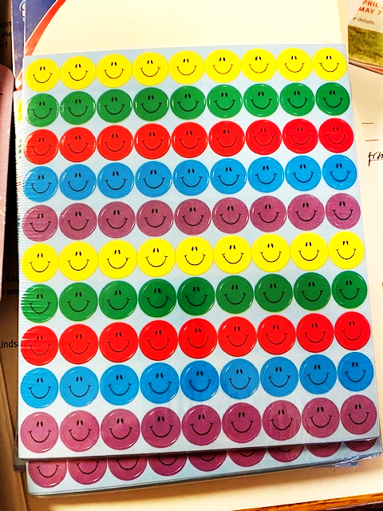
2023 Attendees
  CRIT: 24 incoming Chief Residents (“CRITers”)
    18 Internal Medicine, 3 Family Medicine, 1 Pediatrics, 2 Family Medicine & Psychiatry
    22 programs (9 new) from 16 states
    4 Faculty Mentors (“Mentors”) attending with their CR
  CFS: 10 Scholars (“Scholars”)
    3 General Internal Medicine, 4 Family Medicine, 1 Pediatrics, 1 Med-Peds, 1 Hepatology
    10 institutions from 7 states
  FIT: 8 Fellows (“FITers”)
    3 ID, 1 GI/Transplant Hepatology, 1 Cardiology, 1 GI, 2 Adolescent Medicine
    6 institutions (2 new) from 6 states
  Special Attendees: 4 Addiction Medicine fellows, 1 Humphrey Fellow from the country Georgia

Slide 4
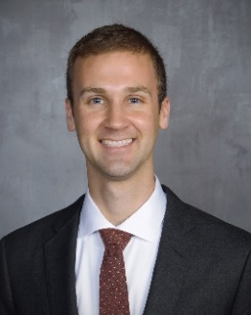
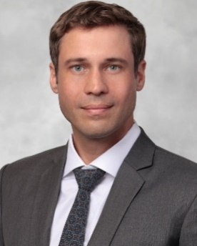
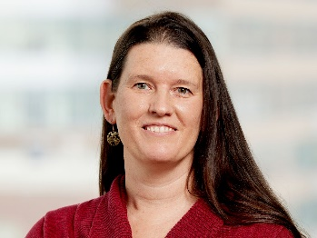
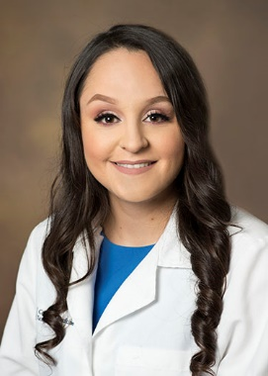
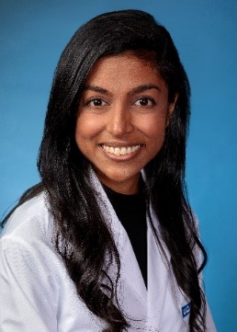
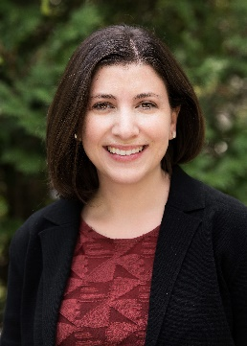
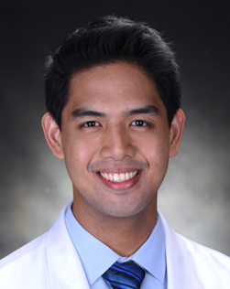
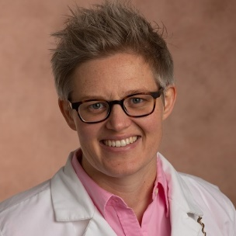
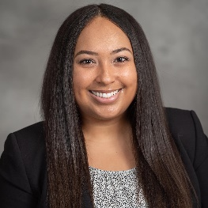
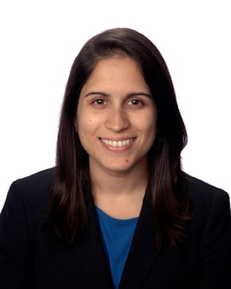
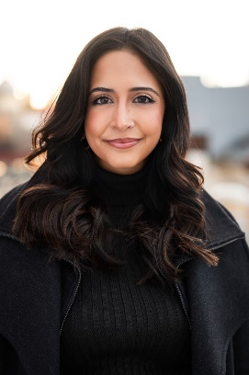
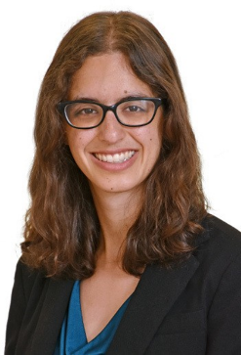
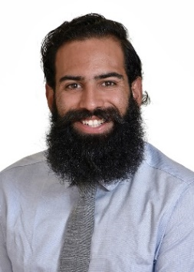
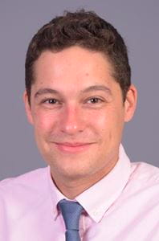
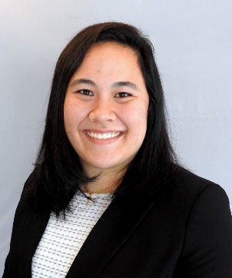
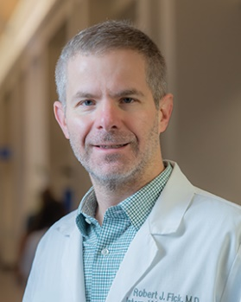
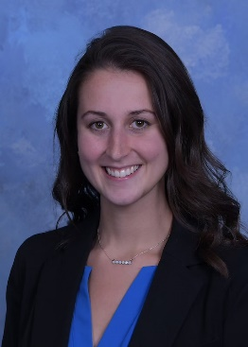
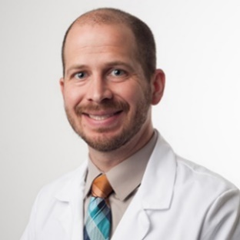
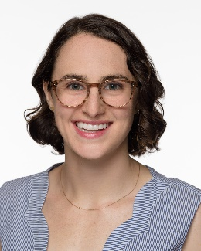
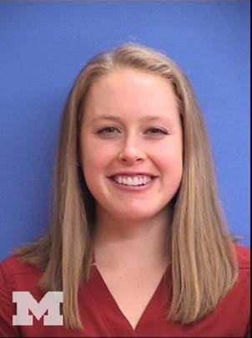
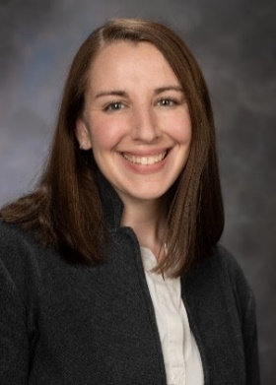
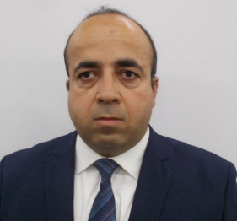
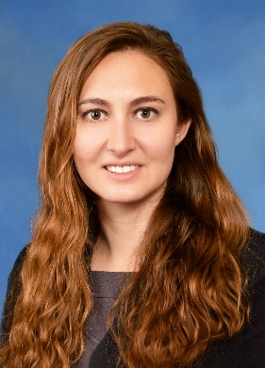
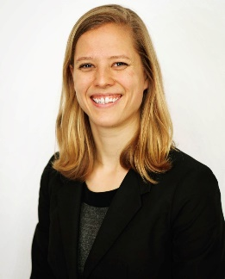
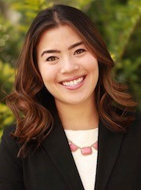
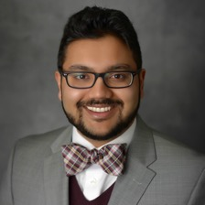
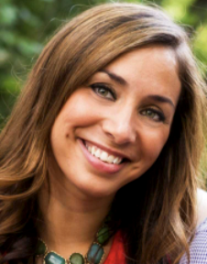
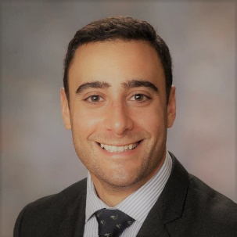
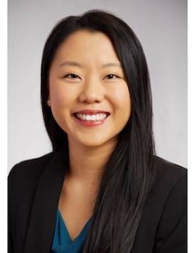
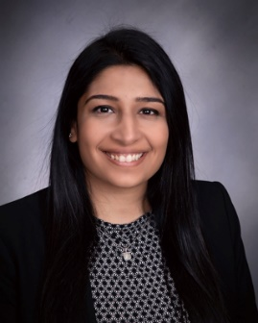
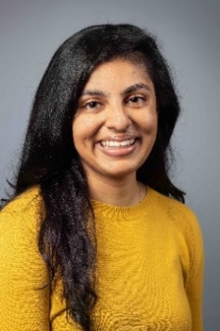
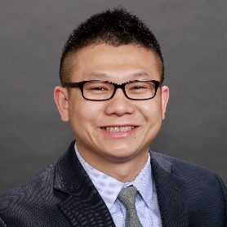
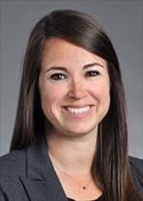
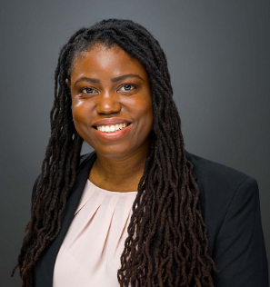
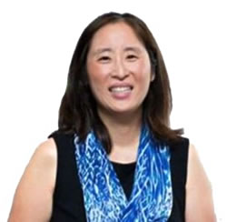
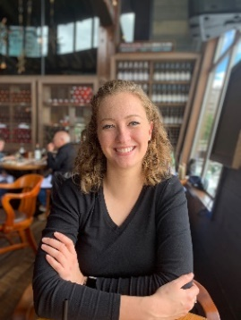
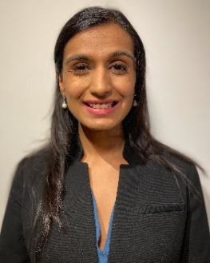
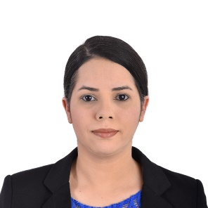
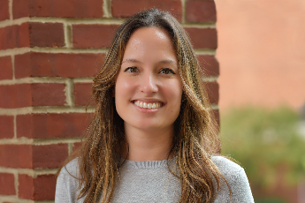
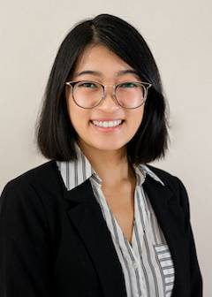
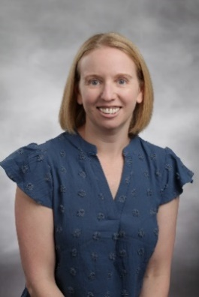
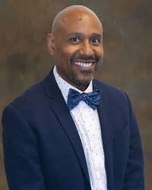
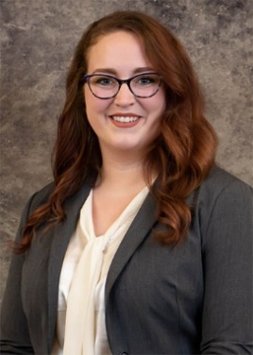
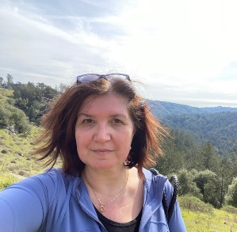

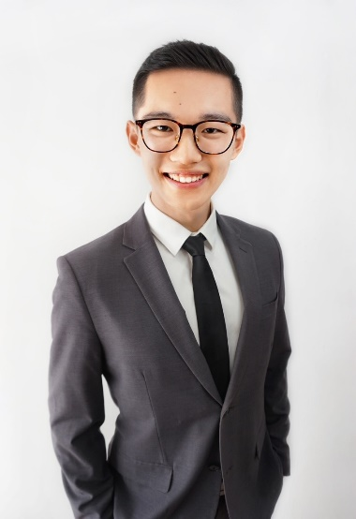
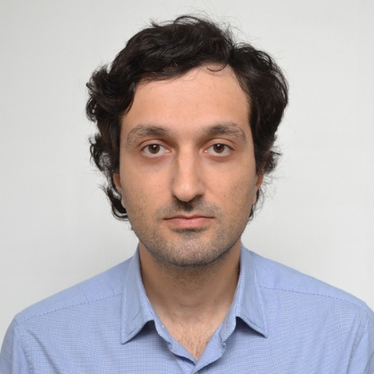

2023 Immersion Training in Addiction Medicine Program Participants
12
31
37
9
4
33
40
8
17
46
14
50
49
1
13
22
21
42
3
6
34
48
45
10
32
11
7
30
29
2
5
51
36
43
26
15
28
27
16
25
35
39
19
44
20
41
Photo Border Key
23
38
Chief Resident Immersion Training (CRIT)
24
Fellow Immersion Training (FIT)
CARE Faculty Scholars (CFS)
CRIT Faculty Mentor
Addiction Medicine/NIDA Invest Fellow
International Program Attendees
18
47

Slide 5
Examples of what you said you plan to do after the training…
Integrate case-based workshops in addiction medicine into curriculum for interns
Create a new addiction medicine rotation at specialized clinical sites
Dedicate a single hour-long lecture each month to teaching addiction medicine topics for a longitudinal learning immersion experience
Implement monthly addictions and social medicine rounds
Teach residents to start pharmacotherapy and link patients to services
Develop a formal addiction medicine curriculum that complements their clinical exposure
Broadening the reach of addiction medicine tools to patients in low-resource communities
Incorporate OUD treatment into the usual care of our continuity clinic patients
Destigmatizing addiction medicine care and education
Integrate substance use science into early foundation as a clinician-investigator

Slide 6
Program Highlights
Large group sessions (core content)
Small group sessions
  CRIT: skills practice sessions, case discussions, Substance Use Teaching Project (SUTP) mentoring
  CFS: skills practice sessions, case discussions, Addiction Medicine Enhancement Project (AMEP) mentoring
  FIT: case discussion, Project Development Plan/Analytic Plan (PDP/AP) mentoring
Mutual help meetings (Tuesday evening, Wednesday morning)
Meet the faculty lunch (Tuesday)
Naloxone Training Session and Harm Reduction Van (Wednesday)
Meetings with guests in recovery (Wednesday)

Slide 7
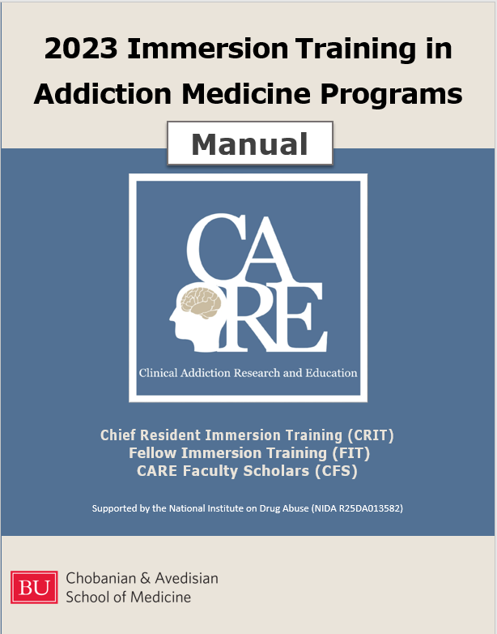
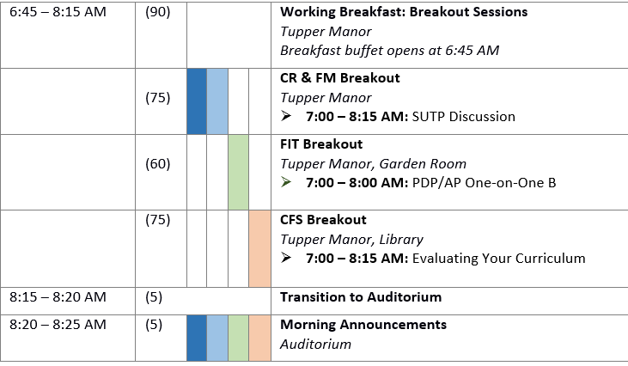
The Manual and Schedule
Manual
  Schedule
  Didactic session cover pages, references
  All groupings (“tracks”):
    CRIT – SUTP mentoring groups | small group sessions
    CFS – Small group sessions
    FIT – Project Development Plan and Analytic Plan workshop, 1:1 groups
  Faculty bios and email addresses
  Participant information and email addresses
  and much, much more....
Legend
Dark Blue | Chief Resident (CR)
Blue | Faculty Mentor (FM)
Green | Fellow (FIT) attendees
Orange | CARE Faculty Scholars (CFS) attendees

Slide 8
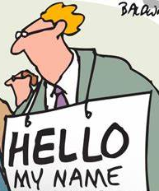

General Announcements
Please wear your name tag at all sessions
Each session will start on time
Question cards
Know your breakout groups
COVID-19 related issues…
  Masks are optional
  If you are not feeling well, please do not attend in-person sessions
PowerPoints and reference articles are on Box.com (please notify program staff if you do not have access)

Slide 9

Free CME
Counts towards new DEA requirement that all prescribers complete 8h of training on the management of patients with SUD prior to renewing their DEA registration
Can find the form in box.com
Email your completed form to Ilana Hardesty at hardesty@bu.edu
see CME section in Manual for further information

Slide 10

Evaluations and Surveys
Daily evaluations emailed at the end of each day via REDCap
Pre- and post-knowledge test
  Pre-test (completed) and Post-test will be completed at the end of Wednesday
All attendees will be asked to complete brief surveys throughout the year. See evaluation page in the Manual for further information
We strive to attain a 100% response rate on evaluations and surveys

Slide 11

Richard Saitz, MD, MPH Clinical Addiction Research and Education (CARE) Program Achievement Award
Professor of Medicine & Public Health, international leader in the field of addiction. His research improved how patients with substance use problems are treated in medical settings. He demanded clarity on what evidence could support, and what it did not.
A Chief Resident participant (CRITter) will be awarded the annual “Richard Saitz, MD, MPH CARE Program Achievement Award” based on their Substance Use Teaching Project (SUTP) quality (breadth, promotion of evidence-based care, and impact) and degree of completion at 10 months post-CRIT
The CRIT Program Course Directors will select the recipient of the award based on the chief resident’s responses to SUTP specific questions on the CRIT program 10-month survey
The awardee will receive a plaque commemorating the award and the awardees program director and department chair will receive a letter notification of the honor
Notes:
Richard Saitz, MD, MPH (1963-2022)
Professor of Medicine and Public Health, Chair of Community Health Sciences at Boston University and international leader in the field of addiction medicine
CRIT/JFIT/FIT core faculty from the beginning and created Alcohol, Other Drugs, and Health: Current Evidence - free online newsletter summarizing the latest clinically relevant research on substance use and health
Decades of research aimed at improving how patients with substance use problems are treated in medical settings “Addiction care should be no different than getting care for a heart condition or depression. Separate but equal is unacceptable in society, it should be unacceptable for the care of people with addictions.”
He demanded clarity on what evidence could support, and what it did not, challenging the already “established” ideas, that were lacking evidence
He championed the “words matter” movement believing that clinical and scientific speaking and writing is the beginning of the process that will ultimately lead to wider use of accurate non-stigmatizing terms

Slide 12
Using Non-Stigmatizing Language
Say this… | Instead of this…
Person with a SUD, person with addiction, person who uses drugs, person who injects drugs | Addict, junkie, abuser, pill-popper, drug seeker
Risky or unhealthy alcohol or drug use | Alcohol or drug abuse
Treatment, Medication for addiction treatment (MAT), Medication for opioid use disorder (MOUD) | Medication-assisted treatment (MAT), replacement therapy
Urine drug test consistent with active drug use Urine drug test consistent with remission from drug use | Dirty or clean urine, dirty
Neonatal Abstinence Syndrome Newborn with substance exposure | Addicted baby, Crack baby
“We do not make recommendations regarding what terms people with disorders should use. Some patients…find benefit to calling themselves an alcoholic or an addict. Changing the language in clinical communication … will ultimately lead to wider use of accurate nonstigmatizing terms” Richard Saitz, MD, MPH

Slide 13









CRIT/CFS Core Faculty
Dan Alford
Jeffrey Samet
Angela Jackson
Miriam Komaromy
Ricardo Cruz
Alyssa Peterkin
Jessica Taylor
Marielle Baldwin
Lindsay Demers

Slide 14




FIT Core Faculty
Alex Walley
Jennifer McNeely
Sarah Bagley
Scott Hadland

Slide 15

Program Participants
Please state your….
  Name
  Position (chief resident, faculty mentor, CARE faculty scholar, fellow, special attendee)
  Specialty
  Institution and State
  and 1 thing you like to do outside of work
All in 15 seconds or less…

