Slide 1



Substance Use
Screening, Assessment and Brief Intervention
Immersion Training in Addiction Medicine Programs 2023
Jeffrey H. Samet, MD, MA, MPH
John Noble Professor of Medicine and Professor of Public Health
Daniel P. Alford, MD, MPH
Professor of Medicine and Director, Clinical Addiction Research and Education (CARE) Unit

Slide 2
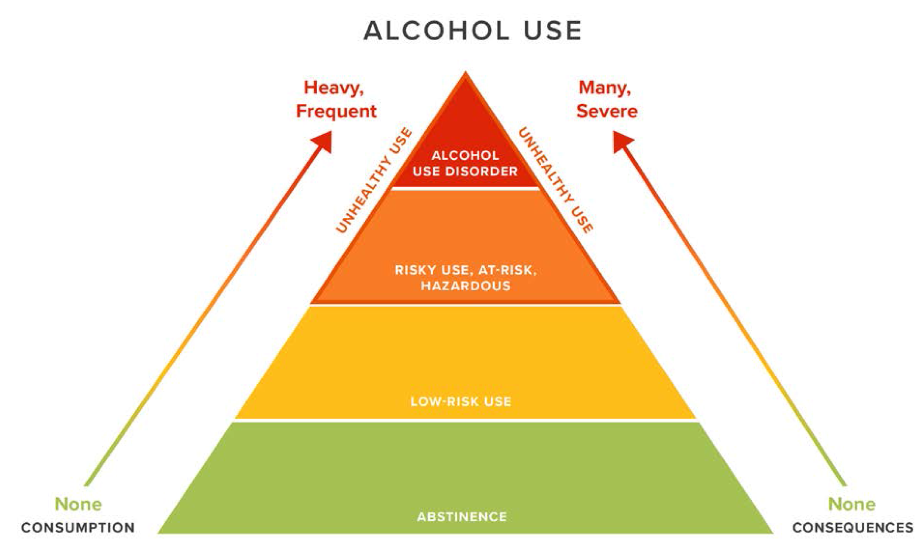
Unhealthy Substance Use
“Unhealthy Use”
Use that risks consequences or have resulted in consequences
DSM-5 substance use disorder
Adapted with permission from Saitz R. New Engl J Med 2005

Slide 3
Case
A 28-year-old resident enjoys 2-3 beers 2-3 times a week after work.
Is the resident’s alcohol use unhealthy or risky?

Slide 4


Slide 5
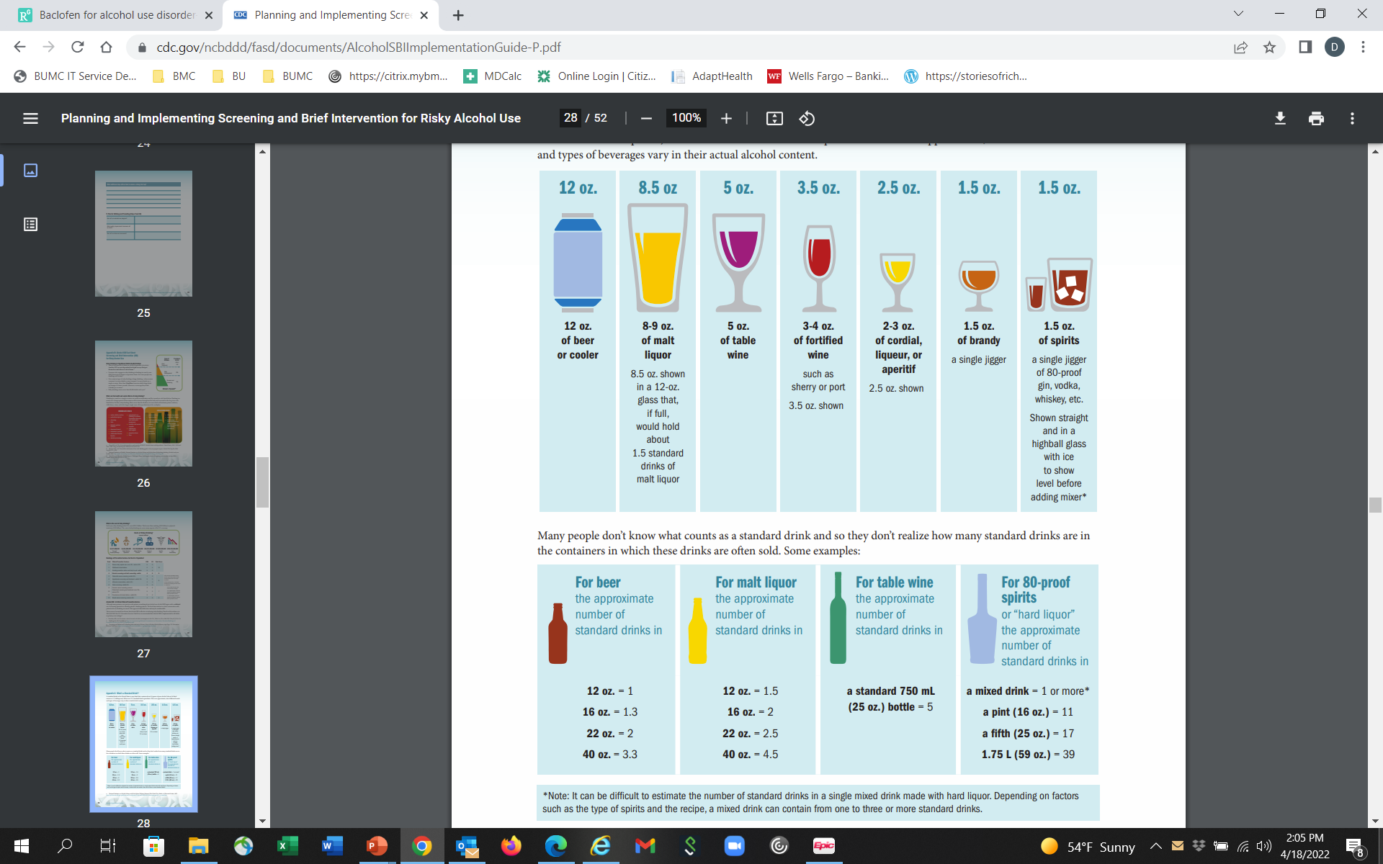
What is a Standard Drink?
Number of standard drinks in a bottle
“Doc, I drink a fifth of vodka a day” = ~17 drinks/day

Slide 6
Risky Alcohol Use
NIAAA (quantity, frequency)
Men (<65)
  >14 drinks per week, >4 per occasion (5+)
Women (Men 65+)
  >7 drinks per week, >3 per occasion (4+)
Any alcohol use?
↑ All-Cause Mortality (Zhao J. JAMA Network Open. 2023)
  low-volume alcohol use (1.3-24 g/d), associated with higher all-cause mortality
↑ Cardiovascular Dz (Biddinger KJ. JAMA Network Open. 2022)
Carcinogen (Klein WMP. JAMA. 2019)
  breast, oral, pharynx, liver, esophagus, colorectum
Teratogen (Bandoli G. Pediatrics. 2019)
  Fetal Alcohol Spectrum Disorders
USDA, Dietary Guidelines 2020
Women: 1 drink or less in a day
Men: 2 drinks or less in a day
Risky Drug Use
Any drug use? What about cannabis?
Notes:
43
21
Treatment Need
Injection, use of heroin once, marijuana daily, other drug weekly, or use with prior treatment history

Slide 7
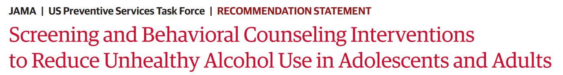
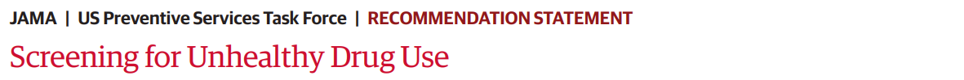
Screen for unhealthy alcohol use in primary care settings in adults 18 years or older, including pregnant women…provide persons engaged in risky or hazardous drinking with brief behavioral counseling interventions to reduce unhealthy alcohol use. (since 1996, updated November 2018)
Screen by asking questions about unhealthy drug use in adults 18 years or older…should be implemented when services for accurate diagnosis, effective treatment, and appropriate care can be offered or referred. (Screening refers to asking questions about unhealthy drug use, not testing biological specimens.) (since June 2020)

Slide 8
Screening Workflow
Screen for Unhealthy Substance Use (SISQ, AUDIT-C, TAPS)
Screen negative
for unhealthy substance use
Screen positive
for unhealthy substance use
Positive reinforcement
Screen (Assess) for SUD
AUDIT, DAST, CAGE-AID, DSM-5
SUD unlikely
SUD likely
Brief Negotiated Interview
Monitor
Brief Negotiated Interview
Treat +/- Refer
Notes:
.auditctool
.auditcscoring

Slide 9
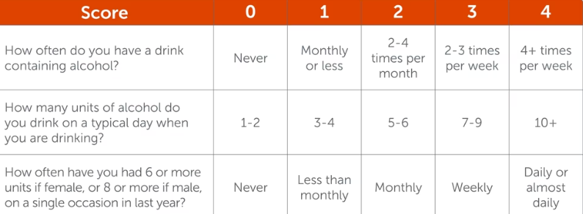
Alcohol Use Disorders Identification Test
Consumption items (AUDIT-C)
Scored 0 - 12
>4 men
Unhealthy alcohol use: (sensitivity: 86%, specificity 72%); AUD: (sensitivity 79%, specificity 56%)
>3 women
Unhealthy alcohol use: (sensitivity 66%, specificity 94%); AUD: (sensitivity 80%, specificity 87%)
Bradley KA, et al. Alcohol. Clin. Exp. Res. 2007; Bush K et al. Arch Intern Med. 1998; Bradley KA et al. Arch Intern Med. 2003

Slide 10
‘Single’ Item Screening Questions (SISQ)
  Alcohol
  “Do you sometimes drink beer wine or other alcoholic beverages?”
  “How many times in the past year have you had 5 (4 for women) or more drinks in a day?”
    Positive = greater than “never” (82% sensitive, 79% specific for unhealthy alcohol use)
  Drug
  “How many times in the past year have you used an illegal drug or used a prescription medication for non-medical reasons?”
    Positive = greater than “never” (100% sensitive, 74% specific drug use disorder)
NIAAA. Clinicians Guide to Helping Patients Who Drink Too Much, 2007.
Smith PC, Saitz R. J Gen Intern Med 2009
Smith PC, Saitz R. JAMA Intern Med 2010
Saitz R et al. J Studies Alcohol Drugs. 2014
McNeely J et al. Validation for self-administration. J Gen Intern Med. 2015

Slide 11
Screening for Unhealthy Substance Use
Tobacco, Alcohol, Prescription meds and other Substances (TAPS)
(TAPS-1) In the past 12 months, how often have you:
  Used any tobacco product (cigarettes, e-cigarettes, cigars, pipes or smokes tobacco)?
  Had (5 [males], 4 [females]) or more drinks containing alcohol in one day?
  Used any drugs including marijuana, cocaine or crack, heroin, methamphetamine, hallucinogens, ecstasy?
  Used any prescription medications just for the feeling, more than prescribed, or that were not prescribed for you? (e.g., opioid pain relievers, medications for anxiety or sleeping, medications for ADHD)
Response options:
Daily or almost daily
Weekly
Monthly
Less than monthly
Never
If positive on TAPS-1 (i.e., other than “never“) use TAPS-2, which consists of brief substance-specific questions to determine risk level ranging from “problem use” to SUD
McNeely J et al. Ann Intern Med. 2016
Notes:
This quick substance use screening has only 1-2 questions for alcohol and 1 question for drugs. These questions are validated screening tools, and should be asked as presented here.
The single item alcohol screening question is, “Do you sometimes drink beer, wine, or other alcoholic beverages?”
If someone says no, you can follow up with the question, “Why not?” because it’s so normative for people to drink occasionally. Maybe the person’s in recovery, maybe they have a family history of unhealthy substance use, and those would be important things to find out.
If they say yes, which most people will, you’ll want to find out whether they are drinking unhealthy amounts. For men under 65 years old the question is, “How many times in the past year have you had five or more drinks in a day?” For women and men 65 or older, it’s four or more drinks in a day.
The single item drug screening question is “How many times in the past year have you used an illicit drug or used a prescription medication for nonmedical reasons?”
If asked what non-medical reasons are, you can say taking a medicine you weren’t subscribed or taking more than prescribed (this is also mentioned in slide 4 – keep here, there, or both?)
The way these questions are asked is important. It’s not asking people, “you don’t drink a lot do you?” That’s very easy to say no to. The questions are asked in a very normative way so that people feel comfortable answering - “how many times in the past year.”

Slide 12
Alcohol Use Disorder Identification Test (AUDIT)
  10 questions (score: 0-40)
  Most widely validated in a wide range of racial/ethnic groups
  8+ is unhealthy alcohol use
  15+ suggests moderate to severe AUD
Saunders et al. Addiction. 1993
Drug Abuse Screening Test (DAST-10)
  10 questions (yes/no) (score: 0-10)
  6-10 is very high risk, probable DUD
Skinner HA. Addict Behav. 1982

Slide 13
DSM-5 Substance Use Disorders (SUD)
1.
Tolerance
2.
Withdrawal
3.
Larger amounts and/or longer periods
4.
Inability to cut down on or control use
5.
Increased time spent obtaining, using or recovering
Physiologic
Loss of Control
6.
Craving/
Compulsion
7.
Role failure: work, home, school
8.
Social, interpersonal problems
9.
Reducing social, work, recreational activity
10.
Physical hazards
11.
Physical or psychological harm
Continued Use Despite Negative Consequences
Mild SUD: 2-3 Criteria
Moderate SUD: 4-5 Criteria
Severe SUD: >6 Criteria
APA. (2013). Diagnostic and Statistical Manual of Mental Disorders (5th ed.)
Notes:
DSM-5 Opioid Use Disorders
In terms of diagnosing an opioid use disorder, the DSM-V criteria are an agreed upon set of criteria that allow you to assess your patients. So these evaluate tolerance and withdrawal, though it’s important to note that these first two criteria may be seen in patients on prescribed opioids and do not necessarily by themselves constitute a use disorder, and the 11 criteria go on to assess for loss of control and for continued use despite negative consequences. And patients can be stratified into a mild, moderate or severe opioid use disorder based on how many criteria out of these 11 that they meet.

Slide 14
CAGE CAGE-AID*
Assessment
Have you ever felt you should Cut down on your drinking?
Have people Annoyed you by criticizing your drinking?
Have you ever felt bad or Guilty about your drinking?
Have you ever taken a drink first thing in the morning (Eye-opener) to steady your nerves or get rid of a hangover?
Or drug use?
Or drug use?
Or drug use?
Or used drugs?
* "Adapted to Include Drugs”
Mayfield D et al. Am J Psych 1974; Brown RL & Rounds LA. Wisconsin Med J 1995
Notes:
7
Here are the CAGE questions, first published in 1974 by Mayfield.
I’d like to mention just 2 additional issues with the CAGE questionnaire. First, the questions ask if the patient has ever cut down, been annoyed, felt guilty or had an eye-opener, allowing us to identify patients in remission as well as those with acute problems. Second, we translated the CAGE into Spanish, backtranslated it, checked it for accuracy and validated it here in the primary care clinics and found that at least in Carribean Latinos, the test had sensitivity and specificity at least as good as that found for English speakers.
4 items, yes/no
brief, memorizable
detects lifetime problems\
usual cutoff >1 or 2
may miss some hazardous drinkers
Doesn’t ask quantity
CAGE AID validated in 63 elders. 63 elderly (>age 60) persons with drug abuse/dep, 838 controls
>1: 92% sensitive, 48% specific
AGE-AID: 82% sensitive, 69% specific
>2: 81% sensitive, 72% specific
AGE-AID: 77% sensitive, 89% specific
Hinkin 2001

Slide 15
Screening Results in Primary Care
10-20% unhealthy alcohol use
  Of those, 1/5 alcohol use disorder (AUD)
3% unhealthy drug use
  Of those, 1/3 drug use disorder (DUD)
Mertens JR et al. Alcoholism: Clinical and Experimental Research. 2005
In past 12 months…
  62% any alcohol use
    22% AUD (11% mild, 11% moderate/severe)
  28% any drug use (marijuana 21%, cocaine 7%, opioids 5%, heroin 4%, sedatives 4%)
    50% DUD (14% mild, 36% moderate/severe)
Wu LT, McNeely J, et al. Drug Alcohol Depend. 2017
Notes:
Mertens, ACER 2005, HMO, in a pop had 3.2% drug, 7.5% alc, 10% had at least one of the 2
Wu et al.
Methods: This study analyzed data from a multisite validation study of a substance use screening instrument conducted in a diverse sample of 2000 adults aged ≥18 years recruited from five primary care practices in four states. Prevalence and correlates of 12-month DSM-5 SUDs were examined.
Results: Overall, 75.5% of the sample used any substance, including alcohol (62.0%), tobacco (44.1%), or illicit drugs/nonmedical medications (27.9%) in the past 12 months (marijuana 20.8%, cocaine 7.3%, opioids 4.8%, sedatives 4.1%, heroin 3.9%). The prevalence of any 12-month SUD was 36.0% (mild disorder 14.2%, moderate/severe disorder 21.8%): tobacco 25.3% (mild 11.5%, moderate/severe 13.8%); alcohol 13.9% (mild 6.9%, moderate/severe 7.0%); and any illicit/nonmedical drug 14.0% (mild 4.0%, moderate/severe 10.0%). Among past 12-month users, a high proportion of tobacco or drug users met criteria for a disorder: tobacco use disorder 57.4% (26.1% mild, 31.3% moderate/severe) and any drug use disorder 50.2% (14.3% mild, 35.8% moderate/severe); a lower proportion of alcohol users (22.4%) met criteria for alcohol use disorder (11.1% mild, 11.3% moderate/severe). Over 80% of adults with opioid/heroin use disorder met criteria for a moderate/severe disorder. Younger ages, male sex, and low education were associated with increased odds of having SUD.

Slide 16
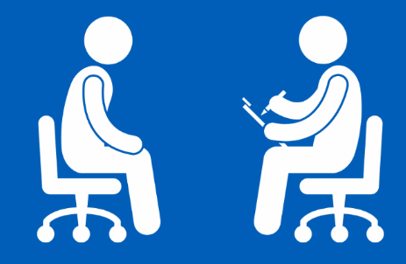
Brief Intervention (BI) for Alcohol
50+ Years of Trials
Modest efficacy for reducing self-reported consumption
  3-4 fewer drinks/week, 10-12% less unhealthy use (e.g., 57% vs 69% at 1 year)
  No consistent effects on anything else
No evidence it prevents developing AUD
No effect on ‘moderate to severe AUD,’ very heavy use, or getting people identified by screening to treatment
Evidence is mixed for ED and inpatient as most patients identified have a mod/severe AUD
BUT, repeat, and be available when patients are ready and counsel long-term
USPSTF. JAMA. 2018;320(18):1899-1909.
Jonas DE et al. Ann Intern Med 2012;157:645-54.
Kaner et al. Drug and Alcohol Review 2009;28:301–23
Beich et al. BMJ 2003;327:536
Bertholet et al. Arch Intern Med. 2005;165:986
Kristenson H, et al. Alcohol Clin Exp Res 1983;7:203 (mortality, 3-16 yrs)
Fleming MF et al. Alcohol Clin Exp Res. 2002;26(1):36-43 (cost)
Cuijpers et al. Addiction 2004;99: 839–845 (mortality)

Slide 17
Brief Intervention (BI) for Drugs
Previous studies found BI may help some patients reduce their illicit drug use
  RCT in urgent care setting¹
  Observational study in general medical settings²
However, 2 RCTs^{3,4} found BI in primary care settings not effective for reducing illicit drug use or prescription drug misuse
With BI efficacy uncertain, the goal is to diagnose and treat
“There are other reasons to identify and address drug use in primary care (e.g., to make appropriate diagnoses, for safer prescribing)…clinicians should look beyond BI…to lengthier and more complex longitudinal care management strategies—as the main solution to addressing illicit drug use and prescription drug misuse in primary care patients.”
Saitz R et al. JAMA. 2014
1. Bernstein J, et al. Drug Alcohol Depend. 2005
2. Madras BK, et al. Drug Alcohol Depend. 2009
3. Saitz R, et al. JAMA. 2014
4. Roy-Byrne P, et al. JAMA. 2014
Notes:
Zahradnik A, et al. Addiction. 2009;104(1):109–117
Otto C, et al. Drug Alcohol Depend 2009;105:221-6
Bernstein et al. Drug Alcohol Depend 2005;77:49
Woodruff SI et al. Addict Sci Clin Pract (2014) 9:8.doi:10.1186/1940-0640-9-8
Blow FC et al. Poster, and Abstract book p.14
CPDD 77th Annual Meeting • Arizona Biltmore, Phoenix, Arizona
Bogenschutz JAMA Internal Med 2014;174:1736-45
Gelberg L, et al. Addiction. 2015;110:1777–1790
JAMA. 2014;312(5):502-513. doi:10.1001/jama.2014.7862.
JAMA. 2014;312(5):492-501. doi:10.1001/jama.2014.7860

Slide 18
Brief Negotiated Interview (BNI)
Six Steps, after asking permission:
“Is it okay if we talk about your use of [X]?”
Explore Pros and Cons
Review Health Risks
Summarize and Ask Key Question
Explore Readiness
Negotiate Goals
Explore Confidence
Bernstein E, et al. Ann Emerg Med 1997

Slide 19
Step 1: Explore Pros and Cons
Ask PROS
Ask CONS
What do you enjoy/like about [X]? What else?
What do you enjoy less (or regret) about your [X] use? What else?
Explore problems mentioned in screening, if done. You mentioned … Can you tell me more about that situation?”
Notes:
Highlight:
Why do we ask about pros- why are they important- why do we ask them first? Be sure to keep it short.

Slide 20
Step 2: Review Health Risks
1. Elicit: patient knowledge of risks
2. Provide information
3. Elicit response
What do you know about the health effects and/or risks of [X]?
Would it be okay if I shared some additional information* with you? ….Provide the information
What do you think about that?
* Link any medical problems with [X] use
* For alcohol, review lower risk drinking levels
Notes:
Assessing student’s own knowledge
Explain info you have so that it is tangible- avoid medical terminology, avoid lingo
Make sure to break it up
Be aware of pushback, tune out

Slide 21

Step 3: Summarize & Key Questions
1. Summarize what the patient’s said so far
2. Use a key question to elicit response (change talk) from the patient
So, to summarize, on the one hand, you said [pros], AND on the other hand you said [cons] and we discussed [risks]…
Did I get that right?
Where does that leave you with your [X] use?

Slide 22
Step 4: Explore Readiness
1. Importance ruler
2. Ask about lower number
To help me understand how you feel about making a change in your [X] use…
On a scale of 0 to 10, how important is it for you right now to change your [X] use?... “0 is not ready”, “10 completely ready”
Why did you choose a [X] and not a lower number like a 1 or 2?
If they choose “a zero” - What would need to happen in your life to consider making a change?

Slide 23
Step 5: Negotiate Goals
You mentioned some reasons to change.
What type of changes might you make?
Is it OK if I share some suggestions that might be helpful?
Cut back to lower risk amounts if:
  Risky drinking amounts without reported negative consequences
  "You may want to cut back on your drinking in order to avoid risks"
Abstain if:
  Negative consequences from [X] use
  Known medications or medical conditions that are risky with [X] use
  Pregnant or trying to conceive
    "You should stop drinking if you are pregnant or trying to get pregnant"
What are your thoughts about that?

Slide 24
Step 6: Explore Confidence
If you decide to change your use of X, on scale of 0 to 10, how confident are you that you will be successful?
  What are some challenges to being successful?... reaching your goals?
  How can you overcome those challenges?
  Can I suggest other strategies that have helped other patients? *Recommend 1-2 strategies that may help
Thanks for being so open with me today!
1. Explore confidence
2. Explore challenges
3. Suggest other strategies

Slide 25
Brief Negotiated Interview (BNI)
Six Steps, after asking permission:
“Is it okay if we talk about your use of [X]?”
Explore Pros and Cons
Review Health Risks
Summarize and Ask Key Question
Explore Readiness
Negotiate Goals
Explore Confidence
Bernstein E, et al. Ann Emerg Med 1997
Notes:
Same as slide 19, do we want both?

Slide 26
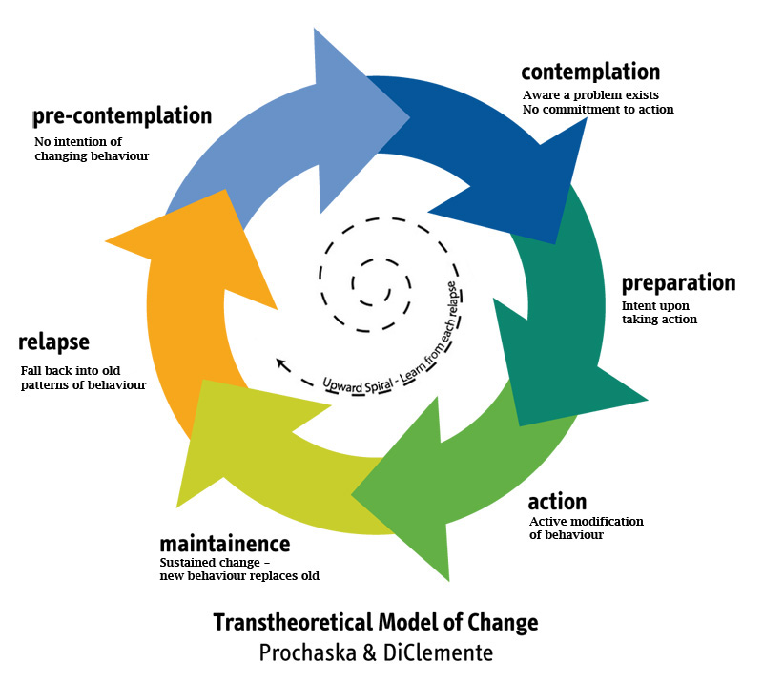
Addressing Different Stages of Change
determination/

Slide 27
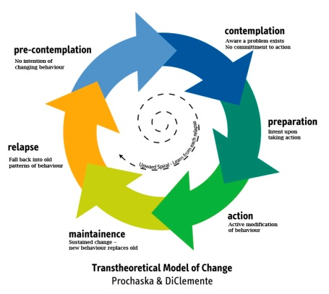
Precontemplation
Goal is to raise doubt, increase perception/ consciousness of problem
  express concern
  state the problem non-judgmentally
  agree to disagree
  advise a trial of abstinence or cutting down
  importance of follow-up (even if using)
  less intensity is better
Samet, JH, Rollnick S, Barnes H. Arch Intern Med. 1996;156:2287-2293.

Slide 28
Contemplation
Goal is to tip the balance
  elicit positive and negative aspects of drinking
  elicit positive and negative aspects of not drinking
  summarize (patient could write these down)
  demonstrate discrepancies between values and actions
  advise a trial of abstinence or cutting down

Slide 29
Determination/Preparation
Goal is to help determine the best course of action
  working on motivation is not helpful
  supporting self-efficacy is (remind of strengths--i.e. period of sobriety, coming to doctor)
  help decide on achievable goals
  caution re: difficult road ahead
  relapse won’t disrupt relationship

Slide 30
Summary
Screen to identify the spectrum of unhealthy alcohol and other drug use
  Includes (risky) use, use disorder
Validated questions best
Incorporate into health history, ask “matter of fact”
Assess after a positive screening test
  To confirm unhealthy use
  To identify use disorder
Use brief negotiated interview to address unhealthy substance use to help motivate patients to change cognizant of their stage of change

