Slide 1
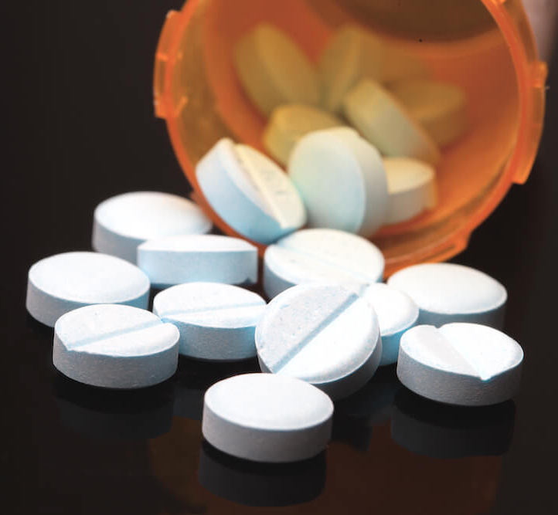
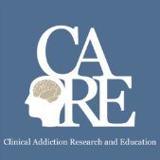


Pain, Opioids and
Addiction
Immersion Training in Addiction Medicine Programs 2023
April 2023
Daniel P. Alford, MD, MPH
Professor of Medicine
Associate Dean, Continuing Medical Education
Director, Clinical Addiction Research and Education (CARE) Unit

Slide 2
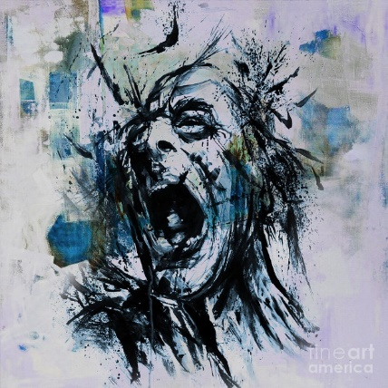
State of Pain
Acute pain is an adaptive symptom that is life preserving
Chronic pain is…
  maladaptive and may present as a disease in and of itself
  common (21% of US adults [~50 million] reported pain on most days or everyday)
  subjective to the patient and the clinician
  associated higher fatal and nonfatal suicide attempts
Pain contributes to disparities by disproportionally impacting females, elderly, and those with lower socioeconomic backgrounds
Painting by Gull G
Yong R et al. Pain 2022
Dahlammer J et al. MMWR Morb Mortal Wkly Rep 2018
Institute of Medicine. 2011 Relieving Pain in America. Washington DC

Slide 3
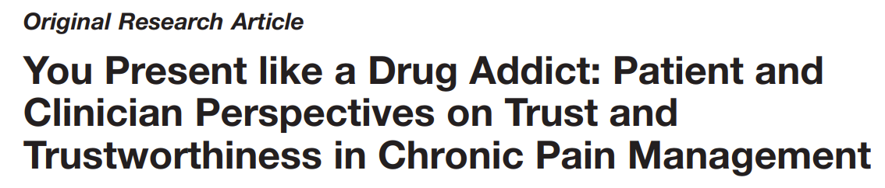
Qualitative study of adults with low back pain living in an urban setting in British Columbia, Canada
Semi-structured interviews (N=27)
Patient and provider themes
Buchman DZ et al. Pain Med. 2016

Slide 4
Patient Theme 1:
Threats to Trustworthiness and Iatrogenic Suffering
Perceptions that their clinicians have demonstrated a lack of care, empathy, and respect…affecting patients’ assessments of clinician trustworthiness… negative interactions with clinicians caused them further suffering.
SUSAN: “You could just tell that he just didn’t believe me that I was in as much pain as I was. He was just very unsympathetic. He would literally walk away while I was in the middle of a sentence.”
Buchman DZ et al. Pain Med. 2016

Slide 5
Patient Theme 2:
Motive, Honesty, and Testimony
Patients’ doubts that their clinicians believed that they were being honest about their motives for seeking treatment (e.g., drug misuse or drug diversion). Patients described being perceived as untrustworthy by clinicians
LUDWIG: “When I was in [hospital] just a couple of weeks ago…the ambulance drivers just took one look at me and it was, like—the look in their eyes was like, ‘Oh, he’s just a junkie looking to get stoned.’ They didn’t believe that I was actually suffering and in pain. They thought I was faking it completely…”
Buchman DZ et al. Pain Med. 2016

Slide 6
Clinician Theme 1:
Challenges of the Practice Context
Physicians highlighted the challenging context in which chronic pain management is delivered. They recalled several difficult interactions and the impact these interactions had on their approach to care
DR. JOHN: “The things that we remember are the times that we got burned, right . . . You may get burned one in 100, but that one in 100 is enough to burn an impression in your mind that makes you wary of all patients potentially.”
Buchman DZ et al. Pain Med. 2016

Slide 7
Clinician Theme 2:
Complicated Clinical Relationships
Chronic pain management involving opioid analgesics can prohibit or destabilize the development of trusting clinical relationships. Physicians…did not necessarily see their role as a collaborative partner…[they] saw themselves in a defensive role of interrogator
DR. HENRY: “In most doctor–patient relationships we learn to listen to the patient and accept their testimony…in some instances, to be quite honest, we are interviewing the patient as if we are a police officer or a lawyer, trying to find flaws in their story…So there is a different relationship here.”
Buchman DZ et al. Pain Med. 2016

Slide 8
Building Trust
After completing a thorough pain history, focused physical exam, and appropriate diagnostic testing…
  Show empathy for the patient’s experience…
“It must be difficult to enjoy life with such severe pain.”
  Validate that you believe pain and suffering is real…
“I believe you and want to help.”
Believing the severity of a patient’s pain complaint
does not mean opioids are indicated

Slide 9
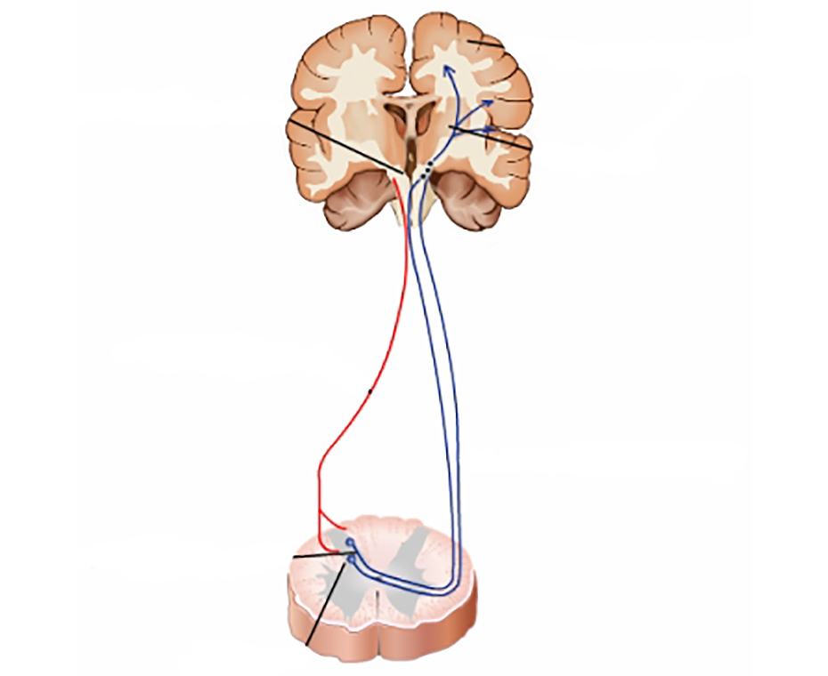
Opioid Analgesics
Somatosensory
cortex
Periaqueductal
gray area
Thalamus
Analgesia
  Turn on descending inhibitory systems
  Prevent ascending transmission of pain signal
  Inhibit terminals of C-fibers in the spinal cord
  Inhibit activation of peripheral nociceptors
  Variable response (not all patients respond to the same opioid in the same way)
    >3,000 polymorphisms in the human μ-opioid receptor gene
    Single nucleotide polymorphisms (SNPs) affect opioid metabolism, transport across the blood brain barrier, and activity at receptors and ion channels
Active the reward pathway
Descending
pathway
Ascending
pathways
Peripheral
nerves
Dorsal Horn
McCleane G, Smith HS. Med Clin N Am. 2007
Smith HS. Pain Physician. 2008

Slide 10

Opioids and Chronic Pain
“The problem is, there’s no evidence that opioids work for chronic pain, according to guidelines released in 2016 by the CDC”
Julia Lurie – reporter, Mother Jones,
April 27, 2018

Slide 11
Opioid Efficacy for Chronic Pain
Meta-analyses (1-6 month follow-up)
  Opioids v placebo (high quality evidence) Statistically significant improvements in pain^{1,2} and functioning.²
  Opioids v placebo (neuropathic pain) (low-mod quality evidence) Clinically relevant pain relief and reduction of disability³
  Opioids v nonopioids (low-mod quality evidence) Similar benefits²
RCT⁴ found opioids not superior to nonopioids for improving musculoskeletal pain-related function over 12 months
Limitations to generalizability:⁵
Excluded patients already on long-term opioids
89% of eligible patients declined to be enrolled
Two longer term follow-up studies found 44.3% on chronic opioids for chronic pain had at least 50% pain relief ⁶
1. Meske DS, et al. J Pain Res. 2018
2. Busse JW, et al. JAMA. 2018
3. Sommer C et al. Eur J Pain. 2020
4. Krebs EE, et al. JAMA. 2018
5. Webster L. Pain Med. 2019
6. Noble M, et al. Cochrane Syst Rev. 2010
Notes:
Opioid Efficacy for Chronic Pain
How good are opioids for chronic pain? What is the efficacy for chronic pain? Now, this is different than acute pain, and I would argue that the efficacy for acute pain is probably 100 percent effective. For someone who comes in with a femur fracture, we would never withhold an opioid, because we assume that they’ll be some efficacy. There may be variability in terms of how much relief somebody gets, but we wouldn’t withhold it from someone with severe pain like that.
For chronic pain, it’s completely different. We’ve already talked about it as being more like a chronic disease. Well, lately, in the past year, we’ve had a couple of meta-analyses that have looked at opioids versus placebo for chronic pain. Unfortunately, these studies only evaluate for up to three to six months, and follow-up. So, we don’t have long-term studies, but in these short-term studies for chronic pain, they show that opioids were statistically significantly better, but with a small improvement in pain, and function, versus placebo. And when they compared opioids versus non-opioids, unfortunately, these studies were low to moderate quality, they showed that both were similar in terms of benefits.
There was a study that looked comparatively between opioids, and non-opioids. It was a randomized clinical trial that found that opioids were not superior to non-opioids for improving musculoskeletal pain-related function over 12 months, so a long-term outcome. However, an important limitation is that only 5 percent of those that were randomized actually entered into the study. So, what that tells me is that someone who’s willing to enter into a study where they could be randomized to an opioid or non-opioid that they seem to do equally well on either one. What happens to that 95 percent who said, “I don’t want to be entered into the study?” It’s unclear. Two longer-term follow-up studies, up to about a year, found that 44.3 percent of individuals on chronic opioids for chronic pain had at least 50 percent pain relief. So, it’s not zero percent; it’s not 100 percent. So, it’s around 50 percent of individuals on opioids for chronic pain will get adequate pain relief.

Slide 12
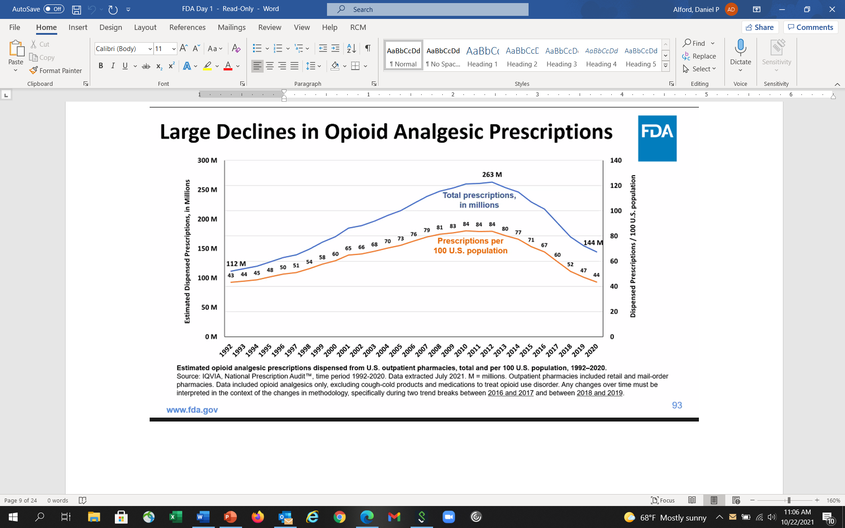
Opioid Prescribing Trends
Compared to Whites, Blacks and Hispanics are less likely to receive opioid analgesics for pain and when they do it’s at a lower dose
Steady ↑ starting in 1990s, peaked in 2012 at 84 scripts/100 persons
↓ starting in 2012, in 2020 lowest in 15 y, at 43 scripts/100 persons
Morden NE et al. NEJM 2021
www.fda.gov

Slide 13
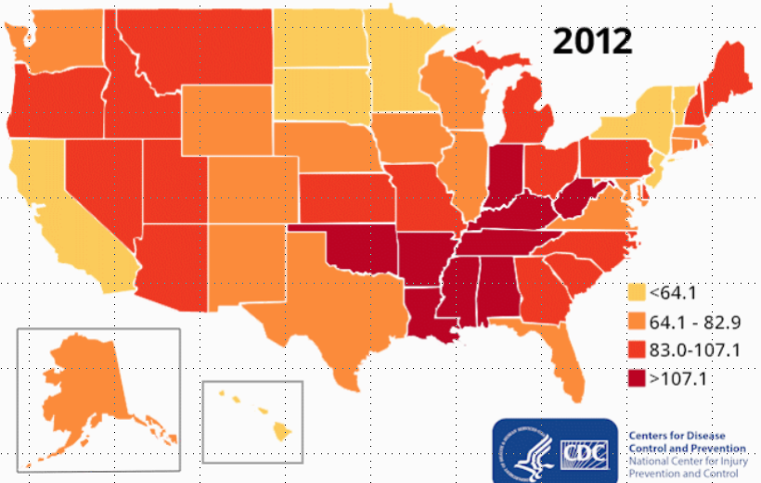
Opioid Dispensing Rates (Scripts/100 People)

Slide 14
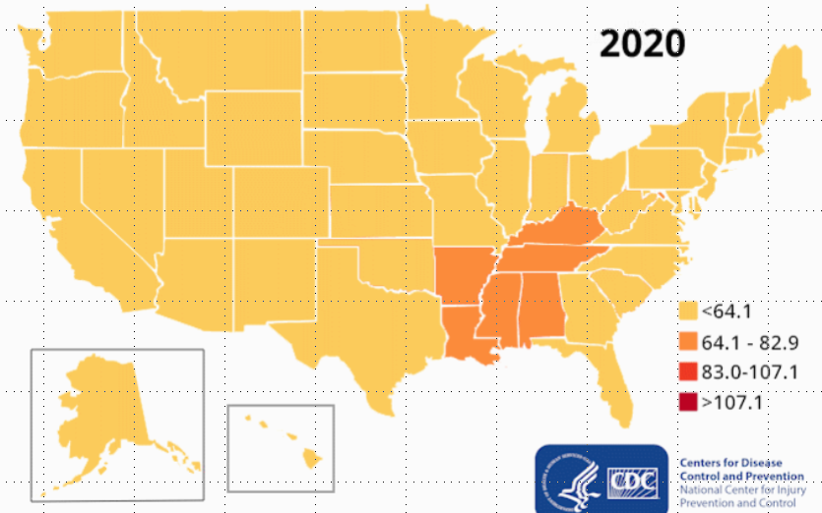
Opioid Dispensing Rates (Scripts/100 People)

Slide 15
Opioid Risks
Allergies are rare
Side effects are common
    Nausea, sedation, constipation, urinary retention, sweating
    Respiratory depression – sleep apnea
Organ toxicities are rare
    Suppression of hypothalamic-pituitary-gonadal axis
Immunosuppression
  Increased risk of invasive pneumococcal disease and community acquired pneumonia
Worsening pain (hyperalgesia in some patients)
Addiction (Opioid Use Disorder)
Overdose
    when combined w/ other sedatives and at higher doses
Dunn KM et al. Ann Intern Med 2010
Li X et al. Brain Res 2001
Doverty M et al. Pain 2001
Angst MS, Clark JD. Anesthesiology 2006
Wiese AD, et al. Ann Intern Med. 2018

Slide 16
Problematic Opioid Use
Systematic review from 38 studies (26% primary care, 53% pain clinics)
  Misuse rates: 21% - 29%
  Misuse: Opioid use contrary to the directed or prescribed pattern of use, regardless of the presence or absence of harm or adverse effects.
  Addiction rates: 8% - 12%
  Addiction: Pattern of continued use with experience of, or demonstrated potential for, harm (eg, “impaired control over drug use, compulsive use, continued use despite harm, and craving”).
Vowles KE et al. Pain. 2015
Notes:
So what is the opioid addiction risk? So when a patient comes to you and you prescribe opioids, what is the risk of them developing an addiction? And unfortunately, the true incidence and prevalence of addiction in chronic pain populations prescribed opioids is unknown. And a lot of it has to do with different criteria used to define addiction in different studies, and so it’s really all over the place.
And the range, if you look at all studies, is anywhere between zero and 50%, so that’s not particularly helpful other than to say it’s not 100%, and it’s probably not 0% either. And it’s probably more like 15 to 20%, when you look at the majority of studies.

Slide 17
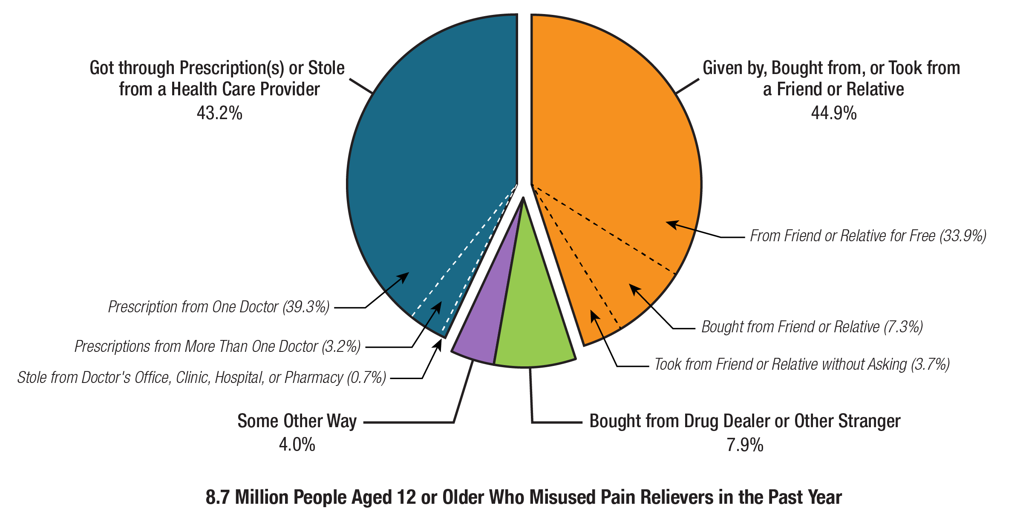
Prescription Opioid Misuse
8.7 Million Adults with Prescription Opioid Misuse in Past Year
SAMSHA (2022), 2021 NSDUH
Notes:
https://www.nytimes.com/2020/10/03/style/am-i-drinking-too-much.html
https://www.rand.org/news/press/2020/09/29.html

Slide 18
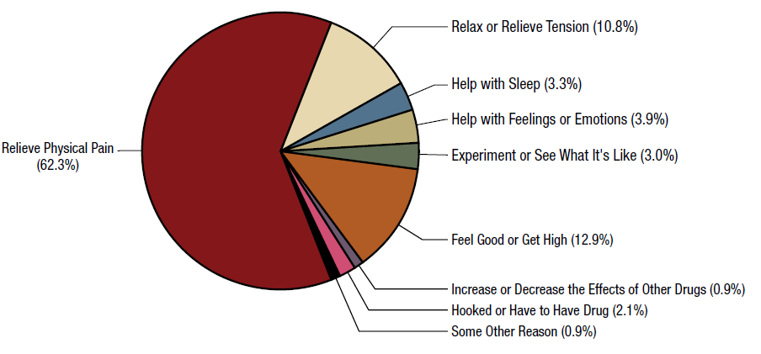
Reasons for Prescription Opioid Misuse
SAMHSA. NSDUH

Slide 19
Risk Factors for Opioid-Related Harm (misuse, overdose, addiction)
Medication Factors
Higher opioid dose
Long-term opioid use (>3 months)
ER/LA opioid formulation
Initial 2 weeks after starting ER/LA opioid
Combination opioids and sedatives (e.g., benzodiazepines)
Patient Factors
Mental health disorder (e.g., depression, anxiety)
Substance use disorder (SUD) (e.g., alcohol, tobacco, illicit and prescription drug)
Family history of SUD
Sleep-disordered breathing
History of opioid overdose
Akbik H, et al. J Pain Symptom Manage. 2006
Ives J, et al. BMC Health Serv Res. 2006
Liebschutz JM, et al. J Pain. 2010
Michna E, et al. J Pain Symptom Manage. 2004
Reid MC, et al. J Gen Intern Med. 2002
Volkow ND, et al. N Engl J Med. 2016

Slide 20
Does my patient have an OUD?
  *Tolerance
  *Withdrawal
  Use in larger amounts or duration than intended
  Persistent desire to cut down
  Giving up interests to use opioids
  Great deal of time spent obtaining, using, or recovering from opioids
  Craving or strong desire to use opioids
Recurrent use resulting in failure to fulfill major role obligations
Recurrent use in hazardous situations
Continued use despite social or interpersonal problems caused or exacerbated by opioids
Continued use despite physical or psychological problems
?
?
?
*These criterion are not considered to be met for those individuals taking opioids solely under appropriate medical supervision
Mild OUD: 2-3 Criteria
Moderate OUD: 4-5 Criteria
Severe OUD: >6 Criteria
American Psychiatric Association. (2013). Diagnostic and statistical manual of mental disorders (5th ed.)
Notes:
The diagnosis of addiction really is based upon the four C’s: loss of control, compulsive use, continued use despite harm, and craving.
The disease of addiction is fairly easy to detect when it’s really apparent. And it always becomes very apparent because people can’t hide from the disease of addiction. Within six months, usually, of exposing somebody to an opioid, those who have clear addiction will surface.
That doesn’t mean that people who are abusing fall into the same category. They can have still very problematic behaviors that look like the disease of addiction, and maybe just as problematic, but may not be quite as egregious in their behaviors as those with the disease of addiction.
Addiction, you know, is not the same as physical dependency, and I think this is an important point that needs to be restated several times because too often physicians think that if you become physically dependent and you have some withdrawal that that means you have the disease of addiction. We see withdrawal symptoms from people who are physically dependent to anticonvulsants, anti-depressants, and a lot of cardiovascular medicines as well, and when we suddenly stop those medications and people go into withdrawal, they’re not addicted to those medicines any more than we would be with an opioid. However, people who are addicted to opioids will have withdrawal if they suddenly stop the use of their medicines as well.

Slide 21
Is my patient addicted to the prescription opioid?
A clinical syndrome presenting as…
  Loss of Control
  Compulsive use
  Continued use despite harm
Worrisome
Medication
Taking
Behaviors
Savage SR et al. J Pain Symptom Manage 2003
Addiction is a chronic relapsing brain disorder
Physical Dependence is a normal physiologic adaptation
Notes:
Behaviors suggestive of addiction may include: inability to take medications according to an agreed
upon schedule, taking multiple doses together, frequent reports of lost or stolen prescriptions, doctor
shopping, isolation from family and friends, and/or use of non-prescribed psychoactive drugs in addition
to prescribed medications. Other behaviors which may raise concern are the use of analgesic medications
for other than analgesic effects, such as sedation, an increase in energy, a decrease in anxiety, or
intoxication; non-compliance with recommended non-opioid treatments or evaluations; insistence on
rapid-onset formulations/routes of administration; or reports of no relief whatsoever by any non-opioid
treatments. Loss of Control over use “Every time I try to limit my use to only once a week, I end up using every day.”“I try to limit myself to one drink per day but once I start, I can’t seem to stop until I pass out.”Continued use despite knowledge of harmful Consequences “I know my drug use caused my HIV but I can’t stop using.”“I have to stop using because my life is out of control, but using is the only option for me.”Compulsion to use “All I do is think about how I am going to score.”“No matter what I do, I can’t get drugs out of my mind and I feel I have to use and use a lot. Once I want to use, it is like I am on autopilot and I just have to use. I’ll do anything to get drugs.” Craving “It’s like a physical drive or urge to use. I want it from the pit of my stomach; I get sweaty just thinking about it. At times, these urges come out of nowhere, or I get them when I meet my using buddies, pass the corner where my dealer hangs out or am feeling down.”

Slide 22
Safer Opioid Prescribing for Pain

Slide 23
Multidimensional Care for Chronic Pain
Restore Function
  Therapeutic Exercise
  Massage
  Traction/Stretching
  Cold and Heat
  Chiropractic
  Therapeutic ultrasound
  Bracing, Orthotics
  TENS
  Cognitive Behavioral Tx
  Acceptance and Commitment Tx
  Mindfulness stress reduction
  Meditation
  Acupuncture
  Yoga
  Tai chi
Study duration on all treatments for chronic pain are < 12 months, vast majority are < 12 weeks
Tayeb BO, et al. Pain Med. 2016
Physical Restorative
Behavioral
Complementary and Integrative
Cultivate
Well-being
SELF
CARE
Reduce Pain
Multimodal approaches are more cost-effective than single modality options
Flor H, et al. Pain 1992
Roberts AH, et al. Clin J Pain. 1993
Patrick LE, et al. Spine. 2004
Kamper SJ, et al. Cochrane Review. 2014
Medication
Procedural
  Acetaminophen
  NSAIDs
  Anticonvulsants
  Antidepressants
  Topical agents
  Opioids
  Others
  Nerve blocks
  Steroid injections
  Radiofrequency ablation
  Trigger point injections
  Neuromodulation
  Stimulators
  Intrathecal pumps
  Autologous stem cell Tx
Improve
Quality of Life
Modified image courtesy of Seddon Savage, MD, MS

Slide 24

Opioid Guideline
Acute pain (recommendations 1 & 6)
Max non-pharm, non-opioids. Only consider opioids if benefits > risks. Discuss realistic benefits, known risks. Prescribe no greater quantity than needed for expected duration of severe pain
Chronic pain (recommendations 2-5, 7-11)
Max non-pharm, non-opioids. Only consider opioids if benefits > risks. Discuss realistic benefits, known risks. Establish treatment goals and how opioids will be d/c’d if benefits < risks
When starting opioids: use immediate-release opioids. Prescribe lowest effective dose. Use caution at any dose. Evaluate benefits and risks when considering increasing dosage. Avoid increasing dose above levels with diminishing benefit relative to risk
Evaluate benefits, risks 1-4 weeks of starting opioids or after dose escalation and then regularly
For patients already on opioids weigh benefits, risks, If benefits > risks, continue opioids and optimize other therapies, If benefits < risks, optimize other therapies, gradually taper. Unless life-threatening issue, do not d/c abruptly or rapidly reduce from higher doses
Use strategies to mitigate risk: naloxone co-prescribing, review PDMP, urine toxicology testing
Use caution when concurrently prescribing opioids and benzodiazepines (and other CNS depressants)
Opioid use disorder (recommendations 12)
Offer or arrange evidence-based medications for treating OUD
Dowell D et al. MMWR 2022

Slide 25
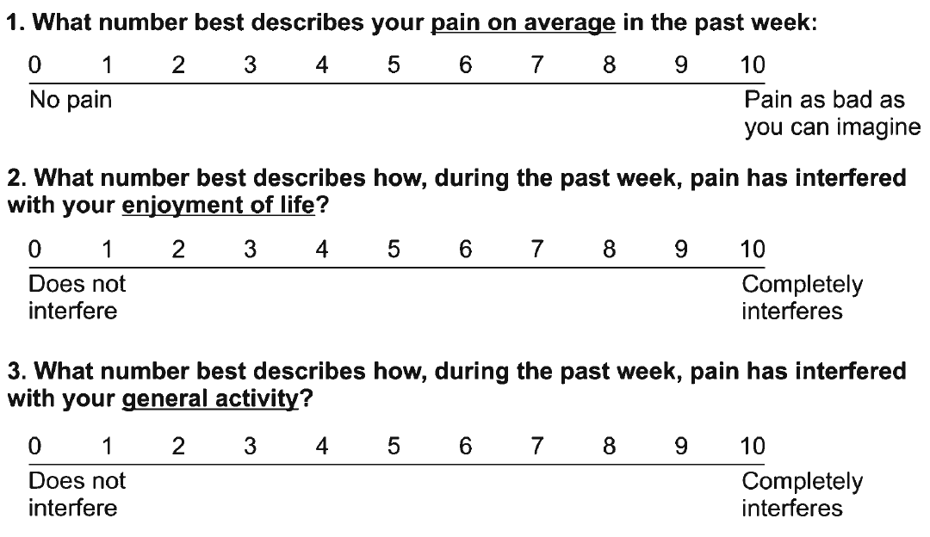
Assessing Benefit – PEG scale
Krebs EE, et al. J Gen Intern Med. 2009

Slide 26
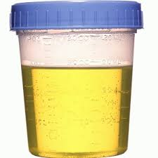
Urine Drug Testing
Objective information that can provide:
  Evidence of therapeutic adherence
  Evidence of use or non-use of illicit drugs
Discuss urine drug testing openly with patient
One medical data point to integrate with others
Urine drug screens usually immunoassays (Risk of false negatives and false positives)
  Opiate = morphine and/or codeine and/or semisynthetic opioid but never a synthetic opioids (e.g., methadone, fentanyl)
Unexpected findings confirm with Gas Chromatography (GC) or Liquid Chromatography (LC) and Mass Spectroscopy (MS) (know expected metabolites)
  e.g., hydrocodone→ hydromorphone; oxycodone→ oxymorphone
Identify a toxicologist for questions regarding unexpected results
  Argoff CE, Alford DP, Fudin J et al. Pain Med. 2018, Nagpal G et al. JAMA. 2017, Christo PJ, et al. Pain Physician. 2011
Notes:
I would use the color urine image

Slide 27
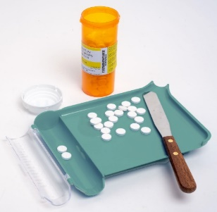

Monitoring: Medication Count and Prescription Drug Monitoring Program (PDMP)
Medication Count
PDMP
  Information on harmful polypharmacy
  Information on multiple provider use
  Information on medication adherence
  Information concerning for diversion
Some states allow delegating access to allied health professionals and have interstate data sharing
Insufficient evidence that implementation either increases or decreases nonfatal or fatal overdoses
28-day (rather than 30-day) prevents running out on weekends and medication hoarding
Fink DS, et al. Ann Intern Med. 2018

Slide 28

Opioids for Chronic Pain
What is the clinician’s role?
Use a risk-benefit framework
Judge the opioid treatment, not the patient
VS.
Nicolaidis C. Pain Medicine 2011
28

Slide 29
Continuation of Opioids
Before writing the next opioid prescription…you should be convinced that there is…
  …benefit (pain, function, QOL) and…
  …absence of harm
Despite subjective assessments (benefits/harms), it should be documented at each visit

Slide 30
Discontinuing (or Decreasing) Opioids
Do not have to prove addiction or diversion - only assess and reassess the risk-benefit ratio
If patient is unable to take opioids safely or is nonadherent with monitoring then discontinuing opioids is appropriate even in setting of benefits
Need to determine how urgent the discontinuation should be based on the severity of the risks and harms
Document rationale for discontinuing opioids
You are NOT abandoning the patient.
You are abandoning the opioid therapy.
Notes:
You don’t have to prove that they are addicted, nor do you have to prove that they’re diverting. You only have to believe that that’s a likely occurrence and you’ve analyzed the situation, you’ve assessed it, you’ve done your risk/benefit analysis and you just are ready to move forward with what you think is the safest for that patient and that is to discontinue the use of the opioids.
Again, this doesn’t mean you discontinue treating the person for their pain, but it means that you won’t prescribe them an opioid.
So, there are just some people who cannot safely take their medications, and they’re not going to adhere, they’re not going to follow the monitoring, and it is the safest and the only real option for some of those patients.
You’ll need to determine though whether this is an urgent situation, that is whether or not you need to discontinue rapidly or whether this is something that occur over a period of time. And that depends largely upon what drives you to the decision to discontinue the opioids.

Slide 31
Tapering Opioids
No validated protocols in patients on opioids for chronic pain
Goal may be to decrease dose or taper off completely
Systematic review found very low-quality evidence suggests that several types of opioid tapers may be effective, and that pain, function, and quality of life may improve for some patients with opioid dose reduction
CDC guideline recommends decrease of 10% per month if patient on opioids for years and decrease of 10% per week if patient on opioids for weeks to months
Frank JW et al. Ann Intern Med. 2017
Dowell D et al. MMWR. 2016

Slide 32
Opioid Discontinuation Risks
Observational studies identified harms (suicide and overdose) associated with opioid tapering and discontinuation^{1,2,3,4}
A comparative effectiveness study⁵ of ~200,000 individuals on stable long-term opioid therapy (i.e., no evidence of opioid use disorder or opioid misuse)
  opioid tapering was associated with a small absolute increase in opioid overdose or suicide compared with maintaining stable opioid dosages
“Tapering/discontinuation should not be considered a harm reduction strategy for patients receiving stable long-term opioid therapy without evidence of misuse”⁵
James JR, et al. J Gen Intern Med. 2019
Mark TL, Parish W. J Subst Abuse Treat. 2019
Oliva EM, Bowe T, Manhapra A, et al. BMJ. 2020
Hallvik SE, et al. Pain. 2022
Larochelle MR et al. JAMA open. 2022

Slide 33
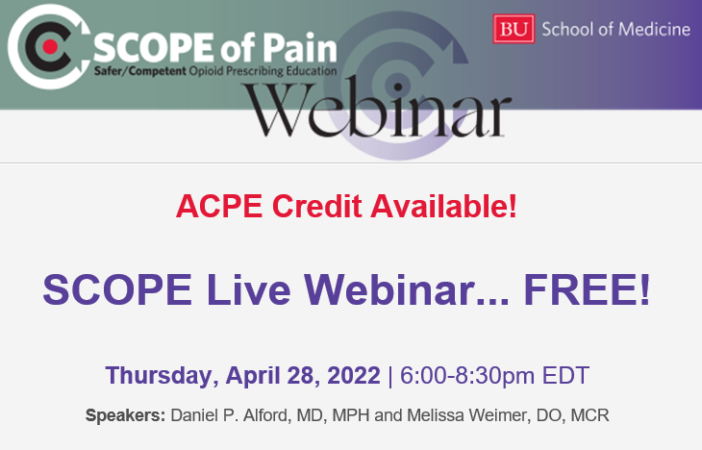
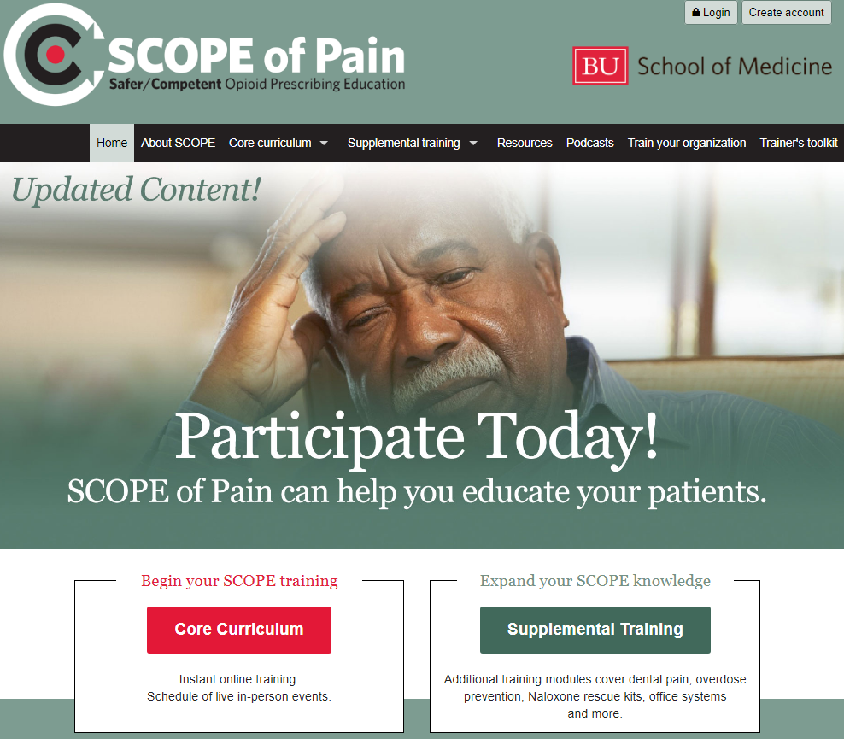
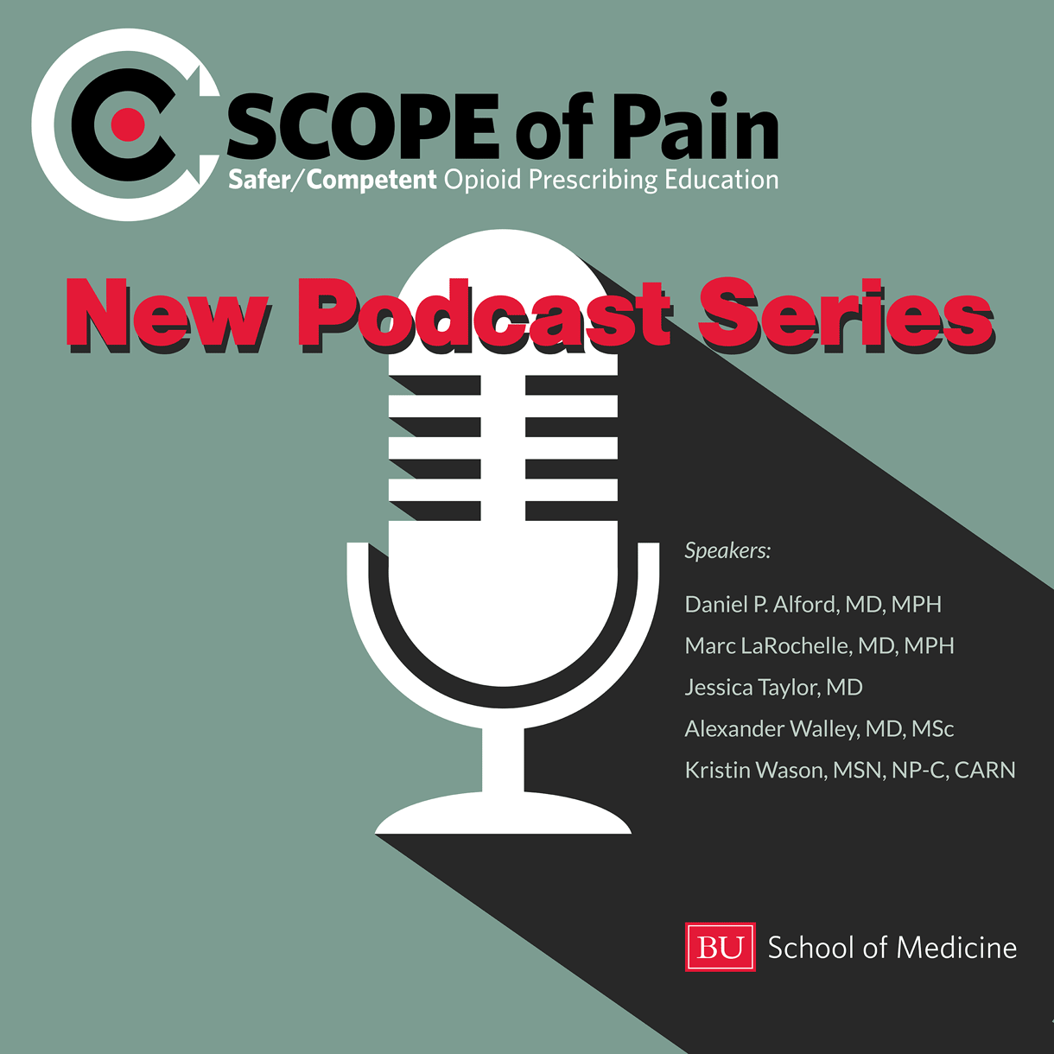
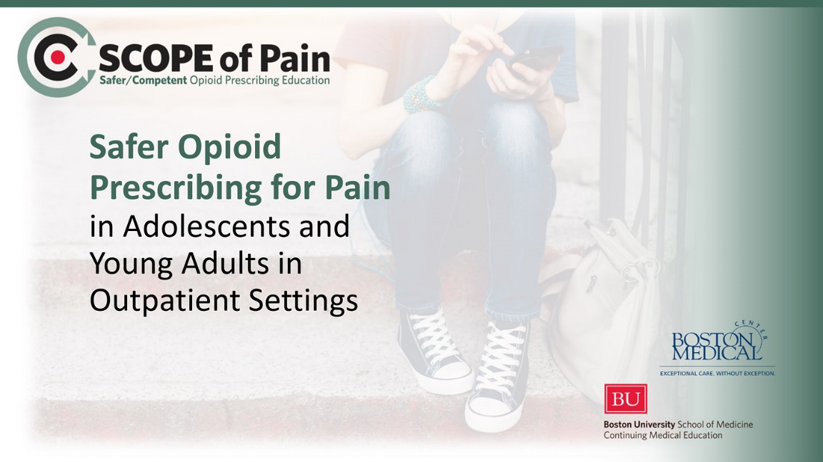
www.scopeofpain.org

Slide 34
Thanks!

