Slide 1
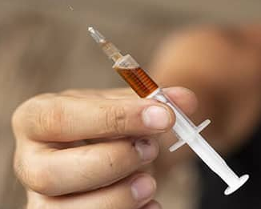



Opioids
Immersion Training in Addiction Medicine Program 2023
April 2023
Daniel P. Alford, MD, MPH
Professor of Medicine
Associate Dean, Continuing Medical Education
Director, Clinical Addiction Research and Education (CARE) Unit

Slide 2
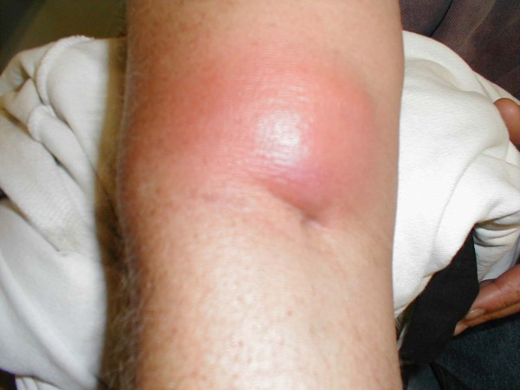
Case
32-year-old male brought into the Emergency Department after an “opioid overdose”
Brisk response to naloxone
Re-sedation after 1 hour requiring repeat naloxone
Antecubital abscess and cellulitis at injection site
Admitted for “drug overdose”, “persistent altered mental status” and “arm cellulitis (?abscess)”

Slide 3
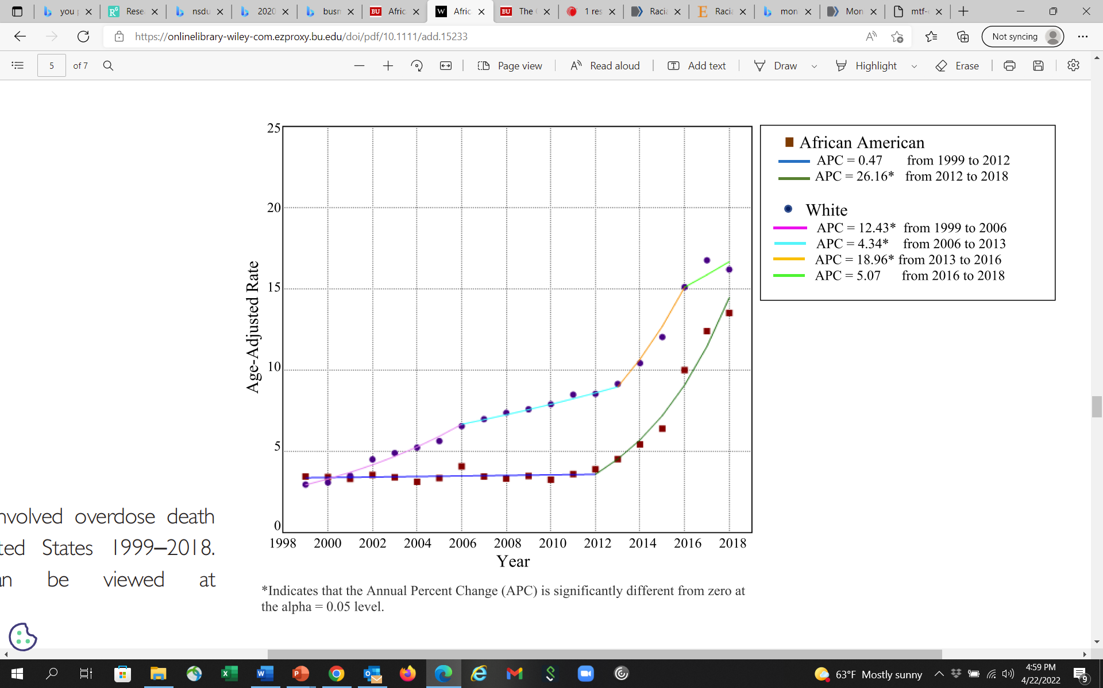
Opioid Overdose Deaths
Whites with multiple periods of acceleration 1999 to 2016 with decrease rate of change 2016 to 2018
African Americans: low rate of change 1999-2012 followed by rapid acceleration (intro of illicit fentanyl)
From 2013–2018 average annual precent change significantly higher in African Americans than Whites
Opioid crisis has focused white, middle-class, suburban and rural users, the impact in African American communities has been unrecognized
Furr-Holden D et al. Addiction. 2020
Notes:
Results The temporal trends of OOD varied by race. African Americans had a persistently low rate of OOD and statistically non‐significant rate of change in OOD from 1999 to 2012 (APC = 0.47; P > 0.05), with a statistically significant and rapid acceleration in OOD rates in 2012 that persisted to 2018 (APC = 26.16; P < 0.01). Whites had three statistically significant periods of acceleration in OOD rate from 1999 to 2006 (APC = 12.43; P < 0.01), 2006 to 2013 (APC = 4.34, P < 0.01) and the greatest increase from 2013 to 2016 (APC = 18.96; P < 0.01). Whites had a statistically non‐significant decrease in OOD from 2016 to 2018 (P = 0.16). The trend for whites more closely aligned with the CDC‐defined epidemic periods than for African Americans. During wave 1 (1999–2010), the average annual percentage change (AAPC) for African Americans was significantly lower than for whites (0.47 versus 9.42, P < 0.01); however, by wave 3 (2013–current; defined by the introduction of illicitly manufactured fentanyl), the AAPC was significantly higher in African Americans (26.16 versus 13.19, P < 0.01).

Slide 4
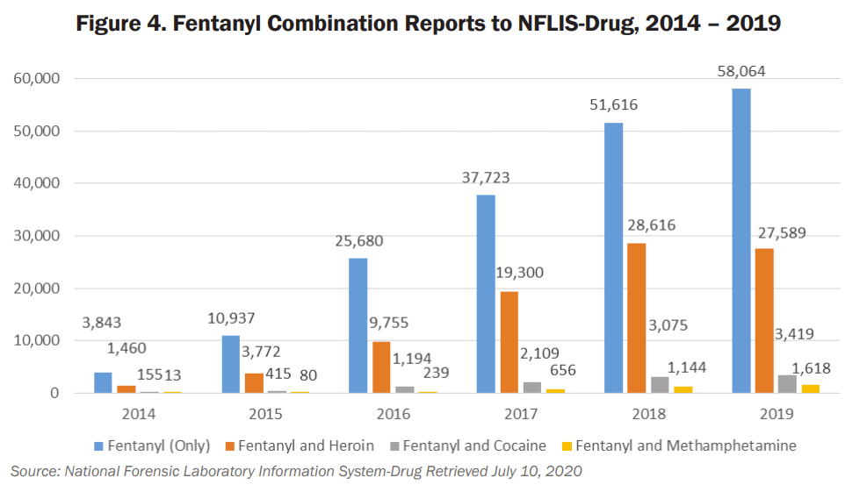
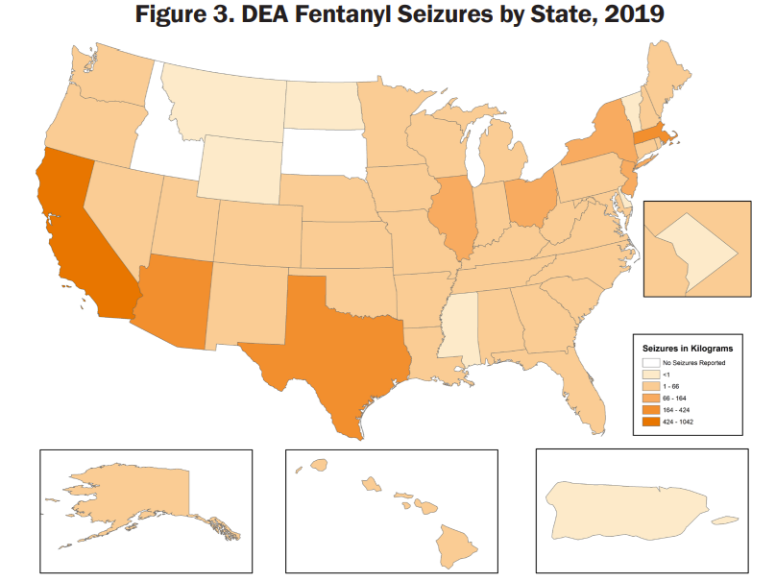
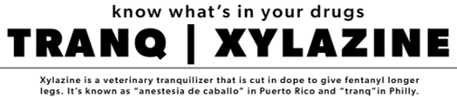
The Illicit Opioid Supply is Changing
DEA National Drug Threat Assessment. March 2021
Notes:
2

Slide 5
Natural History of Opioid Use Disorder
Euphoria
Tolerance
Normal
Withdrawal
Physical Dependence
Initial use
Chronic use
Alford DP. http://www.bumc.bu.edu/care/

Slide 6
Case continued
Substance use history
  Daily heroin/fentanyl use
  Intranasal use for 6 months then IV for 7 years
  History of 2 overdoses
  Had been in recovery for 2 years by going to NA but relapsed 3 months ago
  History of 10 detox’s, no treatment with medications
  No other drug, alcohol or tobacco use
HIV and hepatitis C negative
Unemployed electrician
Lives with wife (in recovery) and 2 young children
Now complaining of arm pain and opioid withdrawal
  How will you assess and treat him?
Notes:
2

Slide 7
Opioid Use Disorder
Complex Provider/Patient Experience
Study conducted on the inpatient medical service of a public urban teaching hospital
Qualitative analysis on the interactions with illicit opioid-using patients and their medical teams identified 4 common themes
Merrill JO, et al. J Gen Intern Med. 2002

Slide 8
Provider Perspective
1. Physician Fear of Deception
Physicians question the “legitimacy” of need for opioid analgesics (“drug seeking” patient vs. legitimate need).
“All of us go through a little bit of a hitch every time we are requested to prescribe narcotics for our patients....Are they trying to get more out of me than they really should have? The last thing I want to do is over-dose them or reinforce this behavior (of) trying to coax more drugs out of you.”
-Senior Medical Resident
Merrill JO, et al. J Gen Intern Med. 2002

Slide 9
Patient Perspective
2. No Standard Approach
The evaluation and treatment of pain and withdrawal is extremely variable among physicians and from patient to patient. There is no common approach nor are there clearly articulated standards.
“The last time, they took me to the operating room, put me to sleep, gave me pain meds, and I was in and out in two days.. . .This crew was hard! It’s like the Civil War. ‘He’s a trooper, get out the saw’. . .’”
-Patient w/ Multiple Encounters
Merrill JO, et al. J Gen Intern Med. 2002

Slide 10
Patient Perspective
3. Avoidance
Physicians focused primarily on familiar acute medical problems and evaded more uncertain areas of assessing or intervening in the underlying addiction problem-particularly issues of pain and withdrawal.
Patient/Resident Dialog
Resident: “Good Morning”
Patient: “I’m in terrible pain.”
Resident: “This is Dr. Attending, who will take care of you.”
Patient: “I’m in terrible pain.”
Attending: “We’re going to look at your foot.”
Patient: “I’m in terrible pain.”
Resident: “Did his dressing get changed?”
Patient: “Please don’t hurt me.”
Merrill JO, et al. J Gen Intern Med. 2002

Slide 11
Patient Perspective
4. Patient Fear of Mistreatment
Patients are fearful they will be punished for their drug use by poor medical care.
“I mentioned that I would need methadone, and I heard one of them chuckle. . .in a negative, condescending way. You’re very sensitive because you expect problems getting adequate pain management because you have a history of drug abuse. . .He showed me that he was actually in the opposite corner, across the ring from me.”
-Patient
Merrill JO, et al. J Gen Intern Med. 2002

Slide 12
Opioid Withdrawal Assessment
Grade
Symptoms / Signs
0
Anxiety, Drug Craving
1
Yawning, Sweating, Runny nose, Tearing eyes, Restlessness Insomnia
2
Dilated pupils, Gooseflesh, Muscle twitching & shaking, Muscle & Joint aches, Loss of appetite
3
Nausea, extreme restlessness, elevated blood pressure, Heart rate > 100, Fever
4
Vomiting / dehydration, Diarrhea, Abdominal cramps, Curled-up body position
Clinical Opiate Withdrawal Scale (COWS): pulse, sweating, restlessness & anxiety, pupil size, aches, runny nose & tearing, GI sx, tremor, yawning, gooseflesh (score 5-12 mild, 13-24 mod, 25-36 mod severe, 36-48 severe)

Slide 13
Inpatient Goals
Prevent/treat acute opioid withdrawal
  Inadequate treatment may prevent full treatment of medical/surgical condition
Don’t expect to cure OUD during hospitalization
  Withholding opioids will not cure patient’s OUD
  Administering opioids will not worsen patient’s OUD
Initiate addiction treatment referral
Diagnose and treat medical illness
  Growing evidence that medications for OUD facilitates the treatment of other serious complications of OUD e.g., endocarditis and osteomyelitis (Jo Y, et al. Addiction. 2021)
Notes:
6

Slide 14
Inpatient Treatment of Opioid Withdrawal
Methadone
Start w/ 20 mg po
Reassess q 2-3 h, give additional 5-10 mg until withdrawal signs abate
Don’t exceed 40 mg/24 hrs
Buprenorphine
Start with 2-4 mg SL (or low dose: 0.5 mg SL, 20 mcg/hr TD patch, 150-450 mcg buccal)
Reassess q 2-3 h, give additional 4 mg until withdrawal signs abate
Don’t exceed 16 mg/24 hrs
“Authorized hospital staff [may] administer narcotic drugs in a hospital to maintain or detoxify a person as an incidental adjunct to medical or surgical treatment of conditions other than addiction” (Code of Federal Regulations title 21, up to date as of 4/20/2023)
Monitor for response and CNS and respiratory depression
Give same dose each daily including day of discharge
Cannot give a methadone prescription at time of discharge
Can give a buprenorphine prescription at time of discharge
Peterkin A et al. Med Clin N Am. 2022
Sokolski E et al. J Addict Med. 2023
Cohen SM et al. J Addict Med. 2022
Notes:
9

Slide 15
Case continued
Hospital course
Arm abscess I and D, cellulitis treated with IV Vancomycin
Opioid withdrawal management included methadone 30 mg during his hospital course
He did not want to remain on medication (methadone or buprenorphine) for his OUD at the time of discharge
6 months later
He presents to your primary care clinic requesting referral to “detox” for his opioid use disorder
He has been using heroin/fentanyl since the day he left the hospital
Notes:
11

Slide 16
Opioid Detoxification Outcomes
Low rates of retention in treatment
High rates of relapse post-treatment
  < 50% abstinent at 6 months
  < 15% abstinent at 12 months
  Increased rates of overdose due to decreased tolerance
O’Connor PG JAMA 2005
Mattick RP, Hall WD. Lancet 1996
Stimmel B et al. JAMA 1977

Slide 17
Reasons for Relapse
Protracted abstinence syndrome
  Secondary to derangement of endogenous opioid receptor system
  Symptoms
    Generalized malaise, fatigue, insomnia
    Poor tolerance to stress and pain
    Opioid craving
Conditioned cues (triggers)
Priming with small dose of drug

Slide 18
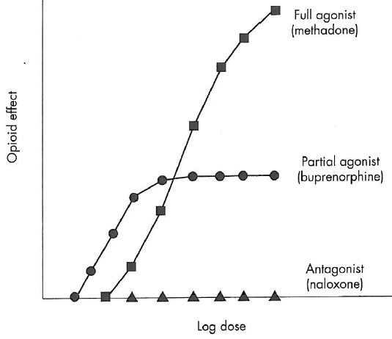
Medications for OUD (MOUD) Treatment
Goals
Suppress opioid withdrawal*
Opioid blockade
Alleviate drug craving
Normalized brain changes
Options
*Opioid Agonist Therapy (OAT)
  Methadone (full agonist)
  Buprenorphine (partial agonist)
Naltrexone (full antagonist)
Peterkin A et al. Med Clin N Am. 2022

Slide 19
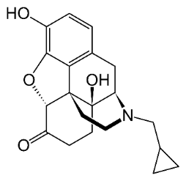
Naltrexone
Pure opioid antagonist
    Patients physically dependent must be opioid free for at least 7-10 days before treatment
  Oral naltrexone (daily)
    Well tolerated, safe, duration of action 24-48 hours
    No statistically significant difference compared to placebo due to poor retention (Minozzi S et al. 2011)
  More effective than placebo when patients legally mandated to take it
Injectable XR naltrexone (monthly)
  IM w/ customized needle, administered by healthcare provider
  Increased abstinence (90% vs 35% [Krupitsy E, et al. Lancet, 2011])
  Poor retention (40% at 3 months, <10% at 6 months [Cousins SJ et al. J Sub Abuse Treat 2016])

Slide 20
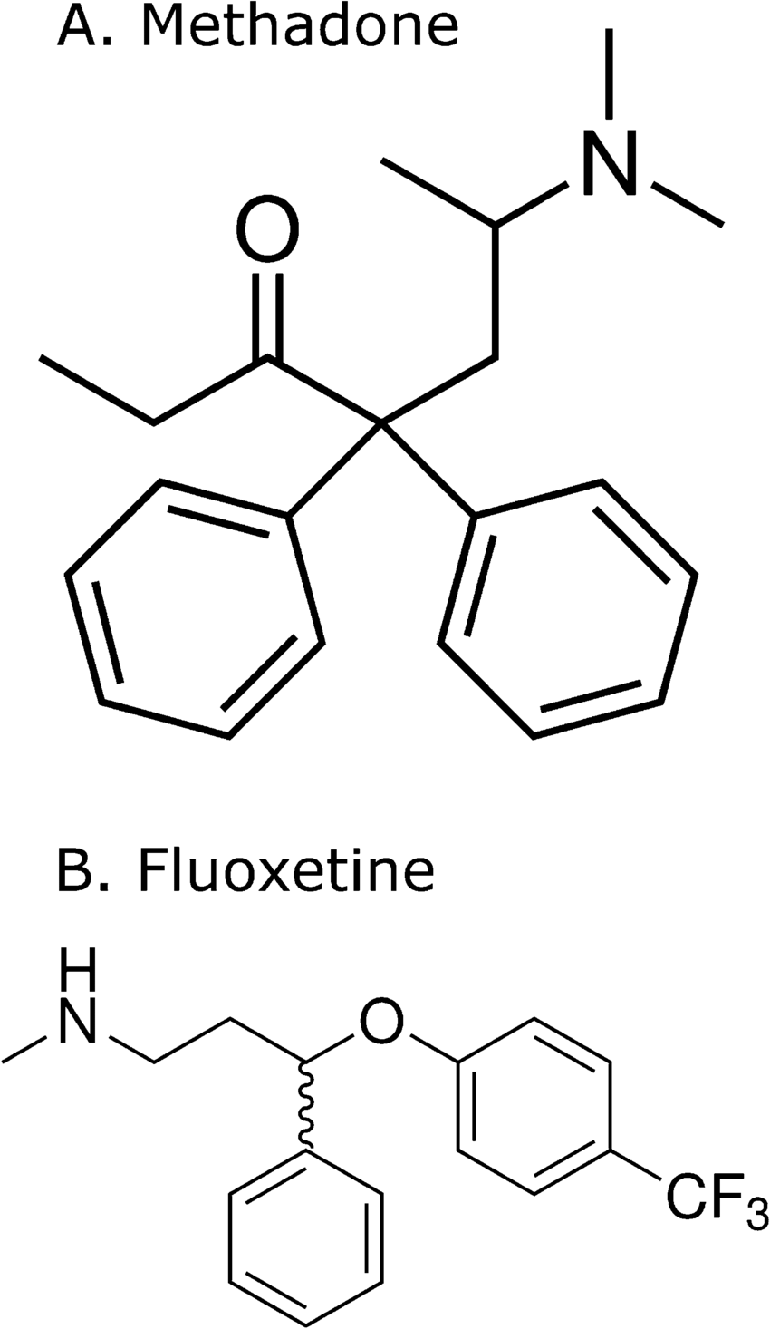
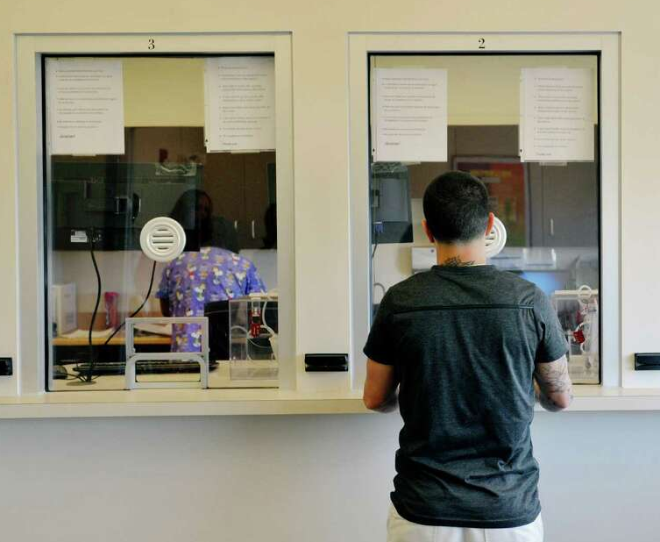
Methadone
Methadone
  Full opioid agonist
  PO onset of action 30-60 minutes
  Duration of action 24-36 hours to treat OUD
  Proper dosing for OUD
    20-40 mg for acute withdrawal
    > 80 mg for craving, “opioid blockade”
Opioid Treatment Program
  Highly structured
  Observed daily → “Take homes”

Slide 21
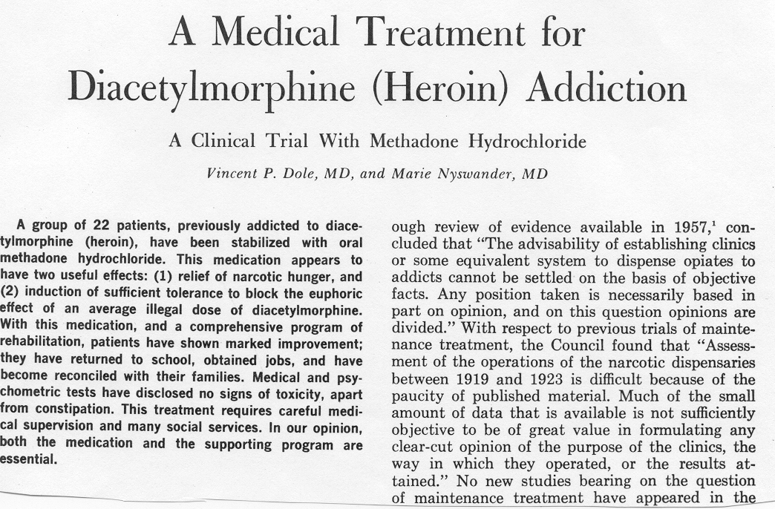
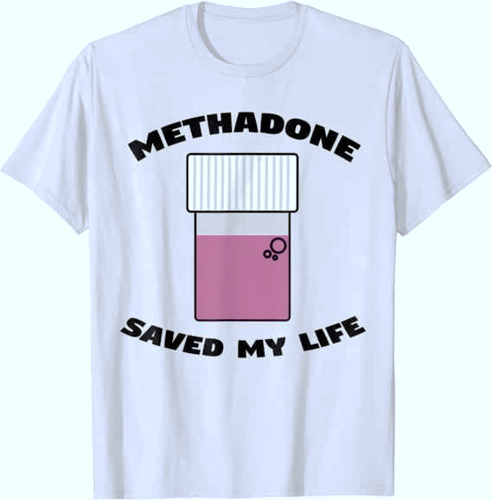
Extensive Research on Effectiveness
JAMA 1965
Increases treatment retention
Decreases illicit opioid use
Decreases hepatitis and HIV seroconversion
Decreases mortality
Decreases criminal activity
Increases employment
Improves birth outcomes

Slide 22
Methadone Maintenance Limitations
Highly regulated - Narcotic Addict Treatment Act 1974
Limited access
Inconvenient and highly punitive
Mixes stable and unstable patients
Lack of privacy
No ability to “graduate” from program
Stigma

Slide 23
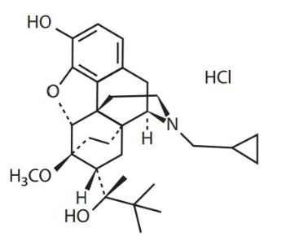
Buprenorphine
Semi-synthetic analogue of thebaine
FDA approved 2002 as schedule III – up to 5 refills
Ceiling effect on CNS and respiratory depression
Mu-opioid receptor partial agonist
Kappa-opioid receptor antagonist (antidepressant and anxiolytic effects)
Formulations: sublingual tab and film combined with naloxone, monthly SQ injection (administered by healthcare provider only)

Slide 24
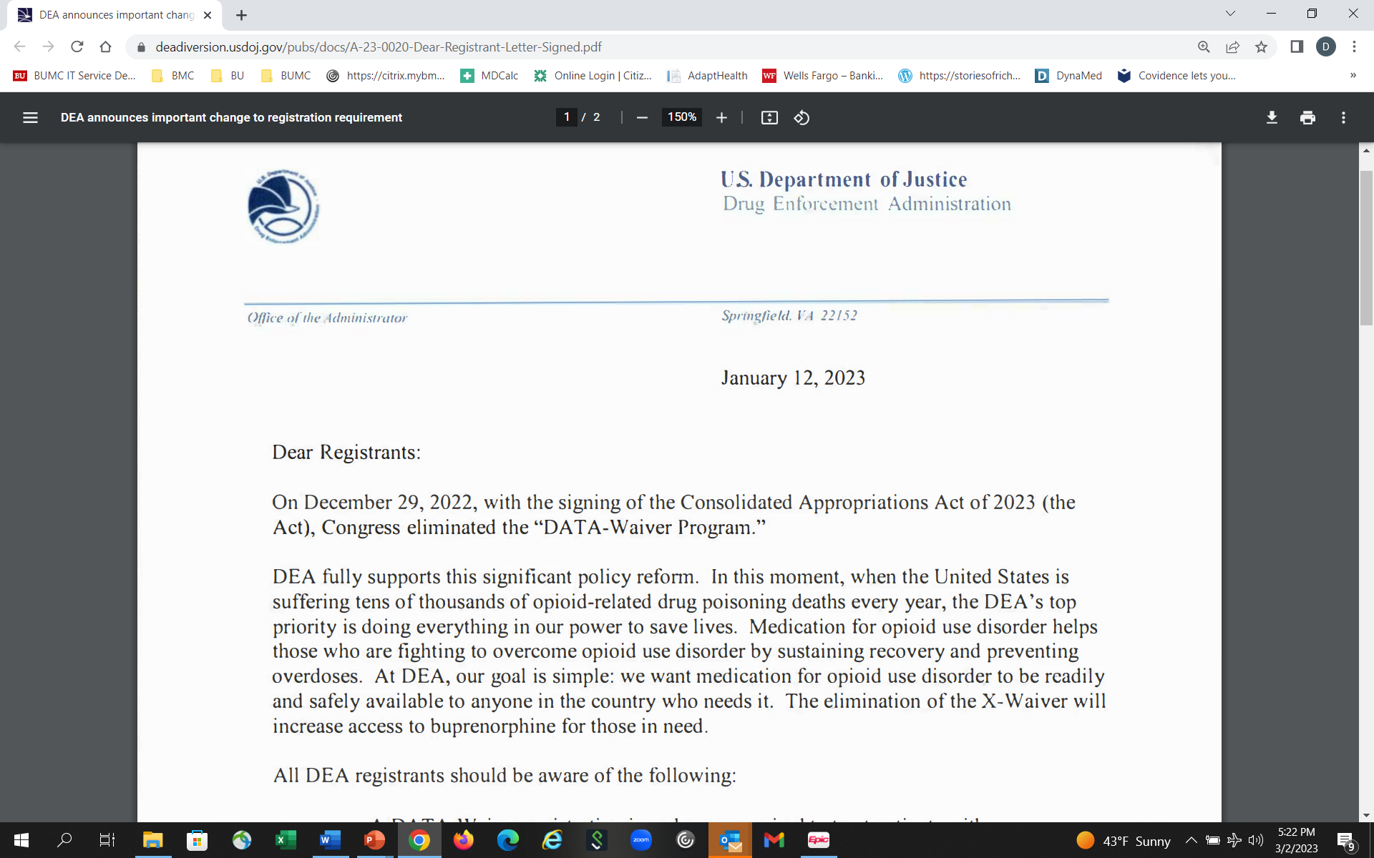
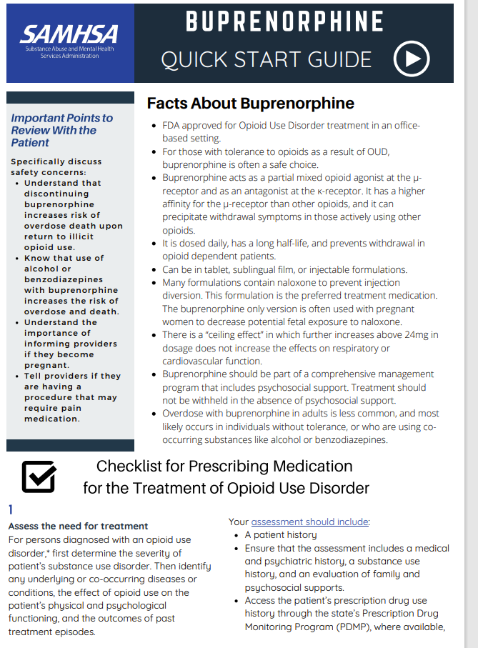
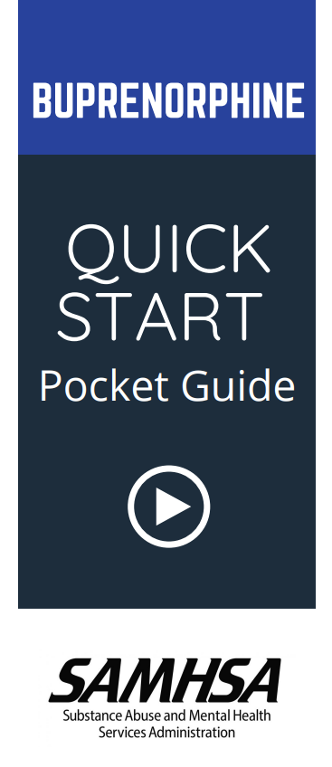
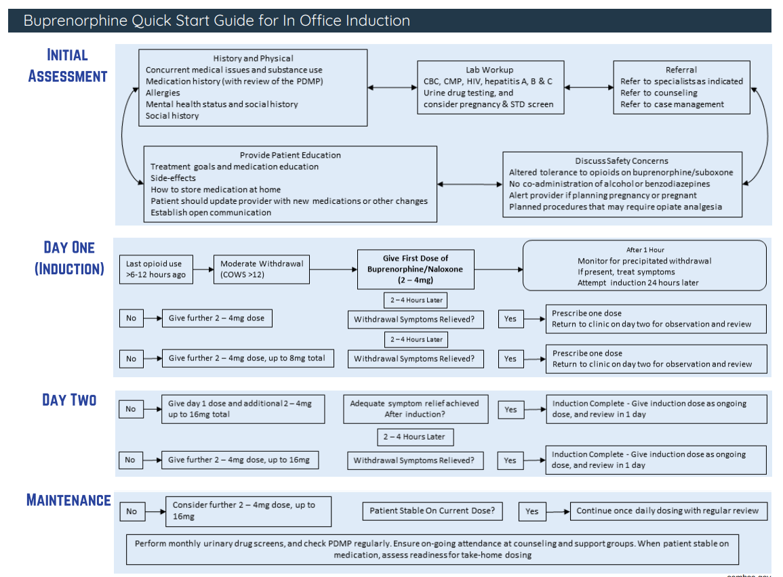
Buprenorphine
  Waiver not required to prescribe buprenorphine for OUD
  No limits on number of patients that a prescriber may treat for OUD with buprenorphine

Slide 25
Buprenorphine Efficacy Summary
Studies (RCT) show buprenorphine (16-24 mg) more effective than placebo and equally effective to moderate doses (80 mg) of methadone on primary outcomes of:
  Retention in treatment
  Abstinence from illicit opioid use
  Decreased opioid craving
  Decreased mortality
  Improved occupational stability
  Improved psychosocial outcomes
Johnson et al. NEJM 2000
Fudala PJ et al. NEJM 2003
Kakko J et al. Lancet 2003
Sordo L et al. BMJ 2017
Mattick RP et al. Conchrane Syst Rev 2014
Parran TV et al. Drug Alcohol Depend 2010

Slide 26
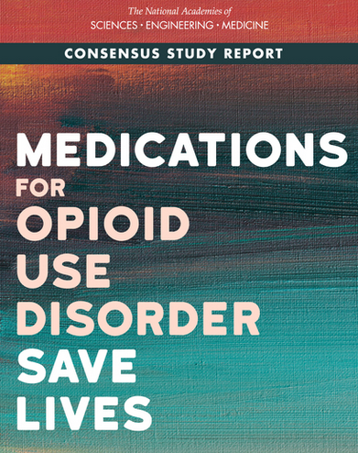
Barriers to Use of MOUD
Delay between OUD onset and MOUD receipt 4-7 years
Blacks have less than half the odds of initiating MOUD than Whites
Stigma toward drug addiction, individuals with OUD, and the medications to treat it
Inadequate education of health professionals
National Academies of Sciences, Engineering, and Medicine. 2019. The National Academies Press.

Slide 27
MOUD after Opioid Overdose
Data from multiple Massachusetts administrative systems (2011-2015)
Retrospective cohort of overdose survivors (N=17,568)
For the 12 months after the index overdose only 17% received buprenorphine, 11% received methadone, and 6% received naltrexone
Compared with no MOUD, receipt of buprenorphine or methadone was associated with a two-thirds reduction in death (all-cause and opioid-related mortality)
Larochelle MR , et al. Ann Intern Med. 2018

Slide 28
Starting MOUD Wherever Patients Present
Inpatient Service
Compared with an inpatient detox, initiation of and linkage to buprenorphine treatment is effective for engaging hospitalized patients who are not seeking addiction treatment and reduces illicit opioid use after hospitalization (Liebschutz JM et al. JAMA Intern Med. 2014)
Patients receiving inpatient MOUD were mostly white, non-Hispanic. Receipt of MOUD resulted in significant reductions in LOS and readmission rates (O’Rourke BP et al. Drug Alc Depend. 2022)
Emergency Department
ED-initiated buprenorphine vs brief intervention/referral significantly increased engagement in addiction treatment, reduced self-reported illicit opioid use (D’Onofrio G et al. JAMA. 2015)
Despite high fentanyl prevalence, the incidence of precipitated withdrawal in ED-initiated buprenorphine (8-12 mg) was < 1%, similar to rates among those using heroin or prescription opioids (D’Onofrio G et al. JAMA Network Open. 2023)

Slide 29
Transitions of Care
Systematic review on interventions for optimizing transitions in care from hospital to community for individuals with a SUD
31 studies including 7 RCTs and 24 quasi-experimental designs which focused on opioid use (n = 8), alcohol use (n = 5), or polysubstance use (n = 18)
  Interventions included pharmacotherapy initiation (n = 7), addiction consult services (n = 9), protocol implementation (n = 3), SBIRT (n = 2), patient navigation (n = 4), case management (n = 1), and recovery coaching (n = 3)
Both pharmacologic and psychosocial interventions improved engagement in care and reduce hospital readmission and ED presentations
James H et al. Drug Alc Depend 2023

Slide 30
Bridge Clinics
On-demand access to MOUD Low-barrier, transitional SUD treatment models (outpatient hospital-based, EM-based, virtual)
  Non-OTP providers administer methadone for up to 72 hours while arranging OTP linkage (Taylor JL et al. Drug Alc Depend. 2022)
Harm reductions service integration – overdose education, naloxone, safer injection and smoking materials, lower barrier STI, viral hepatitis, HIV screening, treatment, prevention including POC rapid HIV testing, PrEP, PEP, wound care, contraceptive services
Data on effectiveness in linking to long-term care are limited
Taylor JL, et al. Addiction Science & Clinical Practice. 2023 (narrative review)

Slide 31
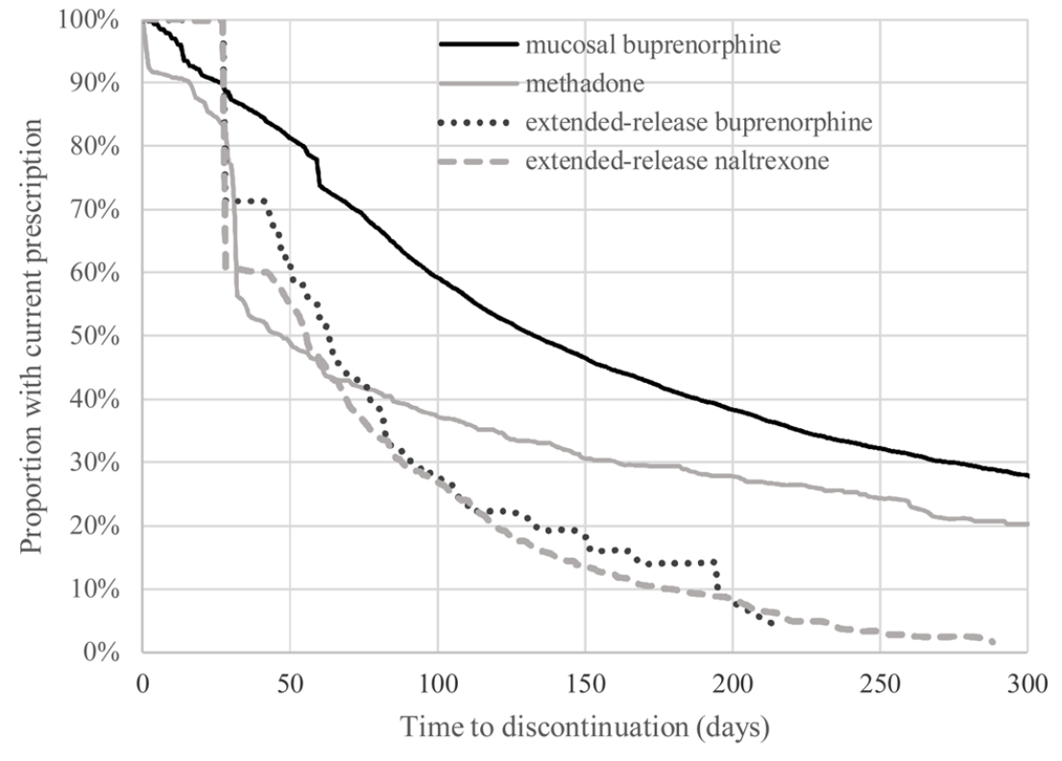
Treatment Retention with MOUD
National data of commercially insured individuals
14,358 initiated MOUD
  85% SL buprenorphine
  8% XR naltrexone
  6% methadone
  1% XR buprenorphine
Treatment discontinuation rates (3m)
  34% SL buprenorphine
  50% XR buprenorphine
  58% methadone
  65% XR naltrexone
Morgan JR, et al. Drug Alcohol Depend. 2021

Slide 32
Periop Pain Management in Patients Taking Methadone or Buprenorphine
Patients with an OUD are more sensitive to painful stimuli
Continue methadone or buprenorphine throughout the perioperative period
Treat pain with analgesics on top of the patients daily MOUD
Opioid analgesic requirements are often higher due to increased pain sensitivity and opioid cross tolerance
Ineffective pain management can result in disengagement of care
Hickey T et al. Med Clin N Am. 2022
Veazie S et al. J Gen Intern Med. 2020
Kohan L et al. Reg Anesth Pain Med. 2021
Alford DP, Compton P, Samet JH. Ann Intern Med 2006

Slide 33
Thanks!

