Slide 1
SPECIAL CONSIDERATIONS IN CARING FOR ADOLESCENTS, YOUNG ADULTS, AND WOMEN
Sarah M. Bagley, MD, MSc
April 26 , 2023

Slide 2
Why are we talking about this?
Substance use often begins in adolescence
What happens in childhood/adolescence affects how our adult patients present care throughout their lives
Women, (including those who are pregnant and parenting) present unique opportunities and barriers to care
Notes:
We

Slide 3
Language Matters: “hard to reach”
I am not hard to reach, people just generally don’t know how to reach me

Slide 4
Identity Formation
“They don't want their life to continue to be defined by their substance use, including if that means being defined by not using substances… I think the conversation isn't just about …people won't die … It's like people will be present for their lives again.”
Eitan (non-binary, 23)
Schoenberger (2022). JGIM.

Slide 5
Learning Objectives
1
Describe the current trends in adolescent and young adult substance use, overdose, and treatment
Identify 2 opportunities and 2 barriers to provide evidence-based addiction care for adolescents and young adults
Discuss the different considerations of women who use drugs
2
3
Notes:
2 minutes intro
LO 1, 7 minutes= 4 slides
LO 2, 7 minutes= 5 slides
LO 3, 7 minutes= 4 slides
Summary slide 2 minutes
25 minutes

Slide 6
1
Describe the current trends in adolescent and young adult substance use, overdose, and treatment
Notes:
Summarize the Weiss talk here
Developmental considerations-- emphasize how the benefits of youth risk taking, we want to encourage it but want to optimize safety because the same qualities provide opportunities for critical growth and the potential for injury/harm

Slide 7
Current Trends
Substance | Change from 2021-2022
Cannabis | - Rate remained the same
Nicotine (vaping) | - Rate remained the same
Alcohol*
Cocaine*
Hallucinogens*
Prescription opioids*
Monitoring the Future (2022). NIH: Advancing Addiction Science
* Indicates a return to pre-pandemic levels
Notes:
https://monitoringthefuture.org/results/publications/monographs/

Slide 8
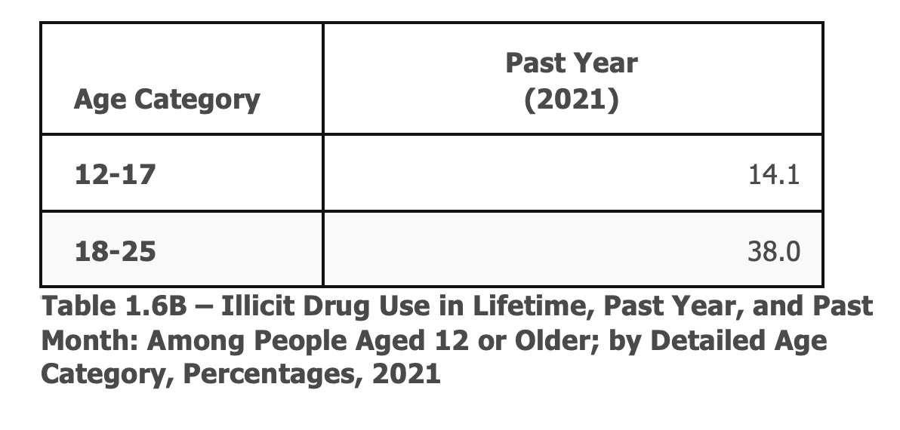
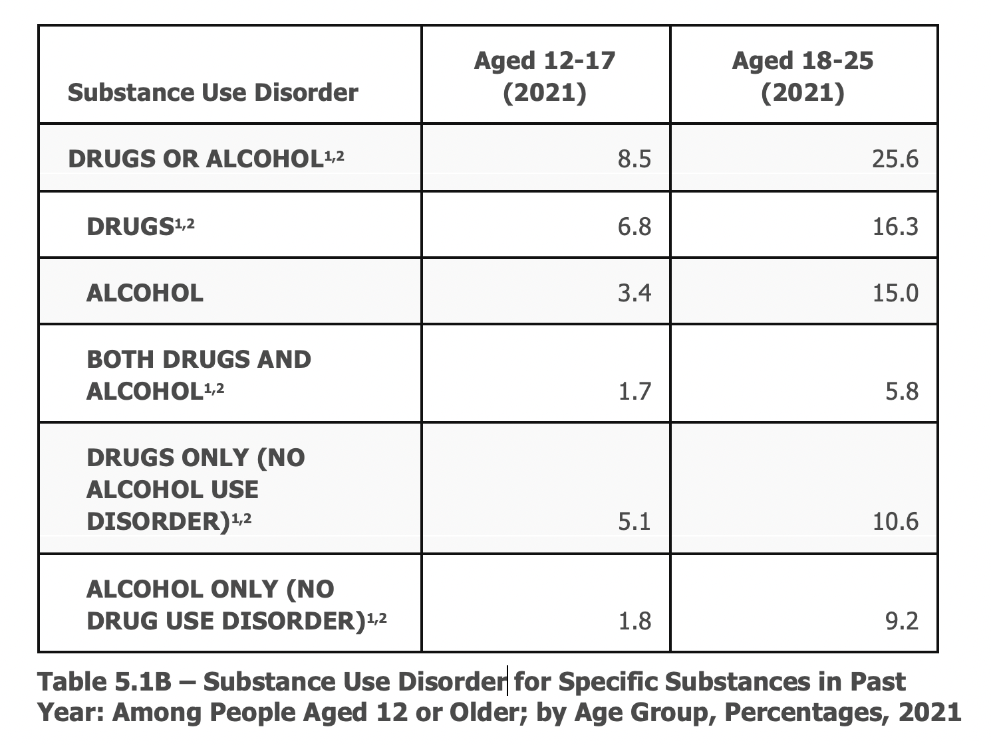
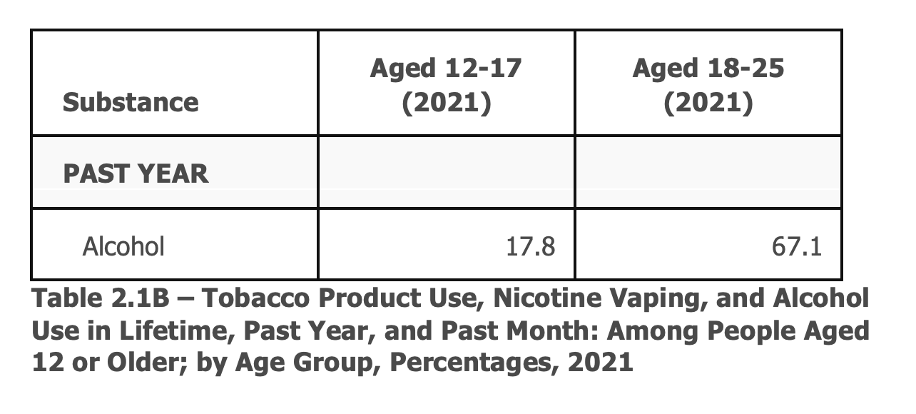
USE $≠$ SUBSTANCE USE DISORDER
PAST YEAR ILLICIT DRUG USE
SUBSTANCE USE DISORDER (DSM-5 CRITERIA)
PAST YEAR ALCOHOL USE
Tables and Data Adapted from the 2021 National Survey of Drug Use and Health (SAMHSA).
Notes:
Jeffrey showed a slide the other day with a triangle and the tip was people who are using alcohol/drugs with more severe use, this is another way to think about it
For youth this, is important because any exposure to alcohol or drugs is potentially harmful, so talking about treatment is really important (and we will talk about it), discussions about minimizing the harms of drug or alcohol use with youth is also really important

Slide 9
Overdose a leading cause of pediatric mortality
JE Goldstick et al. N Engl J Med 2022;386:1955-1956.

Slide 10
Overdose deaths significantly increasing among adolescents
Friedman J et al. (2022). .JAMA.

Slide 11
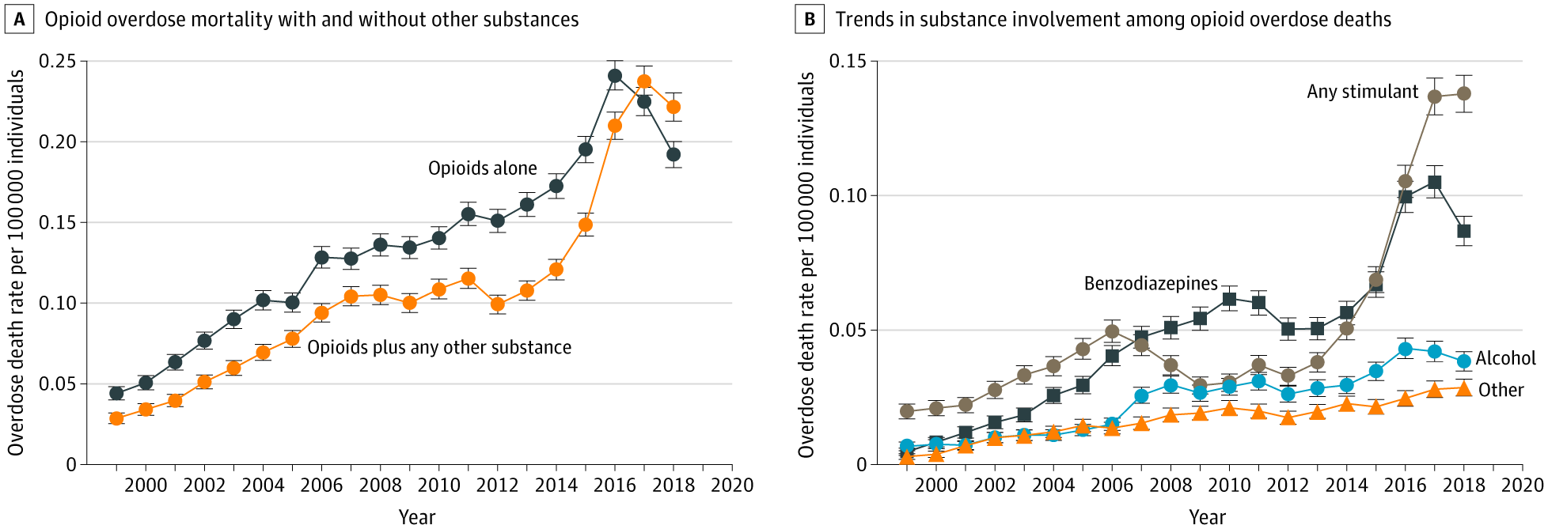
Stimulant-involved deaths increasing among youth
Lim et al., 2020 JAMA Pediatr.

Slide 12
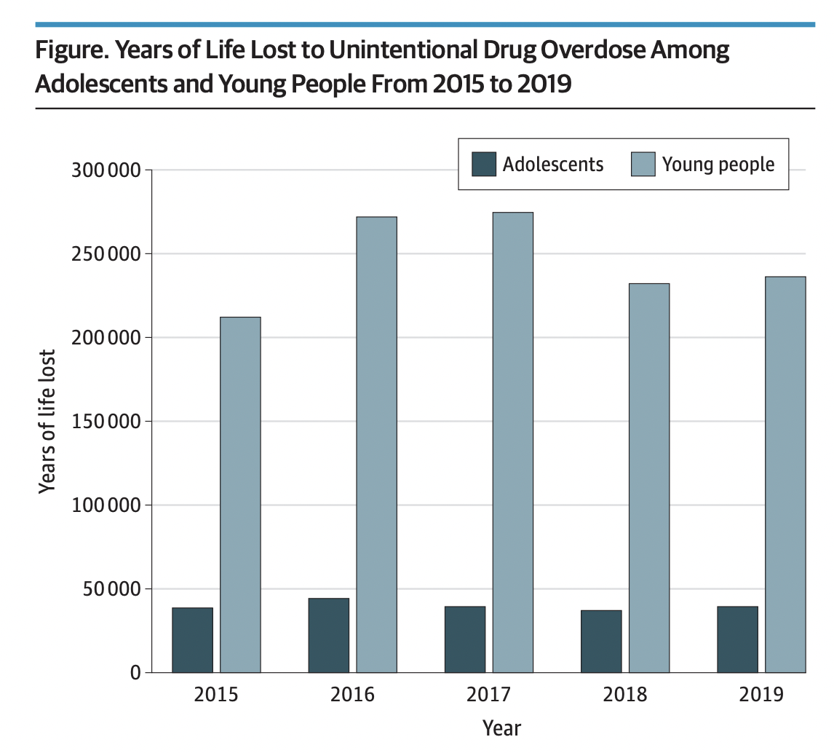
Years of Life Lost to the Overdose Crisis
~200,000 YLL among adolescents (10 - 19 years of age)
~1.25 million YLL among young people (10 - 24 years of age)
Male adolescents and young people accounted for more YLL than females
Hall et al. (2022). JAMA Peds.

Slide 13
CDC MMWR December 2022
Tanz, et al. (2022) MMWR: Centers for Disease Control and Prevention.
Notes:
https://www.cdc.gov/mmwr/volumes/71/wr/mm7150a2.htm

Slide 14
Identify 2 opportunities and 2 barriers to provide evidence-based substance care for adolescents and young adults
2

Slide 15
Case
A teen is referred for ongoing opioid use disorder treatment with buprenorphine
History of more than 10 overdoses
Has never been offered medication treatment before this year

Slide 16
Youth responsive care
Engagement is key
Medications are effective
Language and stigma matter
Families can be allies
Harm reduction principles still apply!

Slide 17
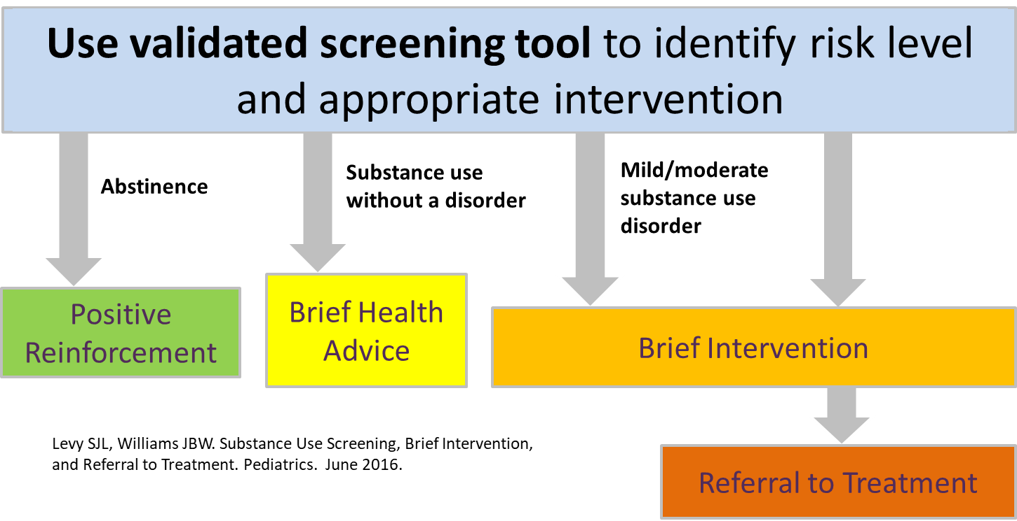
Screening, Brief Intervention and Referral to Treatment (SBIRT)

Slide 18
Validated Screening Tools
BSTAD: Brief Screener for Tobacco, Alcohol, and other Drugs (Kelly S, 2014)
S2BI: Screening to Brief Intervention (Levy, 2014)

Slide 19
Medications for Opioid Use Disorder
Medication | Medication & Dose | Access/Use Notes
Buprenorphine | Daily pill or film Monthly injectable Subdermal implant +/- Naltrexone | NO X WAIVER REQUIREMENT NOW FDA approved for AYA $≥$ 16 years old (sublocade efficacy not proven for <17 years old) Safe in pregnancy with or without Naloxone
Methadone | Daily medication Pill, liquid, wafer form | <18 years old must have 2 prior failed treatment attempts Very limited access for youth Requires DAILY visits to clinic Safe in pregnancy; may increase or split dose
Naltrexone | Daily pill Monthly injectable | FDA-approved for AYA $≥$ 18 years old
Slide courtesy of Jessica Calihan, MD MS
Notes:
Can make a slide for each use disorder if that is easier

Slide 20
What’s the evidence for medication treatment for opioid use disorder?
Improved retention in care (clinical trials and observational data)
Decreased opioid positive urine drug tests (clinical trials)
Improved mortality (observational data)
BUT youth have poorer retention!
Woody et al., (2008) JAMA
Marsch et al. (2016) Addiction
Fishman et al. (2010) Addiction
Matson et al., (2014) J Addict Med

Slide 21
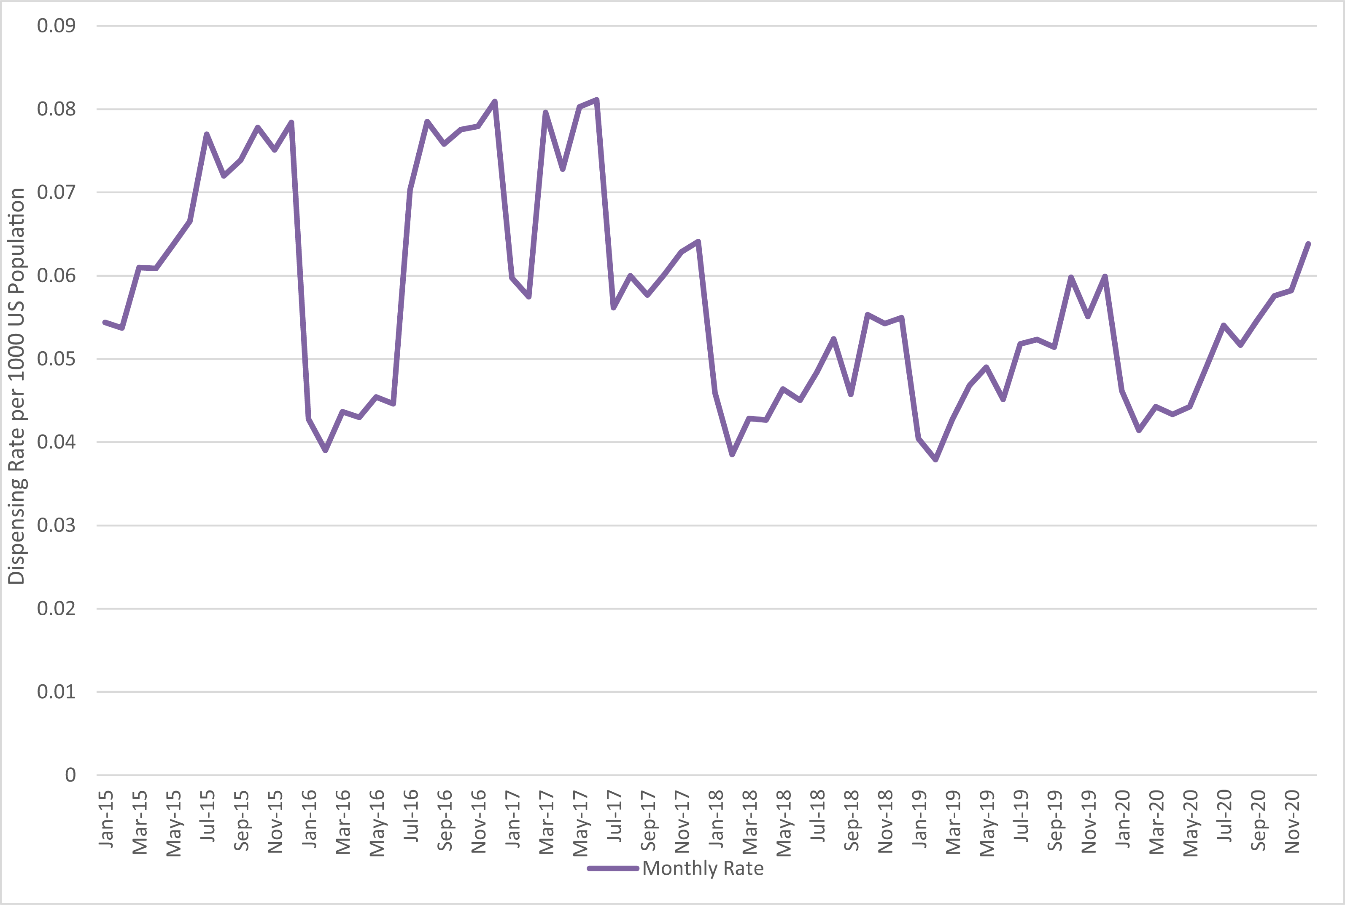
Treatment Access to MOUD
“Efforts to expand access to MOUD for adolescents could include improving training in opioid use disorder treatment of pediatricians…”
Buprenorphine prescription dispensing rates to youth aged 0 to 19 years, 2015 to 2020. Buprenorphine dispensing rates to youth varied over the calendar year. Average dispensing rates to youth declined from 2015 to 2020. Data source: IQVIA NPA data (2015–2020).
Terranella, Guy, & Mikosz (2023)
Notes:
https://publications.aap.org/pediatrics/article-abstract/151/2/e2022058755/190503/Buprenorphine-Dispensing-Among-Youth-Aged-19-Years?autologincheck=redirected
https://jamanetwork.com/journals/jamapediatrics/fullarticle/2751327

Slide 22
Racial Inequities of Medication Receipt
Black youth 42% less likely to receive medication
Hispanic youth 17% less likely to receive medication
Hadland SE, et al. (2017) JAMA Pediatr
Notes:
Scott- here I think that you can add that there are data highlighting that black youth are less likely to use MJ than white youth but more likely to be justice involved/arrested for their use: https://www.ncbi.nlm.nih.gov/pmc/articles/PMC3477985/
Long history of racism built into addressing SU that likely contributes to mistrust of health care and treatment

Slide 23
Medications for Alcohol Use Disorder
Medication | Dose | Use Notes
Naltrexone | Pill – 50 mg daily Injection – 380 mg IM monthly | Decreases reward effects of alcohol Associated with decreased alcohol use, heavy drinking, & cravings Contraindications: If on opioid therapies, liver dysfunction Safe in pregnancy
Acamprosate | Pill – 666 mg 3x daily | Effects glutamatergic neurotransmission Associated with decreased risk relapse Contraindications: renal dysfunction Category C – possibly teratogenic
Disulfiram | Pill – 250 mg daily | Causes disulfiram-ethanol reaction by blocking alcohol metabolism Sustain abstinence Closely monitored settings Category C – reaction potentially risky for woman & fetus
Slide courtesy of Jessica Calihan, MD MS
Kranzler & Soyka. (2018). JAMA.
Notes:
Can make a slide for each use disorder if that is easier

Slide 24
Access to AUD treatment
14,194 youth with AUD with public insurance
7 in 10 youth received AUD treatment, but only 2 in 100 received medications
Younger age was associated with less treatment receipt and median time in treatment was longer with medication compared to behavioral treatment alone
Earlywine J et al, J Adol Health, in press

Slide 25
Medications for Cannabis Use Disorder
Medication | Medication & Dose | Use Notes
N-acetylcysteine “NAC”* | 600mg QD x3d > 600mg BID x3d > 1200mg BID | Available as an OTC supplement Decreased use in adolescents, no evidence of efficacy in adults Not FDA approved for CUD
Gabapentin* | 1200mg/day | Decreased use, cravings, withdrawal symptoms in adults No evidence for adolescents
Topiramate* | 25mg/day increased by 25mg weekly to 200mg/day | Reduced cannabis use in adolescents High rate of adverse effects → treatment discontinuation Side effects: neurocognitive slowing, memory difficulties, weight loss, & poor appetite
Gray et al. (2012). American Journal of Psychiatry.
Gray et al. (2017). Drug Alcohol Depend.
Mason et al. (2012). Neuropsychopharmacology.
Miranda et al. (2017). AddictionBiology.
Bahji et al. (2021). Intern J of Drug Policy.
Medications with * indicate off-label use but present evidence to be clinically effective
Slide courtesy of Jessica Calihan, MD MS

Slide 26
Medications for Nicotine Use Disorder
Medication | Medication & Dose | Use Notes
Nicotine Replacement (NRT) | Patch: 7mg, 14mg, 21mg daily Lozenge/Gum: 2-4mg as needed | No evidence for patients that vape Side effects: insomnia, nightmares Improved abstinence during treatment
Varenicline | 0.5mg daily x3d > 0.5mg 2x/day x3d > 1mg 2x/day | Partial agonist at ACh nicotinic receptor Contraindicated: patients <17y (relative), seizures Side effects: nausea, insomnia, odd dreams, headaches
Buproprion | 150mg daily x3d > 150mg 2x/day | Antidepressant; unclear mechanism for smoking cessation Greater abstinence days & abstinence duration Good option for patients with depression Contraindicated: seizures, eating disorder
Slide courtesy of Jessica Calihan, MD MS
Dawson et al. (2016). J Am Acad Child Adolesc Psychiatry.
Notes:
Can make a slide for each use disorder if that is easier

Slide 27
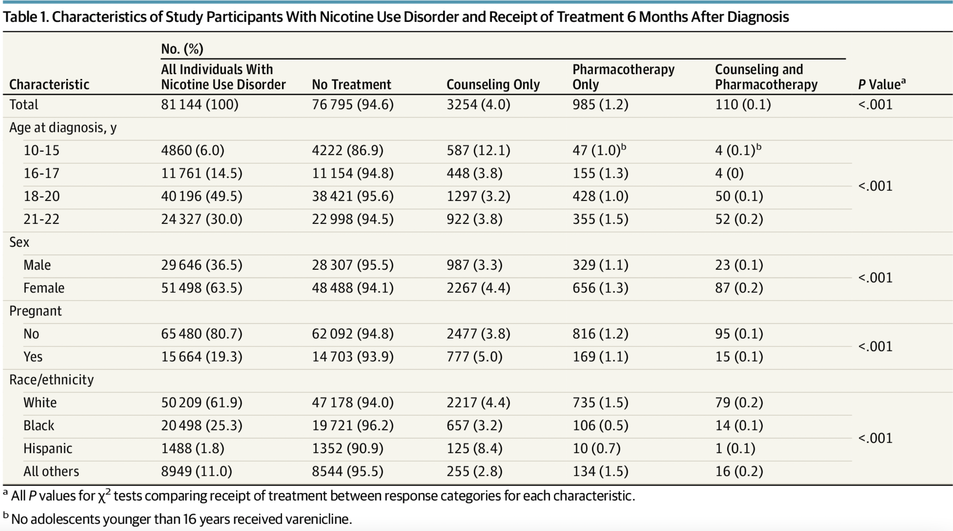
Access to NUD treatment
Adolescent Medicaid Enrollees:
“Such low treatment rates during a developmental period when adolescents and young adults are at increased risk of developing lifelong nicotine addiction likely represent a missed opportunity to address NUDs in this population.”
Chadi et al. (2019). JAMA Pediatr.

Slide 28
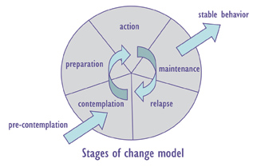
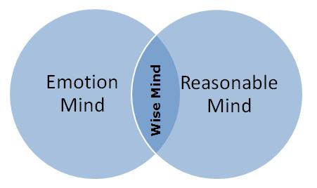
Treatment for SUDs– Behavioral Approaches
1. Motivational Interviewing
3. Cognitive Behavioral Therapy
5. Adolescent Community Reinforcement Approach
Shift Reinforcers:
Social
Recreational
Vocational
2. Dialectical Behavioral Therapy
4. Contingency Management
6. Family-Based Therapies
Family communication skills;
Parent-teen relationships
Behavior
Consequence
Conflict and negative interactions

Slide 29
Harm Reduction and Youth
“Underlying all of these strategies is the provision of compassionate care that validates adolescents’ experiences and motivations, is non-judgmental, assures them that they have value, and gives gratitude to them for trusting the HCP.”
Naloxone!
HIV prevention and PrEP
Clean syringes and supplies for injecting drugs, fentanyl test strips
Abstinence may not be the goal for many AYA
Safer sex supplies
Protective behavioral trategies (plan to get home safe from places where substances used i.e. having a designated driver)
Winer, Yule, Hadland, & Bagley (2022). Annals of Medicine.

Slide 30
Play a role in promoting risk reduction and contribute to reductions in substance use through improved family functioning
Have a positive impact on engagement in care (even if the youth is not “ready”)
Equip family members with the evidence-based necessary on treatment approaches and dispel myths about SUD generally
Family Involvement in the Care of Youth with an SUD

Slide 31
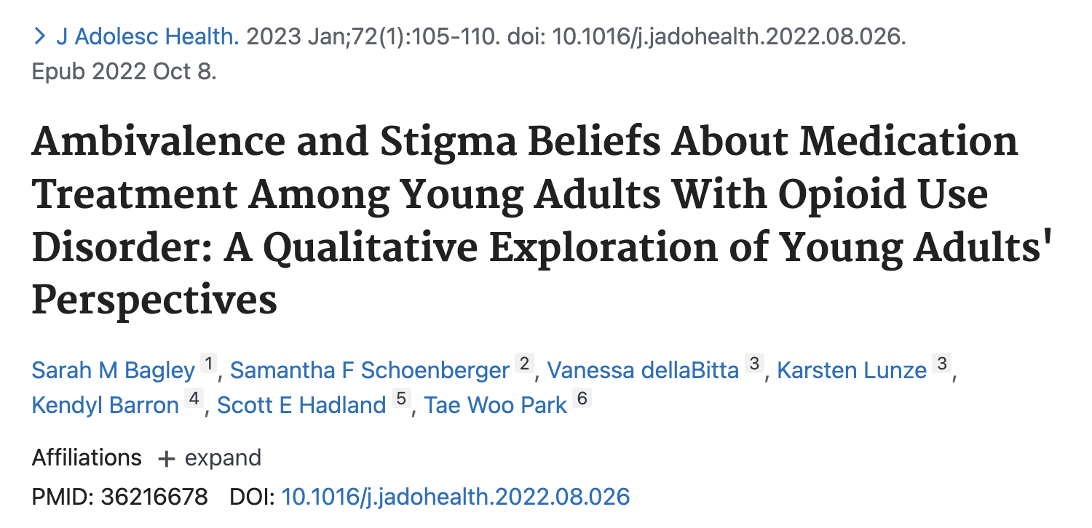
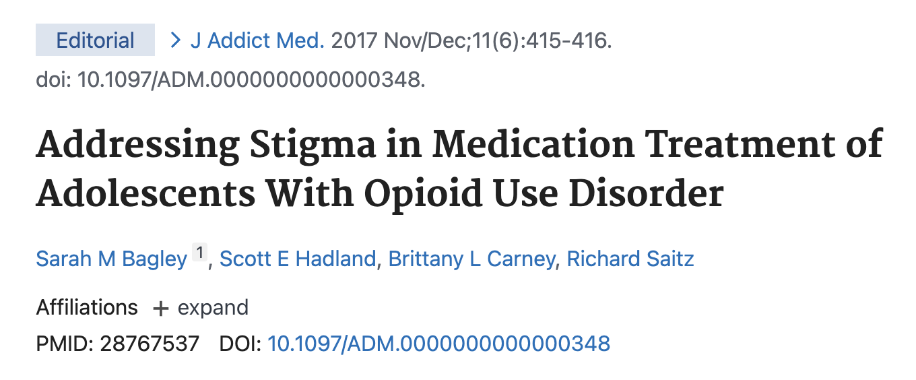
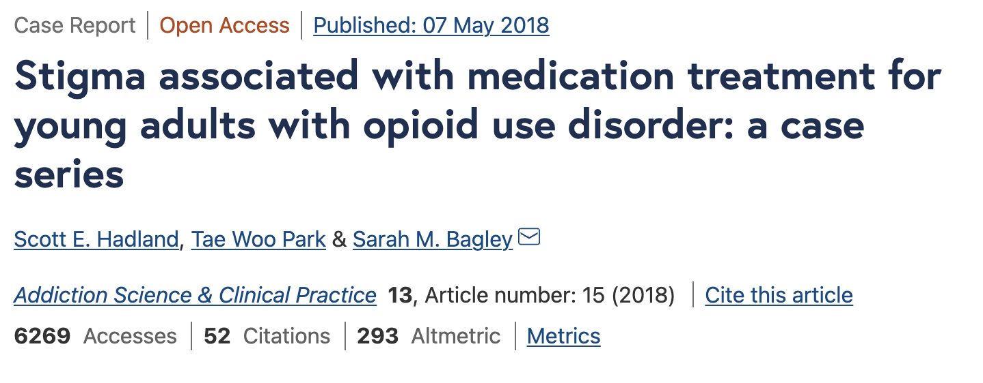
Treatment & Stigma

Slide 32
Youth Mental Health Crisis
From 2009 – 2019
High school students reporting:
Persistent feelings of sadness or hopelessness increased by 40%
Seriously considering attempting suicide increased by 36%
Creating a plan for suicide increased by 44%
Between 2011 and 2015
Youth psychiatric visits to ED for depression, anxiety, and behavioral challenges increased by 28%
**Youth mental health crisis exacerbated by COVID-19 pandemic
Protecting Youth Mental Health: The U.S. Surgeon General’s Advisory (Dec. 2021)

Slide 33
3
Discuss the different considerations of women who use drugs

Slide 34
Defining gender
Gender refers to the socially constructed roles, behaviours, expressions and identities of girls, women, boys, men, and gender diverse people. It influences how people perceive themselves and each other, how they act and interact, and the distribution of power and resources in society. Gender identity is not confined to a binary (girl/woman, boy/man) nor is it static; it exists along a continuum and can change over time.
https://cihr-irsc.gc.ca/e/48642.html

Slide 35
Context: Why we do we care about gender in addiction?
Gender differences exist in the:
Origins
Development
Course and treatment of SUD
Historically men used alcohol/drugs more > women
Addiction services, research, and polices have been either tailored to men or designed using a gender-neutral approach
Gender-neutral approaches tend to benefit men
They fail to consider the specific needs of women or gender diverse people
Meyer et al. (2019). Drug Alcohol Depend.
Keyes et al. (2008). Drug Alcohol Depend.
Slide adapted from Miriam Harris

Slide 36
Impact on Substance Use Disorder
Women who use start using drugs/alcohol have higher rates of psychiatric comorbidities & trauma
Women develop substance use disorders and health-related problems in less time (telescoping)
Women develop more severe SUDs
Women experience higher rates of harms from drug use
Injection related infections
HIV
HCV
McHugh et al. Clin Psychol Rev.
Pinkham et al. (2008). Reprod Health Matters.
El-Basse et al. (2015). J Acquir Immune Defic Syndr.
Slide courtesy of Miriam Harris

Slide 37
Inequities in Receipt of Treatment
Among 5247 women with an opioid use disorder in Massachusetts, Black non-Hispanic and Hispanic women had lower odds of receiving medication treatment
Black non-Hispanic and Hispanic women were also less likely to receive buprenorphine
Although addiction touches everyone, our responses do not
Schiff et al. (2020). JAMA Open Network.

Slide 38
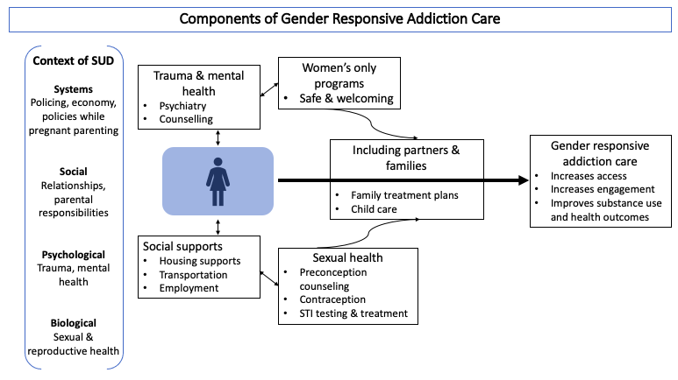
Slide courtesy of Miriam Harris
Notes:
Trauma and mental health: As discussed earlier, co-occurring mental health disorders and trauma is high among women with substance use disorders. Programs should offer trauma informed integrated treatment for co-occurring mental health disorders, including considering single-gender group therapy, which some women report offers a safer environment.⁶⁶
Sexual health: If available, programs should offer comprehensive reproductive and sexual health care. In addition to routine screening for sexually transmitted infections, age-appropriate cervical cancer screening, assessing pregnancy timing goals, and providing appropriate counseling for contraception or preconception should be offered. Addressing the sexual and reproductive health needs of women increases engagement with addiction treatment.⁹³
Social needs: Different clinical programs will have varying capacity to respond to social needs affecting women. However, having the capacity to refer to clinical and community supports such as housing services, life skills programs, and recovery management are necessary. Where possible providing child care, transportation and cell phones for those who need them can concretely increase access to care for women.⁹⁴
Women’s only programs: Women’s only treatment offers a safe environment that women may be more comfortable accessing. Programs unable to offer women’s only spaces all of the time could alternatively offer select women’s only groups, days, or times for treatment or harm reduction services.⁹⁵
Including partners and families: Data demonstrate the importance of including families and partners in treatment.⁹⁶ Families can provide critical support for women outside of the clinical setting at home and in the community. When possible, this includes providing childcare services for parenting women.

Slide 39
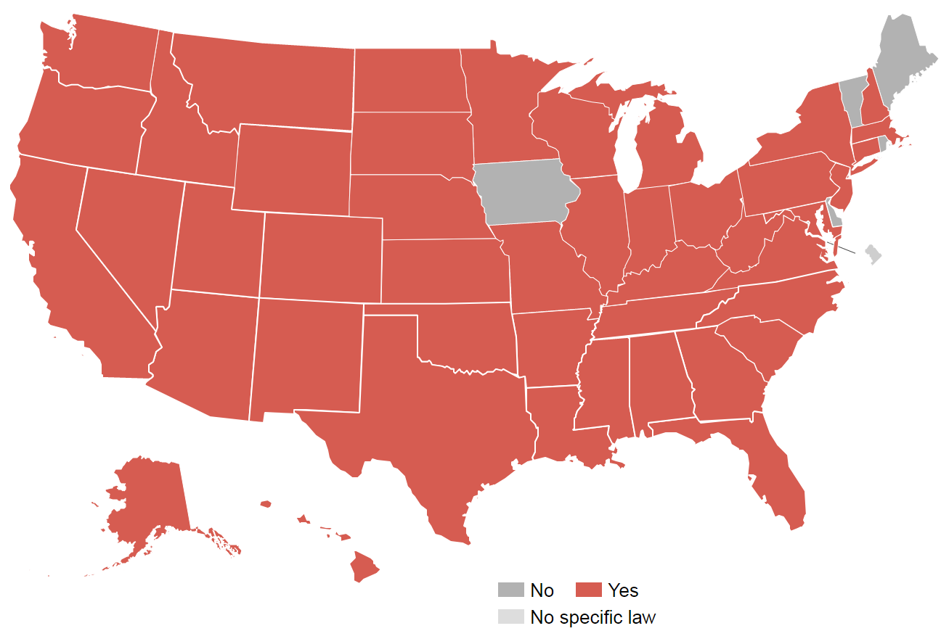
Criminalization of Pregnant People and Parents who Use Drugs
States where women have been prosecuted for drug use during pregnancy
Projects.propublica.org

Slide 40
Overdose Risk Dependent on Treatment Status
Schiff et al. (2018) Obstet Gynecol.

Slide 41
THANK YOU

Slide 42
Substance use disorder early in life matters
Notes:
Add summary of what Dan said on Monday

Slide 43
Low Timely Receipt of Medication among Youth
Only 1 in 4 youths received treatment within 3 months of OUD diagnosis
Hadland et al. (2018) JAMA Pediatr.
https://www.eurekalert.org/pub_releases/2018-09/bmc-bsa091018.php

Slide 44
Defining Gender
Figure taken from NIH: Office of Research on Women’s Health

Slide 45
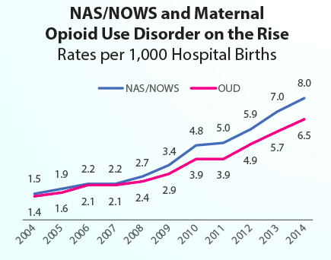
Epidemiology of OUD
Globally, the number opioid-related deaths in women increased 92% in the past 10 years, compared to a 63% increase in men
>Five-fold increase in maternal opioid use and neonatal opioid withdrawal syndrome from 2004-2014
UN. World Drug Report 2020. 2021
Honein et al. (2019). Pediatrics.
Slide courtesy of Miriam Harris

Slide 46
Screening for Drug Use during Pregnancy
American College of Obstetricians and Gynecologist recommends universal screening at first prenatal visit using validated tool (4Ps, NIDA quick screen, and CRAFFT)
Urine drug testing can be done if there is a positive test but MUST be done with the patient’s permission

Slide 47
Access to Timely Addiction Treatment is Lacking
<1/3 received timely addiction treatment after overdose
Only 1 in 54 received MOUD
Youths who experienced a heroin overdose were significantly less likely than those who overdosed on other opioids to receive any treatment
Alinsky et al. (2020) JAMA Pediatrics

Slide 48
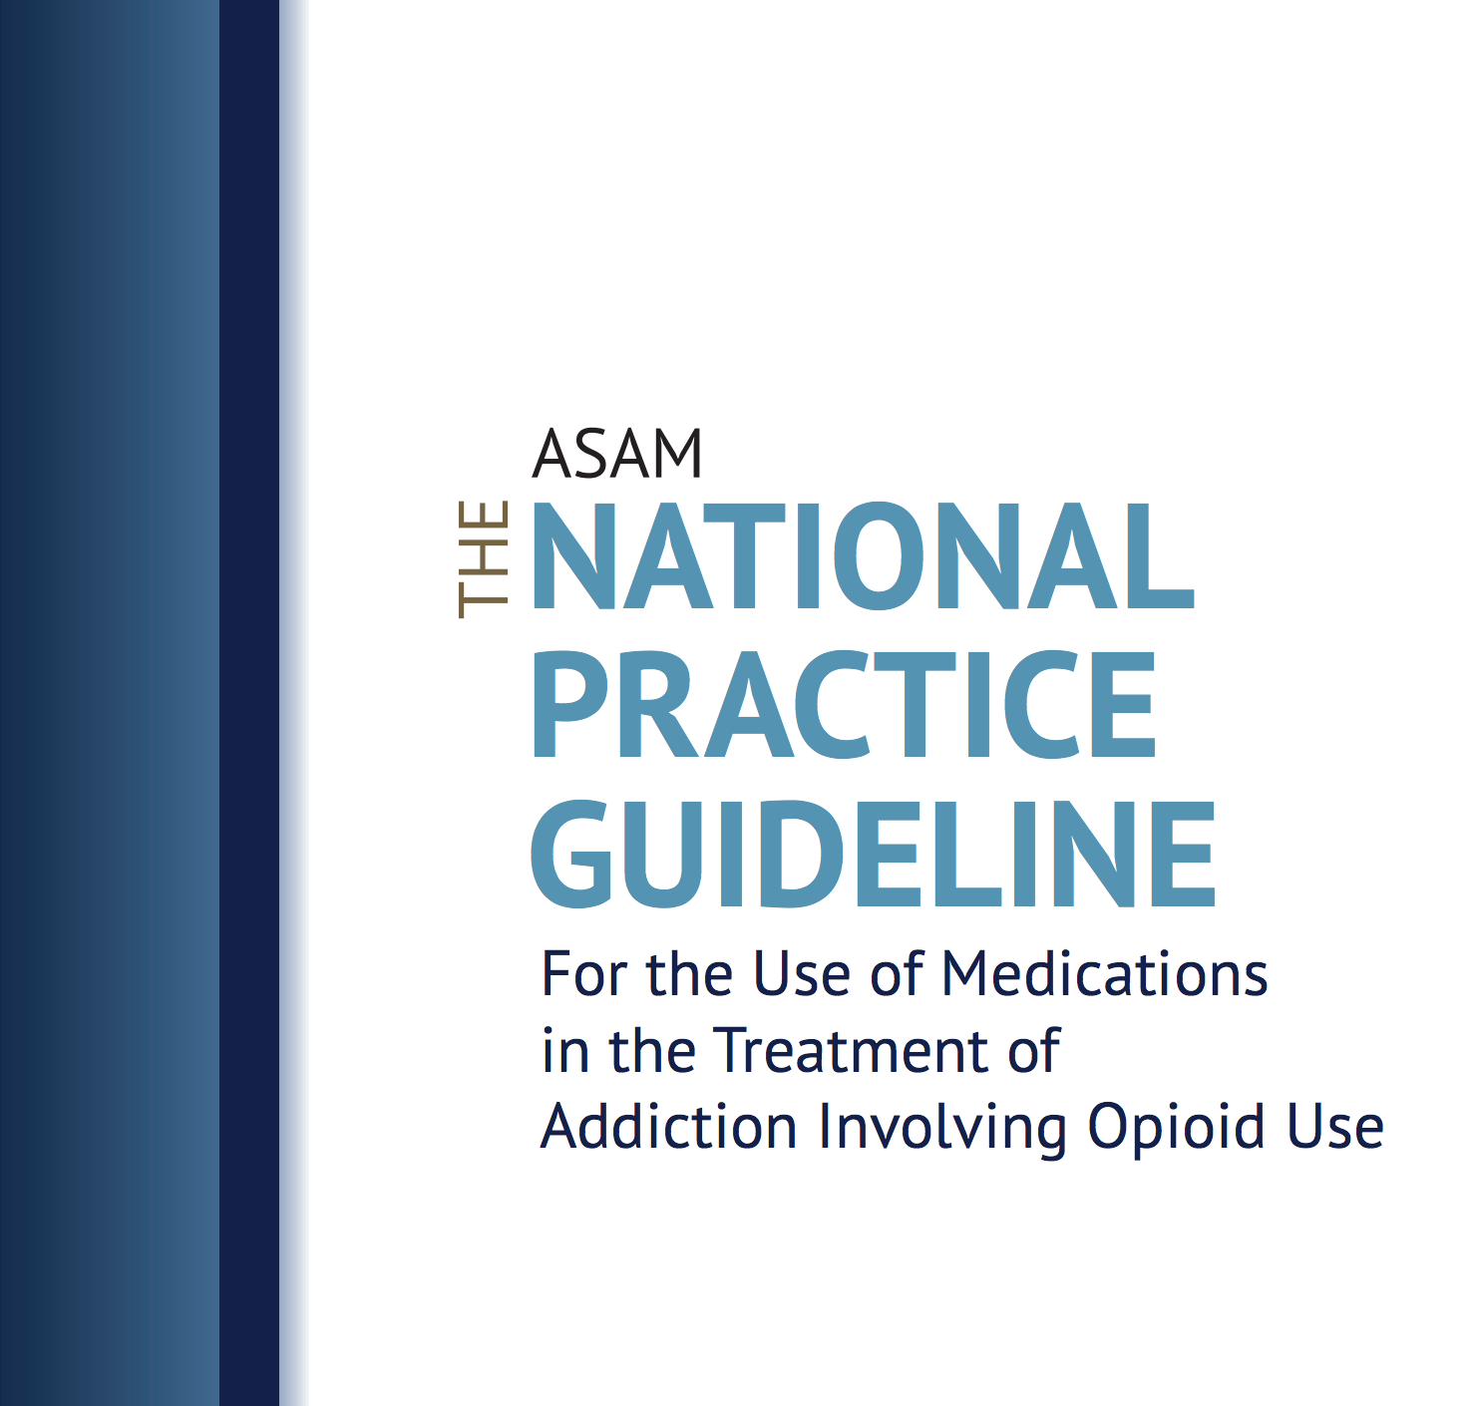
When is Pharmacotherapy Indicated?
American Academy of Pediatrics (2016):
Encourage pediatricians to consider offering medication treatment or discuss referrals to other providers for this service
American Society of Addition Medicine (2015):
Clinicians should consider treating adolescents using the full range of treatment options, including pharmacotherapy
Committee on Substance Use and Prevention Medication-assisted treatment of adolescents with opioid use disorders. (2016) Pediatrics.
Kampman K & Jarvis M. (2015) Journal of Addiction Medicine.

Slide 49
Impact of Family Beliefs
“The other day my mom was like, ‘Are you getting off of it yet? How long till you get off it’ and I'm like, ‘Mom, we just talked about this. If I get off it too quick, I'm just going to relapse. Let me do it in my own time.’ She's like, ‘It's been long enough.’”
Maria (female, 29)
Bagley SM et al, J Addict Med, 2022

Slide 50
Breastfeeding
Breastfeeding rates among women with OUD vary widely
Breastfeeding is an important aspect of the postpartum period
Specific advantages of breastfeeding for substance-exposed mother-infant dyads
Reduces severity of neonatal-opioid withdrawal syndrome
Decreases need for pharmacologic treatment
Welle-Strand, et al. (2013).Acta Paediatr Oslo Nor.
Slide courtesy of Miriam Harris

Slide 51
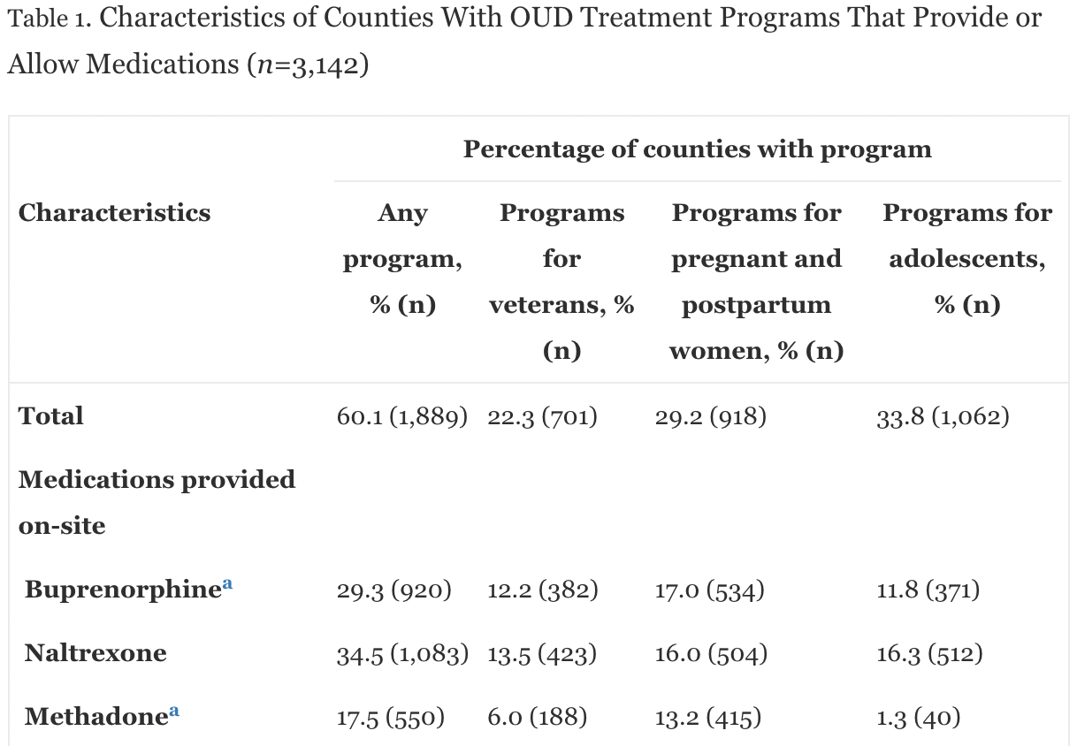
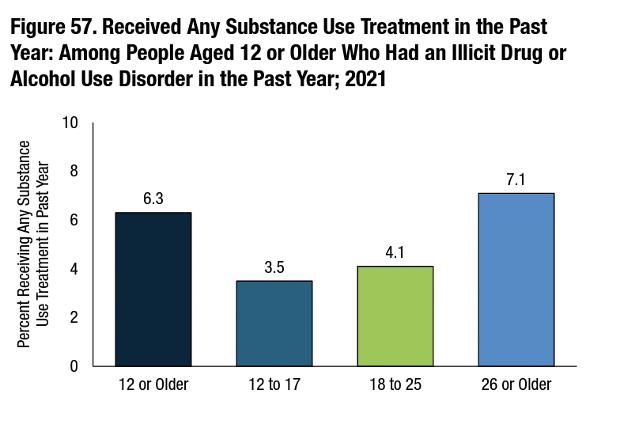
Treatment Access (Behavioral & Medication) = Limited
“Less than one-in-three substance abuse treatment providers offer services that may be appropriate for this age group [adolescents].”
Mericle et al. (2015). J Child Adolescent Adolesc Subst Abuse.
Hadland et al. (2020). American Journal of Preventive Medicine.
SAMHSA (2021). Results from the 2021 National Survey on Drug Use and Health.

Slide 52
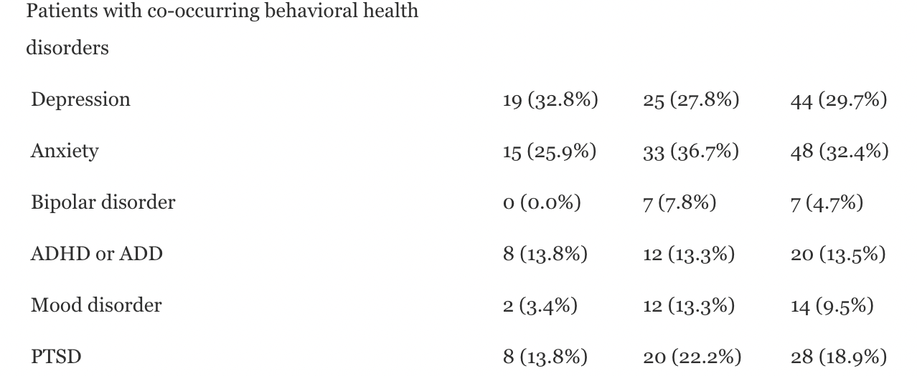
Addressing Co-Occurring Mental Health Disorders
“Given the high prevalence of co-occurring disorders among this population, programs that address youth substance use should also have the capacity to offer evidence-based treatment for other mental health disorders.”
Bagley et al. (2021). JSAT.
Notes:
https://pubmed.ncbi.nlm.nih.gov/34080547/
https://pubmed.ncbi.nlm.nih.gov/35900132

Slide 53
Confidentiality and Legal Considerations
Confidentiality
Should be discussed with every young person at the beginning of every visit
Creating a space where youth will feel comfortable sharing sensitive information and thus increases adolescent participation and connection with healthcare providers
Encouraging youth to be honest/truthful
It is important to clarify the limits of confidentiality and reasons to breach confidentiality (i.e. to parents):
Acute safety concerns in relation to self-harm/suicidality, harm to others, sexual abuse
Winer, Yule, Hadland, & Bagley (2022). Annals of Medicine.

