Slide 1

Stimulants: Cocaine and Methamphetamine
CRIT/FIT/JFIT/AFIT program – April 2022
Alex Walley, MD, MSc

Slide 2
Learning Objectives
At the end of this session, participants will be able to:
Understand how and why people use stimulants
Know the characteristics of stimulant intoxication and withdrawal syndromes
Understand the consequences of these drugs
Know the current options for treatment of stimulant dependence

Slide 3
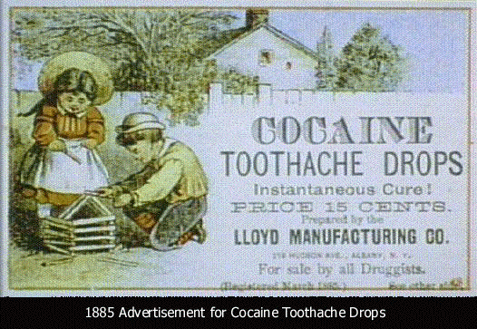
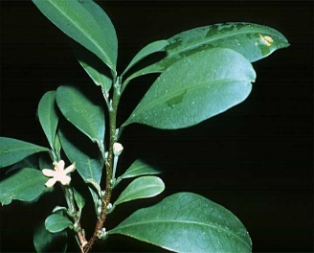
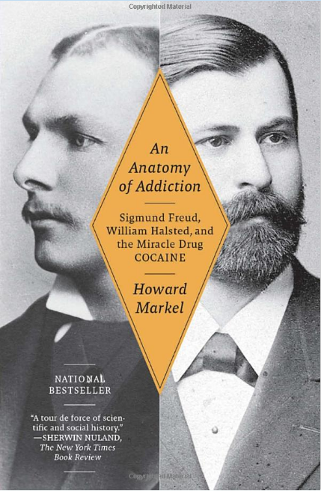
History: Cocaine
From erythroxylum coca leaves in Andes
Leaves chewed for thousands of years as stimulant
1884 Freud published, Uber Coca, describing cocaine’s effects on Freud and its potential to treat opiate addiction
1885 Halsted published study about anesthetic uses
1886 Halsted raided ship medicine cabinet for fix
Used in medicines and beverages until early 1900s
Street preparations 10-50% cocaine
  Hydrochloride powder is snorted or injected
  Alkaline rocks (aka crack) are smoked
  Crack, Rock, Base

Slide 4
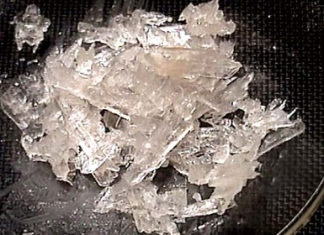
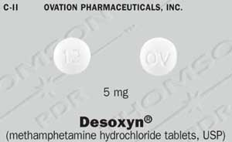
History: Methamphetamine
1893 methamphetamine first synthesized in
Japan as decongestant
Used by German, English, American, and Japanese military in WWII for performance enhancement.
First epidemic occurred in Japan when the military dumped large quantities into the civilian market
Popular among truckers and west coast bikers in 1970s
DESOXYN to treat ADHD and obesity
Speed, Crystal, Crank, Ice, Meth, Tina
Lineberry 2006

Slide 5
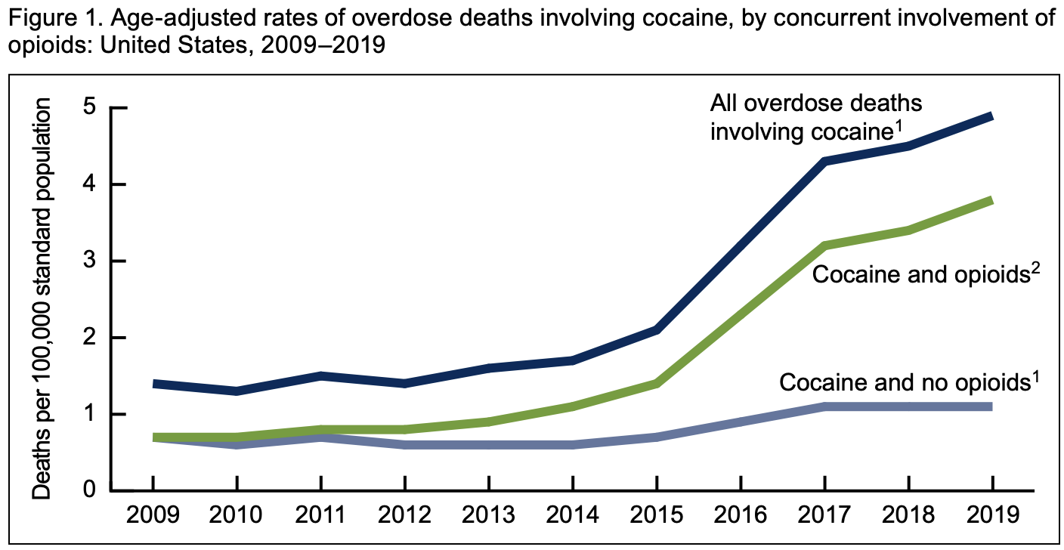
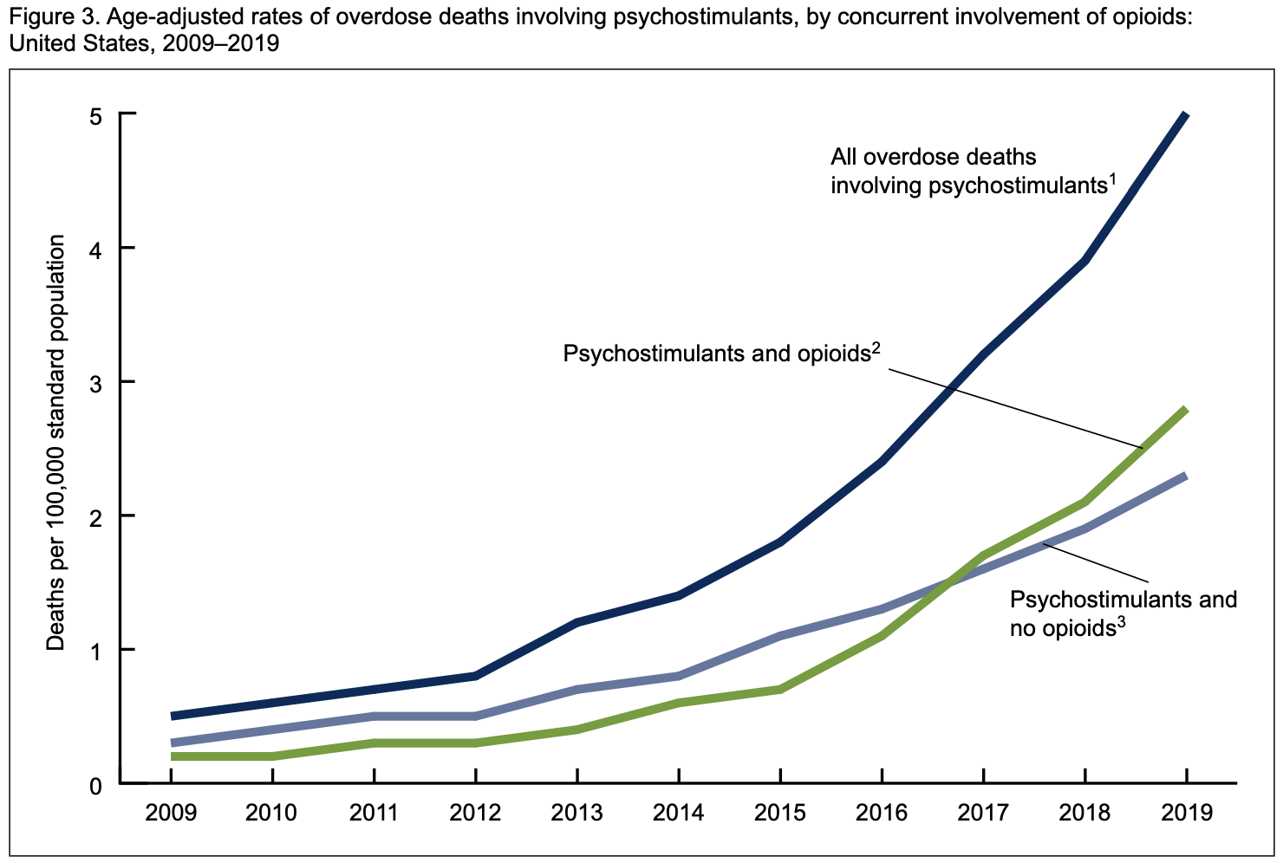
Stimulant-involved overdose deaths surging with opioids
https://www.cdc.gov/nchs/data/databriefs/db406-H.pdf

Slide 6
Stimulant-involved overdose deaths surging with opioids
https://www.cdc.gov/nchs/data/databriefs/db406-H.pdf
https://www.cdc.gov/nchs/data/databriefs/db406-H.pdf

Slide 7
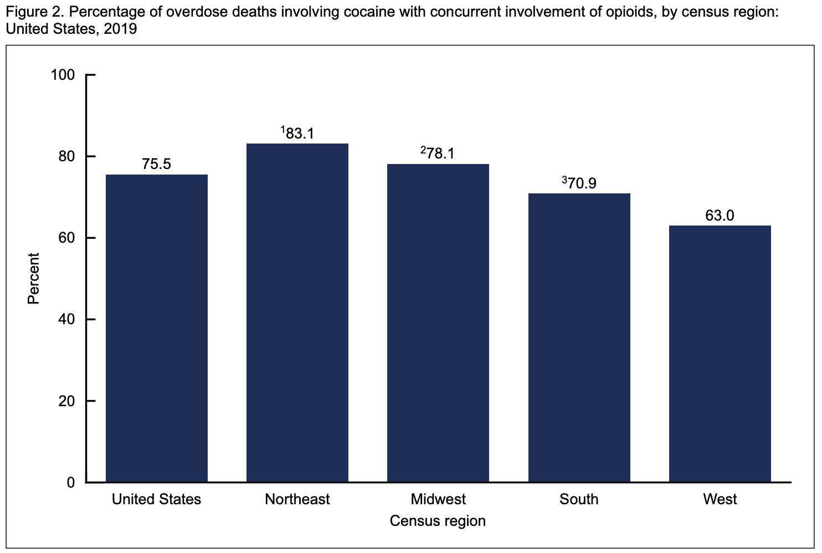
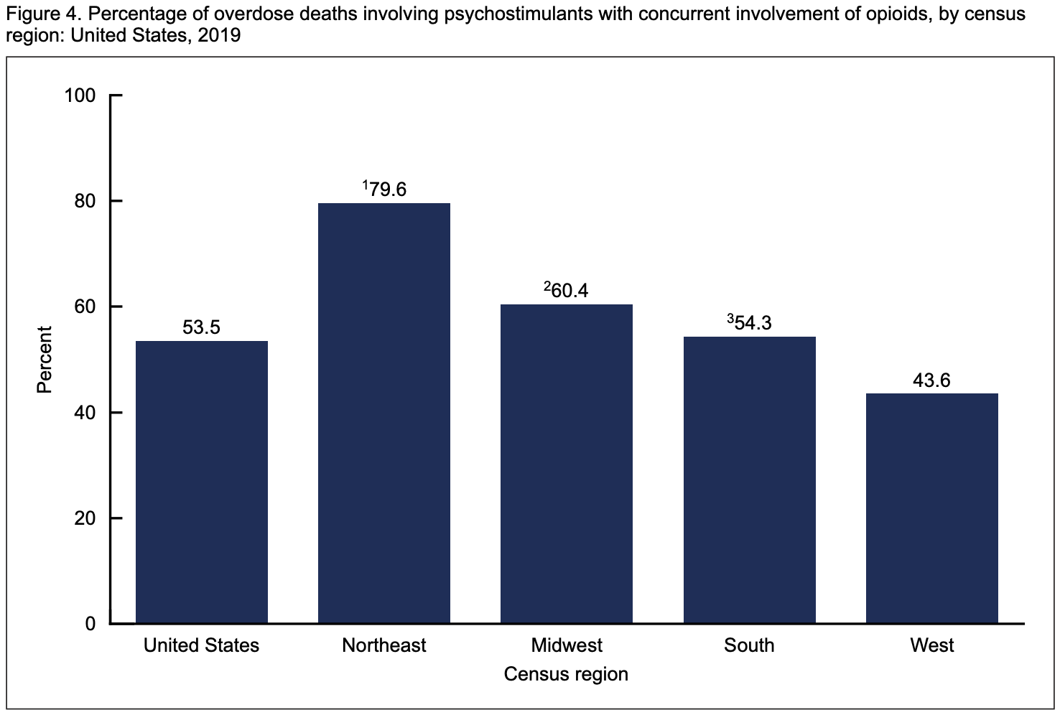
Stimulant-involved overdose deaths surging with opioids
% cocaine-involved deaths with opioids present, 2019
% of stimulant-involved deaths with opioids present, 2019
https://www.cdc.gov/nchs/data/databriefs/db406-H.pdf

Slide 8
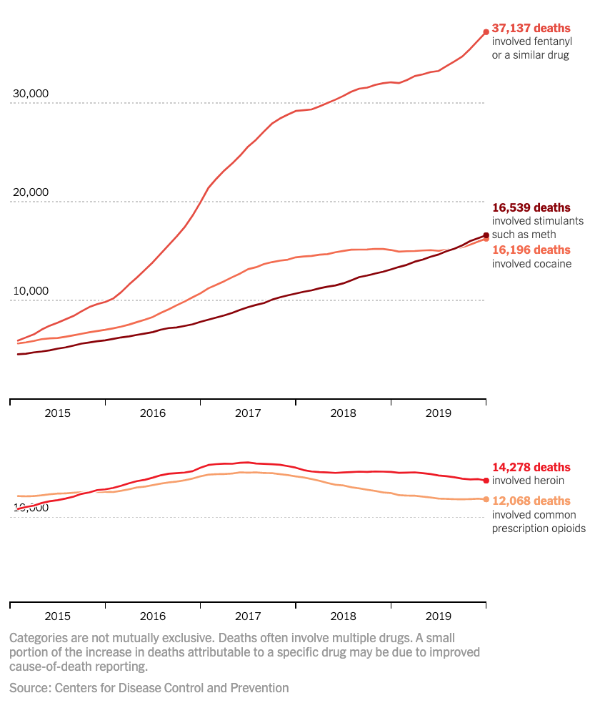
Stimulant-involved overdose deaths surging with opioids
Katz, J. The First Count of Fentanyl Deaths in 2016: Up 540% in Three Years. NYT – The UpShot 9/2/2017.

Slide 9
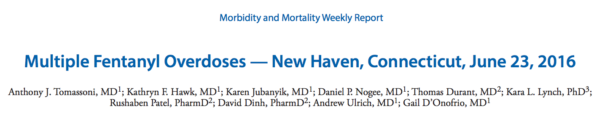

Over 8 hours at the ED of Yale Hospital, white powder advertised as cocaine resulted in 12 patients for signs of opioid overdose, presumed from snorting
9 admitted, 4 to ICU, 3 intubated, 1 on naloxone gtt, 3 died
High doses of naloxone required: 4mg and higher
Drug sample tested had 6.6% fentanyl by weight and trace amounts of cocaine + inert adulterant

Slide 10
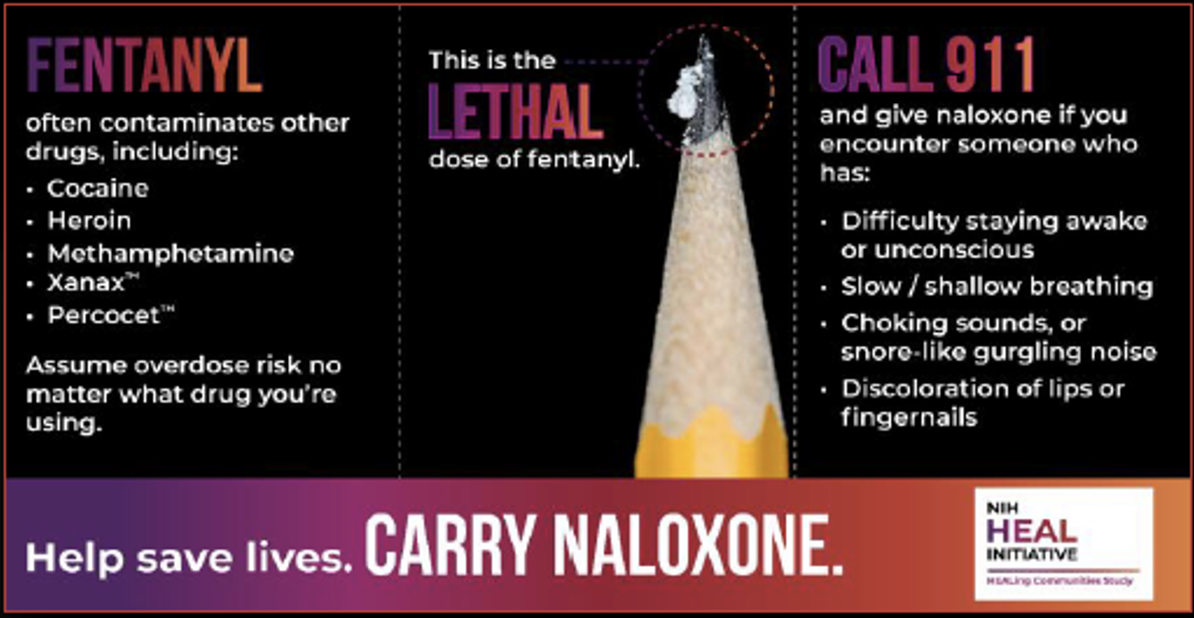
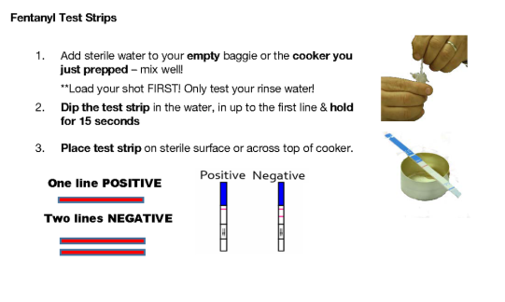
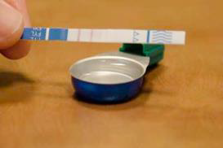
Response to fentanyl-contamination of cocaine, methamphetamine, counterfeit pills
Public education campaigns
Tailor outreach for cocaine, methamphetamine, counterfeit pills
  Naloxone
  Fentanyl test strips
  Safer smoking supplies to engage
Coordinate surveillance and response for outbreaks
Develop and promote accessible, evidence-based treatment for people who use other substances

Slide 11
2011 Emergency Department visits per 100,000 people
Drug Abuse Warning Network 2011 Report: www.samhsa.gov/data/sites/default/files/DAWN127/DAWN127/sr127-DAWN-highlights.htm
Notes:
ED perspective

Slide 12
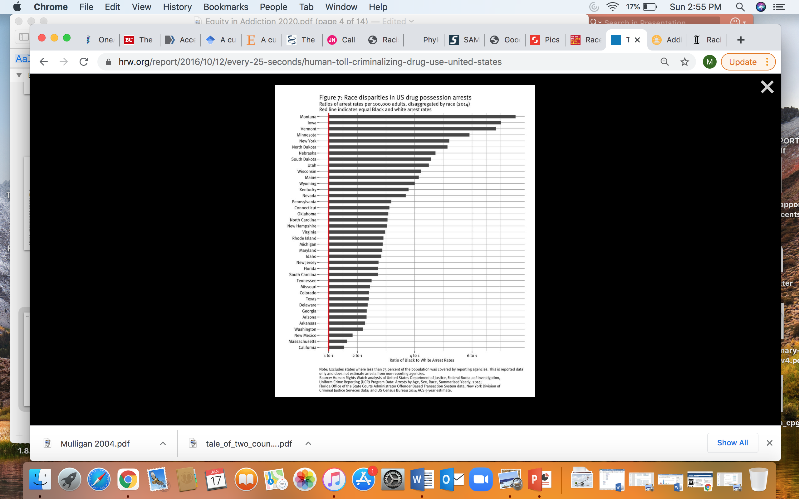
Substance use rates are similar across racial and ethnic groups,
yet people of color are much more likely to be arrested for drug possession

Slide 13
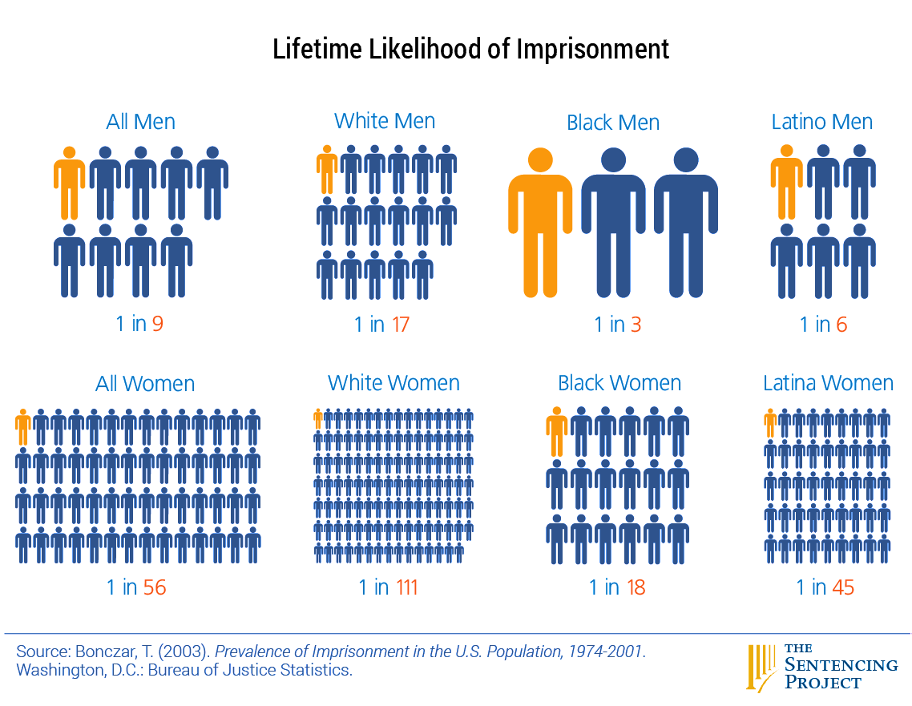

Slide 14
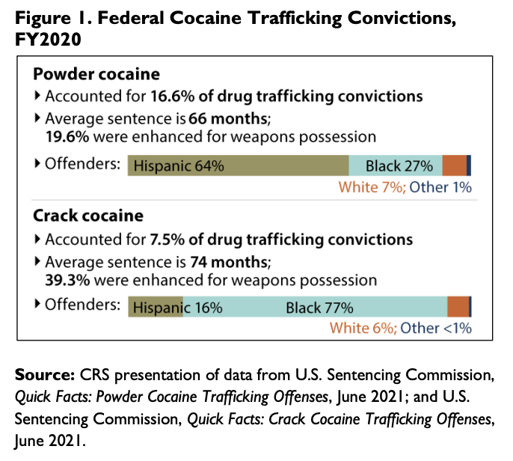
Historic and ongoing systemic inequities:
Race, ethnicity, crack and powder cocaine
Despite harsher penalties for crack versus powder cocaine, crack use declined less than powder cocaine and even less than drugs not included in sentencing policies. These findings suggest that mandatory minimum sentencing may not be an effective method of deterring cocaine use.
Walker LS, Mezuk B. Mandatory minimum sentencing policies and cocaine use in the U.S., 1985-2013. BMC Int Health Hum Rights. 2018 Nov 29;18(1):43.
5.2 million Americans use cocaine – 657k use crack – 1 million with CUD (NSDUH)
1972 Controlled Substances Act did not distinguish powder from crack cocaine
1986 Anti-Drug Abuse Act ->imposed mandatory minimum sentencing for trafficking – 5 years for 5g of crack/ 500g of powder (100:1 ratio)
1988 Anti-Drug Abuse Act -> 5-year minimum for simple possession of crack
2010 Fair Sentencing Act – 5years for 28g of crack/ 500g of powder and eliminated the simple possession mandate (18:1 ratio remains)
2018 First Step Act – Applied the 2010 rules retroactively and allowed for resentencing
Racial minorities were at low risk for powder cocaine use and Hispanics were at low risk for crack use. Blacks were at increased risk for lifetime and recent crack use, but not when controlling for other socioeconomic variables.
Palamar JJ, Davies S, Ompad DC, Cleland CM, Weitzman M. Powder cocaine and crack use in the United States: an examination of risk for arrest and socioeconomic disparities in use. Drug Alcohol Depend. 2015 Apr 1;149:108-16.
Notes:
Cocaine,: Crack and Powder Sentencing Disparities
Congression Research Service, November 9, 2021
https://sgp.fas.org/crs/misc/IF11965.pdf

Slide 15
Stimulant Effects

Slide 16
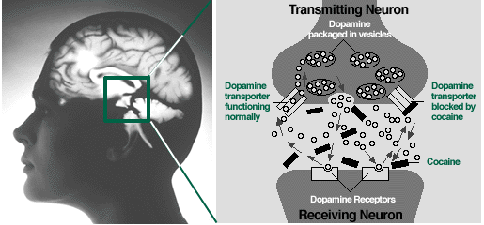
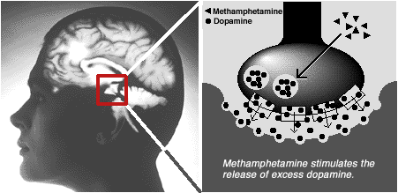
Cocaine
Blocks the re-uptake of dopamine
Methamphetamine
Stimulates dopamine release and blocks re-uptake
Relative lack of dopamine during abstinence results in withdrawal symptoms – cravings, anhedonia, depression

Slide 17
PK: Cocaine
 | IV | Smoked | Snorted
Time to effect | 10-60sec | 3-5sec | 1-5min
Peak concent. | 3-5min | 1-3min | 15-20min
Half-life | 20-60min | 5-15min | 60-90min
Lange, R. A. and L. D. Hillis (2001). "Cardiovascular complications of cocaine use." N Engl J Med 345(5): 351-8.
PK: Methamphetamine
 | IV | Smoked | Snorted | Ingested
Time to effect | 15-30 sec | Immediate | 3-5 min | 15-20 min
Peak concent. | 2-4 h | 2-4 h | 2-4 h | 2-4 h
Half-life | 10-12 h | 10-12 h | 10-12 h | 10-12 h
Lineberry 2006
Notes:
In effort to recapture initial rush, people use repetitively, despite mounting levels drug. Acute tolerance to this rush develops, leaving the binger in the “tweaking” state. Eventually use ceases, perhaps after days, ending in crash into nonrestful sleep.
The rush that users get from IV use and smoking is similar in both cocaine and MA. The rush is the most reenforcing part of using. Acute tolerance occurs to this rush occurs quickly and requires repeated administration to recapture this euphoria. HOWEVER, cocaine has a half-life of about 90 minutes compared to 10-12 hours for MA. Thus the buildup of MA levels during repetitive use (seen during binging) can be very high compared to cocaine. This buildup explains the “tweaker” state – restless anxiety, irritability, fatigue, and dysphoria.

Slide 18
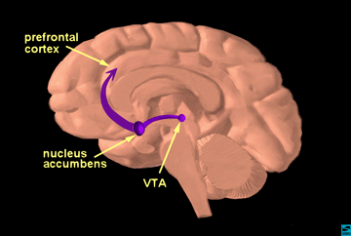
Why do people use stimulants?
Euphoria - Rush
  Onset and intensity depends on delivery method
Increased energy, alertness, libido
Diminished social inhibition
Decreased appetite
Notes:
MENTION DOPAMINE
So why do people use methamphetamine? Because it is highly re-enforcing, it feels good.

Slide 19






Notes:
Stimulant binge
Euphoria - Rush
Onset and intensity depends on delivery method
Increased energy, alertness, libido
Diminished social inhibition
Decreased appetite
For methamphetamine, there is acute tolerance to the euphoric/ rewarding effects, but the andrenergic effects persist and thus accumalte with repetitive use.

Slide 20
Acute Toxicity = “Over-amping”
Binges
2-3 day binges are typical, called runs
Regular re-dosing to maintain rush or high in setting of acute tolerance
Ends when drug or money runs out, or paranoia/ disorganized thinking sets in
Dry mouth, clenching
Elevated BP and HR
Arrythmia
Vasoconstriction
Hyperthermia
Agitation
Rhabdomyolysis
Seizure
Acute psychosis → prolonged psychosis
  Paranoid delusions
  Visual, sensory, and auditory hallucinations
    formications

Slide 21
Stimulant Intoxication Treatment = De-escalation
Ten Domains of De-escalation:
1. Respect personal space
2. Do not be provocative
3. Establish verbal contact
4. Be concise
5. Identify wants and feelings
6. Listen actively; respond appropriately
7. Agree or agree to disagree
8. Lay down the law and set clear limits
9. Offer choices and optimism
10. Debrief the patient and staff.
Interventions
Sunglasses and earplugs to redue stimuli
Water and gum for dry mouth
Neuroleptics (ie olanzapine) for agitation
Benzos to control seizures
Treat hyperthermia (external cooling)
For increased BP+HR, use vasodilators and CCB or non-selective beta-blockers
Richmond JS, Berlin JS, Fishkind AB, et al. Verbal De-escalation of the Agitated Patient: Consensus Statement of the American Association for Emergency Psychiatry Project BETA De-escalation Workgroup. West J Emerg Med. 2012;13(1):17-25.
Notes:
Supportive care

Slide 22
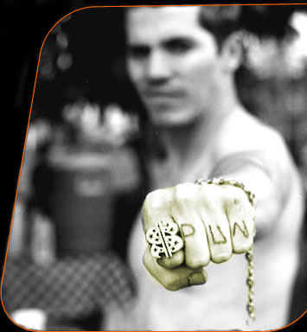
Health Consequences
Dental
Darkened teeth
Caries
Periodontal disease
Neuro-psychiatric
Stroke
Seizure
Depression
Anxiety
Mania
Impulsivity
Paranoia
Auditory/ visual hallucinations + formications
Violence
Pulmonary
Acute pulmonary edema
Pulmonary HTN
Inhalation injury
Cardiovascular
Hypertension
DCM
Arrythmia/ Tachycardia
Acute Coronary Syndrome
Aneurysm/ dissection
Erectile dysfunction
Renal/Metabolic
Rhabdomyolisis
Dehydration
Acute Renal Failure
Acidosis
Hyperthermia
Infectious
HIV risk
HCV/ HBV
STDs
Skin
Cellulitis/ abscess
Excoriations
Chemical burns

Slide 23
ETOH + Cocaine >> Cocaethylene
Psychoactive substrate from ETOH+cocaine
ETOH commonly used as “landing gear”
ETOH before cocaine inhibits cocaine metabolism, producing cocaethylene
60-90% of people who use cocaine, useETOH
Greater cardiac toxicity
Greater rates of seizures, hepatic damage
Notes:
Mention practice of buying alcohol with cocaine.
Is it to bring an endpoint or is itto potentiate the high?
Bottom line: Screen forETOH when you encounter cocaine

Slide 24
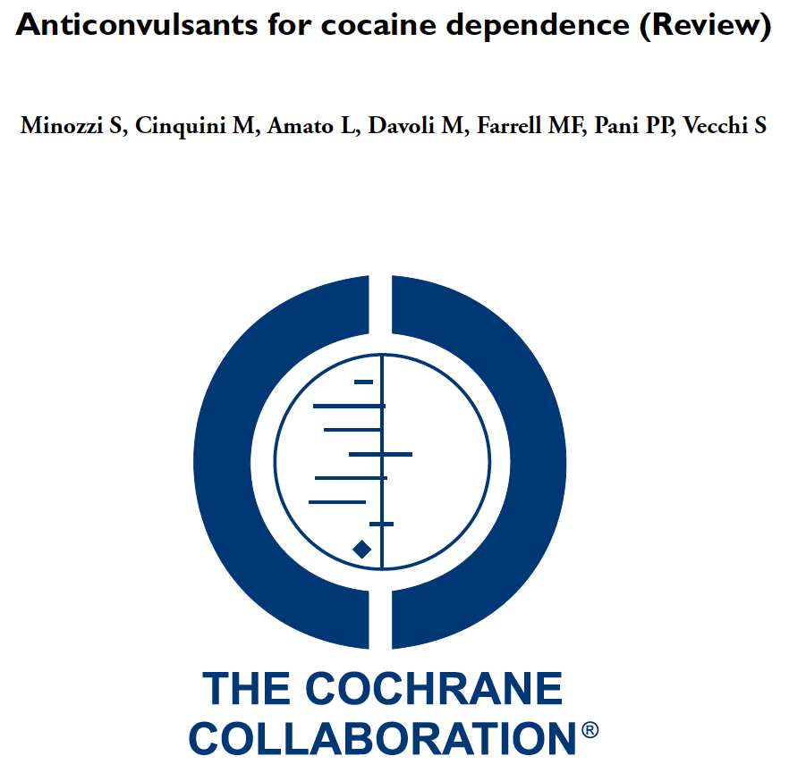
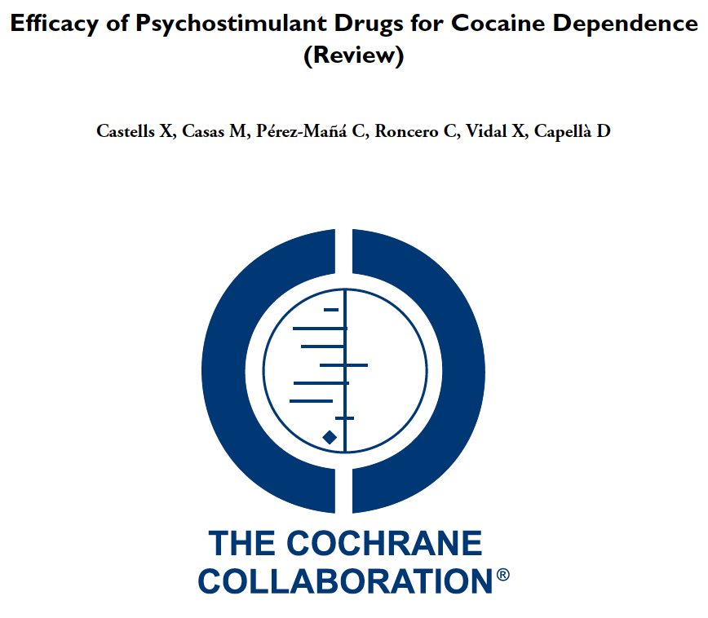
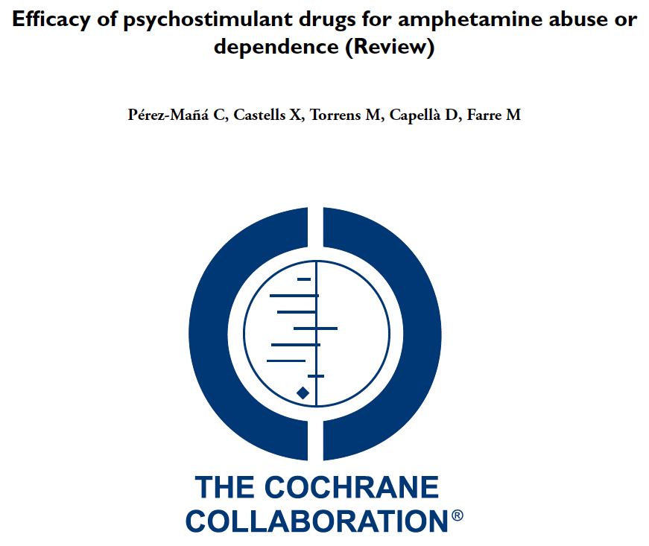
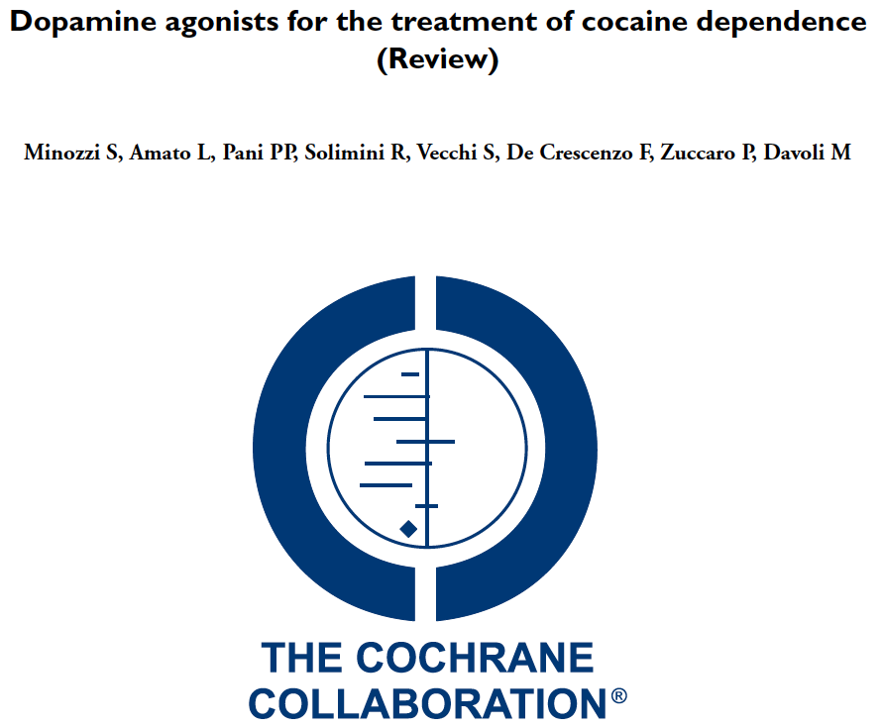
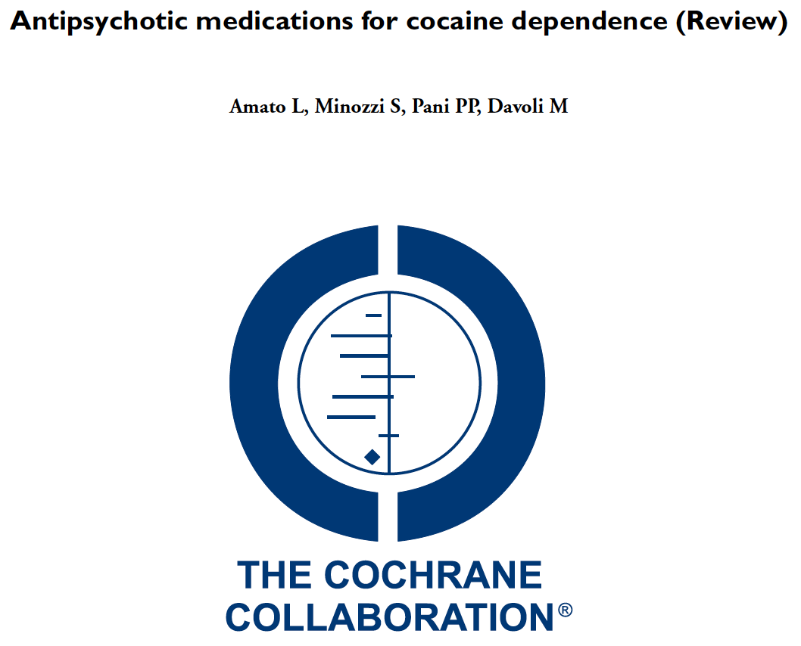
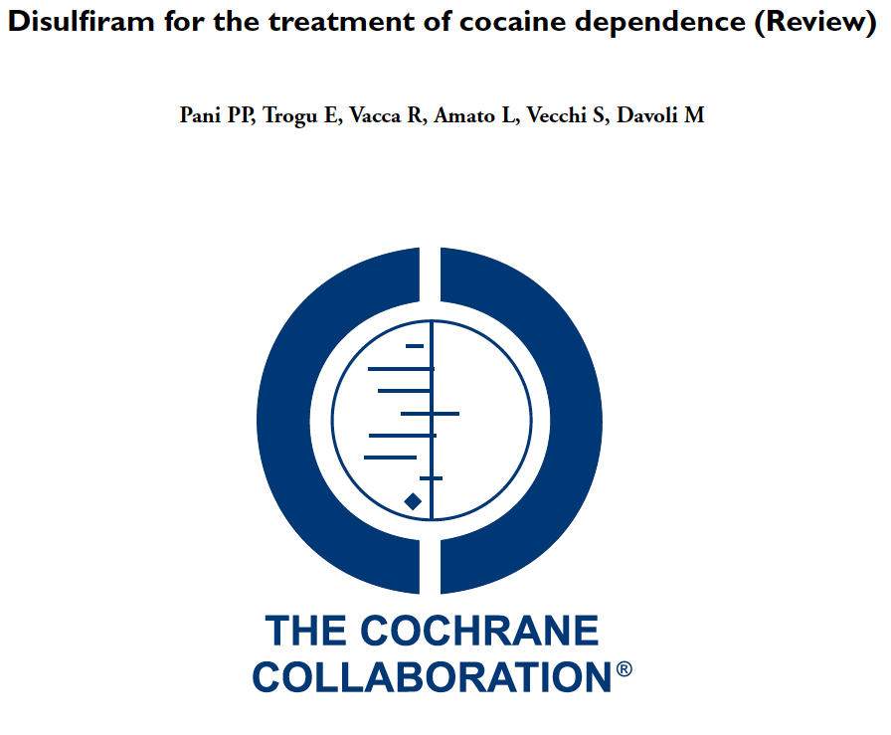
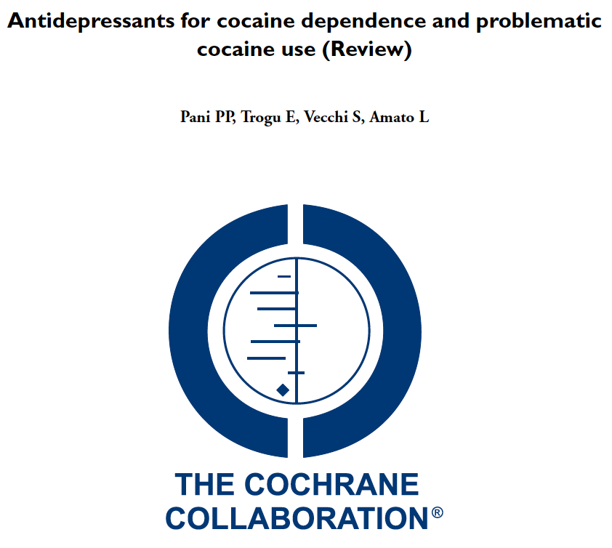
Treatment of stimulant use disorder: A systematic review of reviews
This review supports the use of contingency management interventions for the treatment of stimulant use disorder. Although evidence to date is insufficient to support the clinical use of psychostimulants, results demonstrate potential for future research in this area. Given the urgent need for effective pharmacological treatments for stimulant use disorder, high-quality primary research focused on the role of medications for the treatment of stimulant use disorder is needed.
- Ronsley C, Nolan S, Knight R, Hayashi K, Klimas J, et al. (2020) PLoS ONE 15(6)
Notes:
Castells X, Cunill R, Pérez‐Mañá C, Vidal X, Capellà D. Psychostimulant drugs for cocaine dependence. The Cochrane Library. 2016 Jan 1.
Pérez‐Mañá C, Castells X, Torrens M, Capellà D, Farre M. Efficacy of psychostimulant drugs for amphetamine abuse or dependence. Cochrane Database of Systematic Reviews. 2013(9).
Ronsley C, Nolan S, Knight R, Hayashi K, Klimas J, Walley A, et al. (2020) Treatment of stimulant use disorder: A systematic review of reviews. PLoS ONE 15(6)

Slide 25
Promising medications for Cocaine Use Disorder
Cocaine Use Disorder | Comparison | Population | Outcomes | Dropout
Nuijten M et al. Lancet. 2016; 387:2226-34. | Dexamphetamine 60mg QD vs. placebo | 73 Dutch patients with cocaine UD on heroin+ methadone maintenance | At 12 weeks Fewer days of cocaine use More cocaine-neg tox tests No differences in craving, use of other substances, or criminality | 11% dropout
Levin FR et al. JAMA Psychiatry. 2015 1;72:593-602. | Mixed amphetamines (MAS-ER) 60-80mg QD vs. placebo | 126 US patients with adult-ADHD and cocaine UD | At 13 weeks Reduced ADHD symptoms: 60-75% vs 40% 3-wk abstinence: 30-17% vs. 7% | 26% dropout
Dakwar E et al. Am J Psychiatry. 2019 176(11):923-930. | 40 min infusion of ketamine at 0.5mg/kg vs. midazolam + All 5-wks counseling | 55 inpatients with cocaine UD | At 5 weeks Abstinence: 48% vs. 11% Cravings: Ketamine 58% lower | dropout: 26% ketamine; 57% midazolam
Levin FR et al. DAD 2020 206:107700. | MAS-ER at 60mg QD + topiramate 100 BID vs. plaebo | 127 adults with CUD using at least 9 days in the prior month | At 3 weeks Abstinence: 14% vs. 0% | 20% discontinued for elevated HR/BP
Notes:
Levin FR, Mariani JJ, Pavlicova M, Choi CJ, Mahony AL, Brooks DJ, Bisaga A, Dakwar E, Carpenter KM, Naqvi N, Nunes EV, Kampman K. Extended release mixed amphetamine salts and topiramate for cocaine dependence: A randomized clinical replication trial with frequent users. Drug Alcohol Depend. 2020 Jan 1;206:107700. doi: 10.1016/j.drugalcdep.2019.107700. Epub 2019 Nov 1. PMID: 31753736; PMCID: PMC6980777.

Slide 26
Promising medications for Methamphetamine Use Disorder
MA Use Disorder | Comparison | Population | Outcomes | Limitations
Coffin PO et al. JAMA Psychiatry 2020 77(3):246-255 | Mirtazapine 30mg vs. placebo once daily + counseling | 120 men who have sex with men who use methamphetamine | At 24 weeks RR of 0.75 for MA use RR <0.52 for multiple sex partners, condomless anal sex Improved depressive symptoms and insomnia severity | Medication adherence was almost 40%
Trivedi MH et al. N Engl J Med. 2021 384(2):140-153 | IM-NTX 380mg Q3wks +Bupropion 450mg vs. placebo | 403 with MA UD in stage 1 and 225 with MA UD in stage 2 | At 6 weeks BPP+NTX 13.6% vs. Placebo 2.5% (3 of 4 MA negative urine tox) | Adherence to medication was 75-86%, Adverse events: Nausea, vomiting, dizziness
Notes:
Coffin PO, Santos GM, Hern J, Vittinghoff E, Walker JE, Matheson T, Santos D, Colfax G, Batki SL. Effects of Mirtazapine for Methamphetamine Use Disorder Among Cisgender Men and Transgender Women Who Have Sex With Men: A Placebo-Controlled Randomized Clinical Trial. JAMA Psychiatry. 2020 Mar 1;77(3):246-255. doi: 10.1001/jamapsychiatry.2019.3655. PMID: 31825466; PMCID: PMC6990973.

Slide 27
Stimulant maintenance for people with concomitant ADHD or HUD
73 Dutch patients with cocaine UD on heroin+methadone maintenance
Dexamphetamine SR 60mg once daily observed vs. placebo
11% dropout
At 12 weeks
  45 versus 61 days of cocaine use
  21% versus 8% >= 1 cocaine-negative urine in last 4 weeks
  No differences in craving, use of other substances, or criminality
Nuijten M et al. Lancet. 2016; 387:2226-34.
126 US patients with adult-ADHD and cocaine UD
Mixed amphetamine salts SR 60 or 80mg once daily vs. placebo
Weekly CBT groups
26% dropped out
At 13 weeks
  Reduced ADHD symptoms: 60-75% vs 40%
  3-wk abstinence: 30-17% vs. 7%
Levin FR et al. JAMA Psychiatry. 2015 1;72:593-602.

Slide 28
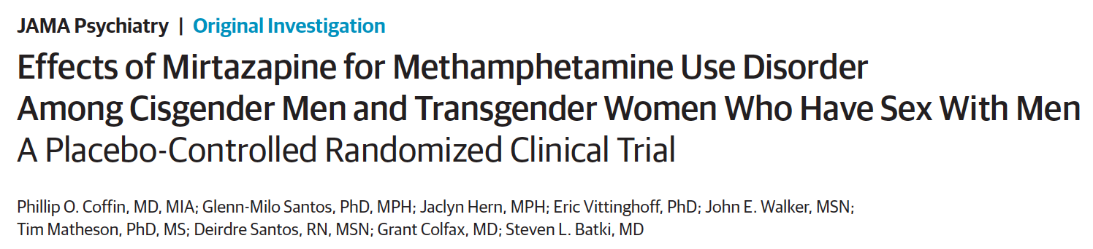
120 men who have sex with men who use methamphetamine
Randomized to mirtazapine 30mg or placebo once daily for 24 week + counseling
Medication adherence was almost 40%
Mirtazapine group had at 24 weeks
  RR of 0.75 for MA use
  RR <0.52 for multiple sex partners, condomless anal sex
  Improved depressive symptoms and insomnia severity
Notes:
Coffin PO, Santos GM, Hern J, Vittinghoff E, Walker JE, Matheson T, Santos D, Colfax G, Batki SL. Effects of Mirtazapine for Methamphetamine Use Disorder Among Cisgender Men and Transgender Women Who Have Sex With Men: A Placebo-Controlled Randomized Clinical Trial. JAMA Psychiatry. 2020 Mar 1;77(3):246-255. doi: 10.1001/jamapsychiatry.2019.3655. PMID: 31825466; PMCID: PMC6990973.

Slide 29
Bupropion and naltrexone in MA use disorder
BPP is stimulant-like antidepressant that may mitigate MA withdrawal. NTX may decrease MA rewards and craving.
403 with MA UD in stage 1 and 225 with MA UD in stage 2 randomized to IM-NTX+BBP 450mg vs. placebo
Outcome – 3 of 4 MA negative urine tox at 6 weeks
Result: BPP+NTX 13.6% vs. Placebo 2.5% (Weighted average)
  Adherence to medication was 75-86%, but missing urine tox was 30-50% and counted as positive
Adverse events: Nausea, vomiting, dizziness
Trivedi MH et al. Bupropion and Naltrexone in Methamphetamine Use Disorder. N Engl J Med. 2021 Jan 14;384(2):140-153

Slide 30
Single infusion of ketamine for cocaine use disorder
55 inpatients with CUD were randomized to a 40minute infusion of ketamine at 0.5mg/kg vs. midazolam. Both arms received 5-weeks of mindfulness based relapse prevention counseling, daily for 4 days, then weekly for 4 weeks
Ketamine 48% vs. midazolam 11% 2-week abstinence at 5weeks
Ketamine group 53% less likely to relapse
Ketamine group 58% lower craving scores
44% reported 6mo abstinence in ketamine group; 0 in the midazolam group
Dropout: 7 of 27 ketamine; 16 of 28 midazolam
Dakwar E, Nunes EV, Hart CL, Foltin RW, Mathew SJ, Carpenter KM, Choi CJJ, Basaraba CN, Pavlicova M, Levin FR. A Single Ketamine Infusion Combined With Mindfulness-Based Behavioral Modification to Treat Cocaine Dependence: A Randomized Clinical Trial. Am J Psychiatry. 2019 Nov 1;176(11):923-930.
Notes:
Dakwar E, Nunes EV, Hart CL, Foltin RW, Mathew SJ, Carpenter KM, Choi CJJ, Basaraba CN, Pavlicova M, Levin FR. A Single Ketamine Infusion Combined With Mindfulness-Based Behavioral Modification to Treat Cocaine Dependence: A Randomized Clinical Trial. Am J Psychiatry. 2019 Nov 1;176(11):923-930.

Slide 31
Behavioral Health Treatment for Stimulant Use Disorder
Evidence-Based Treatments | Description of Treatment | References
Contingency Management | Provides incentives ($, gift cards, motivational encouragement, etc) for treatment adherence. | (Bach et al., 2020; Brown & DeFulio, 2020; Lake et al., 2020; Minozzi et al., 2016; Okafor et al., 2020)
Community Reinforcement Approach | Using therapeutic modalities, job training, education, behavioral skills training, social training, relapse prevention and relationship counseling. | (Meyers et al., 2011; Riccardo De Giorgi et al., 2018; Stitzer et al., 2011)
Matrix Model | An 8-16-week structured intensive outpatient group utilizing group therapy, connection to self-help, and exploration of underlying causes of disease. Regular UDS screening. | (Huber et al., 1997; Rawson et al., 1995, 2002)
Exercise Supported Recovery | Varying exercise programs have been described, but those with a combination of daily aerobic and anaerobic exercise are associated with long term recovery. | (Huang et al., 2020; Killeen et al., 2020; Liu et al., 2021; Zhou et al., 2021)
Trauma-Informed Care Seeking Safety | A therapeutic model for the treatment of co-occurring PTSD and SUD that emphasizes the need to be safe in order to explore and cope with trauma. | (Lange-Altman et al., 2017; Lenz et al., 2016; Morley et al., 2016; Murphy et al., 2019; Najavits & Anderson, n.d.; Sperlich et al., 2021; Takahashi et al., 2020)
Slide from Justin Alves – BMC OBAT TTA
Notes:
Wang D, Zhou C, Zhao M,Wu X, Chang YK.
Dose-response relationships between exercise
intensity, cravings, and inhibitory control in
methamphetamine dependence: an ERPs study.
Drug Alcohol Depend. 2016;161:331-339.
Rawson RA, Chudzynski J, Mooney L, Gonzales R, Ang A, Dickerson D, Penate J, Salem BA, Dolezal B, Cooper CB. Impact of an exercise intervention on methamphetamine use outcomes post-residential treatment care. Drug Alcohol Depend. 2015 Nov 1;156:21-28. doi: 10.1016/j.drugalcdep.2015.08.029. Epub 2015 Sep 3. PMID: 26371404; PMCID: PMC4633370.

Slide 32
Evidence for Contingency Management for stimulants
Systematic Review – DeCrescenzo 2018 PloS Medicine – 50 studies
CM in combination with community re-enforcement approach or cognitive behavioral therapy was most efficacious and acceptable
  Increases abstinence
  Improves treatment retention
Barrier: Regulations that restrict the amount of incentives that can be given to patients to $75 per patient per year
RCT in 6 community methadone programs of CM among stimulant users
Usual Care vs.
Intermittent, escalating re-enforcement
  1000 chips
    500 “Good job”
    250 “Small” - $1 value – i.e. toiletries
    209 “Large” - $20 value – i.e. kitchenware
    1 “Jumbo” – $80-100 value – tv, stereo
  # of draws = # of weeks with clean urine
Peirce et al. Arch Gen Psychiatry. 2006;63:201-208.
Notes:
De Crescenzo F, Ciabattini M, D'Alò GL, De Giorgi R, Del Giovane C, Cassar C, Janiri L, Clark N, Ostacher MJ, Cipriani A. Comparative efficacy and acceptability of psychosocial interventions for individuals with cocaine and amphetamine addiction: A systematic review and network meta-analysis. PLoS Med. 2018 Dec 26;15(12):e1002715. doi: 10.1371/journal.pmed.1002715. PMID: 30586362; PMCID: PMC6306153.
Medicare and State Health Care Programs: Fraud and Abuse; Revisions to Safe Harbors Under the Anti-Kickback Statute, and Civil Monetary Penalty Rules Regarding Beneficiary Inducements
•77684 Federal Register / Vol. 85, No. 232 / Wednesday, December 2, 2020 / Rules and Regulations

Slide 33
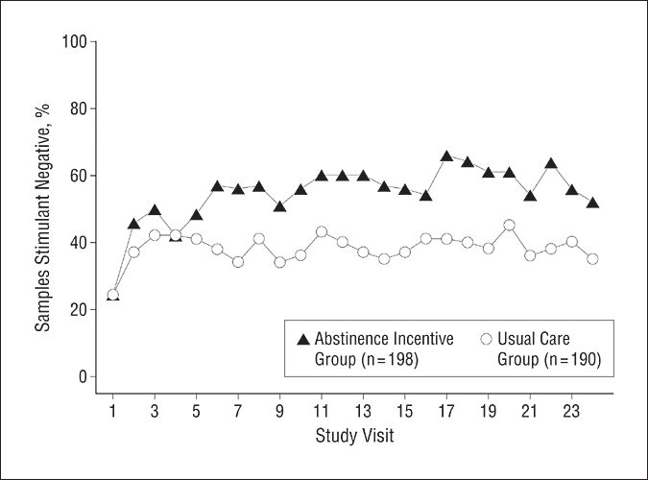
Contingency Management
  The mean percentage of submitted samples testing negative for target drugs (stimulants and alcohol) is shown for abstinence incentive and usual care participants at each of 24 study visits.
  Average cost = $1.46 per person/day
Peirce et al. Arch Gen Psychiatry. 2006;63:201-208
Notes:
With contingency management mention drug courts and appointment intervals

Slide 34

How can we help our stimulant-using patients?
Decriminalize substance use
Ask and educate about complications, overdose
Harm reduction and engagement–
  Safer supplies (syringes, smoking glass), naloxone, quiet, safe and clean spaces, safer sex supplies and education, toothpaste - chapstick
Refer/provide CM, CRA, and CBT, if available
No FDA-approved medications
  Stimulants and ?ketamine? have shown some promise for cocaine
  Mirtazapine and BPPN+NTX has shown some promise for methamphetamine
Advocate, research and develop novel strategies in the treatment of stimulant use disorders

Slide 35
Learning Objectives
At the end of this session, participants will be able to:
Understand how and why people use stimulants
Know the characteristics of stimulant intoxication and withdrawal syndromes
Understand the consequences of these drugs
Know the current options for treatment of stimulant dependence

Slide 36
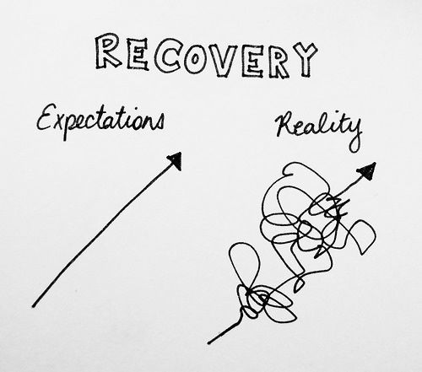
Realistic Expectations!
Addiction is a chronic relapsing condition
Over time treatment works
People get better, if the stay alive
Engage people before, at, and after health system touchpoints awalley@bu.edu

