Slide 1
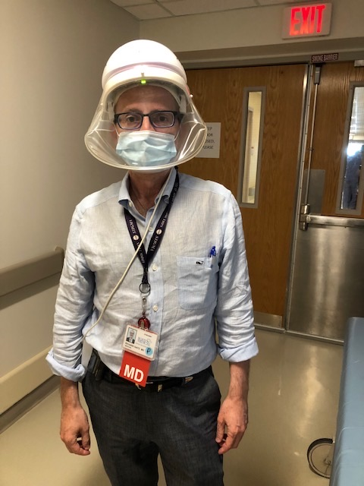
Designing Clinical Addiction Research
Fellow Immersion Training in Addiction Medicine
Sunday, April 24, 2022

Slide 2

Goals and Objectives
Goal: General principles of designing feasible clinical addiction research
Learning objectives
  Be able to specify and refine each component of a research question
  Review the top ten considerations for designing and implementing clinical research as a fellow
  Share ways to incorporate addictions questions into other studies

Slide 3
Clinical research question: PICOT
- Key for hypothesis testing
P = Patient or problem
  Population that uses substances?
I/E = Intervention or exposure
  Type of substance use, type of treatment?
C = Comparison
O = Outcomes
  Death, overdose, substance use, medical outcome, QOL?
T = Timing
  Cross-sectional vs. longitudinal
Notes:
Underneath each of these is a thorough literature review, especially – innovation, limitations, and model for your manuscript

Slide 4
Clinical research question: PICOT Exercise
Among a [Population], is an [Intervention/Exposure] compared to a [Comparison] associated with an [Outcome] when measured at [Time] intervals?
From the abstract generate this sentence…..
Among general medical service inpatients, is having a substance use disorder diagnosis compared to not having a substance use disorder diagnosis associated with the rate and risk of acute care hospitalization when measured at 30 days?
Answer: Medical patients with substance use disorder diagnoses, specifically those with drug use-related diagnoses, have higher rates of recurrent acute care hospital utilization than those without substance use disorder diagnoses.
Walley AY, Paasche-Orlow M, Lee EC, Forsythe S, Chetty VK, Mitchell S, Jack BW. Acute care hospital utilization among medical inpatients discharged with a substance use disorder diagnosis. J Addict Med. 2012 Mar;6(1):50-6.

Slide 5
Review box.com templates:
Analytic Plan and Project Development Plan

Slide 6
PICOT Exceptions: Additional Study Approaches
Qualitative Research – Explore what should the population, exposure, exposure/intervention, comparison, or outcome be
  -> Hypothesis generating; Intervention forming
Case Study, Case Series, Program Descriptions – Describe what you see defining the population, exposure/intervention, outcome and timing, but may not have a comparison group
Prevalence – How common is an exposure?

Slide 7
Qualitative Research: Exploring emerging phenomena
Study Aim: The overall aim of this study is to explore experiences, beliefs, and attitudes of PWUIO who have attempted self-treatment with buprenorphine in an era of non-prescribed fentanyl and fentanyl analogue use.
“SMS: Do you notice any differences in how well the Suboxone works for heroin versus how it works for fentanyl?
A: Yes, for me it sends me into precipitated withdrawals every f*ing time that I try to get off of fentanyl. Then I have these Sub doctors telling me that it's not real and it's like, go f*ing ask the people that are buying it off the streets. It is real! I waited 80 hours. I was in a detox and after 80 hours they gave me a Suboxone and it still put me into precipitated.”
Silverstein SM, Daniulaityte R, Martins SS, Miller SC, Carlson RG. "Everything is not right anymore": Buprenorphine experiences in an era of illicit fentanyl. Int J Drug Policy. 2019 Dec;74:76-83.
Notes:
Silverstein SM, Daniulaityte R, Martins SS, Miller SC, Carlson RG. "Everything is not right anymore": Buprenorphine experiences in an era of illicit fentanyl. Int J Drug Policy. 2019 Dec;74:76-83. doi: 10.1016/j.drugpo.2019.09.003. Epub 2019 Sep 25. PMID: 31563098; PMCID: PMC6914257.
“I'm going to tell you this…Suboxone does not work with fentanyl.” Despite several successful past self-treatment episodes with buprenorphine, Gaia's most recent attempt was disastrous. Her boyfriend Jay related the story of their recent joint attempt at self-treatment: “I was almost 72 hours into withdrawal...and I took it [Suboxone] and it made me... I couldn't believe it. Cuz I don't puke or get diarrhea, I don't have that happen ever...But immediately—Bam! Not even five minutes after I took it I was dripping sweat. It felt like water had just gotten dumped all over me, I'm puking and it's coming out every end.”

Slide 8

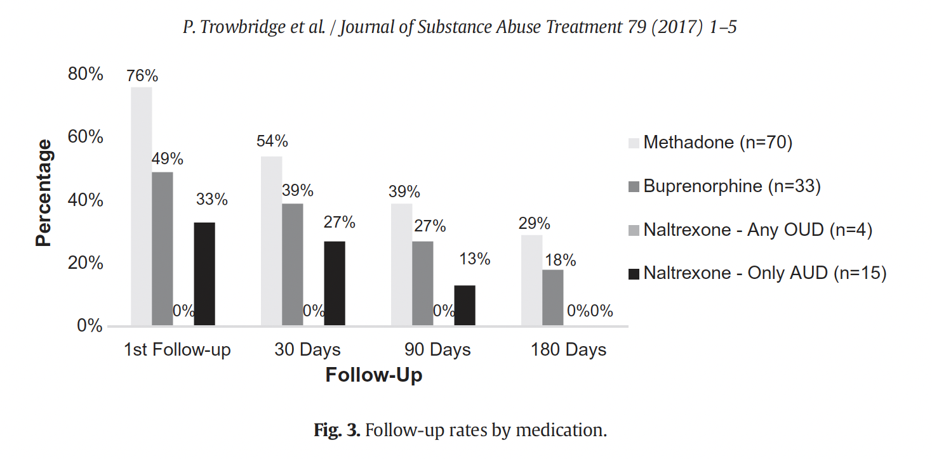
Case Series and Program Description
Study Aim: Here, we describe the initial experience of the BMC ACS: number of consults, diagnoses of patients, use of addiction medications, and linkages to outpatient care.
First 6 months of BMC Addiction Consult Service
Trowbridge P, Weinstein ZM, Kerensky T, Roy P, Regan D, Samet JH, Walley AY. Addiction consultation services - Linking hospitalized patients to outpatient addiction treatment. J Subst Abuse Treat. 2017 Aug;79:1-5.
Notes:
Trowbridge P, Weinstein ZM, Kerensky T, Roy P, Regan D, Samet JH, Walley AY. Addiction consultation services - Linking hospitalized patients to outpatient addiction treatment. J Subst Abuse Treat. 2017 Aug;79:1-5. doi: 10.1016/j.jsat.2017.05.007. Epub 2017 May 11. PMID: 28673521; PMCID: PMC6035788.
Shanahan CW, Beers D, Alford DP, Brigandi E, Samet JH. A transitional opioid program to engage hospitalized drug users. J Gen Intern Med. 2010 Aug;25(8):803-8. doi: 10.1007/s11606-010-1311-3. Epub 2010 Mar 17. PMID: 20237960; PMCID: PMC2896583.
Noska A, Mohan A, Wakeman S, Rich J, Boutwell A. Managing Opioid Use Disorder During and After Acute Hospitalization: A Case-Based Review Clarifying Methadone Regulation for Acute Care Settings. J Addict Behav Ther Rehabil. 2015;4(2):1000138. doi: 10.4172/2324-9005.1000138. PMID: 26258153; PMCID: PMC4527170.

Slide 9
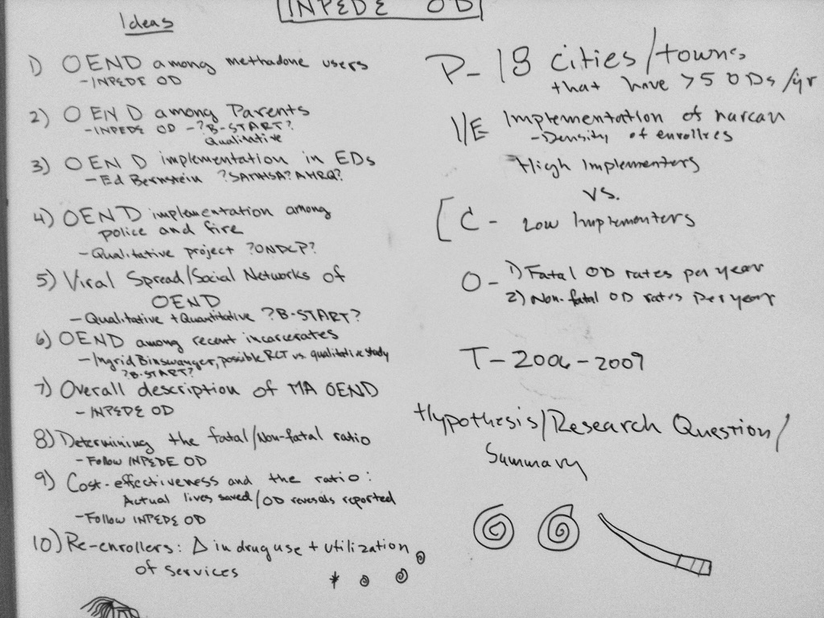
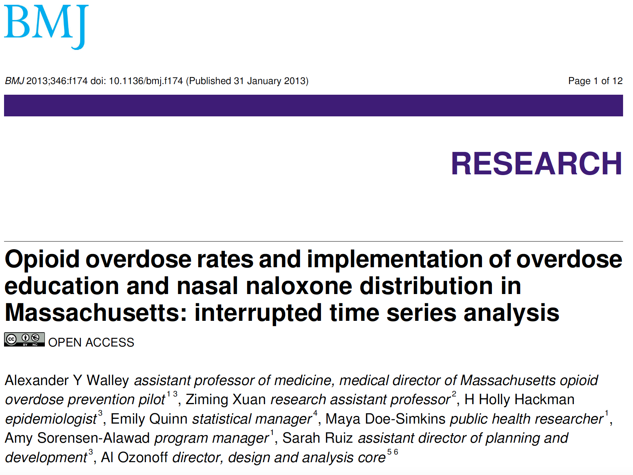
Top Ten Considerations for Designing Clinical Research as a Fellow
10. Make a long list of possible research questions

Slide 10
Top Ten Considerations for Designing Clinical Research as a Fellow
10. Make a long list of possible research questions
9. Consider innovation (has the question been answered?)
8. Consider limitations. Avoid fatal flaws but don’t get paralyzed
7. Consider a line of research
Consider your resources and feasibility. No one can do it alone. Get feedback
--Mentor (expertise+), biostats, data collection/management, coordination
5. Do a thorough literature review
4. Work with your IRB – a barrier and a resource
3. Implement at least two studies, gain different skills
2. Find a model for your manuscript
1. Make sure you love it
Notes:
Underneath each of these is a thorough literature review, especially – innovation, limitations, and model for your manuscript

Slide 11
Incorporating substance use questions
Add new measures to ongoing studies
  E.g. Add questions about fentanyl to an ongoing longitudinal cohort study
Link substance use data to other studies
  E.g. Link cohort to overdose death data
Stratify or subset people who use substances
  E.g. re-hospitalization among inpatients with and without substance use
Address substance use impact on other medical condition outcomes
  E.g. How does substance use impact adherence to HIV medication?
Study substance use in people with other medical conditions
  E.g. Substance use among people treated for cancer
Understand how substance use questions have been used in other studies – validated? Self-administered?
  E.g. Timeline followback for self-reporting overdose

Slide 12
Validated substance use instruments
PhenX Toolkit – Substance and Addiction Collection
Include in your literature review a review of assessments and measures used in previous studies
Notes:
https://nida.nih.gov/nidamed-medical-health-professionals/screening-tools-resources/chart-screening-tools
https://www.phenxtoolkit.org/collections/view/2

Slide 13
Goals and Objectives
Goal: General principles of designing feasible clinical addiction research
Learning objectives
  Be able to specify and refine each component of a research question
  Review the top ten considerations for designing and implementing clinical research as a fellow
  Share ways to incorporate addictions questions into other studies

