Slide 1
FIT 2021
Mentored Research Projects:
Getting the Most Out of Your Mentors,
Overcoming Common Challenges, and Grant Funding
Jennifer McNeely, MD, MS
Associate Professor
Dept. of Population Health
NYU Grossman School of Medicine

Slide 2
With thanks to Chinazo Cunningham, MD, MS (unofficial mentor, role model, friend, and colleague)

Slide 3
Take-home points
Think about your mentoring team
Expect mentorship needs to change over time
Be a proactive mentee
Seek funding to protect your time

Slide 4
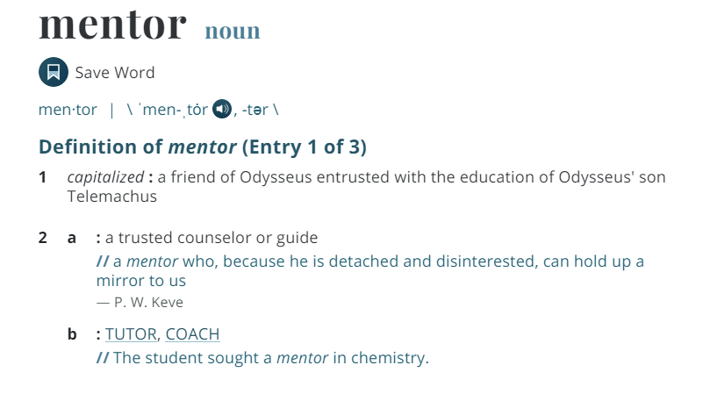
What is a mentor?

Slide 5
Functions of Mentors
Listening
Help with decision-making
Giving informed feedback
Role Modeling
Counseling
Friend
Sponsorship
Coaching
Protecting
Challenging
Providing exposure and visibility
Goal setting
Guiding
Notes:
This is a lot for one person to fill
While the ‘traditional model’ is to have a single mentor, that is somewhat rare

Slide 6
The Mentoring Team
Career Mentor
  Responsible for overall career guidance and support for mentee.
Research Mentor
  Responsible for developing the creative and/or independent research careers of mentees.
Co-Mentor
  Works with the mentee and research mentor to provide specialized content area or methodological expertise.
Peer (Near-Peer) Mentor
  At or near same level as mentee, works alongside to also help guide scholarship
Notes:
For most of us, it makes sense to think of a team - rather than looking for ‘the one’. Individuals may fill one or more roles

Slide 7
What are the key things I’ve gained from mentors?
Early years: Inspiration and confidence
Middle years: Roadmap to a viable career
Later: Networking, access to resources
Now: Being a mentor, navigating institutions, career advice, friendship

Slide 8
Mentors on my path

Slide 9
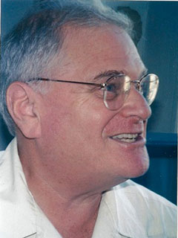

1. Research is about asking interesting questions about things you care about 1997-1999
Working in drug policy reform
Decided to go to medical school, doing post-bac
Ernest Drucker, PhD
Notes:
Demystified research
It’s a way to ask questions that can inform policy or advocacy

Slide 10
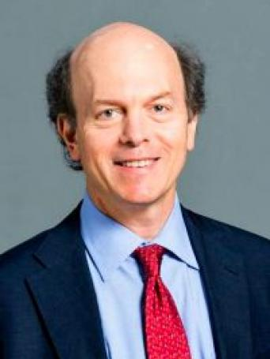
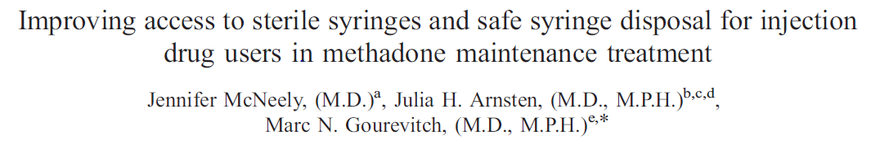
2. You can be an academic and do research about things you care about 2003-2004
Research year during medical school
‘He knows about drugs and he’s just a really good mentor’
Marc Gourevitch, MD, MPH
Notes:
Extended himself
Cared about my research question

Slide 11
3. (Even though you never saw yourself this way) A research career is a viable choice 2007-2010
Residency 2004-2007
Fellowship in Medicine and Public Health Research at NYU
KL2 -> K23 in 2010
Primary mentor Marc Gourevitch, Director, Division of General Internal Medicine
Notes:
Started research fellowship still somewhat undecided
It was the mentorship relationship w/ Marc that really drew me to fellowship and to NYU
He gave me leeway to try out different things, created an environment that encouraged collaboration and pursuing diverse research questions, fostered my enthusiasm

Slide 12
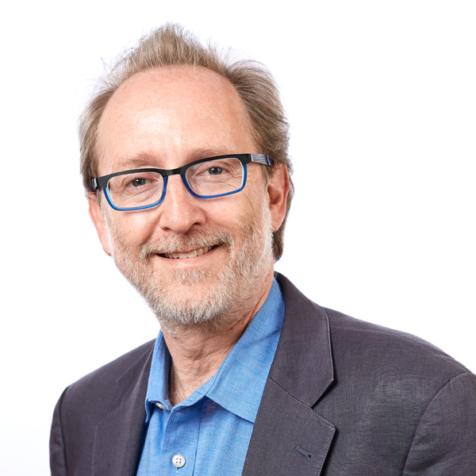

4. Developing a Professional Network and Body of Work
2011-2016
Patient self-administered screening tools for alcohol and drug use
Rich Saitz, MD, MPH
  Key collaborator, unofficial mentor, friend
NIDA Clinical Trials Network
  Co-Lead Investigator of a large CTN trial
AMERSA, INEBRIA
Notes:
NIDA CTN: being part of this network gave me a lot of exposure, experience, and helped w/ resources

Slide 13
5. Surviving and thriving
Associate Professor, Tenure 2019
Co-head of Section on Tobacco, Alcohol, and Drug Use 2020
Marc Gourevitch = primary mentor and Department Chair
  Navigating the institution, being a mentor, trusted advisor, champion
Network of colleagues, collaborators, friends for advice and opportunities

Slide 14
How to Choose Your Mentor(s)
Consider the following qualities:
  Interest in developing your career
  Commitment to mentoring, successful track record
  Works for your interpersonal style
  Research/scholarly interests
  Access to resources
  Will provide networking opportunities
  Is institutionally savvy
  Expresses interest in you as a person

Slide 15
Mentoring content:
Career goals
Conducting research
Confidence building
Critical, informed feedback
Organization and committee participation
Negotiating
Professional networking
Promotion/tenure
Publishing
Grant writing

Slide 16
What Makes a Mentor Effective?
Competence
  Professional knowledge and experience
  Respect
  Interpersonal skills and good judgment
Confidence
  Shares network of contacts and resources
  Allows mentee to develop on his/her own terms
  Demonstrates initiative, takes risks
  Shares credit
Commitment
  Invests time, energy and effort to mentoring
  Shares personal experience
Notes:
Should not be competing with you
Comfortable in their own skin

Slide 17

How do you get the most out of your mentor?
Be a PROACTIVE mentee
Remember that both you and your mentor are busy

Slide 18
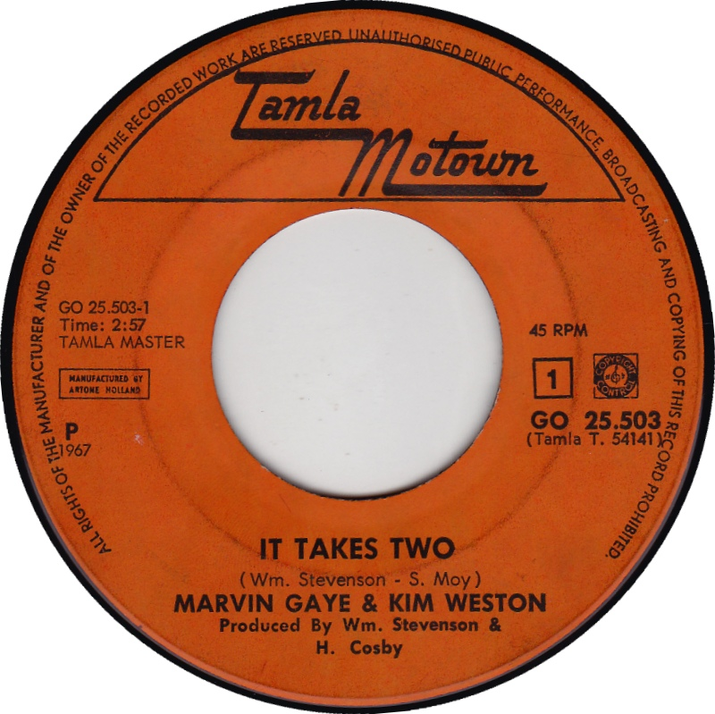
It takes two
Successful mentoring partnerships occur when:
  Mentees take initiative and drive the partnership.
  Mentees determine the pace, route, and destination.
  Mentors can then offers insights and counsel that is focused on mentees’ objectives.

Slide 19
Mentee Do’s and Don’ts
DO
Take initiative
Make and use an IDP
Understand that mentors are busy
Communicate agenda and goals for meetings
Practice self reflection
Clarify goals and expectations
Have multiple mentors
Look for opportunities to teach your mentor
Keep your CV, IDP up to date
DON’T
Be passive—don’t wait for the mentor to initiate interactions
Be late, disorganized
Wait for the last minute to ask for things
Hesitate to ask for what you need
Stay in the comfort zone
Stay in a mentoring relationship when it’s not helpful
Notes:
My postdoc: Drives the relationship, sets agenda for meetings, plans and tells me what to anticipate, teaches me new things (criminal justice)

Slide 20
Unique mentoring issues for women & minority scholars
Challenges
Less likely to be promoted
Less likely to obtain NIH funding
Fewer in leadership/mentorship positions
  - Commitment to mentoring may be there, but bandwidth can be low
Mentoring is even more critical
Have mentors that understand your challenges
Team approach can help
Choose an institution that supports you and your mentors

Slide 21
Grant funding for early/developing investigators
Pilot grants
Institutional career development awards (K12, KL2)
NIH career development awards (K01, K23, K99/R00)
    https://researchtraining.nih.gov/programs/career-development
Other peoples’ grants:
  Co-Investigator
  Study Physician
  Site Lead
Ask your mentors!
Notes:
K99/R00 is designed to facilitate a timely transition from a mentored postdoctoral research position to a stable independent research position with independent NIH or other independent research support at an earlier stage than is currently the norm.
K99/R00: initial phase will provide 1-2 years of mentored support followed by up to 3 years of independent support contingent on securing an independent tenure-track or equivalent research position. limited to postdoctoral trainees

Slide 22
Supplements to NIH grants
Diversity supplements are available for many NIH grant mechanisms
Target groups that are underrepresented in health research
Available for postdocs and early stage investigators
Provide stipend or salary support (up to $60K)

Slide 23
References and Resources
Sambunjak, et al. Mentoring in academic medicine. JAMA. 2006; 296: 1103-1115.
Berk. Measuring effectiveness of faculty mentoring relationships. Acad Med. 2005; 80: 66-71.
Manson, Personal journeys, professional paths: persistence in navigating the crossroads of a research career. Am J Public Health. 2009;99: S20-S25.
Zerzan T, et al. Making the most of mentors: A guide for mentees. Acad Med 2009;84:140-44
NIH Career Development Awards:
https://researchtraining.nih.gov/programs/career-development

