Slide 1


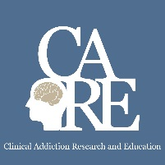

Special Considerations in Caring for Adolescents, Young Adults, and Women
Sarah M. Bagley, MD, MSc
CRIT/JFIT/FIT/AFIT
April 26 , 2022

Slide 2
Disclosure Information
Sarah M. Bagley, M.D., MSc.
Nothing to disclose

Slide 3
Why are we talking about this?
Addiction is a disease of pediatric onset
What happens in childhood/adolescence affects how our adult patients present in adult care
Women, (including those who are pregnant and parenting) present unique opportunities and barriers to care

Slide 4
Learning Objectives
Describe the current trends in adolescent and young adult substance use and treatment
Identify 2 opportunities and 2 barriers to provide evidence-based addiction care for adolescents and young adults
Discuss the different considerations of women who use drugs
1
2
3

Slide 5
Describe the current trends in adolescent and young adult substance use and treatment
1

Slide 6
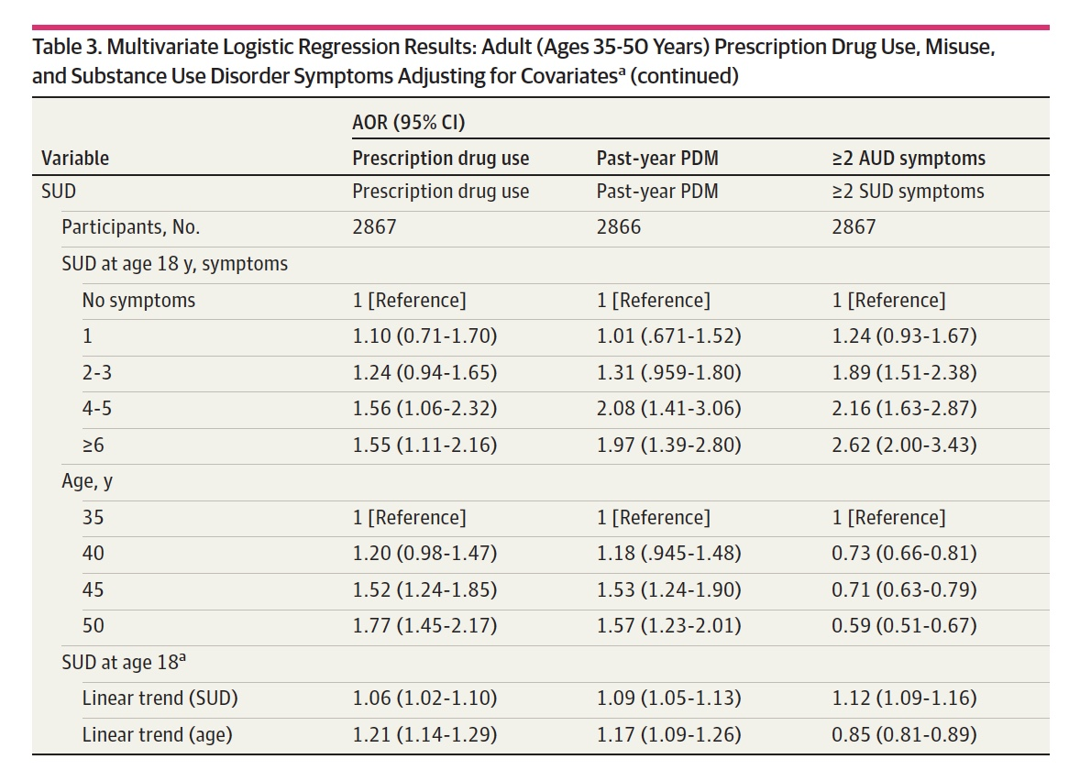
Substance use disorder early in life matters
McCabe, Schulenberg, Schepis et al, JAMA Netw Open 2022
Notes:
Add summary of what Dan said on Monday

Slide 7
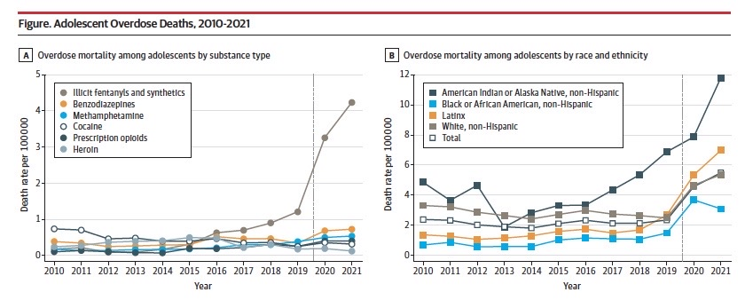
Overdose deaths significantly increasing among adolescents
Friedman J et al. JAMA, 2022

Slide 8
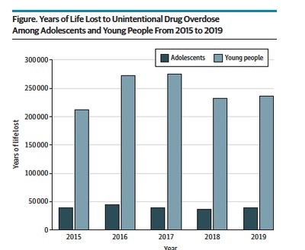
Years of life lost to overdose crisis
200,000 YLL among adolescents
1.25 million YLL among young people
Hall et al, JAMA Peds, 2022

Slide 9
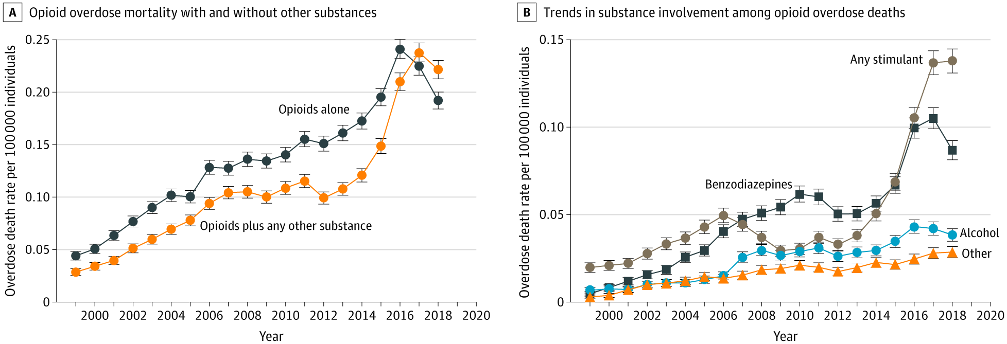
Stimulant-involved deaths increasing among youth
Lim et al., 2020 JAMA Pediatr.

Slide 10
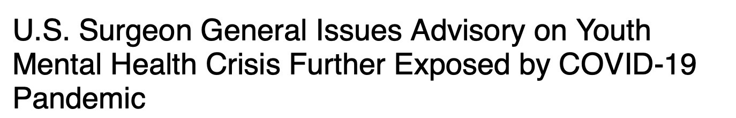
Mental health crisis worsening
Centers for Disease Control and Prevention, US Dept of Health and Human Services

Slide 11
Identify 2 opportunities and 2 barriers to provide evidence-based addiction care for adolescents and young adults
2

Slide 12
Case
20 year-old female referred to us from the adolescent/emerging adult crisis stabilization program
Has had multiple admissions related to opioid use and never offered medication treatment until this last admission
Started on buprenorphine at program and we then see her for regular follow-up
Despite relapse, she explicitly says that medication treatment has made a huge impact on recovery

Slide 13
What does treatment look like for youth?

Slide 14
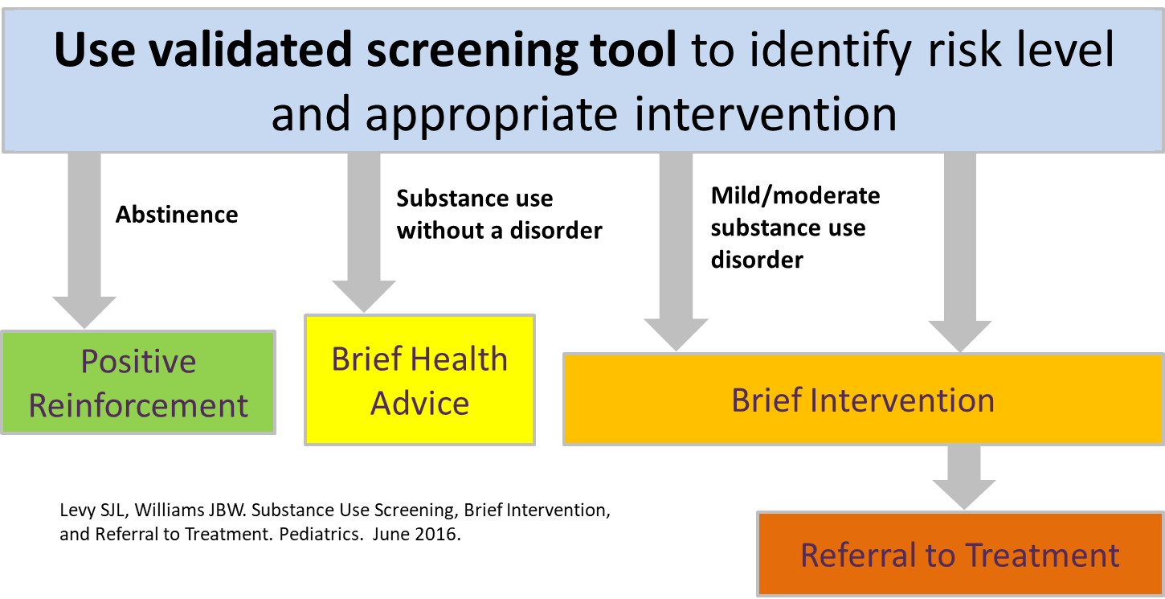
Screening, Brief Intervention and Referral to Treatment (SBIRT)
Slide courtesy of Nic Chadi

Slide 15
Privacy and confidentiality
Important to clarify the limits of confidentiality
Should be discussed with every young person at the beginning of every visit
Encourage the youth to be honest/truthful
Create a space where the youth will feel comfortable sharing sensitive information
Reasons to breach confidentiality (i.e. to parents):
  Self-harm/suicidality, harm to others, sexual abuse
Slide courtesy of Nic Chadi

Slide 16
Validated Screening Tools
BSTAD: Brief Screener for Tobacco, Alcohol, and other Drugs (Kelly S, 2014)
S2BI: Screening to Brief Intervention (Levy, 2014)
CRAFFT 2.1+N: Car-Relax-Alone-Forget-Friend-Trouble (Knight, 2002)

Slide 17
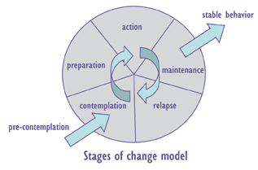
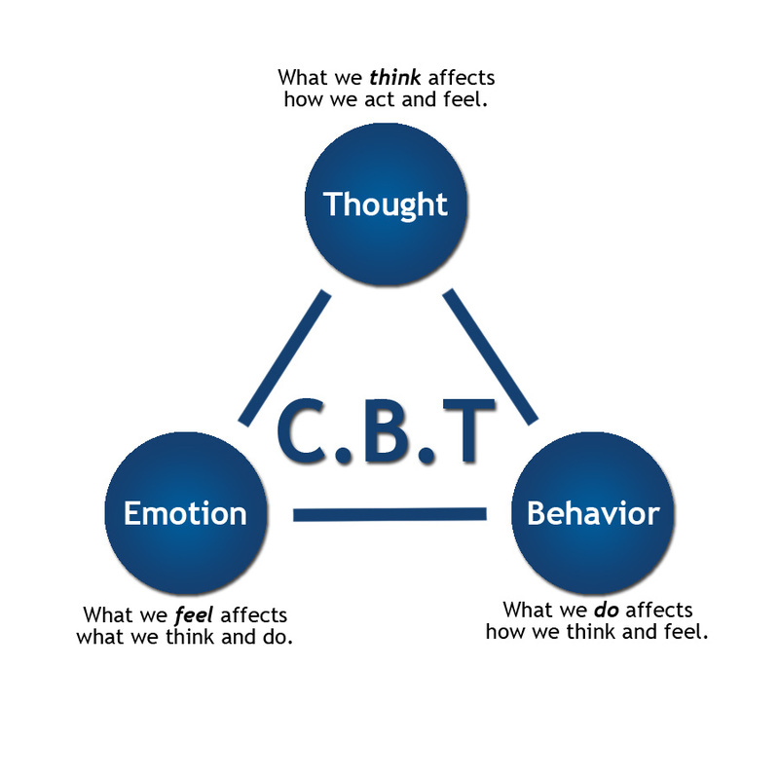
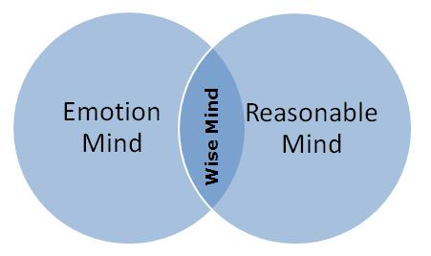
Behavioral approaches for TAY with substance use disorders
Motivational Interviewing
Cognitive Behavioral Therapy
Dialectical Behavior Therapy
Contingency Management
Behavior
Consequence
Slide courtesy of Nic Chadi

Slide 18
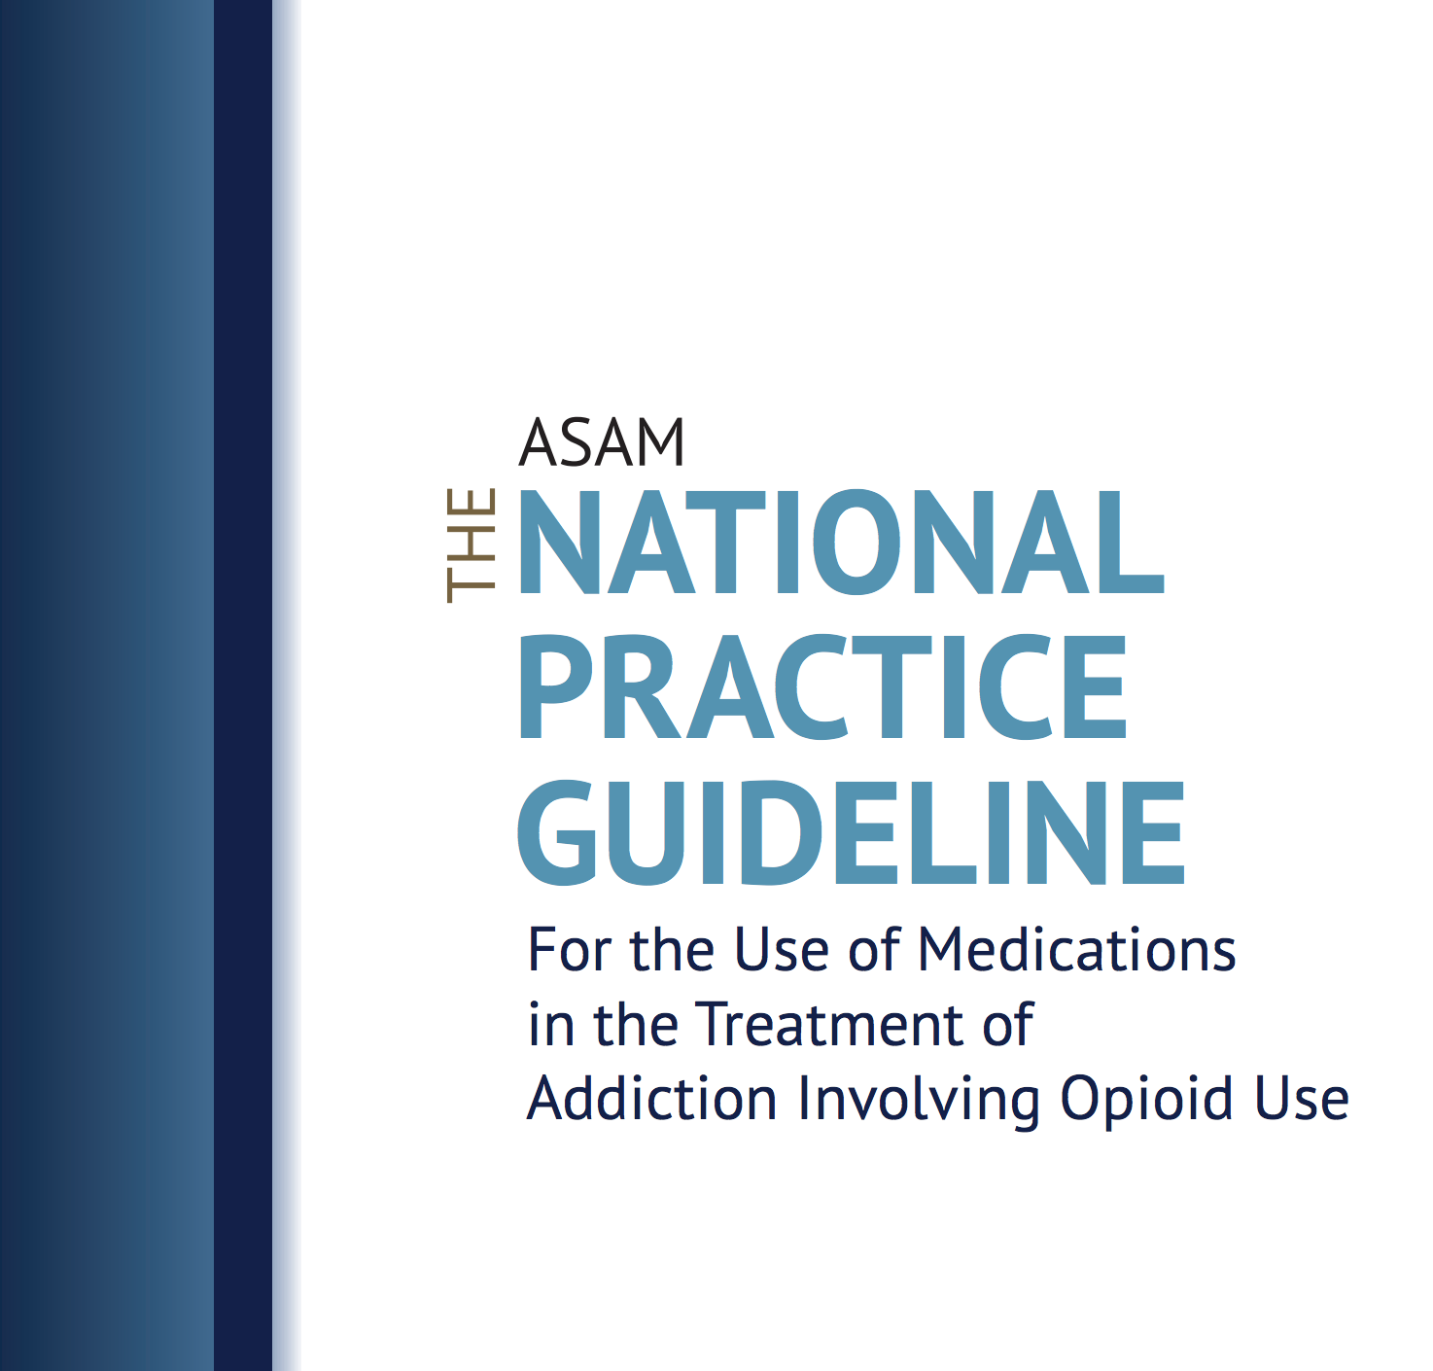
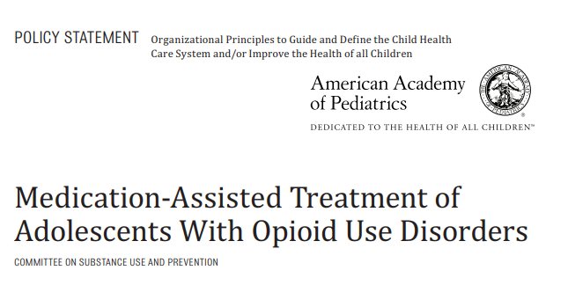
When is pharmacotherapy indicated?
American Academy of Pediatrics (2016):
  Encourage pediatricians to consider offering medication treatment or discuss referrals to other providers for this service
American Society of Addition Medicine (2015):
  Clinicians should consider treating adolescents using the full range of treatment options, including pharmacotherapy
Committee on Substance Use and Prevention Medication-assisted treatment of adolescents with opioid use disorders. (2016) Pediatrics.
Kampman K & Jarvis M. (2015) Journal of Addiction Medicine.

Slide 19
What’s the evidence for medication treatment for opioid use disorder?
Improved retention in care (clinical trials and observational data)
Decreased opioid positive urine drug tests (clinical trials)
Improved mortality (observational data)
BUT AYA youth have poorer retention!
Woody et al., (2008) JAMA
Marsch et al. (2016) Addiction
Fishman et al. (2010) Addiction
Matson et al., (2014) J Addict Med

Slide 20

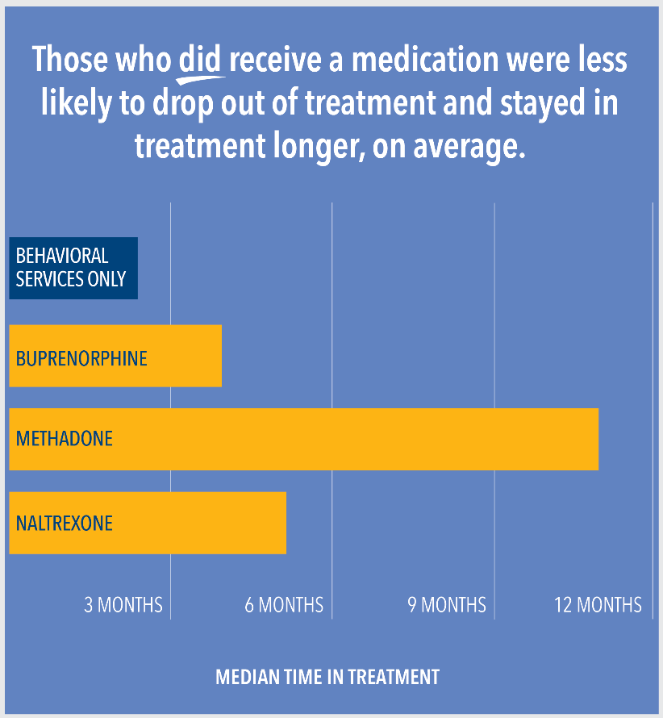
Low timely receipt of medication among youth
Only 1 in 4 youths received treatment within 3 months of OUD diagnosis
Hadland et al. (2018) JAMA Pediatr.
https://www.eurekalert.org/pub_releases/2018-09/bmc-bsa091018.php

Slide 21
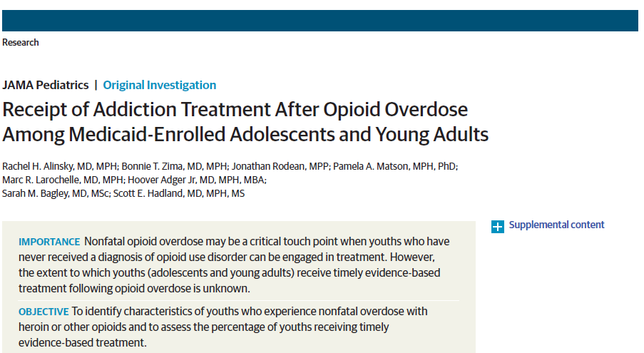
Access to timely addiction treatment lacking
<1/3 received timely addiction treatment after overdose
Only 1 in 54 received MOUD
Youths who experienced a heroin overdose were significantly less likely than those who overdosed on other opioids to receive any treatment
Alinsky et al. (2020) JAMA Pediatrics

Slide 22
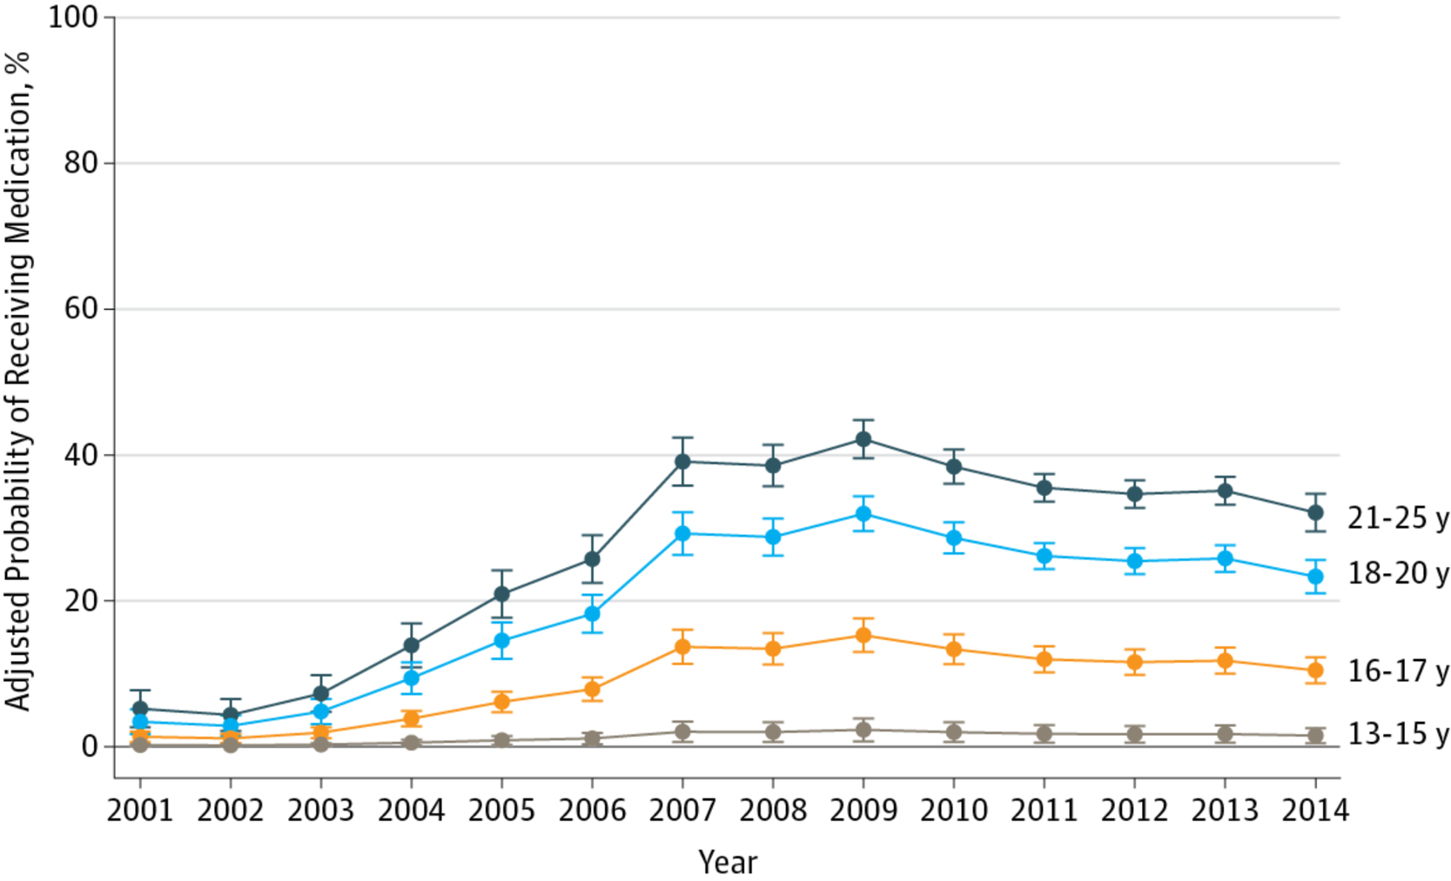
Inequities of medication receipt
Black youth 42% less likely to receive medication
Hispanic youth 17% less likely to receive medication
Hadland SE, et al. (2017) JAMA Pediatr
Notes:
Scott- here I think that you can add that there are data highlighting that black youth are less likely to use MJ than white youth but more likely to be justice involved/arrested for their use: https://www.ncbi.nlm.nih.gov/pmc/articles/PMC3477985/
Long history of racism built into addressing SU that likely contributes to mistrust of health care and treatment

Slide 23
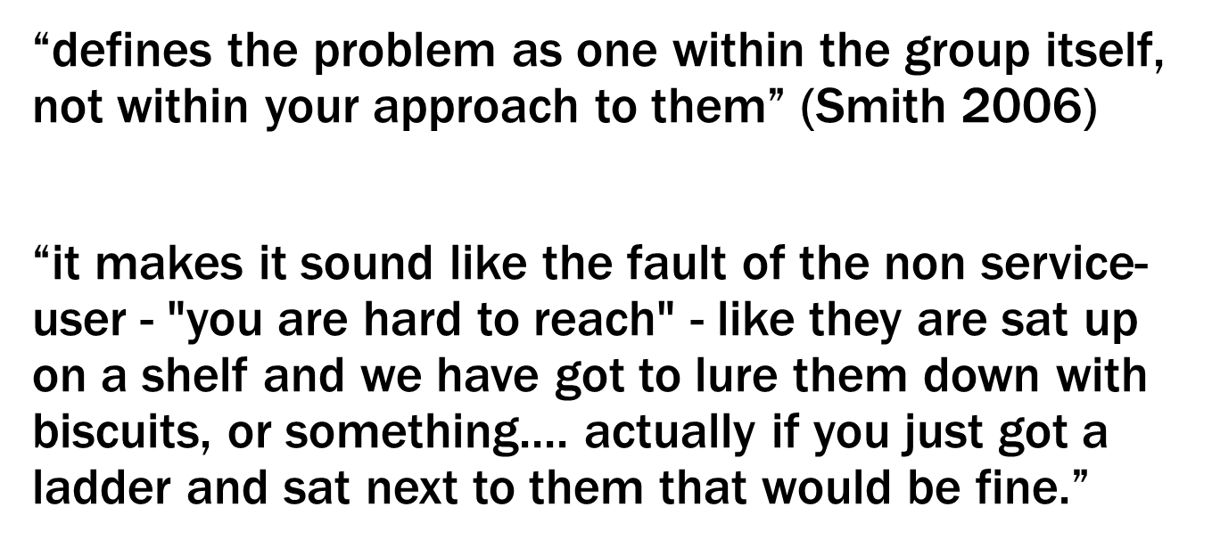
Language Matters: “hard to reach”
Freimuth & Mettger 1990 Public Heealth Rep.
Flanagan & Hancock 2010 BMC Health Serv Res.

Slide 24
Recovery Perspectives
“They don't want their life to continue to be defined by their substance use, including if that means being defined by not using substances…But, I don't think that's what most people want… I think the conversation isn't just about …people won't die … It's like people will be present for their lives again.”
Eitan (non-binary, 23)
Schoenberger SH, JGIM, 2022

Slide 25
Impact of family beliefs
“The other day my mom was like, ‘Are you getting off of it yet? How long till you get off it’ and I'm like, ‘Mom, we just talked about this. If I get off it too quick, I'm just going to relapse. Let me do it in my own time.’ She's like, ‘It's been long enough.’”
Maria (female, 29)
Bagley SM, J Addict Med, 2022 (in press)

Slide 26
Ambivalence and stigma
“I feel like nobody wants to have to depend on something. And you're sick if you don't take it so it's like… It's a very helpful medication but still that's the downside of it. You still aren't going to feel good. And I feel a Suboxone or methadone withdrawal is worse than a heroin withdrawal.”
Leanne (female, 25)
Bagley SM et al, under review

Slide 27
Considerations for youth focused models of care for opioid (any) use disorder
Confidentiality
Family involvement
Harm reduction
Addressing co-occurring mental health disorders
Hadland SE, Park T, Bagley SM. (2018) ASCP.
Bagley SM et al. (2018) JAMA.

Slide 28
Harm Reduction and Youth
Naloxone!
HIV prevention and PrEP
Clean syringes and supplies for injecting drugs, fentanyl test strips
Abstinence may not be the goal for many AYA
Safer sex supplies

Slide 29
Addressing the needs of women

Slide 30
Context: Why we do we care about gender in addiction?
Gender differences exist in the:
Origins
Development
Course and treatment of SUD
Historically men used alcohol/drugs more > women
Addiction services, research, and polices have been either tailored to men or designed using a gender-neutral approach
Gender-neutral approaches tend to benefit men > over women
They fail to consider the specific needs of women
Meyer JP, et al. Drug Alcohol Depend. 2019
Keyes KM, et al. Drug Alcohol Depend. 2008
Slide courtesy of Miriam Harris

Slide 31
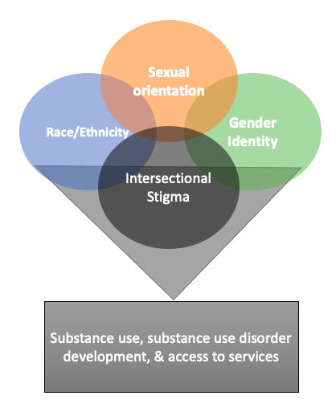
Intersectionality
Hankivsky O, et lal. Soc Sci Med. 2012
American Civil Liberties Union, 2021.
Slide courtesy of Miriam Harris
Notes:
Sex and gender interact with race/ethnicity, class, sexual orientation, and other social categories
Racism is a primary driver of drug law enforcement and public conceptions of drug use
In the US Black women are disproportionately targeted by laws and policies that reinforce racial inequities in the consequences of substance use.

Slide 32
Why understanding intersectionality matters
Transgender and genderqueer women are 2 X > to misuse alcohol/ dugs compared to cis-gender women
Transgender and genderqueer higher risk for other SUD related comorbidities, gender-based violence, suicide, and murder
Racism is a primary driver of drug law enforcement and public conceptions of drug use
  Black, Indigenous and other Women of color are disproportionately targeted by laws & policies
  Reinforce racial inequities & drive consequences of substance use
Connolly D, et al. Addict Behav. 2020
Waltermaurer E, et al. Violence Women. 2006
Slide courtesy of Miriam Harris

Slide 33

Gender impact on substance use disorder
Women who use start using drugs/alcohol have higher rates of psychiatric comorbidities & trauma
Women develop substance use disorders and health-related problems in less time (telescoping)
Women develop more severe SUDs
Women experience higher rates of harms from drug use
  Injection related infections
  HIV
  HCV
McHugh RK, et al. Clin Psychol Rev.
Pinkham S, et al. Reprod Health Matters. 2008
El-Bassel N, et al. J Acquir Immune Defic Syndr. 2015
Slide courtesy of Miriam Harris

Slide 34
Inequities in receipt of treatment
Among 5247 women with an opioid use disorder in Massachusetts, Black non-Hispanic and Hispanic women had lower odds of receiving medication treatment
Black non-Hispanic and Hispanic women were also less likely to receive buprenorphine
Although addiction touches everyone, our responses do not
Schiff DM et al. JAMA Open Network, 2020

Slide 35
Pregnancy: Opportunity for engagement but many barriers
36 states recognize fetuses as potential victims of crime, Tennessee explicitly criminalizes drug use during pregnancy, 23 states classify drug use during pregnancy as child abuse, 3 states find drug use during pregnancy as grounds for civil commitment
25 states (including MA) mandate reporting of prenatal drug use to child welfare services
Despite this…
88% of pregnant women self-disclosed their substance use to their obstetric provider
Chapman SLC, et al. Women Health. 2013
Slide courtesy of Miriam Harris

Slide 36
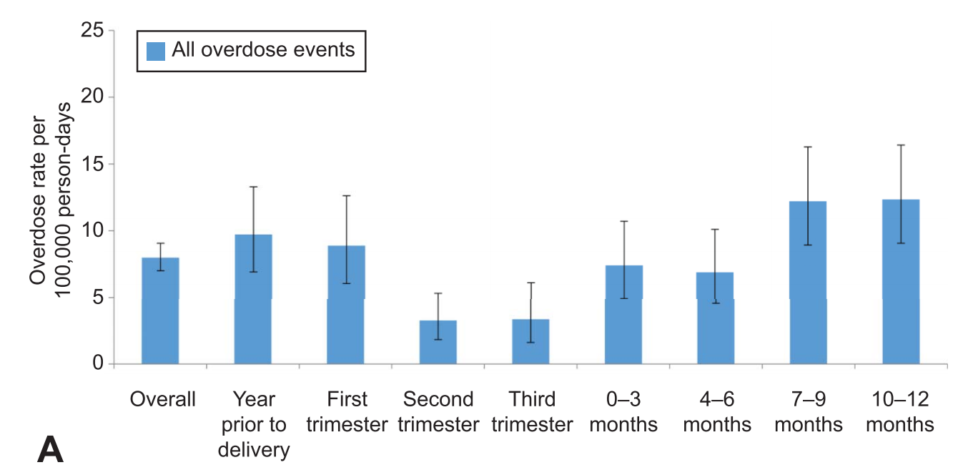
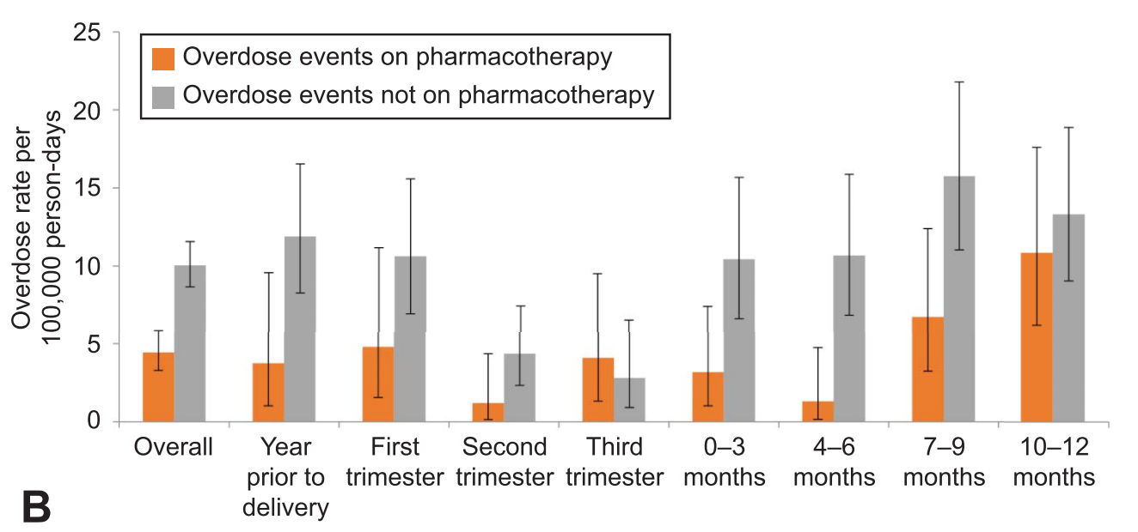
Overdose risk dependent on treatment status
Schiff DA et al, Obstet Gynecol, 2018

Slide 37
Parenting
Same stressors leading to drug and alcohol use and SUD development among women can be exacerbated when parenting
  increases in stress, sleep deprivation, and economic responsibilities
Integrated treatment programs are superior to siloed care
  Dyadic models = provide care to both parents and children
  Integrated programs increase treatment retention, reduce parenting stress, decrease substance use & relapse
Moreland AD, et al. J Subst Abuse Treat. 2018
Slide courtesy of Miriam Harris

Slide 38
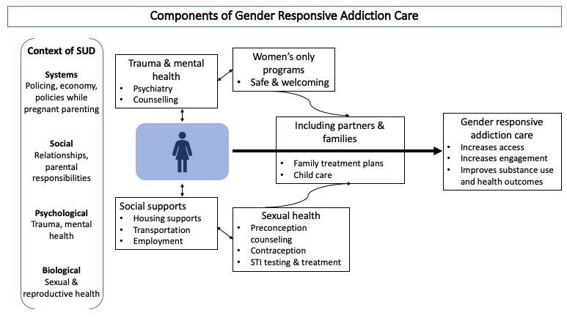
Slide courtesy of Miriam Harris
Notes:
Trauma and mental health: As discussed earlier, co-occurring mental health disorders and trauma is high among women with substance use disorders. Programs should offer trauma informed integrated treatment for co-occurring mental health disorders, including considering single-gender group therapy, which some women report offers a safer environment.⁶⁶
Sexual health: If available, programs should offer comprehensive reproductive and sexual health care. In addition to routine screening for sexually transmitted infections, age-appropriate cervical cancer screening, assessing pregnancy timing goals, and providing appropriate counseling for contraception or preconception should be offered. Addressing the sexual and reproductive health needs of women increases engagement with addiction treatment.⁹³
Social needs: Different clinical programs will have varying capacity to respond to social needs affecting women. However, having the capacity to refer to clinical and community supports such as housing services, life skills programs, and recovery management are necessary. Where possible providing child care, transportation and cell phones for those who need them can concretely increase access to care for women.⁹⁴
Women’s only programs: Women’s only treatment offers a safe environment that women may be more comfortable accessing. Programs unable to offer women’s only spaces all of the time could alternatively offer select women’s only groups, days, or times for treatment or harm reduction services.⁹⁵
Including partners and families: Data demonstrate the importance of including families and partners in treatment.⁹⁶ Families can provide critical support for women outside of the clinical setting at home and in the community. When possible, this includes providing childcare services for parenting women.

Slide 39
Availability of gender-responsive services among SUD treatment programs, United States 2019
Ancillary services | Percent of facilities offering services
Case management | 96%
Mental health | 75%
Transportation assistance | 46%
Domestic violence | 38%
Child-care for client’s children | 6%
Residential bed for client’s children | 3%
*Data derived from the Substance Abuse and Mental Health Services Administration 2019 National Survey of Substance Abuse Treatment Services (N-SSATS)⁴⁸
Slide courtesy of Miriam Harris

Slide 40
THANK YOU

Slide 41
Screening for Drug Use during Pregnancy
American College of Obstetricians and Gynecologist recommends universal screening at first prenatal visit using validated tool (4Ps, NIDA quick screen, and CRAFFT)
Urine drug testing can be done if there is a positive test but MUST be done with the patient’s permission

Slide 42
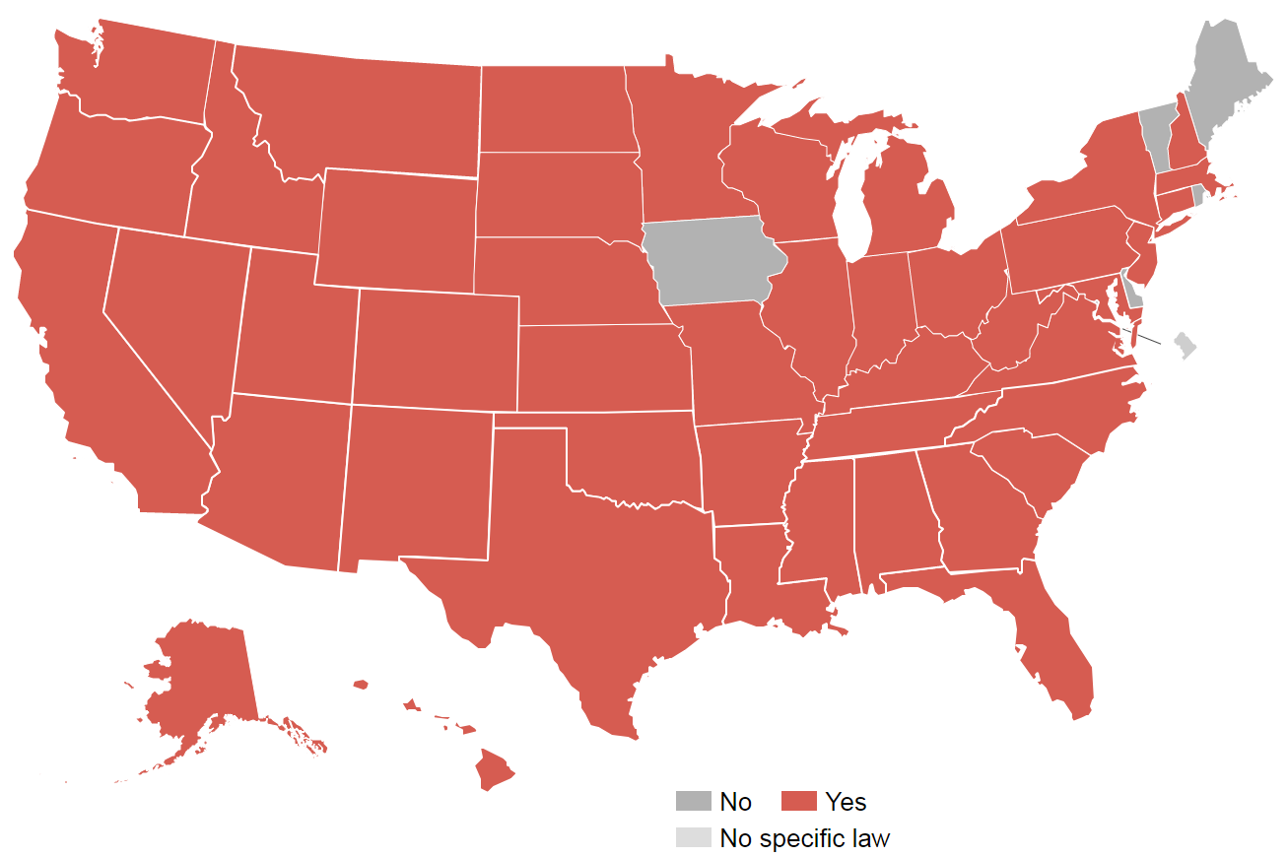
Criminalization of pregnant people and parents who use drugs
States where women have been prosecuted for drug use during pregnancy
Projects.propublica.org

Slide 43

Breastfeeding
Breastfeeding rates among women with OUD vary widely
Breastfeeding is an important aspect of the postpartum period
Specific advantages of breastfeeding for substance-exposed mother-infant dyads
  Reduces severity of neonatal-opioid withdrawal syndrome
  Decreases need for pharmacologic treatment
Welle-Strand GK, et a.l. Acta Paediatr Oslo Nor. 2013
Slide courtesy of Miriam Harris

