Slide 1



The Science of Addiction
Immersion Training in Addiction Medicine Program 2022
April 2022
Daniel P. Alford, MD, MPH
Professor of Medicine
Associate Dean, Continuing Medical Education
Director, Clinical Addiction Research and Education (CARE) Unit

Slide 2
Substance Use Disorder
Substance Use Disorder a diagnostic term in DSM-5 recurrent use of alcohol or other drugs causing significant impairment, such as health problems, disability and failure to meet major responsibilities, craving, withdrawal and tolerance
It combines the DSM-IV categories of substance abuse and substance dependence into a single disorder measured on a continuum from mild, moderate, or severe
Each specific substance is addressed as a separate use disorder
American Psychiatric Association DSM-5 (2013)

Slide 3
Addiction
Addiction indicates the chronic stage of Substance Use Disorder (synonymous with “moderate to severe Substance Use Disorder”)
It is a primary, chronic disease of the brain reward, motivation, memory and related circuitry
Like other chronic diseases, addiction often involves cycles of relapse and remission
Without treatment, addiction is progressive and can result in disability or premature death
Volkow ND et al. N Engl J Med. 2016

Slide 4
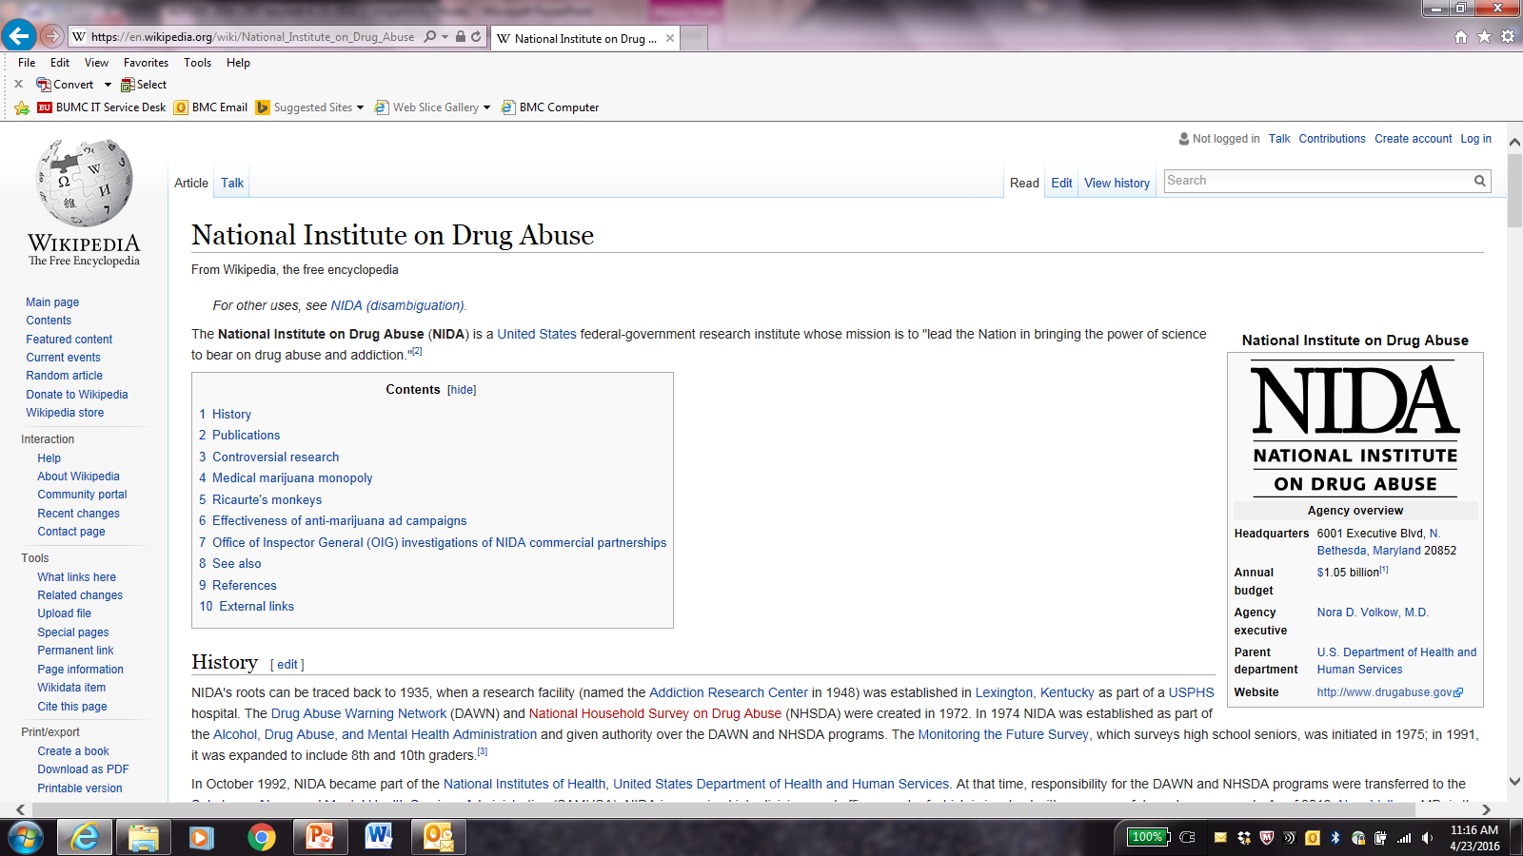
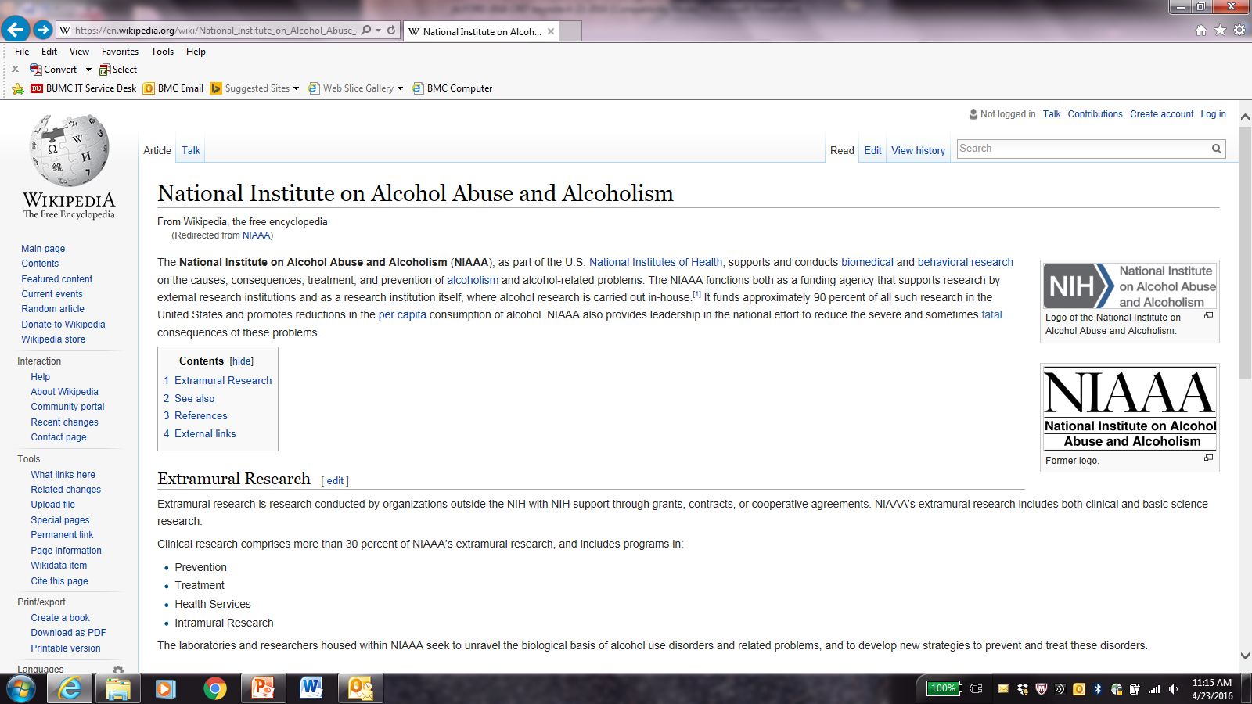
Some Important Organizations (Acronyms)
NIDA (National Institute on Drug Abuse)
  supports and conducts biomedical and behavioral research on the causes, consequences, treatment, and prevention research on drug use and addiction
NIAAA (National Institute on Alcohol Abuse and Alcoholism)
  supports and conducts biomedical and behavioral research on the causes, consequences, treatment, and prevention of alcoholism and alcohol-related problems

Slide 5

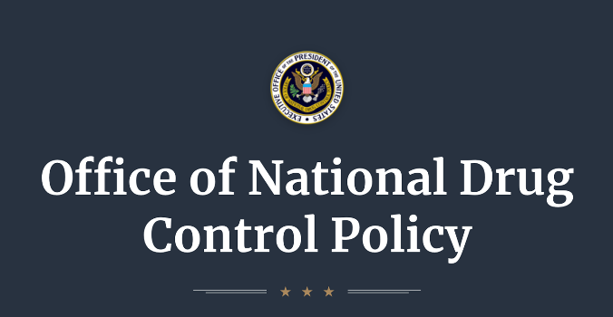
Some Important Organizations (Acronyms)
SAMHSA (Substance Abuse and Mental Health Services Administration)
  a branch of the U.S. Department of Health and Human Services charged with improving the quality and availability of prevention, treatment, and rehabilitative services for substance use and mental illnesses
ONDCP (Office of National Drug Control Policy)
  establishes policies, priorities, and objectives to eradicate illicit drug use, manufacturing, and trafficking, drug-related crime and violence, and drug-related health consequences

Slide 6


Trends: some Sources of Data
National Survey on Drug Use and Health (NSDUH)
  annual since 1971, SAMHSA survey on use of illicit drugs, alcohol, and tobacco in the US civilian, noninstitutionalized population aged >12 years. In 2020, face-to-face interviews at place of residence shifted to web-based interviews obtained from 36,284 individuals
Monitoring the Future (MTF)
  annual since 1975, NIDA funded survey of 8th, 10th, and 12th graders measuring drug, alcohol, and cigarette use by the University of Michigan. More than 11,800 students from 112 public and private schools across the US participated in the survey

Slide 7
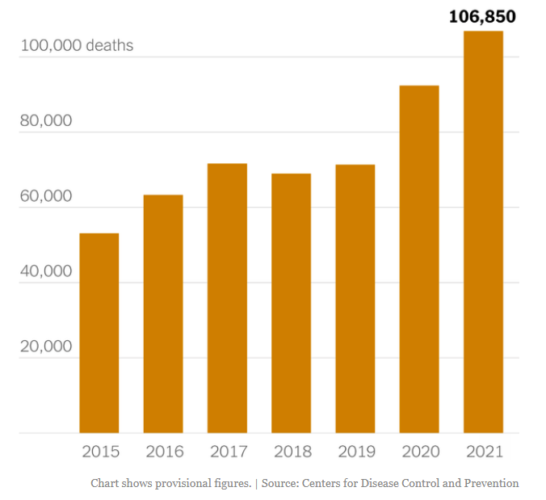
Drug Overdose Deaths Continue to Increase
Opioids - mainly synthetic opioids, are the main driver of drug overdose deaths
  73% of opioid-involved overdose deaths involve synthetic opioids
Drug overdose deaths involving psychostimulants (i.e., cocaine, methamphetamine) are increasing with and without synthetic opioid involvement
www.cdc.gov/drugoverdose/deaths/index.html

Slide 8
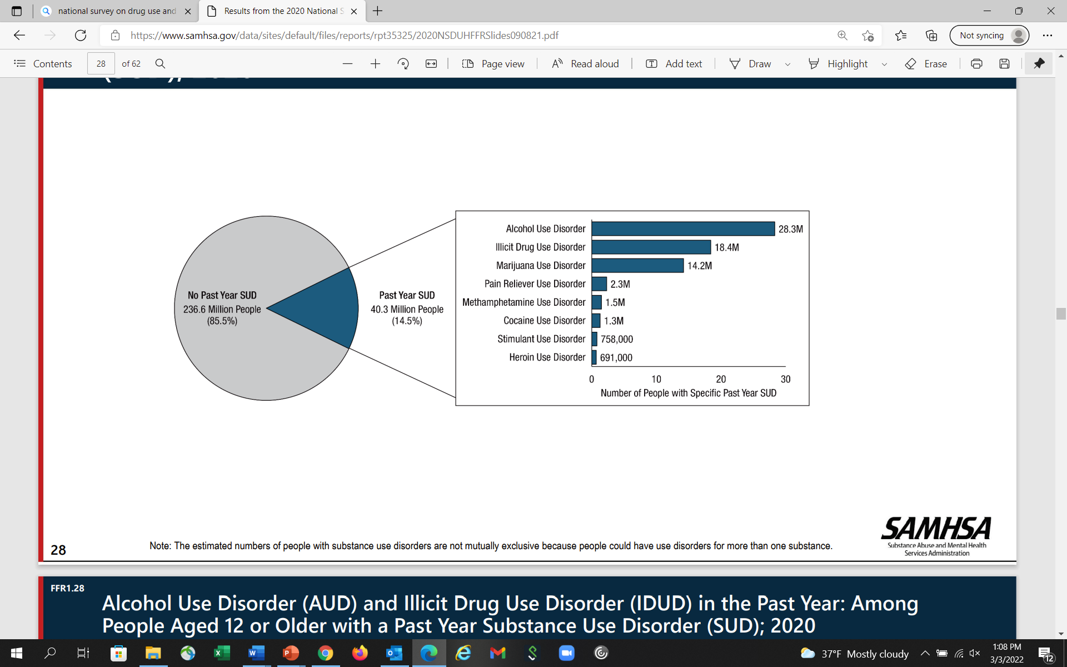
Past Year Substance Use Disorder
~3M
SAMHSA. (2021). 2020 National Survey on Drug Use and Health

Slide 9
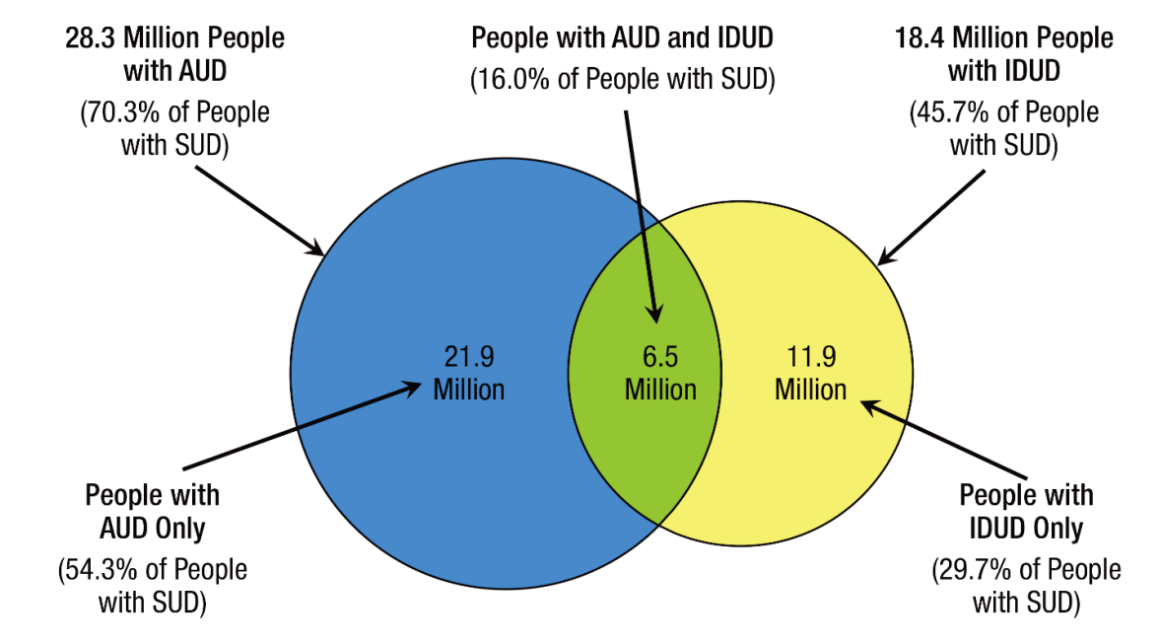
Past Year Alcohol and Drug Use Disorders
SAMHSA. (2021). 2020 National Survey on Drug Use and Health

Slide 10
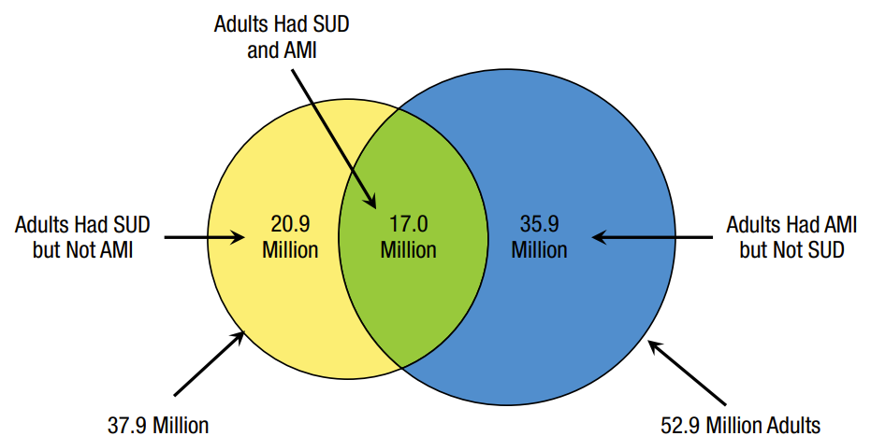
Past Year SUD and Any Mental Illness*
*Any mental, behavioral, or emotional disorder in the past year to meet DSM criteria (excluding developmental disorders and SUDs)
23%
28%
49%
SAMHSA. (2021). 2020 National Survey on Drug Use and Health

Slide 11
Addiction Is a Developmental Disease
1.8
Tobacco
Cannabis
Age at tobacco, alcohol and cannabis dependence, as per DSM IV
1.6
Alcohol
1.4
1.2
1.0
% in each age group to develop
first-time dependence
0.8
0.6
0.4
0.2
0.0
5
10
15
20
25
30
35
40
45
50
55
60
65
70
75
Age
National Epidemiologic Survey on Alcohol and Related Conditions (NESARC), 2003
Notes:
designed to assess the prevalence of alcohol use disorders (AUD) and their associated disabilities in the general population. The survey is the largest ever comorbidity study of multiple mental health disorders among U.S. adults, including alcohol and other substance use disorders, personality disorders, and anxiety and mood disorders. NESARC is designed to be a longitudinal survey with the first wave fielded in 2001–2002. The second wave of interviews was completed in 2004–2005 and used the same sample of respondents.
NESARC is a nationwide household survey with a probability sample representative of US adults. The final sample for Wave 1 was 43,093 respondents; Wave 2 was 34,653 of the Wave 1 respondents.
16% of alcoholics began drinking prior to turning 12 years old, while only 9% first touched alcohol between 15 and 17. This percentage is even lower, at 2.6%, for those who first started the habit after they were 21. These statistics clearly show that introducing a person to alcohol at a very young age can put them at severe risk of dependence or abuse later on in life. Like with alcohol, the earlier someone starts to use drugs, the higher the chance that they will grow to abuse or become dependent on them later on in life.
Most new cases of drug use disorders develop during adolescence. Perhaps there is something special (“sensitive”) about adolescence for developing addiction.
Addiction is also characterized as a developmental disorder characterized by increased risk for substance use disorder for tobacco MJ and alcohol
There are many factor that contribute to the increase in incidence including
-Social/ environmental factors
- Genetic and
Neurobiological factors (Sowell brain volume subtraction method between normal 12-16 year old adolescents and 23-30 year old young adults revealed parietal, temporal and occipital lobes showed little maturational change but, importantly, dorsal, medial and lateral regions of the frontal lobes (purple) those regions involved in executive function and inhibitory control were less developed.
Adolescents with risk haplotype on Chromosome 15 that start smoking before age 15 go on to become more dependent to tobacco as adults than those with other haplotypes
Universal Prevention intervention research is aimed at developing and testing programs that can reduce drug initiation and use during this vulnerable developmental period.

Slide 12
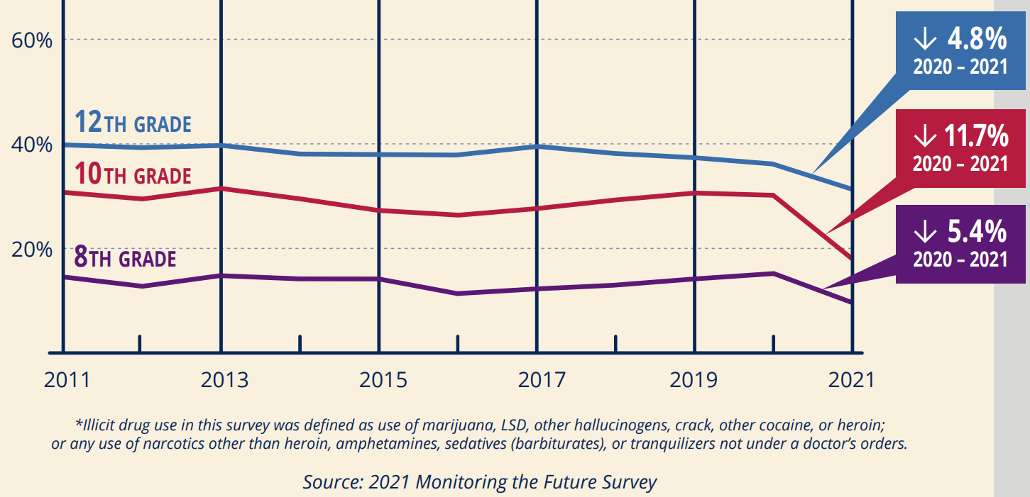
Decreases in Illicit Drug Use Among Adolescents

Slide 13
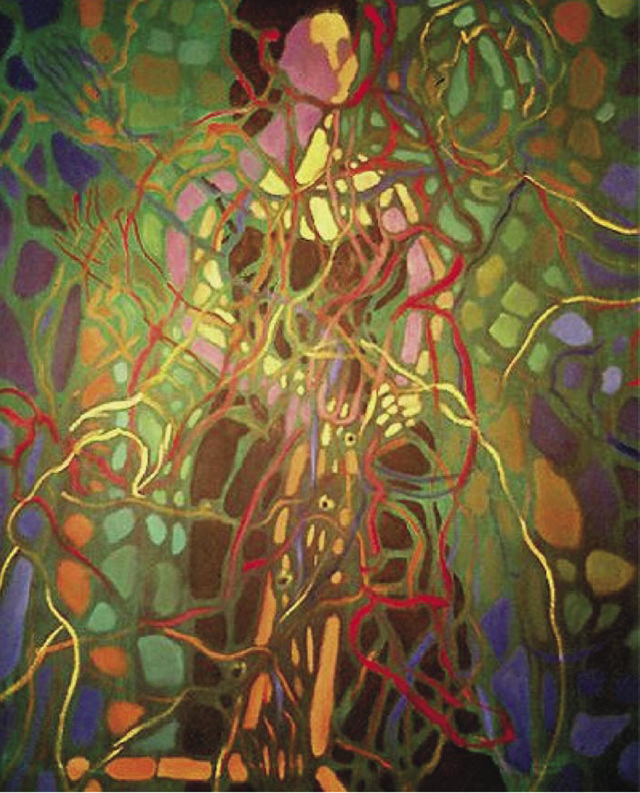

Why do people use substances?
To feel better
To lessen:
Anxiety
Worries
Fears
Depression
Hopelessness
Withdrawal
To feel good
To have novel:
Feelings
Sensations
Experiences
AND
To share them
Drawings courtesy of Vivian Felsen

Slide 14
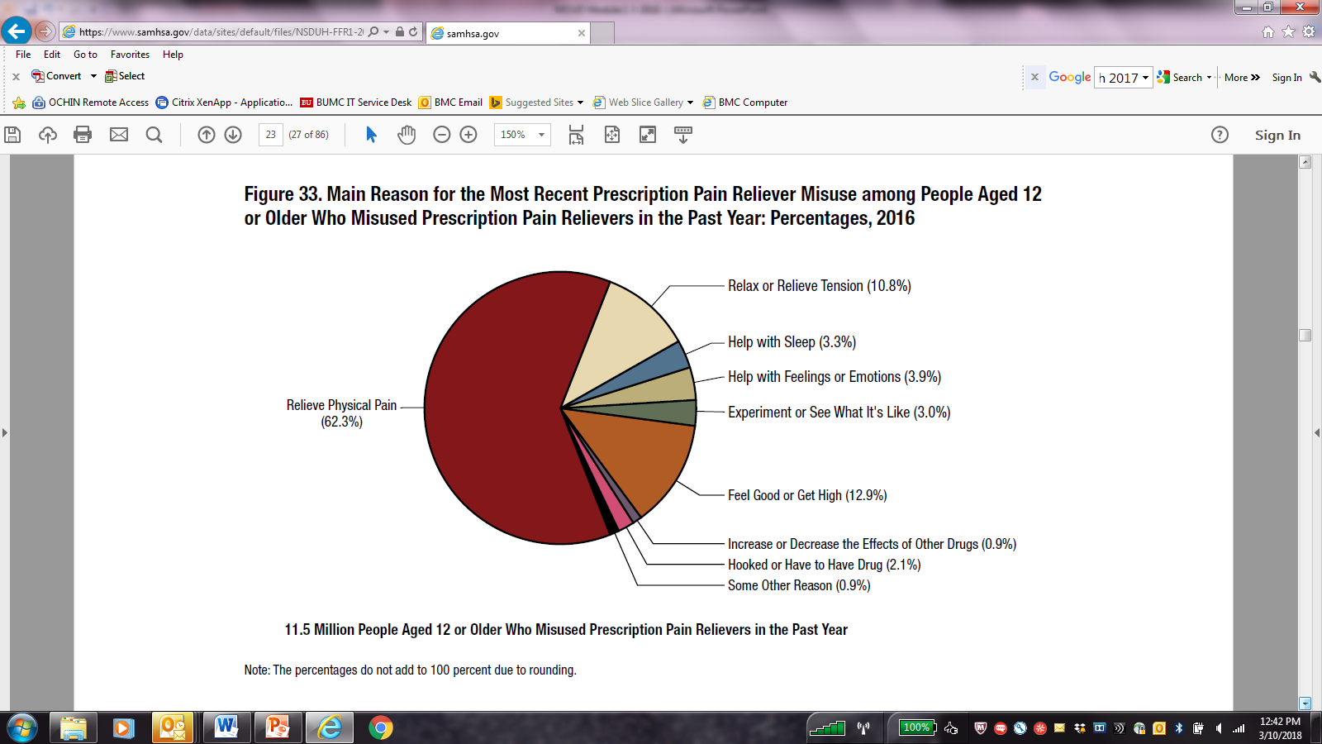
Reasons for Prescription Opioid Misuse
80% to feel better
20% to feel good
SAMHSA. (2017). 2018 NSDUH

Slide 15
?
What have we learned about vulnerability?
Why do some people become addicted while others do not?

Slide 16
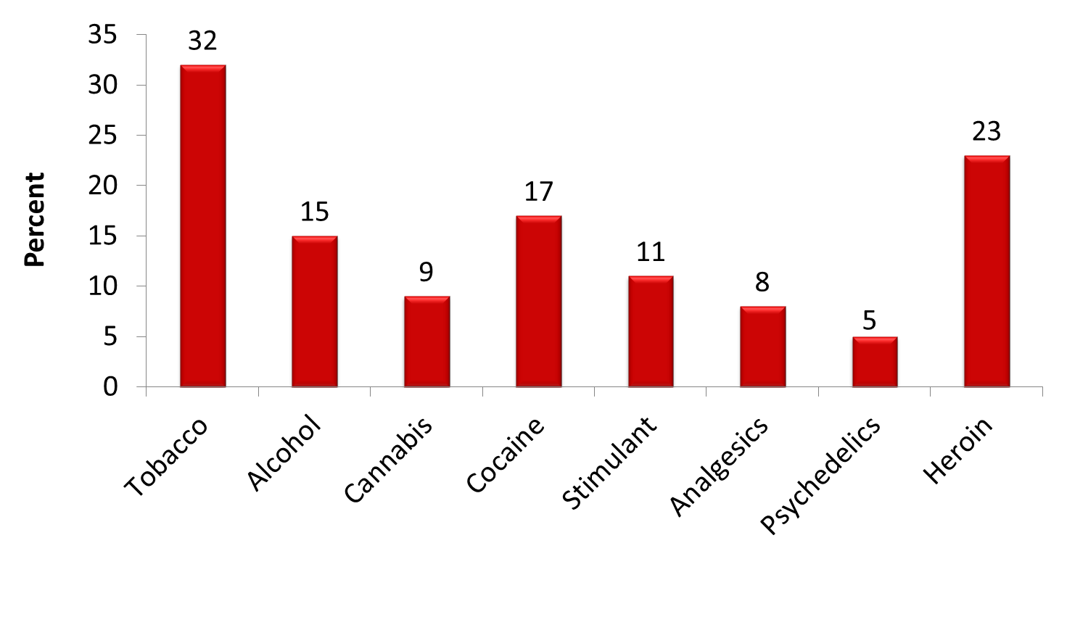
Addiction Prevalence Varies by Substance
National Comorbidity Survey (1990-1992) noninstitutionalized 15-54 years old
(n=8,098)
Estimated Prevalence of Dependence (Use Disorder) among Users
Anthony JC et al., Exp Clin Psychopharm 1994

Slide 17
Development of Substance Use Disorders
Involves Multiple Factors
Biology
Genes/Development
Environment
DRUG/ALCOHOL USE
Brain Mechanisms
Substance Use Disorder

Slide 18
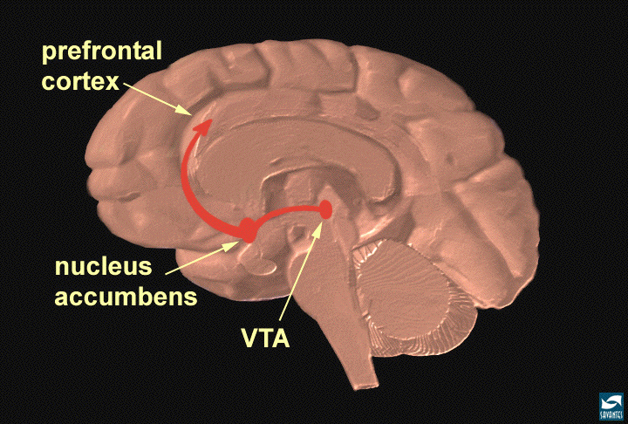
Neuronal Circuits Involved In Substance Use and Addiction
Executive Function
Inhibitory Control
PFC
ACG
OFC
Hipp
SCC
Reward
Motivation
Drive
NAcc
VP
Amyg
Memory
Learning
Notes:
FC – prefrontal cortex; ACG – anterior cingulate gyrus; OFC – orbitofrontal cortex; SCC – subcallosal cortex; NAc – nucleus accumbens; VP – ventral pallidum; Hipp – hippocampus; Amyg – amygdala.

Slide 19
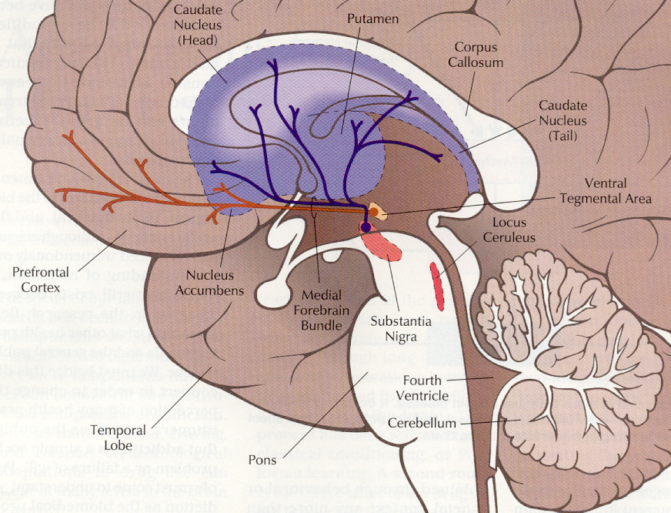
The Reward Pathway
Reward and reinforcement is in part controlled by mu-opioid receptors in the Reward Pathway:
Dopaminergic system
Ventral Tegmental Area (VTA)
Nucleus Accumbens with projections to Prefrontal Cortex
Leshner A. Hospital Practice. 1996

Slide 20
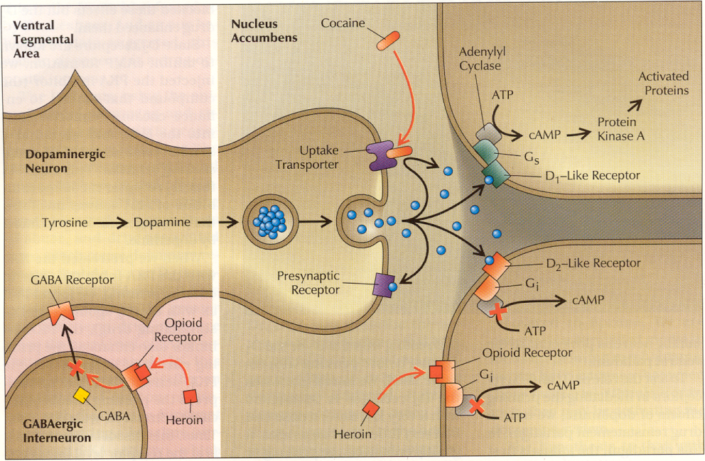
The Reward Pathway
Leshner A. Hospital Practice. 1996

Slide 21
Natural Rewards Elevate Dopamine Levels
Food
Sex
200
200
NAc shell
150
150
% of Basal DA Output
DA Concentration (% Baseline)
100
100
50
Empty
Box Feeding
Female Present
0
0
60
120
180
Sample
Number
1
2
3
4
5
6
7
8
Time (min)
Rat brain dialysis measuring extracellular synaptic dopamine concentration
Di Chiara et al., Neuroscience, 1999
Fiorino and Phillips, J. Neuroscience, 1997
Notes:
21
Natural rewards stimulate dopamine neurotransmission. Eating something that you enjoy or being stimulated sexually can cause dopamine levels to increase. In these graphs, dopamine is being measured inside the brains of animals. Its increase is shown in response to food or sex cues. This basic mechanism of controlled dopamine release and reuptake has been carefully shaped and calibrated by evolution to reward normal activities critical for our survival.

Slide 22
Drugs Elevate Dopamine More/Longer
1100
Amphetamine
400
Cocaine
1000
900
800
300
700
% of Basal Release
600
% of Basal Release
500
200
400
300
200
100
100
0
0
0
1
2
3
4
5
0
1
2
3
4
5
Hrs. after amphetamine
Hrs. after cocaine
250
250
Nicotine
Morphine
200
200
% of Basal Release
150
% of Basal Release
150
100
100
0
0
0
1
2
3
0
1
2
3
4
5
Hrs. after nicotine
Hrs. after morphine
Di Chiara G, Imperato A. Proc Natl Sci. 1988

Slide 23
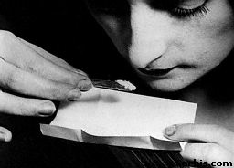
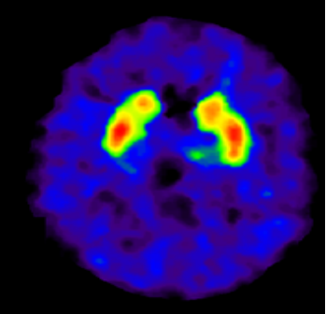
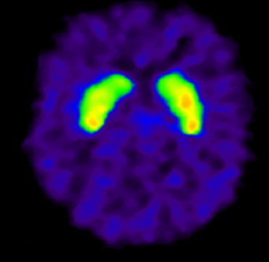

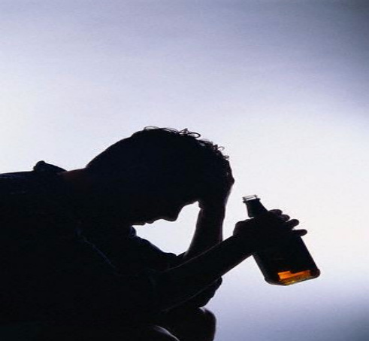
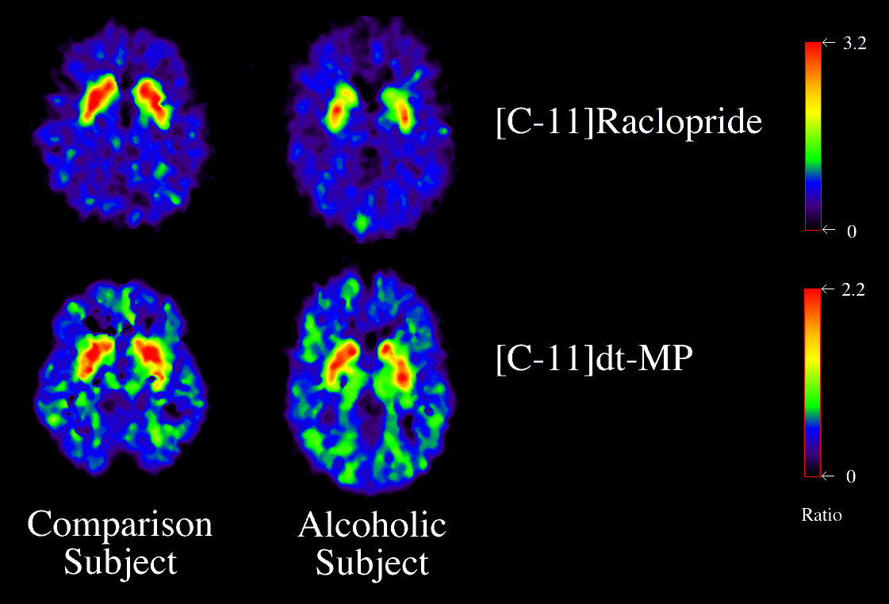
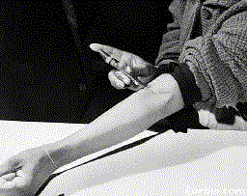
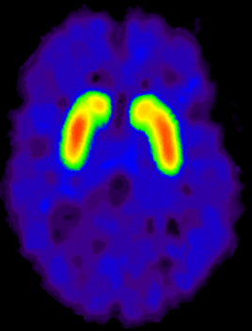
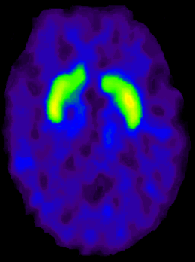
Dopamine Receptors Lower in Individuals with Addiction
“hypo-dopaminergic state”
Volkow et al., Neuro Learn Mem 2002
Clinical Presentation
Protracted abstinence syndrome
  Derangement of endogenous opioid receptor system
  Symptoms
    Malaise, fatigue, insomnia
    Poor tolerance to stress and pain
    Opioid craving
Conditioned cues (triggers)
Priming w/ small dose of drug
Cocaine
DA D2 Receptor Availability
Alcohol
Heroin
Control
Addicted
Notes:
PET studies measuring DA D2 receptors have consistently shown long-lasting decreases in DA D2 receptors in drug abusers when compared with controls (reviewed Volkow & Fowler, 2000) (Table 1) (Fig. 2). We have postulated that the decreases in DA D2 receptors coupled with the decreases in DA brain function in the drug abusers would result in a decreased sensitivity of reward circuits to stimulation by natural reinforcers

Slide 24
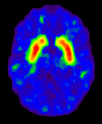
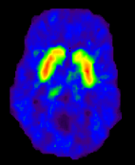
DA Receptor Levels and Predisposition for Drug Use
Striatal Dopamine D2 receptors (D2R) levels and reinforcing responses to the psychostimulant methylphenidate (MP) in nondrug-using subjects (n=7)
Subjects with low D2R levels in the striatum found MP pleasant while those with high D2R found MP unpleasant
Low D2R = “reward deficiency syndrome”
2.5
unpleasant response
0
Striatal D2R modulate reinforcing responses to stimulants and may underlie predisposition for drug use
pleasant response
D2R radioligand and PET imaging
Volkow ND et al. Synapse. 2002
Notes:
We had shown that striatal DA D2 receptors levels predicted the reinforcing responses to the psychostimulant drug methylphenidate in nondrug‐abusing subjects. Here, we assessed the replicability of this finding. We measured D2 receptors with PET and [¹¹C]raclopride (twice to determine stability) in seven nondrug‐abusing subjects to assess if they predicted the self‐reports of “drug‐liking” to intravenous methylphenidate (0.5 mg/kg). DA D2 measures were significantly correlated with “drug‐liking” in both evaluations (r = 0.82 and r = 0.78); subjects with the lowest levels reported the higher ratings of “drug‐liking” and vice versa. These results replicate our previous findings and provide further evidence that striatal DA D2 receptors modulate reinforcing responses to stimulants in humans and may underlie predisposition for drug self‐administration.

Slide 25
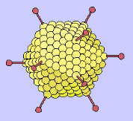
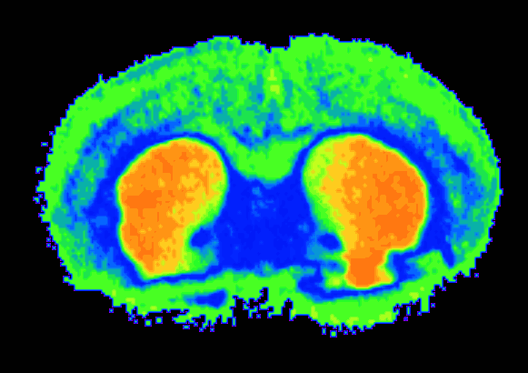
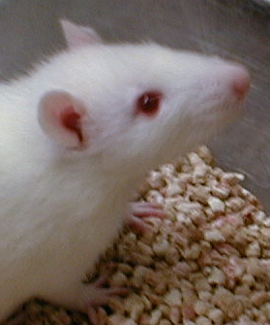
Effects of an Adenovirus Vector Carrying a D2R Gene into NAc
60
1st D2R Vector
p < 0.0005
2nd D2R Vector
50
Rats trained to self-administer alcohol
p < 0.0005
Overexpression of D2R reduces alcohol self-administration
40
p < 0.005
p < 0.005
30
Percent Change in D2R
20
p < 0.10
10
0
4
6
8
10
Null Vector
0
24
0
-20
DA
DA
-40
p < 0.01
DA
DA
% Change in Alcohol Intake
DA
p < 0.01
DA
-60
DA
p < 0.001
DA
-80
p < 0.001
p < 0.001
-100
0
4
6
8
10
24
Thanos, PK et al., J Neurochem, 2001.
Time (days)
Notes:
The mechanism(s) underlying predisposition to alcohol abuse are poorly understood but may involve brain dopamine system(s). Here we used an adenoviral vector to deliver the dopamine D2 receptor (DRD2) gene into the nucleus accumbens of rats, previously trained to self-administer alcohol, and to assess if DRD2 levels regulated alcohol preference and intake. We show that increases in DRD2 (52%) were associated with marked reductions in alcohol preference (43%), and alcohol intake (64%) of ethanol
preferring rats, which recovered as the DRD2, returned to baseline levels. In addition, this DRD2 overexpression similarly produced signi®cant reductions in ethanol nonpreferring rats, in both alcohol preference (16%) and alcohol intake (75%). This is the ®rst evidence that overexpression of DRD2 reduces alcohol intake and suggests that high levels of DRD2 may be protective against alcohol abuse.

Slide 26
Genetics
Gene
Environment
Interaction
Environment
Notes:
From Linda 10/26/00 for New Orleans Neuroscience presentation

Slide 27
Environmental Factors
Drug availability
Peers who use drugs
Family problems
Early physical or sexual trauma
Stress
Notes:
Many environmental factors also contribute to a person’s propensity to take drugs of abuse. These include having a history of physical or sexual abuse, witnessing violence, or experiencing other kinds of stressors. Drug availability is, of course, a primary environmental factor in contributing to drug abuse and addiction.

Slide 28
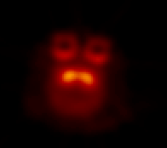
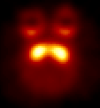
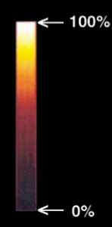
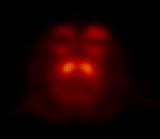
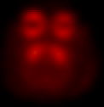
Social Stressors Change D2R Amount and Availability and Propensity to Administer Cocaine
N
Individually
Housed
Group
Housed
Dominant
50
Subordinate
Becomes Dominant
No longer stressed
40
>20% higher D2R
30
*
Reinforcers (per session)
*
20
Social Setting Can Change Neurobiology
10
0
Becomes Subordinate
Stress remains
S
.003
.01
.03
.1
Cocaine (mg/kg/injection)
N=20 monkeys
Morgan, D. et al. Nature Neuroscience, 2002
Notes:
Here we used positron emission tomography (PET) imaging to study brain dopaminergic function in individually housed and in socially housed cynomolgus macaques (n = 20). Whereas the monkeys did not differ during individual housing, social housing increased the amount or availability of dopamine D₂ receptors in dominant monkeys and produced no change in subordinate monkeys. These neurobiological changes had an important behavioral influence as demonstrated by the finding that cocaine functioned as a reinforcer in subordinate but not dominant monkeys. These data demonstrate that alterations in an organism's environment can produce profound biological changes that have important behavioral associations, including vulnerability to cocaine addiction.

Slide 29
Memory Circuit
Hipp
Amyg
MEMORY/
LEARNING
“People, places and things…”

Slide 30
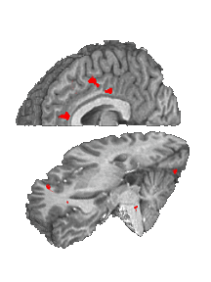

Cocaine Craving
Population (Cocaine Users, Controls) x Film (cocaine )
Cocaine Film
fMRI
Cingulate
Ant Cing
Signal Intensity (AU)
Inf Frontal
Gyrus
Controls (14) Cocaine Users (17)
Garavan H et al. Am J Psychiatry. 2000

Slide 31
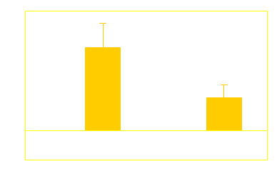
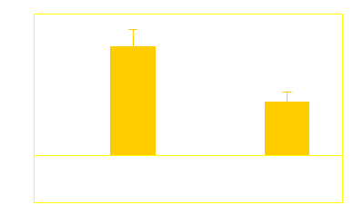
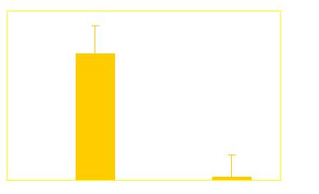
Cocaine Craving
Population (Cocaine Users, Controls) x Film (cocaine, erotic)
Cocaine Film
Erotic Film
fMRI
Cingulate
Ant Cing
Signal Intensity (AU)
Inf Frontal
Gyrus
Controls (14) Cocaine Users (17)
Garavan H et al. Am J Psychiatry. 2000

Slide 32
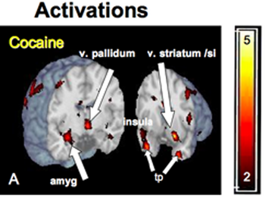
Even Unconscious Cues Can Elicit Brain Responses
Brain Regions Activated by 33 millisecond Cocaine Cues (too fast for conscious recognition)
Childress, et al., PLoS ONE 2008

Slide 33
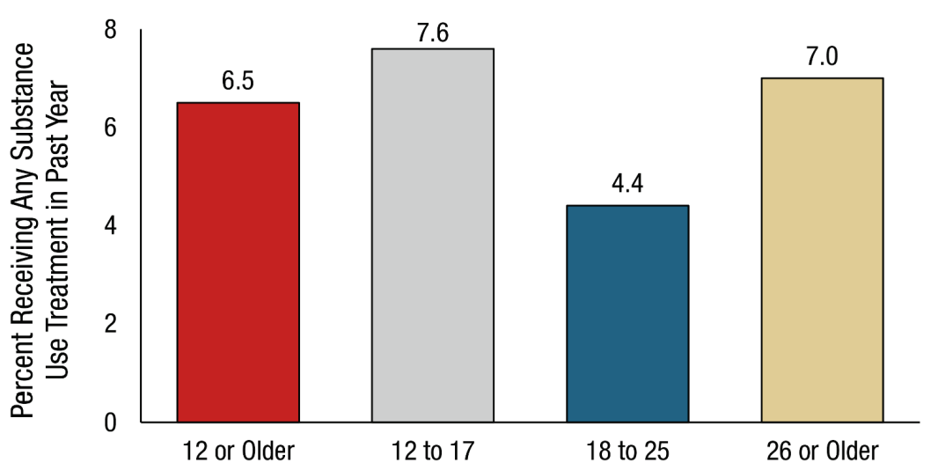
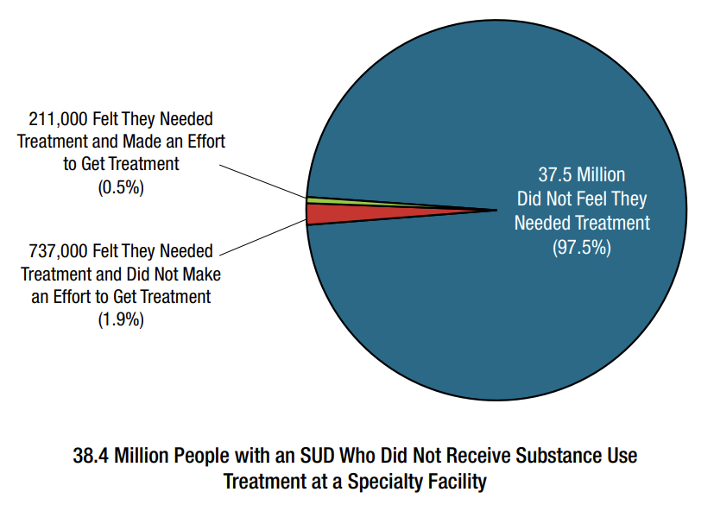
Substance Use Treatment
SAMHSA. (2021). 2020 National Survey on Drug Use and Health

Slide 34
Assessing Treatment Effectiveness
Hypertension Treatment
Addiction Treatment
IT WORKS!
FAILURE!
Stage of Treatment
Stage of Treatment
McLellan AT et al. JAMA 2000

Slide 35
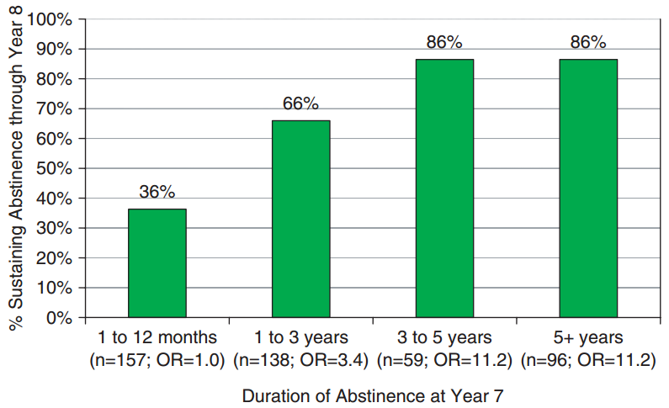
How Long is Treatment Needed?
N=482 abstinent at least a month
Divided into 4 groups based on duration of abstinence at Year 7
Measured continuous abstinence from Year 7 to Year 8
After 3 years in recovery < 15% relapse
It takes a year of abstinence before <50% relapse
Dennis ML et al. Eval Rev. 2007
Notes:
examines how the duration of abstinence at a given point is related to the odds of sustaining abstinence in the subsequent year.
This figure shows the odds of sustaining recovery to year 8 based on the duration of abstinence as of year 7.
Data are from the Pathways to Recovery sample of 1326 patients
Results show that extended abstinence is predictive of sustained recovery.
If abstinent for a year or less, only 36% were likely to still be abstinent the following year.
The odds of remaining abstinent rise above chance if patients had been abstinent 1 to 3 years. 66% percent were still abstinent the following year.
The most telling result is that beyond 3 years of abstinence recovery odds remain high and stable, as indicated by the results for both the 3-5 year group and the greater than 5-year group.
After 5 years of sobriety, their a appears to be a plateau of sustained recovery.

Slide 36
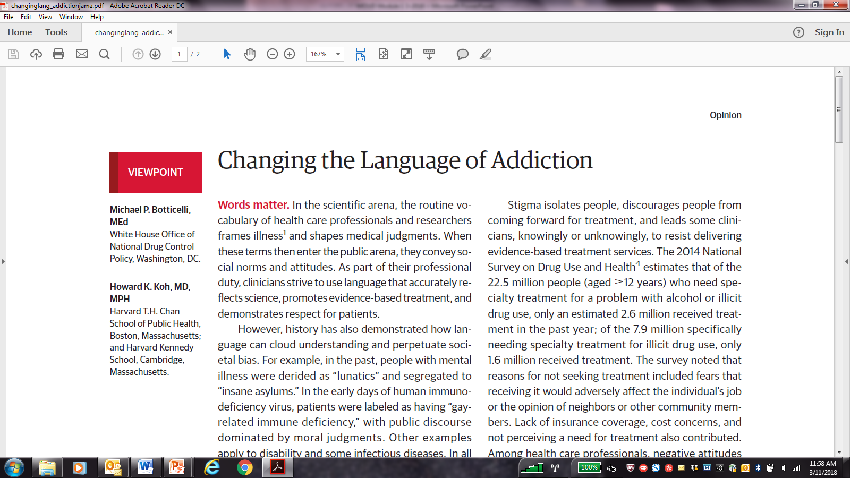
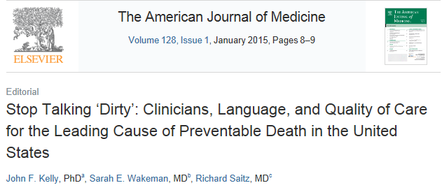
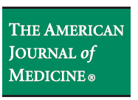
Stigmatizing Language
Non-Stigmatizing Language
Alcoholic, addict, junkie
Abuse, abuser
Addicted babies
Clean, clean urine
Dirty, dirty urine
Replacement therapy, substitution therapy
Person with a substance use disorder
Use disorder, addiction
Babies born with physical dependence
In remission (early [3m-1y], sustained [1+y])
Active substance use
Medication for use disorder
Notes:
Let’s go over some terminology : what is unhealthy substance use?
Isn’t ALL substance use unhealthy?
Is there HEALTHY substance use?
Substance use is alcohol and other drugs
Unhealthy substance use: Is a range of use 2 categories
Substance use disorder: a CLINICAL diagnosis, with diagnostic criteria , generally characterized by loss of control over use, more consequences
replaced old abuse and dependence diagnoses
At risk of risky substance use is consumption based – how much did you drink or use
We will talk about what these at risk consumption levels are
Different for alcohol and other drugs
Unhealthy substance use:
Does that mean there is a level of use that is healthy?
Probably not. It does not meant that it is bad. But it is a stretch to say something is “healthy” or “health promoting
So unhealthy substance use is alcohol and other drug use disorders and at risk use
How is at risk use defined?

Slide 37
Thanks!

