Slide 1
Substance Use Teaching Project (SUTP) Introduction
Immersion Training in Addiction Medicine Programs 2022
CRIT (Chief Residents +/- Faculty Mentor) and JFIT
April 2022
Daniel P. Alford, MD, MPH
Professor of Medicine
Associate Dean, Continuing Medical Education
Director, Clinical Addiction Research and Education (CARE) Unit

Slide 2
SUTP
To develop a teaching project that focuses on teaching addiction medicine and is achievable within 6 months after attending CRIT|JFIT
Meet (virtually) 1-on-1 with core faculty (+/- faculty mentors) during the program to develop your SUTP
Be prepared to review your SUTP worksheet by sharing your screen during your meetings with core faculty

Slide 3
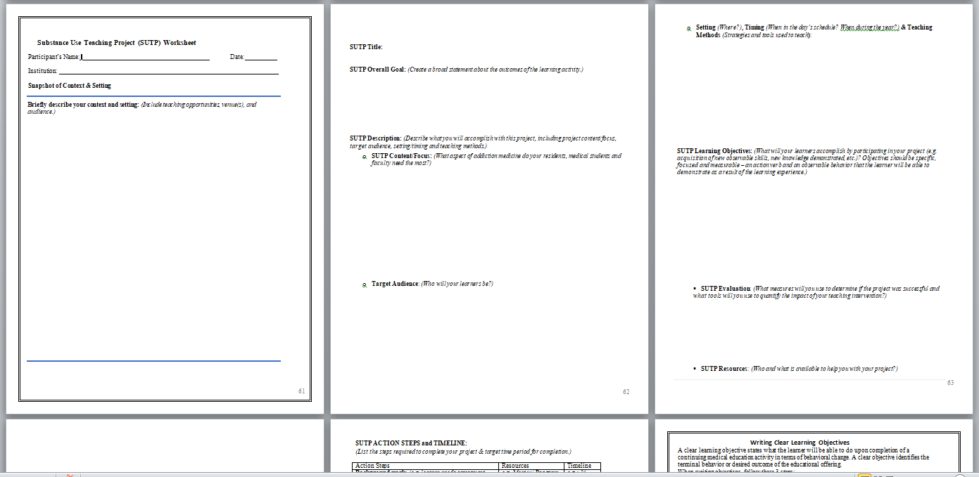

Slide 4
SUTP Examples
Intern workshop series on inpatient management of opioid and alcohol withdrawal
Resident workshop on Recovery Support programs (NA, AA) including visiting a meeting
Resident lecture on medications to treat opioid use disorders including interviewing a patient on medication (e.g. methadone, buprenorphine, naltrexone)
Addiction medicine curriculum for pre-clinic seminar series
Intern workshop on screening and brief intervention for unhealthy substance use (drug, alcohol and/or tobacco) in outpatient clinics
Addiction medicine noon conference lecture series incorporating a patient interview
Addiction medicine modules for use during morning report

Slide 5
SUTP Outline
Snapshot of Context & Setting: Describe your teaching opportunities, venues, and audience during your chief resident year
Project Title
Project Goal: Broad statement about the outcomes of the teaching activity
Project Description
Project content/focus
Target audience
Setting, timing and teaching methods
Project Learning Objectives
Project Evaluation
Resources and Facilitators
Challenges and Barriers
Action Steps and Timeline

Slide 6
Project Description
Project Content/Focus
Target Audience
Setting, Timing & Teaching Methods
Project Description
Project content/focus
Target audience
Setting, timing and teaching methods
Project Learning Objectives
Project Evaluation
Resources and Facilitators
Challenges and Barriers
Action Steps and Timeline

Slide 7
Project Description Project Content/Focus
What aspect of addiction medicine do you think your residents, medical students and faculty need most?
For example, do your residents have trouble managing patients with chronic pain problems on opioids?
If so, you may want to focus on a project to improve identification of prescription drug misuse in the resident’s clinic practice by developing curriculum to teach effective use of screening tools, safe use of opioid analgesics, monitoring for addiction using pill counts and urine drug testing.
Project Description
Project content/focus
Target audience
Setting, timing and teaching methods
Project Learning Objectives
Project Evaluation
Resources and Facilitators
Challenges and Barriers
Action Steps and Timeline

Slide 8
Project Description Target Audience
Who will be the audience e.g., interns, medical students?
Will you target all residents?
Will you include faculty?
Project Description
Project content/focus
Target audience
Setting, timing and teaching methods
Project Learning Objectives
Project Evaluation
Resources and Facilitators
Challenges and Barriers
Action Steps and Timeline

Slide 9
Project Description Setting, Timing & Teaching Methods
Where will the intervention take place? In the clinic? On the wards?
When will the intervention occur in the schedule? Noon conference? Morning report?, Pre-clinic conference?, etc.
How will you do the intervention? Lectures? Role plays (skills practice)? Experiential techniques including visiting 12 step meetings, other site visits (methadone clinic)? Use of guests in recovery? Standardized patients?
Project Description
Project content/focus
Target audience
Setting, timing and teaching methods
Project Learning Objectives
Project Evaluation
Resources and Facilitators
Challenges and Barriers
Action Steps and Timeline

Slide 10
Project Learning Objectives
What will the learners be able to do after participating in your project?
These should be specific, focused and measurable
Use verbs that describe action (see list of action verbs*) and can be observed and measured for example:
learners will be able to describe the neurobiology of opioid use disorder
learners will be able to demonstrate a brief intervention for a patient with risky alcohol use
Project Description
Project Learning Objectives
Project Evaluation
Resources and Facilitators
Challenges and Barriers
Action Steps and Timeline
*Watch me....describe, demonstrate, summarize...NOT understand, appreciate...

Slide 11
Project Evaluation
What will be your outcome measures? What measures will you use to determine if the intervention was successful?
What tools will you use to evaluate the project? (e.g., pre and post test, focus groups, chart audits?)
Project Description
Project Learning Objectives
Project Evaluation
Resources and Facilitators
Challenges and Barriers
Action Steps and Timeline

Slide 12
Resources and Facilitators
Who is available to help you accomplish your objectives for this project e.g., your mentor, program director, clinic preceptors, inpatient attendings, other faculty, CRIT faculty, etc.
What teaching tools will you use? (articles, PowerPoint presentations, CRIT materials, web-based curricula?)
Project Description
Project Learning Objectives
Project Evaluation
Resources and Facilitators
Challenges and Barriers
Action Steps and Timeline

Slide 13
Challenges and Barriers
What challenges do you anticipate and how will you overcome them? (What might impede accomplishing your project e.g., lack of time, lack of money, reluctant learners?)
Project Description
Project Learning Objectives
Project Evaluation
Resources and Facilitators
Challenges and Barriers
Action Steps and Timeline

Slide 14
Action Steps and Timeline
List each step required to complete your project and a target deadline for each step of the project
Remember, ideally your project should be completed during first 6 months after attending CRIT/JFIT but certainly can be implemented during the entire year
Project Description
Project Learning Objectives
Project Evaluation
Resources and Facilitators
Challenges and Barriers
Action Steps and Timeline

Slide 15
SUTP 2022 Schedule 1:1 core faculty mentoring meetings
Meeting #1 (20 minutes)
Monday AM
Meeting #2 (30 minutes)
Tuesday AM or Tuesday PM or Wednesday AM

Slide 16
Samples of CRITter Accomplishments
Alex Walley, MD CRIT 2003 | University of California, San Francisco
Adam Rose, MD CRIT 2004 | Montefiore Medical Center, NY
Aaron D. Fox, MD, MS CRIT 2007 |Montefiore Medical Center, NY
Notes:
Participant introductions

Slide 17
Samples of CRITter Accomplishments
Andrew Chang, MD CRIT 2011 | NYU Medical Center
Angel Brown, MD CRIT 2011 | University of Tennessee
Allison Ruff, MD CRIT 2014 | Cleveland Clinic
Jessica Taylor, MD CRIT 2015 | Beth Israel Deaconess Boston, MA
Notes:
Participant introductions

Slide 18
Samples of CRITter Accomplishments
Ashish Thakrar, MD CRIT 2019 | John Hopkins School of Medicine
Ayako Wendy Fujita, MD CRIT 2019 and FIT 2022 | Emory University
Anna LaRosa, MD CRIT 2019 | University of Pittsburgh
Notes:
Participant introductions

Slide 19
Samples of CRITter Accomplishments
Rosita Frazier, MD CRIT 2011
University of Texas
Patricia Ng, MD CRIT 2015
Brown University

Slide 20
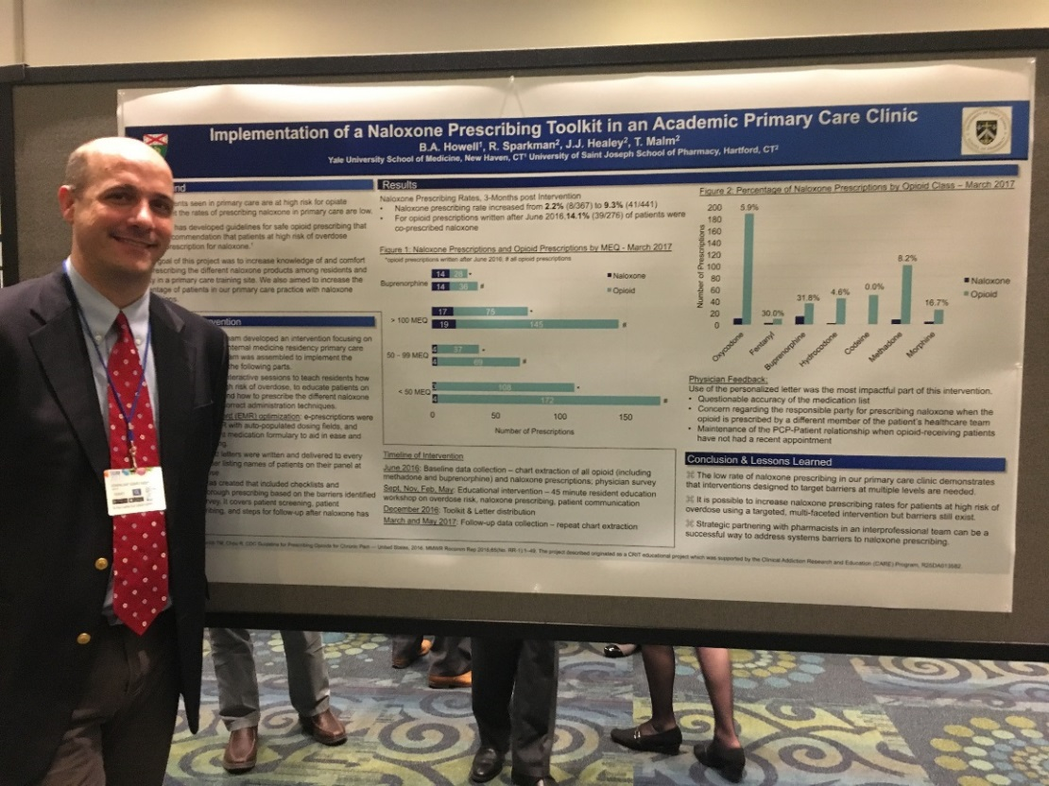
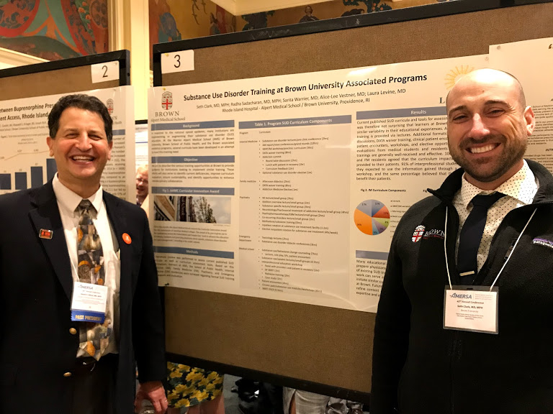
Samples of CRITter and CRIT-FM Accomplishments
Benjamin Howell, MD CRIT 2016
Yale University
Seth Clark, MD CRIT 2017
Brown University

Slide 21
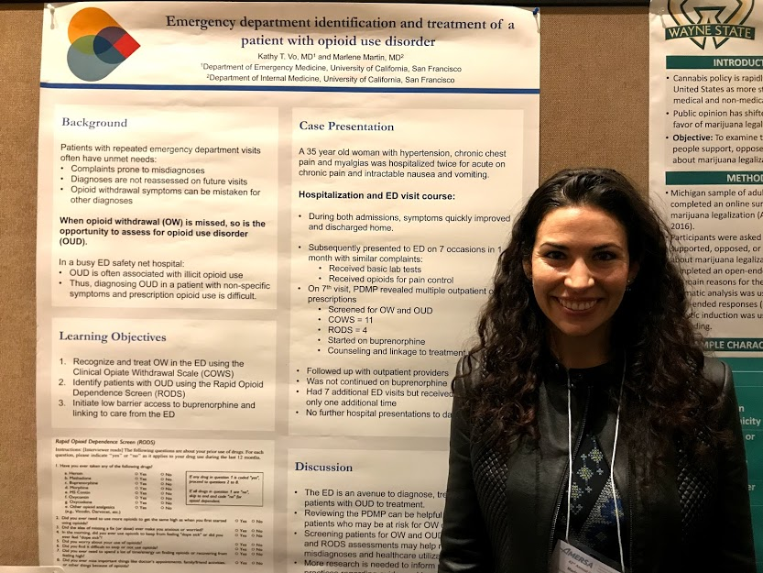
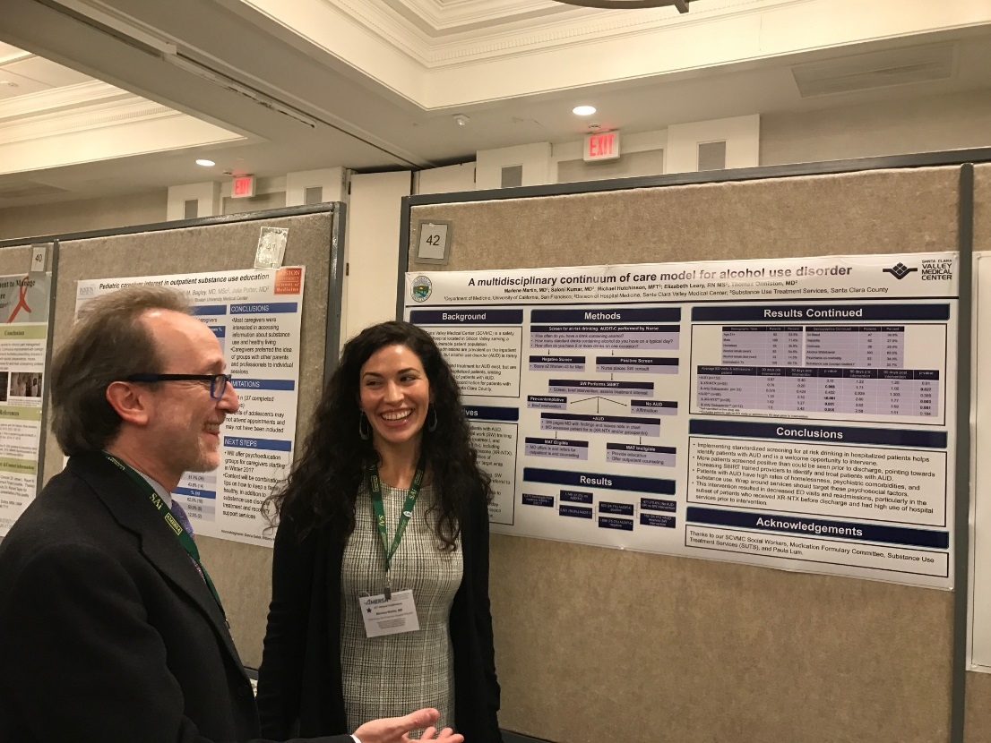
Samples of CRITter and CRIT-FM Accomplishments
Marlene Martin, MD CRIT-FM 2017
Stanford University
Marlene Martin, MD CRIT-FM 2017
Stanford University

Slide 22
Questions?

