Slide 1
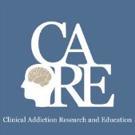


Pain, Opioids and
Addiction
Immersion Training in Addiction Medicine Programs 2022
April 2022
Daniel P. Alford, MD, MPH
Professor of Medicine
Associate Dean, Continuing Medical Education
Director, Clinical Addiction Research and Education (CARE) Unit

Slide 2
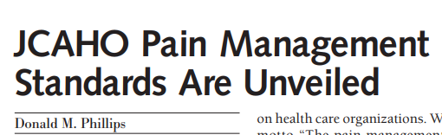
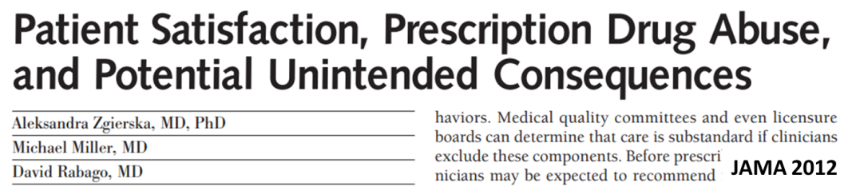
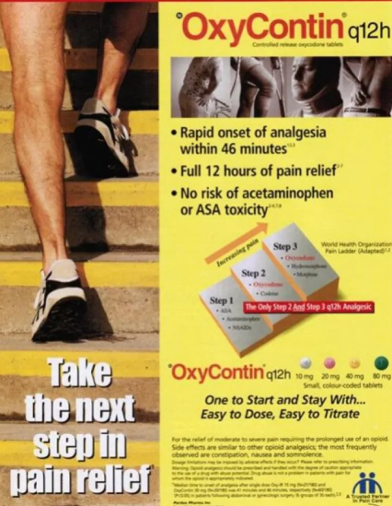
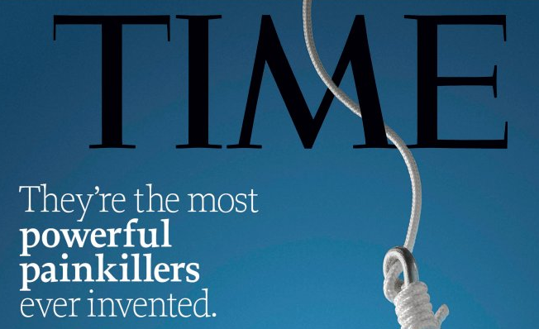
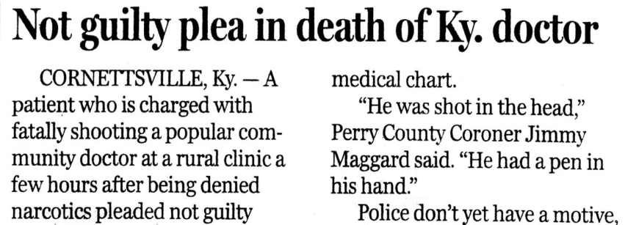
Looking Back to Move Forward
Pain as the 5th vital sign, patient satisfaction surveys
Extended-release opioids, rate hypothesis, over-marketing as safe and effective
Societal medication mania, unrealistic expectations “painkillers”
Confrontation phobia, fear

Slide 3
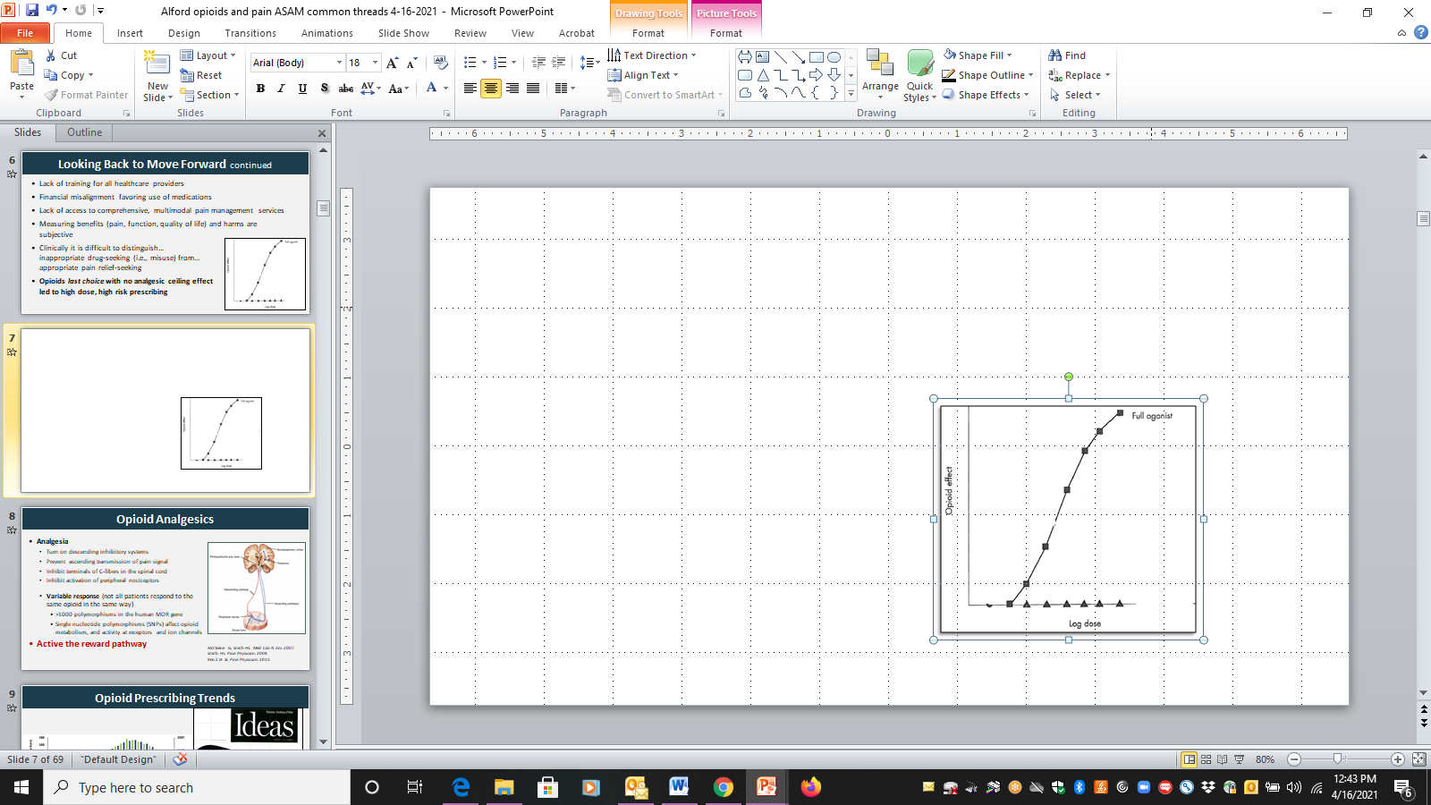
Looking Back to Move Forward continued
Lack of training for all healthcare providers
Financial misalignment favoring use of medications
Lack of access to comprehensive, multimodal pain management services
Challenges of measuring and documenting subjective benefits (pain, function, quality of life) and harms
Clinically difficult to distinguish…inappropriate drug-seeking (i.e., misuse) from…appropriate pain relief-seeking
Opioids as last choice with no analgesic ceiling effect led to high dose, higher risk prescribing

Slide 4
Chronic Pain in Perspective
Acute pain is an adaptive symptom that is life preserving
Chronic pain is maladaptive and may present as a disease in and of itself
Chronic pain is common
Pain is subjective to the patient and the clinician
Pain cannot always be visualized
Chronic pain is often associated with psychiatric co-morbidities
Chronic pain is associated higher fatal and nonfatal suicide attempts
Institute of Medicine. 2011 Relieving Pain in America. Washington DC

Slide 5
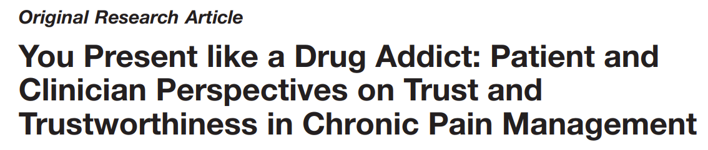
Qualitative study of adults with low back pain living in an urban setting in British Columbia, Canada
Semi-structured interviews (N=27)
Patient and provider themes
Buchman DZ et al. Pain Med. 2016

Slide 6
Patient Theme 1:
Threats to Trustworthiness and Iatrogenic Suffering
Perceptions that their clinicians have demonstrated a lack of care, empathy, and respect…affecting patients’ assessments of clinician trustworthiness… negative interactions with clinicians caused them further suffering.
SUSAN: “You could just tell that he just didn’t believe me that I was in as much pain as I was. He was just very unsympathetic. He would literally walk away while I was in the middle of a sentence.”
Buchman DZ et al. Pain Med. 2016

Slide 7
Patient Theme 2:
Motive, Honesty, and Testimony
Patients’ doubts that their clinicians believed that they were being honest about their motives for seeking treatment (e.g., drug misuse or drug diversion). Patients described being perceived as untrustworthy by clinicians
LUDWIG: “When I was in [hospital] just a couple of weeks ago…the ambulance drivers just took one look at me and it was, like—the look in their eyes was like, ‘Oh, he’s just a junkie looking to get stoned.’ They didn’t believe that I was actually suffering and in pain. They thought I was faking it completely…”
Buchman DZ et al. Pain Med. 2016

Slide 8
Clinician Theme 1:
Challenges of the Practice Context
Physicians highlighted the challenging context in which chronic pain management is delivered. They recalled several difficult interactions and the impact these interactions had on their approach to care
DR. JOHN: “The things that we remember are the times that we got burned, right . . . You may get burned one in 100, but that one in 100 is enough to burn an impression in your mind that makes you wary of all patients potentially.”
Buchman DZ et al. Pain Med. 2016

Slide 9
Clinician Theme 2:
Complicated Clinical Relationships
Chronic pain management involving opioid analgesics can prohibit or destabilize the development of trusting clinical relationships. Physicians…did not necessarily see their role as a collaborative partner…[they] saw themselves in a defensive role of interrogator
DR. HENRY: “In most doctor–patient relationships we learn to listen to the patient and accept their testimony…in some instances, to be quite honest, we are interviewing the patient as if we are a police officer or a lawyer, trying to find flaws in their story…So there is a different relationship here.”
Buchman DZ et al. Pain Med. 2016

Slide 10
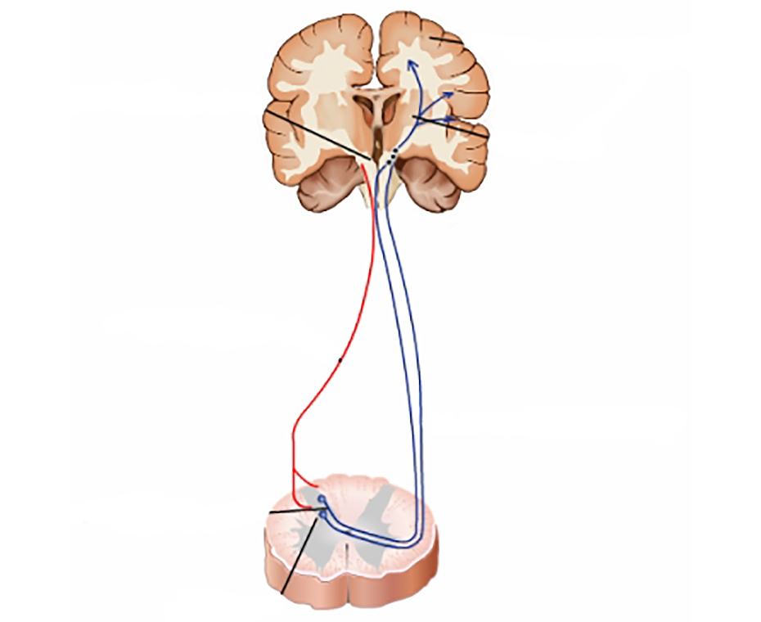
Opioid Analgesics
Analgesia
  Turn on descending inhibitory systems
  Prevent ascending transmission of pain signal
  Inhibit terminals of C-fibers in the spinal cord
  Inhibit activation of peripheral nociceptors
  Variable response (not all patients respond to the same opioid in the same way)
    >3,000 polymorphisms in the human MOR gene
    Differences in pharmacokinetics (opioid metabolism)
Active the reward pathway
Somatosensory
cortex
Periaqueductal
gray area
Thalamus
Descending
pathway
Ascending
pathways
Peripheral
nerves
Dorsal Horn
McCleane G, Smith HS. Med Clin N Am. 2007
Smith HS. Pain Physician. 2008

Slide 11
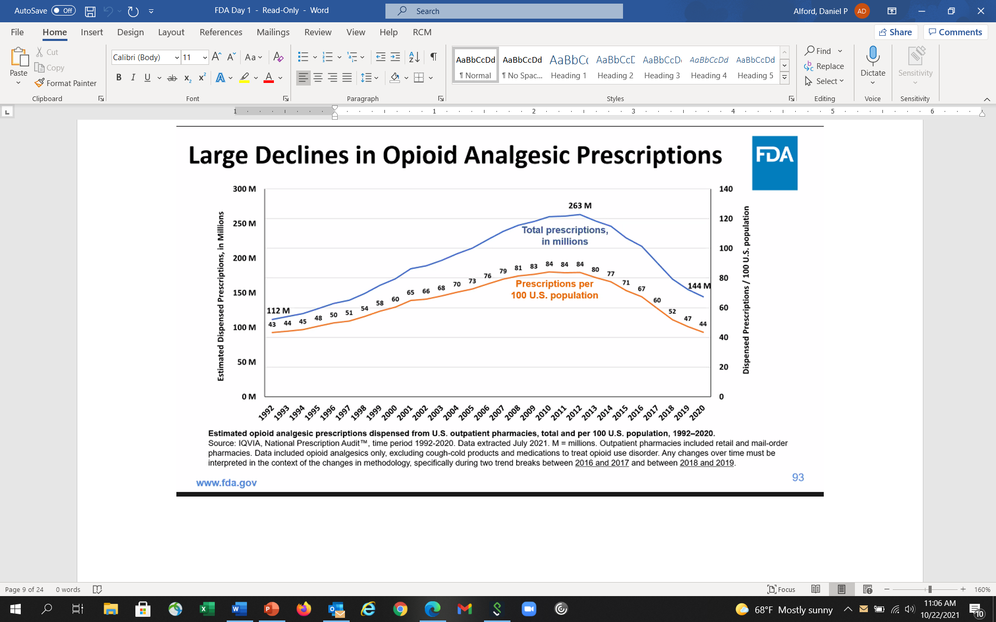
Opioid Prescribing Trends
Compared to Whites, Blacks and Hispanics are less likely to receive opioid analgesics for pain and when they do it’s at a lower dose
Morden NE et al. NEJM 2021
www.fda.gov

Slide 12
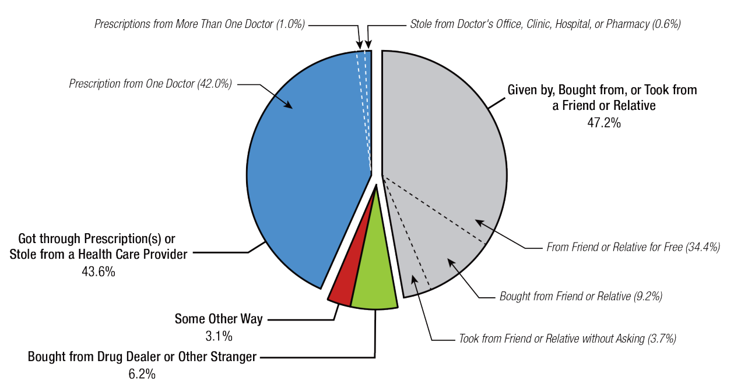
Source of Prescription Opioid Misused
SAMHSA. (2021). 2020 National Survey on Drug Use and Health

Slide 13

Opioids and Chronic Pain
“The problem is, there’s no evidence that opioids work for chronic pain, according to guidelines released in 2016 by the CDC”
Julia Lurie – reporter, Mother Jones,
April 27, 2018

Slide 14
Opioid Efficacy for Chronic Pain
Meta-analyses (1-6 month follow-up)
  Opioids v placebo (high quality evidence) Statistically significant improvements in pain^{1,2} and functioning.²
  Opioids v placebo (neuropathic pain) (low-mod quality evidence) Clinically relevant pain relief and reduction of disability³
  Opioids v nonopioids (low-mod quality evidence) Similar benefits²
RCT⁴ found opioids not superior to nonopioids for improving musculoskeletal pain-related function over 12 months
Study limitations:⁵
Excluded patients already on long-term opioids
89% of eligible patients declined to be enrolled
Two longer term follow-up studies found 44.3% on chronic opioids for chronic pain had at least 50% pain relief ⁶
1. Meske DS, et al. J Pain Res. 2018
2. Busse JW, et al. JAMA. 2018
3. Sommer C et al. Eur J Pain. 2020
4. Krebs EE, et al. JAMA. 2018
5. Webster L. Pain Med. 2019
6. Noble M, et al. Cochrane Syst Rev. 2010
Notes:
Opioid Efficacy for Chronic Pain
How good are opioids for chronic pain? What is the efficacy for chronic pain? Now, this is different than acute pain, and I would argue that the efficacy for acute pain is probably 100 percent effective. For someone who comes in with a femur fracture, we would never withhold an opioid, because we assume that they’ll be some efficacy. There may be variability in terms of how much relief somebody gets, but we wouldn’t withhold it from someone with severe pain like that.
For chronic pain, it’s completely different. We’ve already talked about it as being more like a chronic disease. Well, lately, in the past year, we’ve had a couple of meta-analyses that have looked at opioids versus placebo for chronic pain. Unfortunately, these studies only evaluate for up to three to six months, and follow-up. So, we don’t have long-term studies, but in these short-term studies for chronic pain, they show that opioids were statistically significantly better, but with a small improvement in pain, and function, versus placebo. And when they compared opioids versus non-opioids, unfortunately, these studies were low to moderate quality, they showed that both were similar in terms of benefits.
There was a study that looked comparatively between opioids, and non-opioids. It was a randomized clinical trial that found that opioids were not superior to non-opioids for improving musculoskeletal pain-related function over 12 months, so a long-term outcome. However, an important limitation is that only 5 percent of those that were randomized actually entered into the study. So, what that tells me is that someone who’s willing to enter into a study where they could be randomized to an opioid or non-opioid that they seem to do equally well on either one. What happens to that 95 percent who said, “I don’t want to be entered into the study?” It’s unclear. Two longer-term follow-up studies, up to about a year, found that 44.3 percent of individuals on chronic opioids for chronic pain had at least 50 percent pain relief. So, it’s not zero percent; it’s not 100 percent. So, it’s around 50 percent of individuals on opioids for chronic pain will get adequate pain relief.

Slide 15
Opioid Risks
Allergies are rare
Side effects are common
    Nausea, sedation, constipation, urinary retention, sweating
    Respiratory depression – sleep apnea
Organ toxicities are rare
    Suppression of hypothalamic-pituitary-gonadal axis
Immunosuppression
  Increased risk of invasive pneumococcal dz and community acquired pneumonia
Worsening pain (hyperalgesia in some patients)
Addiction (Opioid Use Disorder)
Overdose
    when combined w/ other sedatives and at higher doses
Dunn KM et al. Ann Intern Med 2010
Li X et al. Brain Res 2001
Doverty M et al. Pain 2001
Angst MS, Clark JD. Anesthesiology 2006
Wiese AD, et al. Ann Intern Med. 2018

Slide 16
Problematic Opioid Use
Systematic review from 38 studies (26% primary care, 53% pain clinics)
  Misuse rates: 21% - 29%
  Misuse: Opioid use contrary to the directed or prescribed pattern of use, regardless of the presence or absence of harm or adverse effects.
  Addiction rates: 8% - 12%
  Addiction: Pattern of continued use with experience of, or demonstrated potential for, harm (eg, “impaired control over drug use, compulsive use, continued use despite harm, and craving”).
Vowles KE et al. Pain. 2015
Notes:
So what is the opioid addiction risk? So when a patient comes to you and you prescribe opioids, what is the risk of them developing an addiction? And unfortunately, the true incidence and prevalence of addiction in chronic pain populations prescribed opioids is unknown. And a lot of it has to do with different criteria used to define addiction in different studies, and so it’s really all over the place.
And the range, if you look at all studies, is anywhere between zero and 50%, so that’s not particularly helpful other than to say it’s not 100%, and it’s probably not 0% either. And it’s probably more like 15 to 20%, when you look at the majority of studies.

Slide 17
Risk Factors: Overdose & Addiction
Medication-related Factors |  | Risk
 | Daily dose >100 MME | overdose | addiction
 | Long-term opioid use (>3 mo) | overdose | addiction
 | ER/LA opioid formulation | overdose
 | <2 weeks after starting ER/LA opioid | overdose
 | Combination opioids + benzodiazepines | overdose
Volkow ND et al. N Engl J Med 2016

Slide 18
Risk Factors: Overdose, Addiction & Misuse
Patient-related Factors |  | Risk
 | Mental health disorder (e.g. depression, anxiety) | overdose | addiction
 | Substance use disorder (e.g., alcohol, nicotine, illicit & prescription drug) | overdose | addiction
 | Family history of substance use disorder |  | misuse
 | Adolescent |  | addiction
 | Age >65 | overdose
 | Sleep-disordered breathing | overdose
 | Legal history (e.g., DUI, incarceration) |  | misuse
 | History of sexual trauma |  | misuse
 | History of overdose | overdose
Akbik H, et al. J Pain Symptom Manage. 2006
Ives J, et al. BMC Health Serv Res. 2006
Liebschutz JM, et al. J Pain. 2010
Michna E, et al. J Pain Symptom Manage. 2004
Reid MC, et al. J Gen Intern Med. 2002
Volkow ND et al. N Engl J Med 2016

Slide 19
Does my patient have an OUD?
  *Tolerance
  *Withdrawal
  Use in larger amounts or duration than intended
  Persistent desire to cut down
  Giving up interests to use opioids
  Great deal of time spent obtaining, using, or recovering from opioids
  Craving or strong desire to use opioids
Recurrent use resulting in failure to fulfill major role obligations
Recurrent use in hazardous situations
Continued use despite social or interpersonal problems caused or exacerbated by opioids
Continued use despite physical or psychological problems
?
?
?
*This criterion is not considered to be met for those individuals taking opioids solely under appropriate medical supervision
Mild OUD: 2-3 Criteria
Moderate OUD: 4-5 Criteria
Severe OUD: >6 Criteria
American Psychiatric Association. (2013). Diagnostic and statistical manual of mental disorders (5th ed.)
Notes:
The diagnosis of addiction really is based upon the four C’s: loss of control, compulsive use, continued use despite harm, and craving.
The disease of addiction is fairly easy to detect when it’s really apparent. And it always becomes very apparent because people can’t hide from the disease of addiction. Within six months, usually, of exposing somebody to an opioid, those who have clear addiction will surface.
That doesn’t mean that people who are abusing fall into the same category. They can have still very problematic behaviors that look like the disease of addiction, and maybe just as problematic, but may not be quite as egregious in their behaviors as those with the disease of addiction.
Addiction, you know, is not the same as physical dependency, and I think this is an important point that needs to be restated several times because too often physicians think that if you become physically dependent and you have some withdrawal that that means you have the disease of addiction. We see withdrawal symptoms from people who are physically dependent to anticonvulsants, anti-depressants, and a lot of cardiovascular medicines as well, and when we suddenly stop those medications and people go into withdrawal, they’re not addicted to those medicines any more than we would be with an opioid. However, people who are addicted to opioids will have withdrawal if they suddenly stop the use of their medicines as well.

Slide 20
Is my patient addicted to the prescription opioid?
A clinical syndrome presenting as…
  Loss of Control
  Compulsive use
  Continued use despite harm
Worrisome
Medication
Taking
Behaviors
Savage SR et al. J Pain Symptom Manage 2003
Addiction is a chronic relapsing brain disorder
Physical Dependence is a physiologic adaptation
Notes:
Behaviors suggestive of addiction may include: inability to take medications according to an agreed
upon schedule, taking multiple doses together, frequent reports of lost or stolen prescriptions, doctor
shopping, isolation from family and friends, and/or use of non-prescribed psychoactive drugs in addition
to prescribed medications. Other behaviors which may raise concern are the use of analgesic medications
for other than analgesic effects, such as sedation, an increase in energy, a decrease in anxiety, or
intoxication; non-compliance with recommended non-opioid treatments or evaluations; insistence on
rapid-onset formulations/routes of administration; or reports of no relief whatsoever by any non-opioid
treatments. Loss of Control over use “Every time I try to limit my use to only once a week, I end up using every day.”“I try to limit myself to one drink per day but once I start, I can’t seem to stop until I pass out.”Continued use despite knowledge of harmful Consequences “I know my drug use caused my HIV but I can’t stop using.”“I have to stop using because my life is out of control, but using is the only option for me.”Compulsion to use “All I do is think about how I am going to score.”“No matter what I do, I can’t get drugs out of my mind and I feel I have to use and use a lot. Once I want to use, it is like I am on autopilot and I just have to use. I’ll do anything to get drugs.” Craving “It’s like a physical drive or urge to use. I want it from the pit of my stomach; I get sweaty just thinking about it. At times, these urges come out of nowhere, or I get them when I meet my using buddies, pass the corner where my dealer hangs out or am feeling down.”

Slide 21
Safer Opioid Prescribing for Chronic Pain

Slide 22
Multidimensional Care for Chronic Pain
Restore Function
All studies on pharmacologic and nonpharmacologic treatments for chronic pain are < 12 m, majority are < 12 w
Tayeb BO, et al. Pain Med. 2016
  Exercise
  Manual therapies
  Orthotics
  TENS
  Other modalities
  (heat, cold, stretch)
  CBT/ACT
  Tx mood/trauma issues
  Address substances
  Meditation
Physical
Psycho-behavioral
Cultivate
Well-being
SELF
CARE
Reduce Pain
Multimodal approaches are more cost-effective than single modality options
Flor H, et al. Pain 1992
Roberts AH, et al. Clin J Pain. 1993
Patrick LE, et al. Spine. 2004
Kamper SJ, et al. Cochrane Review. 2014
Medication
Procedural
  NSAIDs
  Anticonvulsants
  Antidepressants
  Topical agents
  Opioids
  Others
  Acupuncture
  Nerve blocks
  Steroid injections
  Trigger point injections
  Stimulators
  Pumps
Improve
Quality of Life
Notes:
Multidimensional Care for Chronic Pain
I think it’s important to take a multidimensional care approach. And as you can see on this slide, it really starts in the middle with self-care, teaching patients to pace themselves, and care for themselves. And there are lots of apps, and online programs that patients can interact with to learn about self-care, and that our goals include restoring function, reducing pain, improving quality of life, and cultivate well-being.
And how do we do that? Well, we can use physical modalities: Exercise, manual therapies, certainly cycle behavior therapies, CBT, cognitive behavioral therapy, meditation, and so forth; procedures like acupuncture, and nerve blocks, steroid injections, and then medications. And there are lots of medications we can choose from, including NSAIDs, anticonvulsants, topical agents, and opioids. And we’re going to talk more about those in a while.
It’s important to note, however, that studies on all pharmacologic, and non-pharmacological treatments for chronic pain, are generally assessed for less than 12 months, and the vast majority are less than 12 weeks. So, we really don’t have any long-term studies on any treatment for chronic pain. We do know from systematic reviews that multimodal approaches are more cost-effective than single modality options.

Slide 23
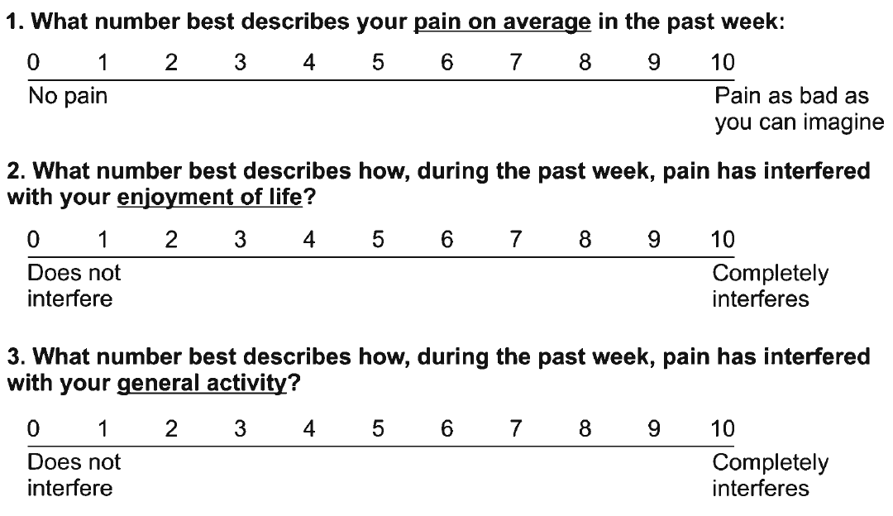
Assessing Benefit – PEG scale
Krebs EE, et al. J Gen Intern Med. 2009

Slide 24
“Universal Precautions”when Prescribing Opioids
(not evidence-based but has become “standard” of care)
Misuse risk assessment
Patient Provider Agreements (PPA)
Medication Management
  Opioids not 1st line, if used - begin with immediate-release formulations
  Minimize dose escalations leading to high MMEs (caution with any dose)
  Avoid (minimize) risky combinations (e.g., benzodiazepines)
Frequent face-to-face visits (Document risks and benefits)
Risk mitigation and monitor for adherence, addiction and diversion
  Urine drug testing (UDT) and pill counts
  Prescription Drug Monitoring Program (PDMP) data
  Naloxone co-prescribing
Gourlay DL et al. Pain Med 2005
Dowell D et al. MMWR 2016

Slide 25
Patient-Provider Agreements (PPA)
PPAs have been recommended as one opioid risk mitigation tool
FDA recommends PPAs to improve safety by clarifying treatment expectations
PPAs (n=121) from a national sample primary care clinicians and pain specialists
  Reading burden surpassed recommended patient education standards, with only 2.5% at or below fifth-grade reading level
  Focused more on rules and consequences of patients’ noncompliance than on a shared treatment plan
Laks J, et al. J Gen Intern Med. 2021

Slide 26
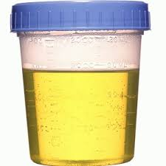
Urine Drug Testing
Objective information that can provide:
  Evidence of therapeutic adherence
  Evidence of use or non-use of illicit drugs
Discuss urine drug testing openly with patient
One medical data point to integrate with others
Urine drug screens usually immunoassays (Risk of false negatives and false positives)
  Opiate = morphine and/or codeine and/or semisynthetic opioid but never a synthetic opioids (e.g., methadone, fentanyl)
Unexpected findings confirm with Gas Chromatography (GC) or Liquid Chromatography (LC) and Mass Spectroscopy (MS) (know expected metabolites)
  e.g., hydrocodone→ hydromorphone; oxycodone→ oxymorphone
Identify a toxicologist for questions regarding unexpected results
  Argoff CE, Alford DP, Fudin J et al. Pain Med. 2018, Nagpal G et al. JAMA. 2017, Christo PJ, et al. Pain Physician. 2011
Notes:
I would use the color urine image

Slide 27
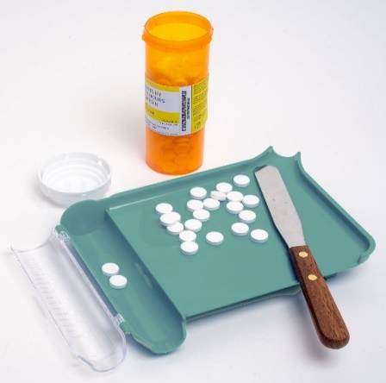
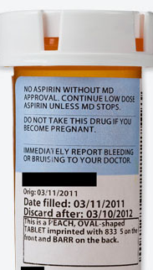
Monitoring: Pill Counts
Objective data that can provide:
  Information on medication adherence
  Information concerning for diversion
28-day supply (rather than 30 days) prevents running out on weekends
Prescribe so patient has remaining medications at appointments
Ask patient to bring in medications at each visit
Notes:
Pill Counts
Now, a word about pill counts. Pill counts can be used to confirm medication adherence, to minimize diversion and there are a couple of strategies that can be effective. First and foremost, it’s a good idea to prescribe a 28-day supply of medication and that’s rather than a 30-day supply. What that does is that ensures that patients never run out of medication on a weekend day, on a day when you may not be available to provide a refill.
It’s recommended to prescribe so that patients actually have leftover medication, have not run out of their prescription on the day of their appointment so that you can do a pill count. I think very commonly we’re writing prescriptions until the next clinic visit, but it can be a good idea to write for beyond the clinic visit so that you can then do a pill count when you see the patient. You can ask patients to bring medications to each of their visits and if you have concerns a higher level of monitoring is random pill counts where patients are called and asked to return with their pill bottles for an immediate count.

Slide 28

Monitoring: Prescription Drug Monitoring Programs (PDMP)
Objective data that can provide:
  Information on harmful polypharmacy
  Information on multiple provider use
Delegates can access in some states
Over 60% of states mandate use before prescribing controlled substances
PDMP use can change prescriber behaviors (e.g., decreased opioid prescribing)
Systematic review* insufficient evidence that PDMP implementation either increases or decreases nonfatal or fatal overdoses
Haffajee RL. N Eng J Med. 2019
Haffajee RL, et al. JAMA. 2015
Haegerich TM, et al. Drug Alcohol Depend. 2014
Patrick SW, et al. Health Affairs. 2016
*Fink DS, et al. Ann Intern Med. 2018
Notes:
Prescription Drug Monitoring Programs (PDMP)
Now, throughout our presentation we’ve mentioned prescription drug monitoring programs. These are pharmacy data that are available to prescribers and occasionally to other team members, and a majority of states now do require the use of PDMP programs before prescribing controlled substances. There’s been some research on the impact of PDMP programs and we know that they can change prescriber behavior. We’re still not quite sure whether prescription drug monitoring program implementation has an impact on overdoses. I think that remains to be seen. But it is something that is recommending and, depending on the state where you practice, may be required.

Slide 29

Opioids for Chronic Pain
What is the clinician’s role?
VS.
Use a risk-benefit framework
Judge the opioid treatment, not the patient
Nicolaidis C. Pain Medicine 2011
29

Slide 30
Continuation of Opioids
Before writing the next opioid prescription…you should be convinced that there is…
  …benefit (pain, function, QOL) and…
  …absence of harm
Despite subjective assessments (benefits/harms), it should be documented at each visit

Slide 31
Discontinuing (or Decreasing) Opioids
Do not have to prove addiction or diversion - only assess and reassess the risk-benefit ratio
If patient is unable to take opioids safely or is nonadherent with monitoring then discontinuing opioids is appropriate even in setting of benefits
Need to determine how urgent the discontinuation should be based on the severity of the risks and harms
Document rationale for discontinuing opioids
You are NOT abandoning the patient.
You are abandoning the opioid therapy.
Notes:
You don’t have to prove that they are addicted, nor do you have to prove that they’re diverting. You only have to believe that that’s a likely occurrence and you’ve analyzed the situation, you’ve assessed it, you’ve done your risk/benefit analysis and you just are ready to move forward with what you think is the safest for that patient and that is to discontinue the use of the opioids.
Again, this doesn’t mean you discontinue treating the person for their pain, but it means that you won’t prescribe them an opioid.
So, there are just some people who cannot safely take their medications, and they’re not going to adhere, they’re not going to follow the monitoring, and it is the safest and the only real option for some of those patients.
You’ll need to determine though whether this is an urgent situation, that is whether or not you need to discontinue rapidly or whether this is something that occur over a period of time. And that depends largely upon what drives you to the decision to discontinue the opioids.

Slide 32
Tapering Opioids
No validated protocols in patients on opioids for chronic pain
Goal may be to decrease dose or taper off completely
Systematic review found very low-quality evidence suggests that several types of opioid tapers may be effective, and that pain, function, and quality of life may improve for some patients with opioid dose reduction
CDC guideline recommends decrease of 10% per month if patient on opioids for years and decrease of 10% per week if patient on opioids for weeks to months
Frank JW et al. Ann Intern Med. 2017
Dowell D et al. MMWR. 2016

Slide 33
Trends of Opioid Tapering
Trends in the rate and rapidity of tapering among 99,874 individuals receiving chronic opioids in a large US claims database (2008-2017)
  Annual % undergoing tapering increased from 13% in 2008 to 23% in 2017
  Tapering was significantly more likely among women and patients with higher baseline opioid doses
  27% with dose reduction rate exceeding 10% per week
Fenton JJ, et al. JAMA Netw Open. 2019

Slide 34
Opioid Discontinuation Risks
Observational cohort study 1.3 million US veterans with an outpatient opioid analgesic prescription over 2 years
Opioid discontinuation was associated with an increased risk of death from overdose or suicide regardless of the length of opioid treatment
  Risk increased with the longer the patient was prescribed opioids (hazard ratios: 1.67 [≤30 days], 2.80 [31-90 days], 3.95 [91-400 days], and 6.77 [>400 days])
Patients with SUD (HR, 2.48) and mental health diagnoses (HR, 1.54) were at most risk for overdose or suicide
Oliva EM, Bowe T, Manhapra A, et al. BMJ. 2020

Slide 35
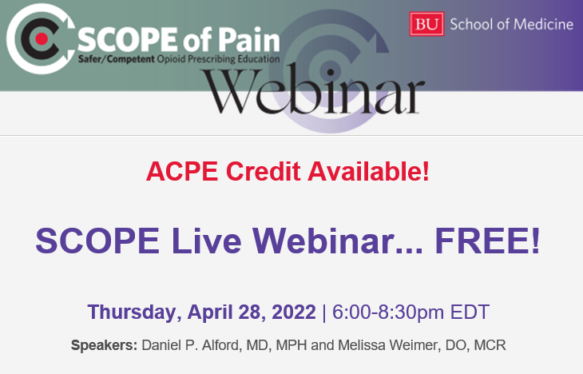
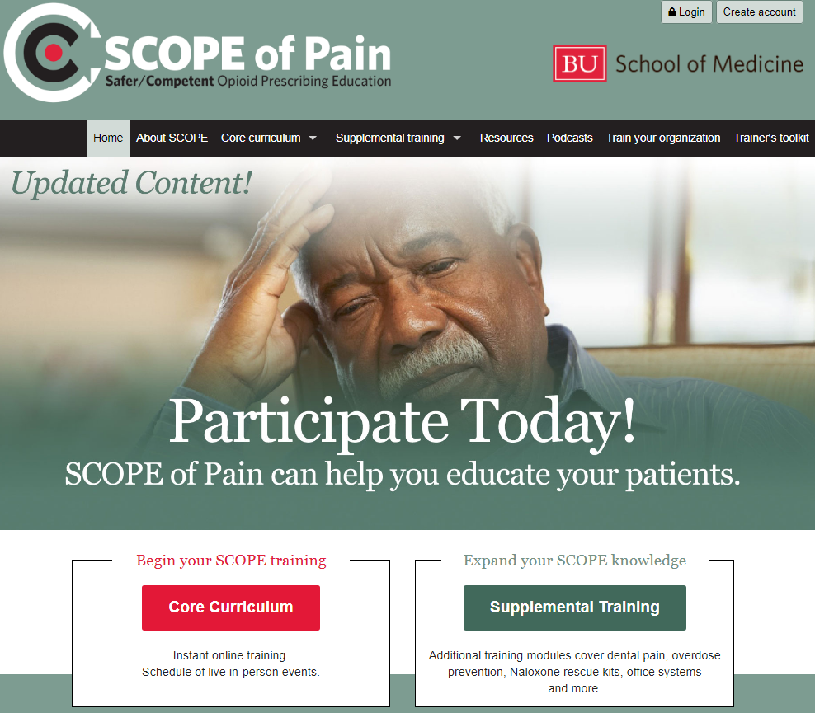
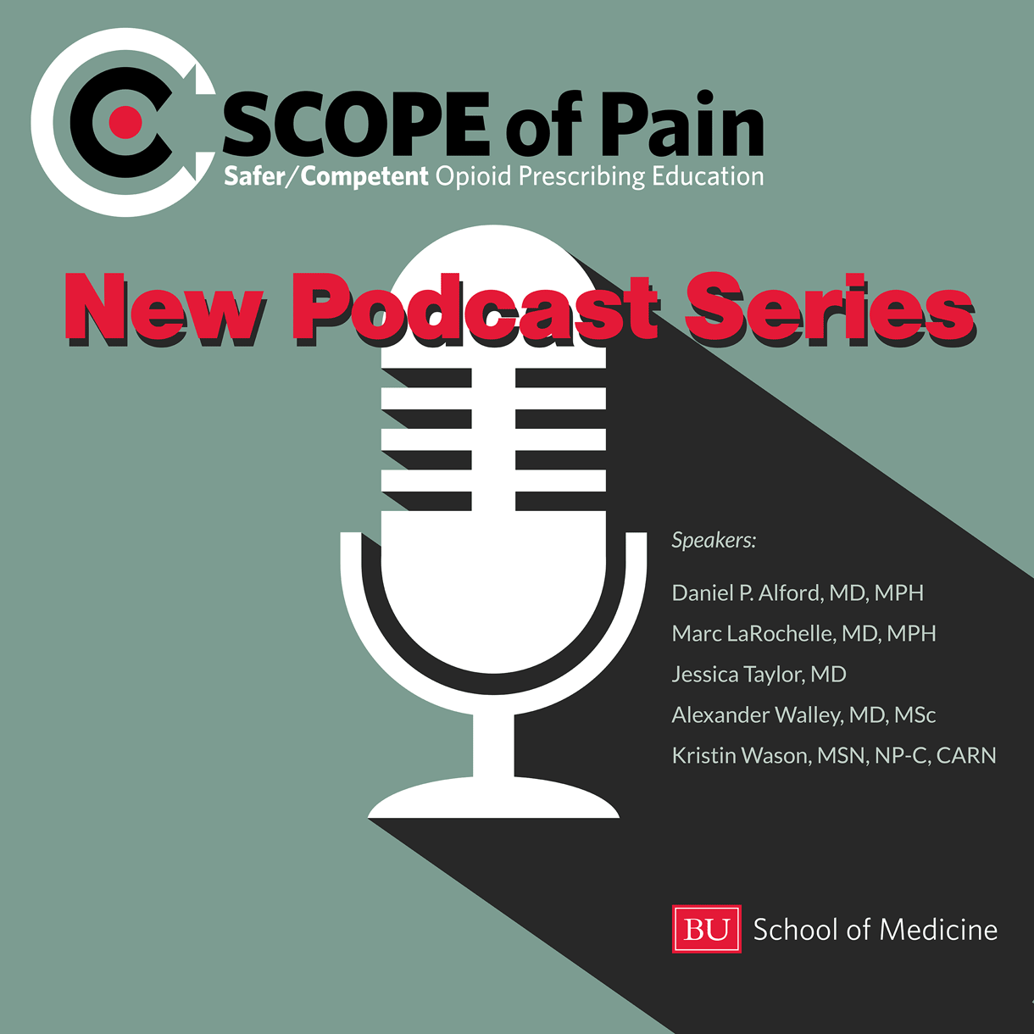
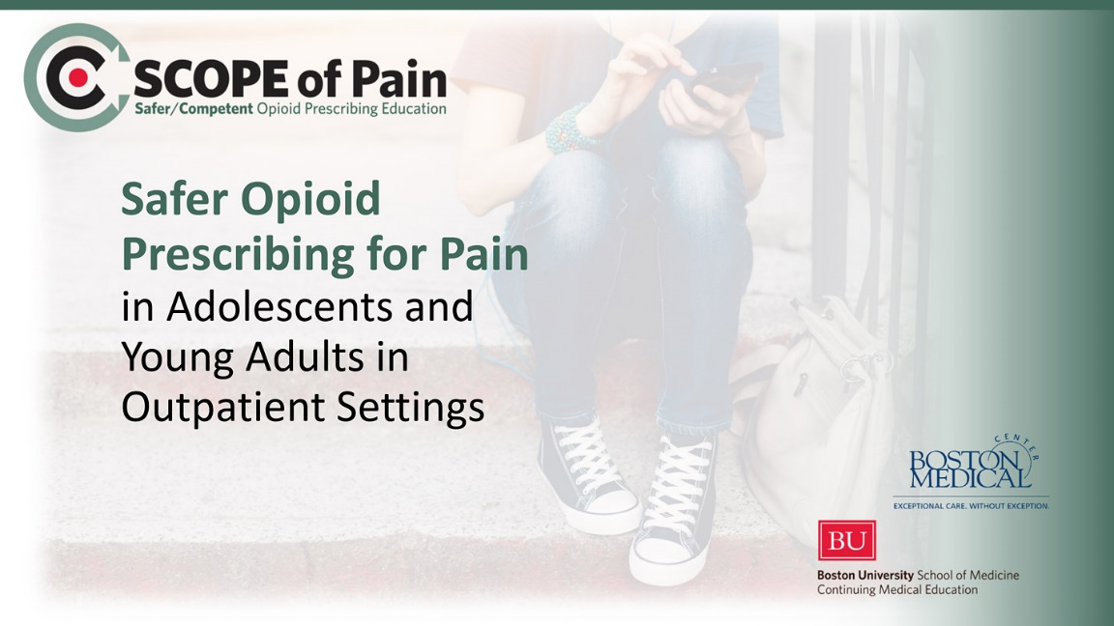
www.scopeofpain.org

Slide 36
Thank you!
Questions? dan.alford@bmc.org

