Slide 1



Opioids
Immersion Training in Addiction Medicine Program 2022
April 2022
Daniel P. Alford, MD, MPH
Professor of Medicine
Associate Dean, Continuing Medical Education
Director, Clinical Addiction Research and Education (CARE) Unit

Slide 2
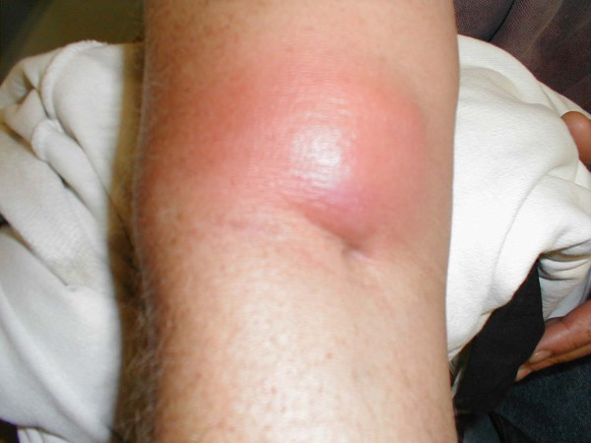
Case
32-year-old male brought into the Emergency Department after and “opioid overdose”
Brisk response to naloxone
Re-sedation after 1 hr requiring repeat naloxone
Antecubital abscess and cellulitis at injection site
Admitted for “drug overdose”, “persistent altered mental status” and “arm cellulitis”

Slide 3
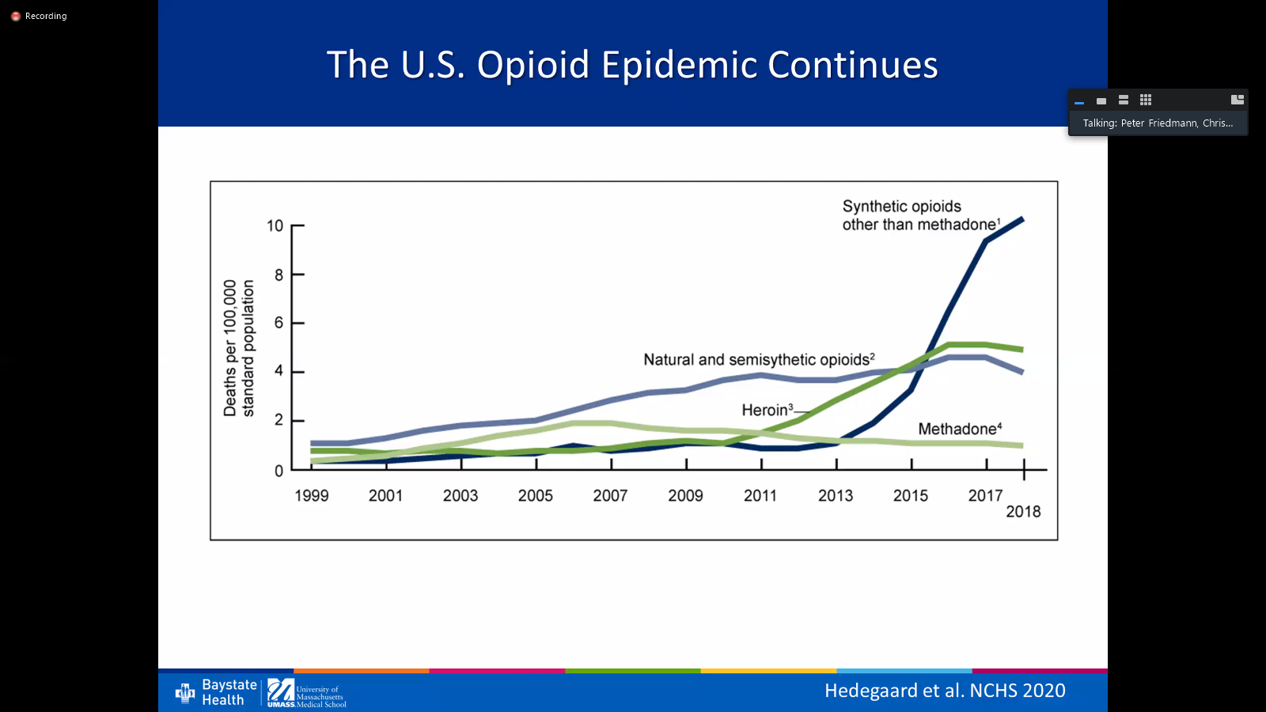
Trends in Opioid Overdose Deaths (OOD)
6/2019 - 6/2020
>83,000 OOD deaths
Highest number in a 12-month period
21% increase compared to the previous year
National Vital Statistics System. 2021, www.cdc.gov/nchs/nvss/
Hedegaard H et al. National Center for Health Statistics. 2020

Slide 4
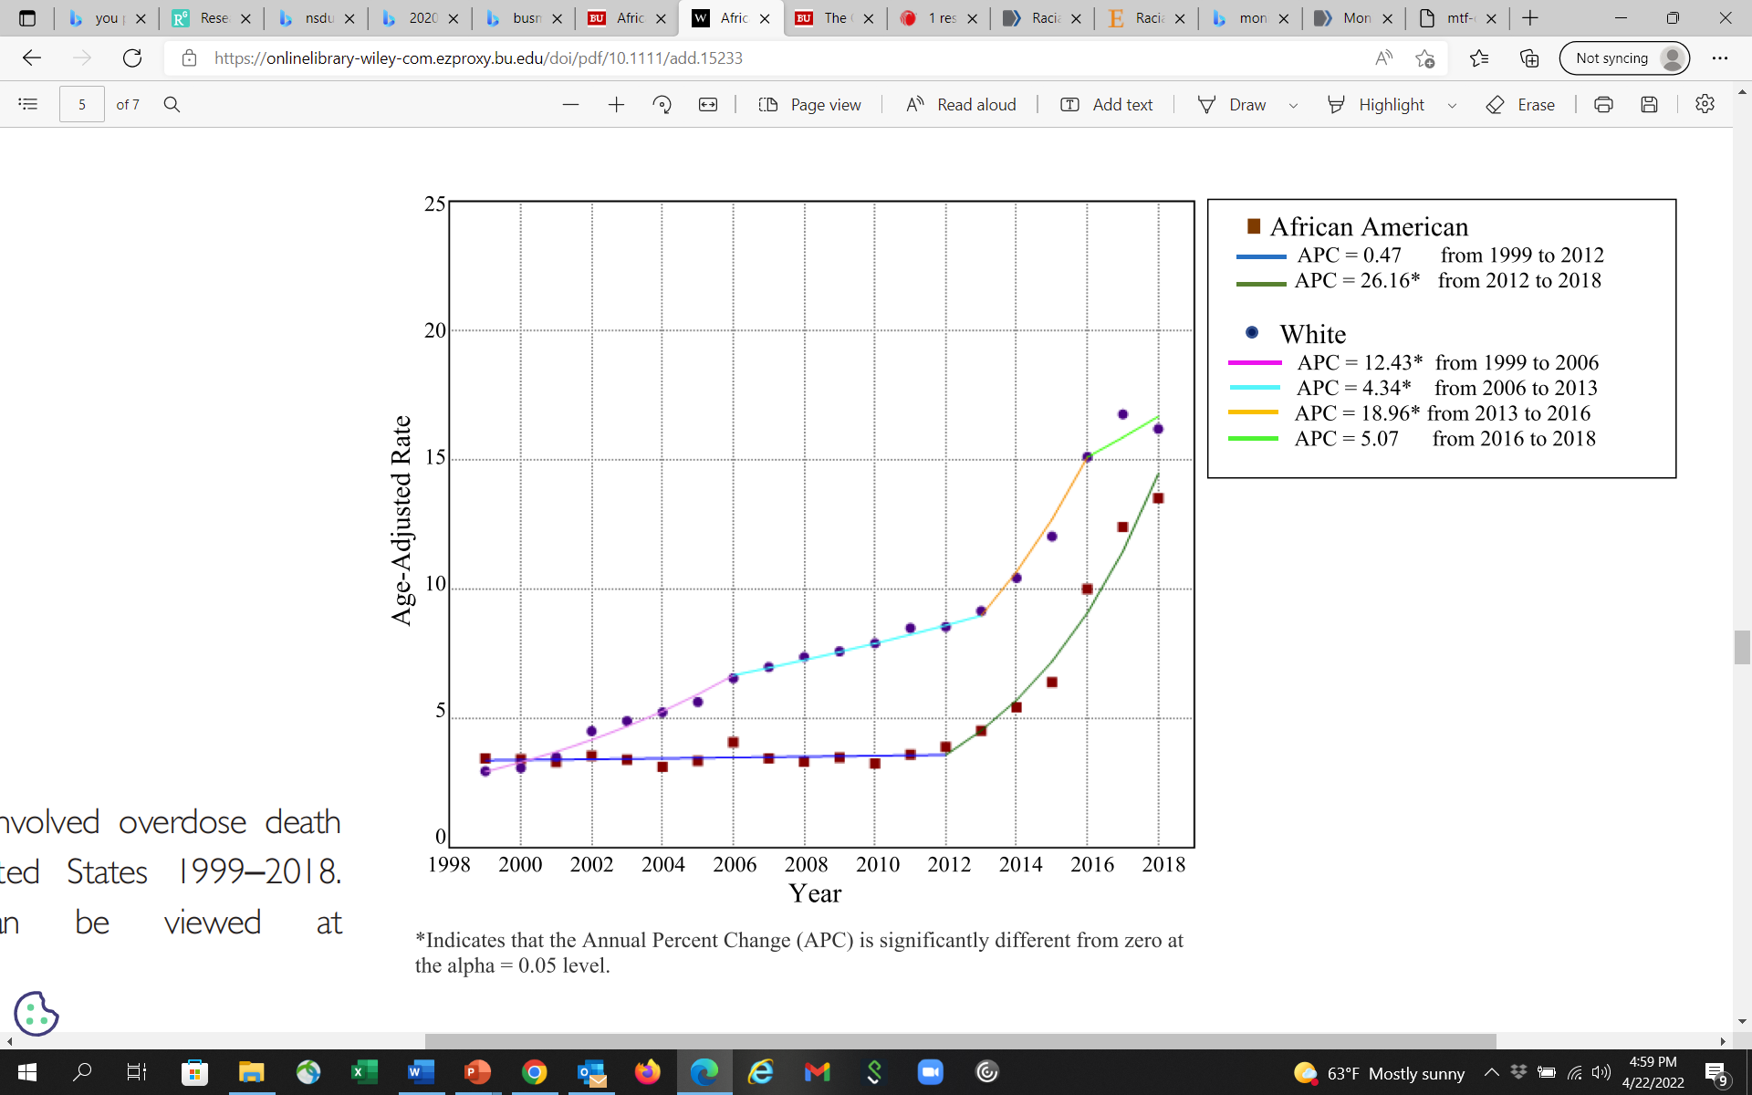
Race and Opioid Overdose Deaths
Whites with multiple periods of acceleration 1999 to 2016 with decrease rate of change 2016 to 2018
African Americans: low rate of change 1999-2012 followed by rapid acceleration (introduction of illicit fentanyl)
From 2013–2018 the average annual precent change was significantly higher in African Americans than Whites
Opioid crisis has focused white, middle-class, suburban and rural users, the impact in African American communities has been unrecognized
Furr-Holden D et al. Addiction. 2020
Notes:
Results The temporal trends of OOD varied by race. African Americans had a persistently low rate of OOD and statistically non‐significant rate of change in OOD from 1999 to 2012 (APC = 0.47; P > 0.05), with a statistically significant and rapid acceleration in OOD rates in 2012 that persisted to 2018 (APC = 26.16; P < 0.01). Whites had three statistically significant periods of acceleration in OOD rate from 1999 to 2006 (APC = 12.43; P < 0.01), 2006 to 2013 (APC = 4.34, P < 0.01) and the greatest increase from 2013 to 2016 (APC = 18.96; P < 0.01). Whites had a statistically non‐significant decrease in OOD from 2016 to 2018 (P = 0.16). The trend for whites more closely aligned with the CDC‐defined epidemic periods than for African Americans. During wave 1 (1999–2010), the average annual percentage change (AAPC) for African Americans was significantly lower than for whites (0.47 versus 9.42, P < 0.01); however, by wave 3 (2013–current; defined by the introduction of illicitly manufactured fentanyl), the AAPC was significantly higher in African Americans (26.16 versus 13.19, P < 0.01).

Slide 5
Natural History of Opioid Use Disorder
Euphoria
Tolerance
Normal
Withdrawal
Physical Dependence
Initial use
Chronic use
Alford DP. http://www.bumc.bu.edu/care/

Slide 6
Case continued
Substance use history
  Daily heroin/fentanyl use
  Intranasal use for 6 months then IV for 7 years
  History of 2 overdoses
  Had been in recovery for 2 years by going to NA but relapsed 3 months ago
  History of 10 detox’s, no treatment with medications
  No other drug, alcohol or tobacco use
HIV and hepatitis C negative
Unemployed electrician
Lives with wife (in recovery) and 2 young children
Now complaining of opioid withdrawal
  How will you assess and treat him?
Notes:
2

Slide 7
Opioid Use Disorder
Complex Provider/Patient Experience
Study conducted on the inpatient medical service of a public urban teaching hospital
Qualitative analysis on the interactions with illicit opioid-using patients and their medical teams identified 4 common themes
Merrill JO, et al. J Gen Intern Med. 2002

Slide 8
Provider Perspective
1. Physician Fear of Deception
Physicians question the “legitimacy” of need for opioid analgesics (“drug seeking” patient vs. legitimate need).
“All of us go through a little bit of a hitch every time we are requested to prescribe narcotics for our patients....Are they trying to get more out of me than they really should have? The last thing I want to do is over-dose them or reinforce this behavior (of) trying to coax more drugs out of you.”
-Senior Medical Resident
Merrill JO, et al. J Gen Intern Med. 2002

Slide 9
Patient Perspective
2. No Standard Approach
The evaluation and treatment of pain and withdrawal is extremely variable among physicians and from patient to patient. There is no common approach nor are there clearly articulated standards.
“The last time, they took me to the operating room, put me to sleep, gave me pain meds, and I was in and out in two days.. . .This crew was hard! It’s like the Civil War. ‘He’s a trooper, get out the saw’. . .’”
-Patient w/ Multiple Encounters
Merrill JO, et al. J Gen Intern Med. 2002

Slide 10
Patient Perspective
3. Avoidance
Physicians focused primarily on familiar acute medical problems and evaded more uncertain areas of assessing or intervening in the underlying addiction problem-particularly issues of pain and withdrawal.
Patient/Resident Dialog
Resident: “Good Morning”
Patient: “I’m in terrible pain.”
Resident: “This is Dr. Attending, who will take care of you.”
Patient: “I’m in terrible pain.”
Attending: “We’re going to look at your foot.”
Patient: “I’m in terrible pain.”
Resident: “Did his dressing get changed?”
Patient: “Please don’t hurt me.”
Merrill JO, et al. J Gen Intern Med. 2002

Slide 11
Patient Perspective
4. Patient Fear of Mistreatment
Patients are fearful they will be punished for their drug use by poor medical care.
“I mentioned that I would need methadone, and I heard one of them chuckle. . .in a negative, condescending way. You’re very sensitive because you expect problems getting adequate pain management because you have a history of drug abuse. . .He showed me that he was actually in the opposite corner, across the ring from me.”
-Patient
Merrill JO, et al. J Gen Intern Med. 2002

Slide 12
Opioid Withdrawal Assessment
Grade
Symptoms / Signs
0
Anxiety, Drug Craving
1
Yawning, Sweating, Runny nose, Tearing eyes, Restlessness Insomnia
2
Dilated pupils, Gooseflesh, Muscle twitching & shaking, Muscle & Joint aches, Loss of appetite
3
Nausea, extreme restlessness, elevated blood pressure, Heart rate > 100, Fever
4
Vomiting / dehydration, Diarrhea, Abdominal cramps, Curled-up body position
Clinical Opiate Withdrawal Scale (COWS): pulse, sweating, restlessness & anxiety, pupil size, aches, runny nose & tearing, GI sx, tremor, yawning, gooseflesh (score 5-12 mild, 13-24 mod, 25-36 mod severe, 36-48 severe)

Slide 13
Inpatient Goals
Prevent/treat acute opioid withdrawal
  Inadequate treatment may prevent full treatment of medical/surgical condition
Don’t expect to cure OUD during hospitalization
  Withholding opioids will not cure patient’s OUD
  Giving opioids will not worsen patient’s OUD
Initiate addiction treatment referral
Diagnose and treat medical illness
  Growing evidence that medications for OUD facilitates the treatment of other serious complications of OUD e.g., endocarditis and osteomyelitis (Jo Y, et al. Addiction. 2021)
Notes:
6

Slide 14
Inpatient Treatment of Opioid Withdrawal
Methadone
Start w/ 20 mg po
Reassess q 2-3 h, give additional 5-10 mg until withdrawal signs abate
Don’t exceed 40 mg/24 hrs
Buprenorphine
Start with 2-4 mg SL (or 20 mcg/hr TD patch)
Reassess q 2-3 h, give additional 4 mg until withdrawal signs abate
Don’t exceed 16 mg/24 hrs
“Authorized hospital staff [may] administer narcotic drugs in a hospital to maintain or detoxify a person as an incidental adjunct to medical or surgical treatment of conditions other than addiction” (Code of Federal Regulations title 21, up to date as of 4/20/2022)
Monitor for response and CNS and respiratory depression
Give same dose each daily including day of discharge
Cannot give a methadone prescription
Can give a buprenorphine prescription if you are waivered
Peterkin A et al. Med Clin N Am. 2022
Boston Medical Center protocol updated 2019
Notes:
9

Slide 15
Case continued
Hospital course
Arm abscess I and D, cellulitis treated with IV Vancomycin
Opioid withdrawal management included methadone 30 mg during his hospital course
He did not want to remain on medication (methadone or buprenorphine) for his OUD at the time of discharge
6 months later
He presents to your primary care clinic requesting referral to “detox” for his heroin addiction
He has been using heroin since the day he left the hospital
Notes:
11

Slide 16
Opioid Detoxification Outcomes
Low rates of retention in treatment
High rates of relapse post-treatment
  < 50% abstinent at 6 months
  < 15% abstinent at 12 months
  Increased rates of overdose due to decreased tolerance
O’Connor PG JAMA 2005
Mattick RP, Hall WD. Lancet 1996
Stimmel B et al. JAMA 1977

Slide 17
Reasons for Relapse
Protracted abstinence syndrome
  Secondary to derangement of endogenous opioid receptor system
  Symptoms
    Generalized malaise, fatigue, insomnia
    Poor tolerance to stress and pain
    Opioid craving
Conditioned cues (triggers)
Priming with small dose of drug

Slide 18
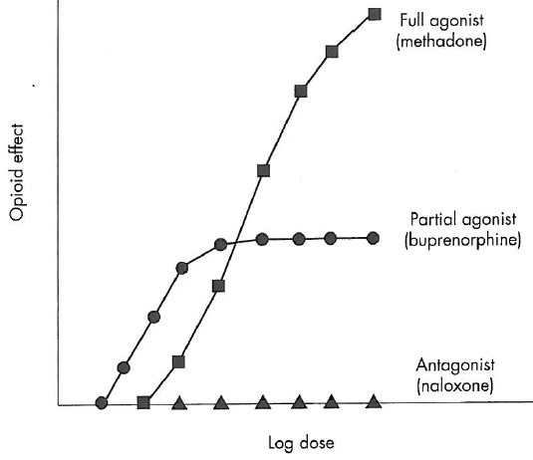
Medications for OUD (MOUD) Treatment
Goals
Suppress opioid withdrawal*
Opioid blockade
Alleviate drug craving
Normalized brain changes
Options
Naltrexone (full antagonist)
*Opioid Agonist Therapy (OAT)
  Methadone (full agonist)
  Buprenorphine (partial agonist)
Peterkin A et al. Med Clin N Am. 2022

Slide 19
Naltrexone
Pure opioid antagonist
    Patients physically dependent must be opioid free for atleast 7-10 days before treatment
  Oral naltrexone
    Well tolerated, safe, duration of action 24-48 hours
    No statistically significant difference compared to placebo due to poor retention (Minozzi S et al. 2011)
  More effective than placebo when patients legally mandated to take it
Injectable XR naltrexone
  IM w/ customized needle/month
  Increased abstinence (90% vs 35% [Krupitsy E, et al. Lancet, 2011])
  Poor retention (40% at 3 months, <10% at 6 months [Cousins SJ et al. J Sub Abuse Treat 2016])

Slide 20
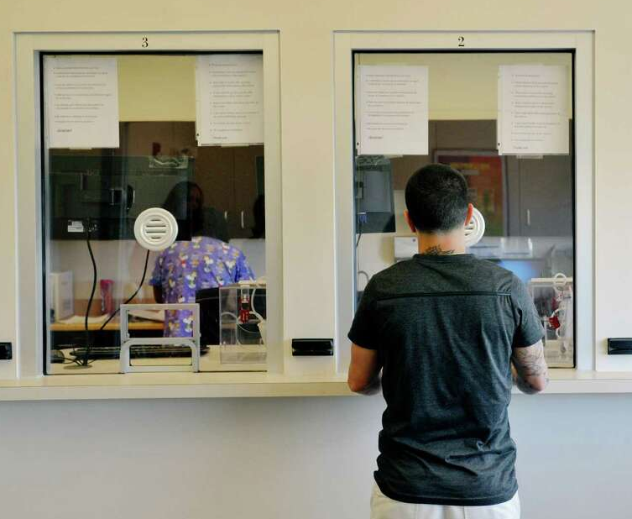
Methadone Maintenance Treatment
Methadone
  Full opioid agonist
  PO onset of action 30-60 minutes
  Duration of action 24-36 hours to treat OUD
  Proper dosing for OUD
    20-40 mg for acute withdrawal
    > 80 mg for craving, “opioid blockade”
Opioid Treatment Program
  Highly structured
  Observed daily → “Take homes”

Slide 21
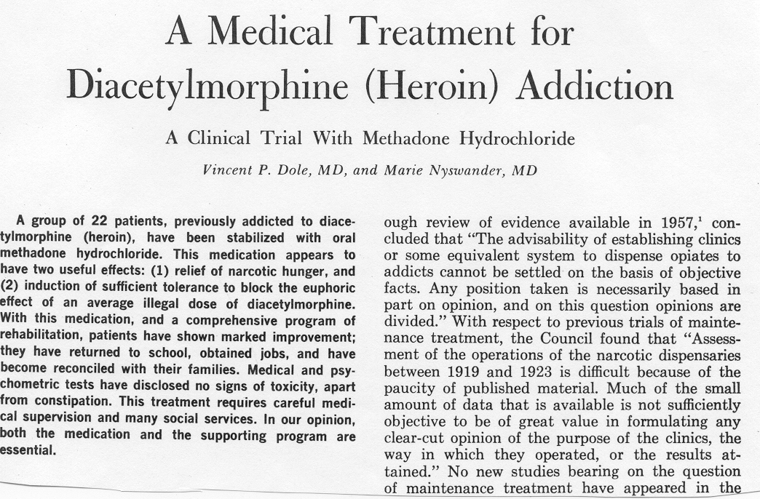
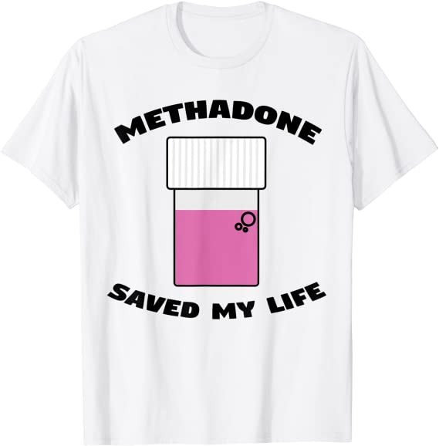
Extensive Research on Effectiveness
JAMA 1965
Increases treatment retention
Decreases illicit opioid use
Decreases hepatitis and HIV seroconversion
Decreases mortality
Decreases criminal activity
Increases employment
Improves birth outcomes

Slide 22
Methadone Maintenance Limitations
Highly regulated - Narcotic Addict Treatment Act 1974
Limited access
Inconvenient and highly punitive
Mixes stable and unstable patients
Lack of privacy
No ability to “graduate” from program
Stigma “Substituting one drug for another…I don’t believe in methadone”

Slide 23
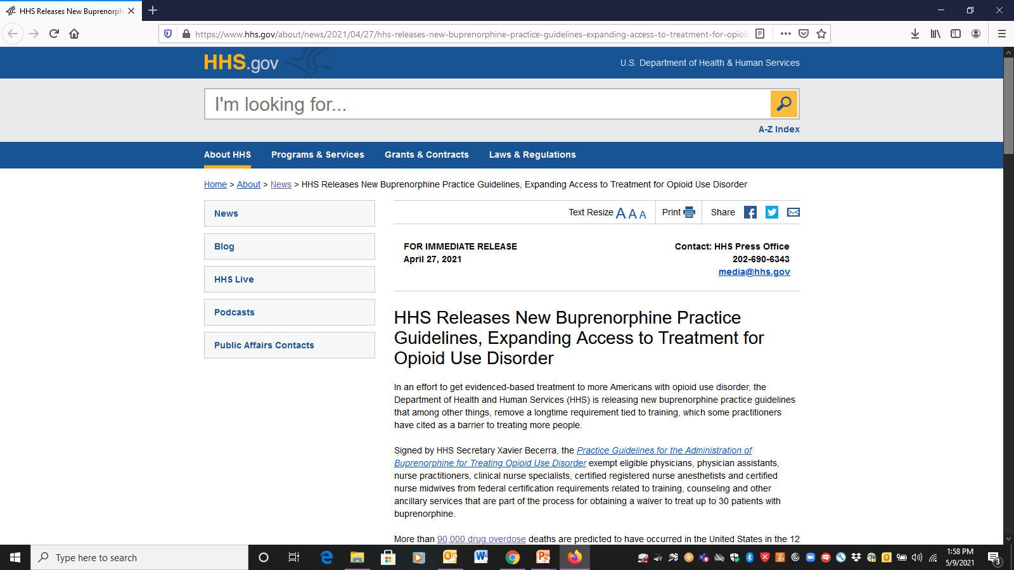
Practitioners (physicians, PAs, NPs, clinical nurse specialists, RN anesthetists, nurse midwives) licensed under state law w/ valid DEA registration, exempt from required training, counseling and other ancillary services
Must obtain a waiver by SAMHSA
30 patient limit
Practitioners who do not wish to practice under the exemption and its 30-patient limit may seek a waiver per established protocols (training requirements)

Slide 24
Buprenorphine
Semi-synthetic analogue of thebaine
FDA approved 2002 as schedule III – up to 5 refills
Ceiling effect on CNS and respiratory depression
Mu-opioid receptor partial agonist
Kappa-opioid receptor antagonist (antidepressant and anxiolytic effects)
Formulations: sublingual tab and film combined with naloxone, subdermal implant (q6 months), SQ injection (monthly)

Slide 25
Buprenorphine Efficacy Summary
Studies (RCT) show buprenorphine (16-24 mg) more effective than placebo and equally effective to moderate doses (80 mg) of methadone on primary outcomes of:
  Retention in treatment
  Abstinence from illicit opioid use
  Decreased opioid craving
  Decreased mortality
  Improved occupational stability
  Improved psychosocial outcomes
Johnson et al. NEJM 2000
Fudala PJ et al. NEJM 2003
Kakko J et al. Lancet 2003
Sordo L et al. BMJ 2017
Mattick RP et al. Conchrane Syst Rev 2014
Parran TV et al. Drug Alcohol Depend 2010

Slide 26
Starting MOUD Wherever Patients Present
Inpatient Service (Liebschutz JM et al. JAMA Intern Med. 2014)
Compared with an inpatient detoxification, initiation of and linkage to buprenorphine treatment is effective for engaging medically hospitalized patients who are not seeking addiction treatment and reduces illicit opioid use 6 months after hospitalization
Emergency Department (D’Onofrio G et al. JAMA. 2015)
ED-initiated buprenorphine treatment vs brief intervention and referral significantly increased engagement in addiction treatment, reduced self-reported illicit opioid use

Slide 27
MOUD after Opioid Overdose
Data from multiple Massachusetts administrative systems (2011-2015)
Retrospective cohort of overdose survivors (N=17,568)
For the 12 months after the index overdose only 17% received buprenorphine, 11% received methadone, and 6% received naltrexone
Compared with no MOUD, receipt of buprenorphine or methadone was associated with a two-thirds reduction in death (all-cause and opioid-related mortality)
Larochelle MR , et al. Ann Intern Med. 2018

Slide 28
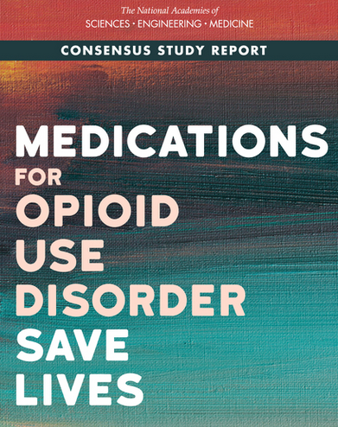
Major Barriers to Use of MOUD
Delay between OUD onset and MOUD receipt 4-7 years
Blacks have less than half the odds of initiating MOUD than Whites
Stigma toward drug addiction, individuals with OUD, and the medications to treat it
Inadequate education of health professionals
Current regulations such as waiver policies, patient limits, restrictions on settings, and others not supported by evidence or employed for other medical disorders
National Academies of Sciences, Engineering, and Medicine. 2019. The National Academies Press.

Slide 29
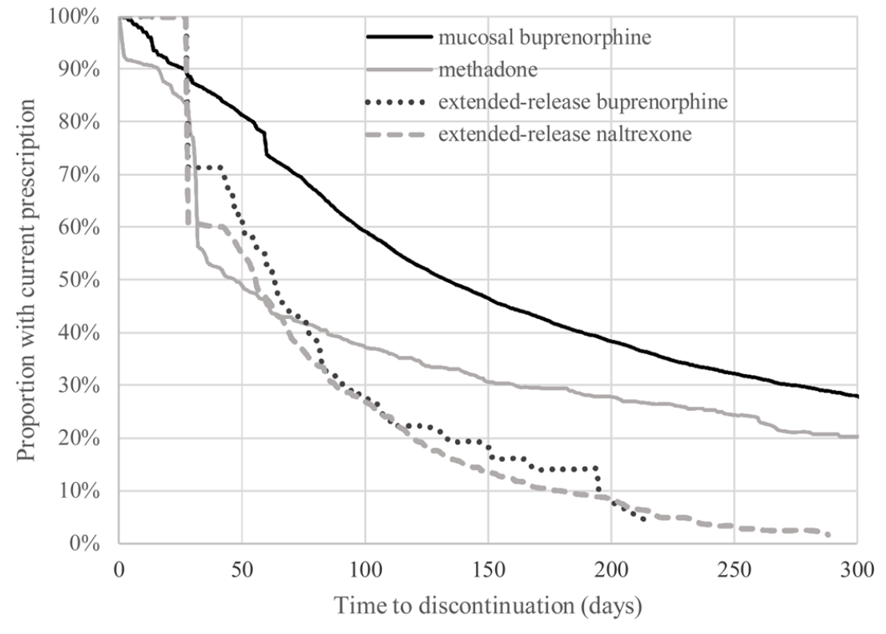
Treatment Retention with MOUD
National data of commercially insured individuals
14,358 initiated MOUD: 85% SL buprenorphine, 8% XR naltrexone, 6% methadone, 1% XR buprenorphine
Treatment discontinuation rates (3m)
  34% SL buprenorphine
  50% XR buprenorphine
  58% methadone
  65% XR naltrexone
Morgan JR, et al. Drug Alcohol Depend. 2021

Slide 30
Opioid Agonist Treatment (OAT) and Acute Pain Management
Patients with an OUD on OAT (i.e., methadone or buprenorphine) have less pain tolerance then matched controls
Patients who are physically dependent on methadone or buprenorphine must be maintained on a daily equivalence (“opioid debt”) before ANY analgesia is achieved with opioids used to treat acute pain
Opioid analgesic requirements are often higher due to increased pain sensitivity and opioid cross tolerance
Hickey T et al. Med Clin N Am 2022
Alford DP, Compton P, Samet JH. Ann Intern Med 2006

Slide 31
Thanks!
Questions?

