Slide 1
Stimulants: Cocaine and Methamphetamine
CRIT/FIT/JFIT/AFIT program – May 2021
Alex Walley, MD, MSc

Slide 2
Learning objectives
At the end of this session, participants will be able to:
Understand how and why people use stimulants
Know the characteristics of stimulant intoxication and withdrawal syndromes
Understand the consequences of these drugs
Know the current options for treatment of stimulant dependence

Slide 3
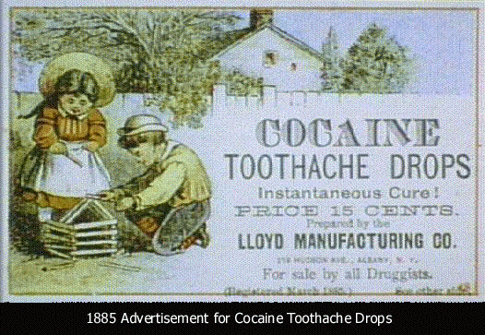
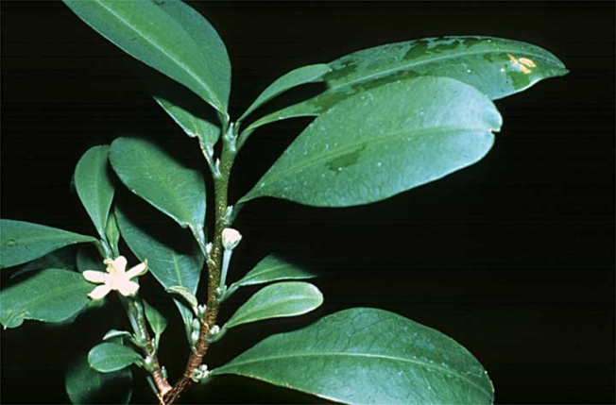
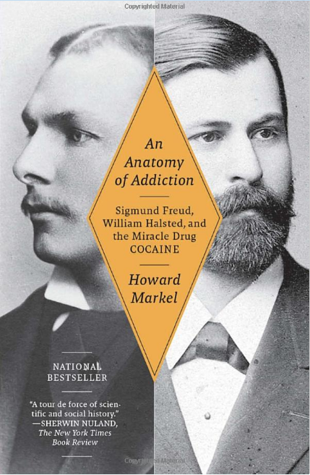
History: Cocaine
From erythroxylum coca leaves in Andes
Leaves chewed for thousands of years as stimulant
1884 Freud published, Uber Coca, describing cocaine’s effects on Freud and its potential to treat opiate addiction
1885 Halsted published study about anesthetic uses
1886 Halsted raided ship medicine cabinet for fix
Used in medicines and beverages until early 1900s
Street preparations 10-50% cocaine
Hydrochloride powder is snorted or injected
Alkaline rocks (aka crack) are smoked
Crack, Rock, Base

Slide 4
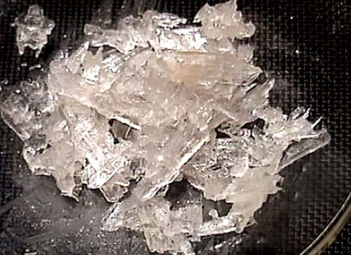
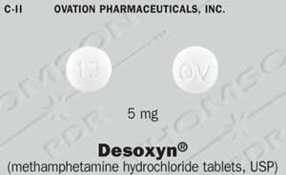
History: Methamphetamine
1893 methamphetamine first synthesized in
Japan as decongestant
Used by German, English, American, and Japanese military in WWII for performance enhancement.
First epidemic occurred in Japan when the military dumped large quantities into the civilian market
Popular among truckers and west coast bikers in 1970s
DESOXYN to treat ADHD and obesity
Speed, Crystal, Crank, Ice, Meth, Tina
Lineberry 2006

Slide 5
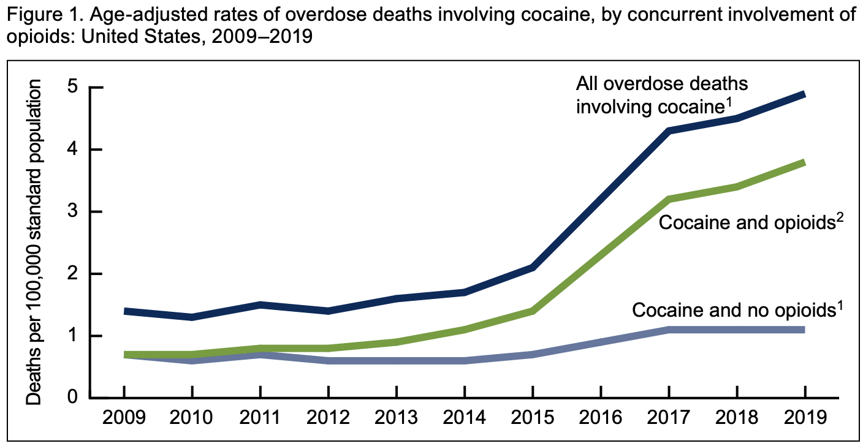
Stimulant-involved overdose deaths surging with opioids
https://www.cdc.gov/nchs/data/databriefs/db406-H.pdf

Slide 6
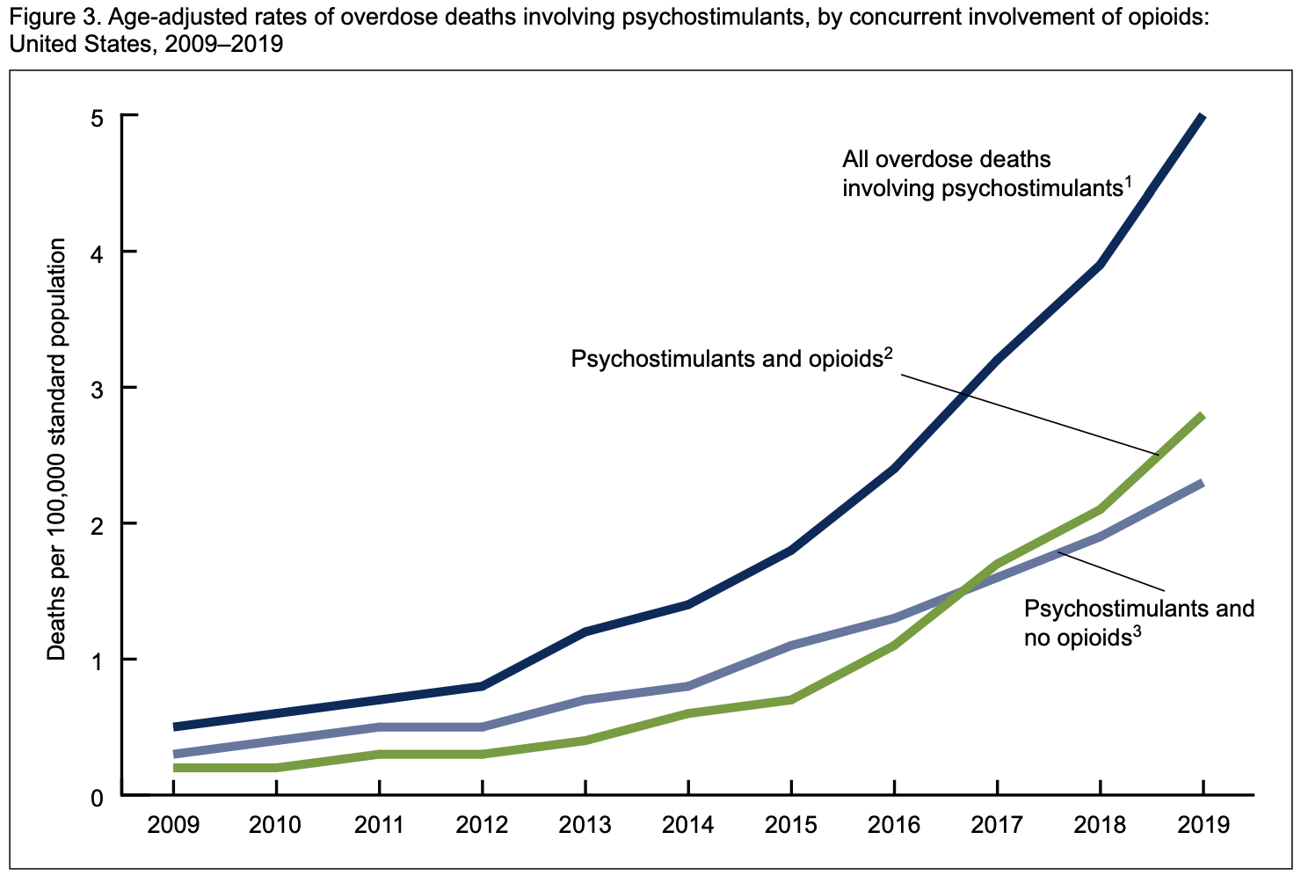
Stimulant-involved overdose deaths surging with opioids
https://www.cdc.gov/nchs/data/databriefs/db406-H.pdf

Slide 7
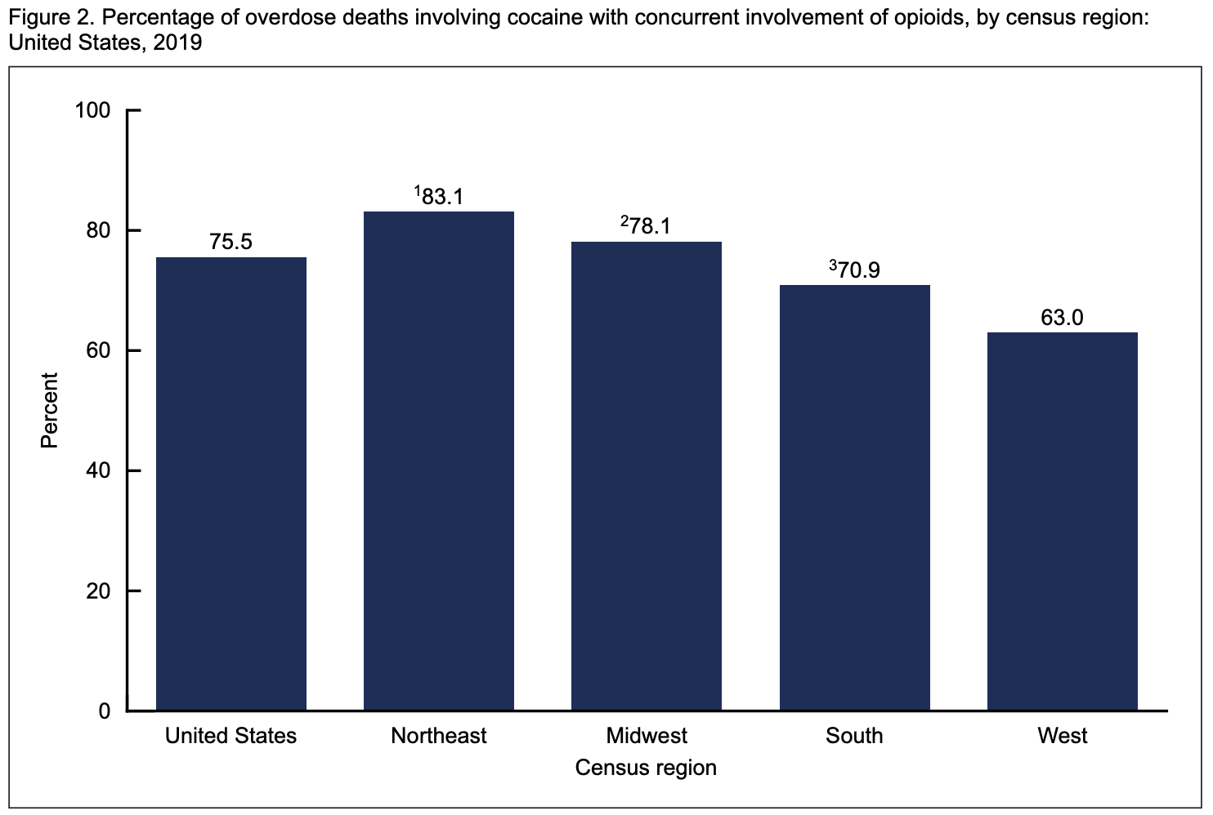
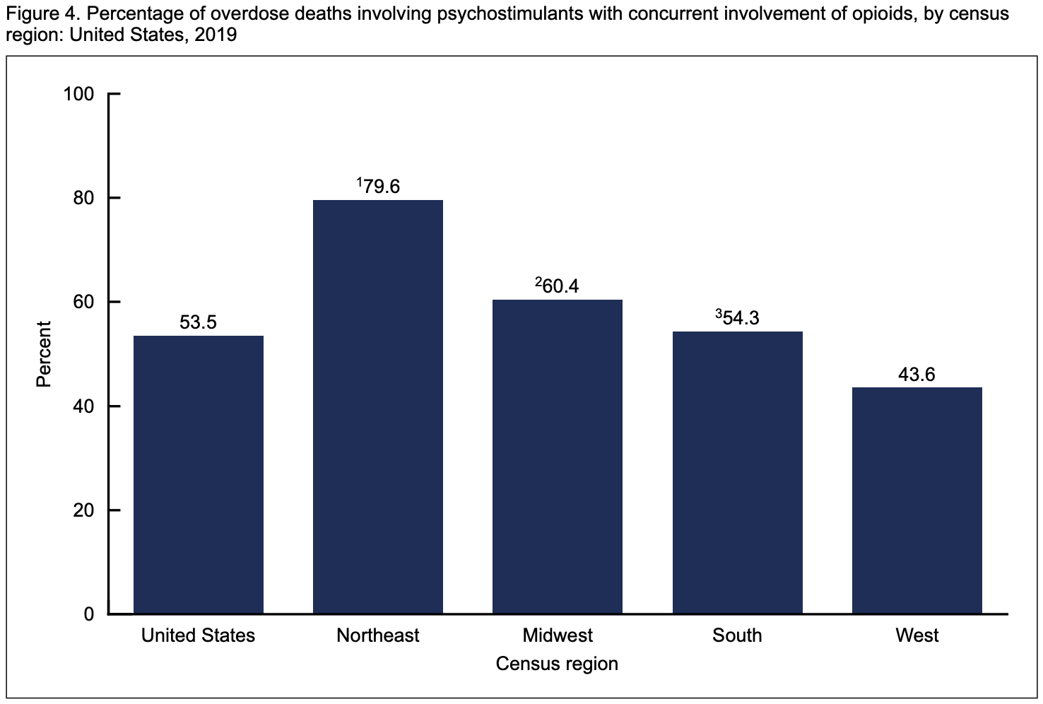
Stimulant-involved overdose deaths surging with opioids
% cocaine-involved deaths with opioids present, 2019
% of stimulant-involved deaths with opioids present, 2019
https://www.cdc.gov/nchs/data/databriefs/db406-H.pdf

Slide 8
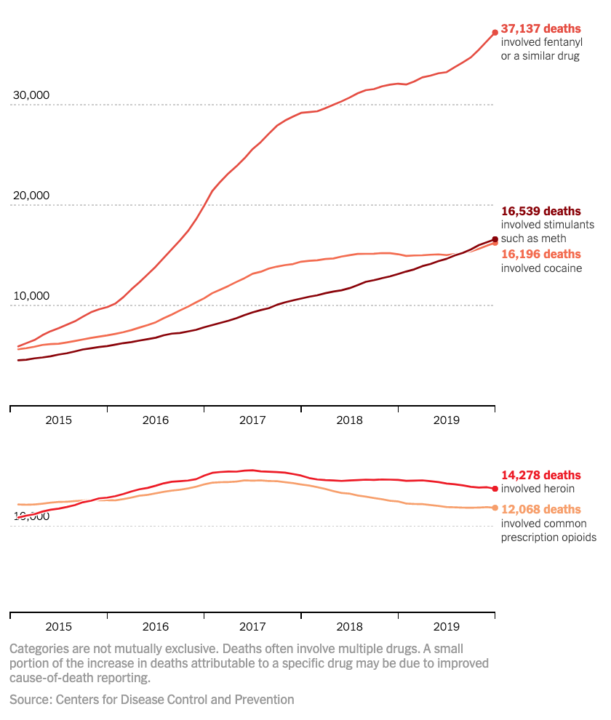
Stimulant-involved overdose deaths surging with opioids
Katz, J. The First Count of Fentanyl Deaths in 2016: Up 540% in Three Years. NYT – The UpShot 9/2/2017.

Slide 9
Over 8 hours at the ED of Yale Hospital, white powder advertised as cocaine resulted in 12 patients for signs of opioid overdose, presumed from snorting
9 admitted, 4 to ICU, 3 intubated, 1 on naloxone gtt, 3 died
High doses of naloxone required: 4mg and higher
Drug sample tested had 6.6% fentanyl by weight and trace amounts of cocaine + inert adulterant

Slide 10
Drug Abuse Warning Network 2011 Report: www.samhsa.gov/data/sites/default/files/DAWN127/DAWN127/sr127-DAWN-highlights.htm
Notes:
ED perspective

Slide 11
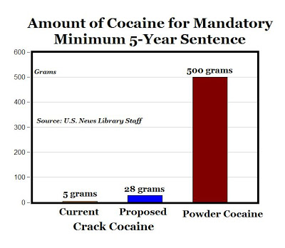
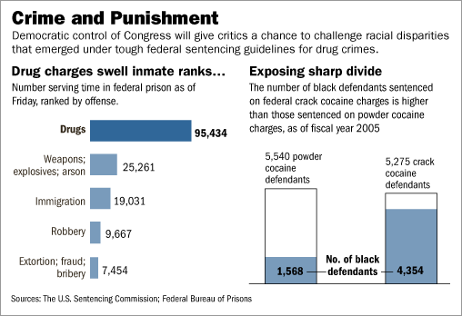
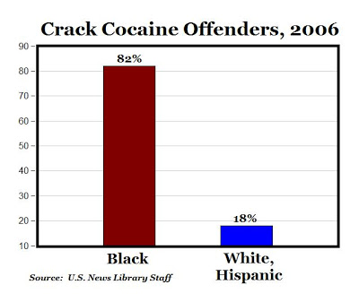
Despite harsher penalties for crack versus powder cocaine, crack use declined less than powder cocaine and even less than drugs not included in sentencing policies. These findings suggest that mandatory minimum sentencing may not be an effective method of deterring cocaine use.
Walker LS, Mezuk B. Mandatory minimum sentencing policies and cocaine use in the U.S., 1985-2013. BMC Int Health Hum Rights. 2018 Nov 29;18(1):43.
Racial minorities were at low risk for powder cocaine use and Hispanics were at low risk for crack use. Blacks were at increased risk for lifetime and recent crack use, but not when controlling for other socioeconomic variables.
Palamar JJ, Davies S, Ompad DC, Cleland CM, Weitzman M. Powder cocaine and crack use in the United States: an examination of risk for arrest and socioeconomic disparities in use. Drug Alcohol Depend. 2015 Apr 1;149:108-16.
Notes:
1980s in bipartisan legislation – 100:1 ratio
-> fueled worsening inequitable mass incarceration that accelerated in the 1990s with the crime bill
2010 – The mandatory minimum ratio was changed from 100:1 to 18:1
WSJ 12/26/2006 - https://www.wsj.com/articles/SB116709740054459343
https://www.aei.org/carpe-diem/from-100-1-to-18-1-improved-disparity-for-double-standard-racist-minimum-drug-sentencing/
Walker LS, Mezuk B. Mandatory minimum sentencing policies and cocaine use in the U.S., 1985-2013. BMC Int Health Hum Rights. 2018 Nov 29;18(1):43.

Slide 12
Stimulant Effects

Slide 13
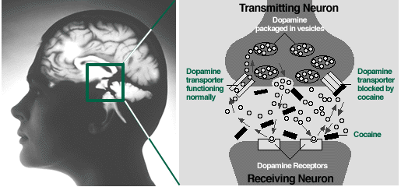
Cocaine
Methamphetamine

Slide 14
PK: Cocaine
 | IV | Smoked | Snorted
Time to effect | 10-60sec | 3-5sec | 1-5min
Peak concent. | 3-5min | 1-3min | 15-20min
Half-life | 20-60min | 5-15min | 60-90min
Lange, R. A. and L. D. Hillis (2001). "Cardiovascular complications of cocaine use." N Engl J Med 345(5): 351-8.
PK: Methamphetamine
 | IV | Smoked | Snorted | Ingested
Time to effect | 15-30 sec | Immediate | 3-5 min | 15-20 min
Peak concent. | 2-4 h | 2-4 h | 2-4 h | 2-4 h
Half-life | 10-12 h | 10-12 h | 10-12 h | 10-12 h
Lineberry 2006
Notes:
In effort to recapture initial rush, people use repetitively, despite mounting levels drug. Acute tolerance to this rush develops, leaving the binger in the “tweaking” state. Eventually use ceases, perhaps after days, ending in crash into nonrestful sleep.
The rush that users get from IV use and smoking is similar in both cocaine and MA. The rush is the most reenforcing part of using. Acute tolerance occurs to this rush occurs quickly and requires repeated administration to recapture this euphoria. HOWEVER, cocaine has a half-life of about 90 minutes compared to 10-12 hours for MA. Thus the buildup of MA levels during repetitive use (seen during binging) can be very high compared to cocaine. This buildup explains the “tweaker” state – restless anxiety, irritability, fatigue, and dysphoria.

Slide 15
Why do people use stimulants?
Euphoria - Rush
Onset and intensity depends on delivery method
Increased energy, alertness, libido
Diminished social inhibition
Decreased appetite
Notes:
MENTION DOPAMINE
So why do people use methamphetamine? Because it is highly re-enforcing, it feels good.

Slide 16
Notes:
Stimulant binge
Euphoria - Rush
Onset and intensity depends on delivery method
Increased energy, alertness, libido
Diminished social inhibition
Decreased appetite
For methamphetamine, there is acute tolerance to the euphoric/ rewarding effects, but the andrenergic effects persist and thus accumalte with repetitive use.

Slide 17
Acute Toxicity
Binges
2-3 day binges are typical, called runs
Regular re-dosing to maintain rush or high in setting of acute tolerance
Ends when drug or money runs out, or paranoia/ disorganized thinking sets in
Elevated BP and HR
Arrythmia
Vasoconstriction
Hyperthermia
Agitation
Rhabdomyolysis
Seizure
Acute psychosis → prolonged psychosis
Paranoid delusions
Visual, sensory, and auditory hallucinations
ie formications

Slide 18
Stimulant Intoxication Treatment = De-escalation
Ten Domains of De-escalation:
1. Respect personal space
2. Do not be provocative
3. Establish verbal contact
4. Be concise
5. Identify wants and feelings
6. Listen actively; respond appropriately
7. Agree or agree to disagree
8. Lay down the law and set clear limits
9. Offer choices and optimism
10. Debrief the patient and staff.
Medical Interventions
Neuroleptics (ie haldol) for agitation
Benzos to control seizures
Treat hyperthermia (external cooling)
For increased BP+HR, use vasodilators and CCB or non-selective beta-blockers
Richmond JS, Berlin JS, Fishkind AB, et al. Verbal De-escalation of the Agitated Patient: Consensus Statement of the American Association for Emergency Psychiatry Project BETA De-escalation Workgroup. West J Emerg Med. 2012;13(1):17-25.
Notes:
Supportive care

Slide 19
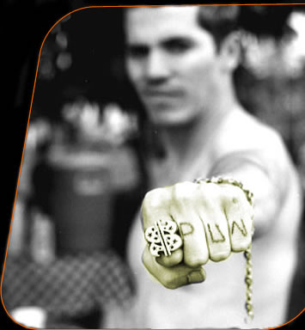
Dental
Darkened teeth
Caries
Periodontal disease
Neuro-psychiatric
Stroke
Seizure
Depression
Anxiety
Mania
Impulsivity
Paranoia
Auditory/ visual hallucinations + formications
Violence
Pulmonary
Acute pulmonary edema
Pulmonary HTN
Inhalation injury
Renal/Metabolic
Rhabdomyolisis
Dehydration
Acute Renal Failure
Acidosis
Hyperthermia
Cardiovascular
Hypertension
DCM
Arrythmia/ Tachycardia
Acute Coronary Syndrome
Aneurysm/ dissection
Erectile dysfunction
Infectious
HIV risk
HCV/ HBV
STDs
Skin
Cellulitis/ abscess
Excoriations
Chemical burns
Health Consequences

Slide 20
ETOH + Cocaine >> Cocaethylene
Psychoactive substrate from ETOH+cocaine
ETOH commonly used as “landing gear”
ETOH before cocaine inhibits cocaine metabolism, producing cocaethylene
60-90% of people who use cocaine, useETOH
Greater cardiac toxicity
Greater rates of seizures, hepatic damage
Notes:
Mention practice of buying alcohol with cocaine.
Is it to bring an endpoint or is itto potentiate the high?
Bottom line: Screen forETOH when you encounter cocaine user

Slide 21
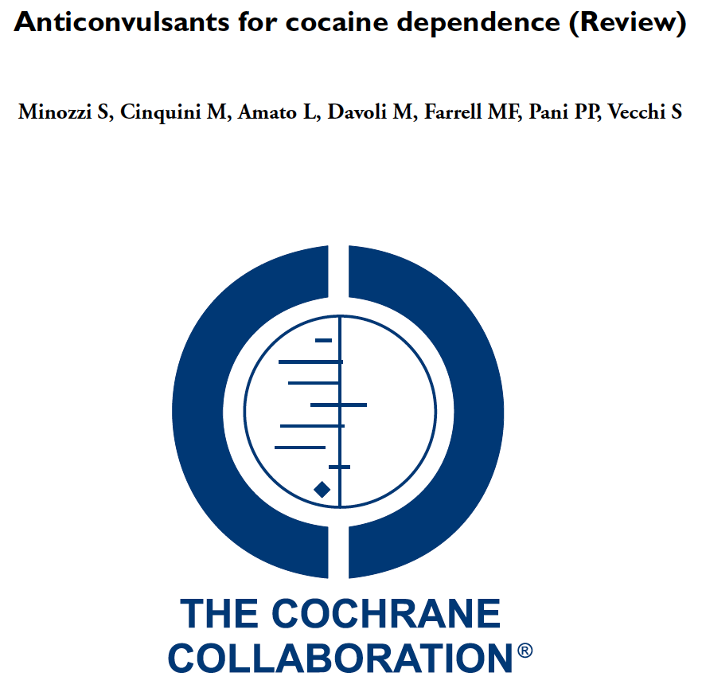
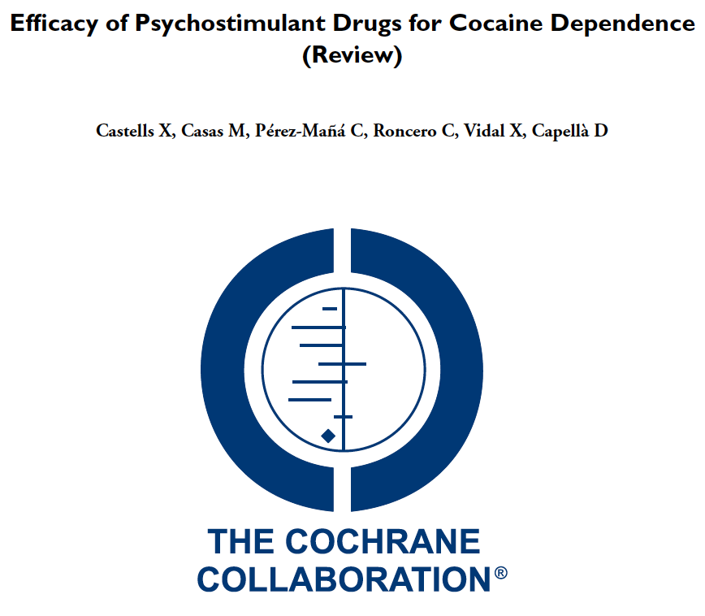
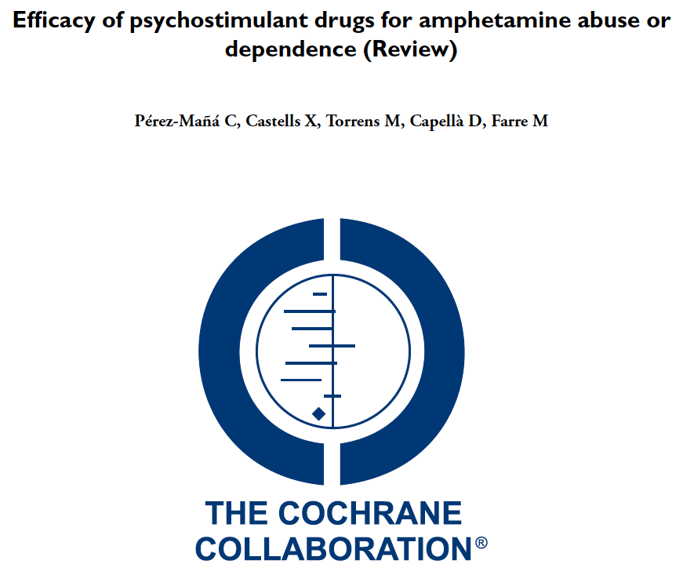
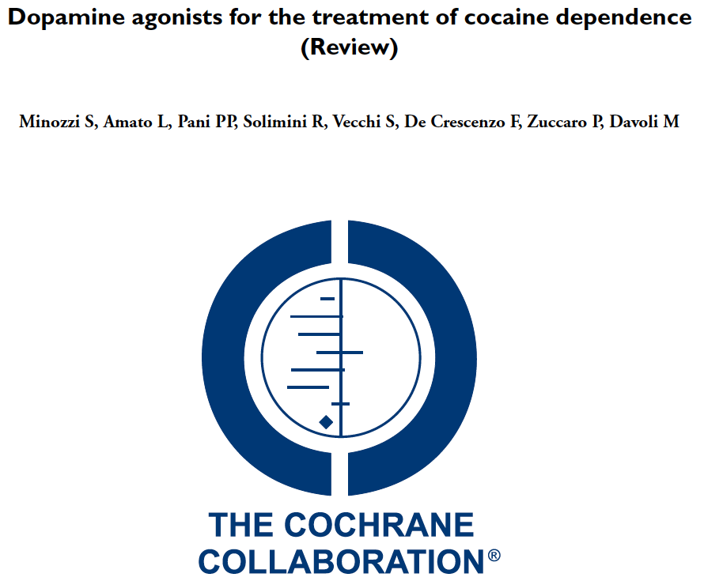
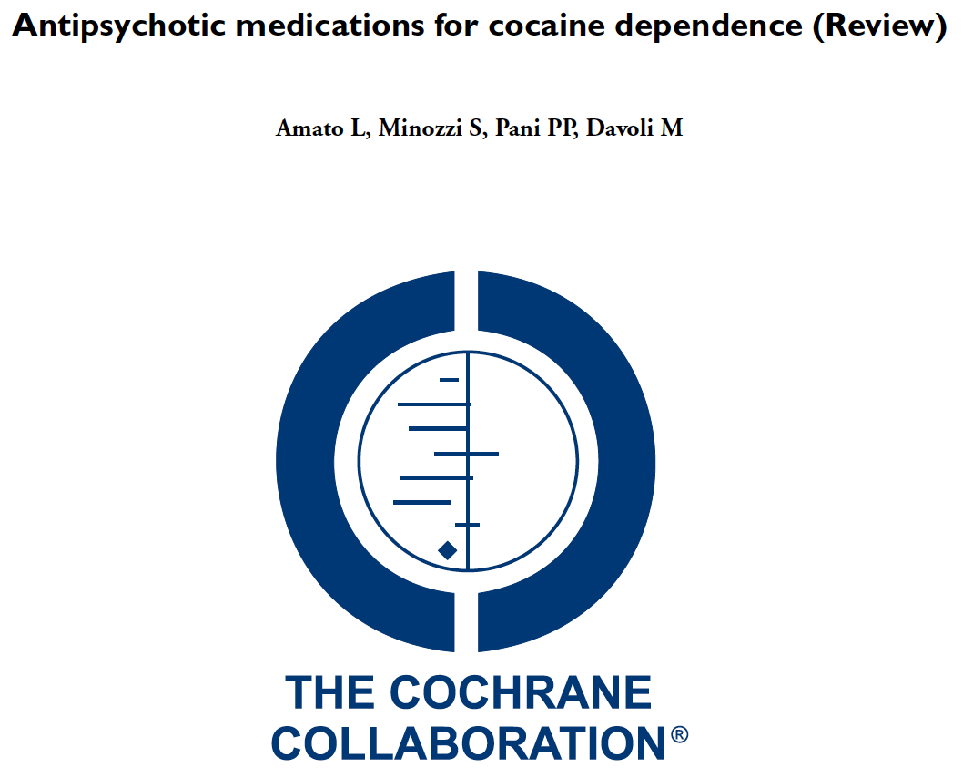
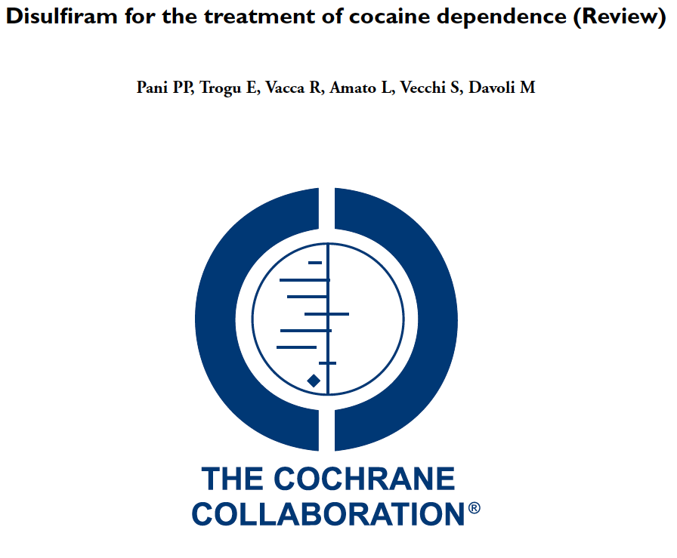
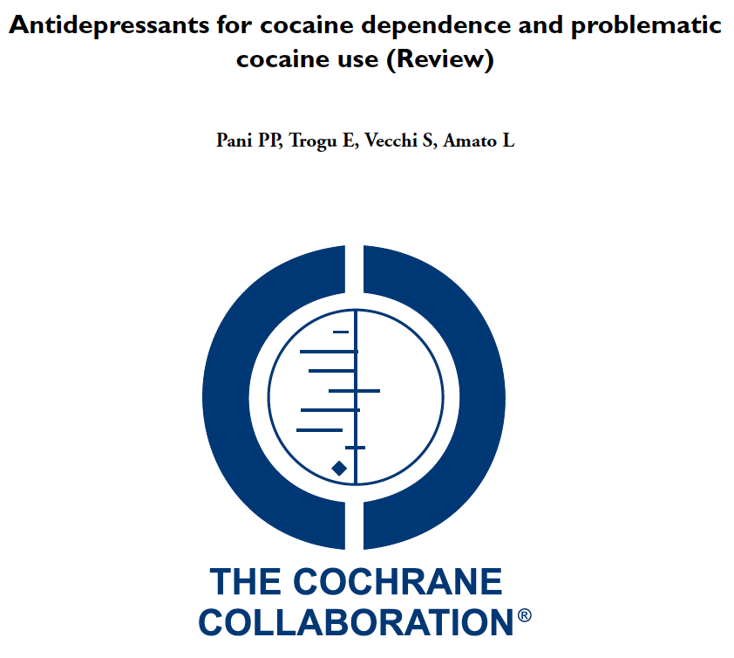
Treatment of stimulant use disorder: A systematic review of reviews
This review supports the use of contingency management interventions for the treatment of stimulant use disorder. Although evidence to date is insufficient to support the clinical use of psychostimulants, results demonstrate potential for future research in this area. Given the urgent need for effective pharmacological treatments for stimulant use disorder, high-quality primary research focused on the role of medications for the treatment of stimulant use disorder is needed.
- Ronsley C, Nolan S, Knight R, Hayashi K, Klimas J, et al. (2020) PLoS ONE 15(6)
Notes:
Castells X, Cunill R, Pérez‐Mañá C, Vidal X, Capellà D. Psychostimulant drugs for cocaine dependence. The Cochrane Library. 2016 Jan 1.
Pérez‐Mañá C, Castells X, Torrens M, Capellà D, Farre M. Efficacy of psychostimulant drugs for amphetamine abuse or dependence. Cochrane Database of Systematic Reviews. 2013(9).
Ronsley C, Nolan S, Knight R, Hayashi K, Klimas J, Walley A, et al. (2020) Treatment of stimulant use disorder: A systematic review of reviews. PLoS ONE 15(6)

Slide 22
Stimulant maintenance for people with concomitant ADHD or HUD
73 Dutch patients with cocaine UD on heroin+methadone maintenance
Dexamphetamine SR 60mg once daily observed vs. placebo
11% dropout
At 12 weeks
45 versus 61 days of cocaine use
21% versus 8% >= 1 cocaine-negative urine in last 4 weeks
No differences in craving, use of other substances, or criminality
Nuijten M et al. Lancet. 2016; 387:2226-34.
126 US patients with adult-ADHD and cocaine UD
Mixed amphetamine salts SR 60 or 80mg once daily vs. placebo
Weekly CBT groups
26% dropped out
At 13 weeks
Reduced ADHD symptoms: 60-75% vs 40%
3-wk abstinence: 30-17% vs. 7%
Levin FR et al. JAMA Psychiatry. 2015 1;72:593-602.

Slide 23
120 men who have sex with men who use methamphetamine
Randomized to mirtazapine 30mg or placebo once daily for 24 week + counseling
Medication adherence was almost 40%
Mirtazapine group had at 24 weeks
RR of 0.75 for MA use
RR <0.52 for multiple sex partners, condomless anal sex
Improved depressive symptoms and insomnia severity

Slide 24
Bupropion and naltrexone in MA use disorder
BPP is stimulant-like antidepressant that may mitigate MA withdrawal. NTX may decrease MA rewards and craving.
403 with MA UD in stage 1 and 225 with MA UD in stage 2 randomized to IM-NTX+BBP 450mg vs. placebo
Outcome – 3 of 4 MA negative urine tox at 6 weeks
Result: BPP+NTX 13.6% vs. Placebo 2.5% (Weighted average)
Adherence to medication was 75-86%, but missing urine tox was 30-50% and counted as positive
Adverse events: Nausea, vomiting, dizziness
Trivedi MH et al. Bupropion and Naltrexone in Methamphetamine Use Disorder. N Engl J Med. 2021 Jan 14;384(2):140-153

Slide 25
Single infusion of ketamine for cocaine use disorder
55 inpatients with CUD were randomized to a 40minute infusion of ketamine at 0.5mg/kg vs. midazolam. Both arms received 5-weeks of mindfulness based relapse prevention counseling, daily for 4 days, then weekly for 4 weeks
Ketamine 48% vs. midazolam 11% 2-week abstinence at 5weeks
Ketamine group 53% less likely to relapse
Ketamine group 58% lower craving scores
44% reported 6mo abstinence in ketamine group; 0 in the midazolam group
Dropout: 7 of 27 ketamine; 16 of 28 midazolam
Dakwar E, Nunes EV, Hart CL, Foltin RW, Mathew SJ, Carpenter KM, Choi CJJ, Basaraba CN, Pavlicova M, Levin FR. A Single Ketamine Infusion Combined With Mindfulness-Based Behavioral Modification to Treat Cocaine Dependence: A Randomized Clinical Trial. Am J Psychiatry. 2019 Nov 1;176(11):923-930.
Notes:
Dakwar E, Nunes EV, Hart CL, Foltin RW, Mathew SJ, Carpenter KM, Choi CJJ, Basaraba CN, Pavlicova M, Levin FR. A Single Ketamine Infusion Combined With Mindfulness-Based Behavioral Modification to Treat Cocaine Dependence: A Randomized Clinical Trial. Am J Psychiatry. 2019 Nov 1;176(11):923-930.

Slide 26
Non-medical treatment for addiction
Contingency management
Community reinforcement approach
Cognitive behavior therapy
Motivational Interviewing
?Physical Exercise?
All treatments require adherence
Notes:
Wang D, Zhou C, Zhao M,Wu X, Chang YK.
Dose-response relationships between exercise
intensity, cravings, and inhibitory control in
methamphetamine dependence: an ERPs study.
Drug Alcohol Depend. 2016;161:331-339.
Rawson RA, Chudzynski J, Mooney L, Gonzales R, Ang A, Dickerson D, Penate J, Salem BA, Dolezal B, Cooper CB. Impact of an exercise intervention on methamphetamine use outcomes post-residential treatment care. Drug Alcohol Depend. 2015 Nov 1;156:21-28. doi: 10.1016/j.drugalcdep.2015.08.029. Epub 2015 Sep 3. PMID: 26371404; PMCID: PMC4633370.

Slide 27
Evidence for Contingency Management for stimulants
Systematic Review – DeCrescenzo 2018 PloS Medicine – 50 studies
CM in combination with community re-enforcement approach or cognitive behavioral therapy was most efficacious and acceptable
Increases abstinence
Improves treatment retention
Barrier: Medicaid regulations that restrict the amount of incentives that can be given to patients to $75 per patient per year
RCT in 6 community methadone programs of CM among stimulant users
Usual Care vs.
Intermittent, escalating re-enforcement
1000 chips
500 “Good job”
250 “Small” - $1 value – i.e. toiletries
209 “Large” - $20 value – i.e. kitchenware
1 “Jumbo” – $80-100 value – tv, stereo
# of draws = # of weeks with clean urine
Peirce et al. Arch Gen Psychiatry. 2006;63:201-208.
Notes:
De Crescenzo F, Ciabattini M, D'Alò GL, De Giorgi R, Del Giovane C, Cassar C, Janiri L, Clark N, Ostacher MJ, Cipriani A. Comparative efficacy and acceptability of psychosocial interventions for individuals with cocaine and amphetamine addiction: A systematic review and network meta-analysis. PLoS Med. 2018 Dec 26;15(12):e1002715. doi: 10.1371/journal.pmed.1002715. PMID: 30586362; PMCID: PMC6306153.
Medicare and State Health Care Programs: Fraud and Abuse; Revisions to Safe Harbors Under the Anti-Kickback Statute, and Civil Monetary Penalty Rules Regarding Beneficiary Inducements
•77684 Federal Register / Vol. 85, No. 232 / Wednesday, December 2, 2020 / Rules and Regulations

Slide 28
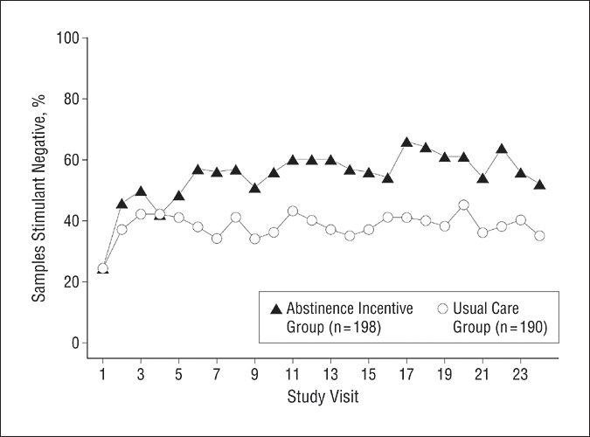
Contingency Management
The mean percentage of submitted samples testing negative for target drugs (stimulants and alcohol) is shown for abstinence incentive and usual care participants at each of 24 study visits.
Average cost = $1.46 per person/day
Peirce et al. Arch Gen Psychiatry. 2006;63:201-208
Notes:
With contingency management mention drug courts and appointment intervals

Slide 29
How can we help our stimulant-using patients?
Decriminalize substance use
Ask and educate about complications, overdose
Harm reduction and engagement–
Safer supplies (syringes, smoking glass), naloxone, quiet, safe and clean spaces, safer sex supplies and education, toothpaste - chapstick
Refer/provide CM, CRA, and CBT, if available
No FDA-approved medications
Stimulants and ?ketamine? have shown some promise for cocaine
Mirtazapine has shown some promise for methamphetamine
Advocate, research and develop novel strategies in the treatment of stimulant use disorders

Slide 30
Learning objectives
At the end of this session, participants will be able to:
Understand how and why people use stimulants
Know the characteristics of stimulant intoxication and withdrawal syndromes
Understand the consequences of these drugs
Know the current options for treatment of stimulant dependence

Slide 31
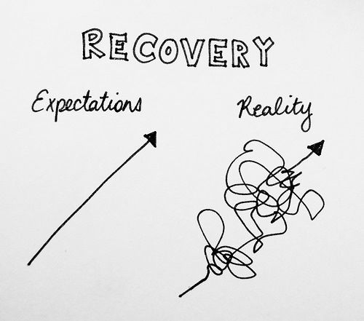
Realistic Expectations! Addiction is a chronic relapsing condition Over time treatment works People get better, if the stay alive Engage people before, at, and after health system touchpoints awalley@bu.edu

