Slide 1
Introduction to Motivational Interviewing:
Helping People Change
Jeanette M. Tetrault, MD FACP FASAM
Professor of Medicine
Yale School of Medicine
These slides were adapted with permission from Dr. Richard Saitz

Slide 2

Notes:
Brainstorm a behavior you would like to change
Type it in the chat
Examples:
Eating poorly
Lack of exercise
Texting and driving
What are some ways that you think others can help you on a path to make that change?

Slide 3

What is motivation (or lack there of…)?
Notes:
What is happening here? Describe what you see.
An assumption underlies the commonly used aggressive or confrontational approach often taken with patients practicing unhealthy behaviors.
That assumption is that the lack of motivation to change is a personality trait or that it is part of a formidable defense mechanism called denial that renders the patient incapable of seeing reality or the right course.
Naturally, aggressive attack strategies would be needed to crush these defenses and have the patient surrender. After all, these are patients obviously demonstrating poor judgement.
But it turns out that confrontational strategies are associated with a lower likelihood of behavior change (compared to other approaches including the more patient centered MI in a RCT). Confrontational style or accusing patients of having some undesirable characteristic (you are addicted, you are being resistant), leads to the resistance seen—arguing, changing the subject, interrupting, denying of a problem. Furthermore, no specific personality traits have been associated with the development of alcoholism, for example, a disorder in which we see denial. In fact, denial, when specifically studied, is no more characteristic of patients with AUD than patient without AUD. Successful treatment outcomes in patients with AUD have been sometimes associated with higher levels of pretreatment denial and a refusal to accept being labeled” Think of some patients with severe unremitting AUD that you have seen—often they know they have a severe problem; they just can’t change it.
So what is it that we so commonly see in patients who continue unhealthy behaviors if not a destructive personality trait?

Slide 4
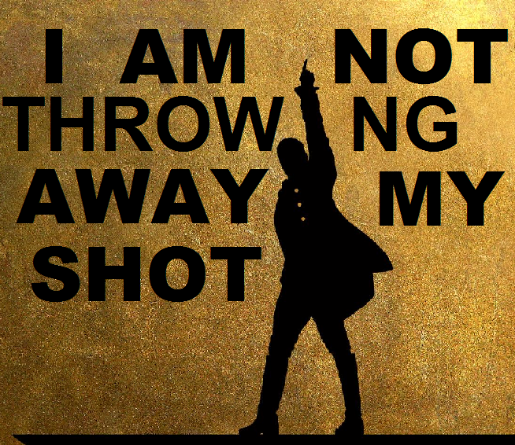
Lack of motivation
A result of a confrontational counseling style
May be related to ambivalence, which is normal
Probability that a person will enter into, continue, and adhere to a specific change strategy
A state of readiness to change
Notes:
Well as I implied, we may be seeing the results of our confrontational interviewing styles. And we may be seeing a normal, common human experience, ambivalence, or feeling two ways about things. Feeling 100% clear about things is probably more exceptional than normal.
Right now you are ambivalent about sitting on zoom for hours on end. You are considering turning off your video now so that you can concentrate on other things…because you are bored by this talk. But perhaps you really want to get some coffee or get through your emails instead
This is normal human behavior….But in the exam room when a patient with diabetes discloses dietary indiscretion… we conclude that the patient MUST be educated and persuaded that this will result in adverse consequences and if they are ambivalent about dietary change, that they lack insight…. A logical conclusion. If the patient disagrees with us then we call it denial. So we tell them that they MUST change. And, naturally, the predictable response, since we have voiced one side of the ambivalence, is for the patient to voice the other—Usually starts, “Yes doctor, but…” and we conclude our patient is resistant to change and our efforts will be futile. Of course if they eventually agree with us…probably just because they want the visit to end….we conclude that our unidirectional education worked.
For patients who disagree with us, they may not actually be “unmotivated.” In fact, what they say is often not reflective of what they do; and it is what they do that we really care about.
So rather than a personality style, a defense mechanism or a patient trait, lets think of motivation or lack of motivation as a probability that a person will enter into, continue and adhere to a specific change strategy, a state of readiness or eagerness to change that fluctuates from time to time.
Motivation IS NOT a static general patient characteristic. We know that patients are motivated to do some things and not others—perhaps a patient with diabetes is motivated to do aerobic exercise and frequently check sugars but not to eliminate their favorite fatty food.
Motivation may be better thought of as our task to enhance rather than a patient characteristic that we must tell them to change.
It engaging with a patient and evoking this state of readiness to change that gives us a shot at helping the patient! And I will tell you…. I am NOT throwing away MY SHOT!!

Slide 5

Enhanced motivation
Notes:
So this is our goal! Instead of forcing the dog to go on a walk because it is the 5 minutes we have in the day, we may need to enhance our dogs motivation so they are ready, willing and able to go on a walk when we have time….

Slide 6
Ready, willing, and able OR willing, able, and ready?
Willing: express the IMPORTANCE of change
Able: CONFIDENT in ability to change
Ready: A matter of priorities…
Notes:
Readiness, willingness, and ableness for a dog may be a lot easier to attain then for a human.
And often times it is not looking at the conditions as being ready, willing and able…..RATHER--being willing and able are often present AND it is the readiness is the hard part.
Take for instance a longstanding patient of yours who has been living with methamphetamine use for years.
They may be willing to agree with you and express the importance of change
They may able to garner confidence in their ability to change
But the being ready to change may be a matter of priorities.
Show of hands….have you ever heard the following?
I know my substance use is a problem and I know I need to stop (IMPORTANCE) . I have stopped before when my kids were little (CONFIDENT), but right now—with all that is going on, I just don’t think I can stop (READY)

Slide 7
Assessing Importance and Confidence
Low CONFIDENCE High | Low IMPORTANCE High
 | Unwilling and Unable | Willing but Unable
 | Unwilling though Able | Willing and Able
Notes:
So we can think of willingness and ableness OR importance and confidence as a two by two table
Strategies to assess patients feelings of importance and confidence
Eliciting and Strengthening Confidence Talk—How important is it for you to….??
The Confidence Ruler—How confident do you feel to make a change?
Reviewing Past Successes—For our patient struggling with methamphetamine use….What worked for you when your kids were little?
Personal Strengths and Supports—What makes you confident in your ability to change?
Brainstorming –can you think of some scenarios where you might choose NOT to use/
Giving Information and Advice—like discussed yesterday—this should be done with permission
Reframing– So what your saying is…
Hypothetical Change—Let’s say there was a situation where you felt confident to change, how would that look for you?

Slide 8
What do you do if your patient is willing AND able BUT NOT READY?

Slide 9
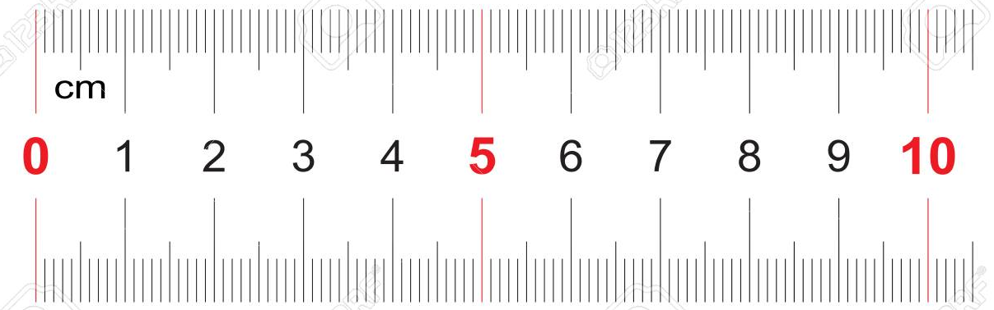
Assessing Readiness to Change: A quick version
“On a scale from 1 to 10, how important is it for you right now to….?”
  “Why did you say a 5 and not a 0?”
  “What would it take to get you from a 5 to a 7?”
“If you decide to change, how confident are you that you will succeed?”
“You’ve decided to change, and you think you can succeed, what comes next?”

Slide 10
Motivational Interviewing
A style of interacting with patients that addresses ambivalence and enhances the patient’s intrinsic motivation to change.
Notes:
A style of interacting with patients that addresses ambivalence –which is common when working with patients with substance use
and enhances the patient’s intrinsic motivation to change.

Slide 11
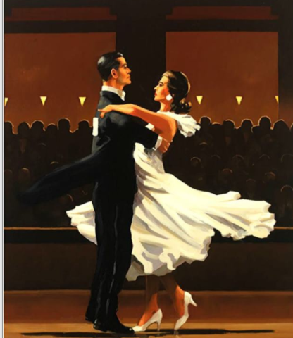
Principles of Motivational Interviewing
Engage patient
  Connect and understand patient
  Provide empathy and affirmation
Focus
  Explore goals and aspirations
  Prioritize and agree on a topic for further exploration
Evoke
  Center on patient’s own reasons for change
  Develop discrepancy
  Elicit change talk
Plan
  Promote self-efficacy
  Negotiate and assess confidence
  Arrange follow-up
Notes:
MI is a gentle dance rather than an argument

Slide 12

Tools for effective Motivational Interviewing
Open-ended questions
Affirmations
Reflective listening
Summarize with purpose

Slide 13
Tools for effective Motivational Interviewing
Open-ended questions
Show curiosity
Avoid yes/no answers
Affirmations
Recognize effort
Positive reframing
Reflective listening
Simple: repeat or rephrase
Complex: paraphrase or
inferred emotion
Summarize with purpose
Big, complex reflections
Notes:
Common reflection stems:
It sounds like…
I hear that you’re…
It seems that you…
So you…
You’re wondering if…
- direct declaration of message
You are not ready to stop smoking, now
- amplify the declaration
No way could you imagine quitting, now
- state opposing messages
You want to breathe better, and you know your asthma improves off cigarettes, but you do not want to make any attempt to quit

Slide 14
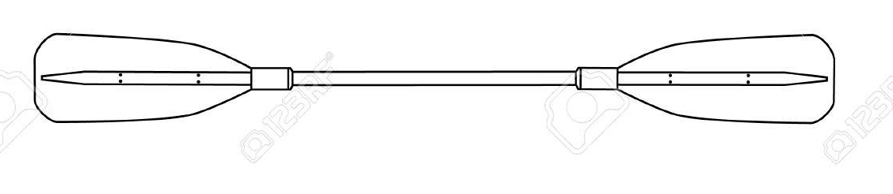
Applying tools to Motivational Interviewing
Engage patient
  Connect and understand patient
  Provide empathy and affirmation
Focus
  Explore goals and aspirations
  Prioritize and agree on a topic for further exploration
Evoke
  Center on patient’s own reasons for change
  Develop discrepancy
  Elicit change talk
Plan
  Promote self-efficacy
  Negotiate and assess confidence
  Arrange follow up
Ask open ended questions
Use reflective listening
Affirm patient’s feelings
Summary statements
Notes:
You should use your oars throughout the motivational interview but here are some examples of parts of the interview where you can use your oars to steer the canoe carrying you & your patient in the direction of change.

Slide 15
Highlighting Components of Motivational Interviewing
Engage patient
  Connect and understand patient
  Provide empathy and affirmation
Focus
  Explore goals and aspirations
  Prioritize and agree on a topic for further exploration
Evoke
  Center on patient’s own reasons for change
  Develop discrepancy
  Elicit change talk
Plan
  Promote self-efficacy
  Negotiate and assess confidence
  Arrange follow up

Slide 16
Highlighting Components of Motivational Interviewing
Engage patient
  Connect and understand patient
  Provide EMPATHY and affirmation
Focus
  Explore goals and aspirations
  Prioritize and agree on a topic for further exploration
Evoke
  Center on patient’s own reasons for change
  Develop discrepancy
  Elicit change talk
Plan
  Promote self-efficacy
  Negotiate and assess confidence
  Arrange follow up

Slide 17

MI is rooted in empathy
Empathy
Notes:
Underlying assumption…MI is rooted in EMPATHY which is the opposite of hostile confrontation.
Acceptance facilitates change
Skillful reflective listening is fundamental
Ambivalence is normal

Slide 18

Let’s explore empathy….
RSA Short: Empathy by Dr. Brene Brown
Notes:
https://youtu.be/1Evwgu369Jw

Slide 19
Highlighting Components of Motivational Interviewing
Engage patient
  Connect and understand patient
  Provide empathy and affirmation
Focus
  Explore goals and aspirations
  Prioritize and agree on a topic for further exploration
Evoke
  Center on patient’s own reasons for change
  DEVELOP DISCREPANCY
  Elicit change talk
Plan
  Promote self-efficacy
  Negotiate and assess confidence
  Arrange follow-up

Slide 20
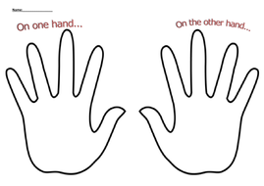
Developing discrepancy
Change is motivated by a perceived discrepancy between present behavior and important personal goals or values
The individual rather than the counselor or clinician should present the arguments for change
Notes:
Change can be motivated by a perceived discrepancy between present behavior and important personal goals or values
This is where providers can do some work in the interview—the provider can set up the discussion such that the individual rather than the counselor or clinician presents the arguments for change.
We explored this a bit yesterday with the ruler exercise in the BNI—why didn’t you pick a lower number?
My favorite technique for doing this is using the hand rule….
On the one hand, you tell me alcohol helps you relax and wind down after a tough day, on the other hand, you are sick of spending money on wine and waking up feeling groggy in the morning.
Usually the patient follows with, Yes! You really heard what I was saying and if you can feel comfortable with silence, the patient feels invited to further present the arguments for change…

Slide 21
Highlighting Components of Motivational Interviewing
Engage patient
  Connect and understand patient
  Provide empathy and affirmation
Focus
  Explore goals and aspirations
  Prioritize and agree on a topic for further exploration
Evoke
  Center on patient’s own reasons for change
  Develop discrepancy
  Elicit CHANGE TALK
Plan
  Promote self-efficacy
  Negotiate and assess confidence
  Arrange follow-up
Notes:
Probably one of the fundamental differences between brief negotiation interview which we learned about yesterday and motivational interviewing, is eliciting change talk

Slide 22
Change Talk: Self-motivating speech
Disadvantage of status quo
“I know my drinking is ruining my marriage”
Optimism for change
“I have stopped using cannabis before, I know I can do it again”
Intention to change
“Once the audit is done at work and I am less stressed, I will cut back on drinking”
Advantage of change
“If I stop using cocaine, I will be more focused at my job”
Notes:
Change talk is that moment when you hear things shifting….it is a form of self motivating speech.
We will go through 4 domains of change talk with examples

Slide 23

DARN_C: Framework for looking for change talk
Desire for change
Ability to change
Reasons for change
Need to change
Commitment to change
Notes:
It helps to have a framework or scaffolding to hang these golden nuggets of information the PATIENT provides onto when we are in the exam room or hospital room.

Slide 24
Highlighting Components of Motivational Interviewing
Engage patient
  Connect and understand patient
  Provide empathy and affirmation
Focus
  Explore goals and aspirations
  Prioritize and agree on a topic for further exploration
Evoke
  Center on patient’s own reasons for change
  Develop discrepancy
  Elicit change talk
Plan
  Promote SELF-EFFICACY
  Negotiate and assess confidence
  Arrange follow-up
Notes:
The last component of MI I want to highlight is self-efficacy

Slide 25
Self-efficacy
An individual’s belief in the possibility of change
  Important motivator
The individual, not the clinician, is responsible for choosing and carrying out change
The clinician’s own belief in the individual’s ability to change becomes a self-fulfilling prophecy
Notes:
An individual’s belief in the possibility of change is an important motivator—understanding that change from the status quo is possible can be very empowering.
The individual, not the clinician, is responsible for choosing and carrying out change—you are not dictating to the patient what they must do through confrontation. They have come up with the idea for change.
The clinician’s own belief in the individual’s ability to change becomes a self-fulfilling prophecy. After expressing empathy and gaining trust, stating that you think the patient can do it may be a very powerful tool.

Slide 26

Roadmap of a Motivational Interview
Part I: Build Motivation for Change
  Enhance alliance and autonomy
Part II: Negotiate Change and
Strengthen Commitment
  Provide information while creating dialogue
START
Notes:
In skills practice session II and III (today and tomorrow), we will focus on skills and components of motivational interviewing. The general structure of a motivational interview, which can occur over multiple visits, is outlined here. In general, there are two major tasks, building motivation for change, during which we enhance alliance and patient autonomy, and negotiating change and strengthening commitment, at which time we provide information while creating dialogue.

Slide 27
Brief Intervention vs. Motivational Interviewing
 | BNI | Motivational Interviewing
Skill | Simple, MI-informed Ask/assess Provide feedback with permission | Higher level skill
Engage | Pros and cons Review health risks | Open ended questions with pros and cons (discrepancy)
Focus |  | Reflective listening
Evoke | Readiness to change | Develop Discrepancy Elicit change talk Summary and key Question
Plan | Provide advice, arrange follow up | Promote self-efficacy
Notes:
What are the differences between a brief negotiation interview which Jeffrey and Dan taught use about yesterday and motivational interviewing which we are exploring today…???

Slide 28
How do I teach this?
Integrate video / media
  How do you have patient-centered conversations? Motivational Interviewing Basics.
Large group demonstration
Skills practice
  Focus on teaching points:
    Reflective Listening
    OARS
    Use real patient cases

Slide 29

Thank you!

Slide 30

Persuade your partner
Pair off in a breakout room for 5 minutes
It is your partners job to get you to change
At 2 min and 30 seconds, switch

