Slide 1
Clearing the Smoke on Cannabis
Jeanette M. Tetrault, MD FACP FASAM
Professor of Medicine
Program Director, Addiction Medicine Fellowship
Associate Director for Education and Training,
Program in Addiction Medicine
Yale School of Medicine

Slide 2
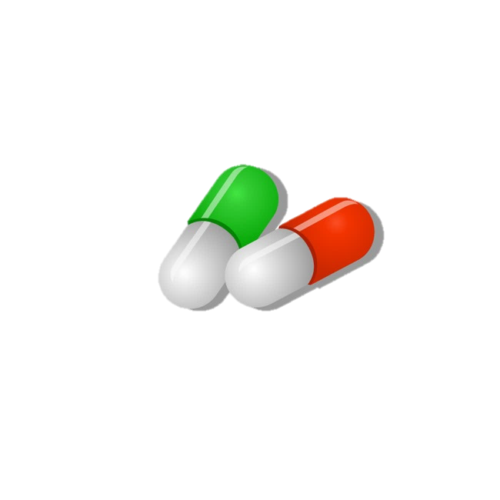


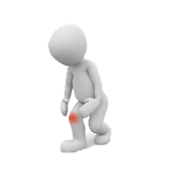


Clinical conundrum
Notes:
48 yo father of two living in CT with obesity and chronic OA of the knee presents for follow up
Initially followed by pain specialist, maintained on MS Contin 30 mg tid and one-two oxycodone 5mg tabs q6 hours for breakthrough pain, not to exceed 6 tabs/day
No longer seeing pain specialist after losing his insurance
In primary care, continued on regimen and followed treatment agreement
Became increasingly sedentary
Diagnosed with other chronic conditions including OSA, COPD and cardiac disease
BMI increased from 28-32 in two years; in a rut can’t exercise due to pain, can’t lose weight because can’t
exercise, weight gain has made the pain worse
History of binge drinking in college BUT NOW drinks 12 beers/week; has not drank more than 5 drinks per occasion in the last year; has not used an illicit substance in the past year.
After discussion with the patient, you both agree, his opioids are no longer optimizing his pain, he understands the risk profile and asks, “maybe you should just prescribe cannabis or I should drive across state lines and get some?”
States he tried it once in college but made him “giggly and a little paranoid” but has heard it has helped, including athletes, with pain. Asks if you will consider giving it to him since you are taking away his opioids

Slide 3
Learning objectives
Define the key components of cannabis and review relevant epidemiology and terminology
Analyze policy issues regarding cannabis legalization
Describe adverse health effects of cannabis use
Counsel patients about cannabis use based on scientific evidence

Slide 4
Learning objectives
Define the key components of cannabis and review relevant epidemiology and terminology
Analyze policy issues regarding cannabis legalization
Describe adverse health effects of cannabis use
Counsel patients about cannabis use based on scientific evidence

Slide 5
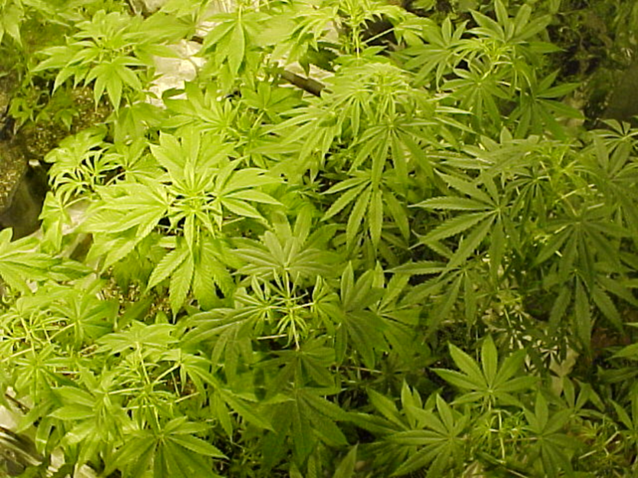
What is cannabis?
Dried flowers, leaves, stems and seeds of Cannabis sativa
Different species:
  Sativa
  Indica
Two main components:
  Terpenes
  Cannabinoids
    Cannabidiol (CBD)
    Δ9-tetrahydrocannabinol (THC)
Potency related to concentration of THC and route of administration

Slide 6
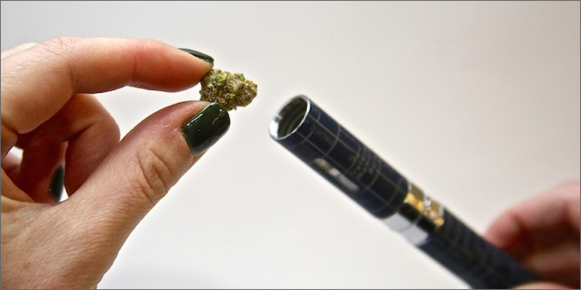
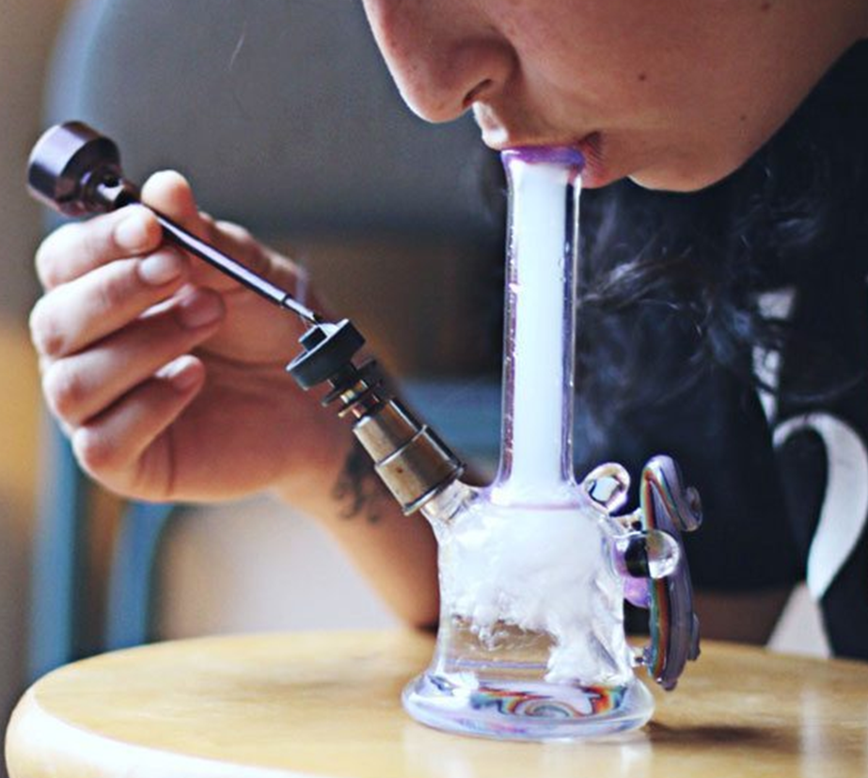
Routes of administration
Smoking
Edibles
Tinctures
Transdermal patch
Suppository
Topical cream
Beverage
Vaping – activating raw plant matter without combustion
  ~40% of individuals with medical cannabis use vape as a route of administration
Dabbing – inhale cannabis vapor from concentrates, oils or extracts through a “dab rig”
  Delivers a high dose of THC in a short period of time

Slide 7
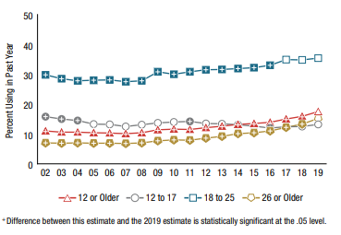
Past-year cannabis use between 2002-2019
SAMHSA 2020
Notes:
Among all people aged 12 or older, past year cannabis increased from 11% in 2002 to 18% in 2019

Slide 8
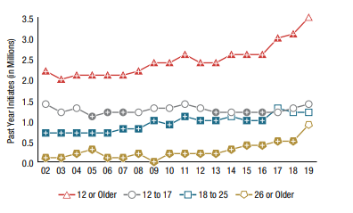
Past-year initiates of cannabis between 2002-2019
SAMHSA 2020
Notes:
Among people aged 12 or older, the number of past year initiates of cannabis increased from 2.2 million people in 2002 to 3.5 million people in 2019. The number of adolescents in 2019 who initiated cannabis use in the past year averaged to about 3,700 adolescents each day

Slide 9
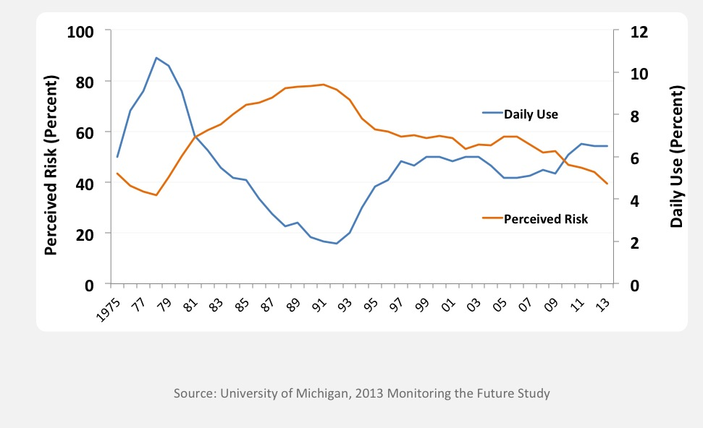
Why the increase?
Daily Cannabis Use vs. Perceived Risk of Regular
Cannabis Use among 12th Graders, 1975-2013
Notes:
Additionally, we know that Education is key, because when risk awareness goes up drug use goes down. Data from the MTF study suggests that there is inverse relationship between perceived risk and marijuana use. As perceived risk goes up (red line), marijuana use (blue line) goes down and vice versa. In recent years perceived risk has been decreasing, while use has been ticking up—even daily use among 12th graders is at about 6% (not shown), which is the highest its been in the history of the Monitoring the Future survey .
As perceived risk decreases, epidemiology increases.

Slide 10
Cannabis Use Disorder DSM 5
Loss of Control
-Larger quantity over longer period of time
-Unsuccessful attempts to cutback or control
-Increased time spent
Consequences -Failure to fulfill major role obligations
-Social/Interpersonal problems -Activities given up -Use in hazardous situations -Physical and psychological consequences
Craving
-Craving
-Tolerance
-Withdrawal
A problematic pattern of cannabis use leading to clinically significant impairment or distress, as manifested by two or more criteria within a 12-month period.
Modified by severity:
Mild: Two to three symptoms
Moderate: Four to five symptoms
Severe: Six or more symptoms
Notes:
BEFORE WE GET INTO THE Policy implications and ADVERSE HEALTH EFFECTS, WE NEED TO GET ON THE SAME PAGE REGARDING TERMINOLOGY AND DSM5 DIAGNOSES
DSM 5 combines abuse and dependence into a single construct called substance use disorder with certain modifiers for mild, moderate or server.
A problematic pattern of cannabis use leading to clinically significant impairment or distress, as manifested by two or more of the following within a 12-month period:
Mild: Two to three symptoms
Moderate: Four to five symptoms
Severe: Six or more symptoms

Slide 11
Cannabis withdrawal: New to DSM 5
Cessation of cannabis use that has been heavy and prolonged
Three or more of the following signs and symptoms develop within approximately one week after the cannabis cessation:
  Irritability, anger, or aggression
  Nervousness or anxiety
  Sleep difficulty (eg, insomnia, disturbing dreams)
  Decreased appetite or weight loss
  Restlessness
  Depressed mood
  At least one of the following physical symptoms causing significant discomfort: abdominal pain, shakiness/tremors, sweating, fever, chills, or headache
Cause distress or impairment
No other explanation for symptoms
Of note, symptoms generally resolve in 7-14 days but may persist for weeks
Notes:
TIMELY: Just added to DSM IV
NEED TO INCLUDE:
The signs or symptoms cause clinically significant distress or impairment in social, occupational, or other important areas of functioning
The signs or symptoms are not attributable to another medical condition and are not better explained by another mental disorder, including intoxication or withdrawal from another substance
Symptoms generally resolve in 7-14 days but may persist for weeks.

Slide 12
Learning objectives
Define the key components of cannabis and review relevant epidemiology and terminology
Analyze policy issues regarding cannabis legalization
Describe adverse health effects of cannabis use
Counsel patients about cannabis use based on scientific evidence

Slide 13
Policy timeline
1970: Controlled Substances Act passed by Congress, cannabis listed as schedule I drug
1996-2020: 17 states + DC legalized; 12 states medical and decriminalized, 36 states with medical only
2005: Supreme Court decision (Gonzales v. Raich)
  Federal law enforcement has the authority to arrest and prosecute MDs or patients
2009, 2014: Department of Justice Memorandum
  Federal resources should not be used to prosecute those who comply with states laws
2008-2010: IOM, ACP, AMA
  Petitioned DEA/FDA to reschedule to schedule II …it remains schedule I to this day
Notes:
I think it is important to review the policy time line with regard to cannabis legislation in this country.
1970: Controlled Substances Act passed by Congress, cannabis is listed as schedule I drug (i.e. no currently accepted medical use, high potential for abuse, and a lack of accepted safety even under medical supervision)
1985: dronabinol or Marinol (synthetic THC) approved in the US for treatment of intractable nausea
Between 1996-2017: 29 states legalize medical cannabis (AK, AZ, CA CO, CT, DE, HI, IL, ME, MD, MA, MI, MT, NV, NH, NJ, NM, NY, OR, RI, VT, WA) AND 4 states and DC legalized recreational use (AK, CO, OR, WA)
On the federal level:
In 2005: Supreme Court decision (Gonzales v. Raich)
Regardless of state laws, federal law enforcement has the authority under the CSA to arrest and prosecute physicians who prescribe or dispense marijuana and patients who possess or cultivate it.
In 2009: Department of Justice
Issued a memorandum to U.S. Attorneys stating that federal resources should not be used to prosecute providers and patients whose actions comply with their states’ laws permitting medical use of marijuana.
Between 2008-2010: several medical organizations including the IOM, ACP, AMA individually
Petitioned DEA/FDA to reschedule marijuana to schedule II …it remains schedule I to this day
Jan 2018: Sessions rescinds Obama era memorandum which in turn gives federal prosecutors around the country more discretion about enforcing federal law in marijuana cases, even in the states where it is legal.—this move has received deep criticism from both sides of the aisle.
Schumer's legislation would remove marijuana from the list of scheduled substances under a 1970 law that classifies marijuana as dangerous as heroin for legal and regulatory purposes.
It would establish funding for women- and minority-owned marijuana businesses, require more research on the drug's public health impact, and maintain federal authority to regulate commercial advertising, similar to existing regulations for tobacco and alcohol.

Slide 14
Racial disparities in enforcement of cannabis laws
Between 2001 and 2010 there were > 8 million arrests related to possession of cannabis in the US.
Cannabis use is roughly similar among Black and white individuals, however, Black individuals are 3.73 times more likely to be arrested for possession of cannabis.
Nearly 80% of people in federal prison and almost 60% of people in state prison for drug related charges are Black or Latinx.

Slide 15
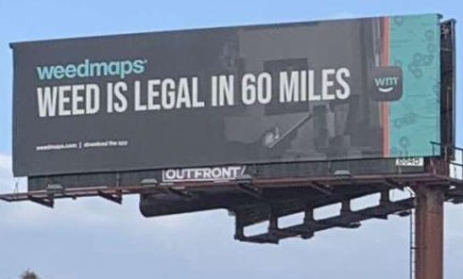
State-to-state variation

Slide 16
Learning objectives
Define the key components of cannabis and review relevant epidemiology and terminology
Analyze policy issues regarding cannabis legalization
Describe adverse health effects of cannabis use
Counsel patients about cannabis use based on scientific evidence

Slide 17
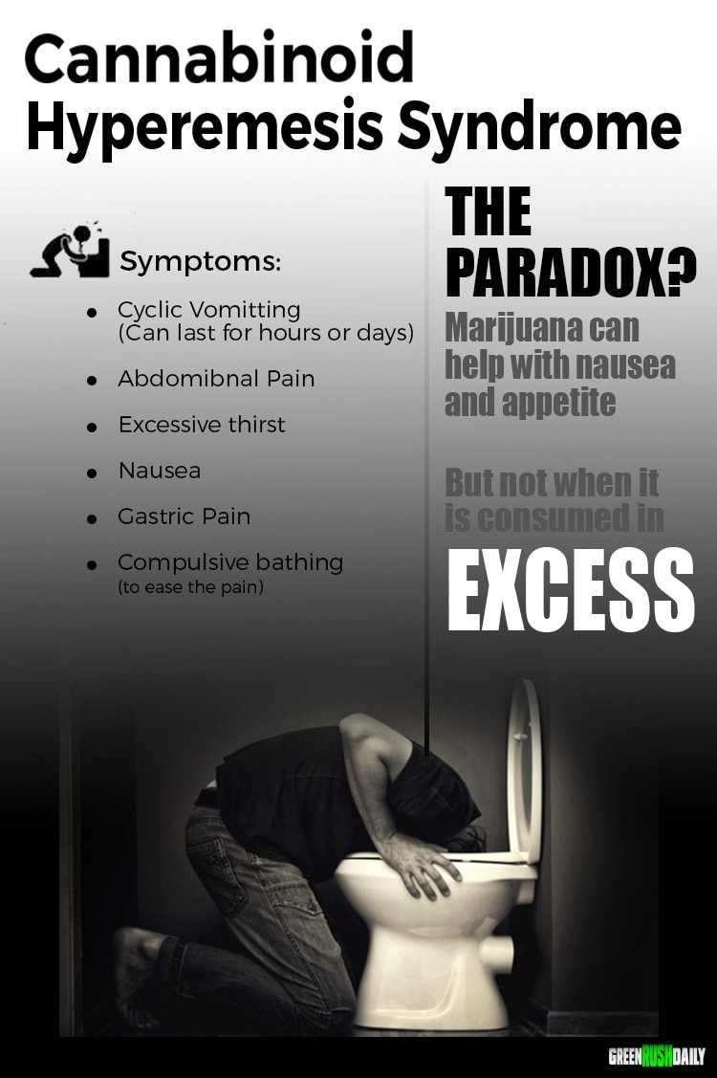
Acute adverse effects
Intoxication
  agitation, psychosis, and anxiety
  tachycardia and hypertension
Cannabinoid Hyperemesis Syndrome
Pediatric Exposures
Kim &Monte Annals of Em Med 2016
https://www.greenrushdaily.com/2016/08/17/cannabinoid-hyperemesis-syndrome-cannabis/
Notes:
We observed a doubling in ED visits for cyclic vomiting after the legalization of medical marijuana in Colorado in 2009 (41 per 113,262 visits prelegalization versus 87 per 129,095 visits postlegalization), although the absolute number of visits remained modest.¹⁸
Public service annoucement add about cannibis hyperemsis syndrome from https://www.greenrushdaily.com/Green Rush Daily is the voice of the cannabis revolution. Providing unbiased, uncensored marijuana news and information.

Slide 18
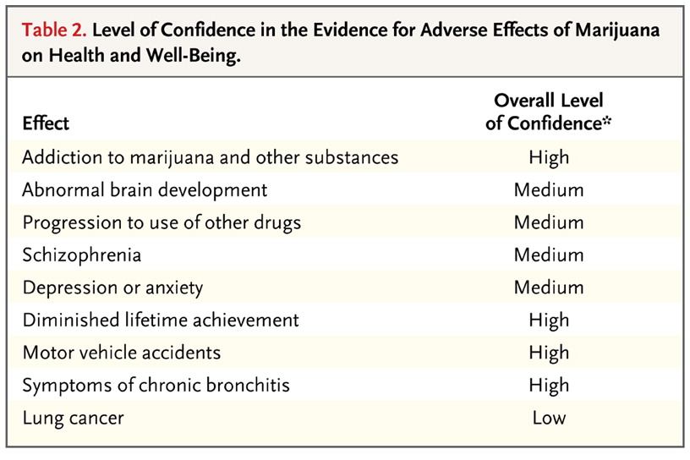

Adverse effects of chronic cannabis use
{
}
Volkow ND et al. NEJM 2014;370:2219-2227.
Notes:
As physicians, it is imperative that we weigh known risks against possible benefits with patients when discussing any therapeutic option with patients. But outlining risks is just as important when discussing substance use with patients.
A recent study published in the New England Journal of Medicine in 2014 by the head of the National Institute on Drug Abuse reviewed the health consequences of marijuana use and graded the overall level of confidence in the existing literature with regard to various health consequences.
I will highlight over the next few slides some of these adverse effects.
The indicated overall level of confidence in the association between marijuana
use and the listed effects represents an attempt to rank the strength of the
current evidence, especially with regard to heavy or long-term use and use
that starts in adolescence.

Slide 19
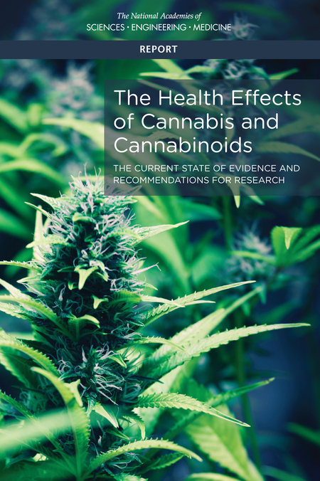
16 person committee reviewed > 10,000 abstracts published since 1999
Focused on recently published systematic reviews and high quality primary research for 11 groups of health effects including both harms and therapeutic effects
Report of National Academies of Science, Engineering and Medicine.
Health Effects of Cannabis and Cannabinoids. 2017

Slide 20
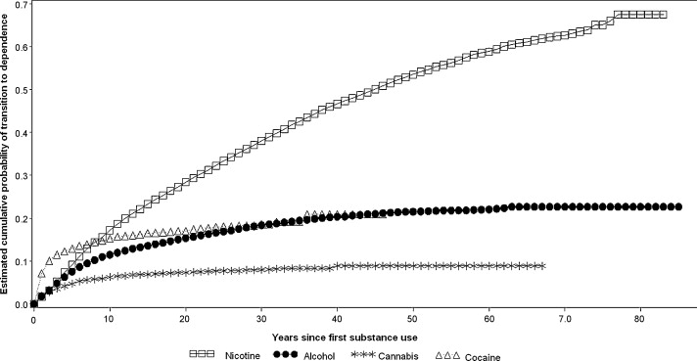
Cumulative Probability of Transitioning to Substance Use Disorder for Nicotine, Alcohol, Cannabis and Cocaine
Develop CUD:
9% of overall,
17% if begin during adolescence,
25-50% if daily use
Lopez-Quintero, C. et al. Drug & Alcohol Dependence 2011
Notes:
The National Academy of Science Engineering and Medicine report noted that
There is substantial evidence that:
Initiating cannabis use at an earlier age is a risk factor for the development of problem cannabis use

Slide 21
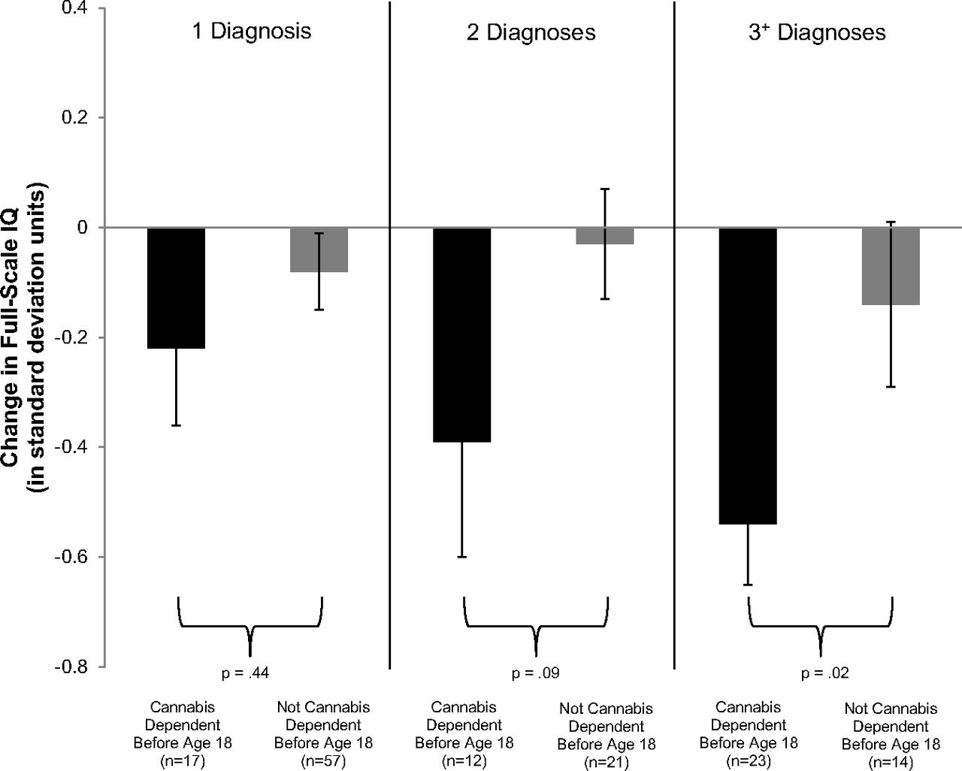
Adolescent vulnerability in IQ decline
Meier M H et al. PNAS 2012
Notes:
Though addiction is concerning especially among individuals who start using in adolescence, so too are concerns about brain development. Here we show data from a
Prospective birth cohort- which followed over 1000 individuals followed from birth to age 38, with multiple testing waves throughout this times period.
This Figure shows Adolescent vulnerability in IQ decline.. Individuals with adolescent-onset cannabis use disorder, shown in black bars, experienced greater IQ decline than individuals with adult-onset cannabis use disorder, shown in gray bars. The IQ decline of individuals with cananbis use beginning in adolescence and persisting into adulthood corresponds to a loss of roughly 8 IQ points.
Follow up data not shown here suggest that those who used cannabis heavily as teenagers and quit using as adults do not recover the lost IQ points. Although the numbers of individuals who met criteria for CUD were relatively small over multiple testing waves, this trend has been replicated in other studies.
There is moderate evidence of a statistical association between cannabis use and:
The impairment in the cognitive domains of learning, memory, and attention

Slide 22
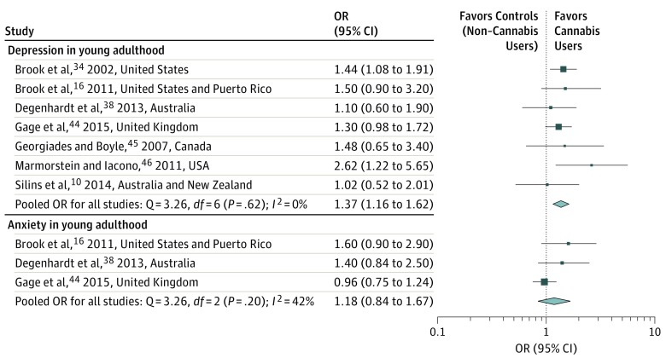
Association between cannabis use in adolescence and mood disorders

Slide 23
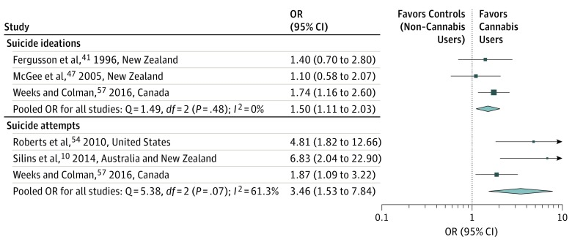
Association between cannabis use in adolescence and suicidality

Slide 24
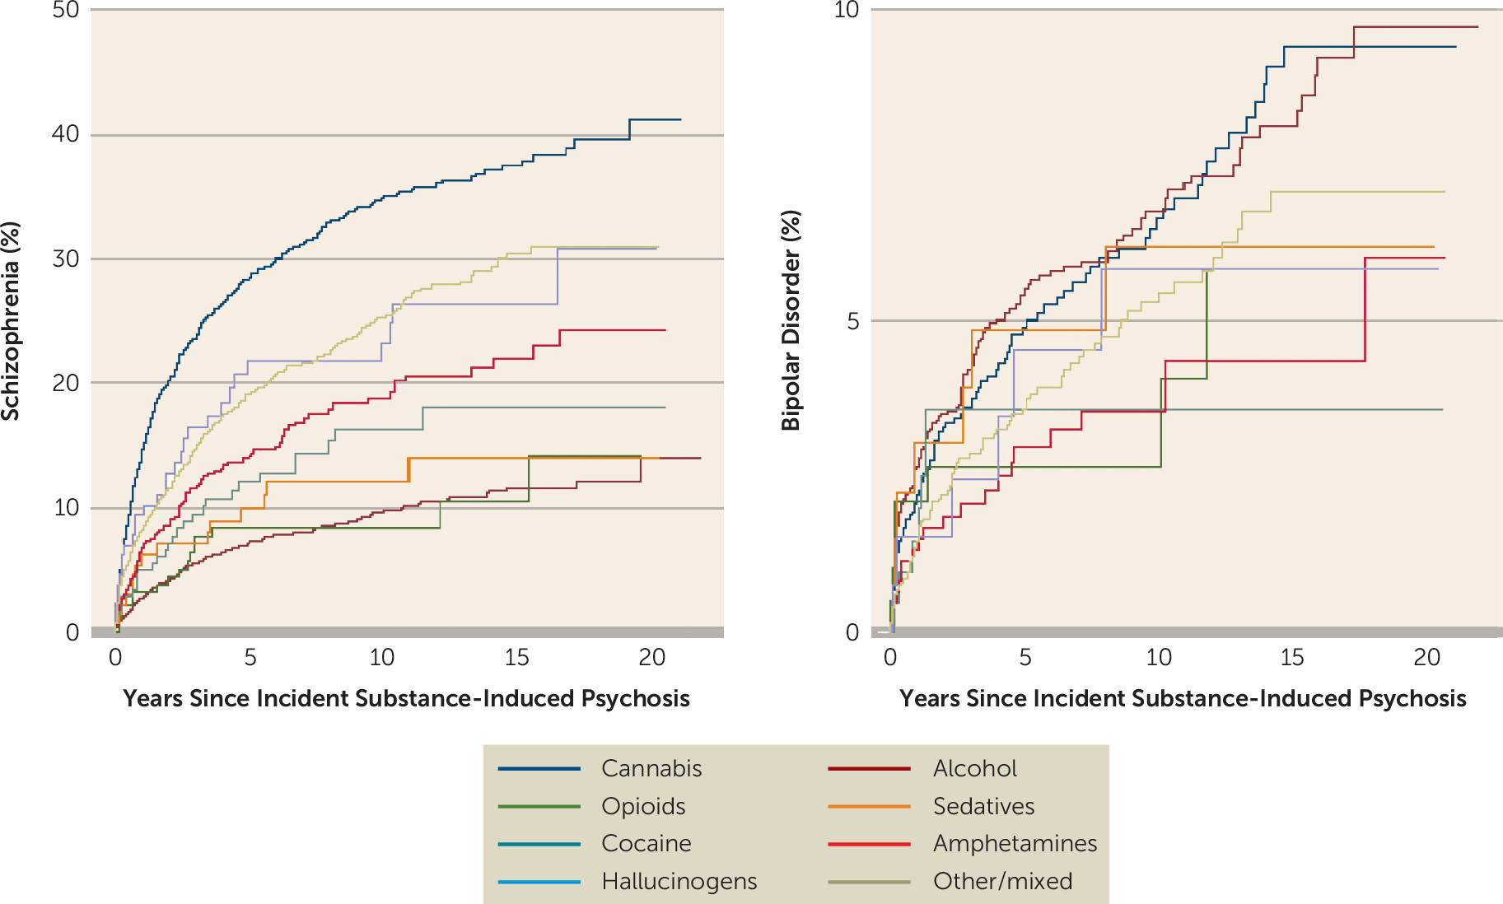
Conversion to schizophrenia and bipolar disorder following SIPD (N=6,788)
Kejser Starzer MS et al, Am J Psychiatry, 2019

Slide 25
Treatment Options for cannabis use disorder
Pharmacotherapy
  No currently approved medication
    cannabinoid antagonist
    oral THC for withdrawal, maintenance or short-term treatment?
      cannabinoid agonist—Levin FR DAD 2011
    N-Acetylcysteine
Behavioral
  Substance use treatment setting
    cognitive-behavioral therapy, contingency management, motivational enhancement, therapeutic living
  General medical settings
    Brief interventions
Notes:
Widespread screening for adolescent substance use is controversial, there is some emerging evidence for BI for mj use

Slide 26
Fundamental tension
Intoxication and withdrawal of cannabis are not fatal
Overdose is unlikely
Long-term, moderate use seems to be relatively frequent (compared to other drugs)
Risk of end-organ damage appears to be lower than several other legal and illegal substances
Ratio of medical benefit to harm may be equal or better than some controlled substances

Slide 27
Health effects of cannabis and cannabinoids:
Therapeutic effects
There is conclusive or substantial evidence that cannabis or cannabinoids are effective:
For the treatment of chronic pain in adults (cannabis)
As antiemetics in the treatment of chemotherapy-induced nausea and vomiting (oral cannabinoids)
For improving patient-reported multiple sclerosis spasticity symptoms (oral cannabinoids)
Report of National Academies of Science, Engineering and Medicine.
Health Effects of Cannabis and Cannabinoids. 2017

Slide 28
Learning objectives
Define the key components of cannabis and review relevant epidemiology and terminology
Analyze policy issues regarding cannabis legalization
Describe adverse health effects of cannabis use
Counsel patients about cannabis use based on scientific evidence

Slide 29
Challenges in conducting research on adverse health effects or therapeutic effects of cannabis
Regulatory barriers, including the classification of cannabis as a Schedule I substance, impede the advancement of cannabis research
A diverse network of funders is needed to support cannabis research
To develop conclusive evidence for the effects of cannabis use on short- and long-term health outcomes, improvements and standardization in research methodology are needed
Report of National Academies of Science, Engineering and Medicine.
Health Effects of Cannabis and Cannabinoids. 2017

Slide 30
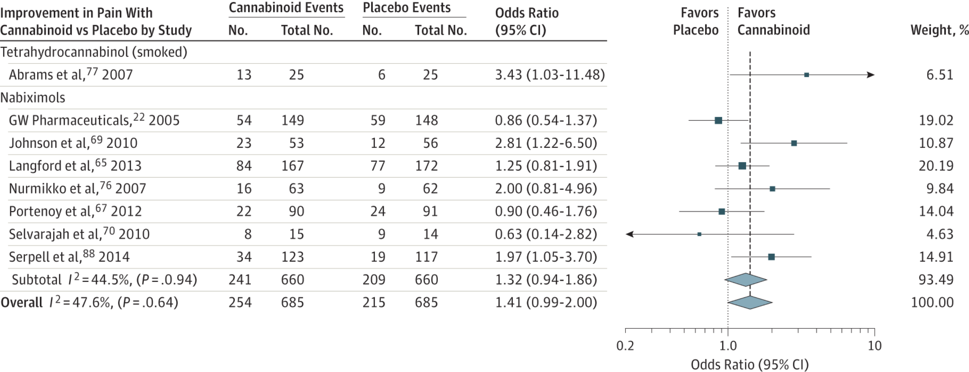
Cannbinoids for medical use: Pain
30% decrease in pain w cannabinoid vs placebo:
OR 1.41 (95% CI, 0.99-2.00)
Whiting PF et al. JAMA.2015;313(24):2456-2473
Notes:
ONE EXAMPLE
There was moderate-quality evidence to support the use of
cannabinoids for the treatment of chronic pain and spasticity. There was low-quality evidence
suggesting that cannabinoids were associated with improvements in nausea and vomiting
due to chemotherapy, weight gain in HIV infection, sleep disorders, and Tourette syndrome.
Cannabinoids were associated with an increased risk of short-term AEs.
Improvement in PainOdds indicate 30% or greater improvement in pain with cannabinoid compared with placebo, stratified according to cannabinoid. The square data markers indicate odds ratios (ORs) from primary studies, with sizes reflecting the statistical weight of the study using random-effects meta-analysis. The horizontal lines indicate 95% CIs. The blue diamond data markers represent the subtotal and overall OR and 95% CI. The vertical dashed line shows the summary effect estimate, the dotted shows the line of no effect (OR = 1).
Change in Ashworth Score for Cannabinoid Compared With Placebo, Stratified According to CannabinoidThe square data markers indicate mean differences from primary studies, with sizes reflecting the statistical weight of the study using random-effects meta-analysis. The horizontal line indicate, 95% CIs. The blue diamond data markers represent the subtotal and overall weighted mean difference and 95% CI. The vertical dashed line shows the summary effect estimate, the solid vertical line shows the line of no effect (mean difference = 0).
NOT Included in the spacticity was the following study:
The Cannabinoid Use in Progressive Inflammatory brain Disease (CUPID) trial: a randomised double-blind placebo-controlled parallel-group multicentre trial and economic evaluation of cannabinoids to slow progression in multiple sclerosis
Health Technology Assessment, No. 19.12; Feb 2015
Susan Ball, Jane Vickery, Jeremy Hobart, Dave Wright, Colin Green, James Shearer, Andrew Nunn, Mayam Gomez Cano, David MacManus, David Miller,Shahrukh Mallik, and John Zajicek.
Headline
The study found that oral dronabinol did not slow down the progression of progressive multiple sclerosis. No major safety concerns were identified in the use of dronabinol

Slide 31
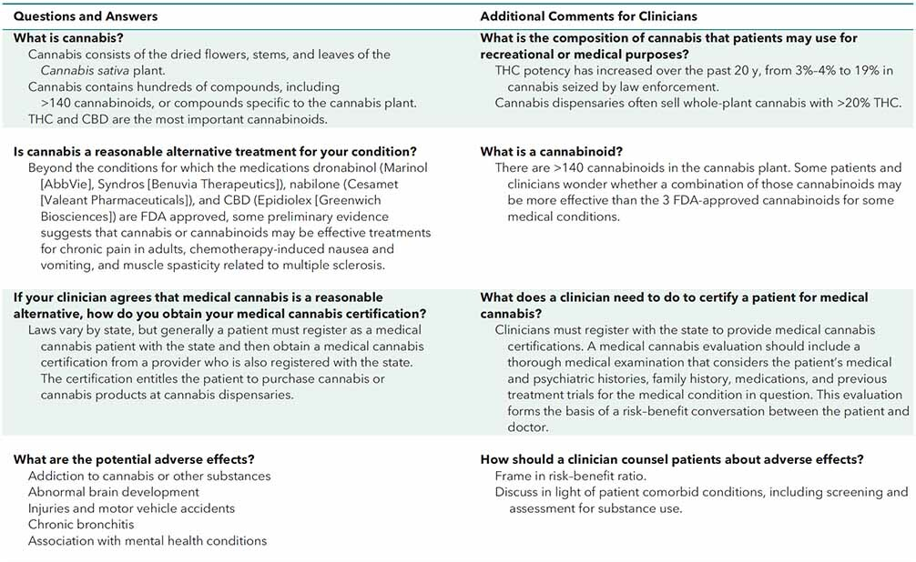
Communicating with patients about therapeutic affects
Smetana GW, Tetrault JM, Hill KP, Burns RB Annals of Internal Medicine Feb 2021

Slide 32
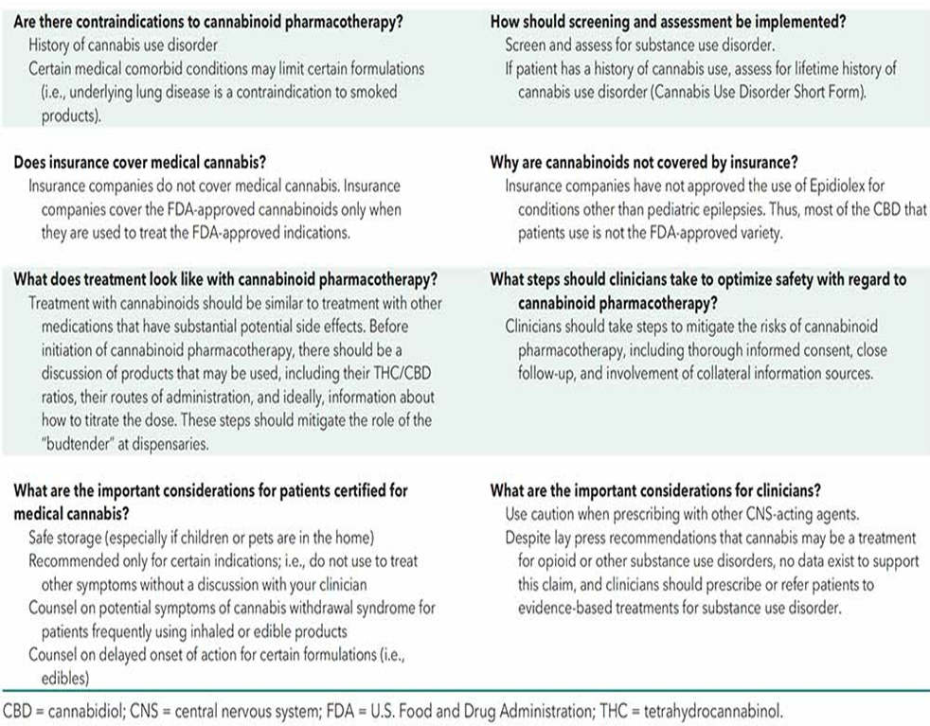
Communicating with patients about therapeutic affects
Smetana GW, Tetrault JM, Hill KP, Burns RB Annals of Internal Medicine Feb 2021

Slide 33
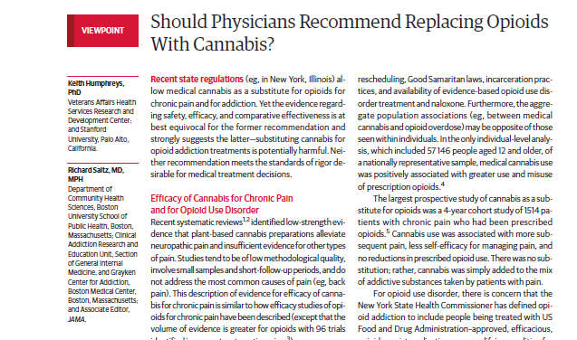
JAMA. 2019;321(7):639-640. doi:10.1001/jama.2019.0077

Slide 34
“For the opioid addiction crisis, clearly efficacious medications such as methadone and buprenorphine are under-prescribed. Without convincing evidence of efficacy of cannabis for this indication, it would be irresponsible for medicine to exacerbate this problem by encouraging patients with opioid addiction to stop taking these medications and to rely instead on unproven cannabis treatment.”
JAMA. 2019;321(7):639-640. doi:10.1001/jama.2019.0077

Slide 35
Reducing potential harm from cannabis use
Caution with edibles
  Describe long onset of action/labelling concerns
Safe storage
Caution with high THC products
  58 mg THC in a joint – don’t smoke the whole joint
Certain routes of administration i.e., dabbing carry particular risk
Consider use of products with lower THC, higher CBD
Cut back—employ brief intervention

Slide 36
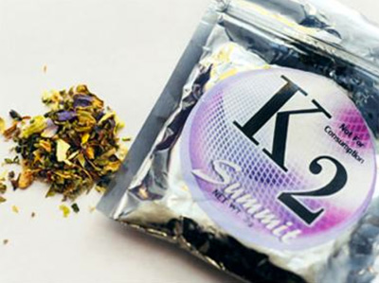
Synthetic cannabis: K2, Spice, etc.
General Information:
  Marketed as safe legal alternative to cannabis
Effects:
  Mild euphoria and relaxation
  Increased sensitivity to external stimuli
  Frank, vivid hallucinations
Adverse effects:
  Dry mouth, palpitations, vomiting, agitation
  Not detected in urine
  May be adulterated with heavy metal residues or other fillers including rat poison

Slide 37
Back to the case…What would you do?
Notes:
Back to our patient, we need to weigh all potential therapeutic effects with potential risk of health hamrs

Slide 38
Interactive teaching scenario: Morning report/role play
Set up a “spicy,” public health debate regarding legalization of recreational cannabis using the following citation as a spring board for discussion:
Kilmer B. Recreational Cannabis — Minimizing the Health Risks
from Legalization. Perspective. NEJM. February 23, 2017
Assign report participants to one of two groups:
  Recreational marijuana SHOULD be legalized in all states nationwide
    Citing adverse effects of criminalization and potential for increasing state budgets through taxation, potential impact on opioid epidemic
  Recreational marijuana SHOULD NOT be legalized in all states nationwide
    Citing current research on adverse health effects and natural experiment data from states that have already legalized recreational marijuana
All arguments need to be evidence-based and factual

Slide 39
Thank you
Questions?
Acknowledgements: several slides adapted from Dr. William Becker (Yale), Dr. Devan Kansagara (OHSU)
Dr. Hilary Kunins (NY DPH), Dr. Jeffrey Hunt (Brown), Dr. Zoe Weinstein (BU)

Slide 40
Extra slides

Slide 41
Health effects of cannabis and cannabinoids: SUD
There is substantial evidence that:
Initiating cannabis use at an earlier age is a risk factor for the development of problem cannabis use
There is moderate evidence of a statistical association between cannabis use and:
The development of substance use disorder for substances, including alcohol, tobacco, and other illicit drugs
Report of National Academies of Science, Engineering and Medicine.
Health Effects of Cannabis and Cannabinoids. 2017

Slide 42
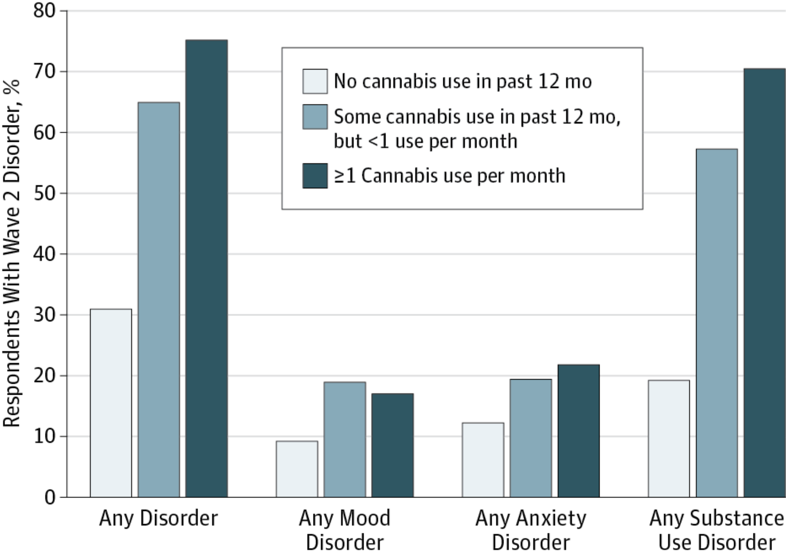
Association between mental health conditions and cannabis use
Blanco et al JAMA Psychiatry, 2016
Notes:
To examine prospective associations between cannabis use and risk of mental health and substance use disorders in the general adult population.
Within the general population, cannabis use is associated with an increased risk for several substance use disorders.
Carlos Blanco, Head of NIDA’s Division of Epidemiology, Services, and Prevention Research at NIH recently published a study using the NESARC data
Nationally representative sample of US adults aged 18 years or older was interviewed 3 years apart in the National Epidemiologic Survey on Alcohol and Related Conditions (wave 1, 2001-2002; wave 2, 2004-2005). In both analyses, the same set of wave 1 confounders was used, including sociodemographic characteristics, family history of substance use disorder, disturbed family environment, childhood parental loss, low self-esteem, social deviance, education, recent trauma, past and present psychiatric disorders, and respondent’s history of divorce.
Cannabis use in wave 1 (2001-2002) was significantly associated with substance use disorders in wave 2 (2004-2005) (any substance use disorder: odds ratio [OR], 6.2; 95% CI, 4.1-9.4; any alcohol use disorder: OR, 2.7; 95% CI, 1.9-3.8; any cannabis use disorder: OR, 9.5; 95% CI, 6.4-14.1; any other drug use disorder: OR, 2.6; 95% CI, 1.6-4.4; and nicotine dependence: OR, 1.7; 95% CI, 1.2-2.4),
but not any mood disorder (OR, 1.1; 95% CI, 0.8-1.4) or anxiety disorder (OR, 0.9; 95% CI, 0.7-1.1).
mood disorders (major depressive disorder, dysthymia, and bipolar disorder), and anxiety disorders (panic disorder, social anxiety disorder, specific phobia, and generalized anxiety disorder).
**WE DO KNOW ABOUT GENETIC PREDISPOSITIONS** MOVED SLIDE TO END BECAUSE WAS PART OF DAN’S OPENING PLENARY

Slide 43
Health effects of cannabis and cannabinoids: Mental Health
There is substantial evidence of a statistical association between cannabis use and:
The development of schizophrenia or other psychoses, with the highest risk among the most frequent users
There is moderate evidence of a statistical association between cannabis use and:
Increased symptoms of mania and hypomania in individuals with bipolar disorders
A small increased risk for the development of depressive disorders
  Major depressive disorder is a risk factor for the development of problem cannabis use
Increased incidence of suicidal ideation, suicide attempts and suicide completion
Increased incidence of social anxiety disorder Major depressive disorder is a risk factor for the development of problem cannabis use
Report of National Academies of Science, Engineering and Medicine.
Health Effects of Cannabis and Cannabinoids. 2017
Notes:
Recent genetic studies examining the association between cannabis and schizophrenia suggest that the association stems partly from shared familial/genetic risk factors and/or reverse causation

Slide 44
Health effects of cannabis and cannabinoids: Psychosocial domains
There is moderate evidence of a statistical association between cannabis use and:
The impairment in the cognitive domains of learning, memory, and attention
Report of National Academies of Science, Engineering and Medicine.
Health Effects of Cannabis and Cannabinoids. 2017
Notes:
There is moderate evidence of a statistical association between cannabis use and:
The impairment in the cognitive domains of learning, memory, and attention
In addition to these findings, the ABCD study suggests that prenatal cannabis exposure is associated with in increased risk of attention issues, thought and social issues, lower congition and gray matter volume.

Slide 45
Pulmonary effects of smoked cannabis
Acute → bronchodilation (FEV₁ increase ~ 0.15-0.25L)
Long-term → cough (OR 2.0, 95% CI 1.32-3.01), phlegm, wheeze
At low levels of exposure, FEV₁ increased by 13 mL/joint-year and FVC by 20 mL/joint-year, but at higher levels of exposure, airflow obstruction was observed
Tetrault JM et al. Archives IM 2007
Pletcher MJ et al. JAMA 2012
Notes:
Most data on the pulmonary effects of MJ show an acute bronchodilatory effect of smoked MJ.
In a systematic review, 34 studies included. Chronic mj smoking was clearly associated with increased likelihood of cough, sputum production and wheeze.
In a 20 year cohort study of MJ smoking

Slide 46
Health effects of cannabis and cannabinoids: Respiratory disease
There is substantial evidence of a statistical association between cannabis smoking and:
Worse respiratory symptoms and more frequent chronic bronchitis episodes
There is moderate evidence of a statistical association between cannabis smoking and:
Improved airway dynamics with acute use, but not with chronic use
Higher forced vital capacity (FVC)
Report of National Academies of Science, Engineering and Medicine.
Health Effects of Cannabis and Cannabinoids. 2017

Slide 47
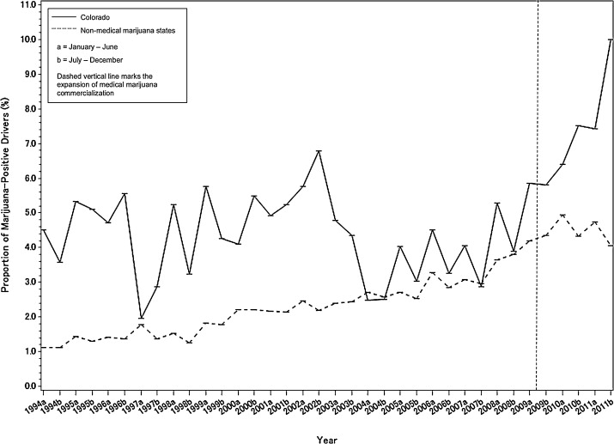
Trends in fatal motor vehicle crashes before and after cannabis commercialization in CO
Salomonsen-Sautel, S. Drug & Alcohol Dependence, 2014
Notes:
Both immediate exposure and long-term exposure
to marijuana have been shown to impair driving ability; marijuana
is the illicit drug most frequently reported
in connection with impaired driving and accidents,
including fatal accidents and According to a recent meta-analysis, the overall
risk of involvement in an accident increases by a
factor of about 2 when a person drives soon after
using marijuana.
Here we show the trends in FATAL motor vehicle crashes before and after MJ commercialization in CO.
In Colorado, since mid-2009 when medical marijuana became commercially available and prevalent, the trend became positive in the proportion of drivers in a fatal motor vehicle crash who were marijuana-positive (change in trend, 2.16 (0.45), p<0.0001); in contrast, NO significant changes were seen in Non Medical Marijuana States. The data are not shown here but for both Colorado and NMMS, NO significant changes were seen in the proportion of drivers in a fatal motor vehicle crash who were alcohol-impaired

Slide 48
Health effects of cannabis and cannabinoids: Injury and death
There is substantial evidence of a statistical association between cannabis use and:
Increased risk of motor vehicle crashes
There is moderate evidence of a statistical association between cannabis use and:
Increased risk of overdose injuries, including respiratory distress, among pediatric populations in U.S. states where cannabis is legal
Report of National Academies of Science, Engineering and Medicine.
Health Effects of Cannabis and Cannabinoids. 2017

Slide 49
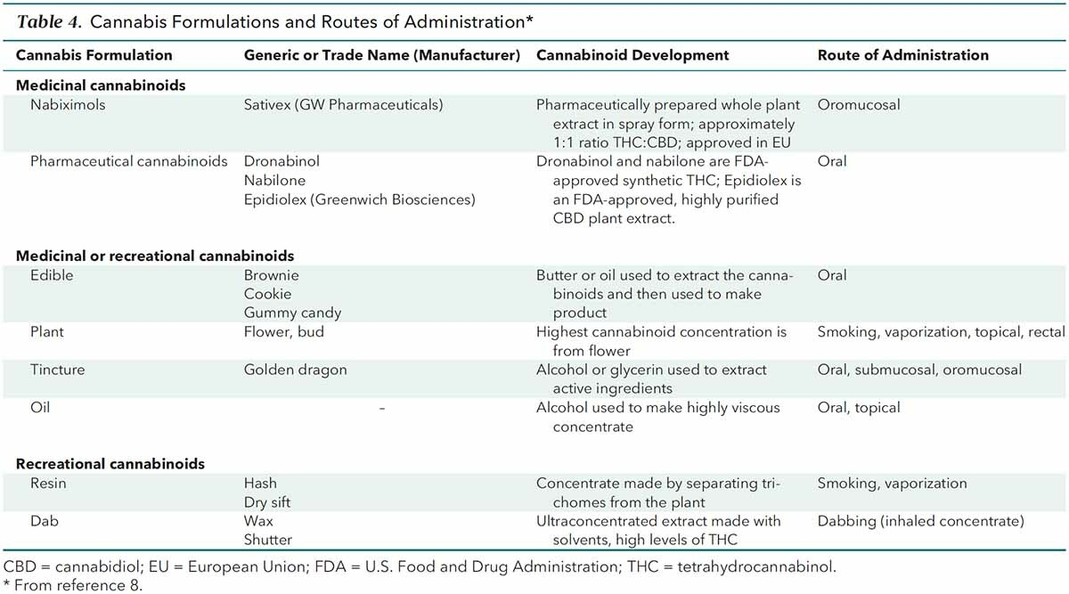
FDA-Approved Cannabinoids
Smetana GW, Tetrault JM, Hill KP, Burns RB Annals of Internal Medicine Feb 2021

